Slide 1
Black Hills Tornado and Hailstorm
July 13 2009
Jonathan Finch
National Weather Service
Dodge City, KS

Slide 2
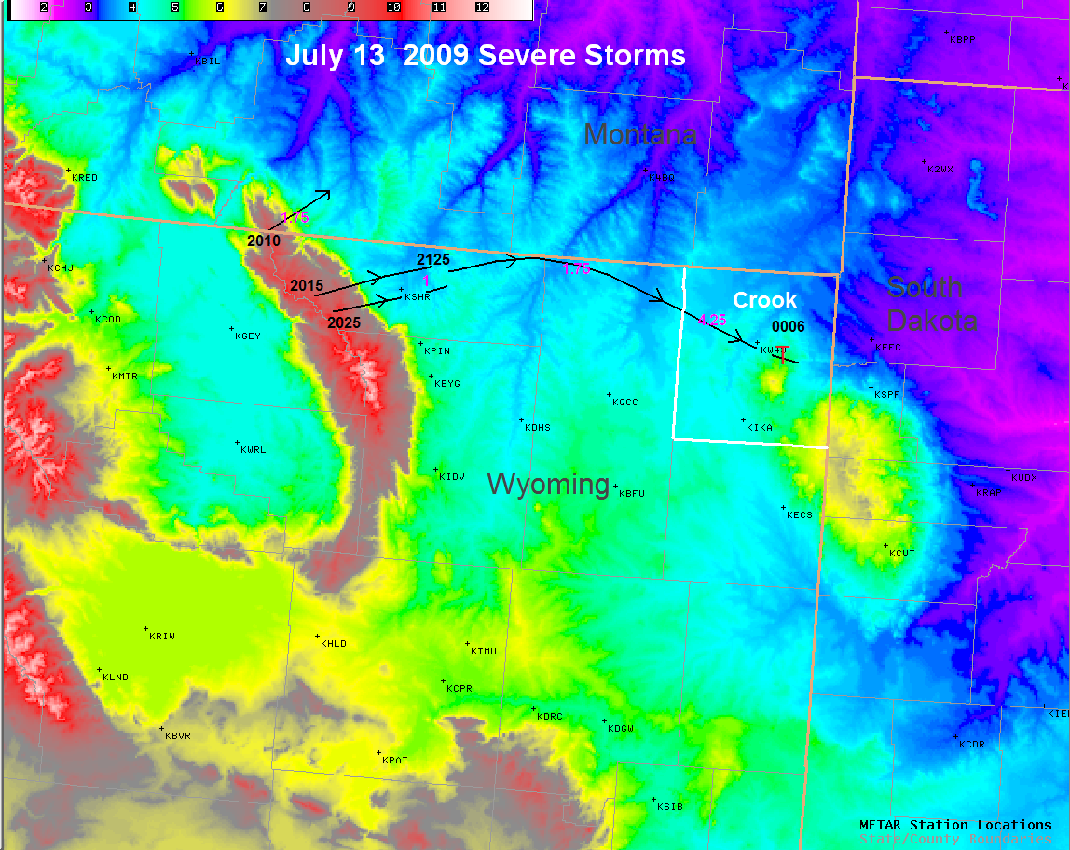

Slide 3
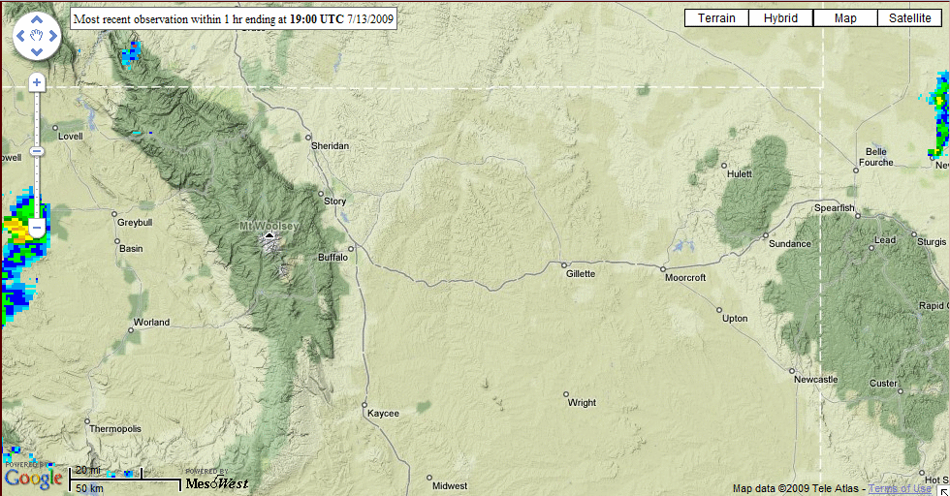
Initiation on the Big Horn Mountains
Frames captured from ‘”MesoWest” webpage and then looped
using ‘convert’ command in AWIPS RedHat Linux

Slide 4
Supplementary Storm Documentation
I placed calls to the affected area using “Dexknows White Pages” online and managed to find pictures of hail and hail damage.

Slide 5
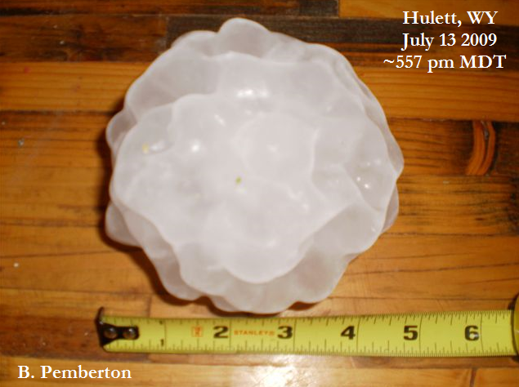
Giant Hail

Slide 6
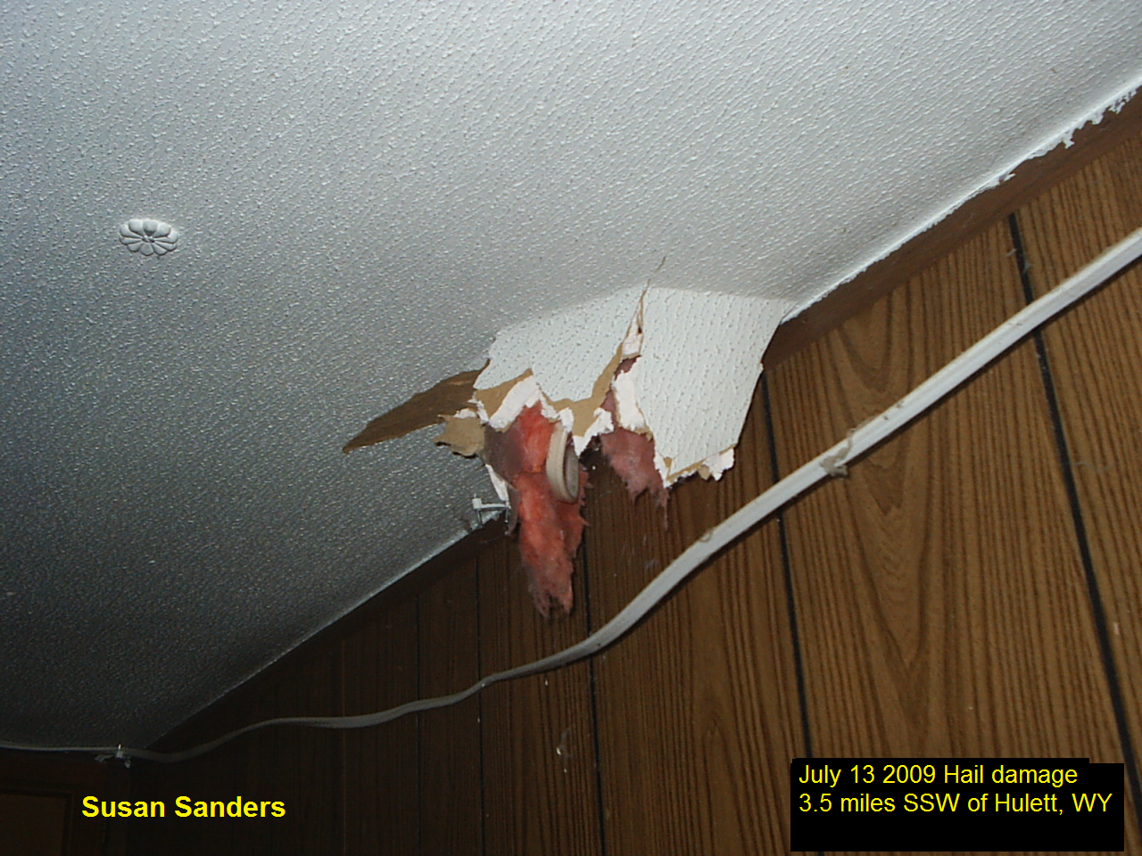
Hail Damage

Slide 7
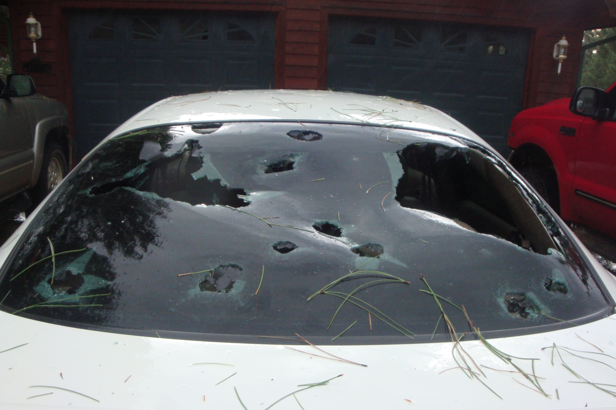
Destroyed Car Window in Hulett
Cassandra Penning

Slide 8
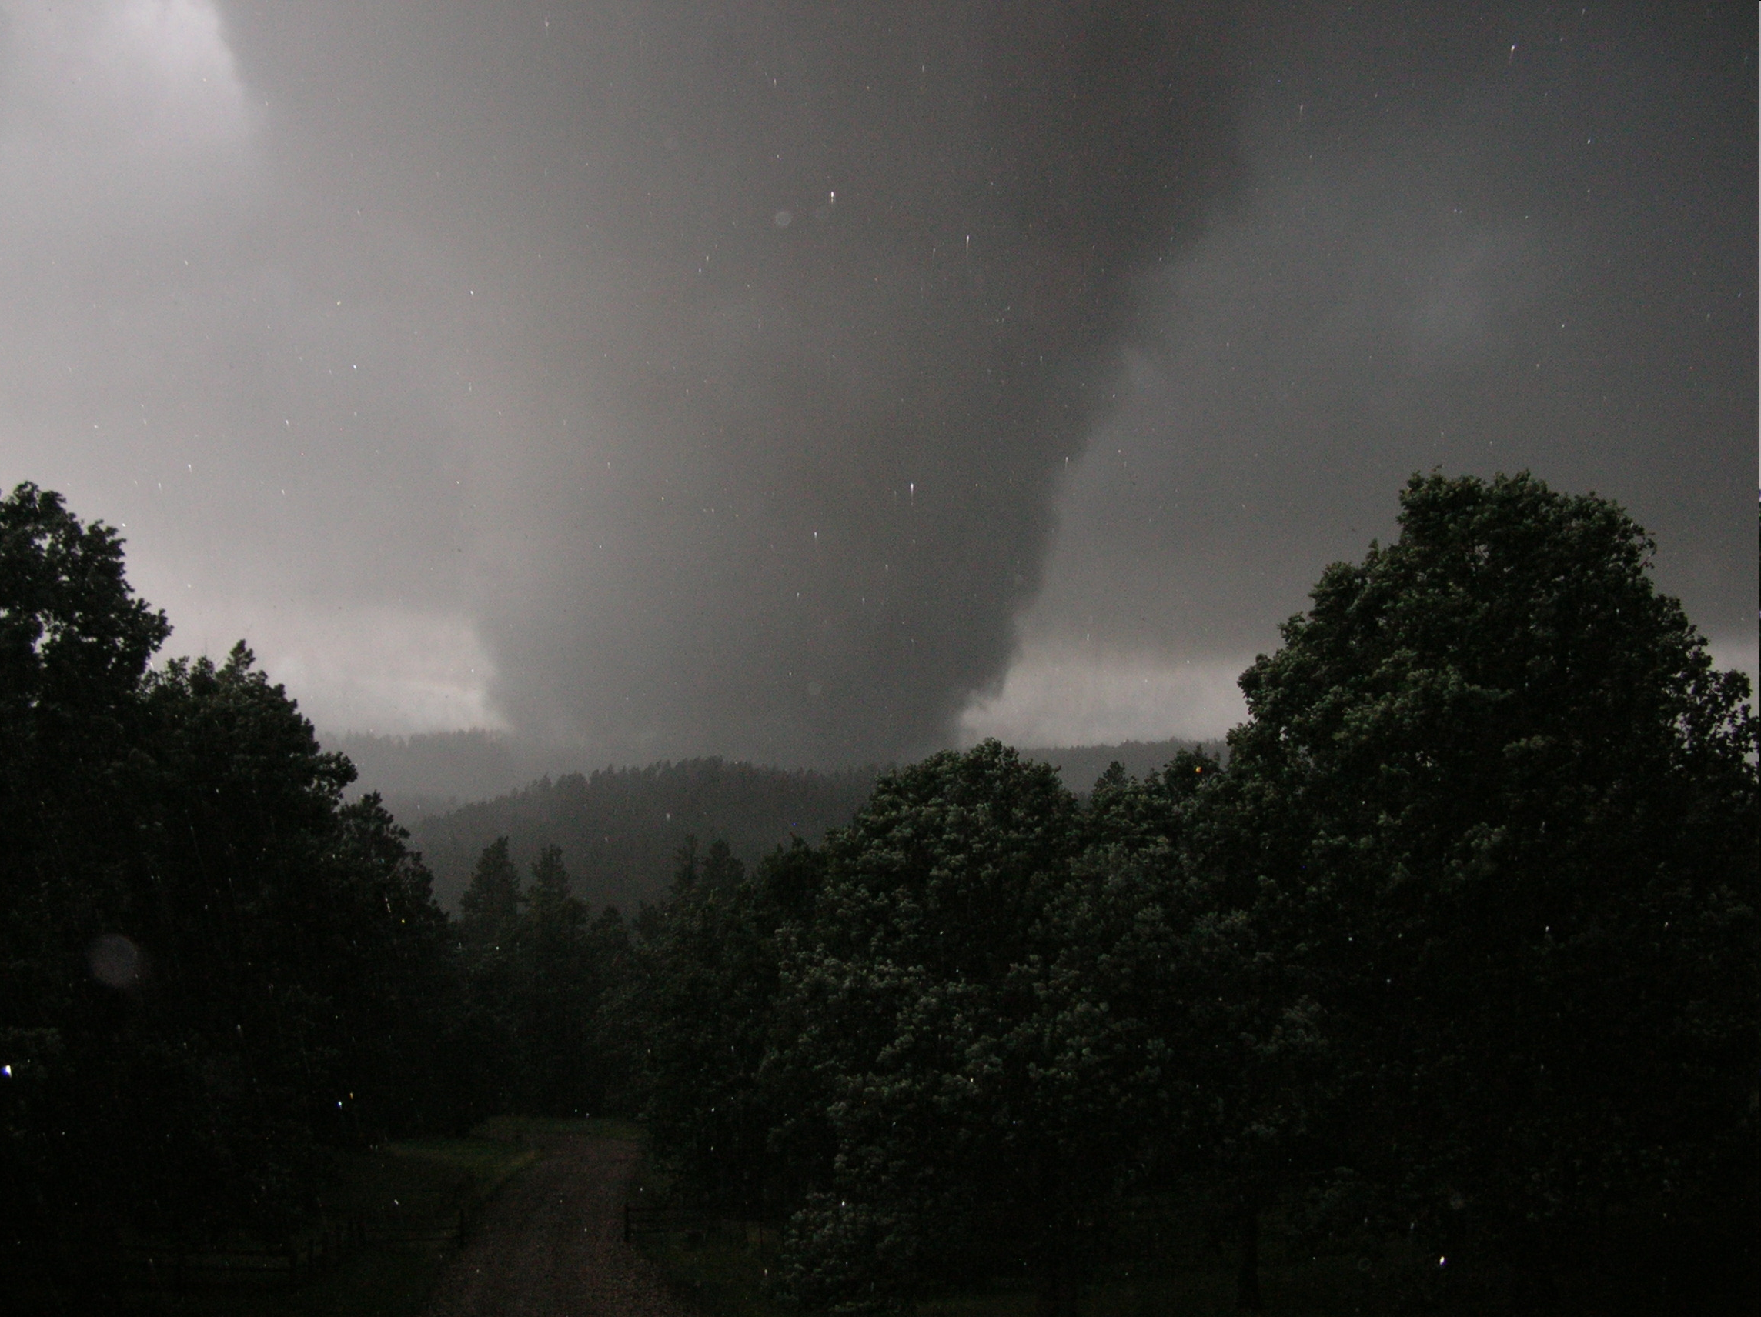
Tornado in Wyoming Black Hills
Phil Mason

Slide 9
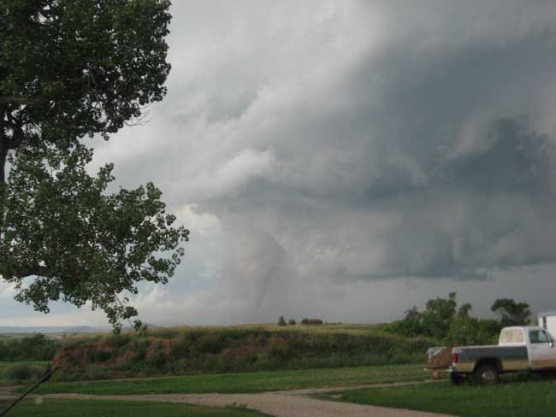
Tornado in Wyoming Black Hills
Doris Brown

Slide 10
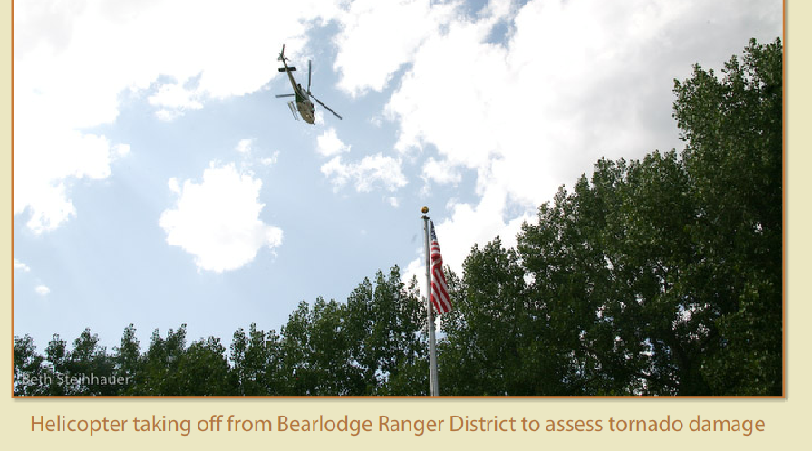

Forest Service Aerial Survey

Slide 11
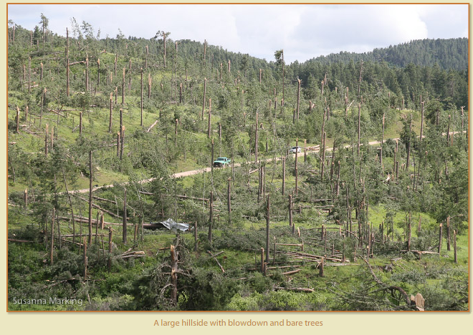

Slide 12
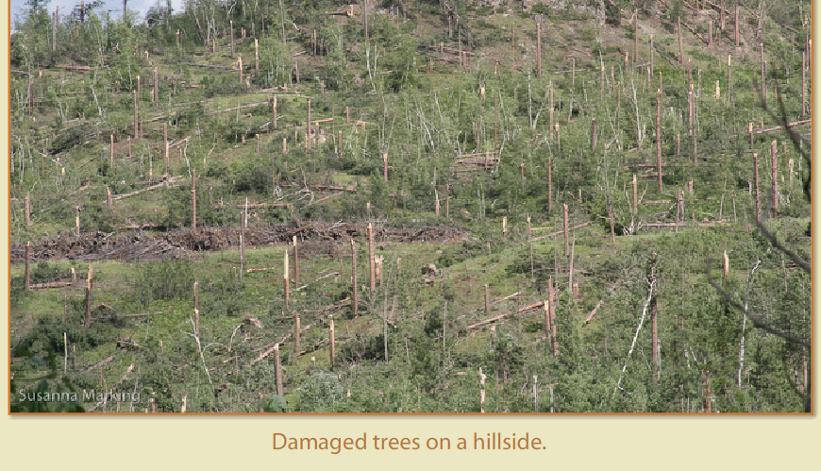

Slide 13
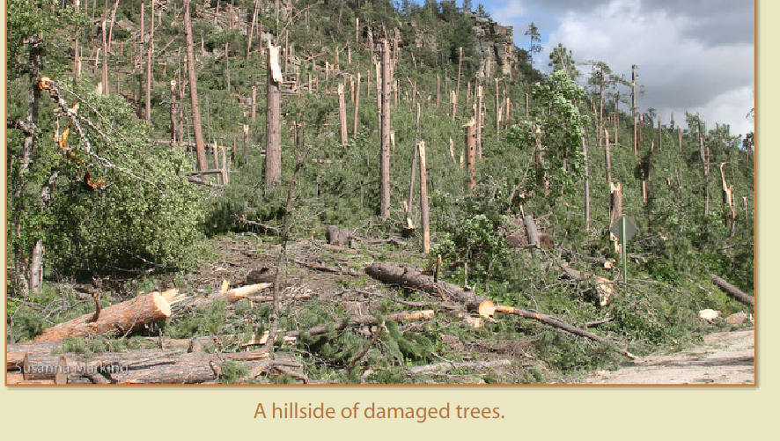

Slide 14
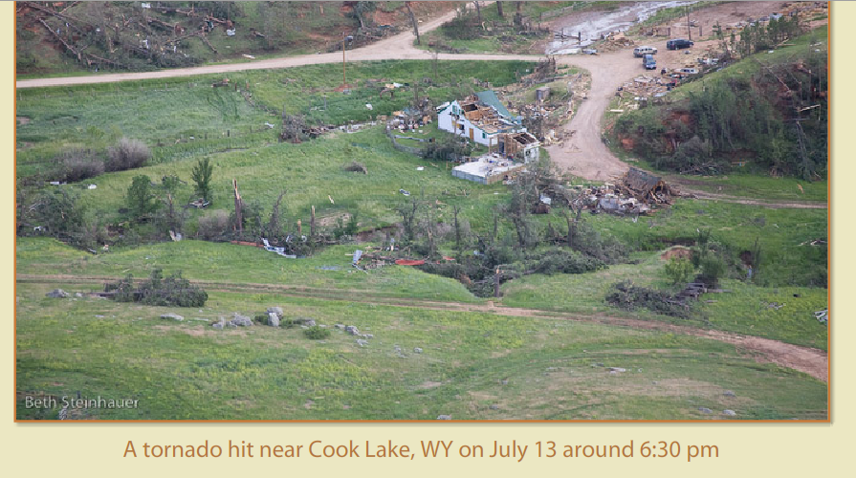

Slide 15
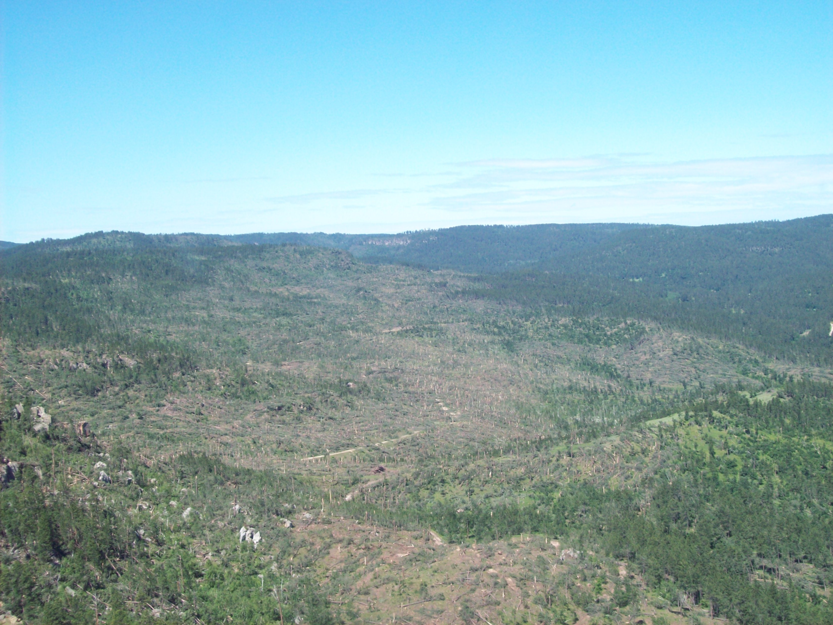
Picture Courtesy Jim Pridgeon
Crook County, WY Homeland Security Coordinator

Slide 16
Large Scale Synoptic Pattern

Slide 17
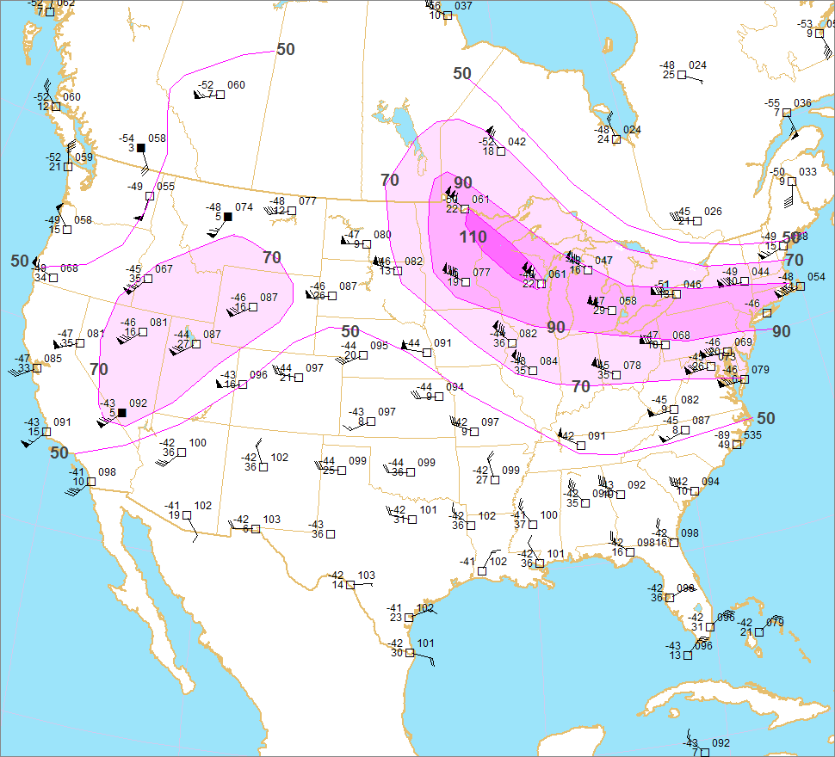
July 13 2009 12 UTC
250mb

Slide 18
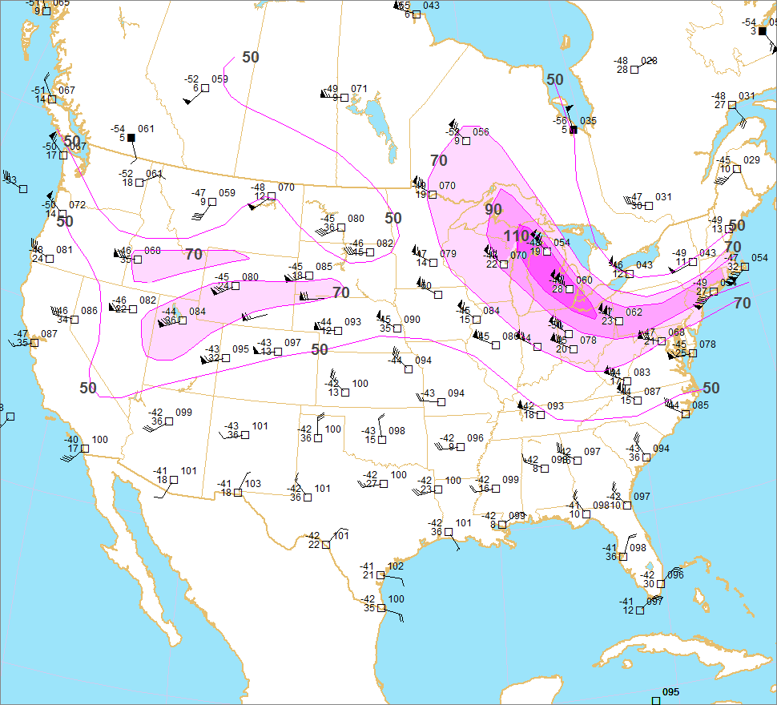
July 14 2009 00 UTC
250mb

Slide 19
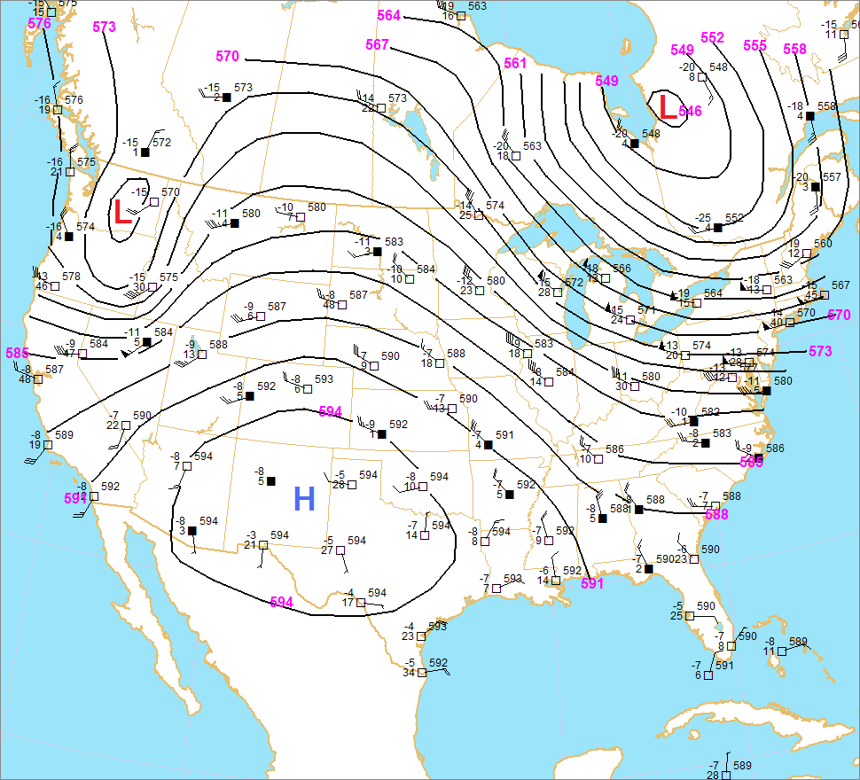
July 13 2009 12 UTC
500mb

Slide 20
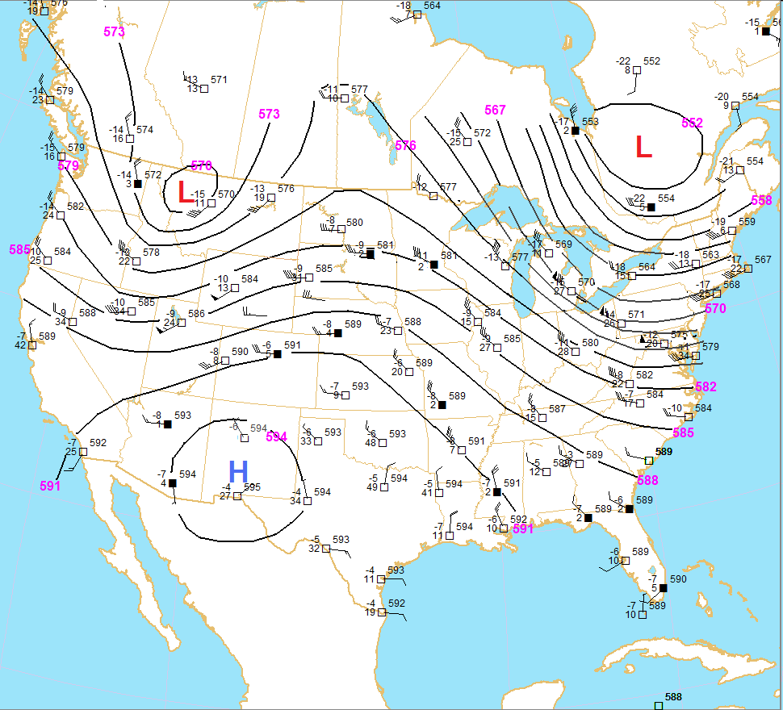
July 14 2009 00 UTC
500mb

Slide 21
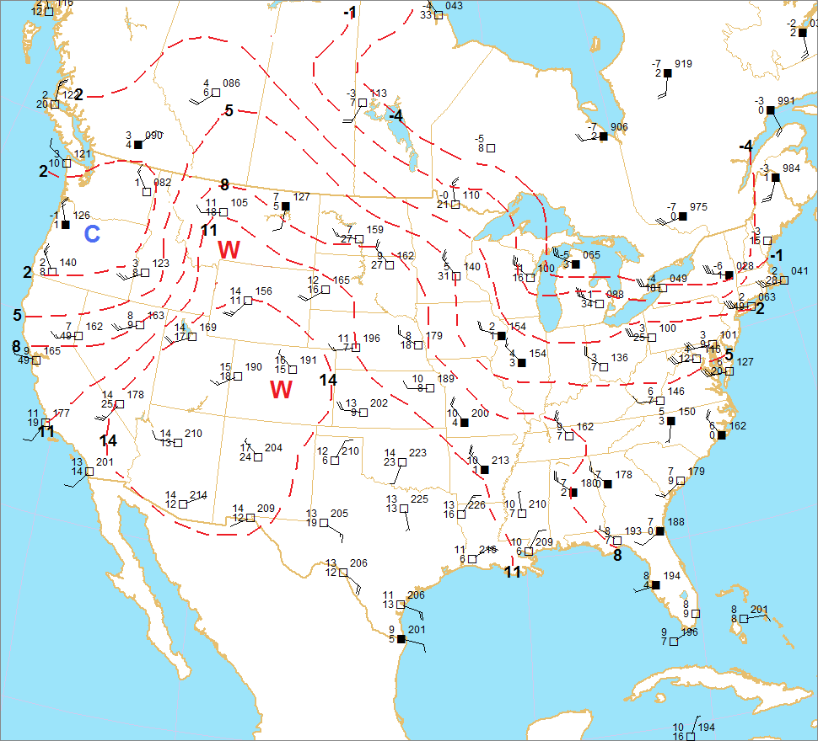
July 13 2009 12 UTC
700mb

Slide 22
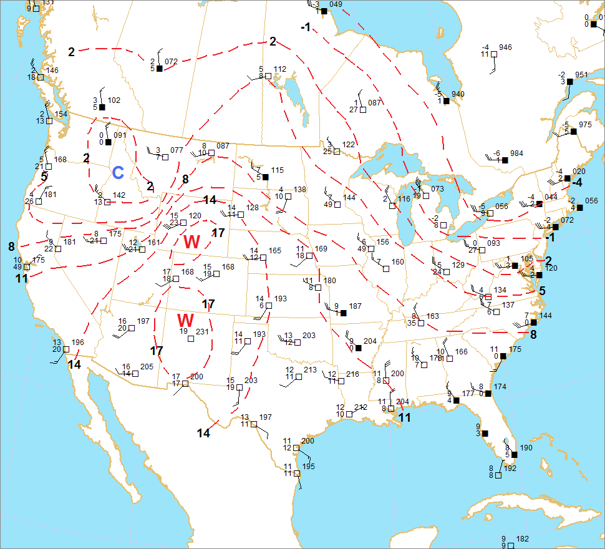
July 14 2009 00 UTC
700mb

Slide 23
Strong shortwave troughs are not uncommon across the northern high plains in July, but few yield significant tornadoes. Many storms in this region have high cloud bases. What was so special about this particular situation?
Mesoscale detail

Slide 24
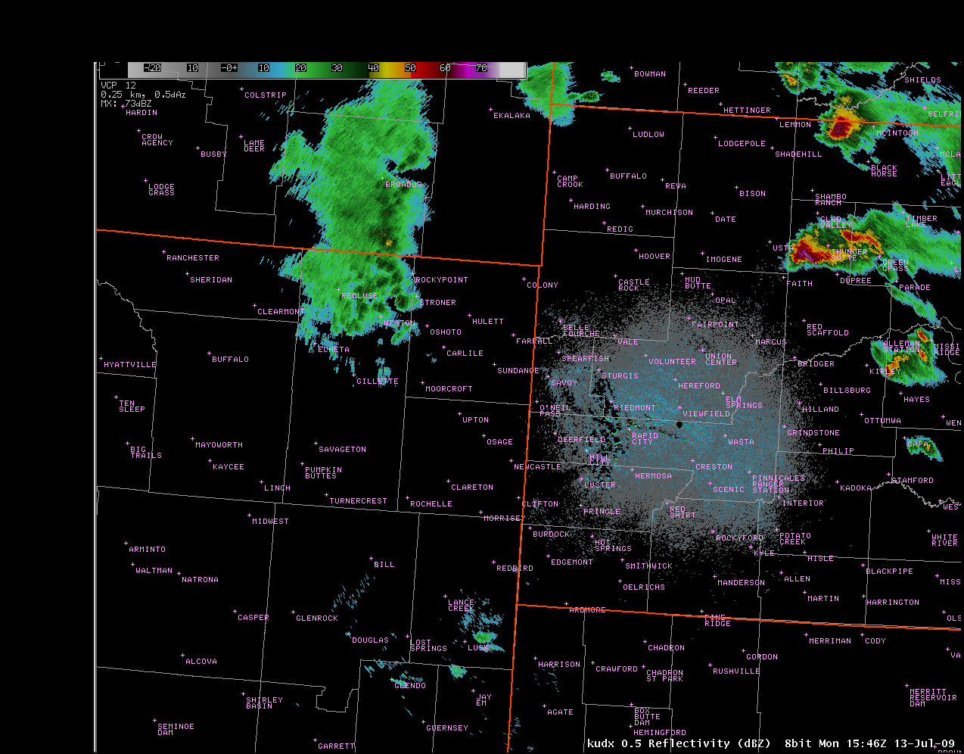
Crook
Rapid City .5° Reflectivity

Slide 25
Real-Time
Meso-Analysis
Is
Crucial!!

Slide 26
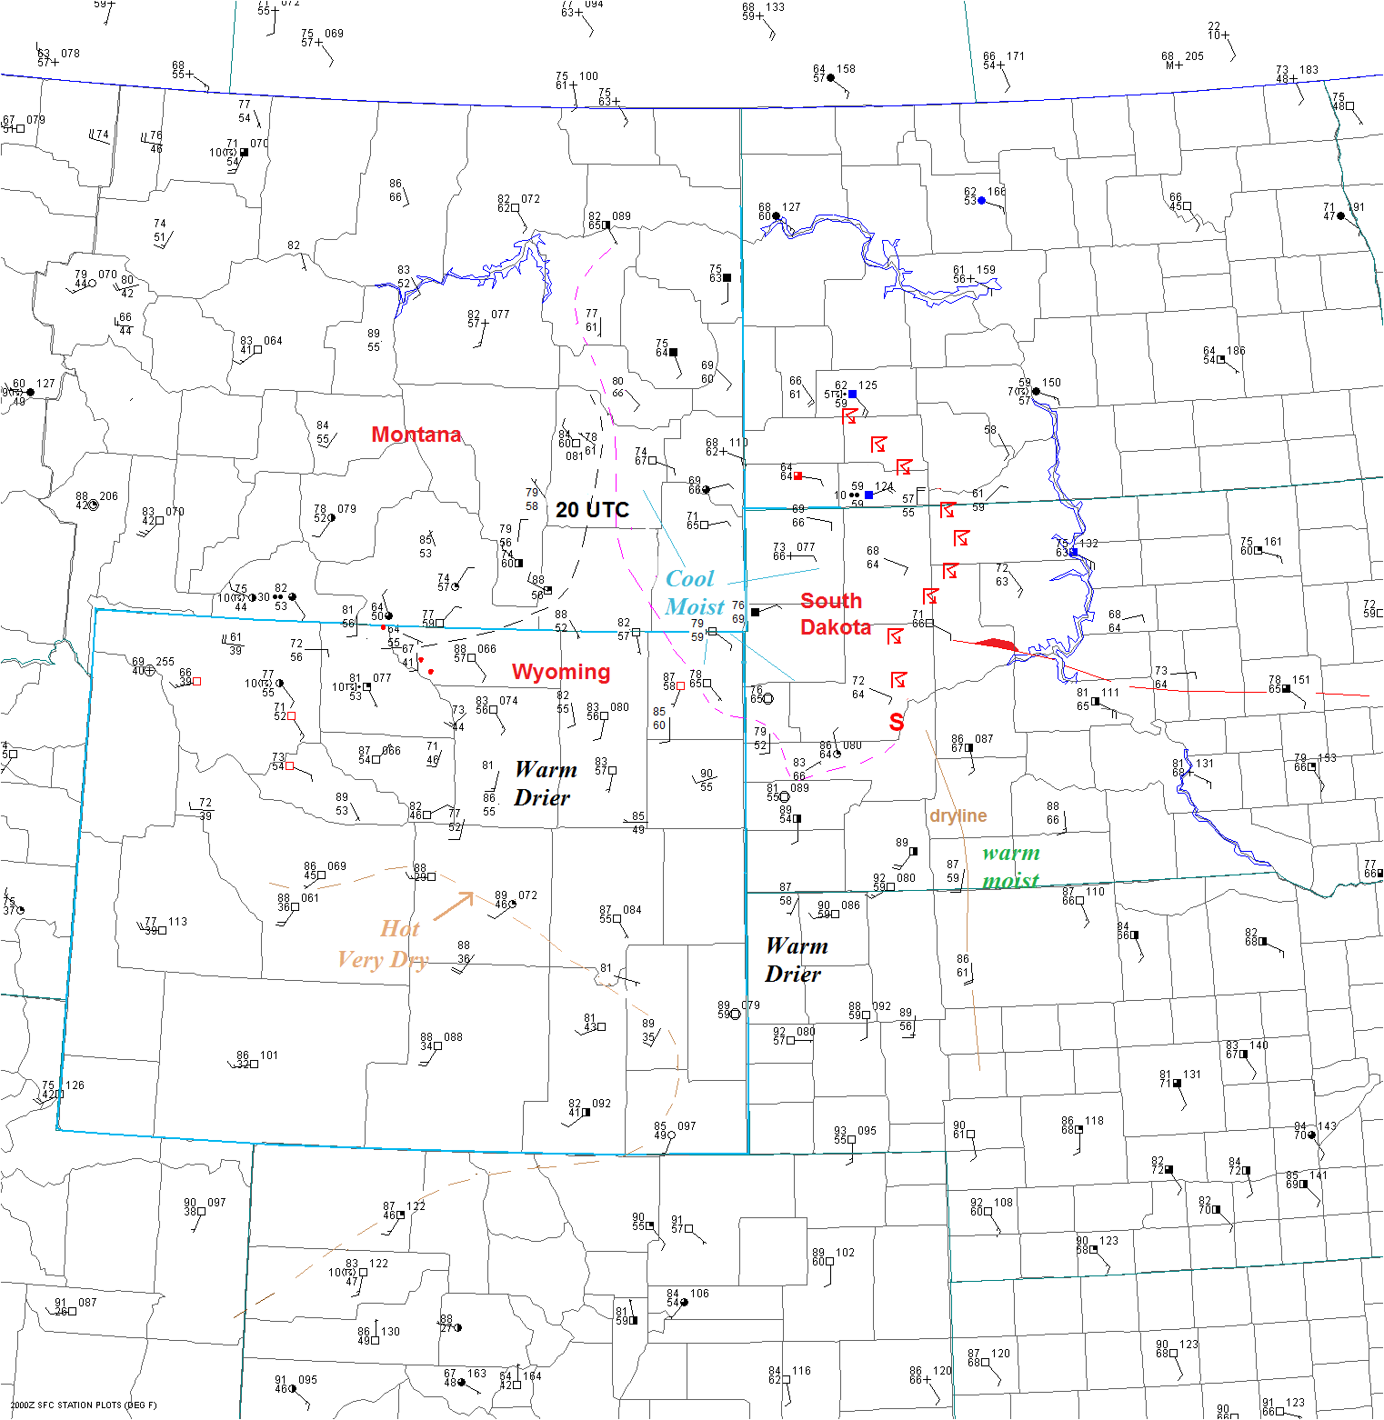
Crook

Slide 27
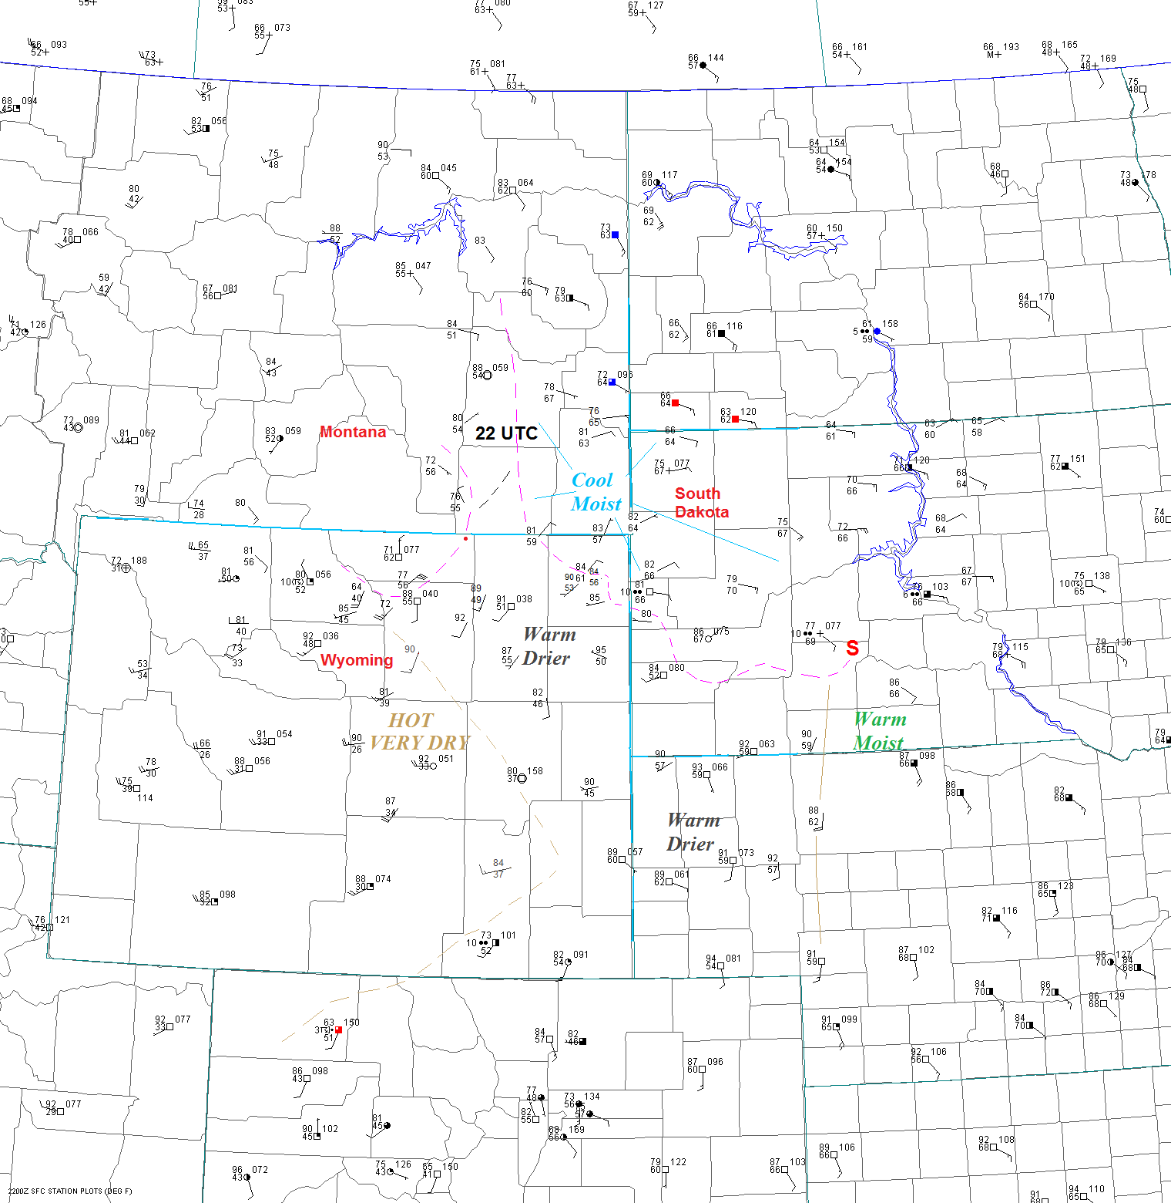
Crook

Slide 28
Meso-Analysis—An Even Closer Look
Using Satellite, SFC OBS and Radar

Slide 29
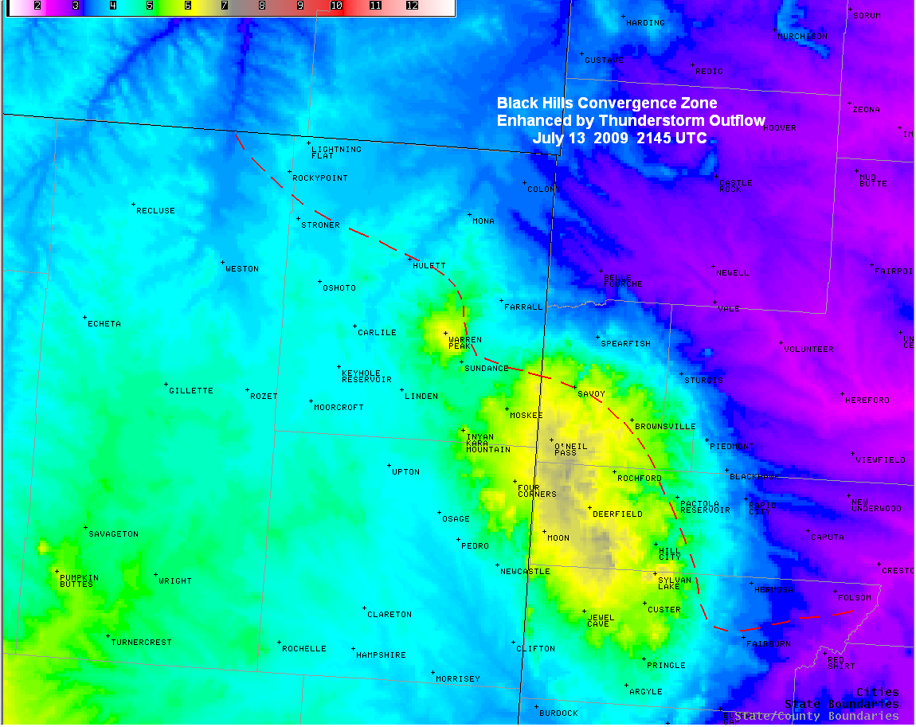
Crook County

Slide 30
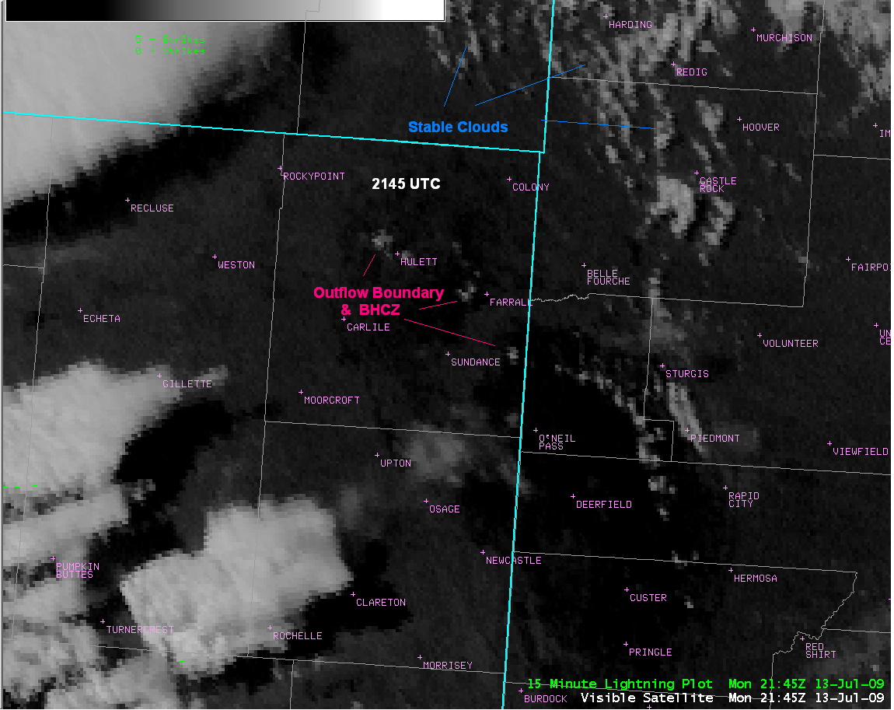
Crook County

Slide 31
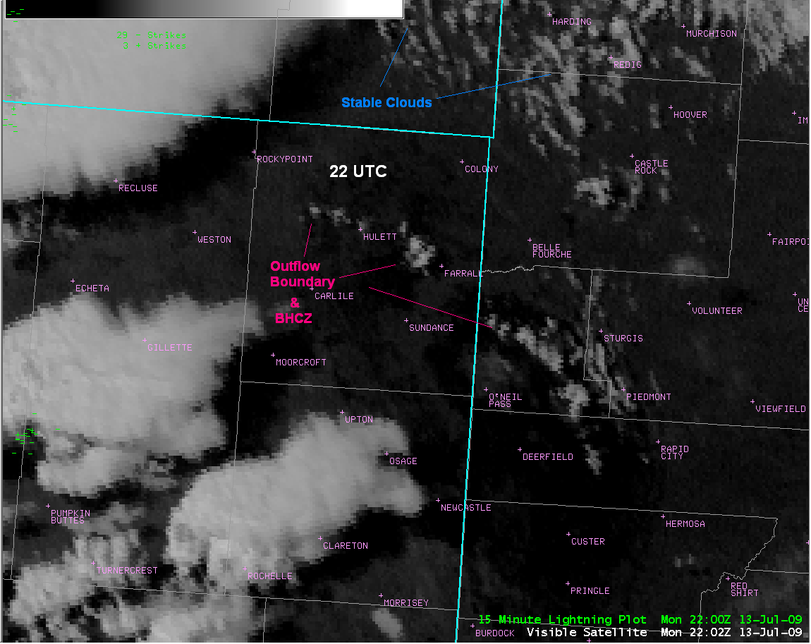
Crook County

Slide 32
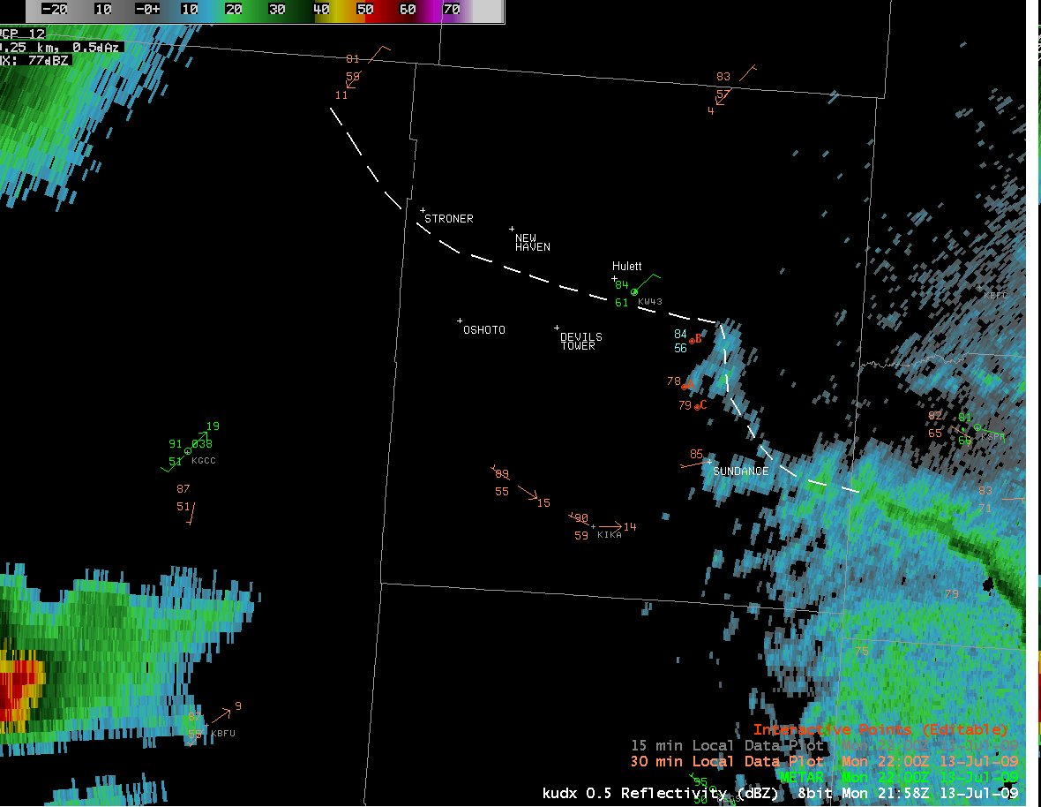
2200 UTC
5 ° Reflectivity Rapid City
with
Surface and Mesonet obs.
Crook County

Slide 33
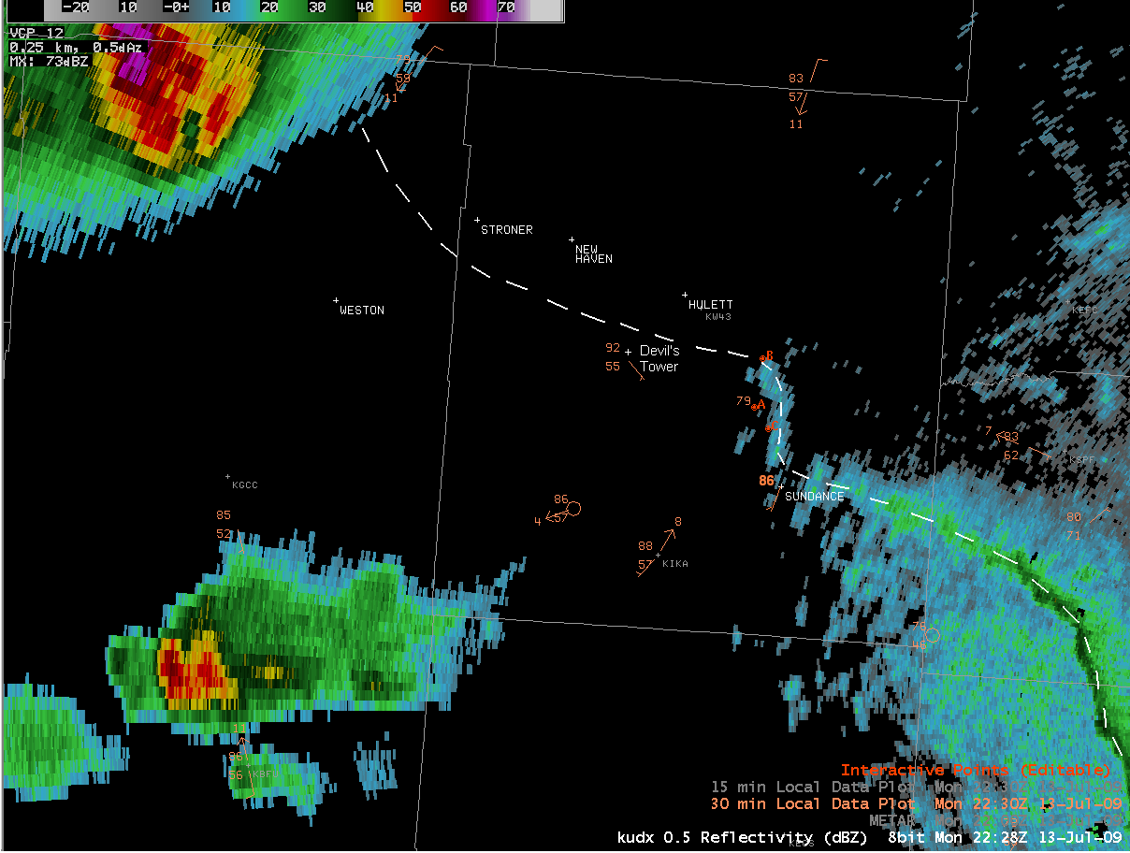
2230 UTC
5 ° Reflectivity Rapid City
with
Surface and Mesonet obs.
Crook County

Slide 34
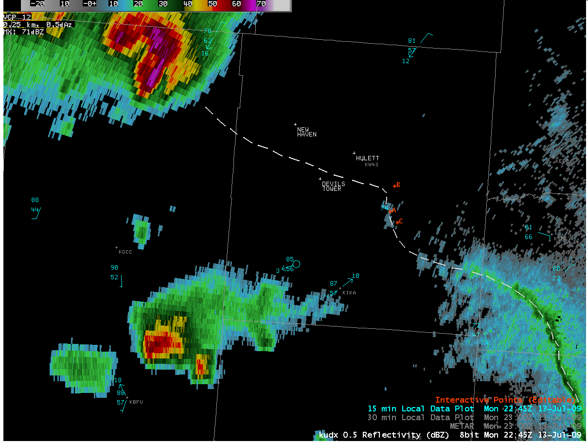
2245 UTC
5 ° Reflectivity Rapid City
with
Surface and Mesonet obs.
Crook County

Slide 35
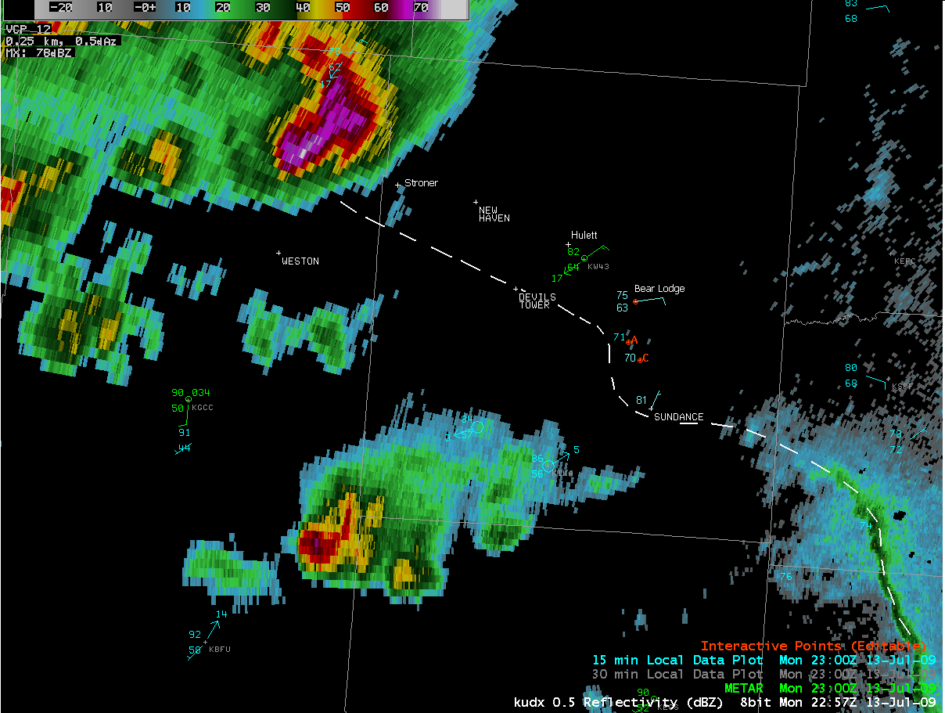
2300 UTC
5 ° Reflectivity Rapid City
with
Surface and Mesonet obs.
Crook County

Slide 36
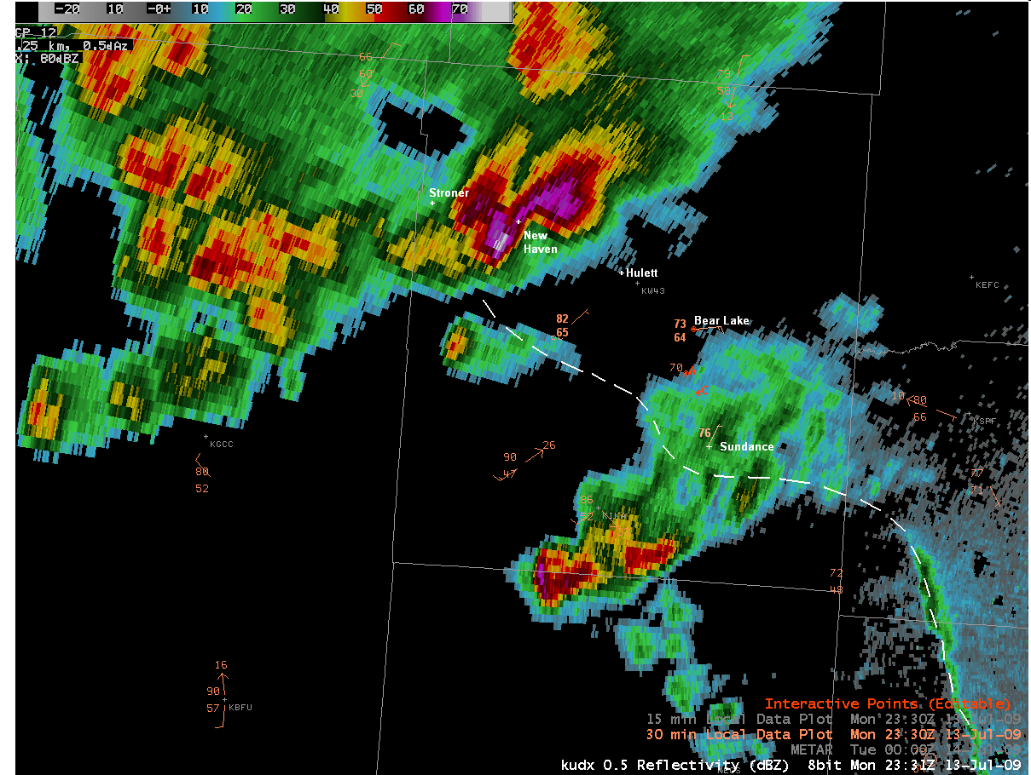
2330 UTC
5 ° Reflectivity Rapid City
with
Surface and Mesonet obs.
Devil’s
Tower
Crook County

Slide 37
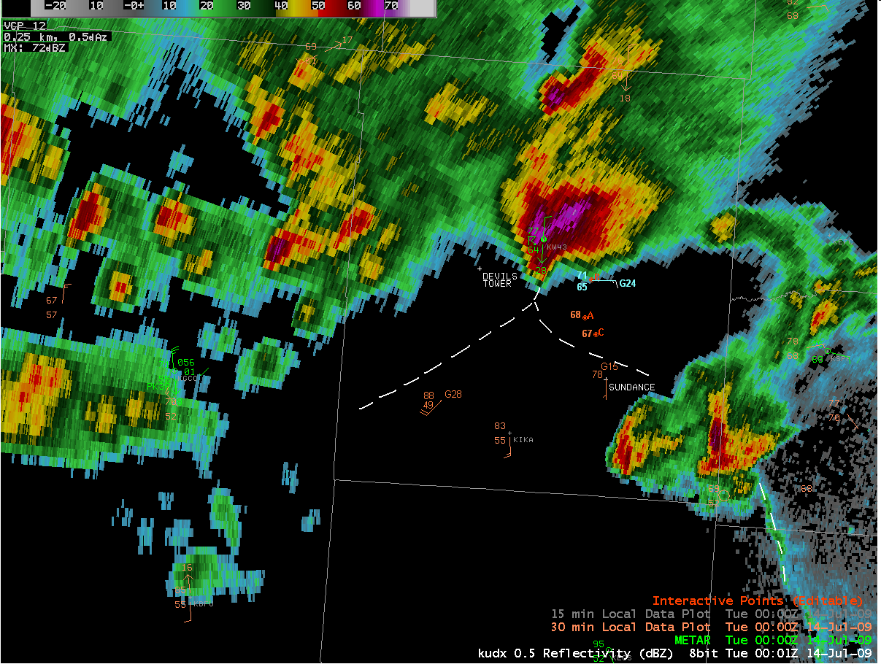
0000 UTC
5 ° Reflectivity Rapid City
with
Surface and Mesonet obs.
Crook County
Crook County

Slide 38
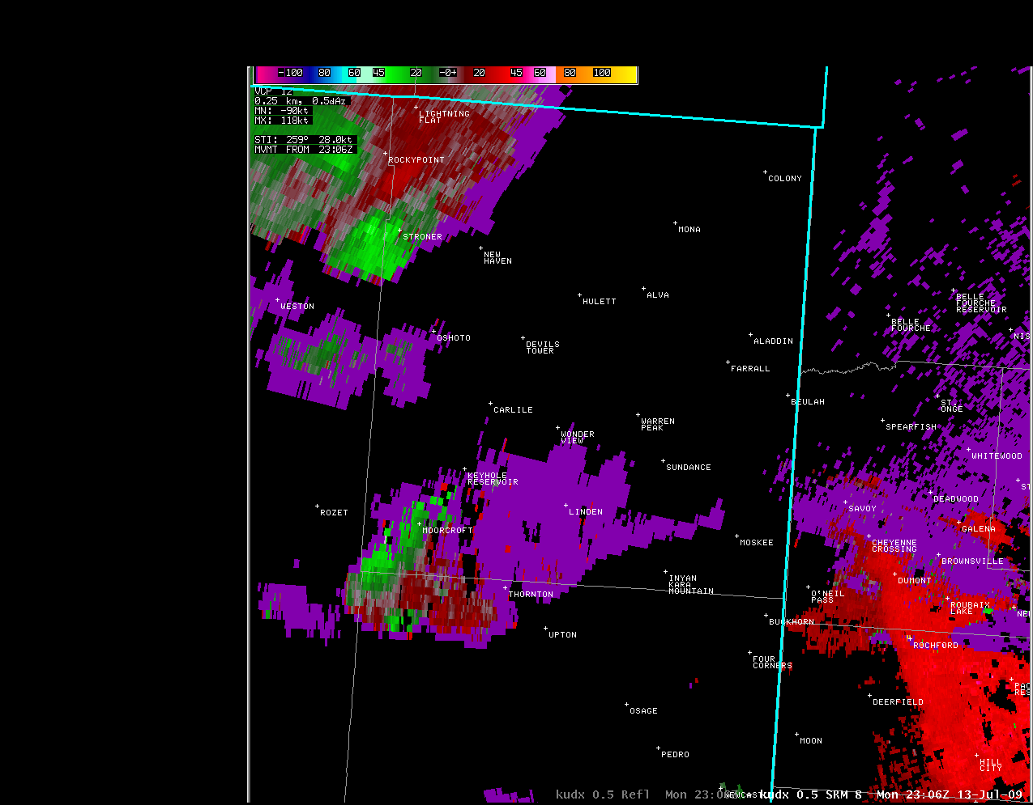
Radar Issues
Crook County
Notice Dealiasing

Slide 39
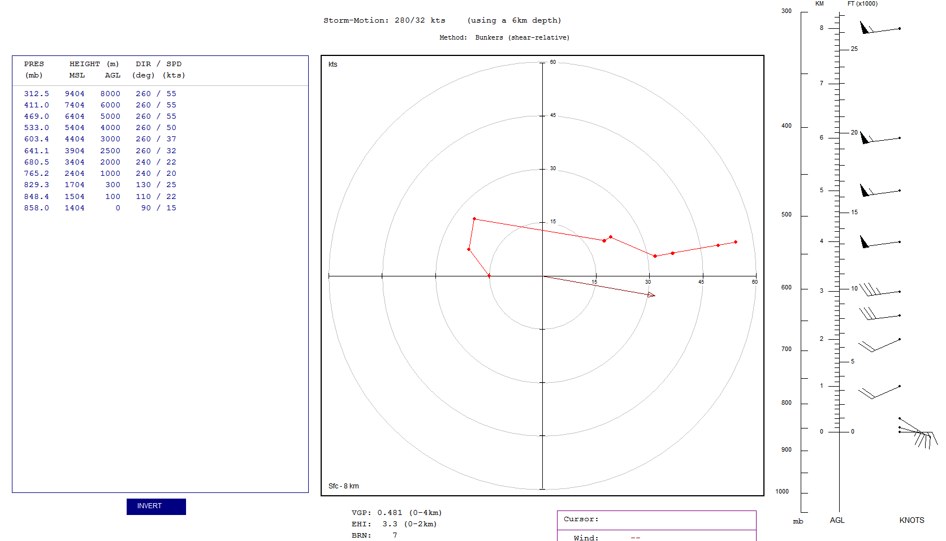
Meso-Analysis Continued
Hodograph for Crook County, WY storm

Slide 40
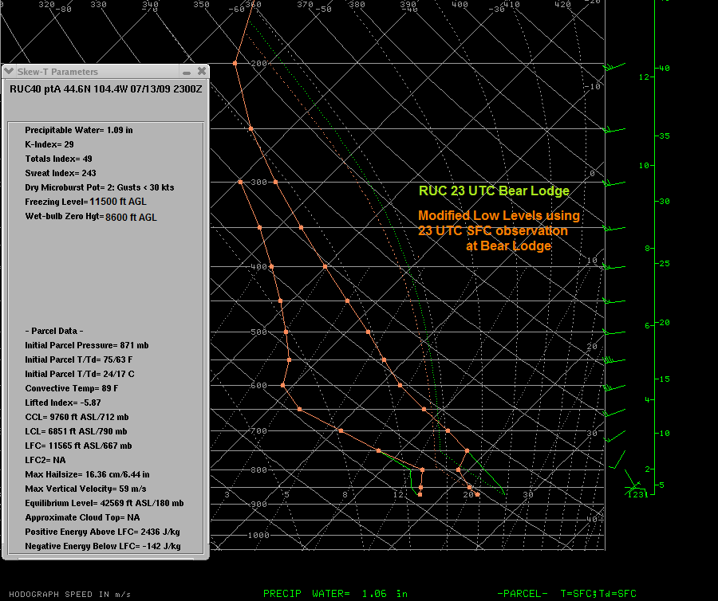
Meso-Analysis Continued
Modified RUC sounding
RUC 40 Terrain Incorrect!!

Slide 41
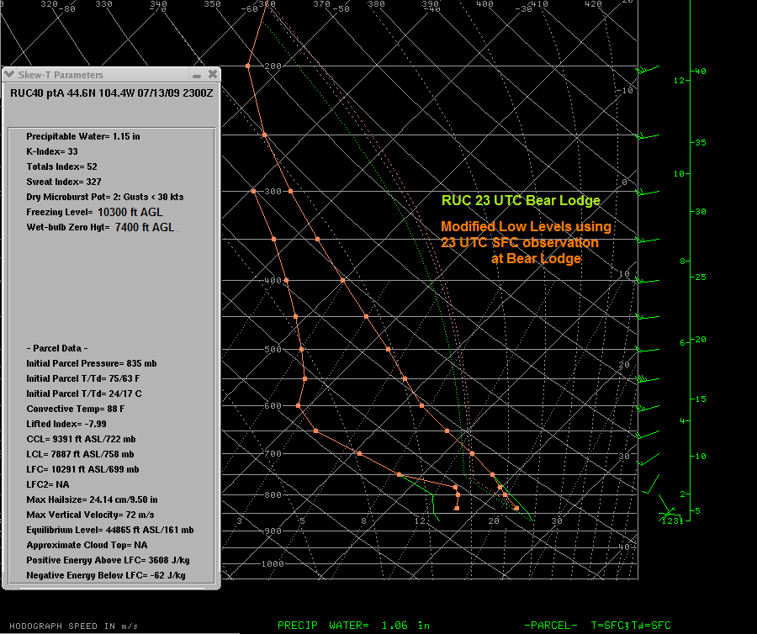
Meso-Analysis Continued
Modified RUC sounding

Slide 42
Why did the South Dakota Storm
Take so Long to Produce a Tornado?

Slide 43
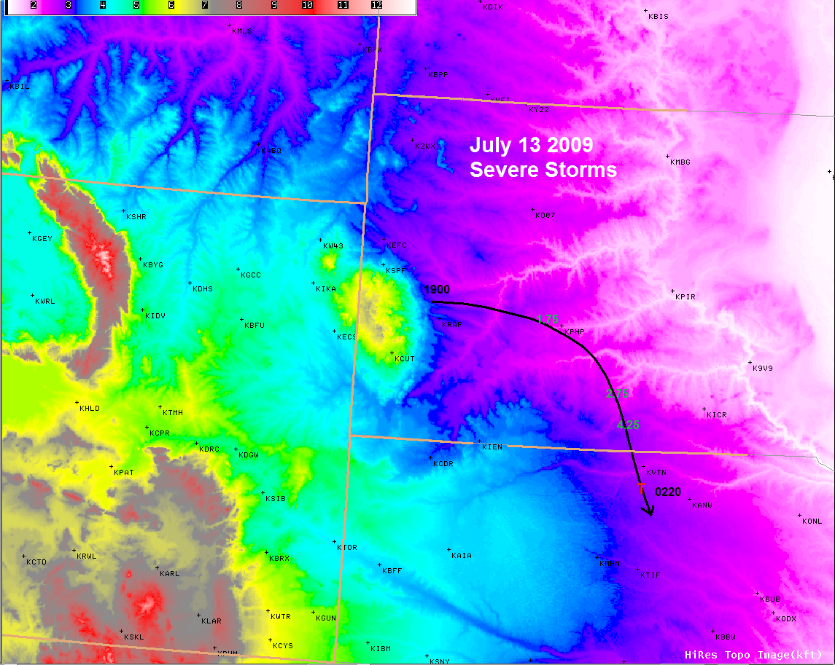

Slide 44
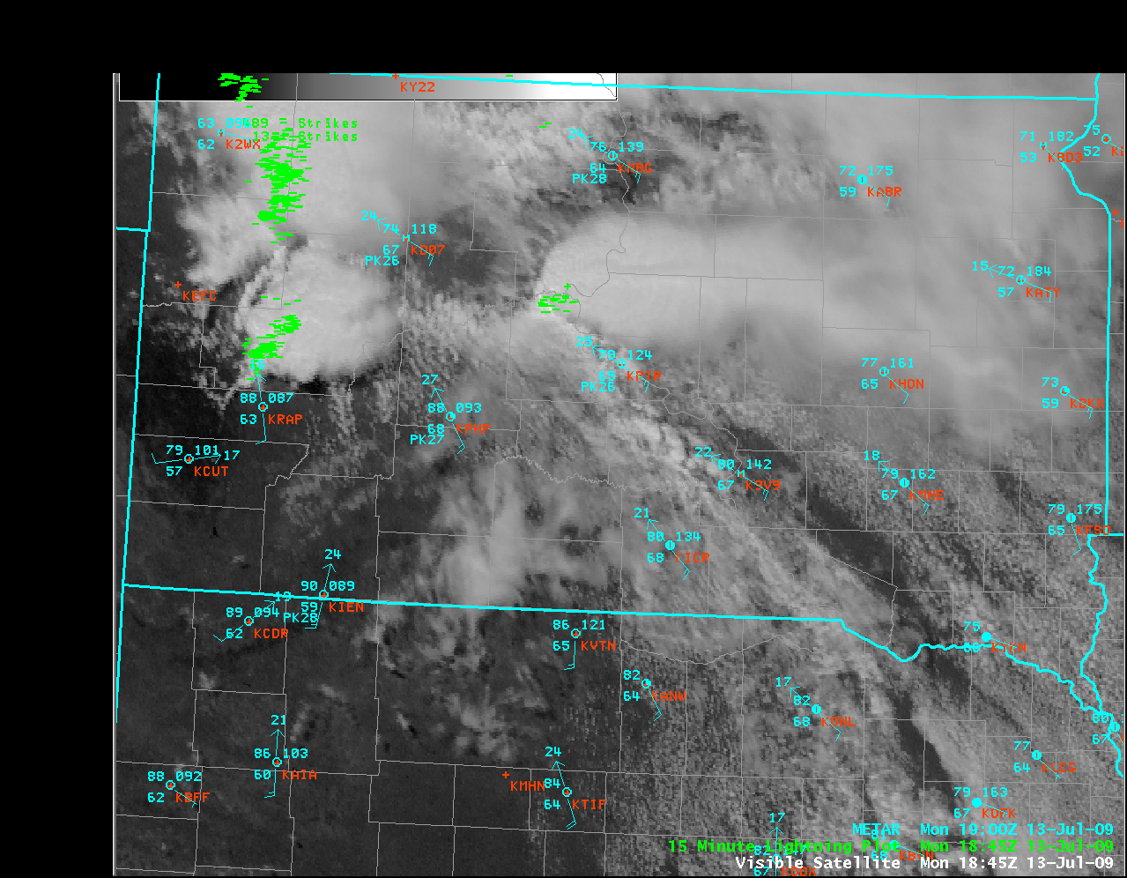

Slide 45
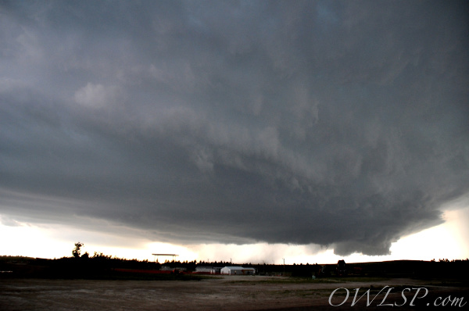
Storm a Little High Based
Wesley Luginbyhl

Slide 46
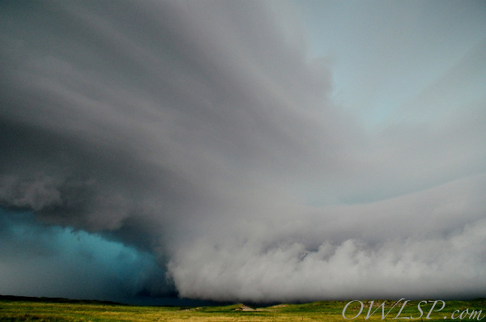
Storm Base Much Lower after 02 UTC
Wesley Luginbyhl

Slide 47
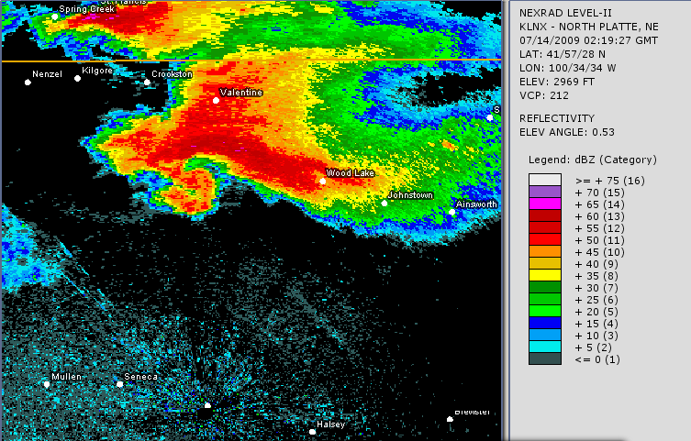
The Southwest South Dakota Storm

