Slide 1
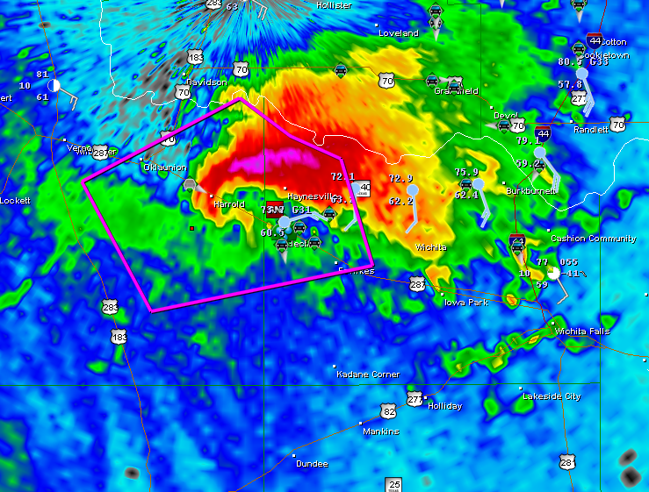
A Detailed Look at the
Hazardous Weather Outlook
Mick McGuire
Christina Henderson
Kelly Ranae Giedd-James

Slide 2
Hazardous weather outlook
Event Forecast | Event Observed |  | Marginal Total
Yes | Hits (a) | False Alarms (b) | a+b
No | Misses (c) | Correct Neg. (d) | c+d
Marginal Total | a+c | b+d | a+b+c+d =n Total
standard categorical verification scores

Slide 3
Hazardous weather outlook
Event Forecast | Event Observed |  | Marginal Total
Yes | Hits (a) | False Alarms (b) | a+b
No | Misses (c) | Correct Neg. (d) | c+d
Marginal Total | a+c | b+d | a+b+c+d =n Total
POD = a / (a+c)
FAR = b / (a+b)
*TS=CSI = a / (a+c+b)
HSS= 2(ad-bc) / [(a+c)(c+d)+(a+b)(b+d)
http://www.bom.gov.au/bmrc/wefor/staff/eee/verif/Finley/Finley_Tornados.html

Slide 4
outline
2004-2008 Warm seasons - Mjja
Past storm reports
http://www.spc.noaa.gov/climo/online/
Central high plains
gld ddc lbf gid

Slide 5
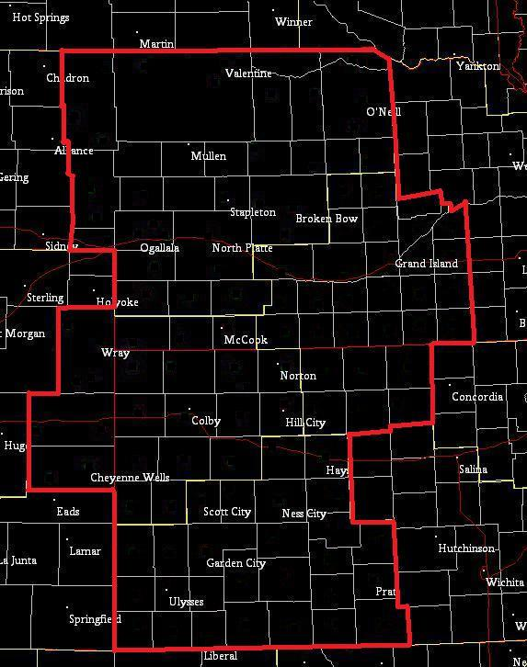
High Plains Offices

Slide 6
High Plains Offices
LBF
32948 mi²
GID
19253 mi²
GLD
20997 mi²
DDC
22442 mi²
http://www.nws.noaa.gov/mirs/public/prods/reports/pdf/office_facility/10-507_cwfa_counties(cr).pdf

Slide 7
High Plains SWX
LBF 215 GLD 202 DDC 190 GID 151 (4) (1) (2) (3)
43 40 38 30
Past storm reports http://www.spc.noaa.gov/climo/online/

Slide 8
High Plains SWX
% DAYS SWX MJJA 2004-2008
Past storm reports http://www.spc.noaa.gov/climo/online/

Slide 9
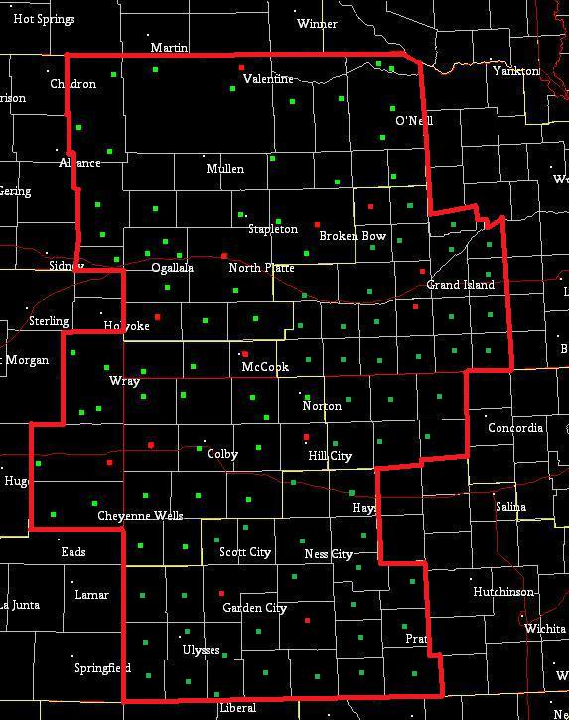
High Plains SWX
Defining a precipitation event
xmACIS http://xmacis.unl.edu/
100 COOP
14 ASOS
Removed T, M and 0.01 (dew tips) 764/38325 or 1.99% and used pcpn ≥ 0.02

Slide 10
% PCPN SWX MJJA 2004-2008

Slide 11
% PCPN SWX May 2004-2008

Slide 12
% PCPN SWX June 2004-2008

Slide 13
% PCPN SWX July 2004-2008

Slide 14
% PCPN SWX aug 2004-2008
*

Slide 15
Day 1-7 POD MJJA 2004-2008
POD = Hits / (Hits + Misses)
%
%
%
30%
%
25%
20%
15%
10%
5%

Slide 16
Day 1-7 POD MJJA 2004-2008
POD = Hits / (Hits + Misses)
%
%
%
%
%
%
%
%
%
%
%
____ of the events that occurred were predicted to occur

Slide 17
Day 1-7 FAR MJJA 2004-2008
FAR = False Alarms / (Hits + False Alarms)

Slide 18
Day 1-7 FAR MJJA 2004-2008
FAR = False Alarms / (Hits + False Alarms)
____ of the forecasts for swx turned out to be false alarms

Slide 19
Day 1-7 HSS MJJA 2004-2008
HSS= 2(ad-bc) / [(a+c)(c+d)+(a+b)(b+d)]
There was a ___% improvement in forecast accuracy when compared to random chance

Slide 20
Day 1-3 POD MJJA 2004-2008
POD = Hits / (Hits + Misses)
%
%
%
%
%
%
%
%
%
%
%
%
%
____ of the events that occurred were predicted to occur

Slide 21
Day 1-3 POD MJJA 2004-2008
POD = Hits / (Hits + Misses)
%
%
%
%
%
%
%
%
%
%

Slide 22
Day 1-3 FAR MJJA 2004-2008
FAR = False Alarms / (Hits + False Alarms)
____ of the forecasts for swx turned out to be false alarms

Slide 23
Day 1-3 FAR MJJA 2004-2008
FAR = False Alarms / (Hits + False Alarms)
____ of the forecasts for swx turned out to be false alarms

Slide 24
Day 1 POD MJJA 2004-2008
POD = Hits / (Hits + Misses)
%
%
%
%
%
%
%
%
%
%
____ of the events that occurred were predicted to occur

Slide 25
Day 4-7 POD MJJA 2004-2008
POD = Hits / (Hits + Misses)
%
%
%
%
%
%
%
%
%
%
%
%
____ of the events that occurred were predicted to occur

Slide 26
Day 4-7 POD MJJA 2004-2008
POD = Hits / (Hits + Misses)
%
%
%
%
%
%
%
%
____ of the events that occurred were predicted to occur

Slide 27
Day 4-7 FAR MJJA 2004-2008
FAR = False Alarms / (Hits + False Alarms)
____ of the forecasts for swx turned out to be false alarms

Slide 28
Day 4-7 FAR MJJA 2004-2008
FAR = False Alarms / (Hits + False Alarms)
____ of the forecasts for swx turned out to be false alarms

Slide 29
Day 4-7 HSS MJJA 2004-2008
HSS= 2(ad-bc) / [(a+c)(c+d)+(a+b)(b+d)
There was a ___% improvement in forecast accuracy when compared to random chance

Slide 30
Day 4-7 HSS MJJA 2004-2008
HSS= 2(ad-bc) / [(a+c)(c+d)+(a+b)(b+d)
There was a ___% improvement in forecast accuracy when compared to random chance

Slide 31
What iF...
Days 4-7 ( May-Aug 2004-2008)
Thunderstorms severe
Impact on categorical verification scores

Slide 32
Day 4-7 what if…
LBF GLD DDC GID
HSS +6.06 +4.69 +6.86 +6.18
FAR +10.39 +35.08 +11.18 +30.14
POD +35.57 +35.08 +25.96 +45.12
HSS 10.81 9.61 13.06 10.55
FAR 58.16 61.98 56.87 55.57
POD 49.50 40.33 35.67 55.36

Slide 33
Conclusions
Why are we Reluctant to include swx in hwo
The worst case scenario
-increased far
-increased pod
-increased hss

