Slide 1
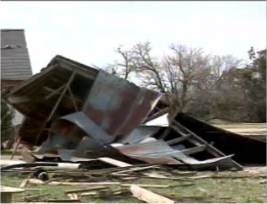
MISOCYCLONE INTERACTION IN THE APRIL 4, 2009 FAIRFIELD NEBRASKA TORNADIC EVENT
AARON W. JOHNSON
NOAA/NWS Weather Forecast Office
Hastings Nebraska

Slide 2

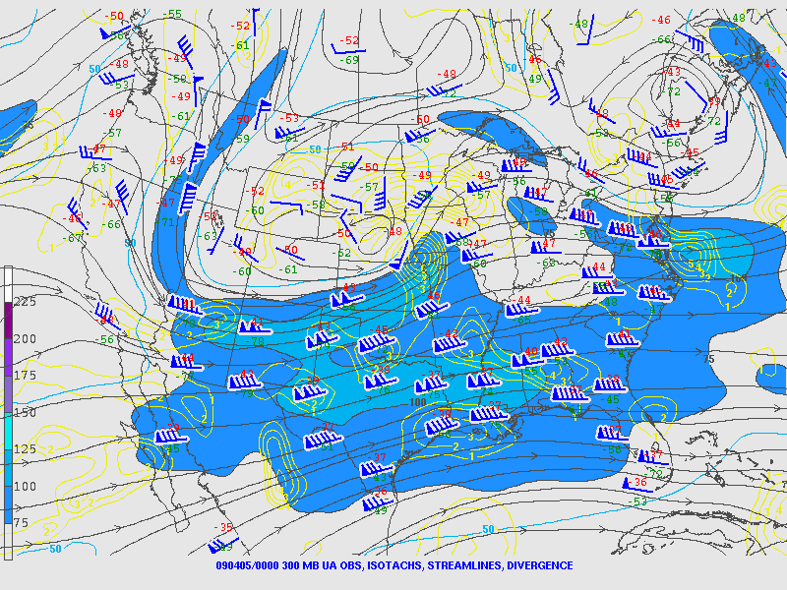
review of APRIL 4 2009

Slide 3
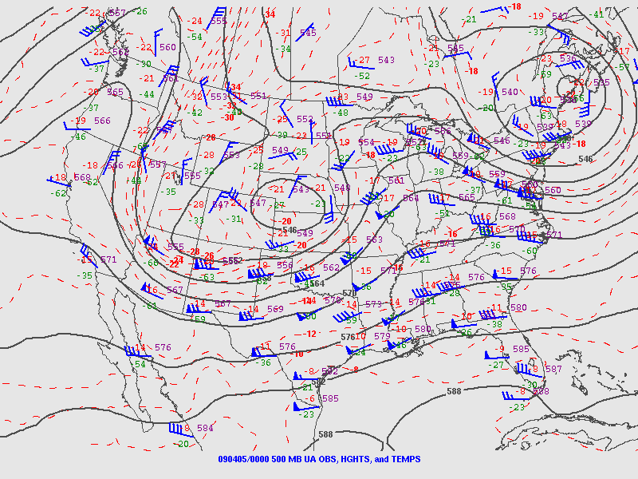
review of APRIL 4 2009

Slide 4
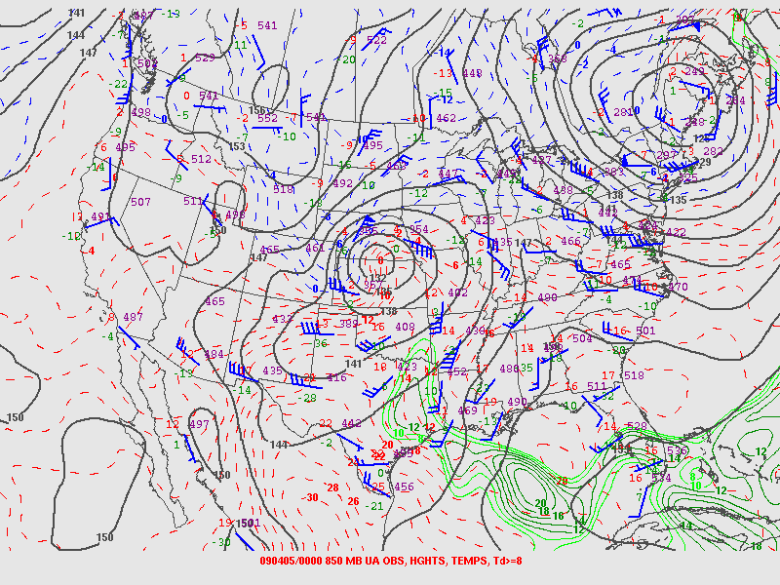
review of APRIL 4 2009

Slide 5
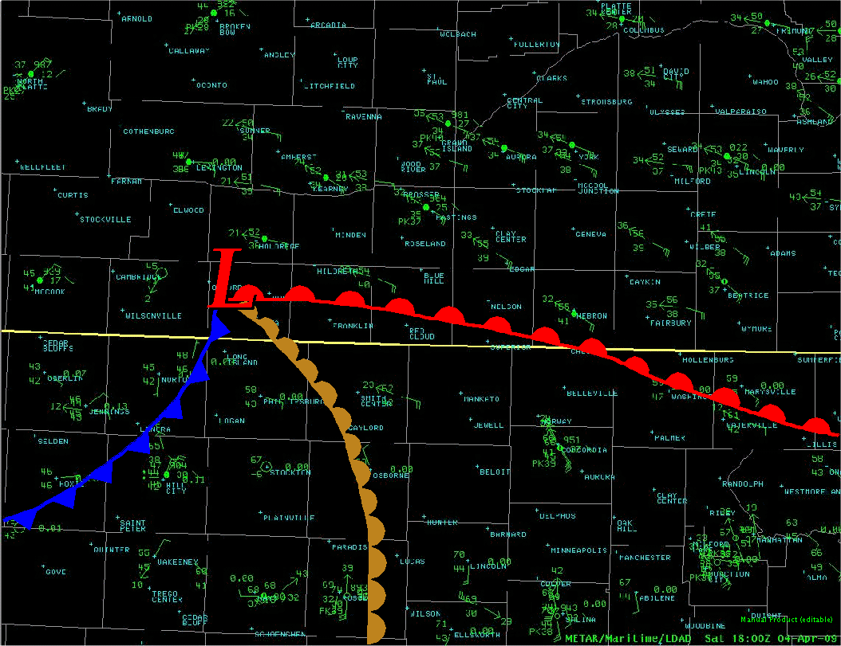
review of APRIL 4 2009

Slide 6
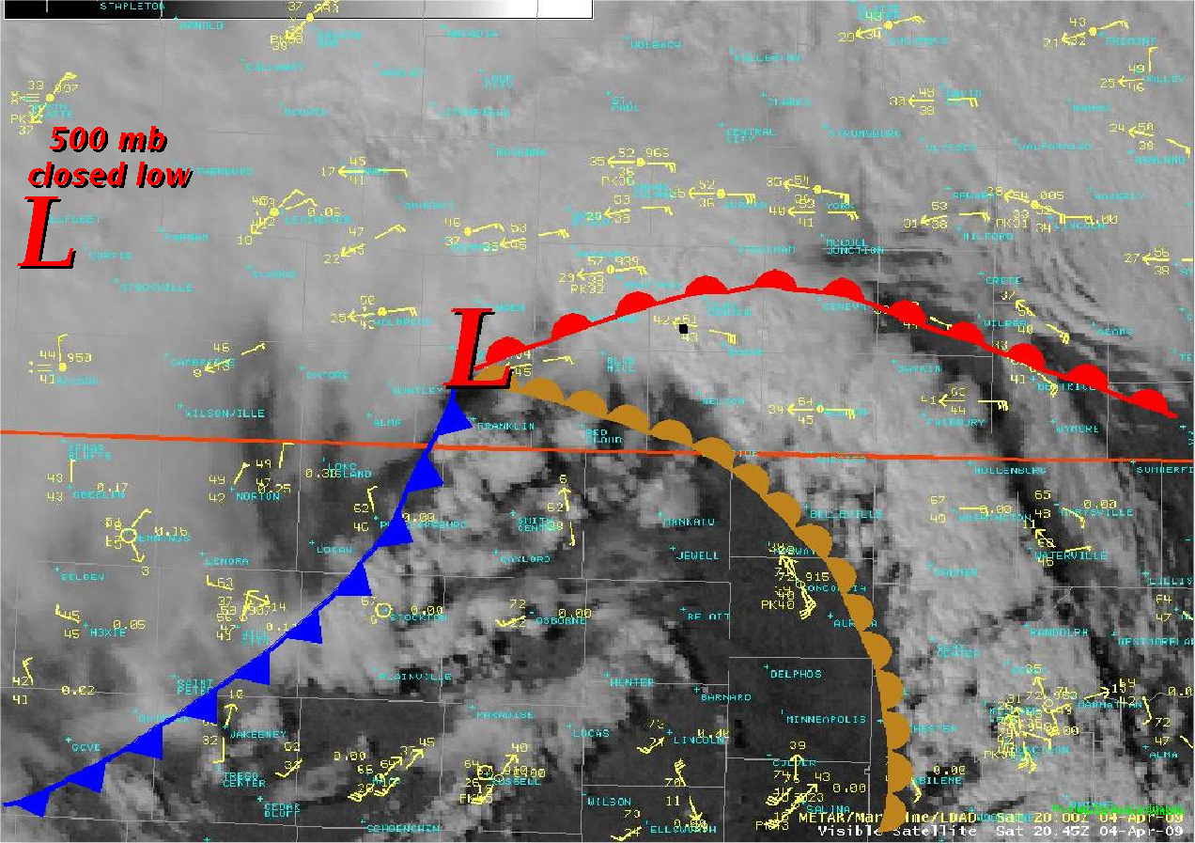
review of APRIL 4 2009

Slide 7
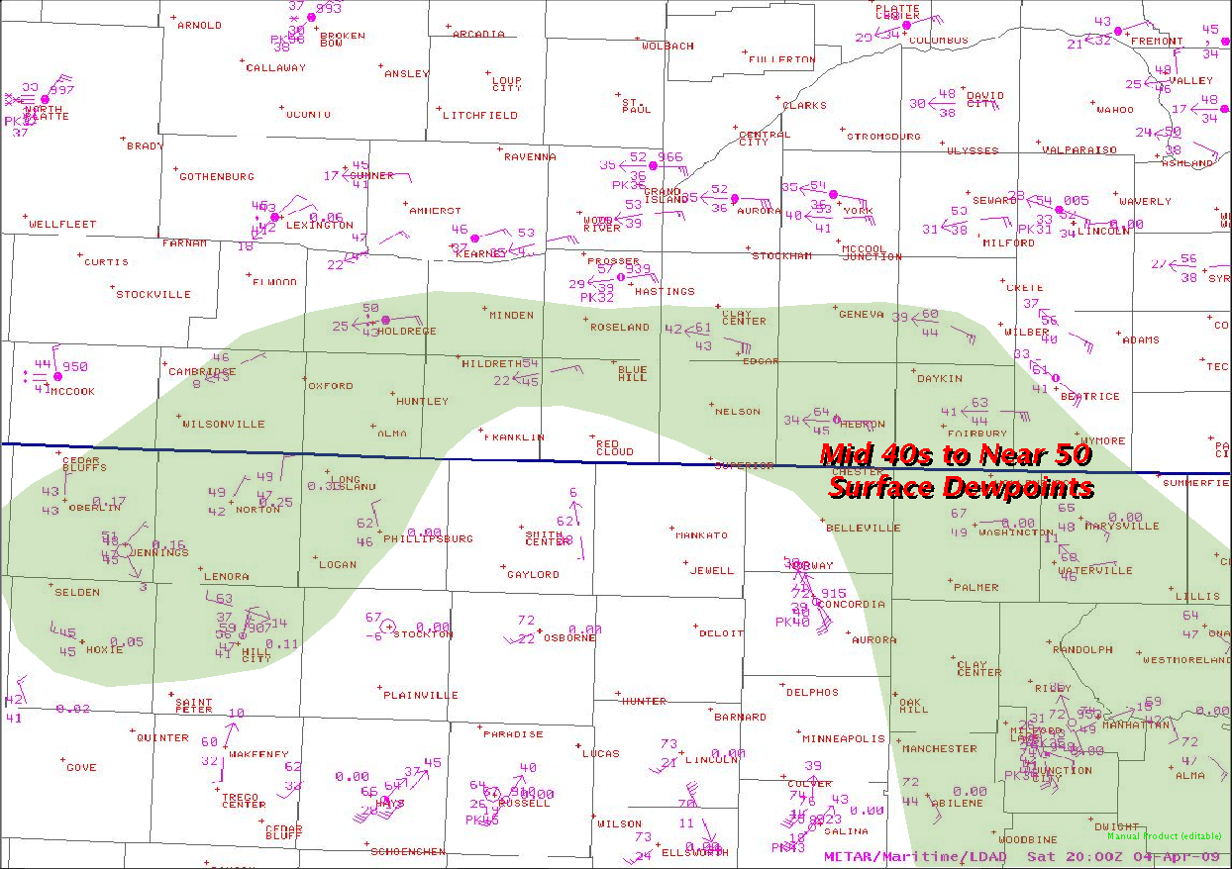
review of APRIL 4 2009

Slide 8
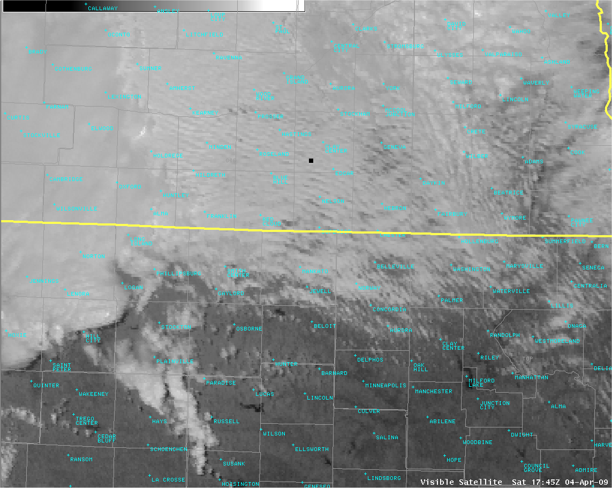
review of APRIL 4 2009

Slide 9
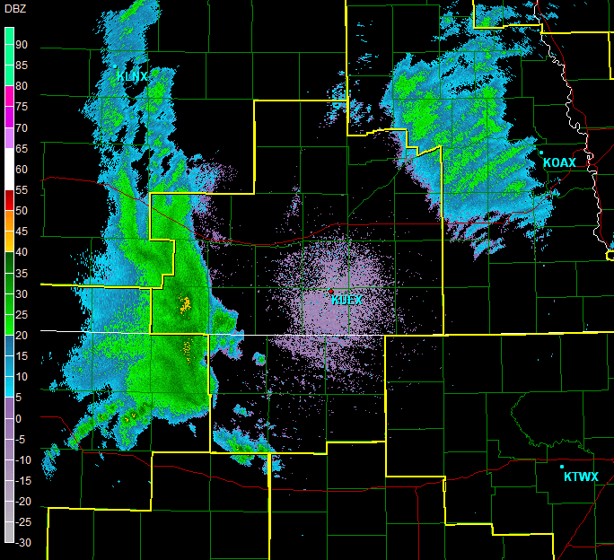
Reflectivity loop

Slide 10
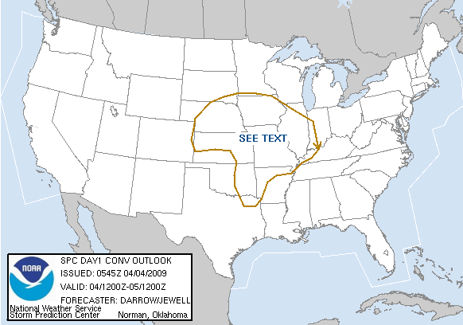
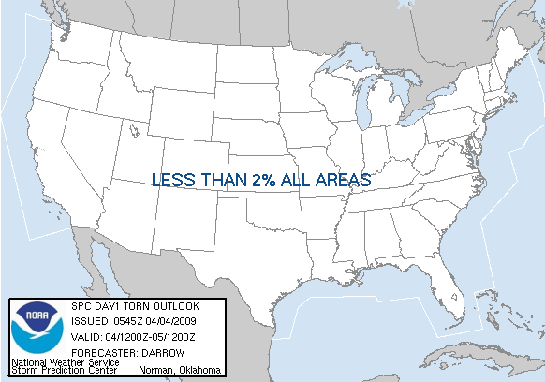
review of
APRIL 4 2009

Slide 11
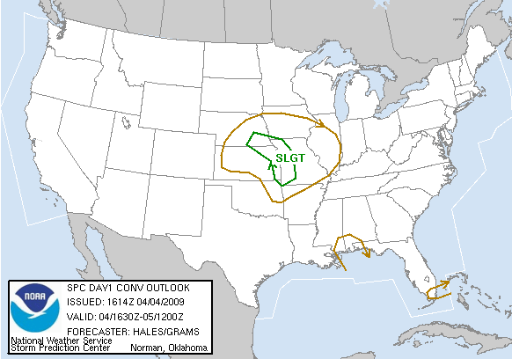
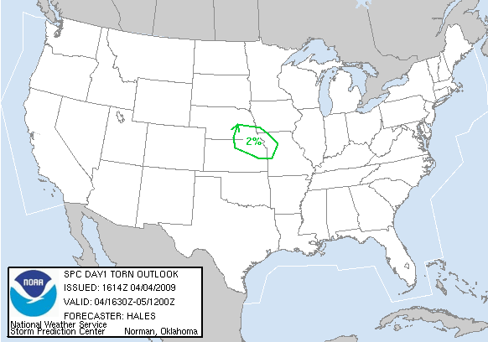
review of
APRIL 4 2009

Slide 12
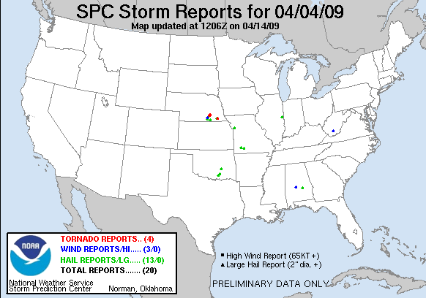
review of APRIL 4 2009

Slide 13
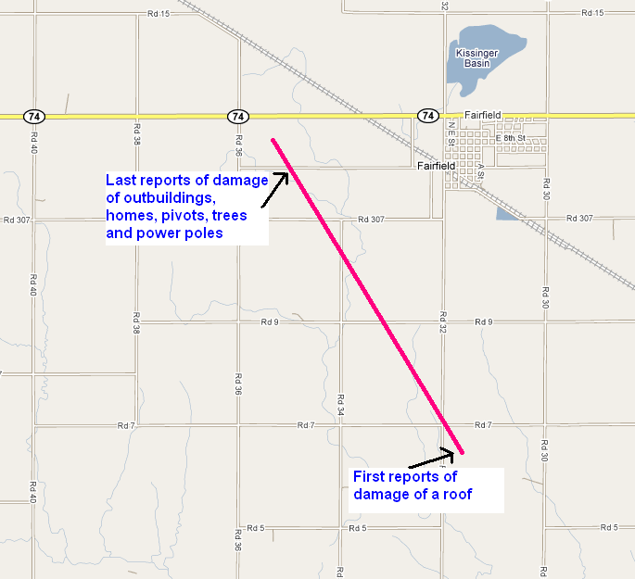
Tornado time estimated between 2038-2043 gmt

Slide 14
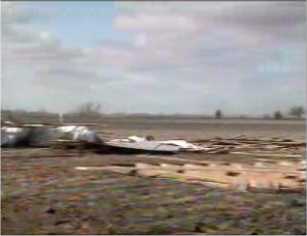
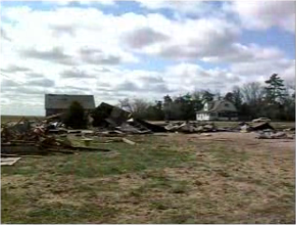
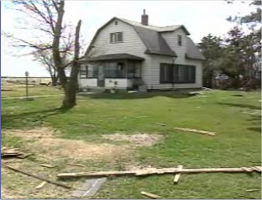
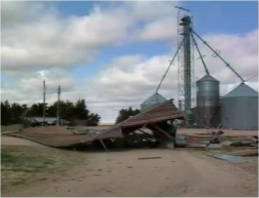
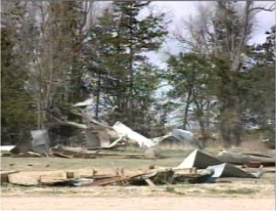
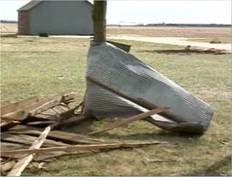
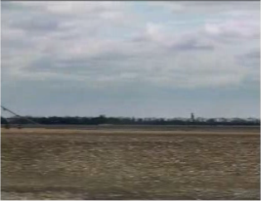
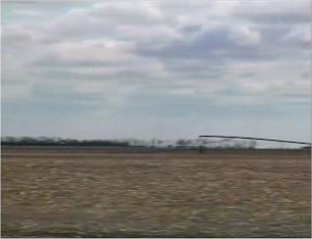
review of APRIL 4 2009

Slide 15
Davies/guyer (2004) and Davies (2006) closed 500MB tornado events…key findings
A surface warm sector with dewpoints usually lower to mid-50s °F or greater located within roughly 320 km of the CC500L
True Vertically Stacked Systems Less Likely to Produce Tornadoes…e.g. “Cold Core” wording with these events is deceptive. Steep low-level lapse rates within the warm sector ahead of the mid-level low more import
A surface boundary intersection or “focus” area (usually east/northeast/southeast of the surface low) located within roughly 320 km of the CC500L.
A surface thermal ridge, extending into the surface boundary intersection area east of the surface low. This thermal ridge would likely increase low-level lapse rates in the local area where the “nose” of the thermal ridge axis meets the edge of the surface moisture axis near the boundary intersection. This steepening of low-level lapse rates could enhance the local environment, increasing the potential for rapid parcel ascent and stretching in low levels.

Slide 16
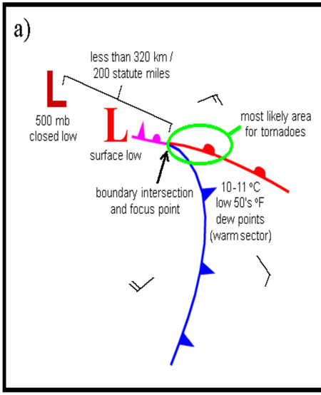
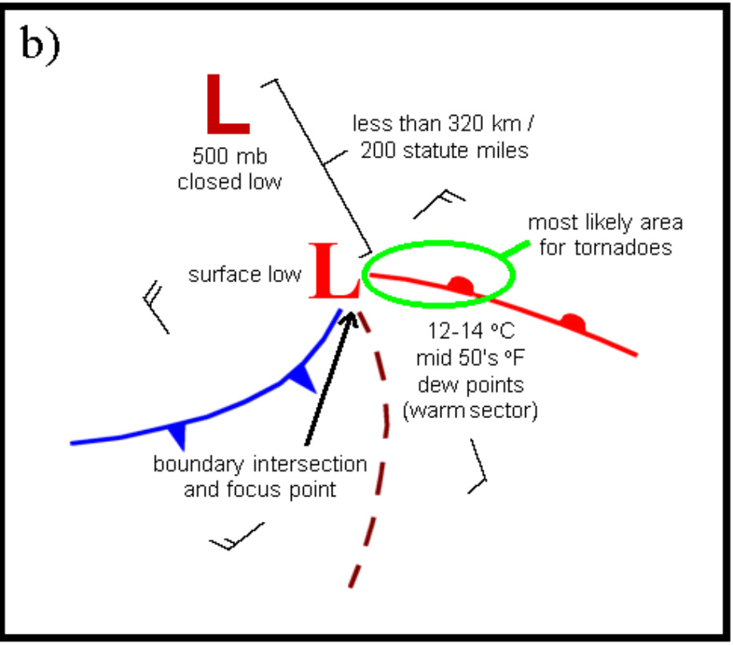
Classic sYNOPTIC setup for tornadoes associated with a closed 500 MB LOW
Davies/Guyer 2004

Slide 17

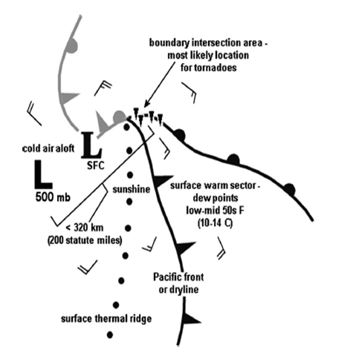
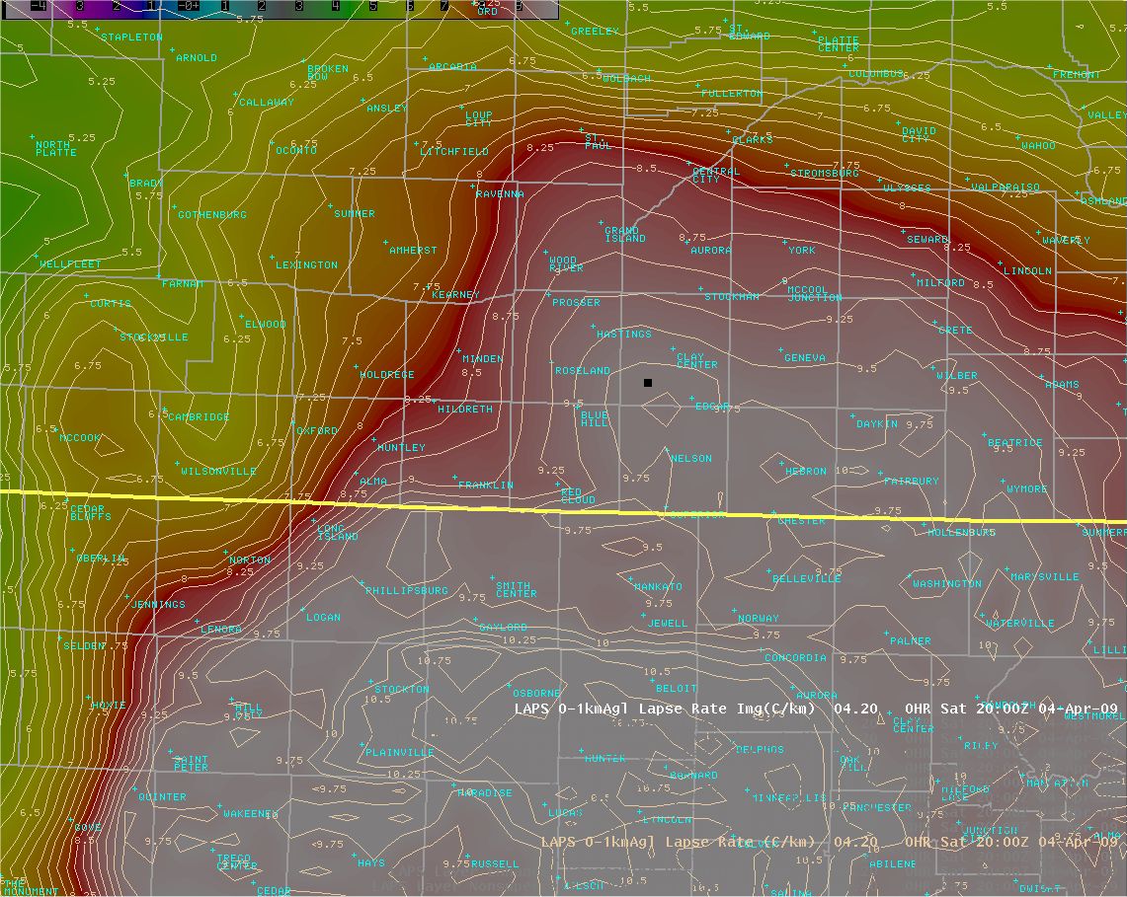
Surface thermal ridge/0-1km lapse rates
Davies 2006

Slide 18
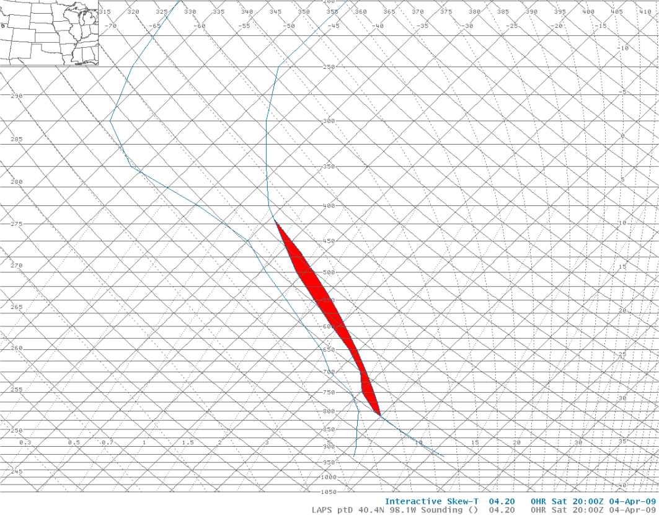
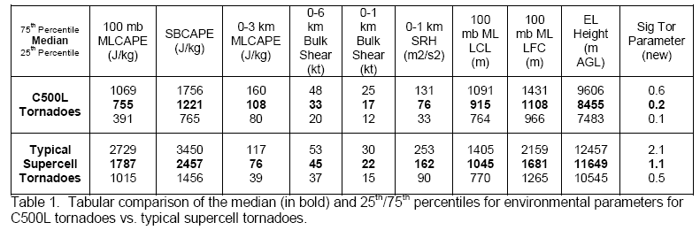
: Davies/guyer 2004
Other Parameter values ON APRIL 4, 2009 (MODIFIED laps SOUNDING) slightly different than previous literature
sb cape = ~300-400 j/kg
0-3km ml cape = 52 j/kg
0-1KM BULK SHEAR = 27 KTS
0-6km Bulk shear = 71kts
Lcl/lfc = ~1200 (m)
El height = ~7 km
0-1km lapse rate = 9.8c/km
0-2 km lapse rate = 8.5 c/km

Slide 19
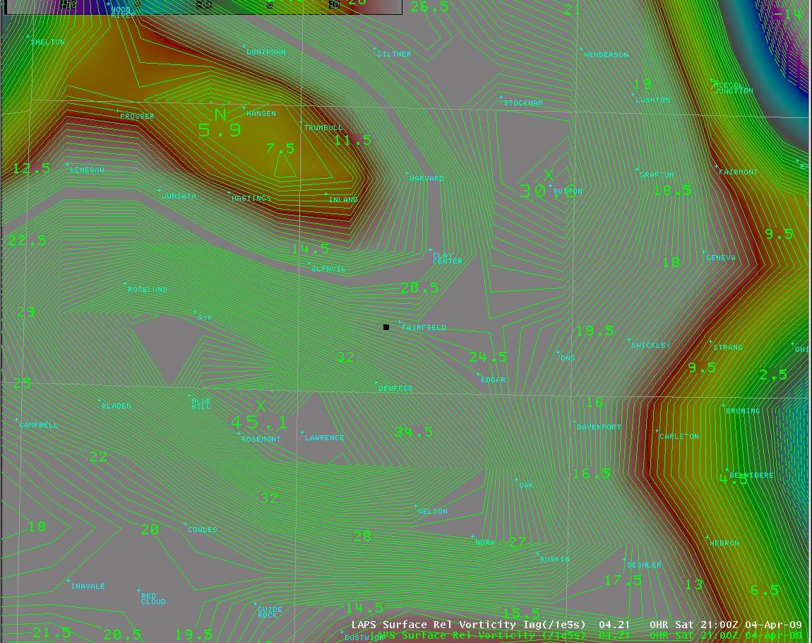
Tight spin/vorticity from the nearby mid-level low???
High Surface Relative Vorticity???

Slide 20
Post event review
detailed analysis of level ii data revealed:
multiple misoscale vorticies traveling along surging dryline feeding into area that spawned tornado
Vorticies moved independent of convective cells and could be traced backwards 30-50 minutes

Slide 21
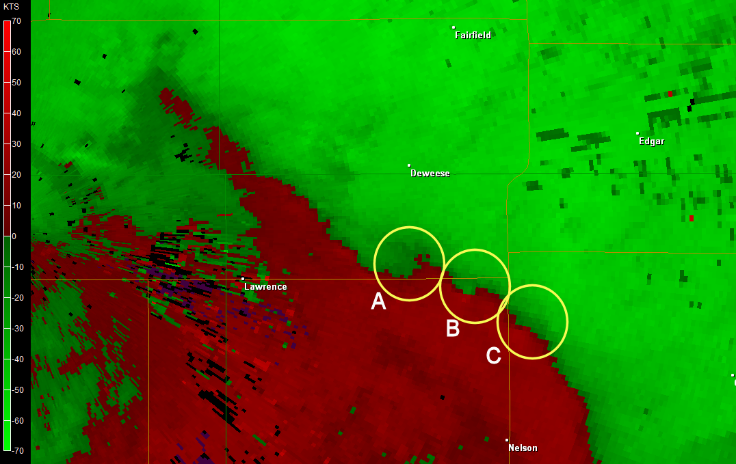
Post event review

Slide 22
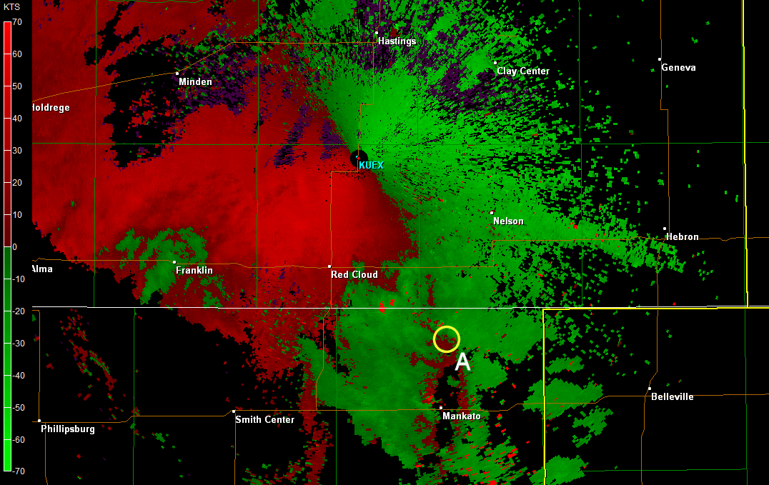
Post event review

Slide 23
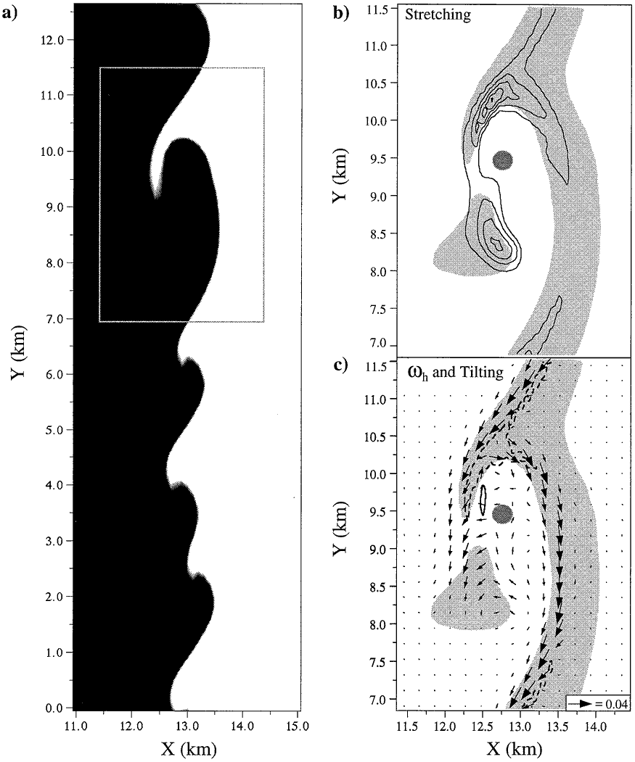
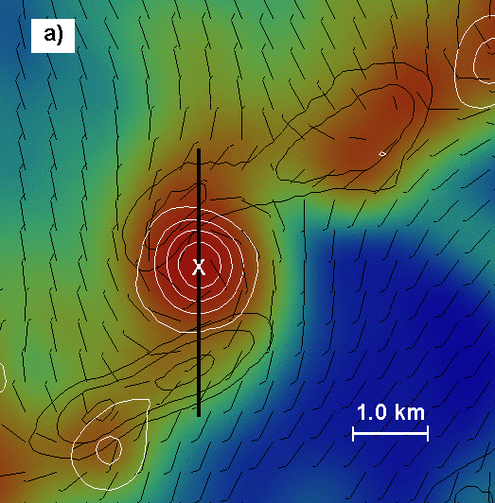
Review on misoscale Vorticy development
In a two-dimensional frame - misocyclones are created by Horizontal shearing Instability (HSI) along a boundary: wakimoto & wilson (1989)/Brady & szoke
(1989)/Lee & Wilhelmson (1997)
HSI s aid in the following :
    Concentrate vertical vorticity at discrete locations along a boundary leading edge
    Further centralize vertical vorticity by subharmonic interactions leading to consolidation events

Slide 24

Review on misoscale Vorticy development
however…boundaries exist BEYOND MAINLY 2-D PROCECESS and are subject to three-dimensional motions.
THE VERTICAL VORTICITY (ζ) TENDENCY EQUATION REVEALS:
    THE INTENSITY OF THE VORTICES CREATED ALONG THE LEADING EDGE OF A BOUNDARY ARE ALSO INFLUENDED BY:
    Stretching OF Preexisting vertical vorticity
    Vertical tilting of horizontal vorticity
    Lee & Wilhelmson Wilson (1997)
    MISOCYCLONES ARE generally SHALLOW IN DEPTH ( < 2-3 KM)
Notes:
The right-hand side terms represent the advection of vertical vorticity (z), the tilting of horizontal vorticity
(vh), and the stretching of vertical vorticity, respectively

Slide 25
Radar review
previous literature such as pietrycha, Manross and Nelson (2006), utilize base velocity over srm…but this involved slow moving or stationary boundaries.
due to fast moving dryline…vorticy features became much more apparent in SRM data versus base velocity while utilizing an average vorticty motion within the previous 30 minutes.
begin radar review at 1950 GMT and end at 2041 GMT (tornado time).

Slide 26
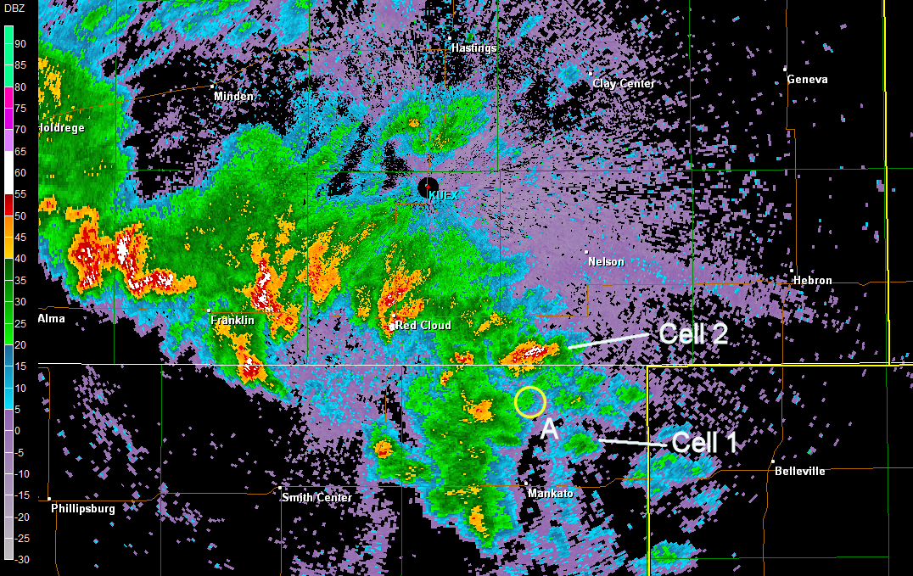
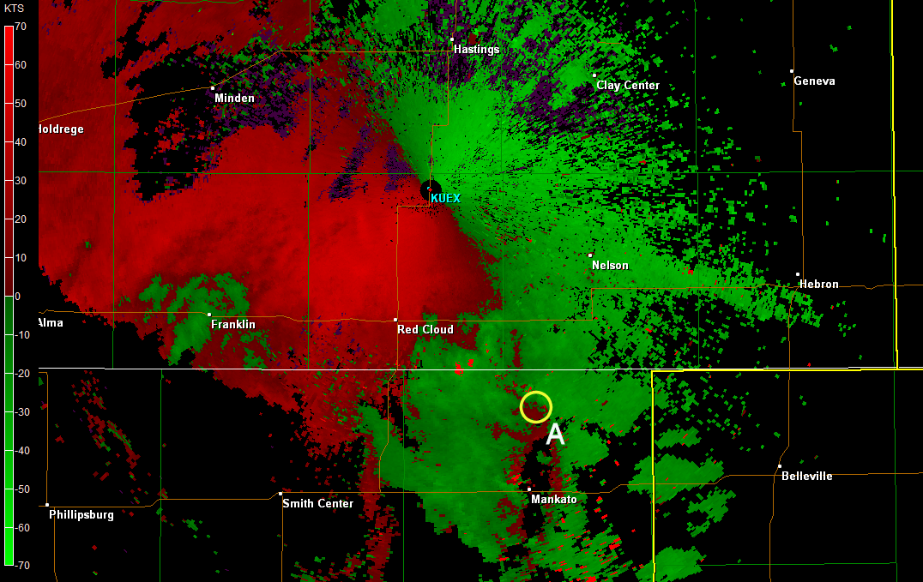
1950 GMT

Slide 27
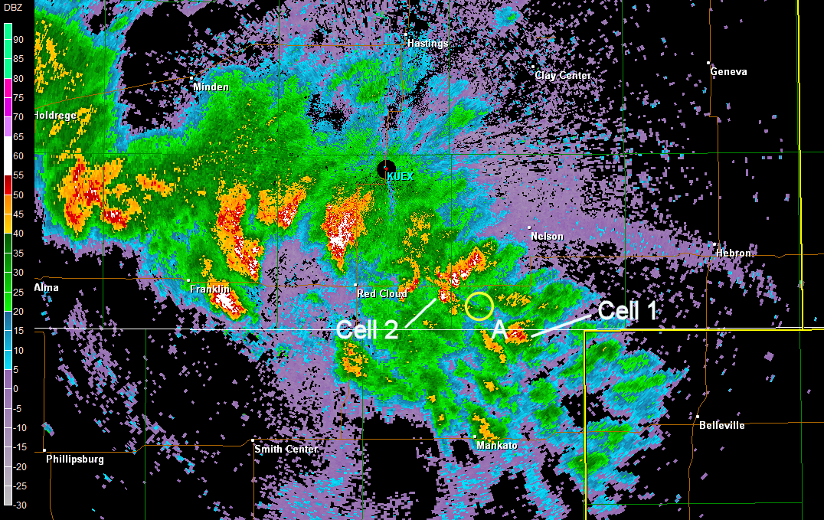
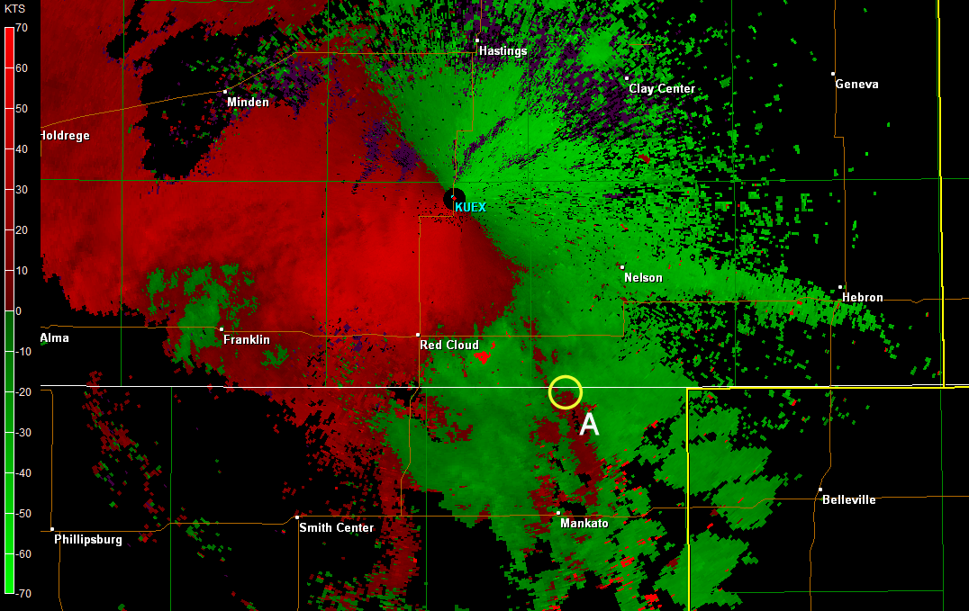
1955 GMT

Slide 28
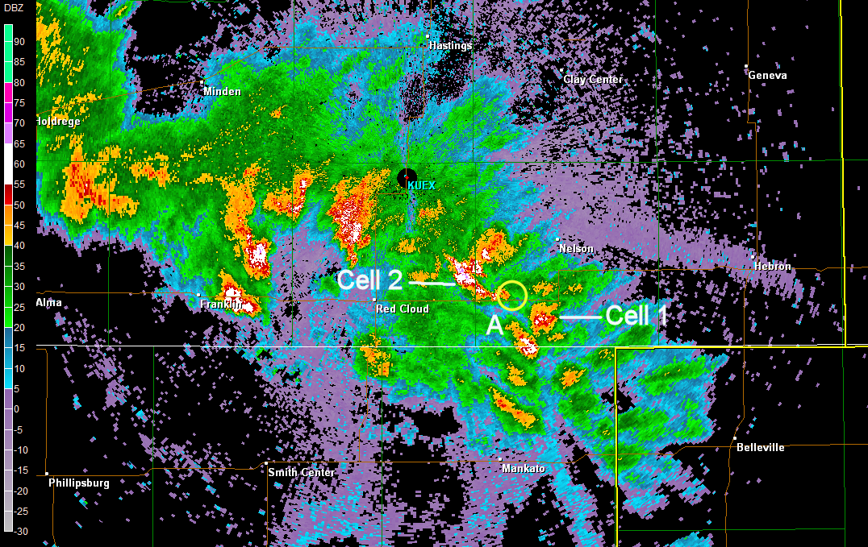
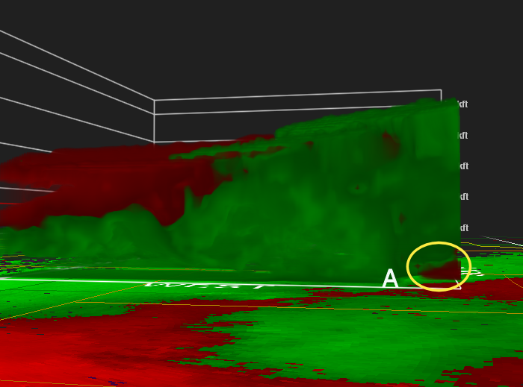
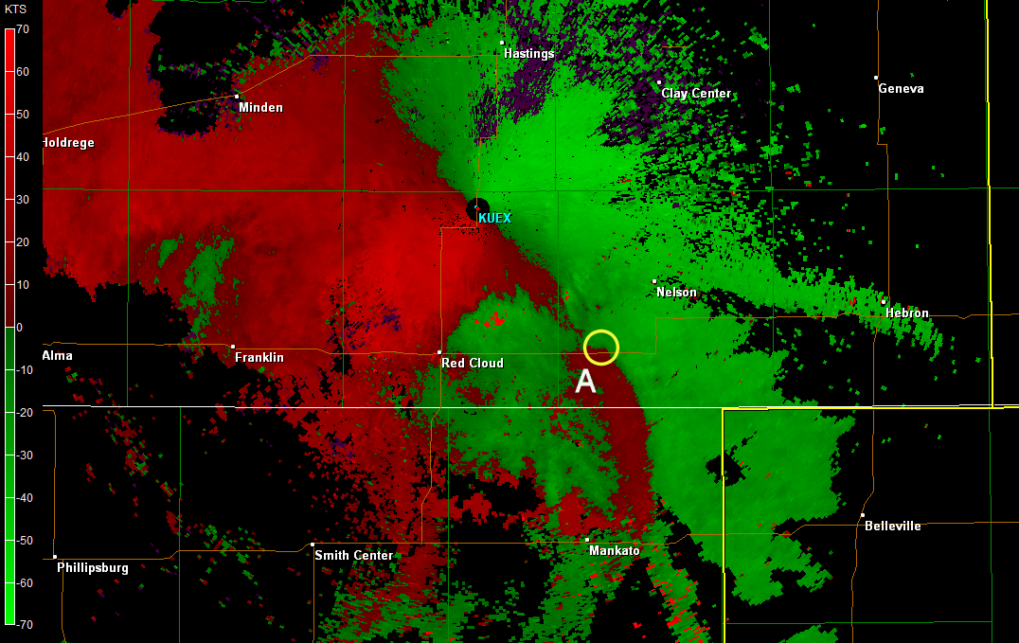
2004 GMT

Slide 29
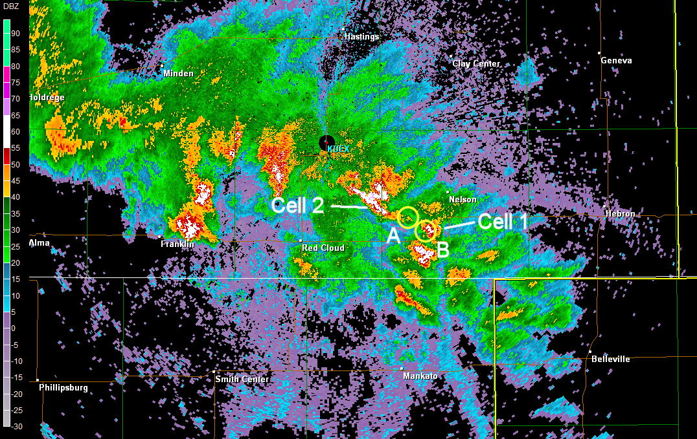
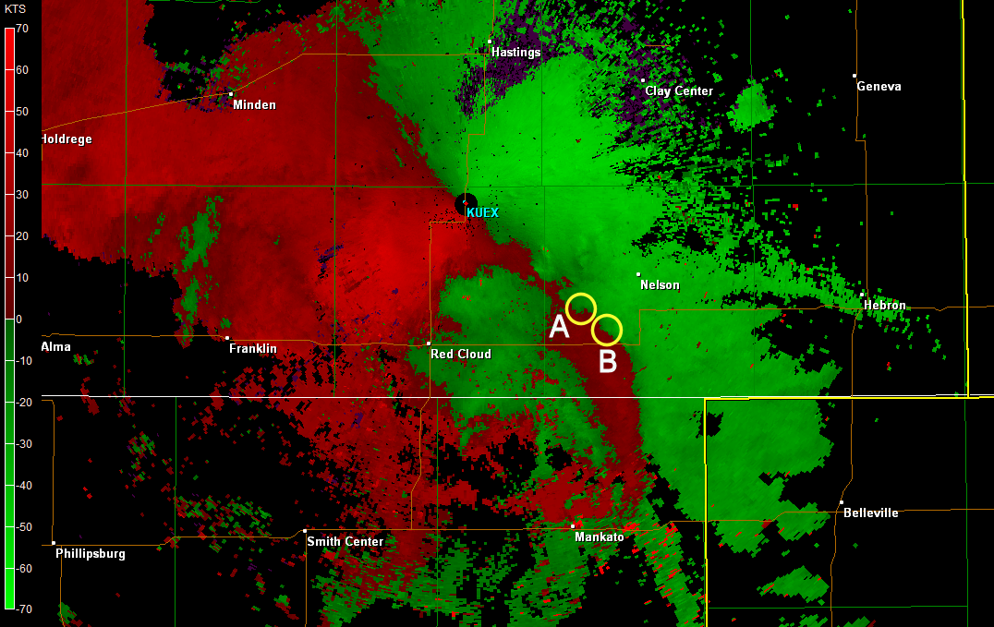
2009 GMT

Slide 30
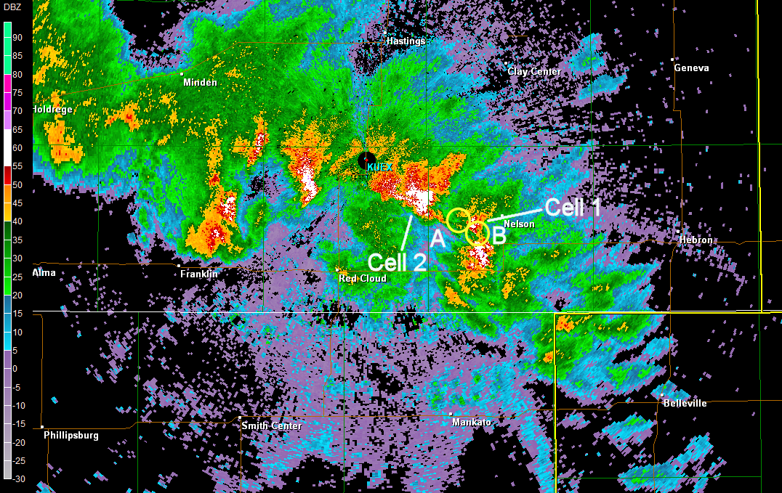
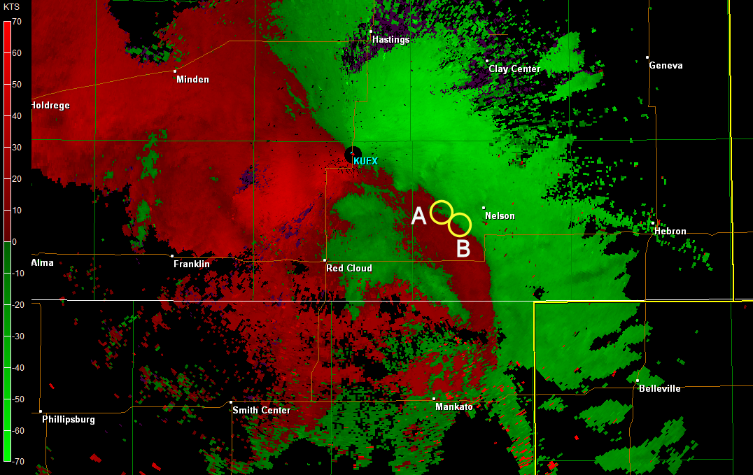
2013 GMT

Slide 31
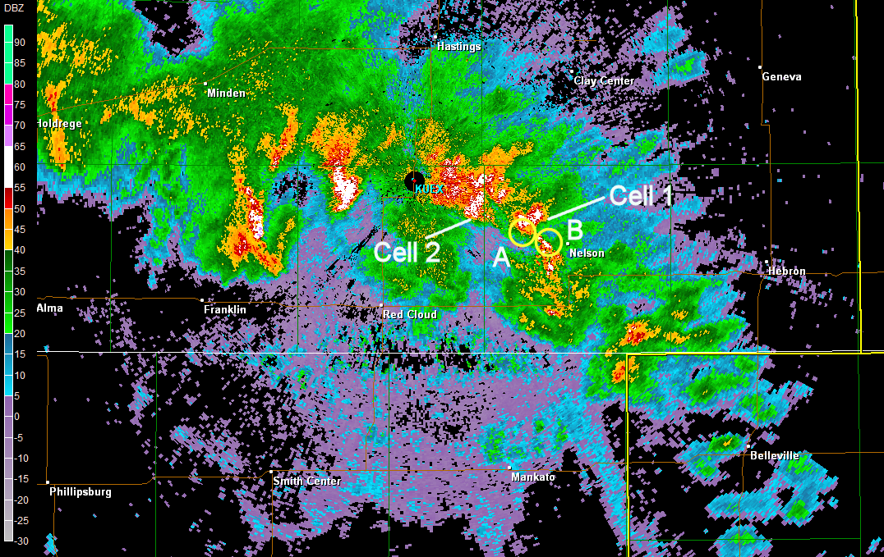
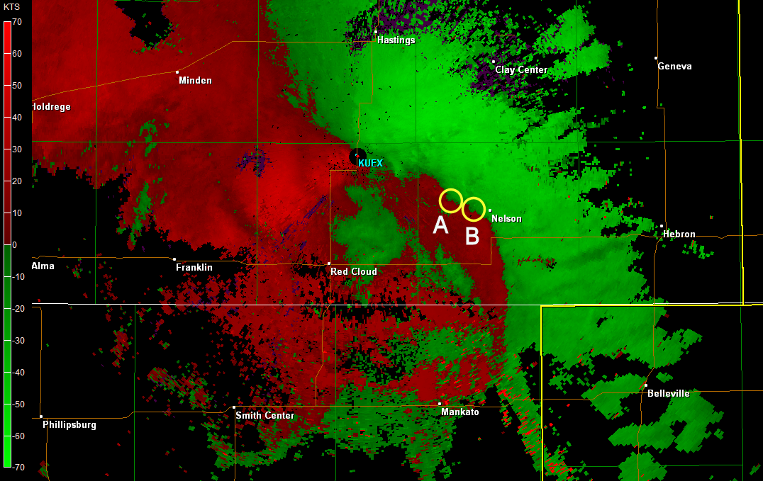
2018 GMT

Slide 32
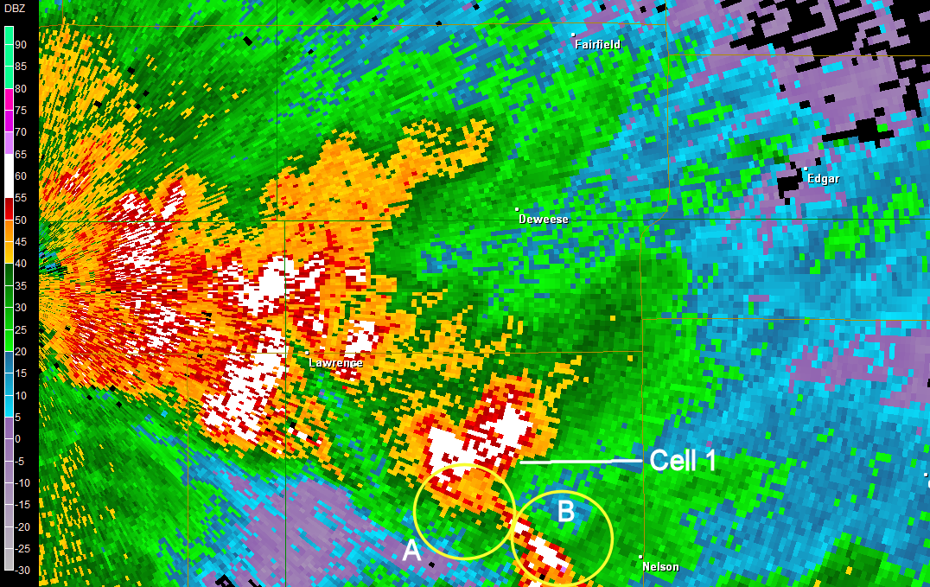
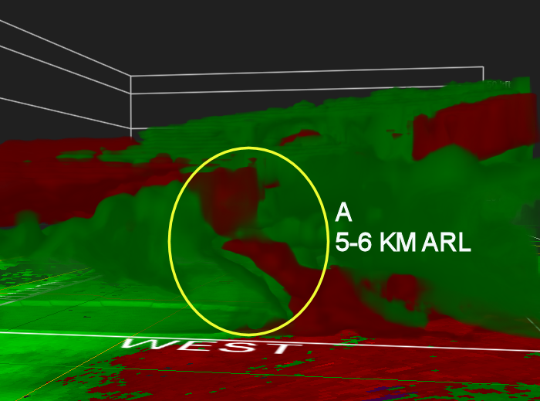
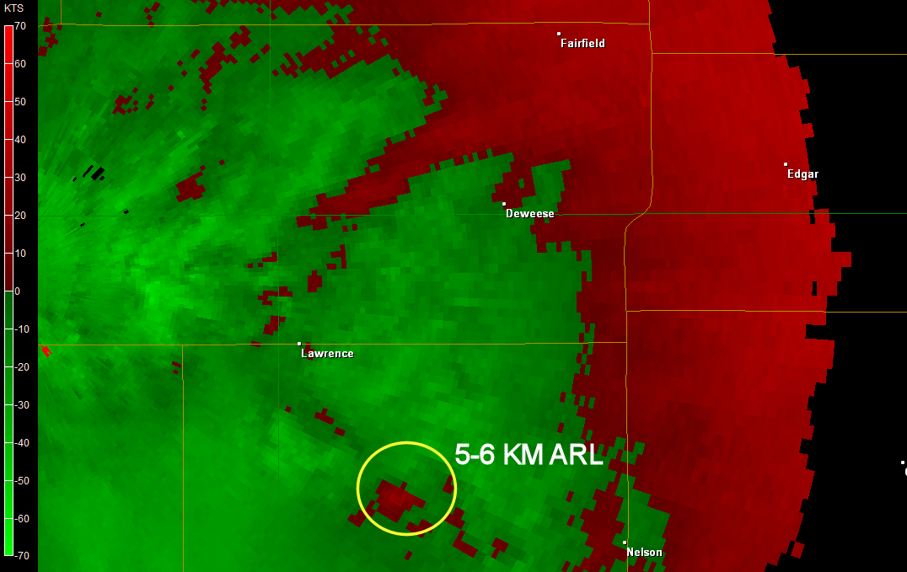

2018 GMT

Slide 33


2022 GMT

Slide 34


2022 GMT

Slide 35


2027 GMT

Slide 36



2027 GMT

Slide 37


2032 GMT

Slide 38



2032 GMT

Slide 39


2036 GMT

Slide 40




2036 GMT

Slide 41


2036 GMT

Slide 42


2041 GMT

Slide 43




2041 GMT

Slide 44



Non-Mesocyclone Tornado???
Fairfield Tornado conditions exibited NmT/landspout similarities
Rapid vortex stretching seen near and prior to tornadogenesis similar to NmT/ landspout development as detailed by wakimoto and wilson (1989) /Brady & szoke (1989)/LEE AND WILHELMSON (1997)

Slide 45

Surface thermal ridge/0-1km lapse rates
Closed Mid Level low
NMT/Landspout
Davies 2006
Jon Davies NMT Ingredients Web Page :

Slide 46


Interesting although possibly irrelevant
one of the cases utilized by Baumgardt and Cook to create the non-supercell tornado parameter (NST) for delineating NMT environments was associated with a closed mid level low

Slide 47
Summary
synoptic/mesoscale environment very similar to Closed mid level low conceptual models derived from previous literature
Multiple vorticies seen traveling along a surging dryline before tornado development
rapid stretching of preexisting vorticies appeared to be key component to tornadogenesis
unknown if is this process of tornadogenesis is more common in closed 500mb low events
Could many of the enviornmental conditions needed for a closed mid-level low to produce a tornado(s)…not be that different than the nmt/landspout environment ???

Slide 48
QUESTIONS???

