Slide 1
Introduction of Weather Forecast Office Probabilistic Services Delivered Within the NDFD Framework
Kenneth R. Cook and Paul J. Howerton
National Weather Service, Wichita, Kansas

Slide 2
Initial Requests
The 2005 NRC Report – NWS: Provide probabilistic forecasts
KDOT – requested probabilistic wind forecast
Wind Energy – power management
Notes:
There have been several entities that have either suggested the NWS do this or have specifically requested it. The NFUSE team has put together some probabilistic MOS products as part of the NDGD, but have had difficulty getting this into the WFO. This process will hopefully bridge that gap.

Slide 3
Methodology
Analysis of wind
  Distribution of wind speed
  Distribution of wind speed error
Can approximate uncertainty
  Probability of Exceedance (PoE)
Distributions found:
  Weibull (speed)
  Gaussian (error)
Notes:
First, we looked at the distribution of wind observations, which follows a Weibull distribution. Then we took a look at the error, which followed a normal or Gaussian distribution.

Slide 4
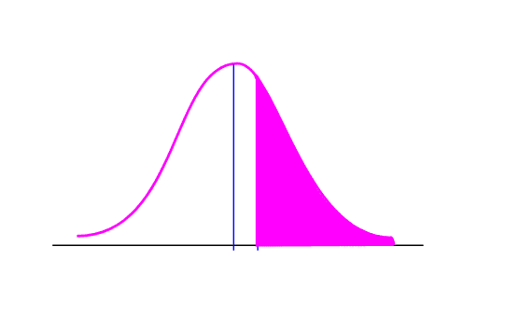
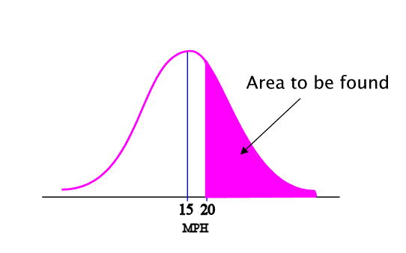
Methodology
Gaussian Distribution:
So, if I have a wind speed forecast of 15 mph, what is the likelihood of it reaching 20 mph?
Notes:
Here is how you have to calculate a probability of exceedance. You have a given standard deviation and you want to find the probability of exceeding a value. All that needs to be done is to calculate the area of what is left. This easier done by tables or should I say “easier said than done”

Slide 5
Methodology
How to proceed?
  Error Climatology vs. Model
Used SREF spread for Wind Speed
  Represented forecast uncertainty
  Portability
Problem! No spread for Wind Gust
  Calibrated via climatological standard deviation of Wind vs. Wind Gust
    30 year climatology
    Observations over 7 WFOs
Notes:
Using a Gaussian distribution, we can approximate the uncertainty based on the standard deviation. We went about this at first with a climatological approach. The drawback in using climatology is that represents a static uncertainty and does not represent the uncertainty of the actual forecast. This would then have to have either one value applied over an entire grid or have a number of values from each station interpolated over the grid. Further, if this technology was to be exported throughout the region, we would need to do climatological uncertainty distributions for every observation site. A decision was made to use the SREF delivered standard deviation because of its representation of forecast uncertainty (model inadequacy noted), grid nativity, and portability.
Another issue cropped up, how to estimate the uncertainty of the wind gust?

Slide 6
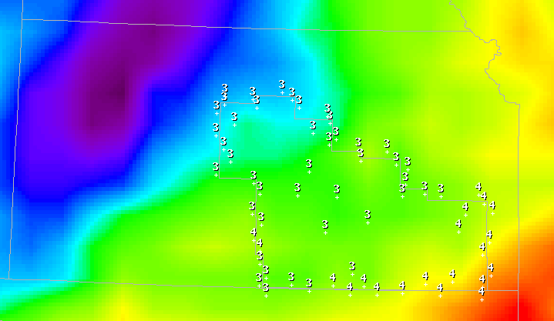
SREF Standard Deviation
Notes:
SREF standard deviation in GFE

Slide 7
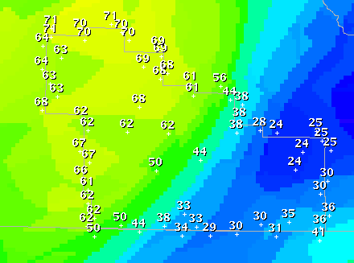
Prob. Wind Exceeding 15 mph
Notes:
GFE graphics here and following

Slide 8
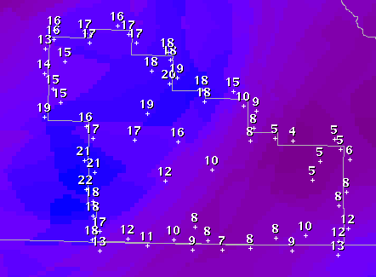
Prob. Wind Exceeding 25 mph

Slide 9
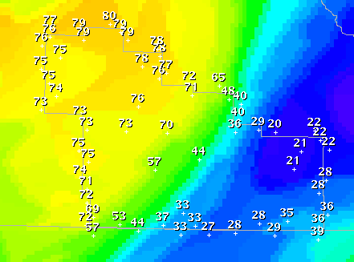
Prob. Gust Exceeding 20 mph

Slide 10
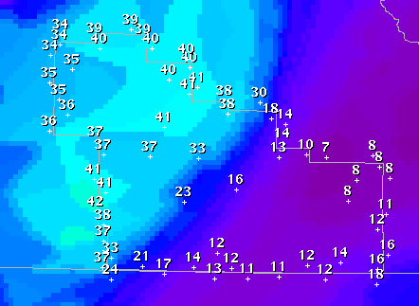
Prob. Gust Exceeding 30 mph

Slide 11
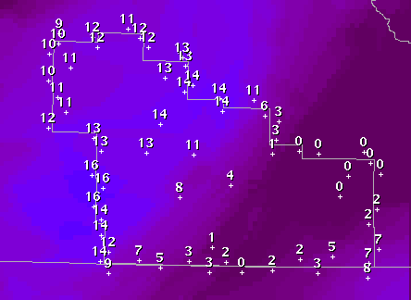
Prob. Gust Exceeding 40 mph

Slide 12
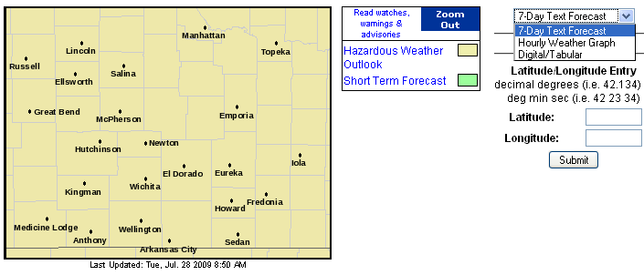
Point and Click Infrastructure
Notes:
We wanted to create and use these data to be incorporated into the current infrastructure. For these, you can use both the hourly weather graph and the tabular output.

Slide 13
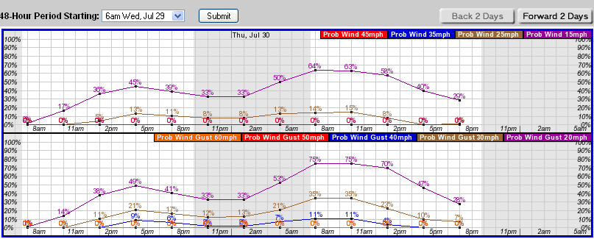
Hourly Weather Graph

Slide 14
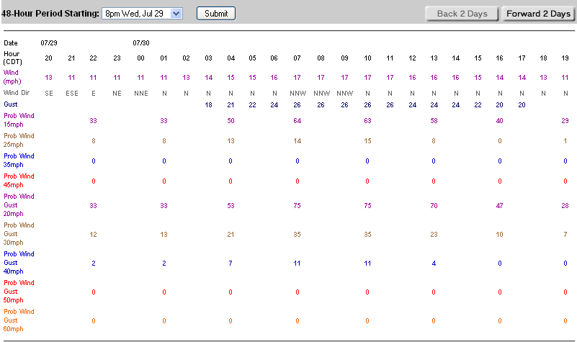
Tabular Output

Slide 15
References and Credits
Wilks, Daniel J., Statistical Methods in the Atmospheric Sciences, Academic Press, 1995
National Research Council, Completing the Forecast, 2005
StatSoft Electronic Textbook, web site: http://www.statsoft.com/textbook/stathome.html
Wolfram MathWorld, web site: http://mathworld.wolfram.com/NormalDistribution.html
Special thanks to Mark Mitchell (ITO EAX) and Scott Mentzer (MIC GLD) who have provided their support and feedback along the way

Slide 16

What’s Left?
Definitions on Web Site
Export technology
NFUSE and WAS*IS
Additional elements (already under way)
Thank you!
Notes:
We are not too far away from getting this through. We will see what happens!

