Slide 1
Composite Analysis of Environmental Conditions Favorable for Significant Tornadoes across Eastern Kansas
Joshua M. Boustead, and Barbara E. Mayes
NOAA/NWS WFO Omaha/Valley, NE
William Gargan, George Phillips, and Jared Leighton
NOAA/NWS WFO Topeka, KS

Slide 2
Study Motivation
Significant improvements in watch/warning program since the 1950s
  NWS modernization/Doppler radar use
  Media
  Public education
Forecasters still struggle with pattern/environment that produce significant tornadoes
Further understanding of the synoptic patterns that produce significant tornadoes can lead to better preparedness and awareness (pattern recognition)
Operational experience indicates most tornadoes either occur in the warm sector of a cyclone, or along a discernable surface boundary

Slide 3
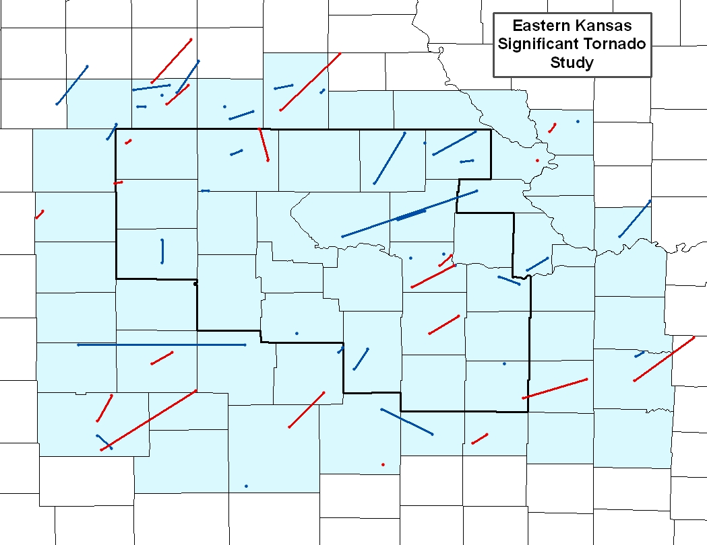
Study Methodology
Database compiled from 1979 to 2007 for a part of eastern KS yielding 97 significant tornadoes
  Based on subjective surface analysis, tornadoes were grouped into occurring within 50 km of a discernable surface boundary or not
NARR data obtained for each tornado occurrence for a predefined box of data around the tornado
Database contained several days with more than one significant tornado
  First tornado was used on a particular day
  Subsequent tornadoes would be used if:
    More than 3 hours seperated signficant tornado occurrences
    If the tornado occurred in a different synoptic setting
20 warm sector tornadoes
25 front sector tornadoes

Slide 4
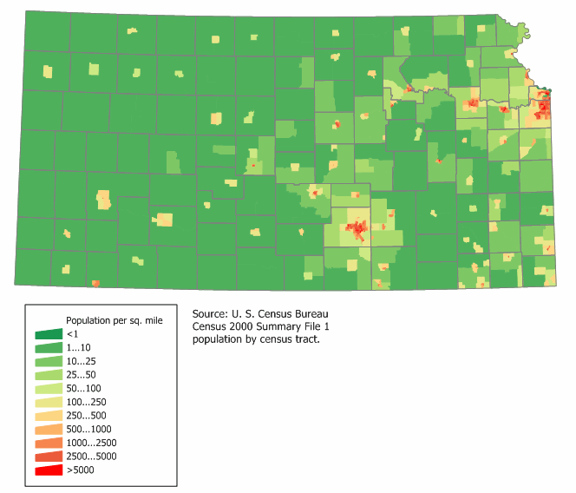
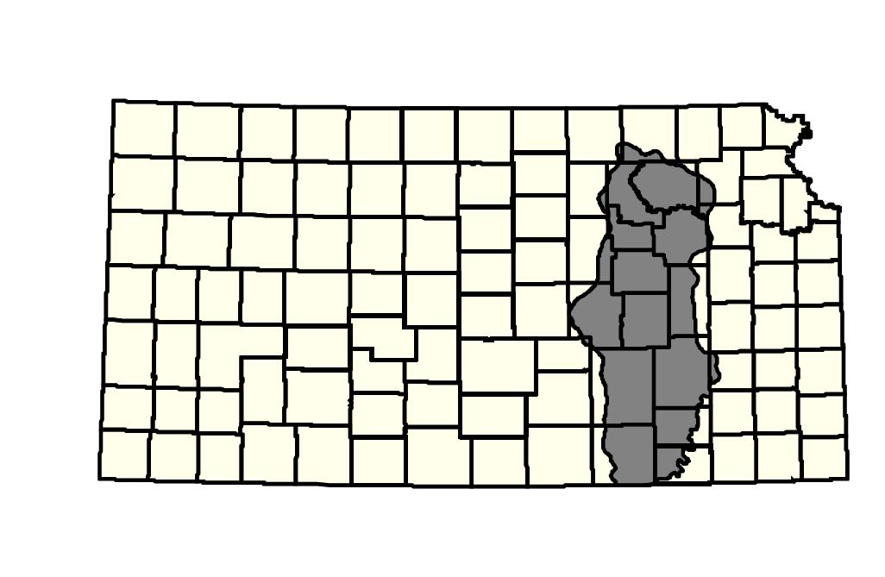
Population Density
Map curtsey of Kansas Department of Commerce, Travel and Tourism

Slide 5
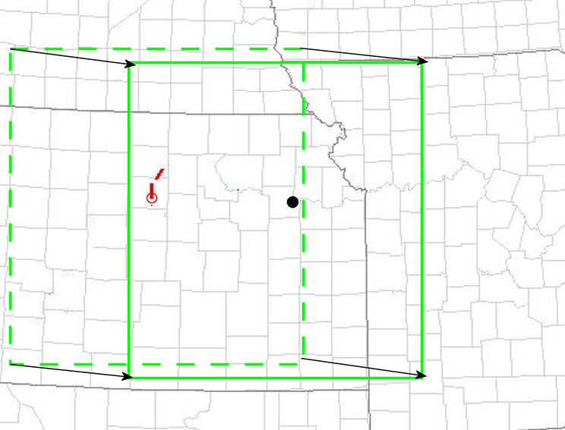
Methodology Continued
A tornado relative grid was utilized for the composites
  Used starting location of tornado
  Used a standard size box around the tornado
  All data boxes then moved to one lat/lon (that of Topeka, KS)
Study had two phases
  Composite and standard deviation analysis at mandatory levels
  Statistical analysis of individual events
    Understanding of the range of values possible

Slide 6
Database Facts
Warm sector tornadoes typically occur early in the year
  Warm sector peaks in March
  Frontal cases peak in June
Only 1 day since 1979 (15 Jun 1992) had warm sector tornadoes past May 29th
2/3rd of the July tornadoes occurred between 5 and 9 am
No occurrences of significant tornadoes from both synoptic settings

Slide 7
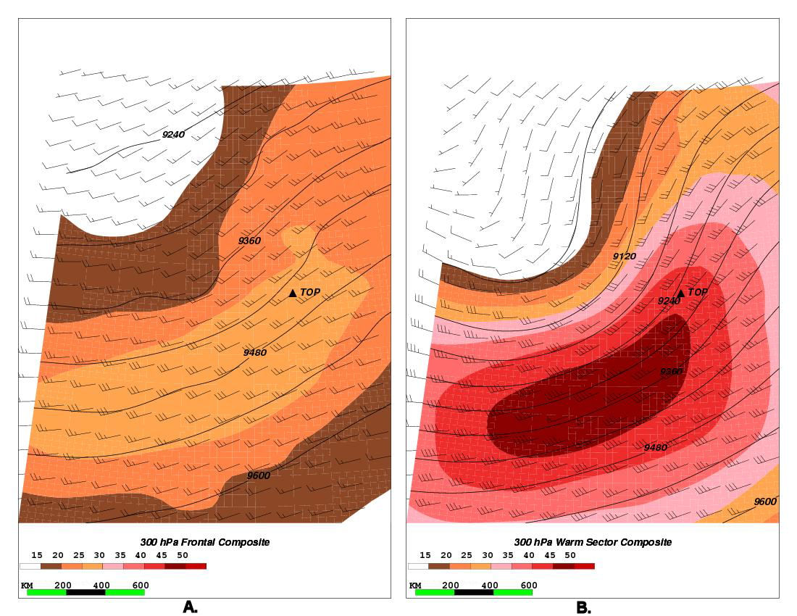
300 hPa Composite
Stronger jet in the warm sector with significant curvature
Left front exit region is favored location in both patterns
Upstream short-wave trough with some negative tilt

Slide 8
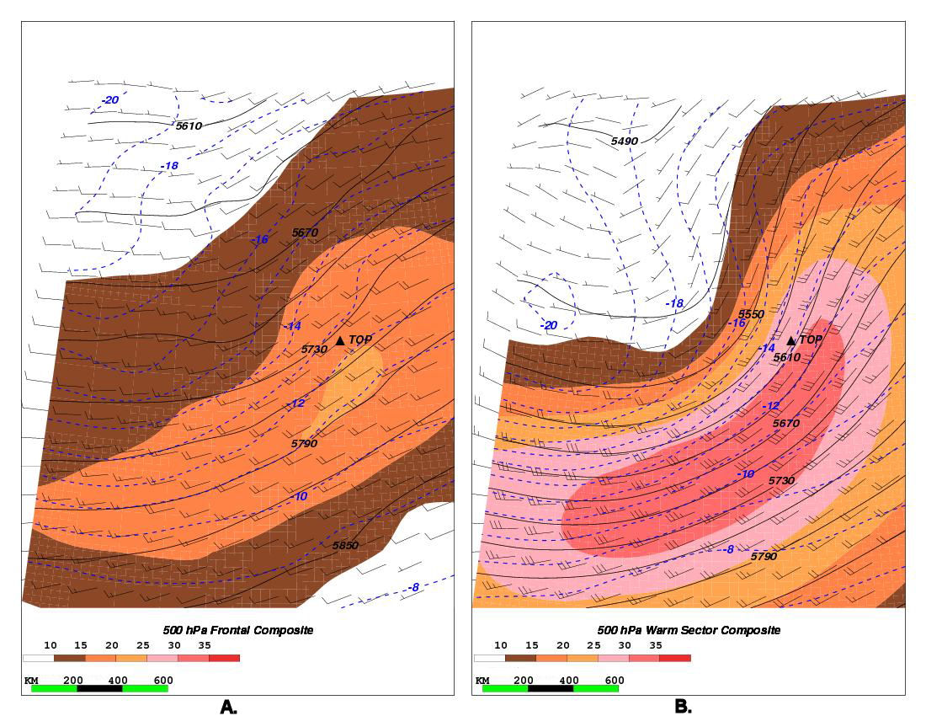
500 hPa Composite
Nose of the jet near the location of the significant tornado
System usually deepening, especially in the warm sector cases
System appears progressive given the jet position

Slide 9
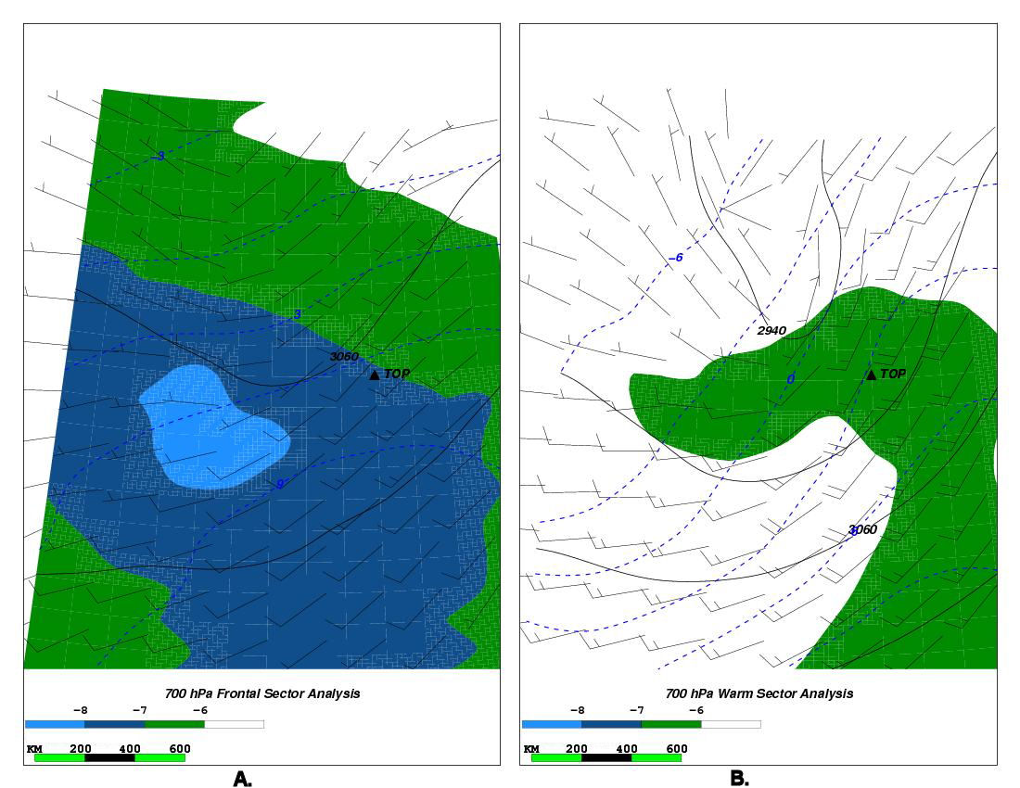
700 hPa Composite
Cool temperatures indicated in both situations
Steeper lapse rates (shaded) in frontal cases
  Later season events
CAA indicated in the warm sector
WAA indicated in the frontal cases

Slide 10
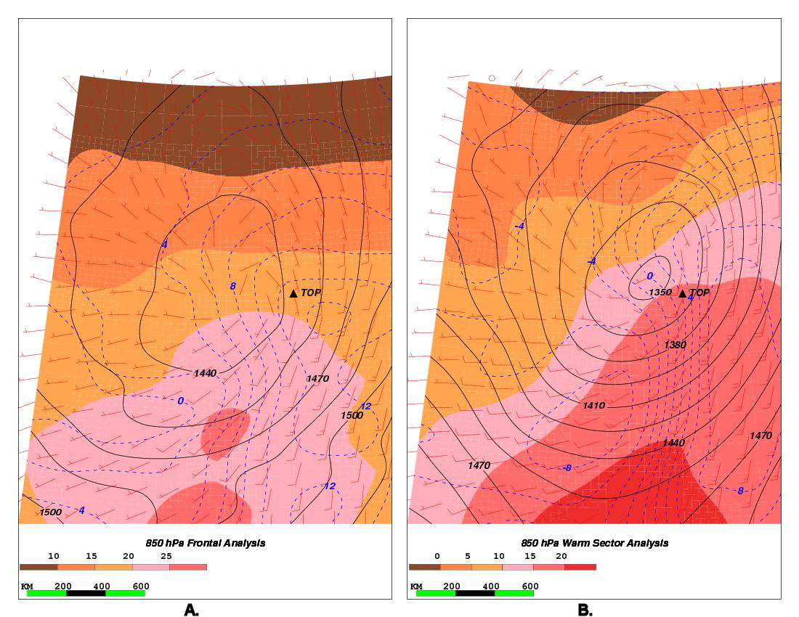
850 hPa Composite
Well defined dry intrusion southwest of tornado
Tornado on western edge of moisture in warm sector cases, and within moist axis in frontal cases
Tornado east (southeast) of low in the frontal (warm sector) cases
Backed flow with respect to south in frontal cases, slightly veered in warm sector cases

Slide 11
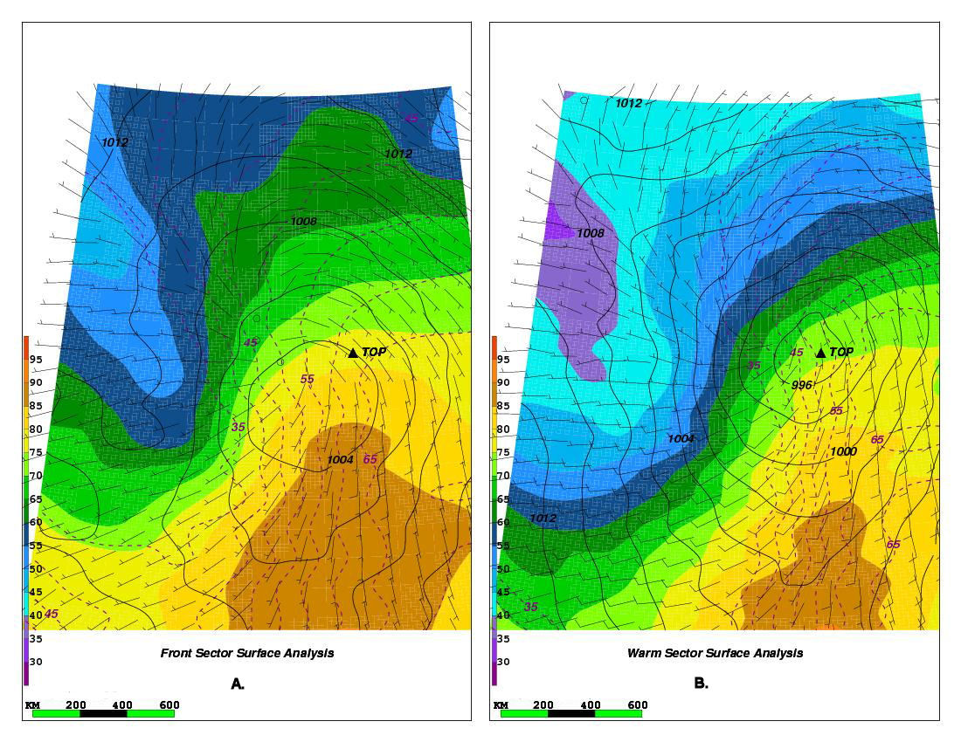
Surface Composite
Weak (strong) baroclinicity along warm front in frontal (warm sector) cases
  Artifact of earlier season events?
  Only 16% of frontal cases occurred before May 1st
Tornado northeast (east) of the low in the frontal (warm sector) cases
Dryline indicated in both cases (less defined in frontal cases)

Slide 12
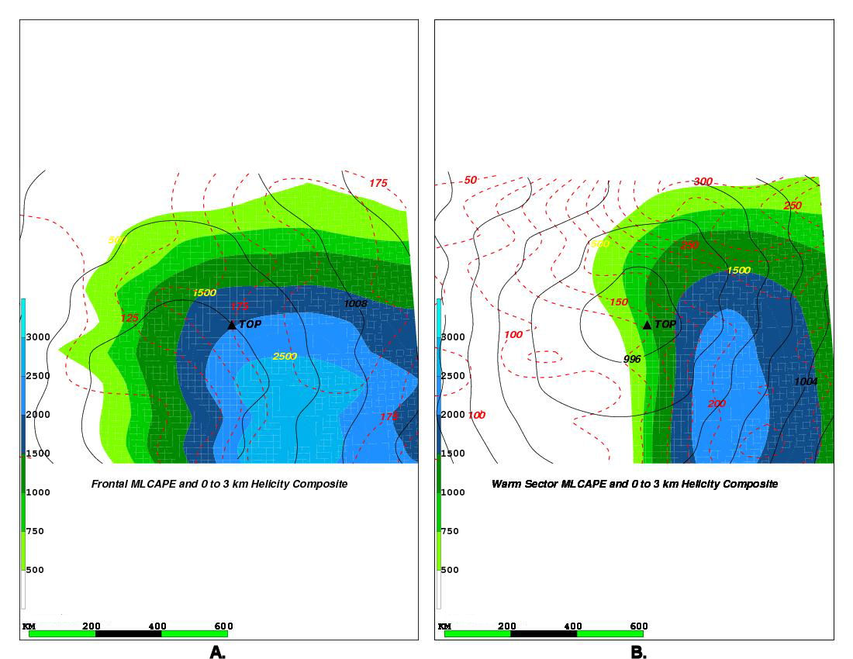
MLCAPE 0 to 3 km SRH
Strong destabilization north of the warm front in frontal cases
Limited instability north of the warm front in warm sector cases
Tornado along western edge of the instability axis warm sector
  Drier atmosphere at the location of tornado
  Sufficient SRH for supercells in both cases

Slide 13
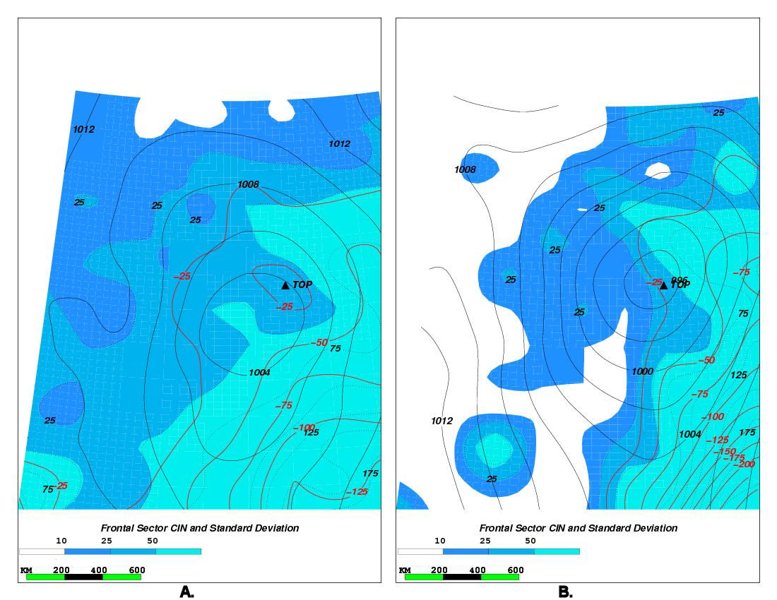
MLCIN and Standard Deviation
Minimal MLCIN indicated near tornado location
Standard deviation indicates little variability in MLCIN in either composite

Slide 14

Shear Orientation-Surface Forcing
Orientation of the 0 to 6 km shear vector parallel (normal) to the surface forcing in frontal (warm sector) composite
Longer track warm sector tornadoes

Slide 15
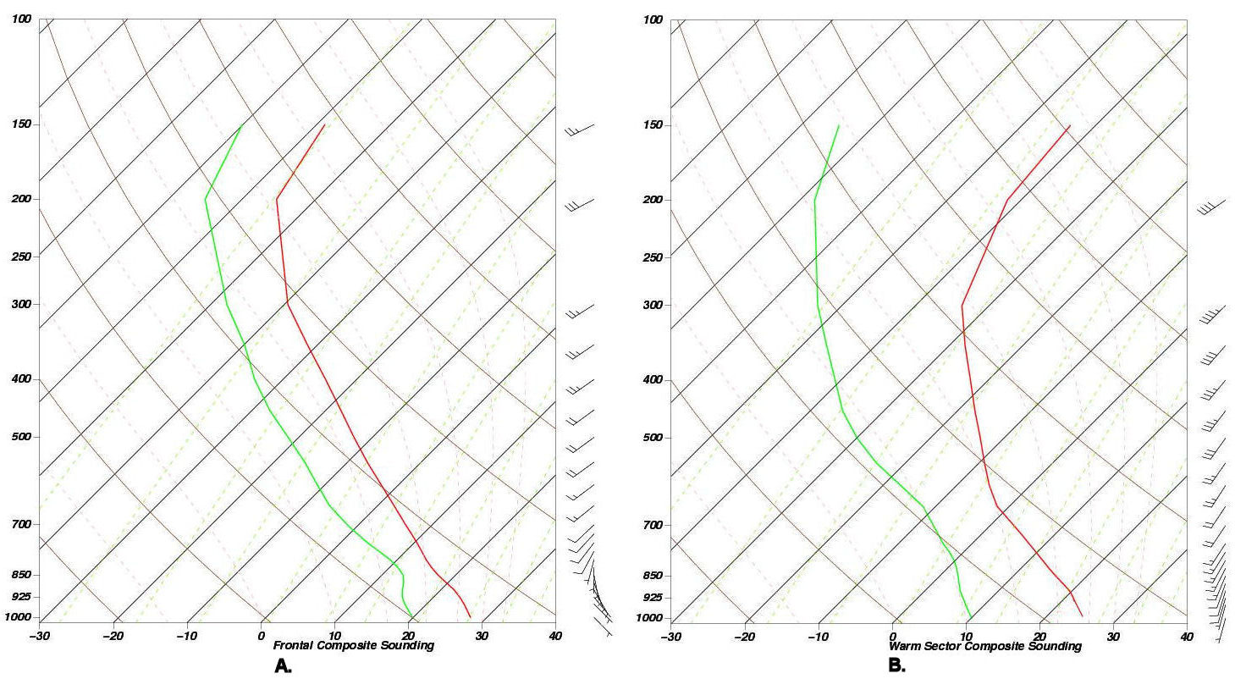
Composite NARR Soundings
Warm sector composite too dry
  Events on western edge of moist axis likely led to a few events being to far into the dry air in the NARR
  This could also effect the low level wind profile
  Nevertheless suggests warm sector events happen in a drier atmosphere than frontal events with less backed low level flow
Frontal composite warm, moist and unstable
  No significant mid level dry intrusion noted in the composite
  Strong turning in the lowest 2 km
  Low LCL/LFC indicated

Slide 16
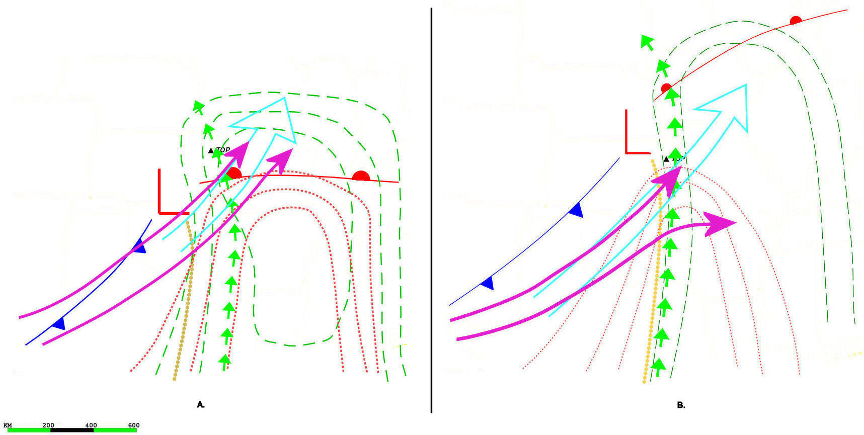
Composite Overview
Jet placement in relation to tornado near the same
Stronger instability, less baroclinicity north of the warm frontal cases
TOP in the moisture/instability axis for front cases and on the western edge for warm sector cases
Backed (with respect to south) low level flow in front cases instead of slightly veered in warm sector

Slide 17
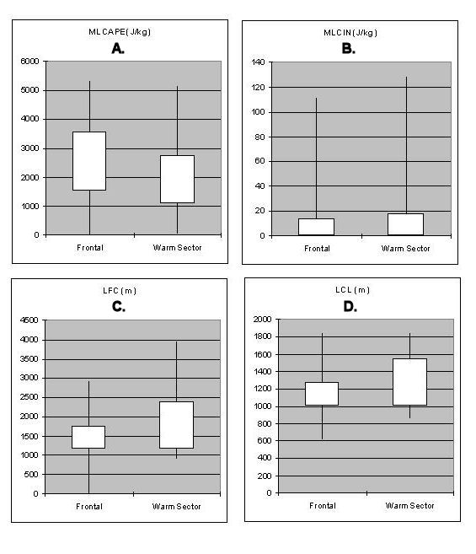
Thermodynamic Statistics
Little difference in MLCAPE
MLCIN values less than 20 J kg⁻¹ in both cases
Higher values of LFC and LCL likely due to drier warm sector atmosphere

Slide 18
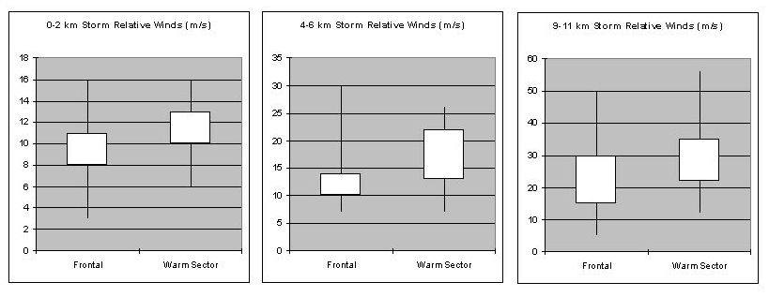
Storm Relative Flow
Strong storm relative winds generally indicated in both synoptic situations
  Higher values in warm sector cases
  Some weakness noted in the mid levels of frontal cases
    More high precipitation supercells?
    Shorter lived tornadoes?

Slide 19
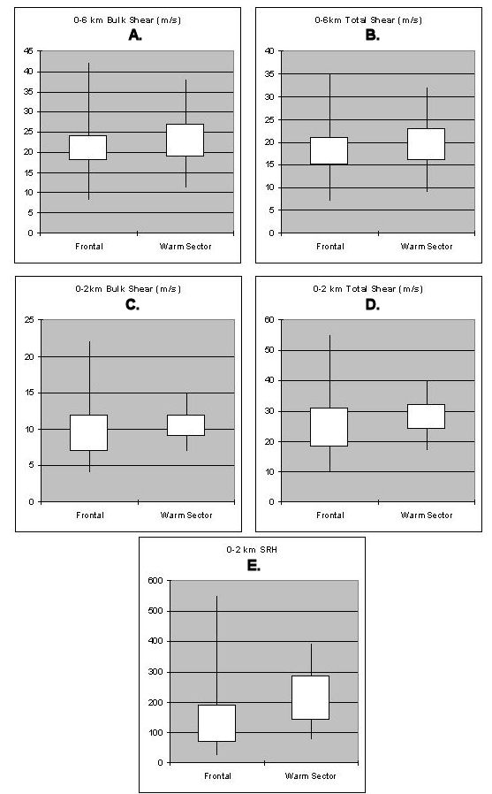
Shear
Deep layer bulk and cumulative shear above 20 ms⁻¹
Stronger total shear in the 0 to 2 km layer than bulk
  Strong low level turning in the hodograph
Higher 0 to 2 km SRH values in warm sector

Slide 20
Conclusions
Mid and upper levels similar, but some significant differences were noted in the composites
  700 hPa WAA (CAA) were found in the frontal (warm sector) cases
  Tornado occurs within the CAPE max for frontal cases, while on the western edge of the max for warm sector events
  The strong destabilization noted north of the warm front in frontal cases appears to be important
No occurrences of significant tornadoes on a front and in the warm sector on the same day
  Warm sector remained capped?
  Ambient shear in the warm sector not strong enough to support significant tornadoes on frontal days?
Shear
  Strong bulk and cumulative deep layer shear
  Strong low level cumulative shear noted in the lowest 2 km indicating turning
  Higher values of SRH likely indicated in warm sector cases
Later season events more likely to happen near a front, especially in the summer in eastern Kansas

Slide 21
Future Work
Develop a more realistic warm sector composite sounding
  Use the end of the tornado track?
  Use the NARR 6 hours prior to the tornado?
Composite non-significant tornado events
  Develop database of non-tornadic supercells for same study area
  Composite the environment with the non-tornadic supercells
  Compare these composites to the significant tornado composites
Develop composite hodographs for both composite datasets

Slide 22
The End
josh.boustead@noaa.gov

