Slide 1
Meteorological Aspects of the
24 Sept 2008 Gove County Kansas Heavy Rain Event
Christopher S. Foltz
Jeremy Martin
Brad Mickelson
NWS WFO Goodland, KS
13th High Plains Conference
27-28 August 2009

Slide 2
Overview
Highly localized heavy rain event took place over northeast Gove County, KS during the afternoon and evening of 24 September, 2008
COOP observer reports of 6 to 8 inches of rainfall with an unofficial report of 10.6 inches
Precipitation fell over roughly a 7 hour time frame

Slide 3
Overview (con’t)…
Only slight chance POPs (20%) were forecasted with minimal QPF (~0.03”)
Purpose of this presentation will be to examine the synoptic and mesoscale environment as well as forecaster thought process surrounding this event

Slide 4
Excerpt from afternoon AFD
122 PM MDT WED SEP 24 2008
PRIMARY FORECAST CONCERNS REVOLVE AROUND PRECIP CHANCES THIS EVENING AND THEN AGAIN SUNDAY INTO MONDAY. AS MENTIONED ABOVE...DIFFUSE WARM FRONT PUSHING NORTH OVER THE CWA WITH A WEAK AREA OF SURFACE LOW PRESSURE DEVELOPING OVER SOUTHEAST COLORADO. SOUTHERLY TO SOUTHEASTERLY FLOW HAS ALLOWED FOR AN INCREASE IN BOUNDARY LAYER MOISTURE. 315K GFS ISENTROPIC SURFACE SHOWS AN INCREASE IN MOISTURE TRANSPORT THIS AFTERNOON WITH BEST LIFT FOCUSED OVER THE EASTERN PORTIONS OF THE GLD CWA BY 00Z. BY 06Z THURSDAY...GREATEST FORCING FOR ASCENT SHIFTS EAST OF THE AREA SO HAVE POPS ENDING AT THIS TIME. WITH 800-1000 J/KG ML CAPE IN PLACE...CAN'T RULE OUT ISOLATED SEVERE BUT THREAT SHOULD BE LIMITED AS FLOW ALOFT IS WEAK.

Slide 5
Gove County Zone Forecast
KSZ029-251030-
GOVE-INCLUDING THE CITIES OF...QUINTER
317 PM CDT WED SEP 24 2008
.TONIGHT...MOSTLY CLOUDY WITH ISOLATED THUNDERSTORMS IN THE EVENING...THEN PARTLY CLOUDY AFTER MIDNIGHT. LOWS IN THE UPPER 50S. SOUTH WINDS 10 TO 15 MPH. CHANCE OF THUNDERSTORMS 20 PERCENT.

Slide 6
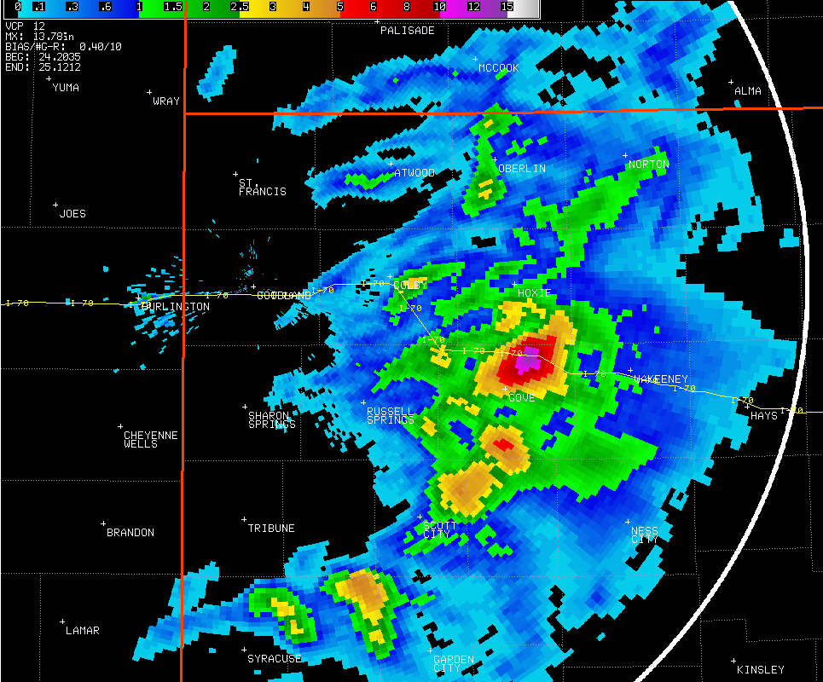
KGLD WSR-88D Storm Total Precipitation

Slide 7
A few precipitation reports…
10.6” – 3 miles east-southeast of Grainfield by a Gove County Road and Bridge employee
7.51” – 2.8 miles south of Park by a COOP observer
2.63” – in Grainfield by a COOP observer
0.91” – 3.7 miles south of Monument by a COOP observer

Slide 8
Let's take a look at basic upper air data…

Slide 9
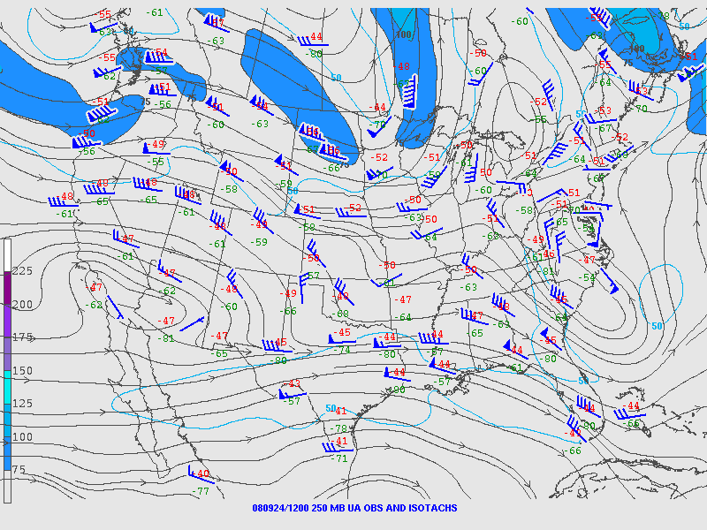
1200 UTC 9/24/08 250 mb Analysis

Slide 10
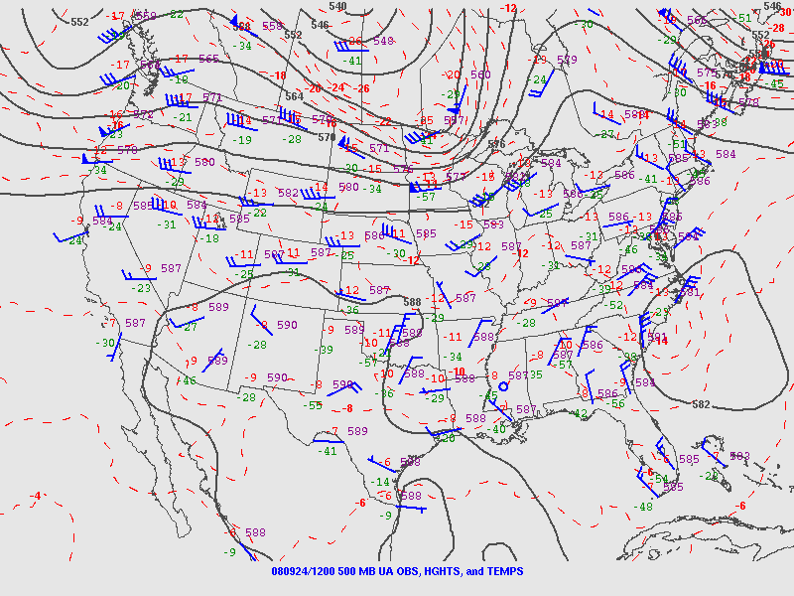
1200 UTC 9/24/08 500 mb Analysis

Slide 11
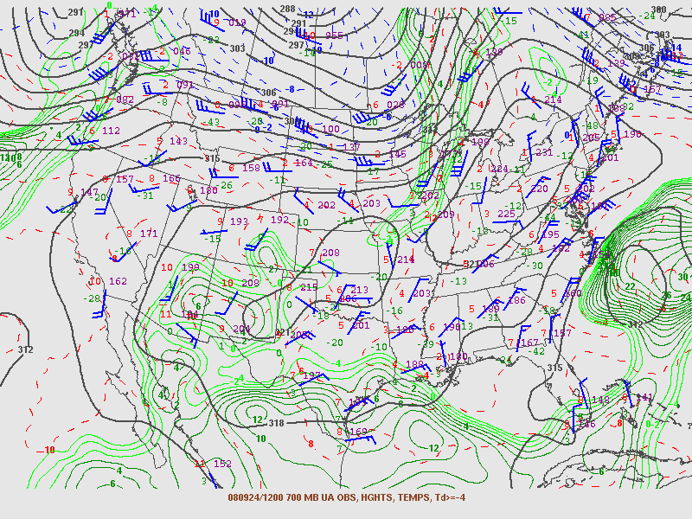
1200 UTC 9/24/08 700 mb Analysis

Slide 12
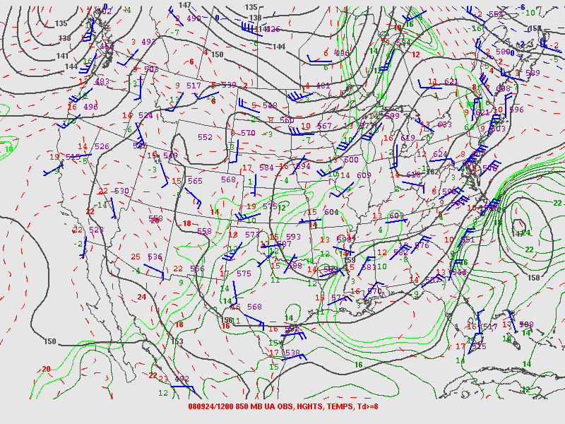
1200 UTC 9/24/08 850 mb Analysis

Slide 13
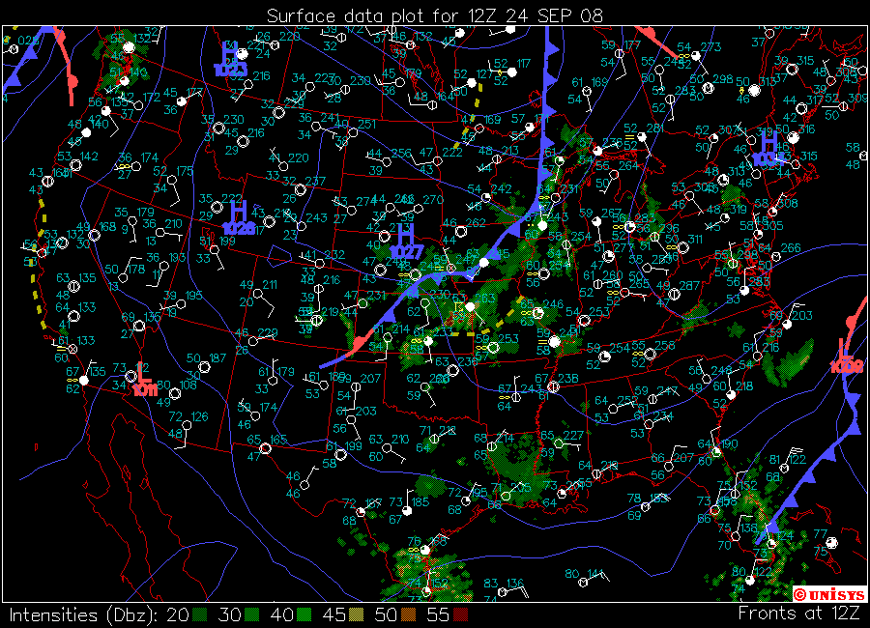
1200 UTC 9/24/08 Surface Analysis

Slide 14
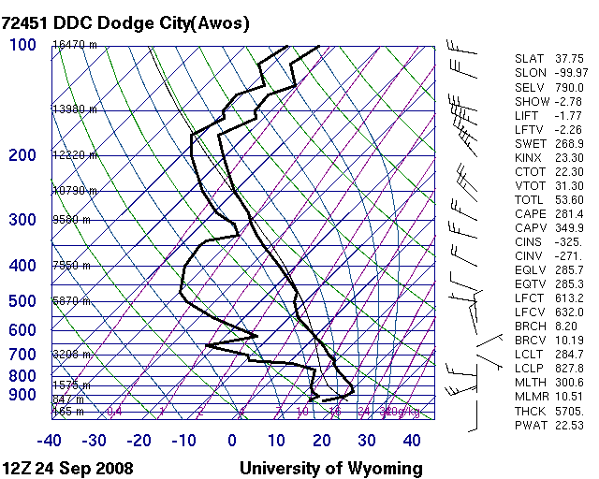
1200 UTC 9/24/08 KDDC Sounding

Slide 15
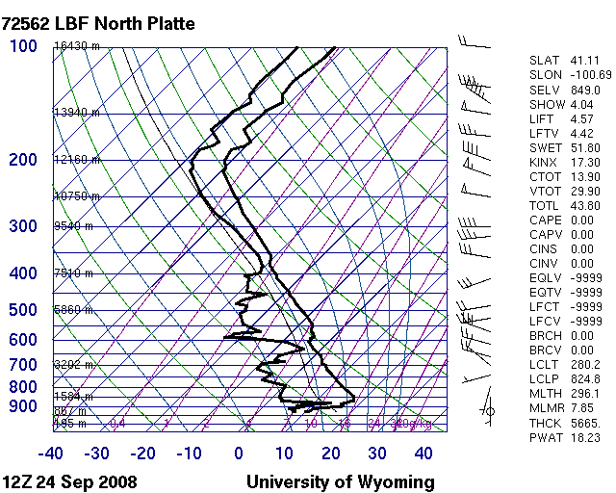
1200 UTC 9/24/08 KLBF Sounding

Slide 16
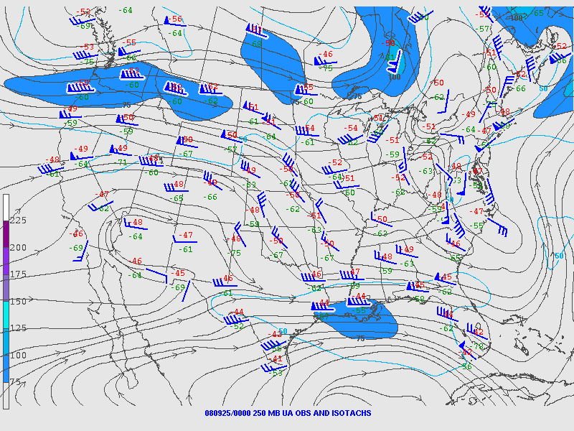
0000 UTC 9/25/08 250 mb Analysis

Slide 17
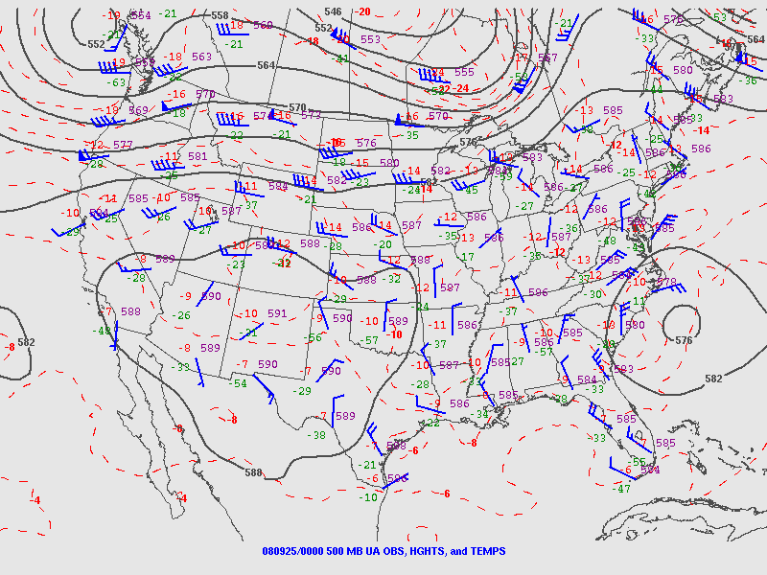
0000 UTC 9/25/08 500 mb Analysis

Slide 18
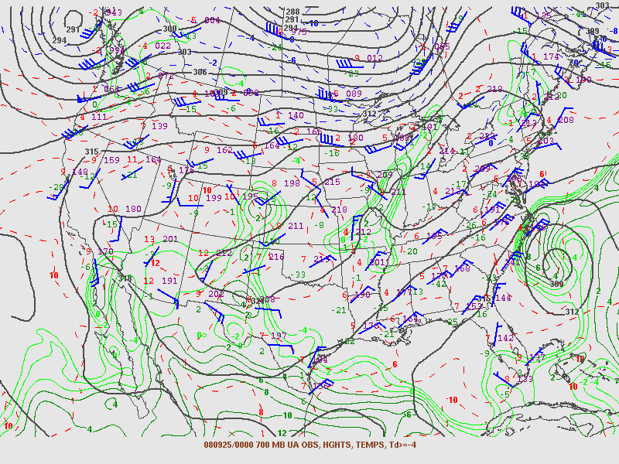
0000 UTC 9/25/08 700 mb Analysis

Slide 19
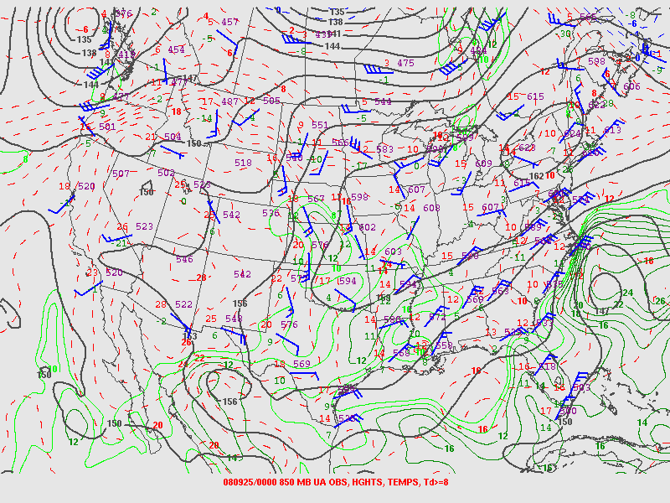
0000 UTC 9/25/08 850 mb Analysis

Slide 20
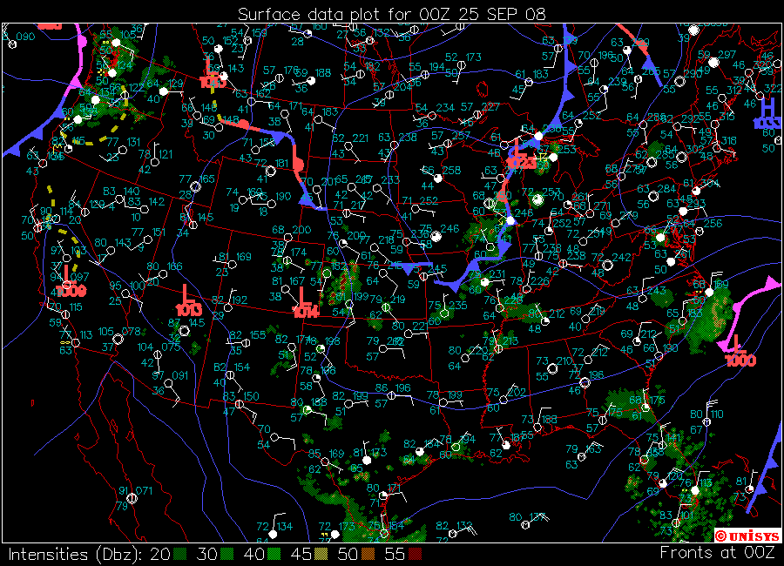
0000 UTC 9/25/08 Surface Analysis

Slide 21
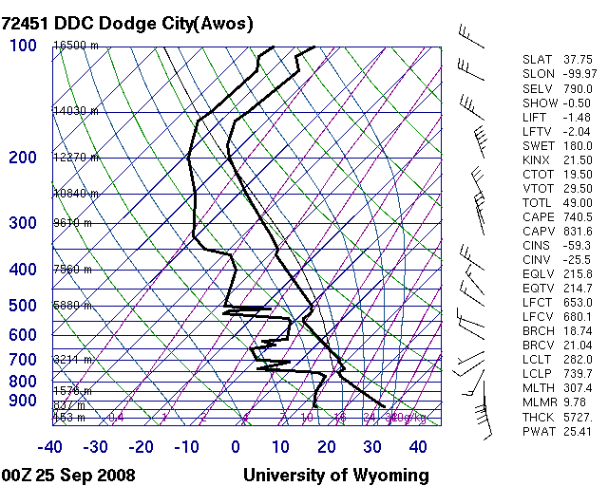
0000 UTC 09/25/08 KDDC Sounding

Slide 22
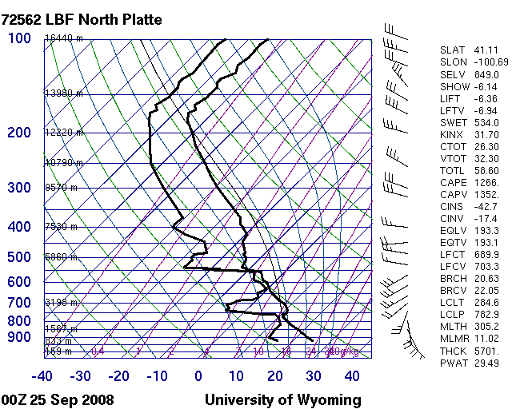
0000 UTC 09/25/08 KLBF Sounding

Slide 23
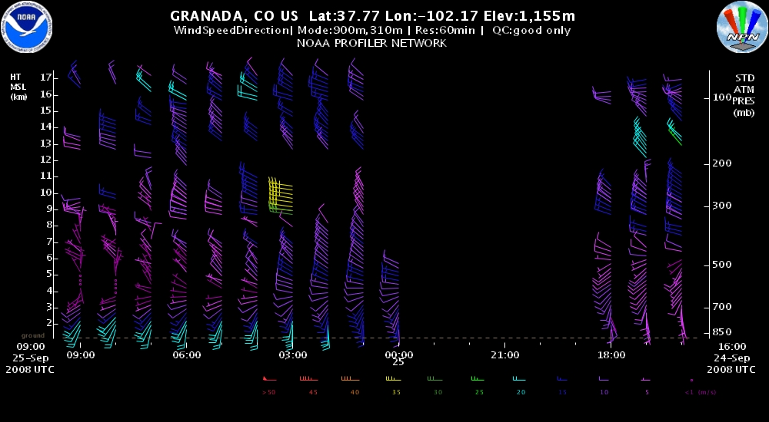
Grenada Profiler

Slide 24
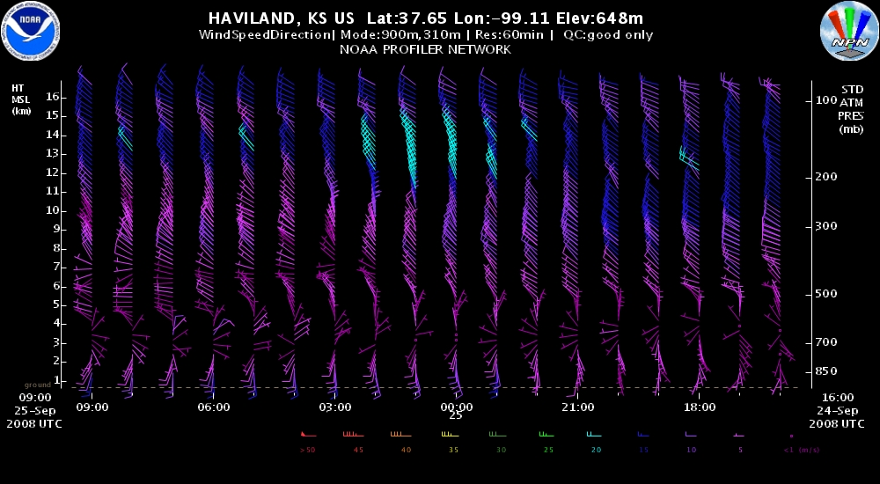
Haviland Profiler

Slide 25
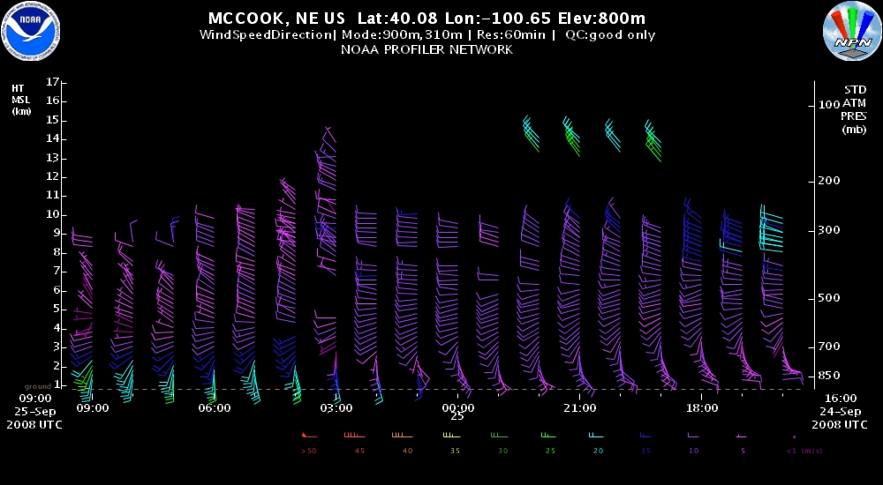
McCook Profiler

Slide 26
A few contributing factors…
Environment being advected into the region could be characterized by weak deep layer shear (~25-30 kts) and a moderately deep warm layer which helped contribute to warm rain processes
Warm front mixing northward was the primary focusing mechanism for initial convective initiation but outflow/cold pool generation from this convection combined with increasing low level (850 mb) jet (~40kts) helped maintain multicell storm environment
Looked at PWAT values which were progged to be ~1” for both DDC and LBF, but failed to look at this as a percent of normal (DDC ~145%, LBF ~185%)

Slide 27
Let's take a look at radar…

Slide 28
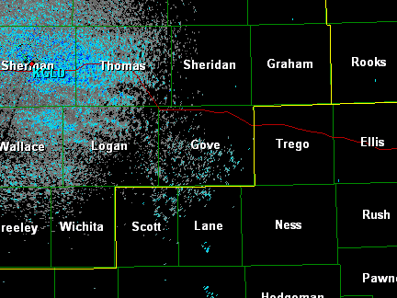
KGLD 0.5° Base Reflectivity
2008/09/24 2000 UTC- 2008/09/25 0500 UTC

Slide 29
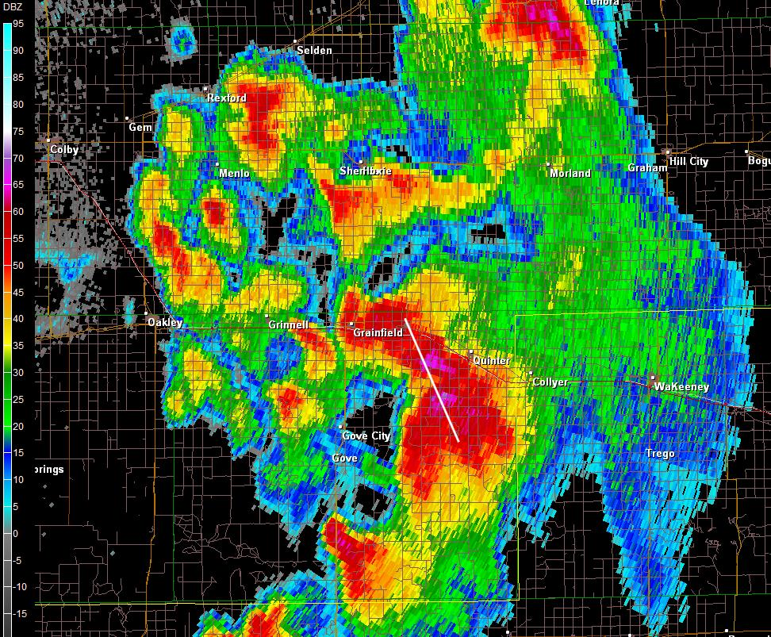
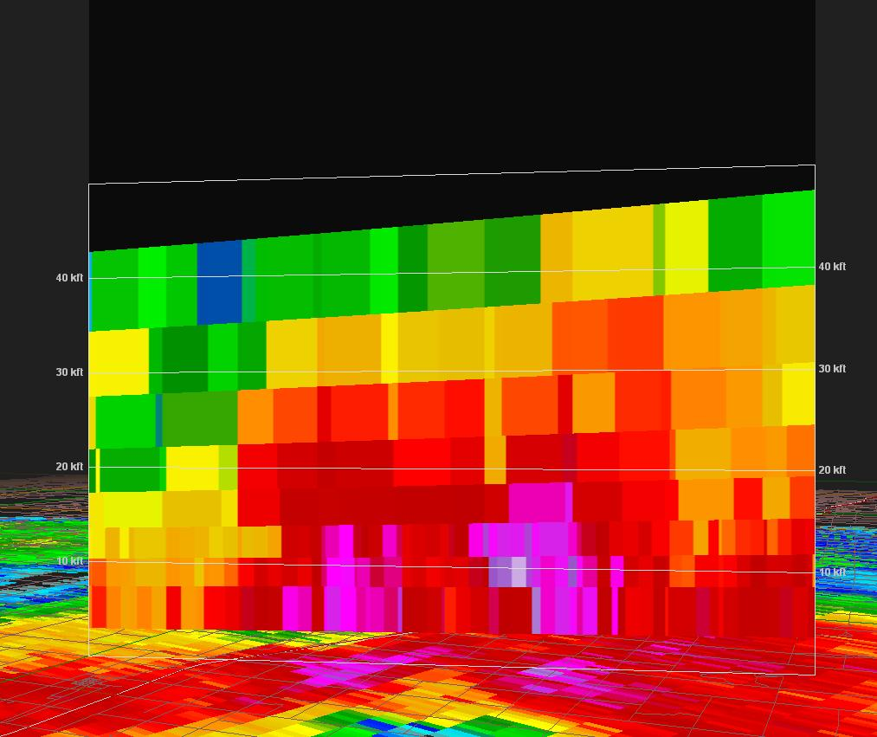
0.5° BREF 2307 UTC 09/24/08

Slide 30
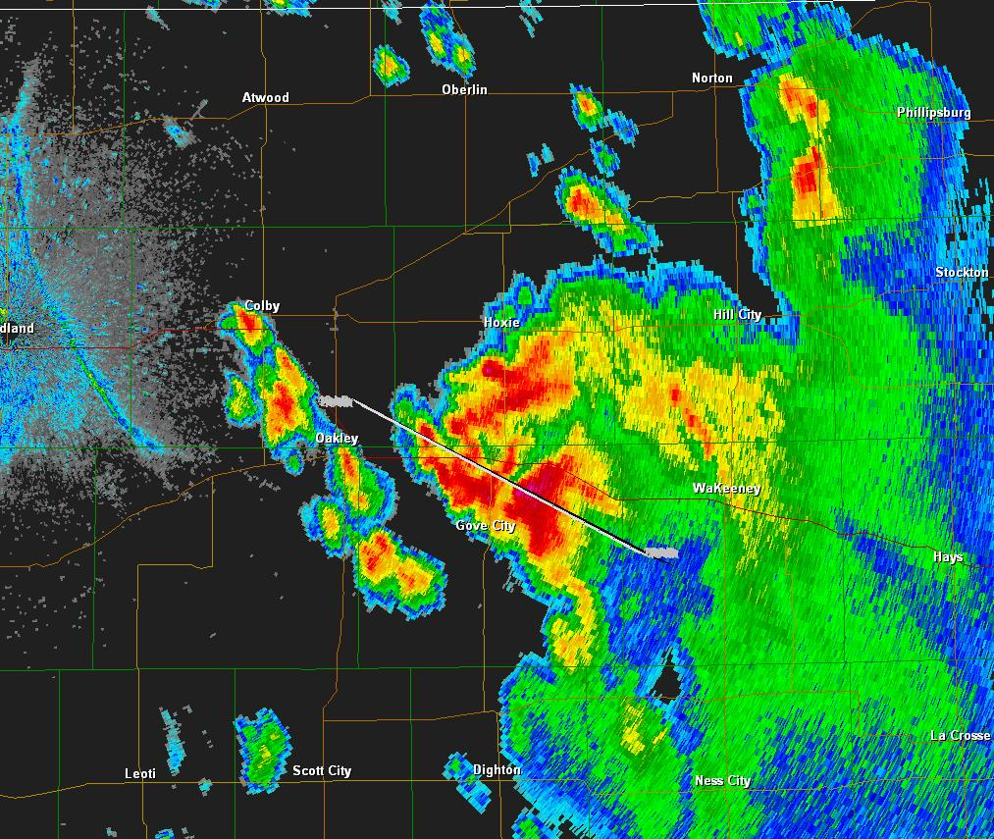
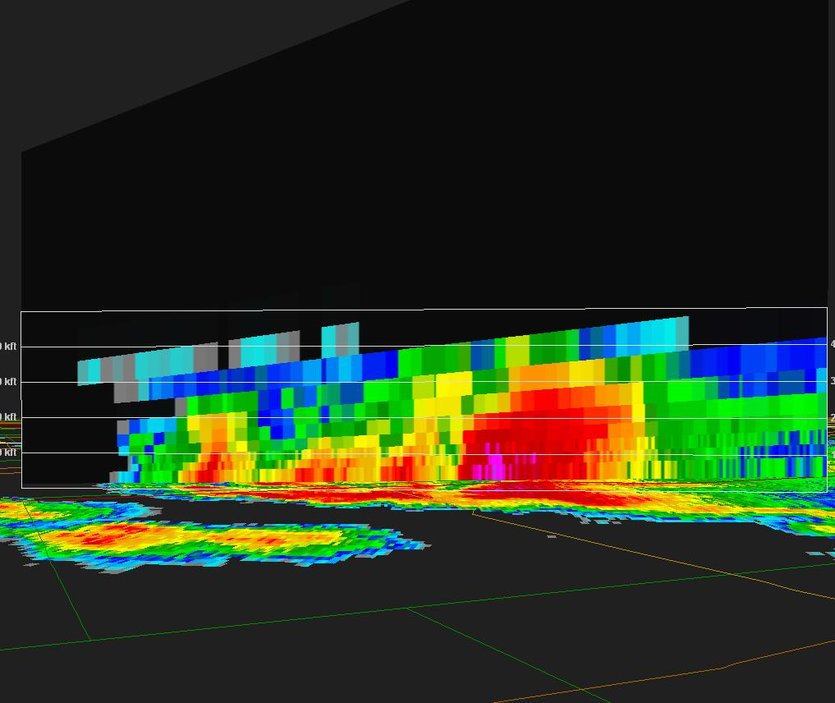
0.5° BREF 0036 UTC 09/24/08

Slide 31
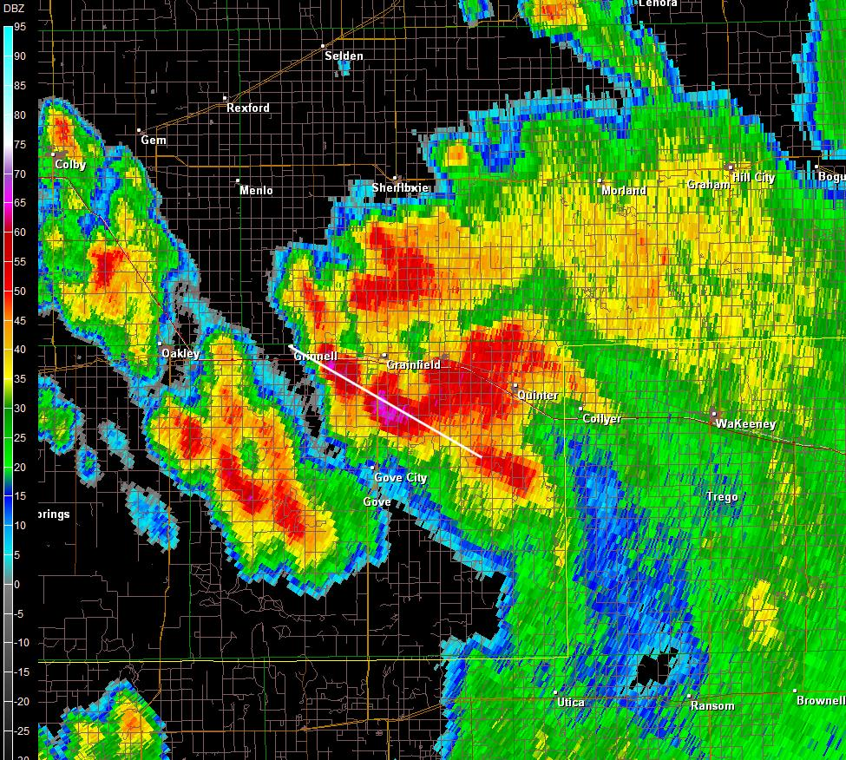
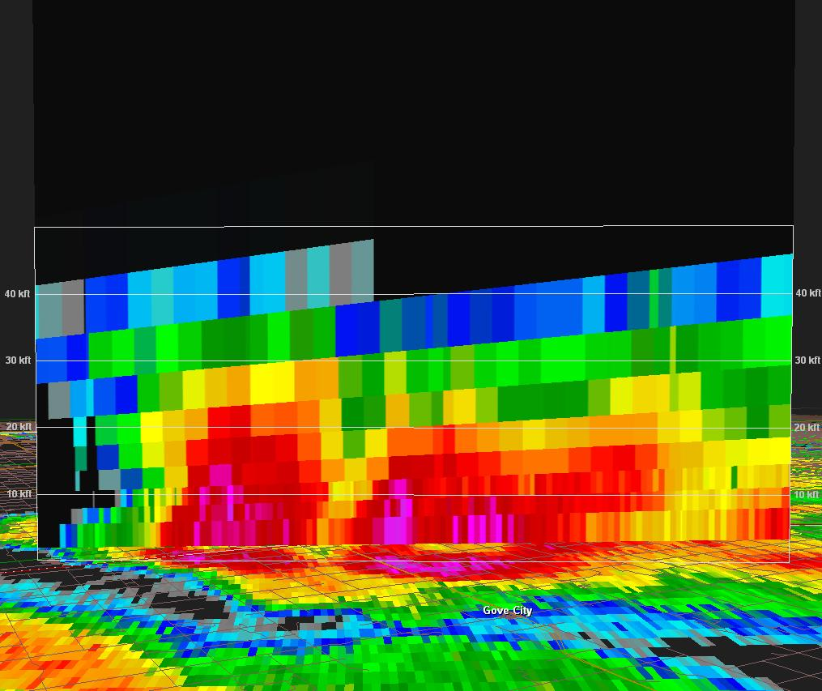
0.5° BREF 0049 UTC 09/25/08

Slide 32
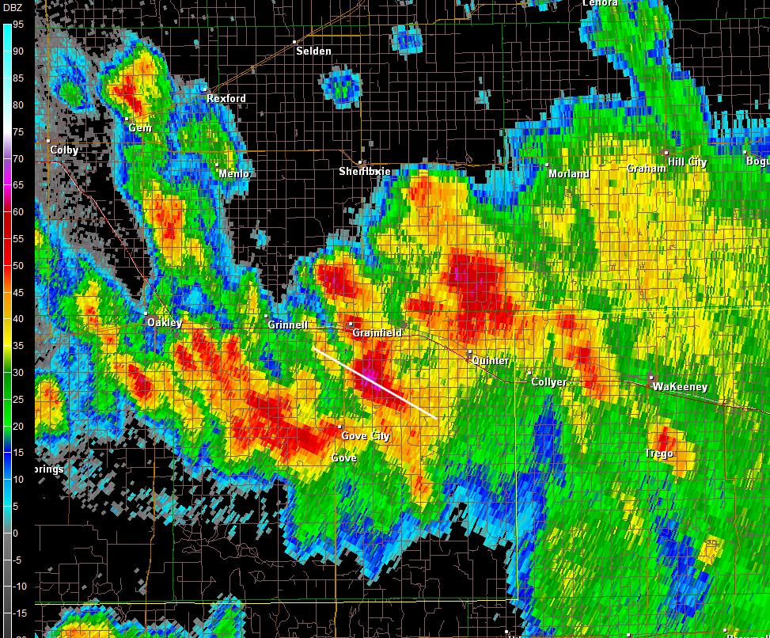
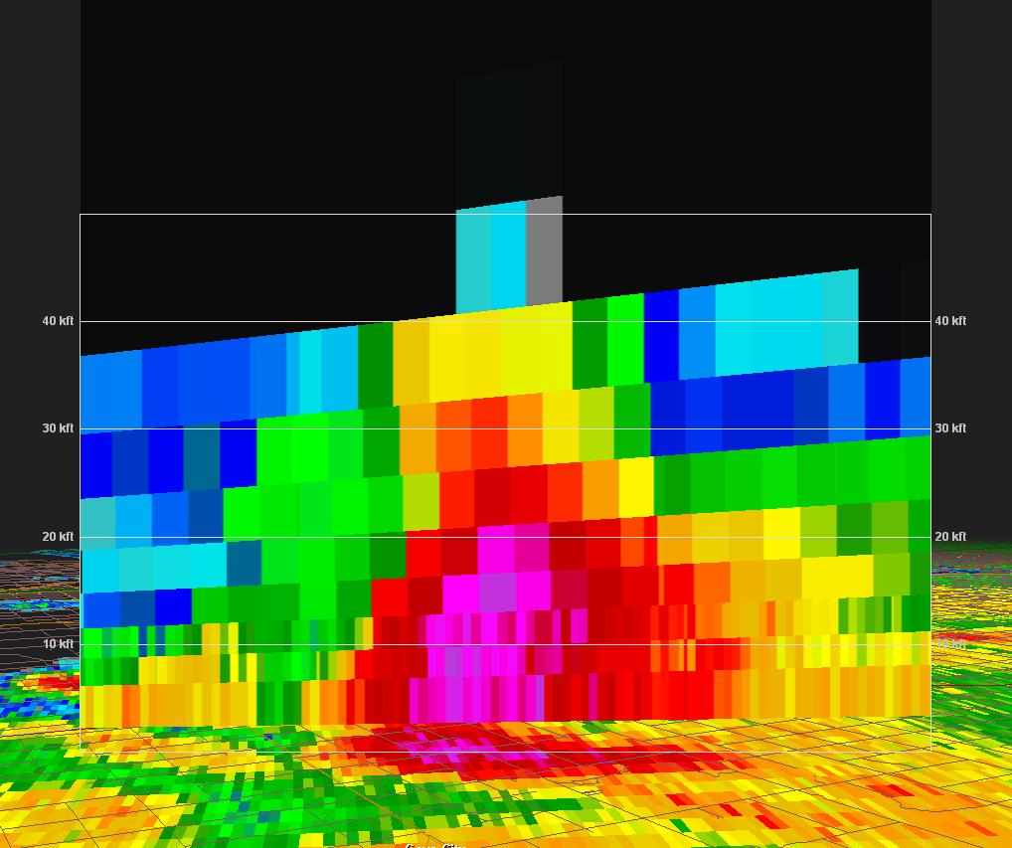
0.5° BREF 0115z UTC 09/25/08

Slide 33
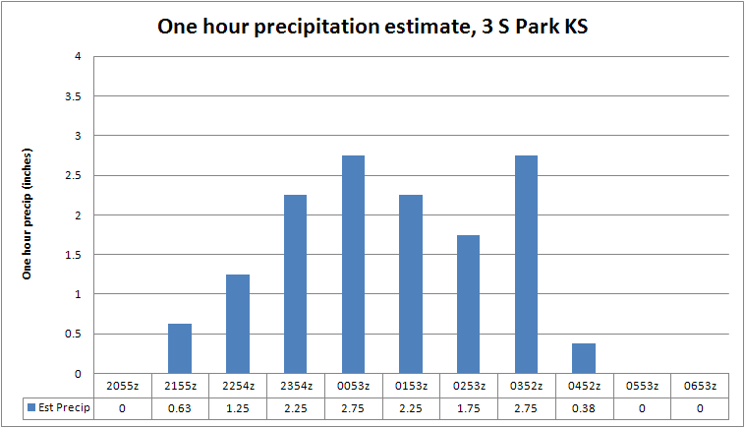

Slide 34
Could this event have been forecasted?
Think in terms of Maddox Flash Flood types but doesn’t really fit into Type I or Type II which are most common over the GLD CWA
Deterministic guidance doesn’t generally model meso/misoscale cold pool effectively
Failed to interrogate PWAT values as a percent of normal which could have provided more insight into the potential for heavy rain producing convection

Slide 35
Future work…
Perhaps investigate the numerous cell splits/mergers that occurred during this event
Use this case as a learning tool for potential future heavy rain events

Slide 36
That’s all folks…
Any questions?

