Slide 1
Flash Flood Climatology for the Goodland County Warning Area
13th High Plains Conference
August 27, 2009

Slide 2
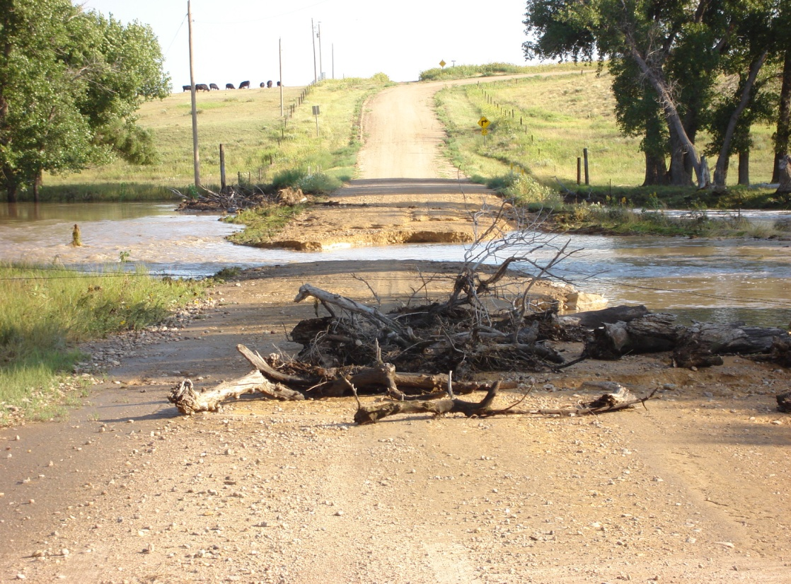
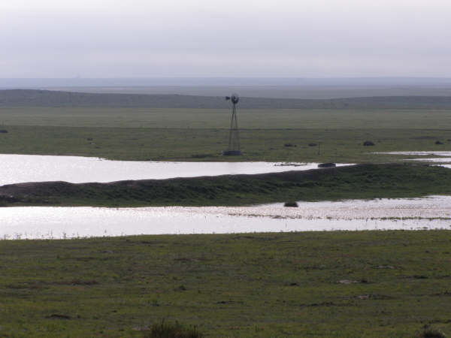
Flash Flood Data
Period of Record (1994-2007)
141 Events (Approximately 11 per year)
78 Flash Flood Days (Approximately 6 per year)

Slide 3
Monthly Climatology
71% occur in JJA

Slide 4
Diurnal Climatology
81% occur between 3 PM and Midnight LST

Slide 5
Maddox Distribution
886% are Maddox Type I or Type II

Slide 6
General facts from the Maddox Study
Events were characterized based on the 500 mb pattern.
In general, flash flood events occurred in weak large scale patterns and without well defined/weak surface features.
Maximum occurrence was in July and August, and had a strong link with the southwest monsoon season.
Most flash floods were produced by rainfalls of 2 inches to less than 4 inches.

Slide 7
TYPE I

Slide 8
TYPE I
Weak short-wave trough moving northward up the western side of a long-wave ridge.
Very moist conditions extend up to 300 mb
Flow is southerly through 200 mb, and is light (less than 40 knots) at all levels.
K index ~40 and LI ~ -4 with PWAT values 184% of the monthly average.
Example of a TYPE I event was the Big Thompson Canyon flash flood from July 1976.
In Maddox’s research, this type included the largest number of events, nearly 50%.

Slide 9
TYPE II

Slide 10
TYPE II
500 mb short-wave trough moving southward down the eastern side of a long-wave ridge.
Winds aloft were westerly with speeds still less than 40 knots at all levels.
Moist air mass extends up to 300 mb with PWATs of 145% of normal.
KI ~ 39 and LI ~ -5
This type accounted for 20% of the events studied by Maddox.

Slide 11
TYPE III

Slide 12
TYPE III
These were strong synoptic systems which were in contrast to the first two types.
The heavy rains usually covered large areas, and affected locations in the far west and southwest portions of the country.
Exception to this was during the late spring, intense systems that cut off over the Great Basin may pull moist/unstable air upslope into the foothills of the Rocky Mountains.

Slide 13
TYPE III
Temperatures are cooler with much stronger winds that veer with height, and increase to more than 80 knots at 200 mb.
PWATs were 159% of normal with KI ~ 27 and LI ~ +1.

Slide 14
Percent of Normal
Precipitable Water
Median is 131% of normal

Slide 15
Storm Motion Climatology
55% between 6 and 15 KT

Slide 16
Synoptic Boundaries
Cold front in area 46% of time - some sort of boundary present 92% of time

Slide 17
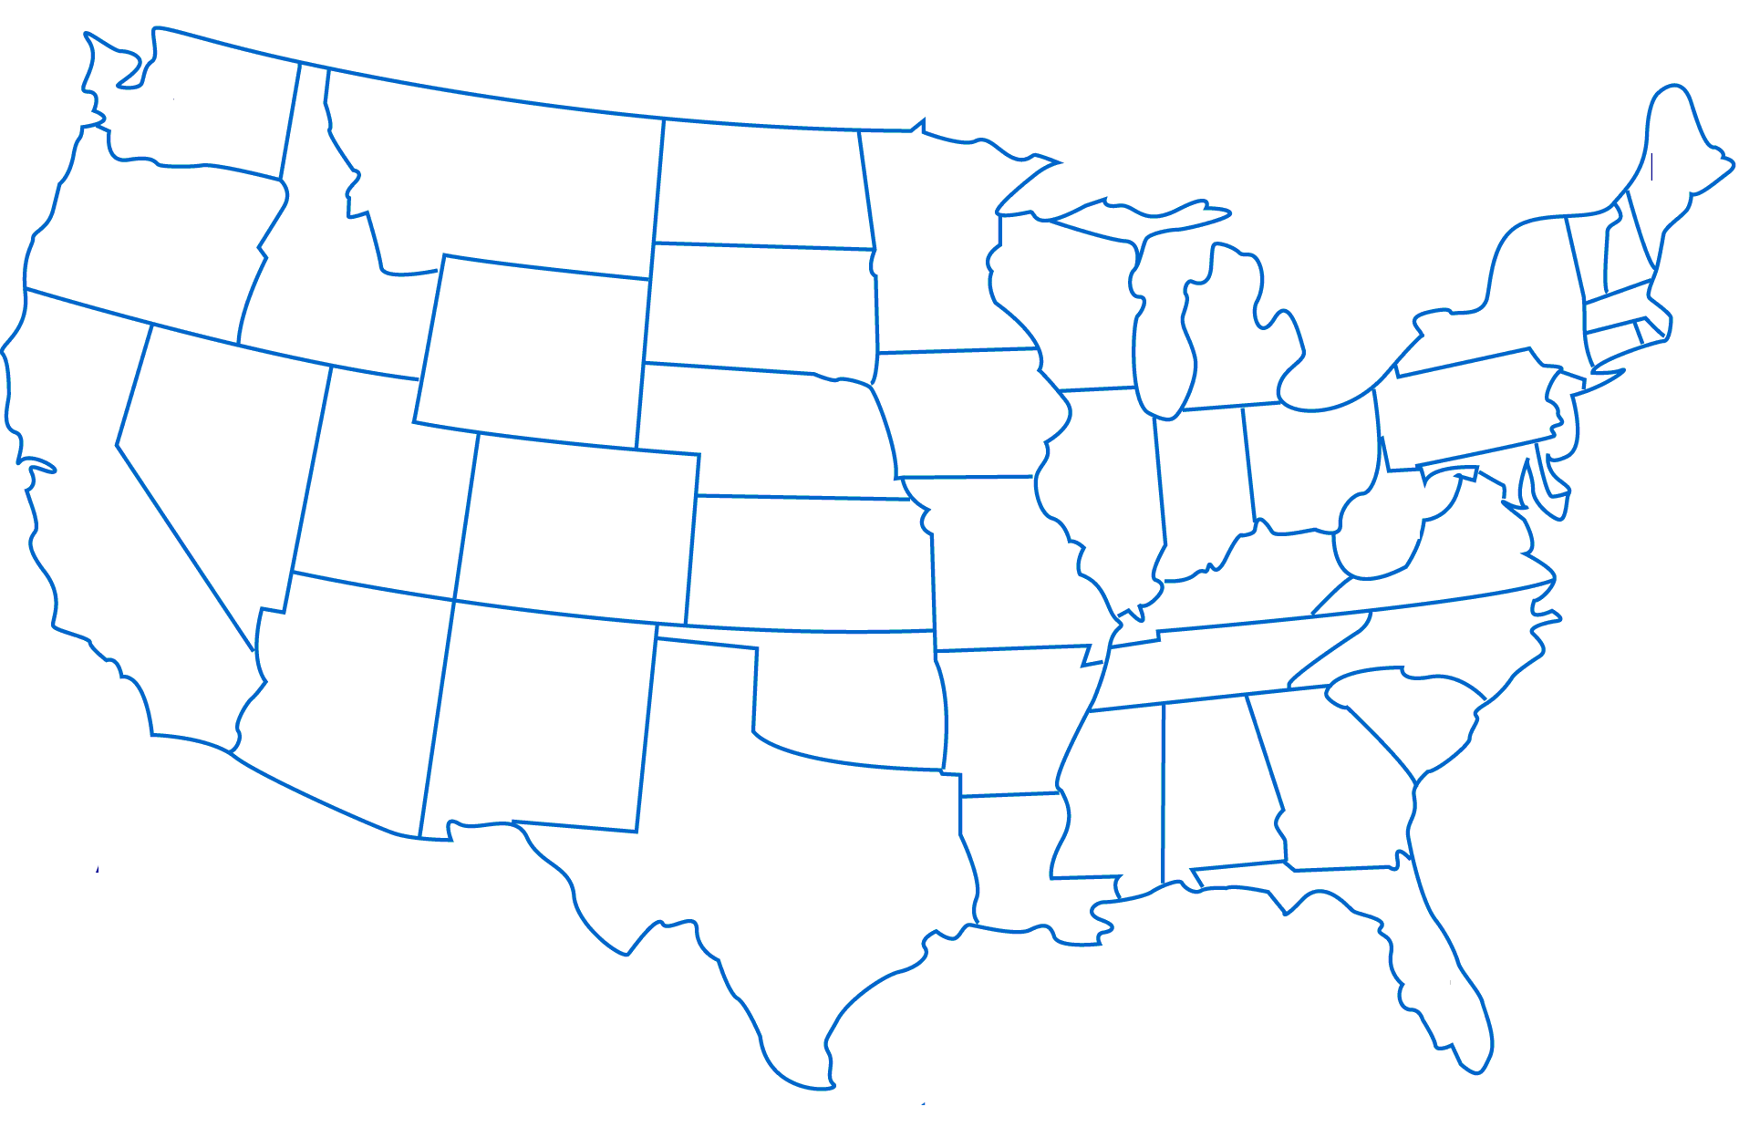
III
IV
I
II
V
Surface Low Position Regions

Slide 18
III
IV
I
II
V
Surface Low Positions

Slide 19
Surface Low Position
58% of events occurred with surface low near the Texas Panhandle.

Slide 20
Synoptic Climatology
(700 mb Theta-E Axis Position)

Slide 21
Significant Rainfall
As a part of going through all of this flash flood data, Scott ran through some rainfall statistics.
From COOP sites in our area, he collected all reports of rain from 1994 to 2007 during March through September.
There were about 250,000 reports of rain.
Using three standard deviations as denoting
statistical significance, rainfall reports over 1.68 inches in 24 hours were considered significant events.
If a station receives over that amount, you were in "significant" territory. Only 2% of the events qualify.

Slide 22
Summary
Flash Flood Events Mainly Occur
  In the summer
  In the late afternoon and evening
  With storm motion speeds between 6 and 15 knots
  With a synoptic boundary in the area
  With a surface low near the Texas Panhandle
  With precipitable water values between 125 and 150% of normal
  With a Theta/e axis over or near the area
  In a Maddox Type I or Type II regime

Slide 23
Future Work
Antecedent precipitation will be looked at prior to flash flood events.

Slide 24
THAT’S ALL!

