Slide 1
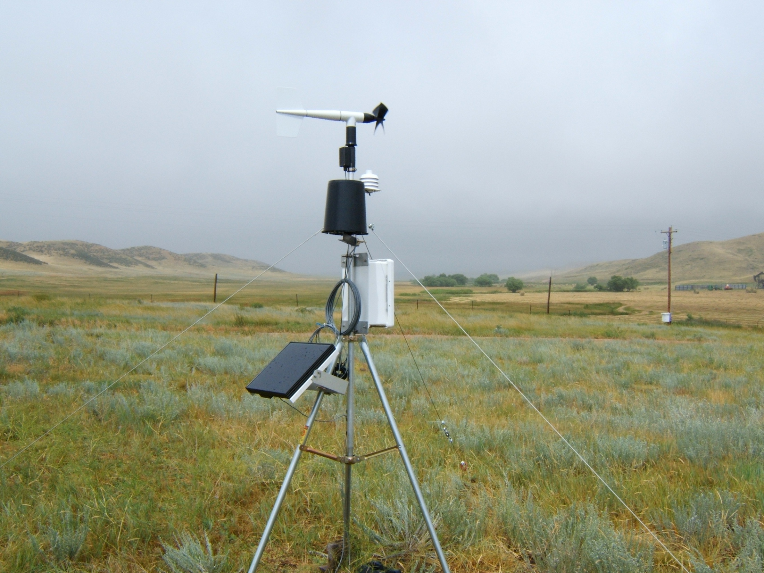

THE BELVOIR RANCH CLIMATE STUDY
LARAMIE COUNTY, WYOMING
BILL ECKRICH
DAYWEATHER, INC.
CHEYENNE, WYOMING

Slide 2
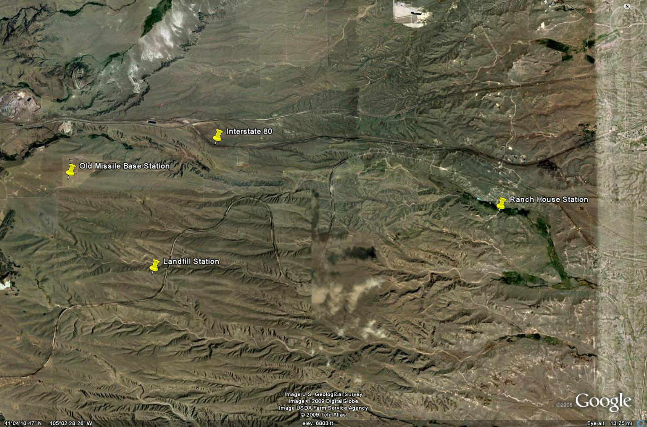
SECTION OF BELVOIR RANCH CONTAINING THE WEATHER STATIONS
INTERSTATE 80
OLD MISSILE BASE STATION
RANCH HOUSE STATION
LANDFILL STATION

Slide 3
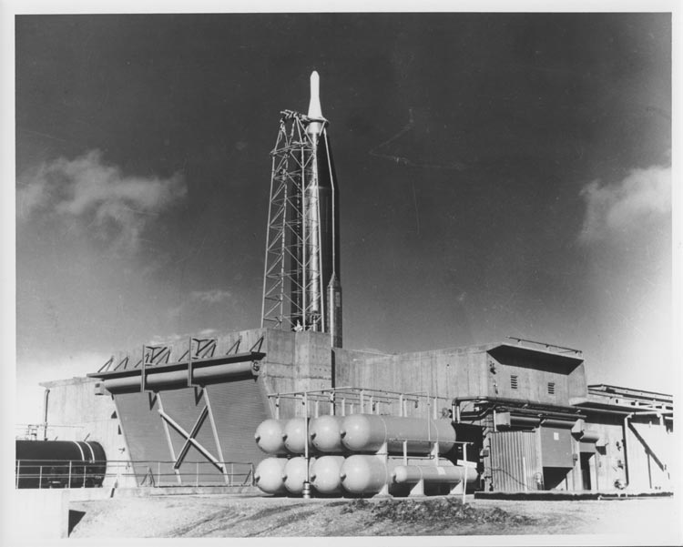

Slide 4
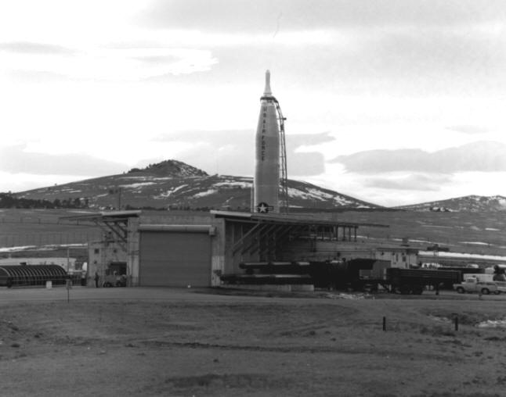

Slide 5
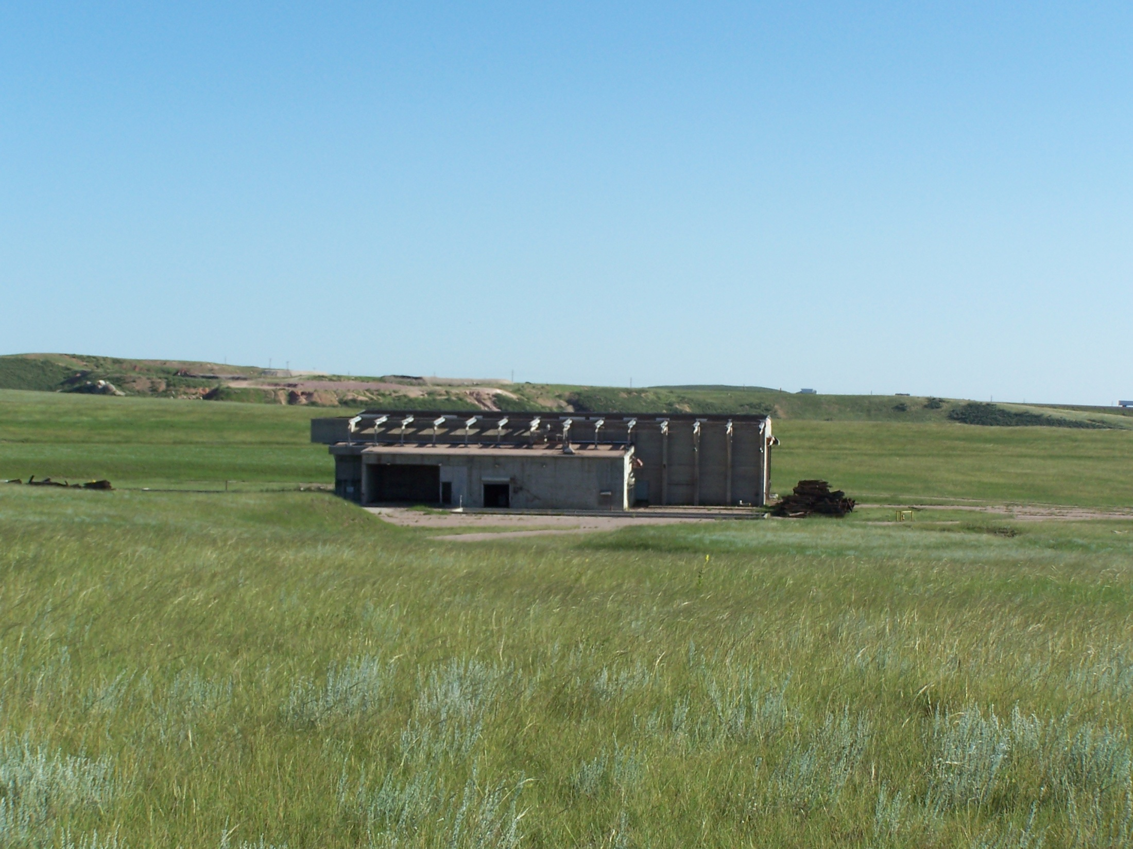

Slide 6
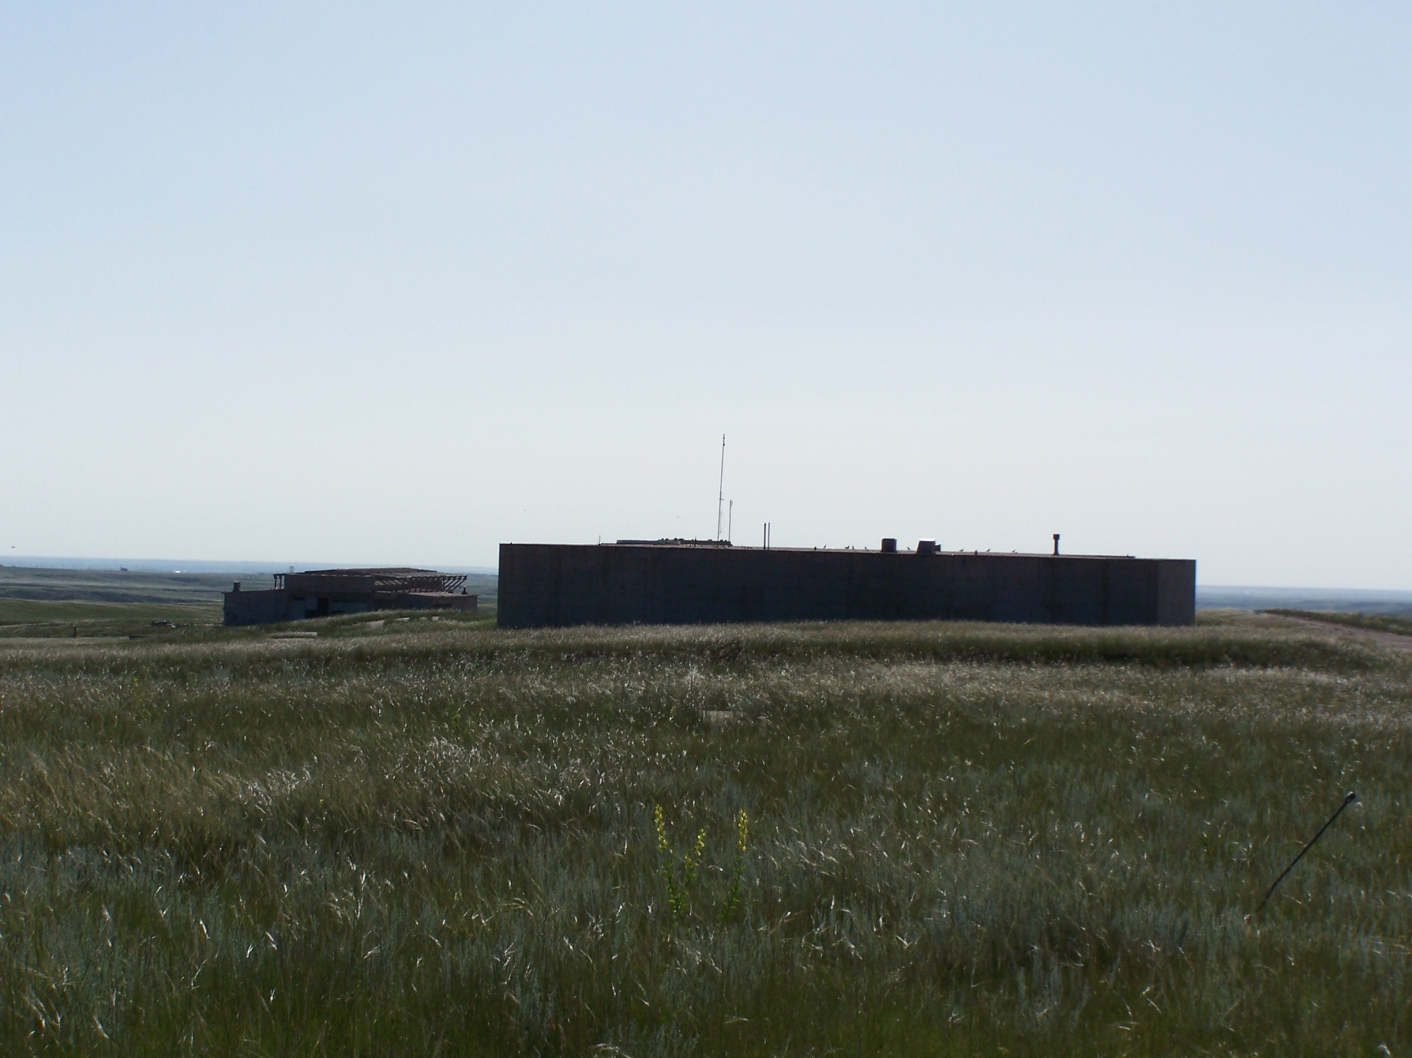

Slide 7
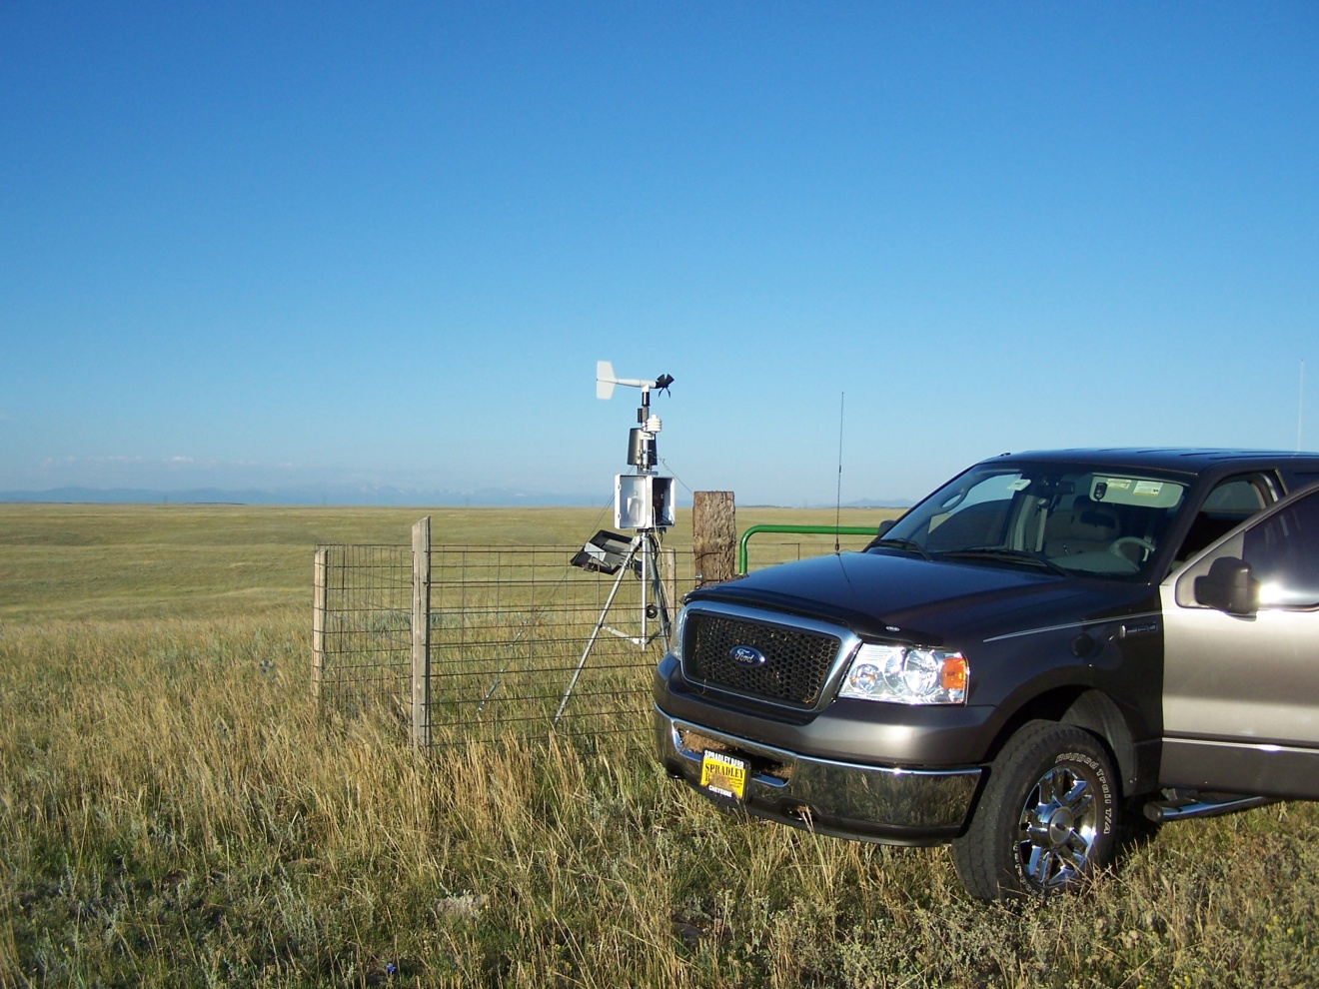
NOVALYNX WS-16 WEATHER STATION

Slide 8
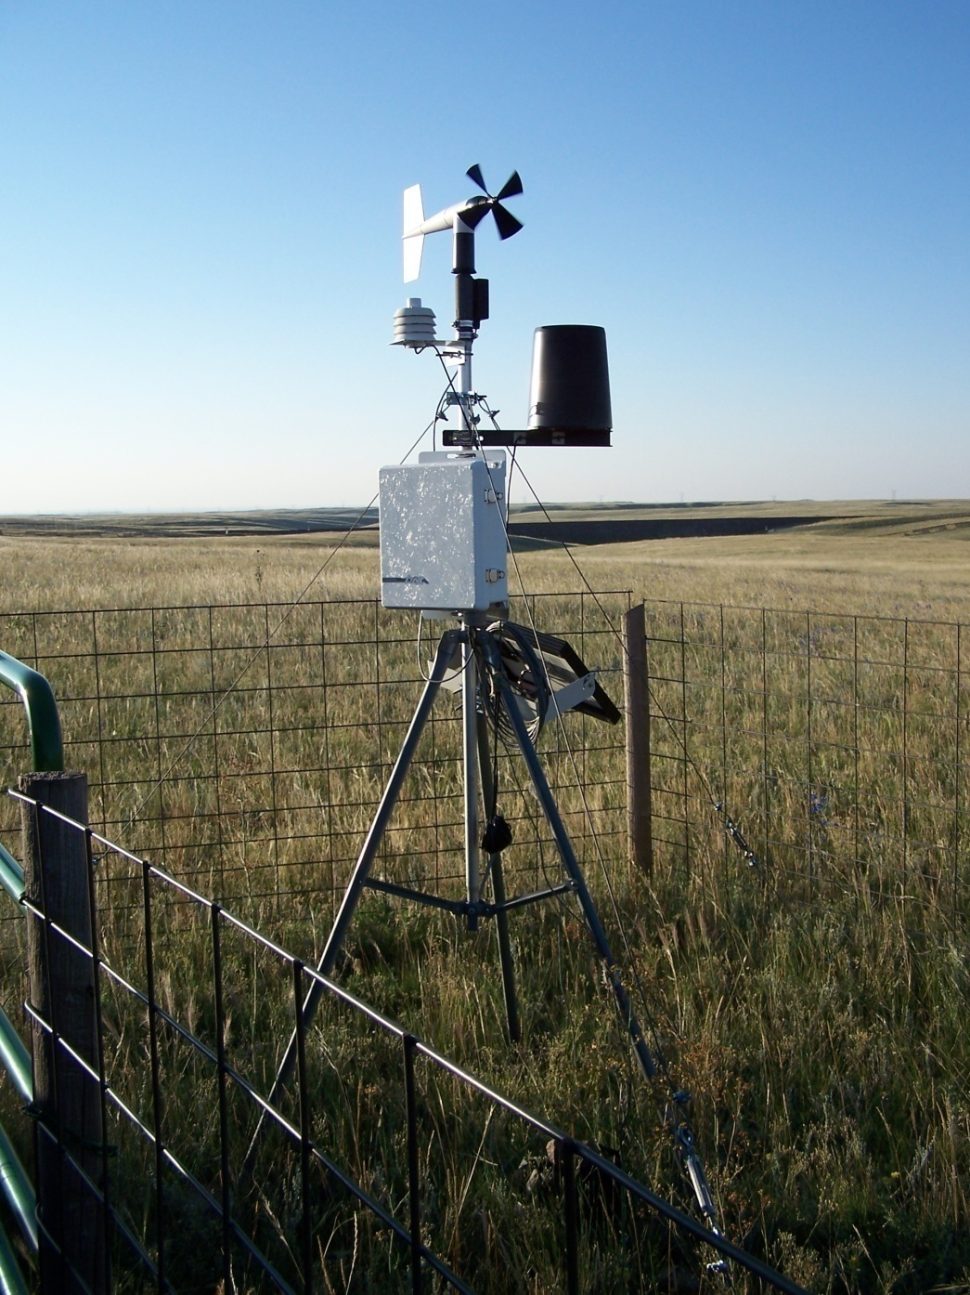

Slide 9
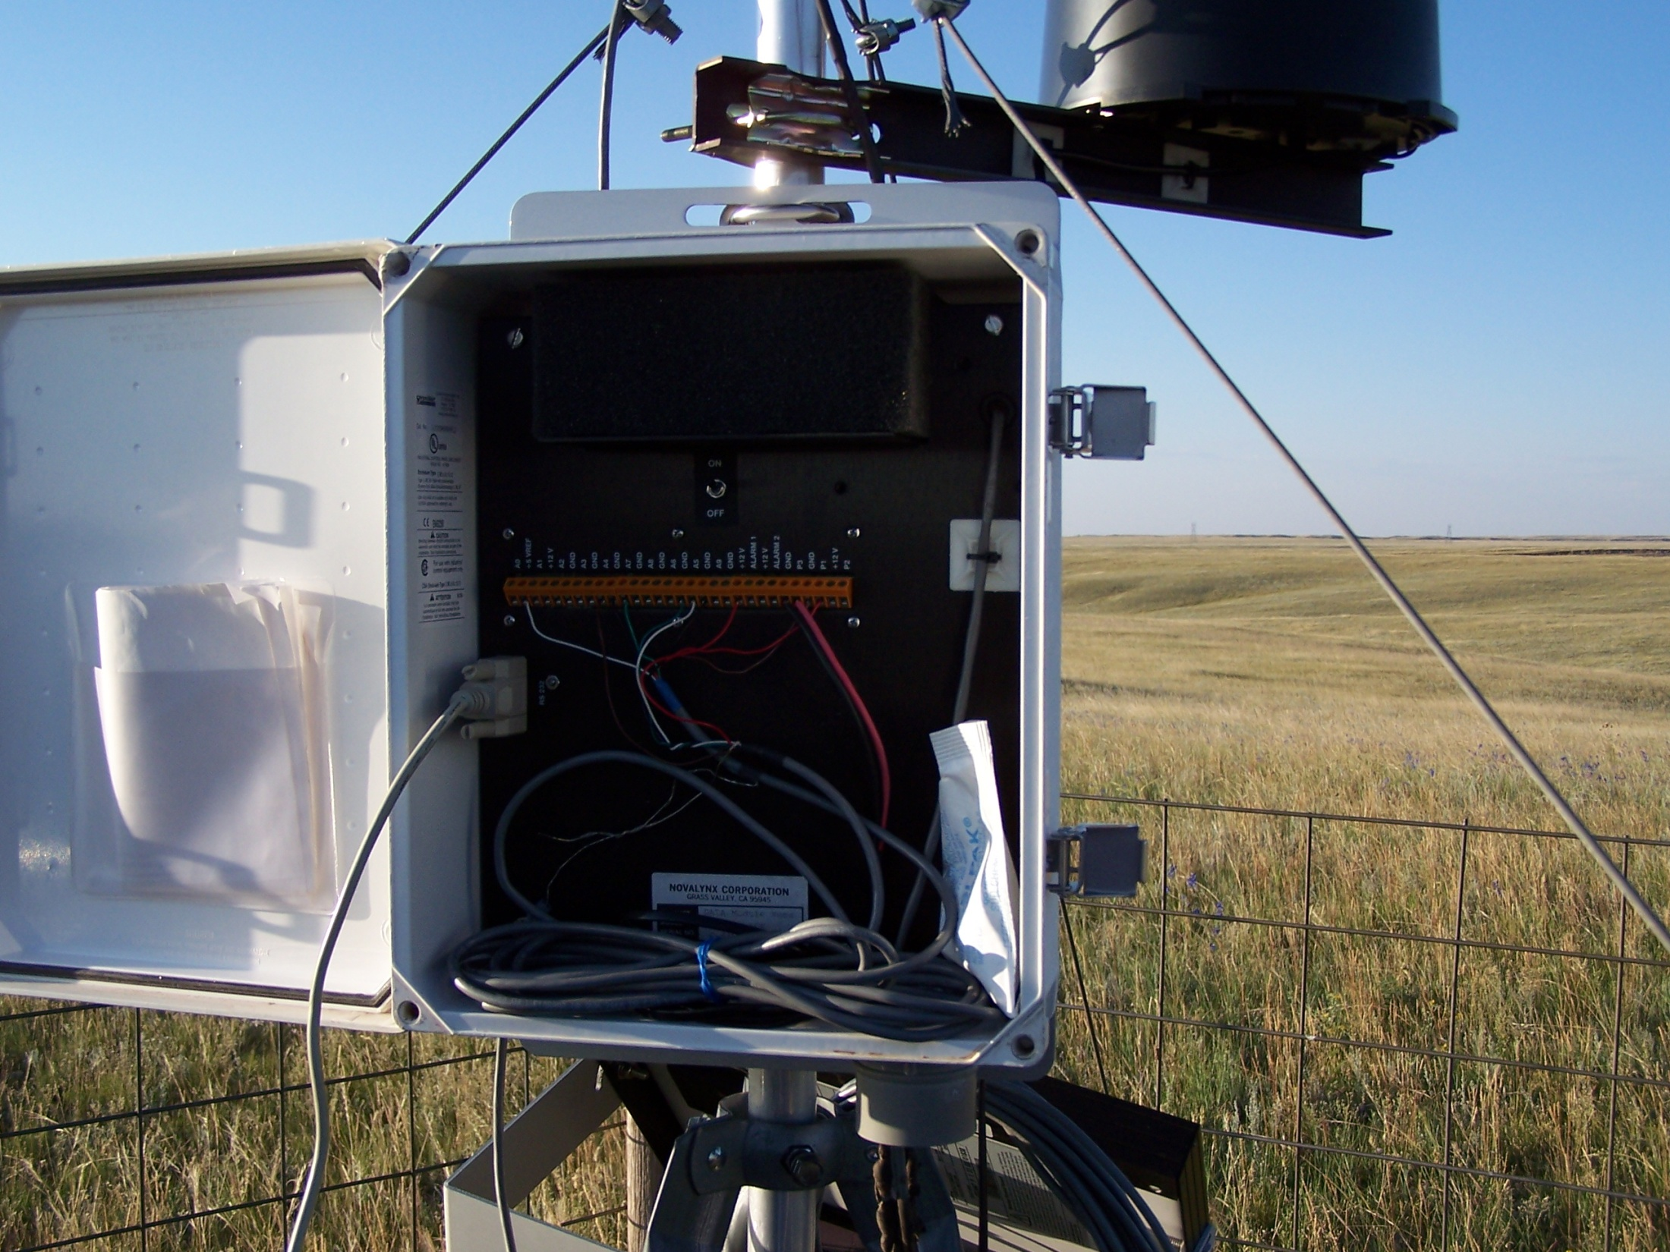

Slide 10
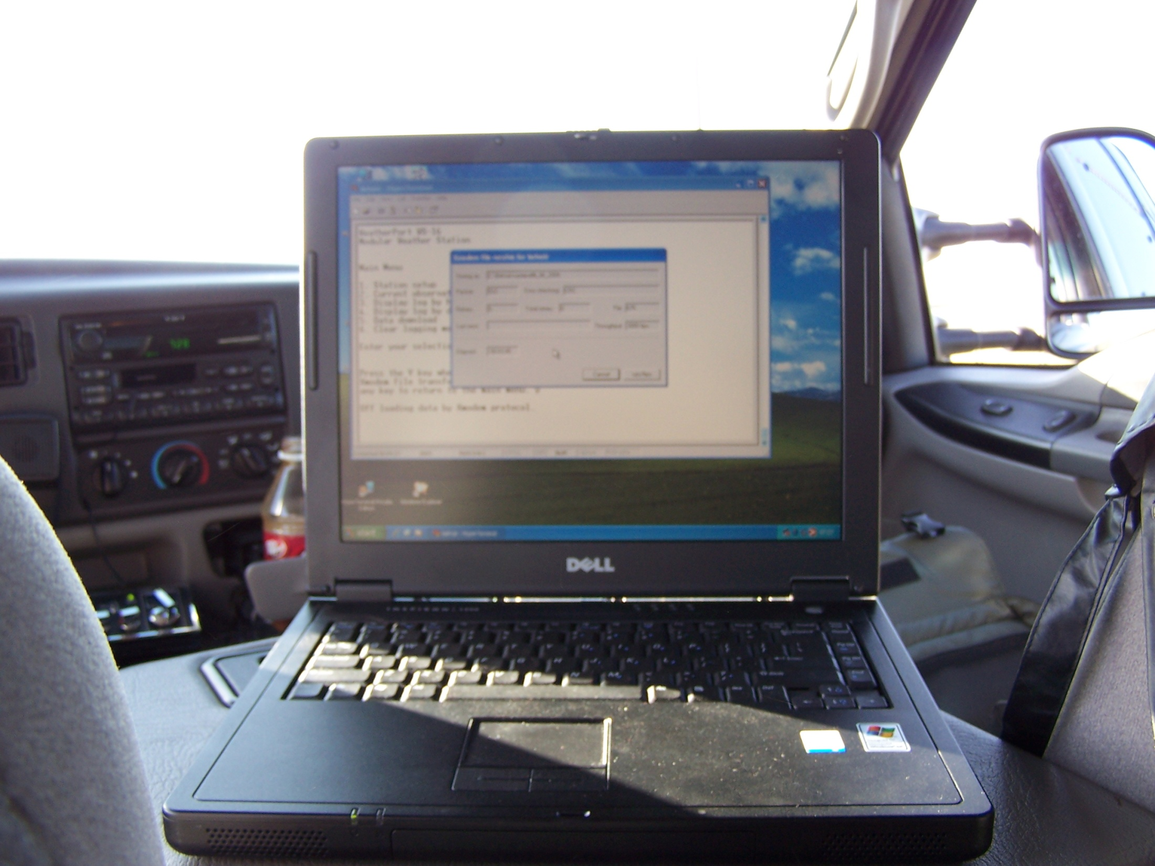

Slide 11
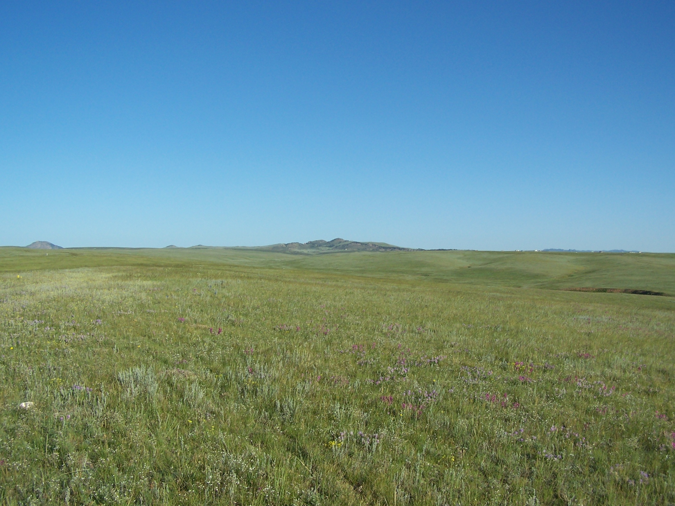
LANDFILL STATION LOOKING NORTHWEST

Slide 12
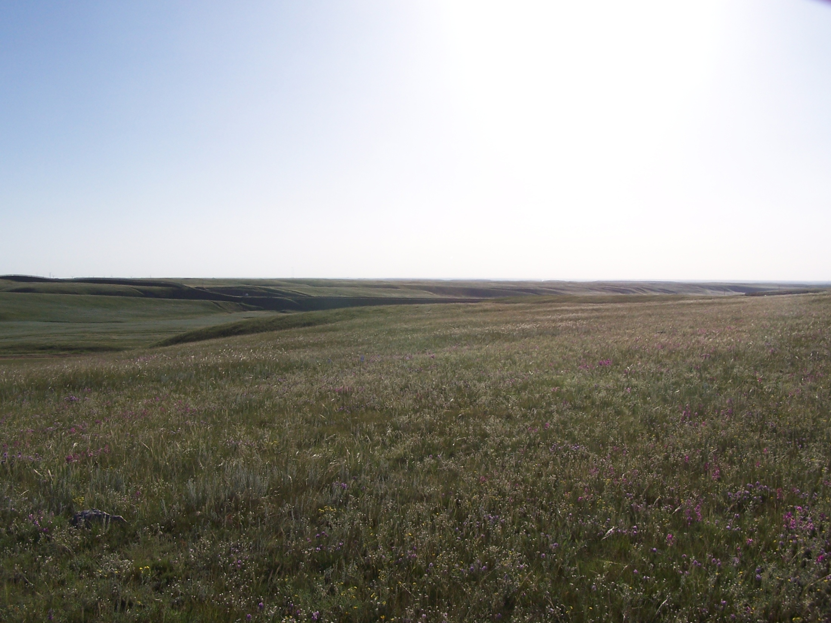
LANDFILL STATION LOOKING NORTHEAST
UNION PACIFIC RAILROAD TRACKS

Slide 13
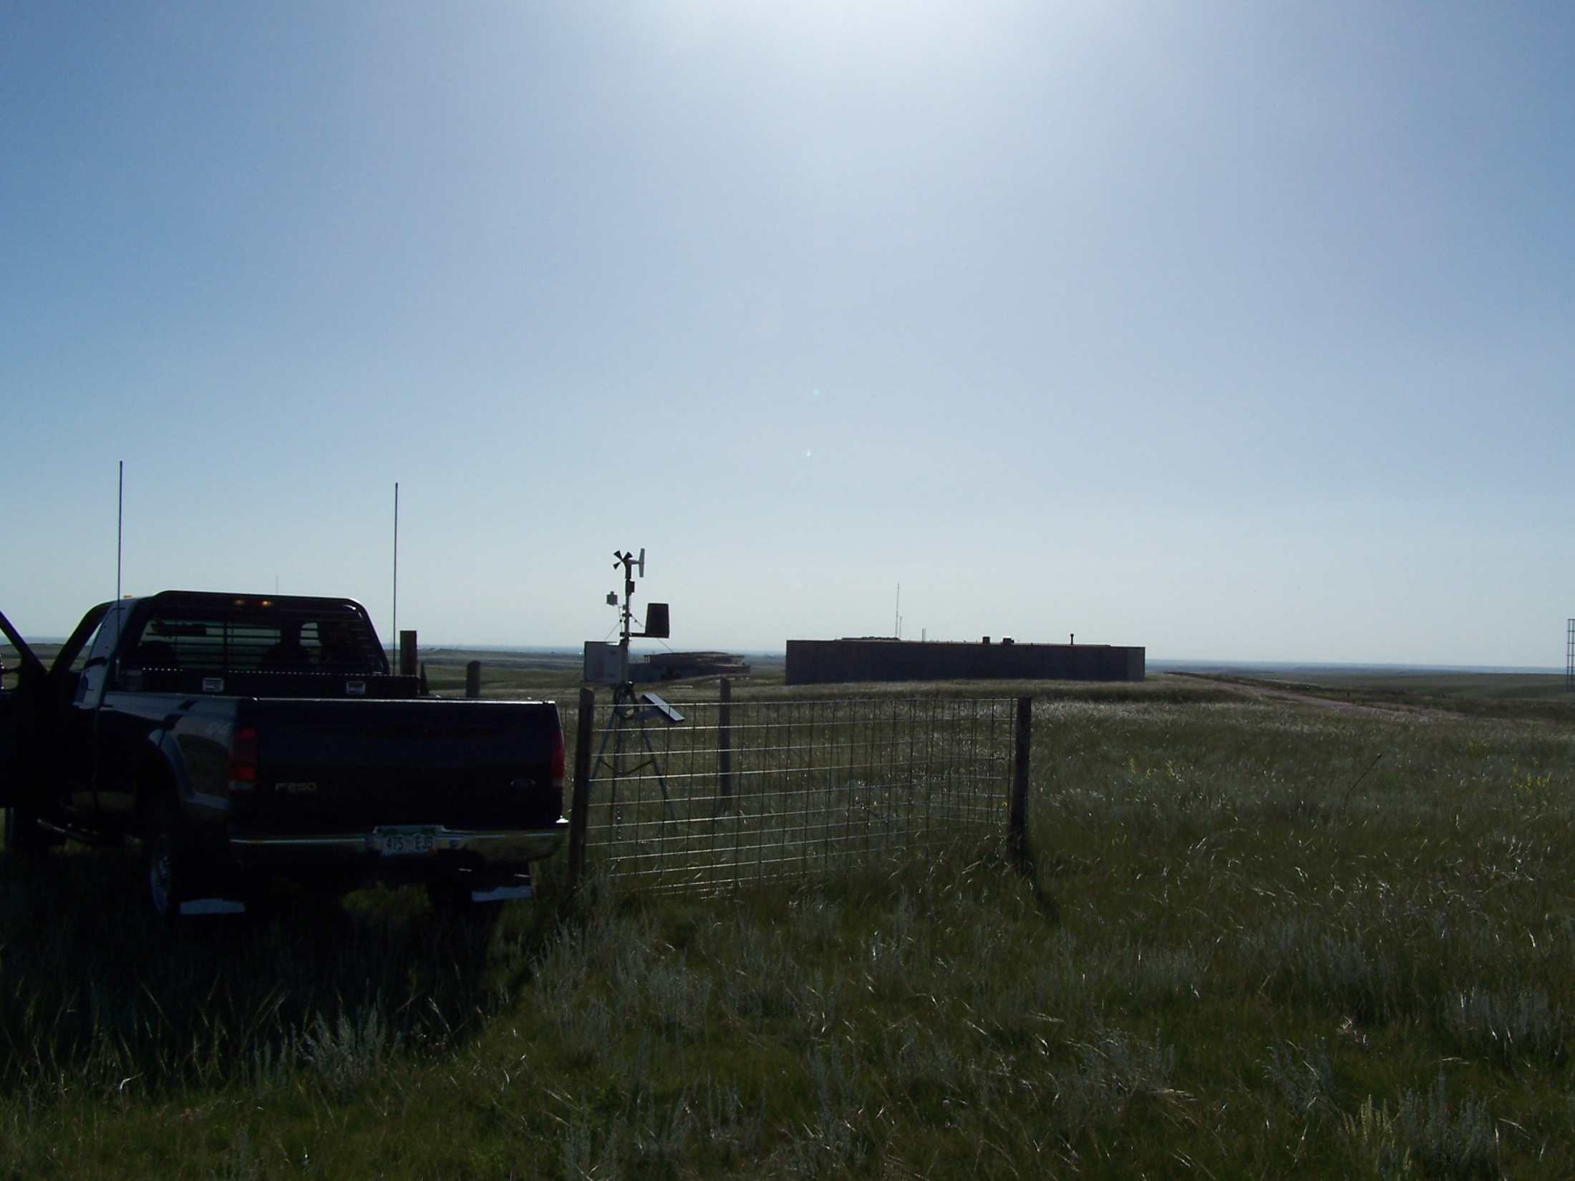
OLD MISSILE BASE STATION LOOKING EAST
OLD ATLAS MISSILE COMMAND CENTER

Slide 14
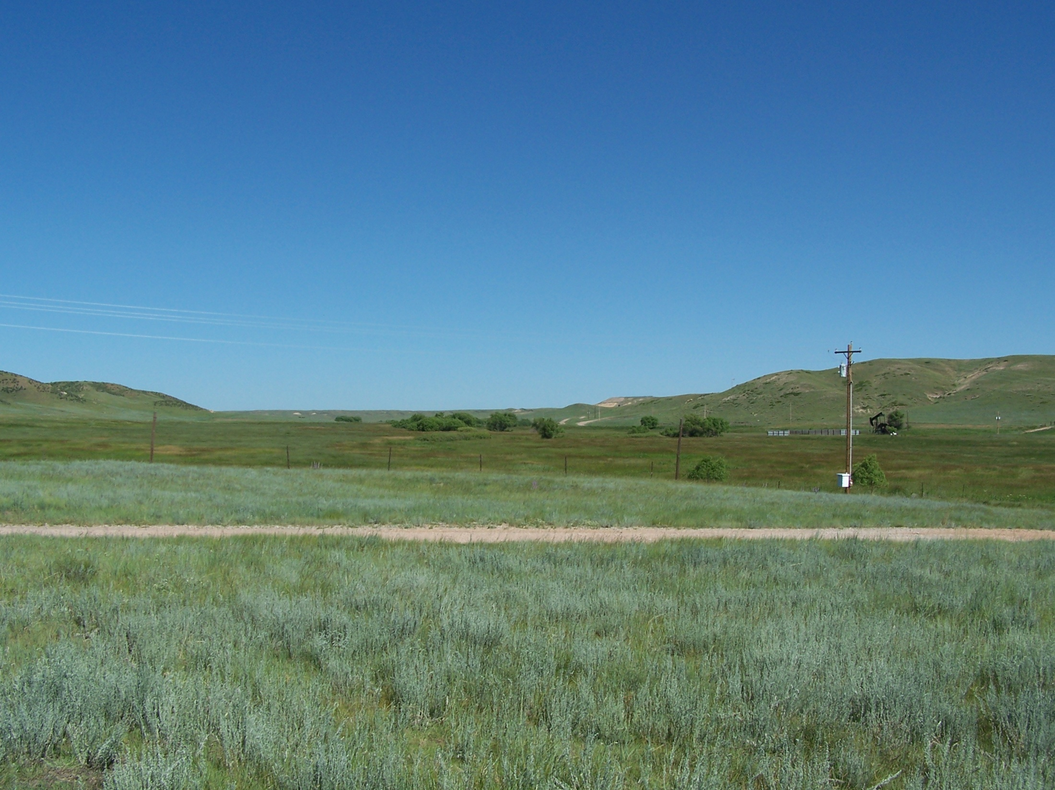
RANCH HOUSE STATION LOOKING NORTHWEST

Slide 15
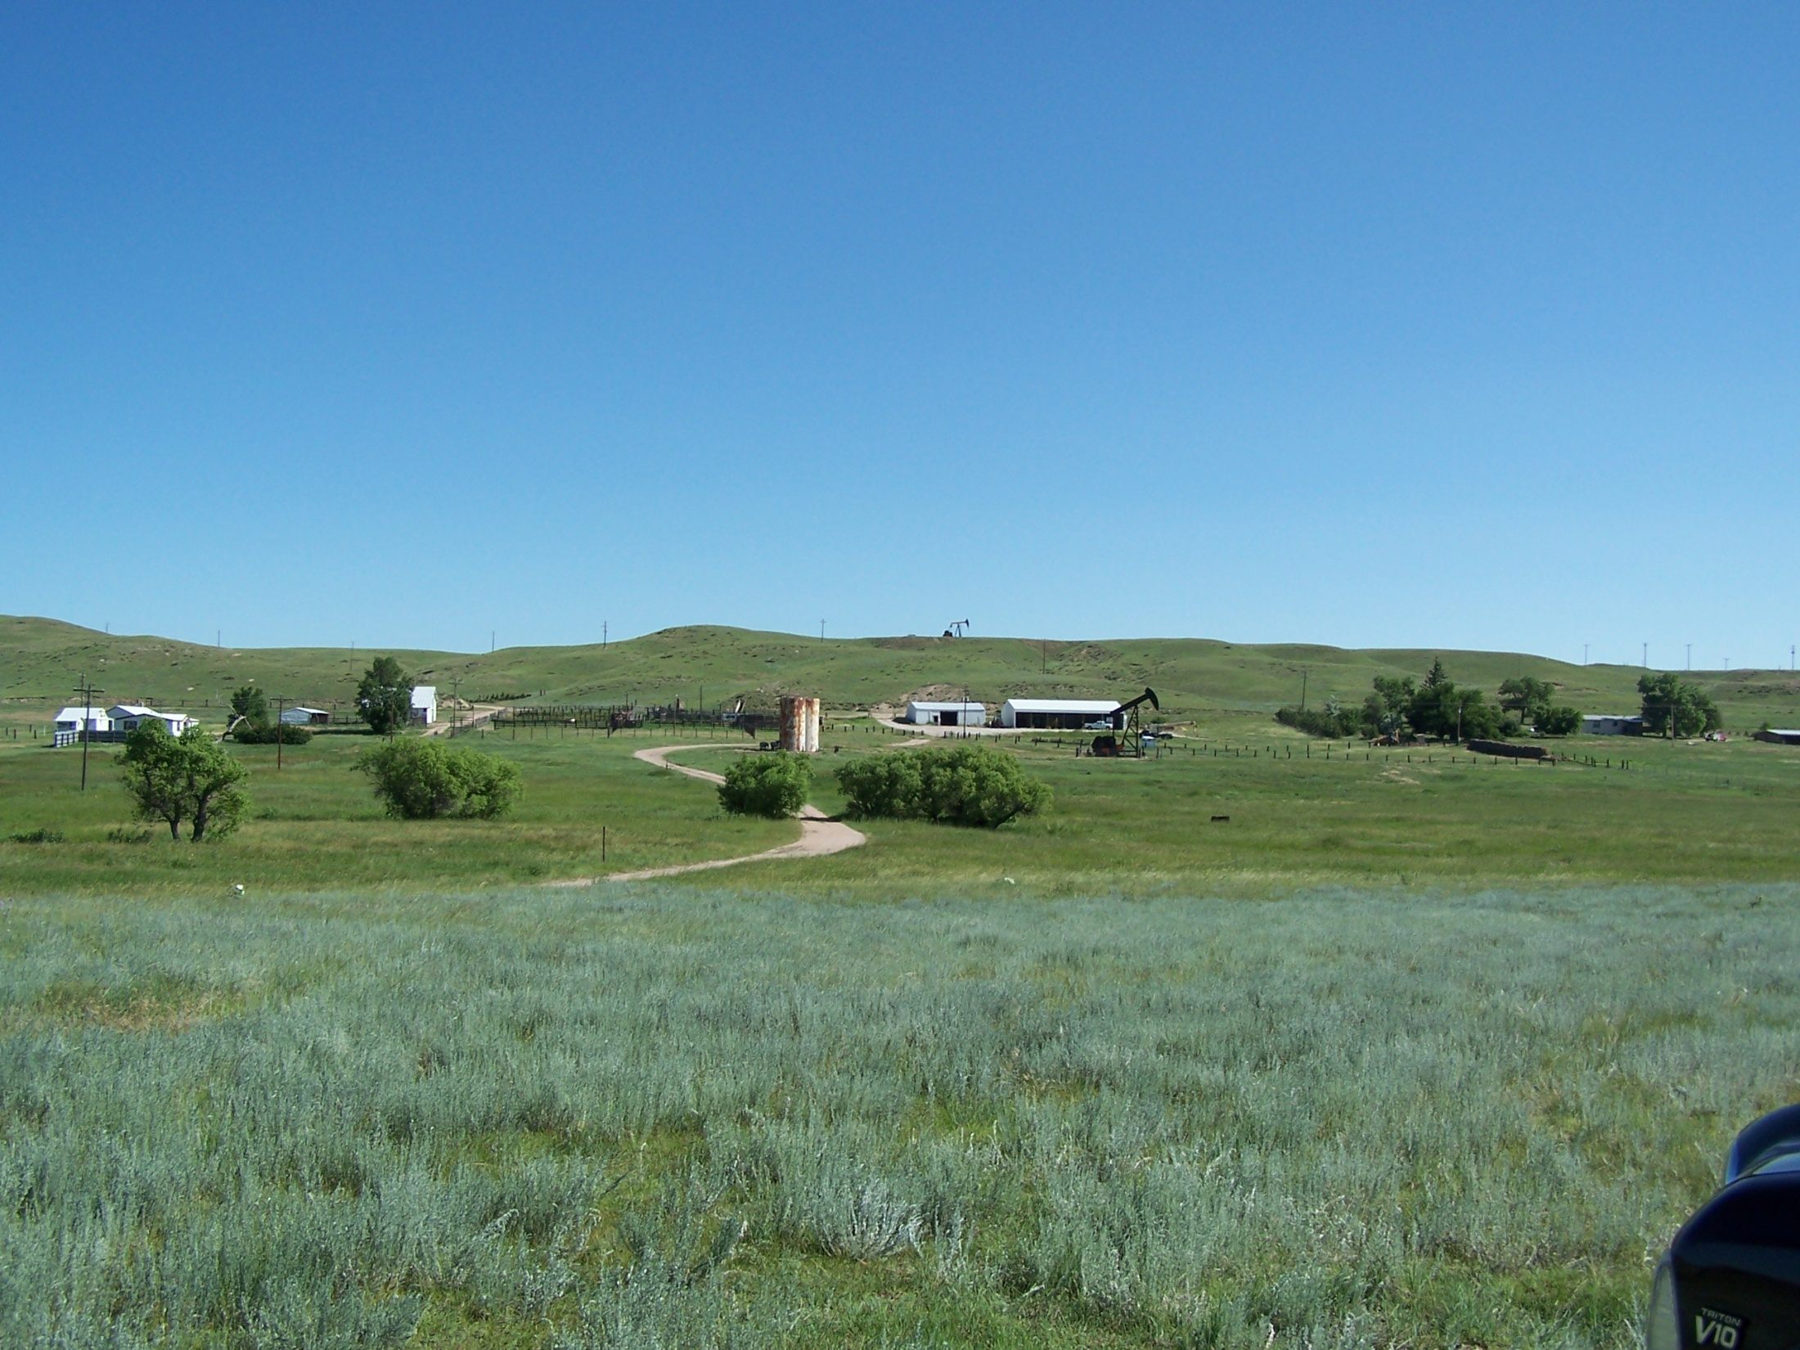
RANCH HOUSE STATION LOOKING NORTH
RANCH HEADQUARTERS

Slide 16
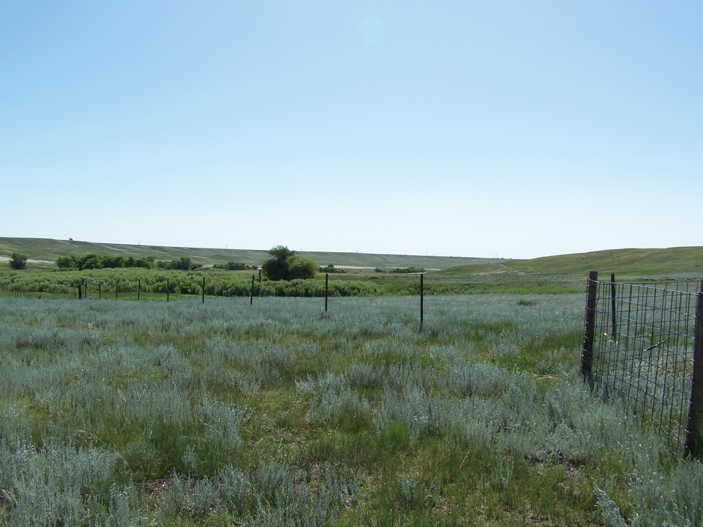
RANCH HOUSE STATION LOOKING EAST

Slide 17
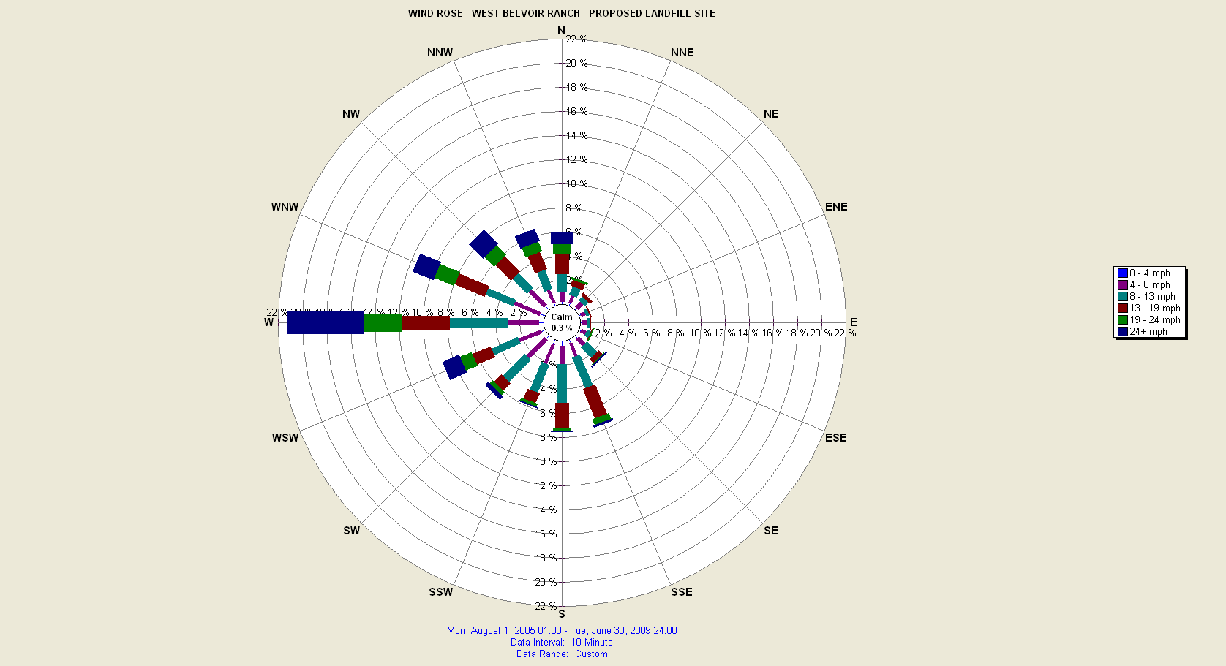
WIND ROSE FOR LANDFILL STATION
08/01/2005 TO 06/30/2009

Slide 18
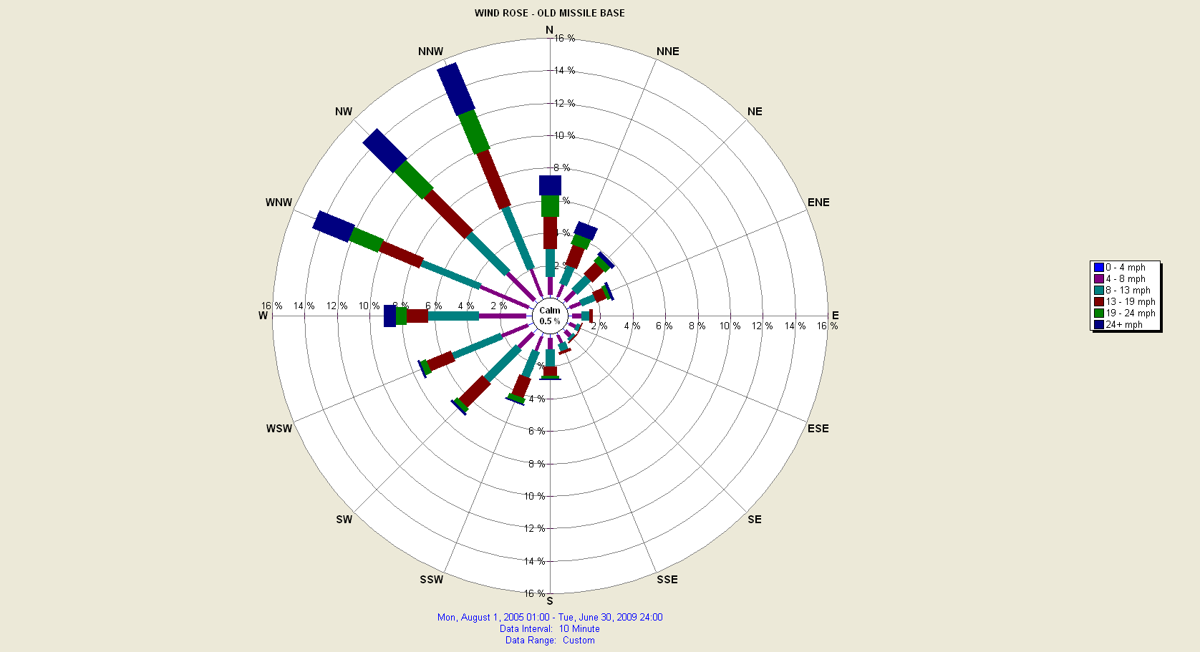
WIND ROSE FOR OLD MISSILE BASE STATION
08/01/2005 TO 06/30/2009

Slide 19
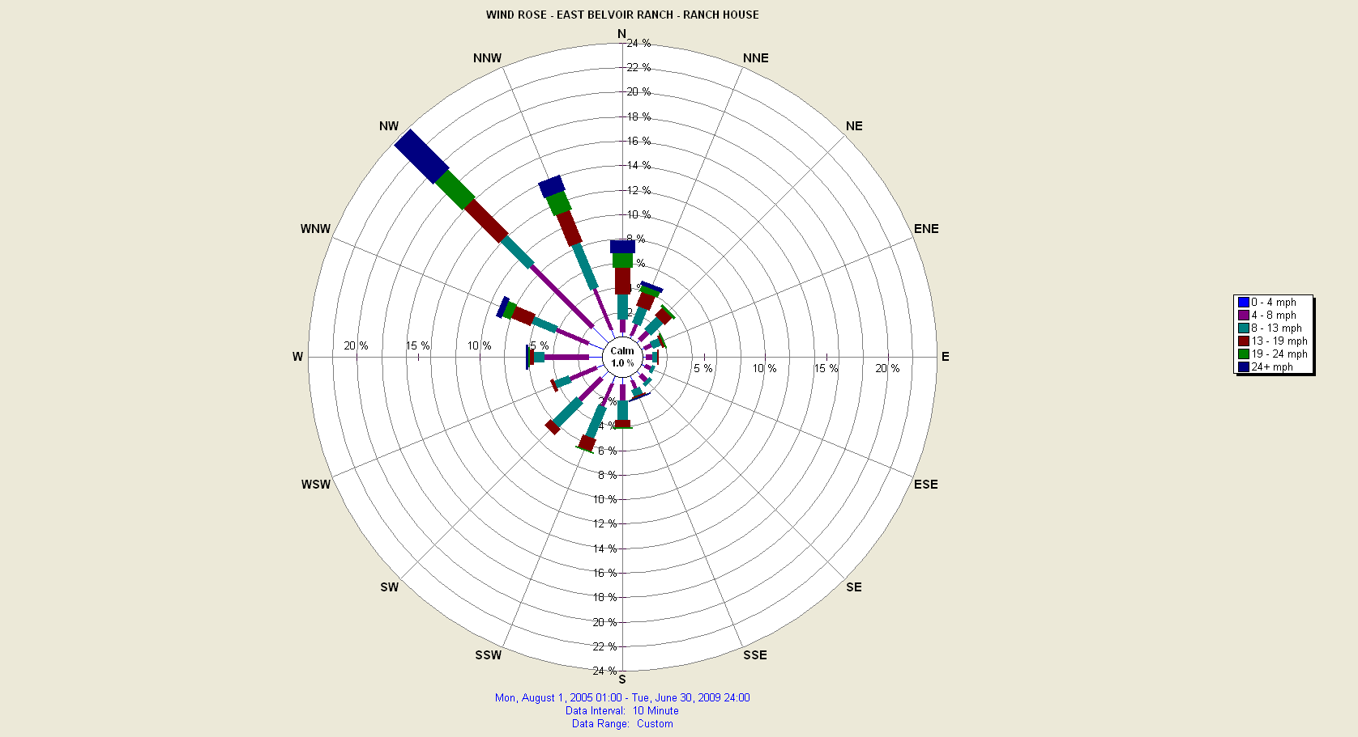
WIND ROSE FOR RANCH HOUSE STATION
08/01/2005 TO 06/30/2009

Slide 20
LANDFILL STATION WIND DATA SUMMARY 10/20/2004 – 06/30/2009
AVERAGE WIND SPEED: 14 MPH
AVERAGE WIND DIRECTION: 217^{O} SSW
PEAK WIND GUST: 69 MPH FROM 263^{O} AT 1030MST ON 01/08/2009

Slide 21
OLD MISSILE BASE STATION WIND DATA SUMMARY 07/21/2005– 06/30/2009
AVERAGE WIND SPEED: 14 MPH
AVERAGE WIND DIRECTION: 242^{O} SW
PEAK WIND GUST: 65MPH FROM 304^{O} AT 1850MST ON 01/03/2006

Slide 22
RANCH HOUSE STATION WIND DATA SUMMARY 07/21/2005– 06/30/2009
AVERAGE WIND SPEED: 11 MPH
AVERAGE WIND DIRECTION: 242^{O} SW
PEAK WIND GUST: 70 MPH FROM 313^{O} AT 2320MST ON 12/31/2008

