Slide 1




The National Drought Mitigation Center: An Overview of Products and Services
Brian Fuchs, Climatologist
National Drought Mitigation Center
University of Nebraska-Lincoln
High Plains AMS/NWA Conference
August 27-28, 2009
North Platte, Nebraska

Slide 2
National Drought Mitigation Center
Founded: 1995 at the University of Nebraska-Lincoln
Mission: To lessen societal vulnerability to drought by promoting planning and the adoption of appropriate risk management techniques.

Slide 3
The Cycle of Disaster Management

Slide 4
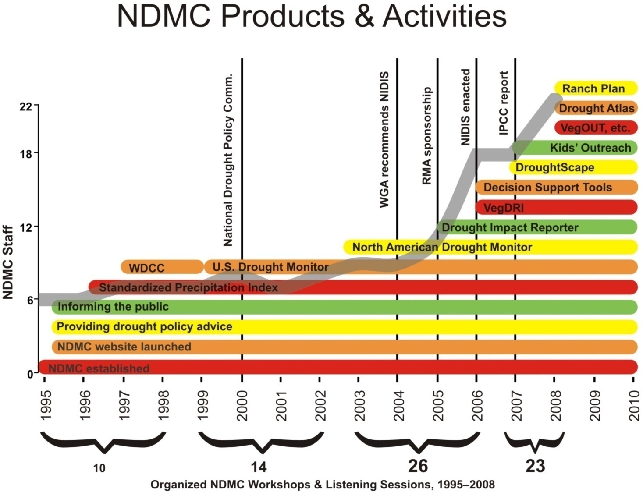
*
*
*
*
*
*
* RMA supported projects developing
drought tools for agricultural producers.

Slide 5
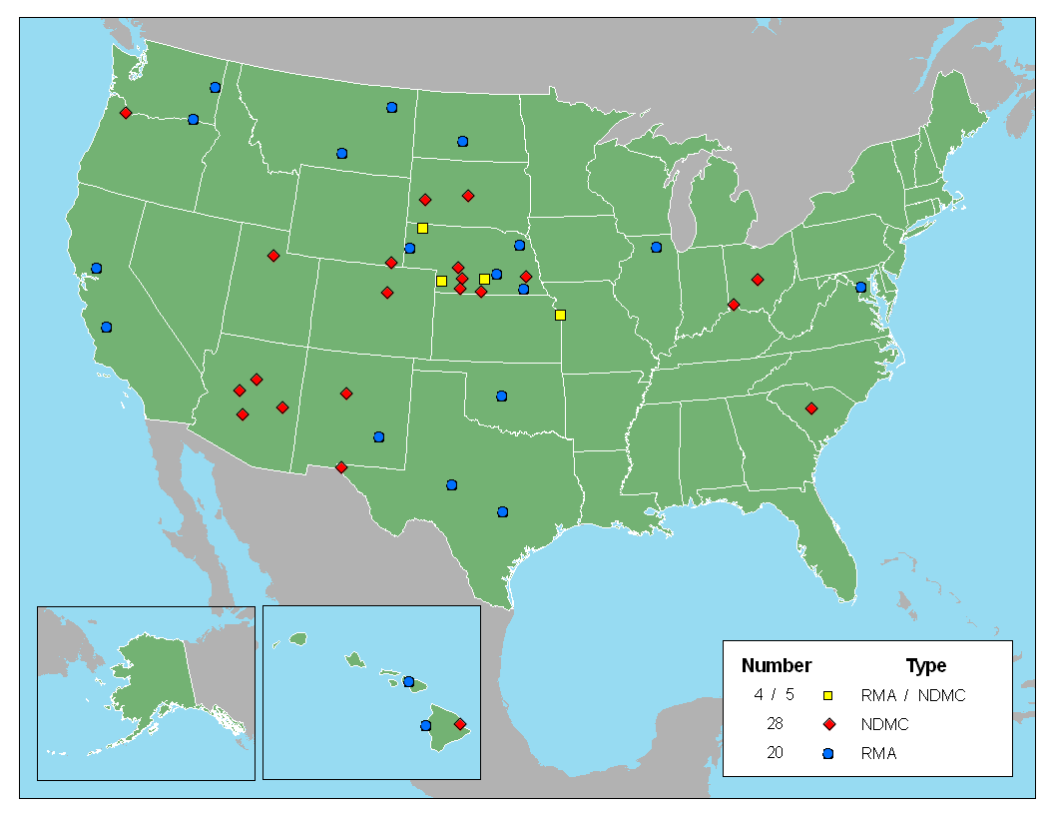
NDMC Stakeholder Workshops 1996-2009

Slide 6
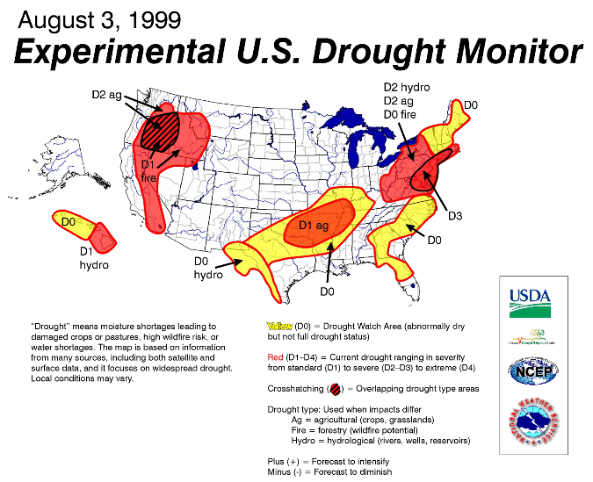
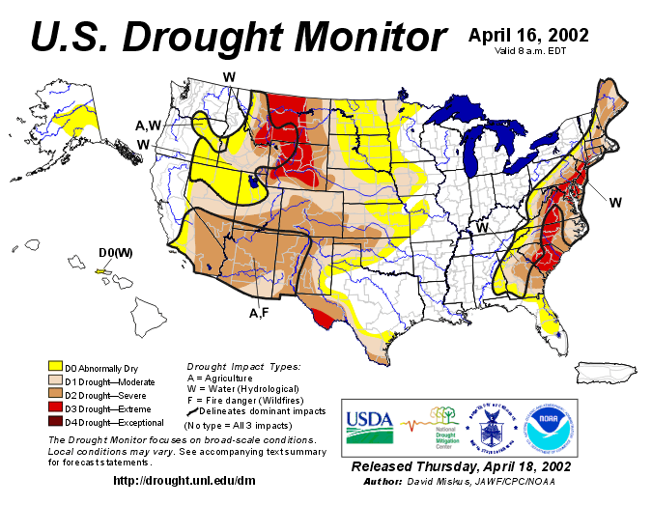
The U.S. Drought Monitor
Since 1999, NOAA (CPC and NCDC), USDA, and the NDMC have produced a weekly composite drought map -- the U.S. Drought Monitor -- with input from numerous federal and non-federal partners

Slide 7
The Drought Monitor Concept
A partnership between the NDMC, USDA and NOAA’s CPC, NCDC, and RCC’s (authors)
Incorporate relevant information and products from all entities (and levels of government) dealing with drought (RCC’s, SC’s, federal/state agencies, etc.) (experts)
The Drought Monitor is updated weekly and provides a general up-to-date summary of current drought conditions across the 50 states, Puerto Rico and the Pacific possessions

Slide 8
The Drought Monitor Concept
A consolidation of indices and indicators into one comprehensive national drought map
Trying to capture these characteristics:
  the drought’s magnitude (duration + intensity)
  spatial extent
  probability of occurrence
  Impacts
Rates drought intensity by
Percentile Rankings

Slide 9
Original Objectives
“Fujita-like” scale
NOT a forecast!
NOT a drought declaration!
Identify impacts (A, H)
Assessment of current conditions
Incorporate local expert input
Be as objective as possible

Slide 10
U.S. Drought Monitor Map
Drought Intensity Categories
D0 Abnormally Dry (30%tile)
D1 Drought – Moderate (20%tile)
D2 Drought – Severe (10%tile)
D3 Drought – Extreme (5%tile)
D4 Drought – Exceptional (2%tile)

Slide 11
Key Variables For
Monitoring Drought
climate data
soil moisture
stream flow
ground water
reservoir and lake levels
snow pack
short, medium, and long range forecasts
vegetation health/stress and fire danger

Slide 12
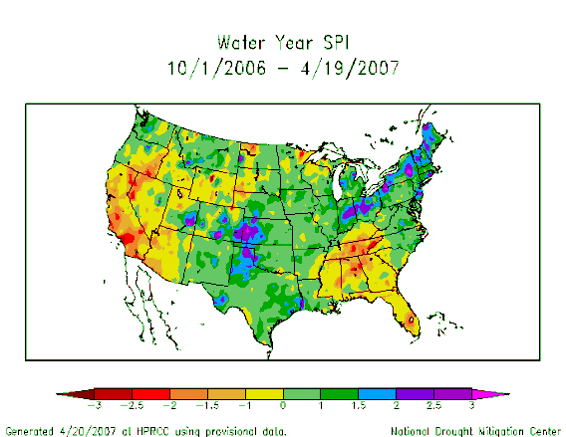
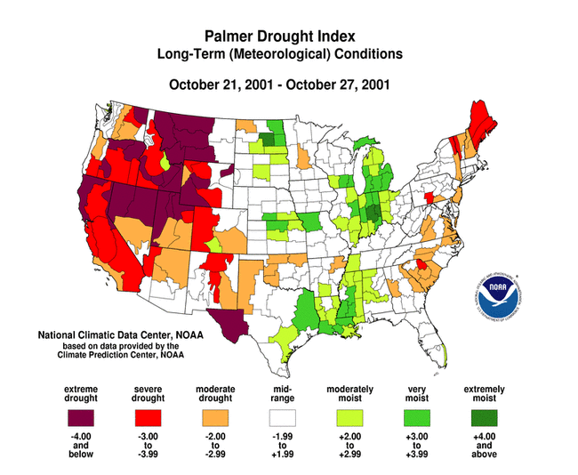
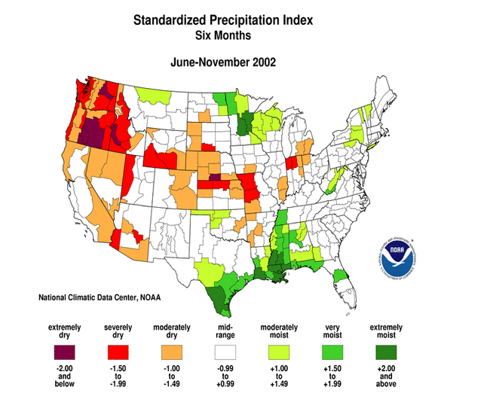
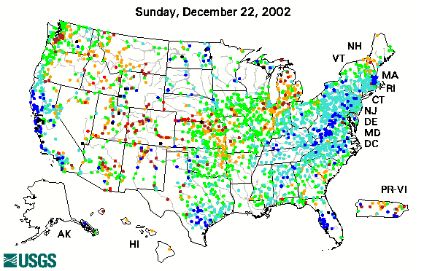
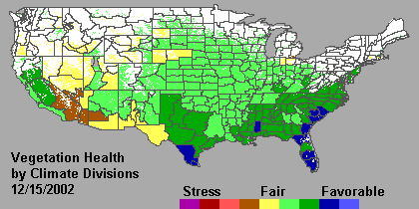
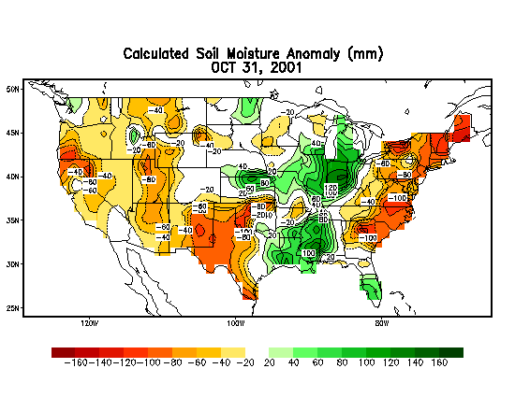
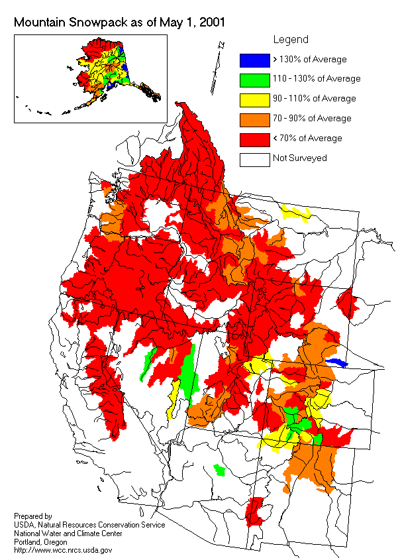
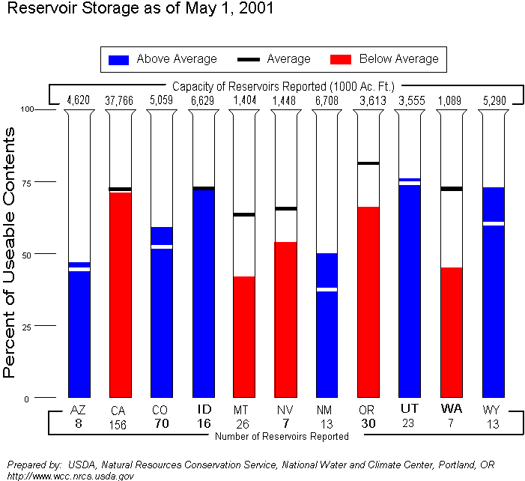
U.S. Drought Monitor
Integrates Key
Drought Indicators:
  - Palmer Drought Index
  - SPI
  - KBDI
  Modeled Soil Moisture
  - 7-Day Avg. Streamflow
  - Precipitation Anomalies
  Growing Season:
  - Crop Moisture Index
  - Sat. Veg. Health Index
  Soil Moisture
  Mesonet data
  In The West:
  - SWSI
  - Reservoir levels
  Snowpack
  Streamflow
  Created in ArcGIS

Slide 13
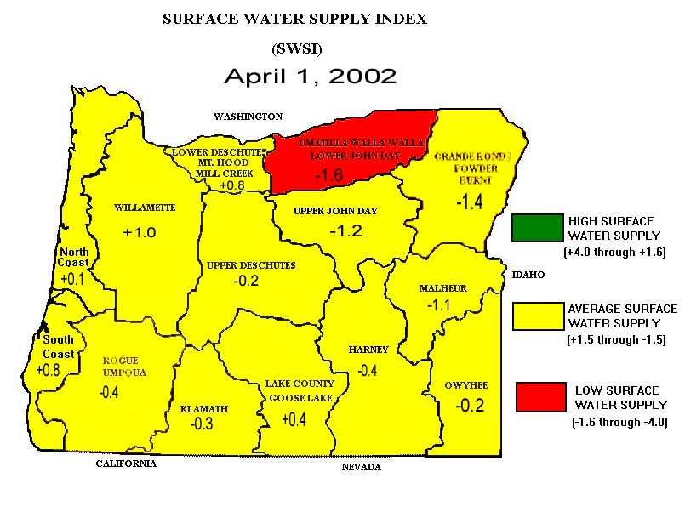
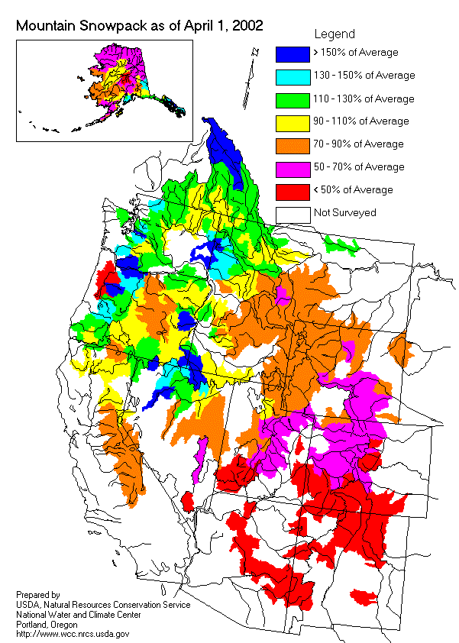
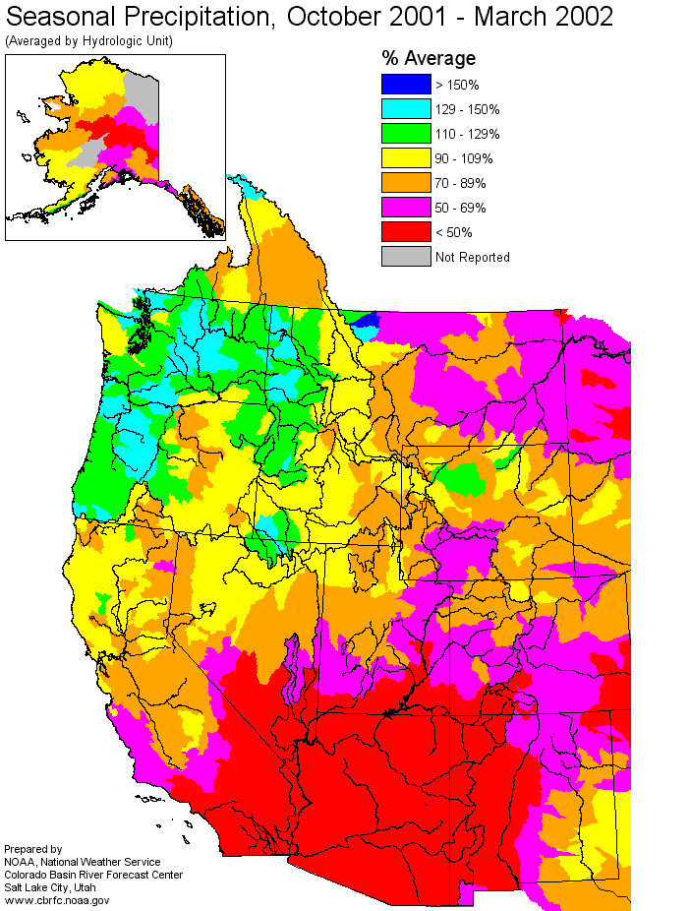
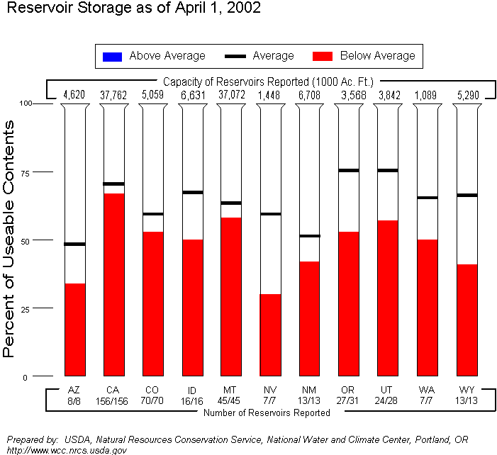
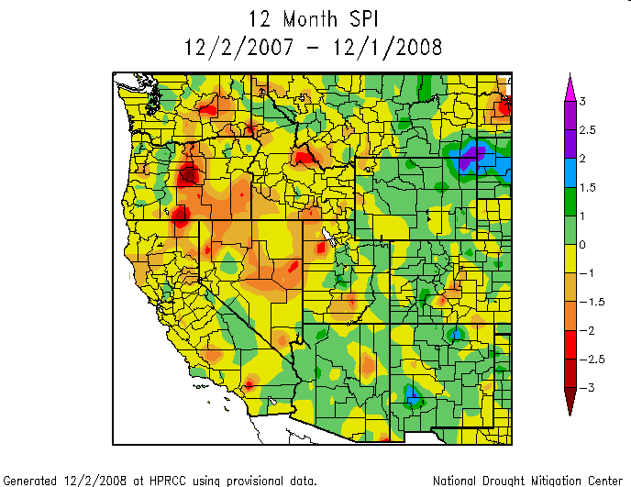
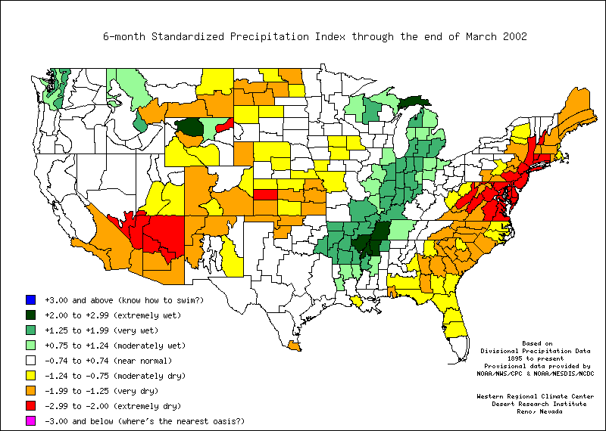
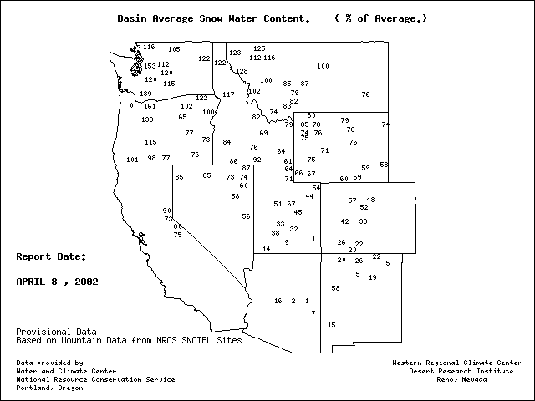
Indices for
“The West”

Slide 14
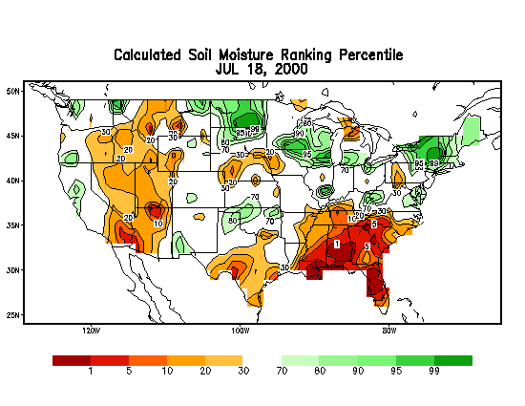
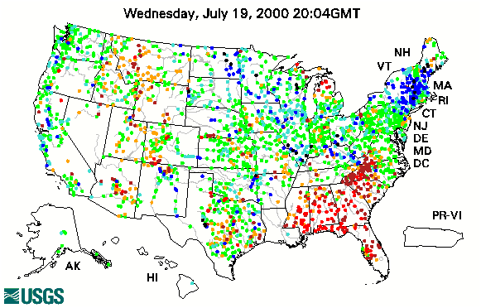
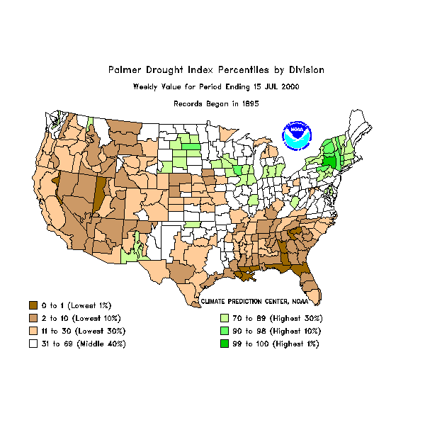
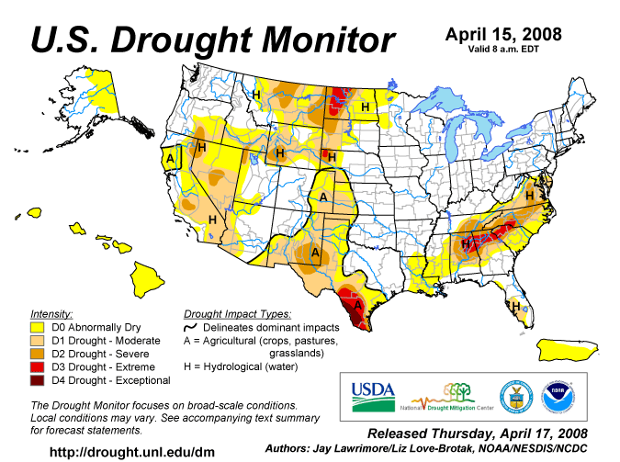
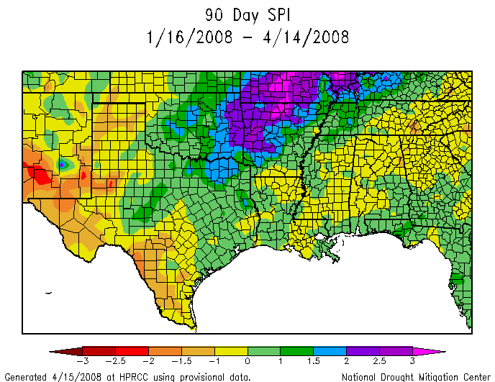
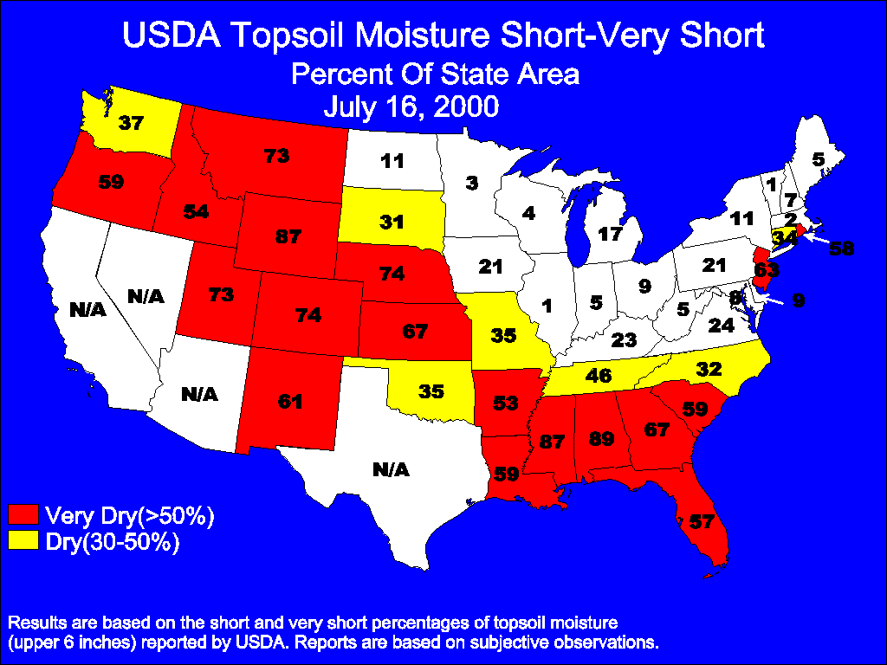
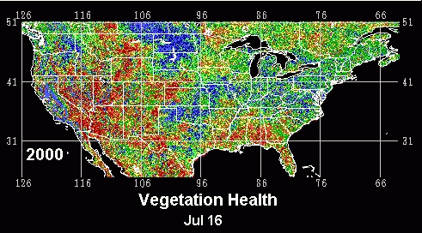
Principal Drought Monitor Inputs
USGS Streamflow
CPC Daily Soil Model
Palmer Drought Index
SPI Drought Index
USDA Soil Ratings
Satellite Veg Health

Slide 15
Monitor Development (Period starts 12Z last Tuesday)
Monday (5 Days available)
Draft map sent to local experts
Tuesday (6 Days available)
Local expert feedback
Draft map sent to local experts
Draft text sent to local experts
Wednesday (7 Days available; ending 12Z yesterday)
Local expert feedback
Draft map(s) sent to local experts
Draft text(s) sent to local experts (Outlook)
Final map and text sent to secured ftp server
Thursday
Final map & text released on NDMC Website

Slide 16
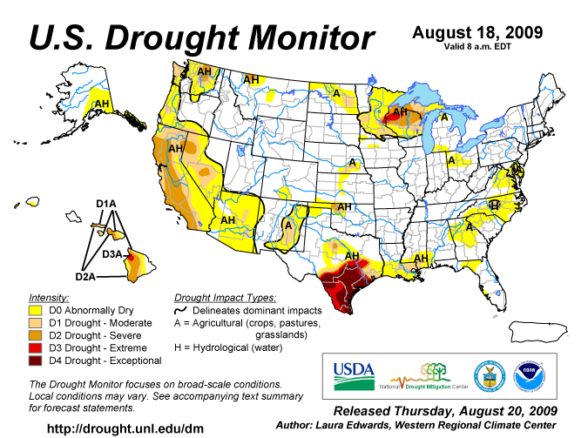

Slide 17
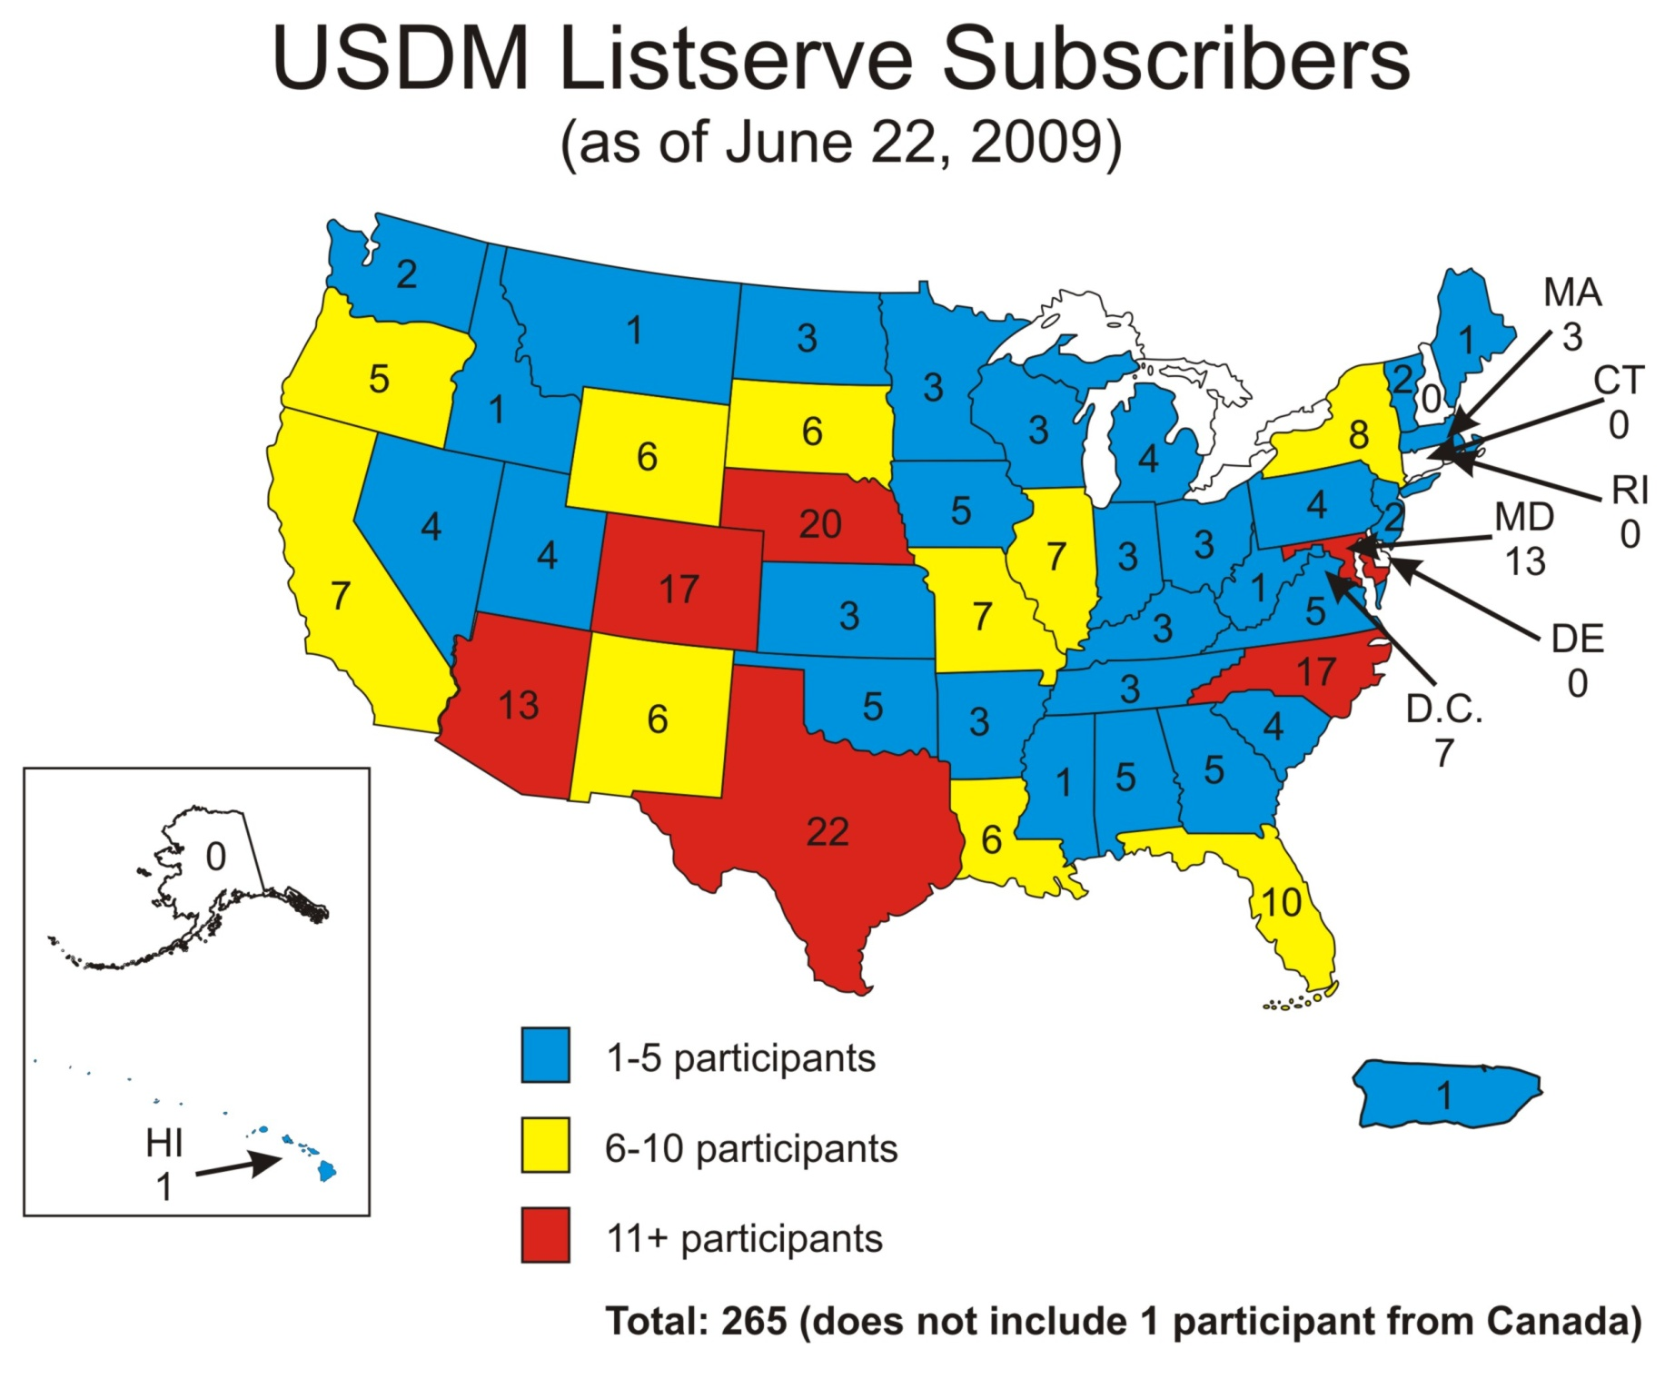

Slide 18
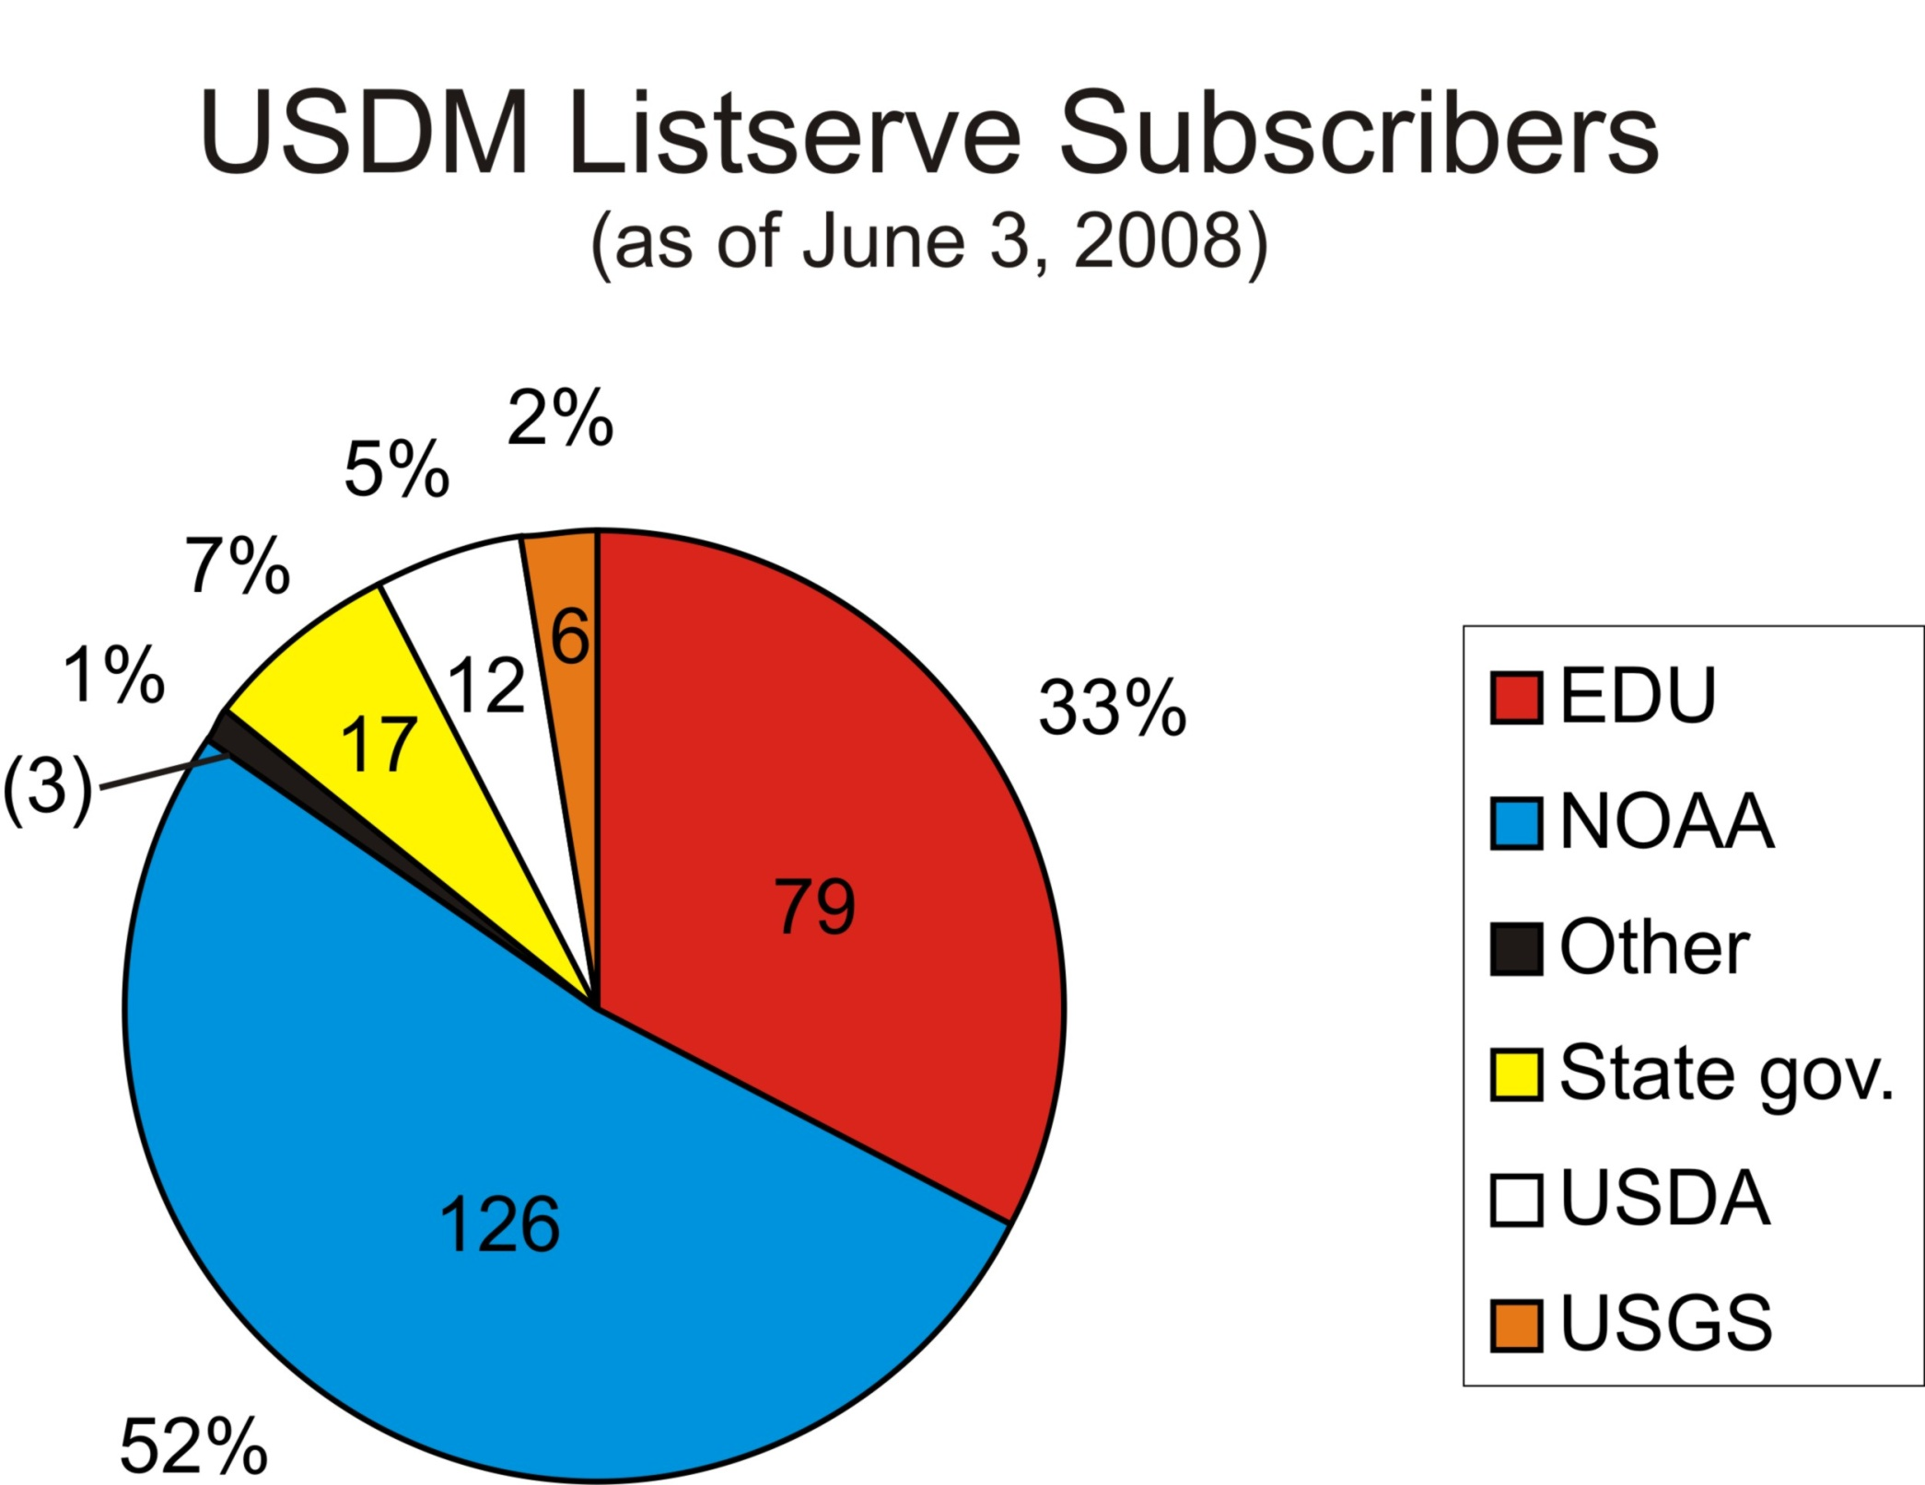

Slide 19
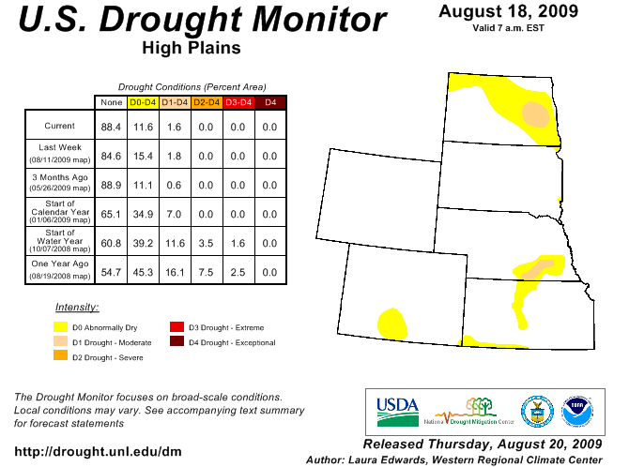

Slide 20
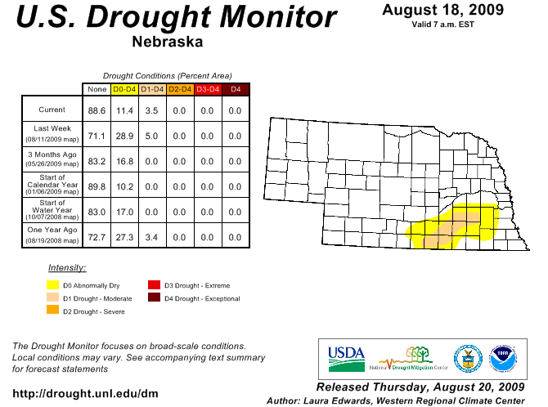

Slide 21
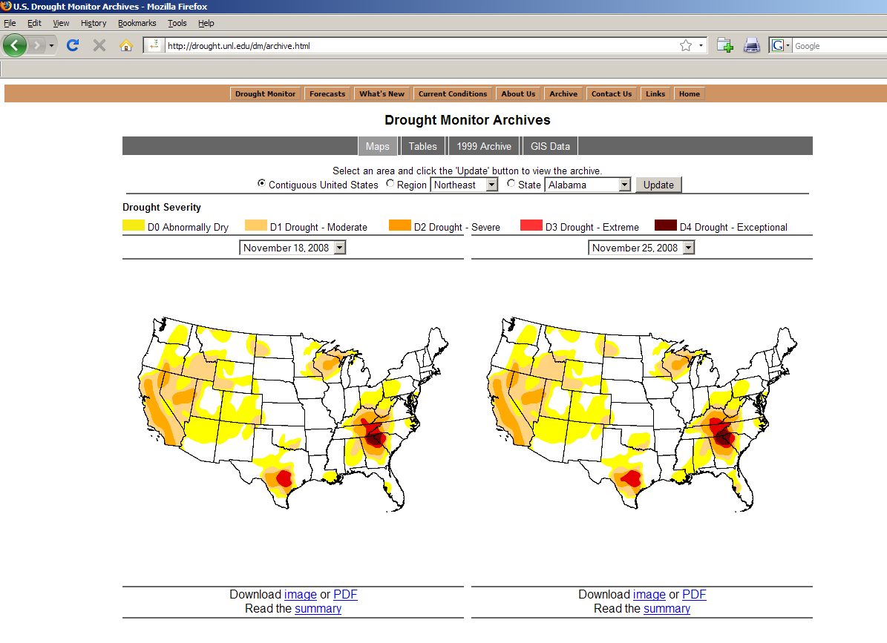

Slide 22
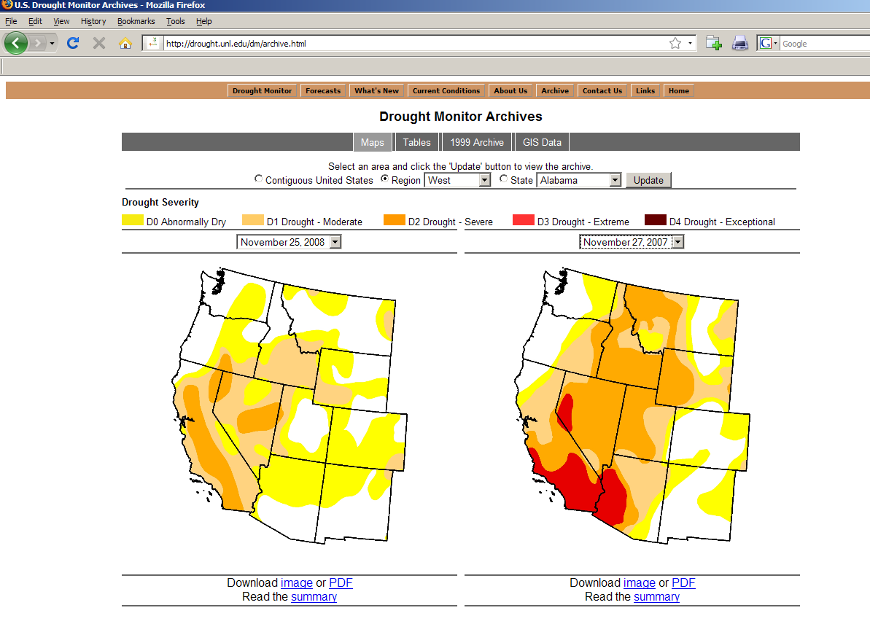

Slide 23
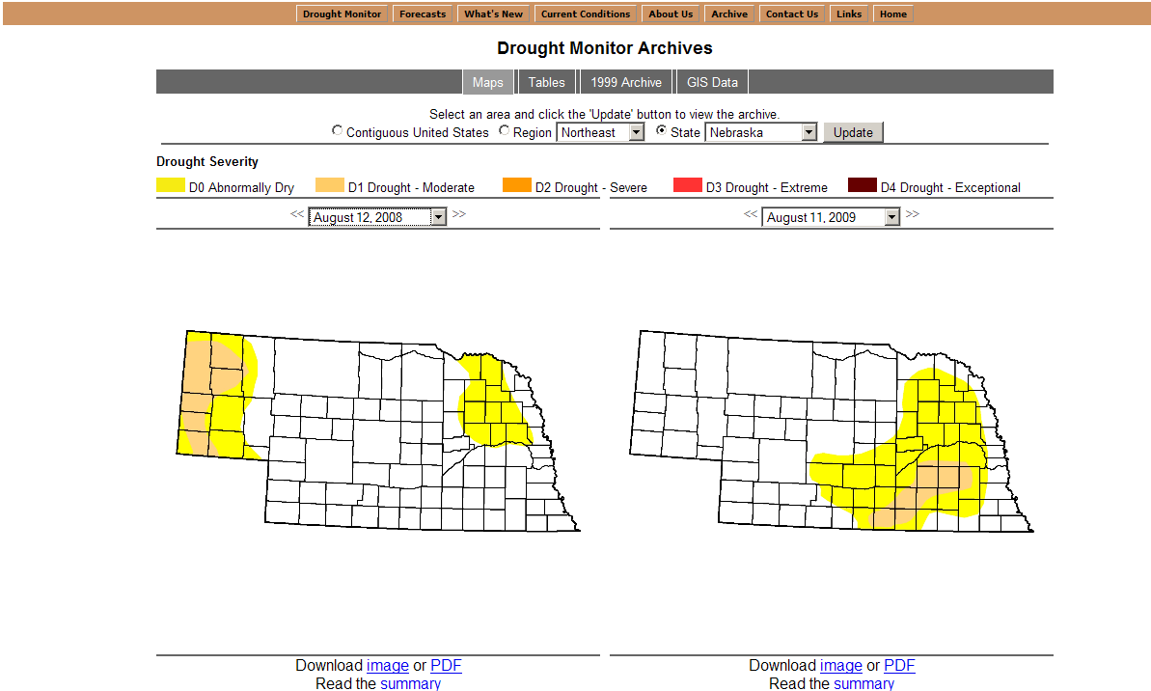

Slide 26
ARCHIVE EXAMPLE???

Slide 27
Use of the DM in Decision Making
USDA Dried Milk Program 2002-03
USDA CRP Release hot spot trigger
Numerous states use as a drought trigger (Governor’s declarations)
2006 USDA Livestock Assistance
2006 IRS (tax deferral on livestock losses)

Slide 28
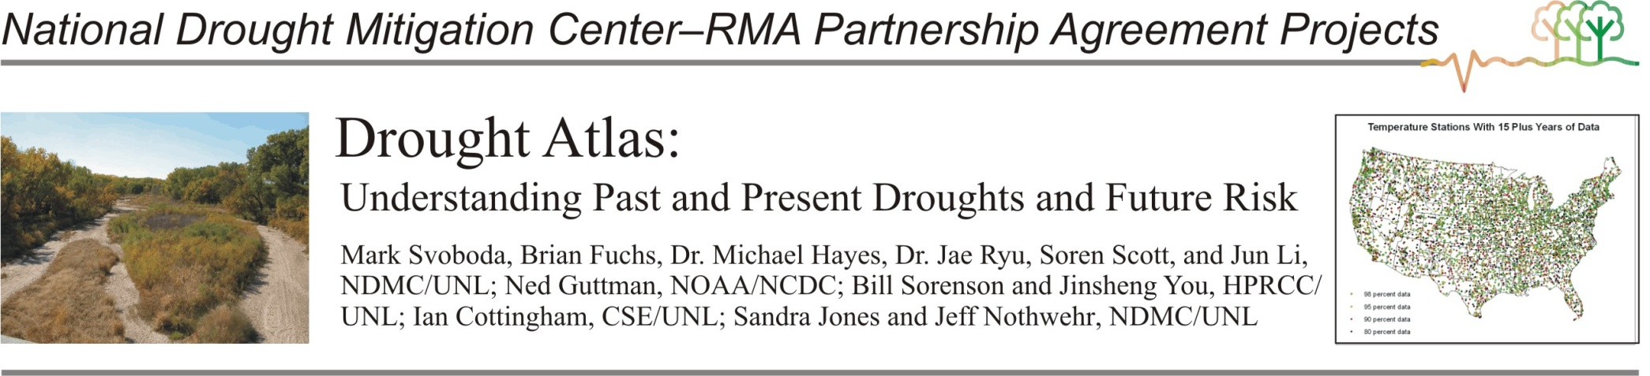
The goal of the atlas is to provide usable tools and products for users at all levels by giving them the ability to visualize and assess their drought risk through a variety of web-based options. The example above shows how producers and other decision makers can assess drought at a variety of time scales and at user-defined spatial levels.

Slide 29
Data Criteria for the Drought Atlas
Minimum of 40 years of Data (original drought atlas, 40 years was the maximum used)
No more than 2 consecutive months missing at any time in the POR
Established unique start dates for each station

Slide 30
Stations being used for the Drought Atlas
2,144 stations with 40 or more years of precipitation data meeting all criteria
1,964 stations with 40 or more years of temperature and precipitation data meeting all criteria
Just over 1,000 stations were used in the original Drought Atlas

Slide 31
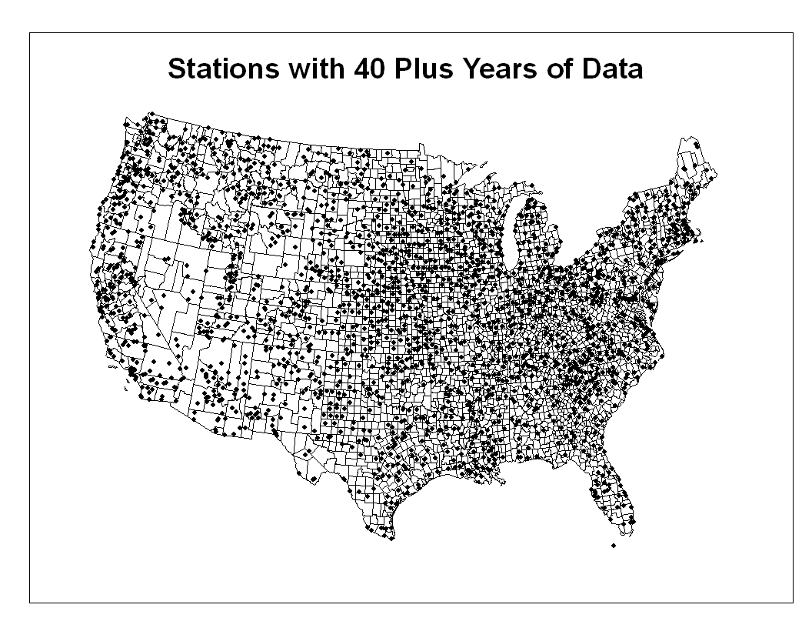
2144 Stations

Slide 32
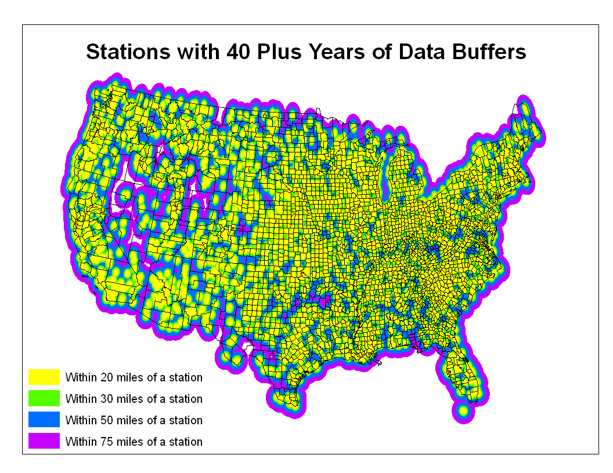

Slide 33
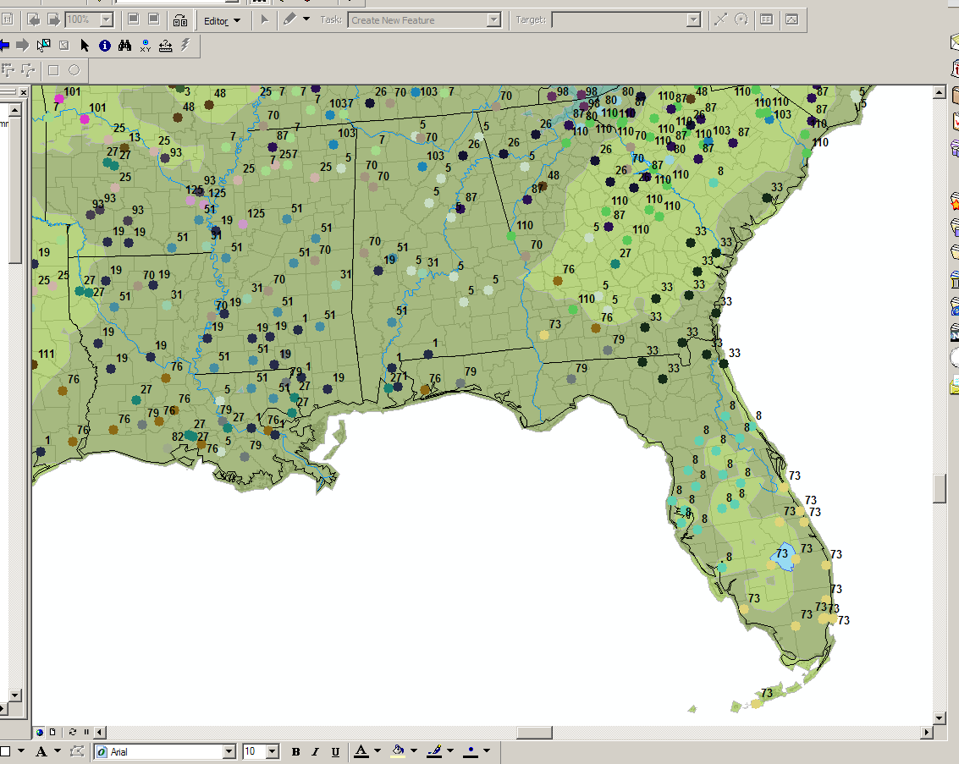
Homogeneous clusters were developed using relationships between precipitation, elevation, latitude and longitude

Slide 34
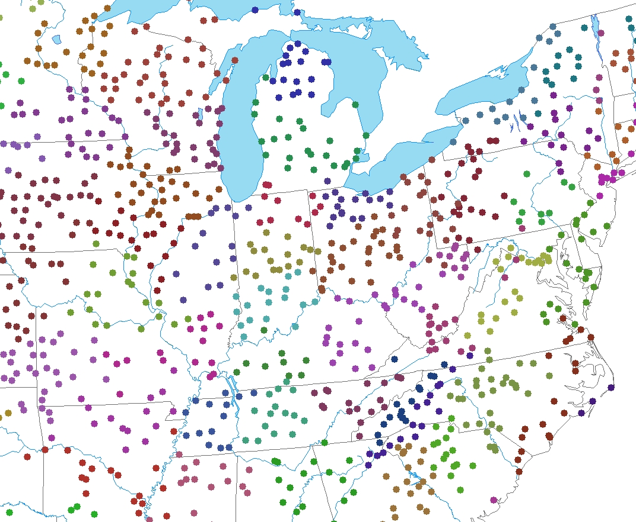
2144 Stations were put into 135 Unique Climate Regimes

Slide 35
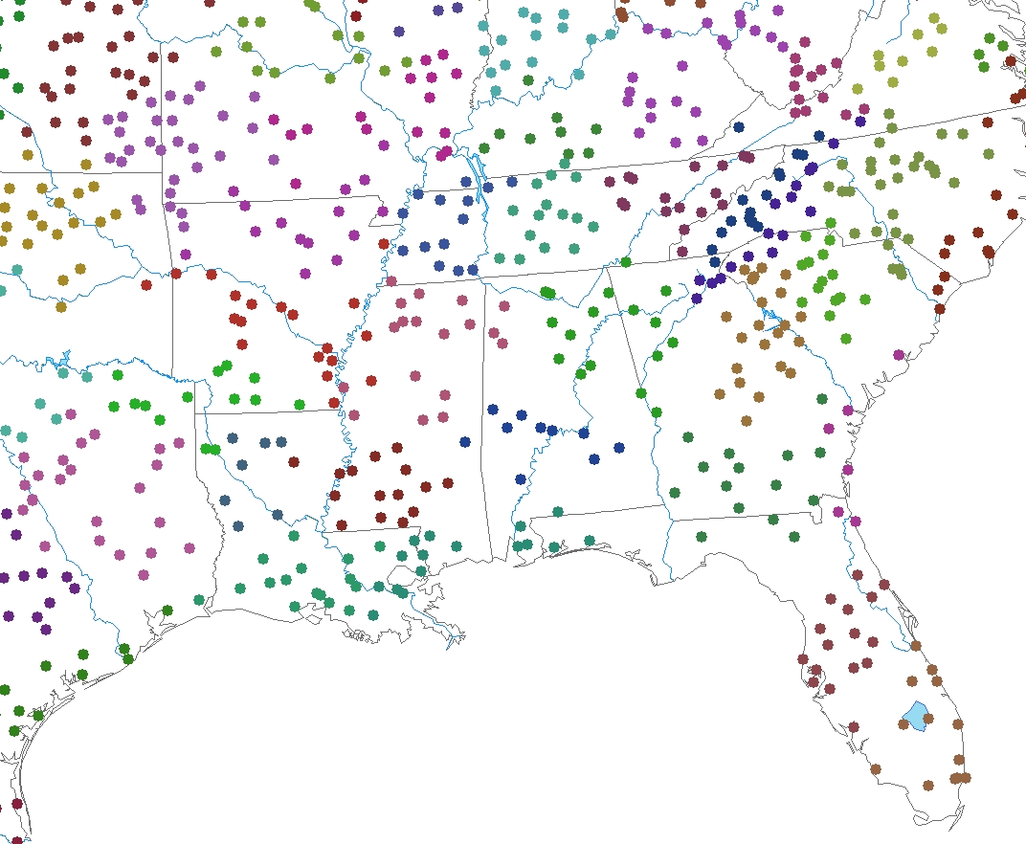
23 Discordant points for the Summer (1.1%)
7 clusters out of 135 failed Homogeneity tests (5.2%) for the Summer season
For all Seasons, 80 clusters passed all Homogeneity tests

Slide 36
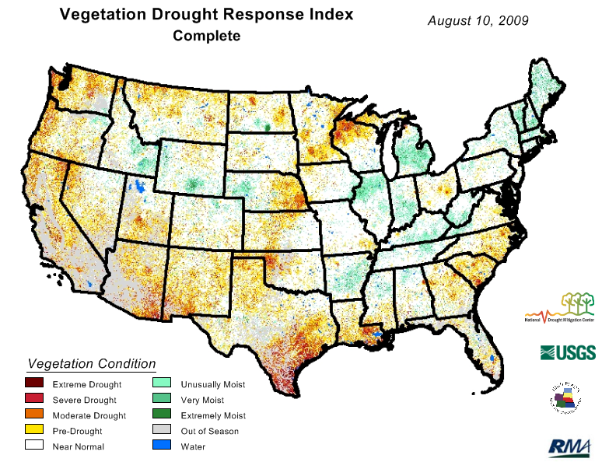
Vegetation Drought Response Index (VegDRI)

Slide 37
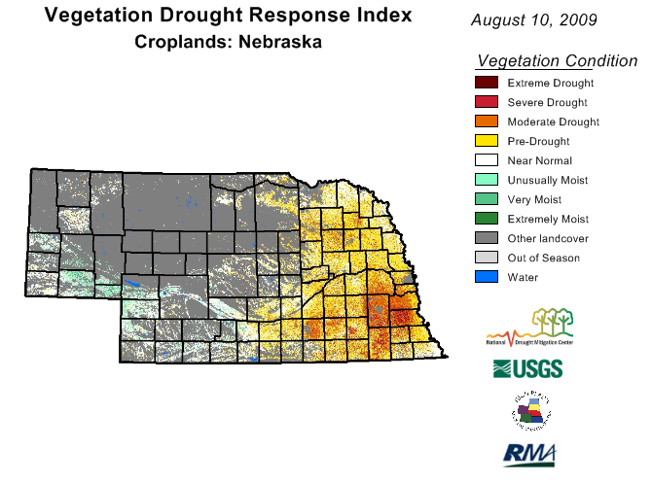
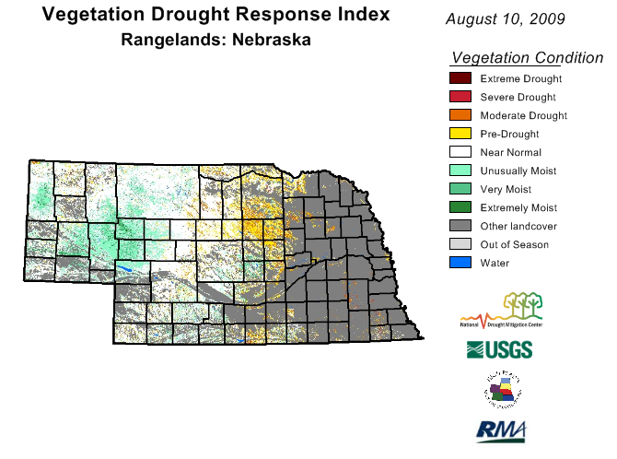
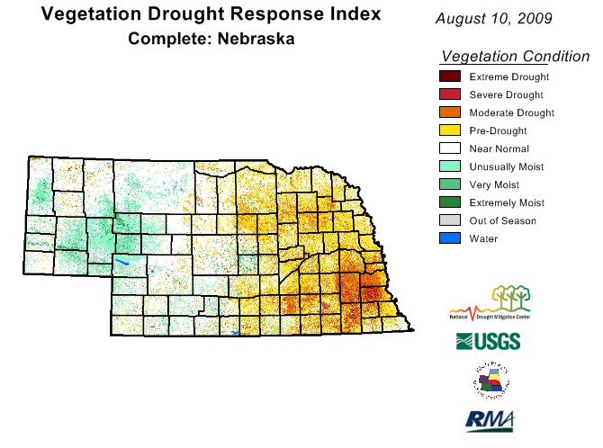

Slide 38
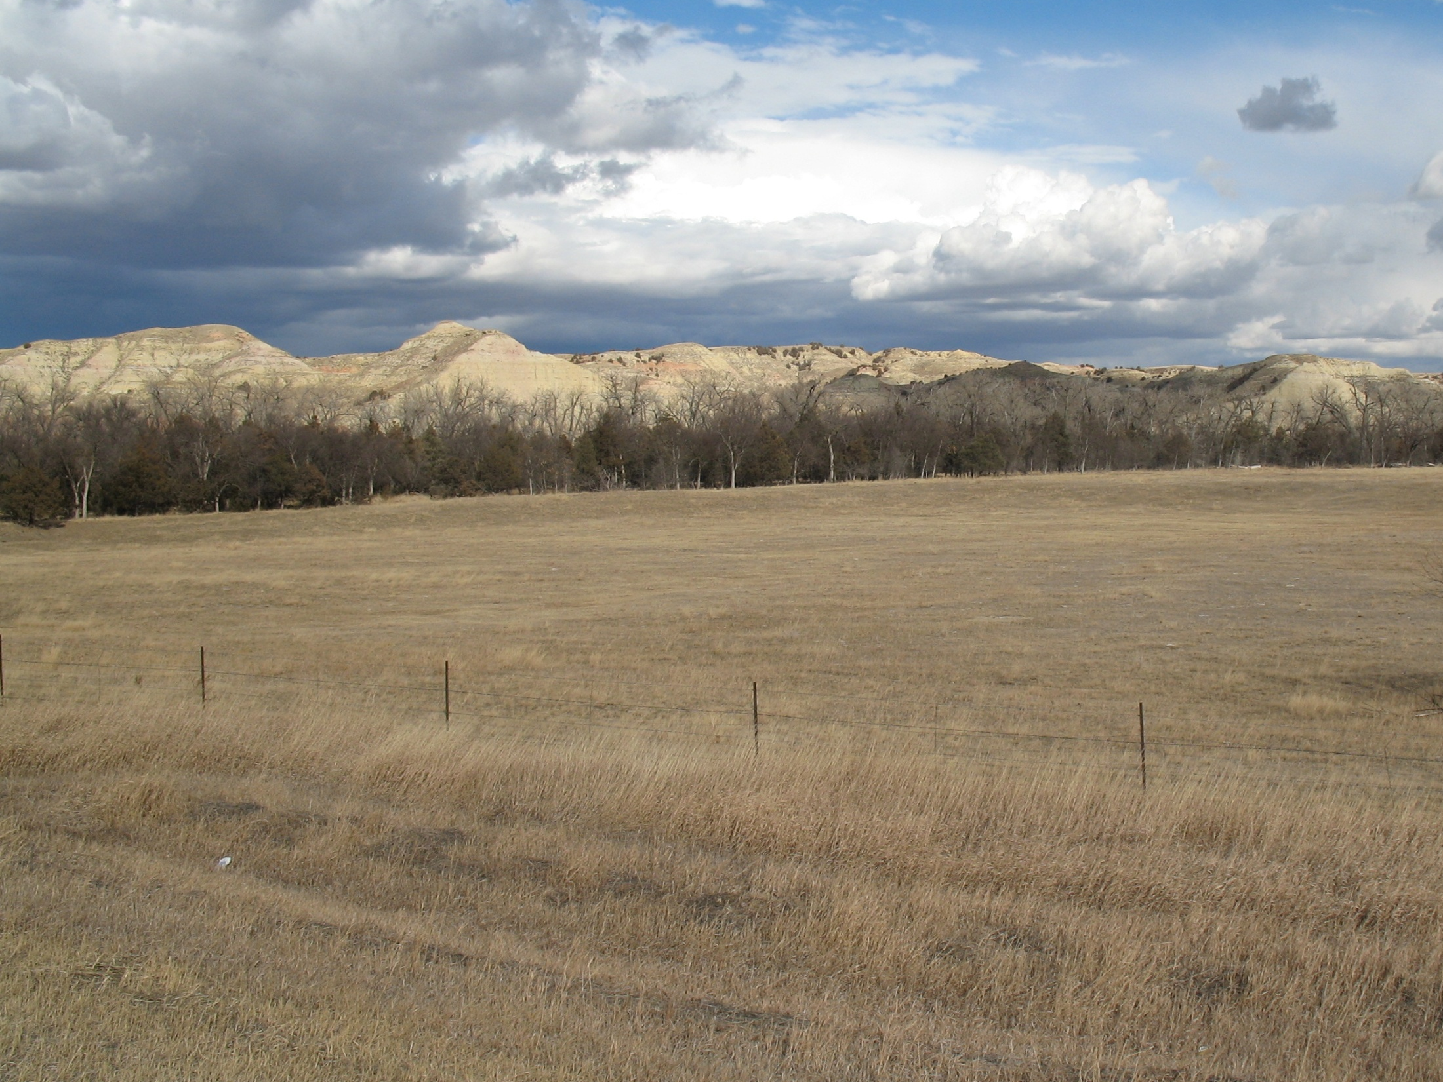
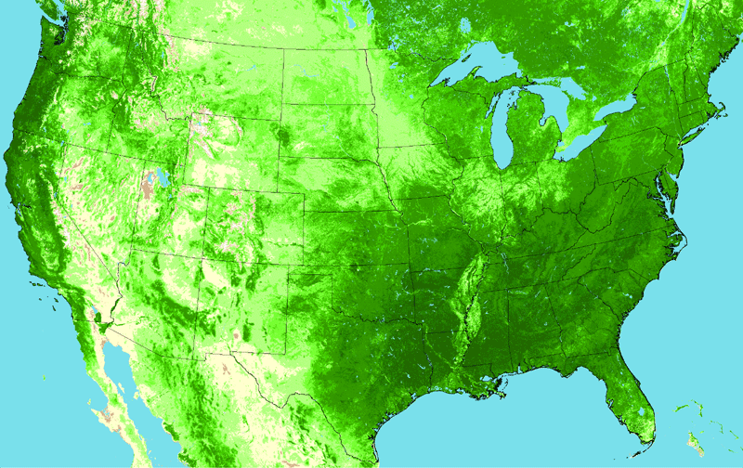
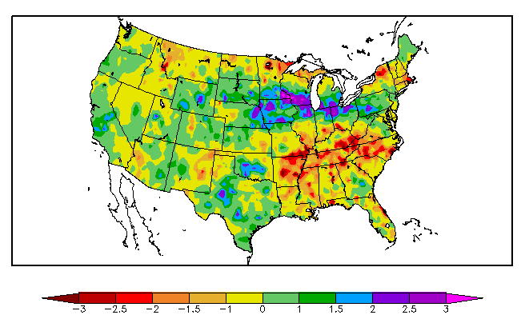
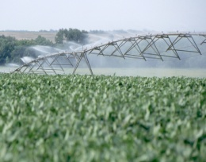
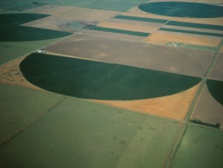
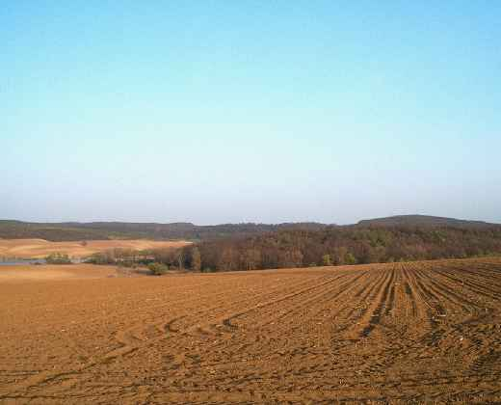

VegDRI - An Integrated Approach
Remote Sensing
Component
Climate
Component
Biophysical
Component
+
+
Role: Satellite-based observations provide information on the
spatial distribution and general condition of vegetation.
(+) Spatially detailed information about vegetation across large
geographic areas.
(-) Difficult to discriminate drought impacted areas from locations
under other types of environment stress (flooding, fire, hail, &
pests) or experiencing land use change.

Slide 39
VegDRI - An Integrated Approach
Remote Sensing
Component
Climate
Component
Biophysical
Component
+
+
Role: Climate-based drought index maps provide a ‘broad-scale’ measure
of dryness that can be used for interpretation of the vegetation stress
recorded in the satellite observations.
    - Drought areas typified by below average vegetation conditions
recorded in the satellite data and drier than normal conditions in the climate data.

Slide 40
VegDRI - An Integrated Approach
Remote Sensing
Component
Climate
Component
Biophysical
Component
+
+
Role: Different characteristics of the environment are considered
that influence climate-vegetation interactions.
- land use/land cover type
- irrigation
- soil available water capacity
- elevation
- ecological setting

Slide 41




VegDRI Methodology
1. Historical Database Development
Satellite Data
Data Input Variables
1) Percent Annual Seasonal Greenness (PASG)
2) Start of Season Anomaly (SOSA)
2. Model
Development
3. Map Generation
Climate Data
1) Palmer Drought Severity
Index (PDSI)
2) Standardized Precip.
Index (SPI)
Regression
Tree
Model ⁽*⁾
Biophysical Data
1) land use/ cover type
soil available water
capacity (STATSGO)
ecoregion type
irrigation status
elevation
1-km VegDRI Map
(*) Models developed from a 20-year historical record (1989 – 2008)
of bi-weekly climate and satellite observations at 2,200+ weather
station locations.
Biophysical variables are static over time.

Slide 42
The Standard Precipitation Index (SPI)
Overview: The SPI is an index based on the probability of precipitation for any time scale.
Who uses it: Many drought planners appreciate the SPI’s versatility.
Pros: The SPI can be computed for different time scales, can provide early warning of drought and help assess drought severity, and is less complex than the Palmer.
Cons: Values based on preliminary data may change.
Developed by: T.B. McKee, N.J. Doesken, and J. Kleist,
Colorado State University, 1993.

Slide 43
SPI Methodology
The SPI was designed to quantify the precipitation deficit for multiple time scales
These time scales reflect the impact of drought on the availability of the different water resources
Soil moisture conditions respond to precipitation anomalies on a relatively short scale. Groundwater, streamflow, and reservoir storage reflect the longer-term precipitation anomalies
For these reasons, McKee et al. (1993) originally calculated the SPI for 3–, 6–,12–, 24–, and 48–month time scales.

Slide 44
SPI Methodology
The SPI calculation for any location is based on the long-term precipitation record for a desired period. This long-term record is fitted to a probability distribution, which is then transformed into a normal distribution so that the mean SPI for the location and desired period is zero (Edwards and McKee, 1997)
Positive SPI values indicate greater than median precipitation, and negative values indicate less than median precipitation
Because the SPI is normalized, wetter and drier climates can be represented in the same way, and wet periods can also be monitored using the SPI.

Slide 45
NDMC SPI Products
Updated daily for several time frames using near real time data from the ACIS data stream from the Regional Climate Centers
SPI map is generated by using Grid Analysis and Display System (GrADS). The discrete station SPI data are interpolated using a Cressman objective analysis. The grid resolution is 0.4 degrees

Slide 46
SPI data used in the U.S. Drought Monitor
D0 Abnormally Dry: SPI value of -0.5 to -0.7
D1 Moderate Drought: -0.8 to -1.2
D2 Sever Drought: -1.3 to -1.5
D3 Extreme Drought: -1.6 to -1.9
D4 Exceptional Drought: -2.0 or less
NDMC Daily Gridded SPI Product

Slide 47
NDMC Drought Impact Reporter
The National Drought Mitigation Center developed the Drought Impact Reporter in response to the need for a national drought impact database for the United States. Drought impacts are inherently hard to quantify, therefore there has not been a comprehensive and consistent methodology for quantifying drought impacts and economic losses in the United States.
The Drought Impact Reporter is intended to be the initial step in creating a comprehensive database. The principal goal of the Drought Impact Reporter is to collect, quantify, and map reported drought impacts for the United States and provide access to the reports through interactive search tools.

Slide 48
NDMC Drought Impact Reporter
The DIR came on-line in July 2005
Since then we’ve logged more than 9,600 impacts, mostly in real-time but a few historic.
  90% from media reports
  10% from government and / or the general public
Uses drought impacts submitted by the public as well as media reports from more than 5,000 media sources
Moving to a new GIS interface in early 2009

Slide 49
NDMC Drought Impact Reporter
From 1/1/2006 through 10/15/2008 there were 7,096 unique impacts added
89% of these were from media reports, the rest from the public or government reports
31% of these were categorized as water/energy related
19% of these were categorized as ag related

Slide 50


Slide 53


Impact Categories
Current
Planned
Notes:
The new Drought Impact Reporter will include more categories.

Slide 54
NDMC Drought Impact Reporter
Allows the public to have a voice in the process of making the weekly United States Drought Monitor
http://droughtreporter.unl.edu

Slide 55

Project initiated in 2006
Project Goals: Develop a model drought planning process and web-based educational delivery system for livestock and forage producers
Collaborators: National Drought Mitigation Center, University of Nebraska-Lincoln, South Dakota State University, and Texas A&M-Kingsville

Slide 56


Slide 57


Slide 58


Slide 59


Slide 60


Slide 61


Slide 62

Thank you!
Please visit us at:
http://drought.unl.edu/
Please contact me at:
bfuchs2@unl.edu

