Slide 1
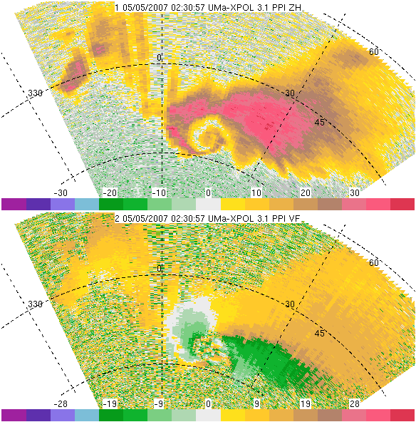
Mobile, X-band Doppler radar data collected in the 4 May 2007 Greensburg, Kansas tornadic storm
Robin L. Tanamachi
Ph.D. Candidate
OU School of Meteorology
High Plains Conference
13 August 2010

Slide 2
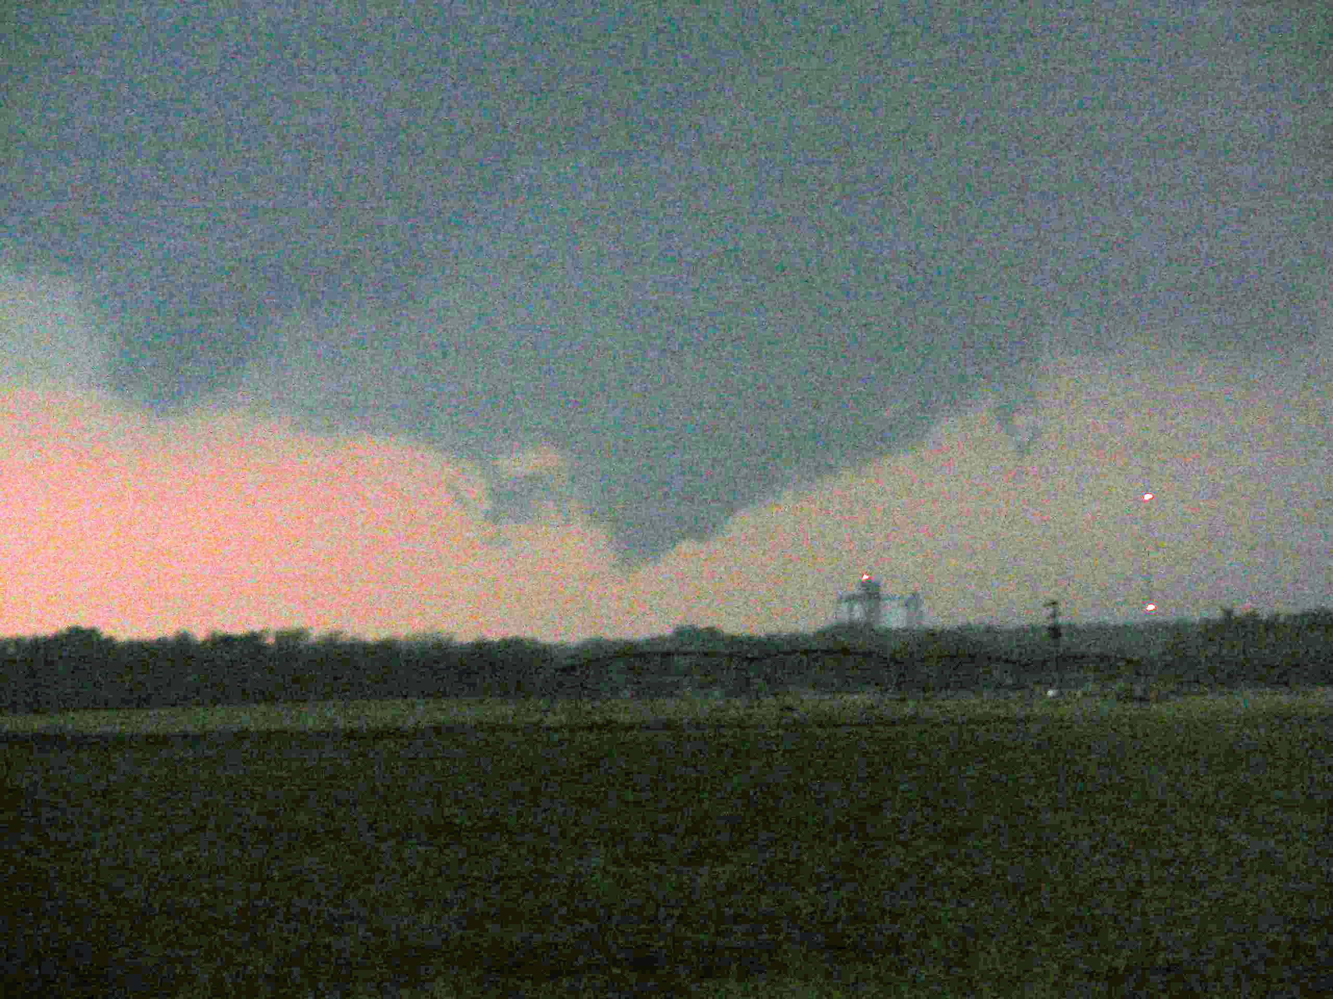
Motivation
The process of tornadogenesis (tornado formation) is not well understood (hence VORTEX2)
Many significant and violent tornadoes occur as part of a series of tornadoes (cyclic tornadogenesis)
Some storms transition between short-track cyclic and long-track cyclic tornadogenesis
We want to exploit the high spatial and temporal resolution of mobile Doppler radar data, as well as data collected at low altitudes, to illuminate this process.

Slide 3
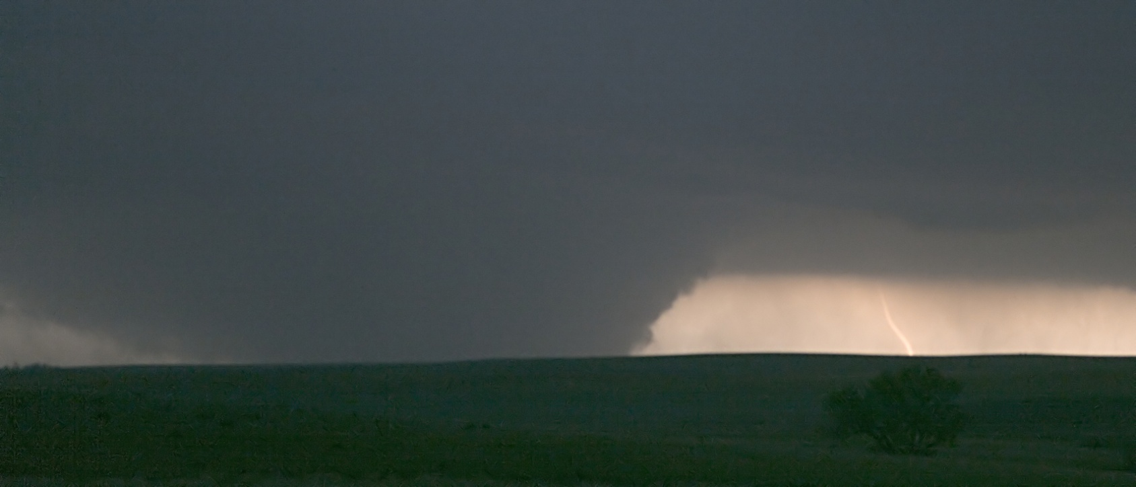
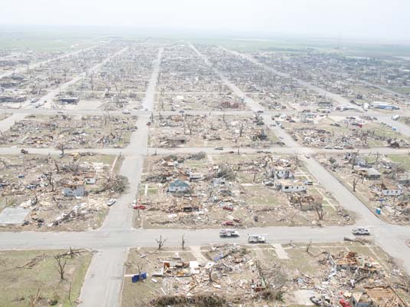
Greensburg Tornado: 5 May 2007
© 2007 Robert Fritchie
First EF-5 tornado
Strongest U.S. tornado since 1999
Widest damage path: 3.1 km (1.9 mi)
Path length: 53 km (33 mi)
11 people died
Destroyed 95% of buildings in Greensburg, Kansas
Damage: $250 million
Complex storm origin (Bluestein 2009)
Source: Lemon and Umscheid (2008), Marshall (2008)

Slide 4
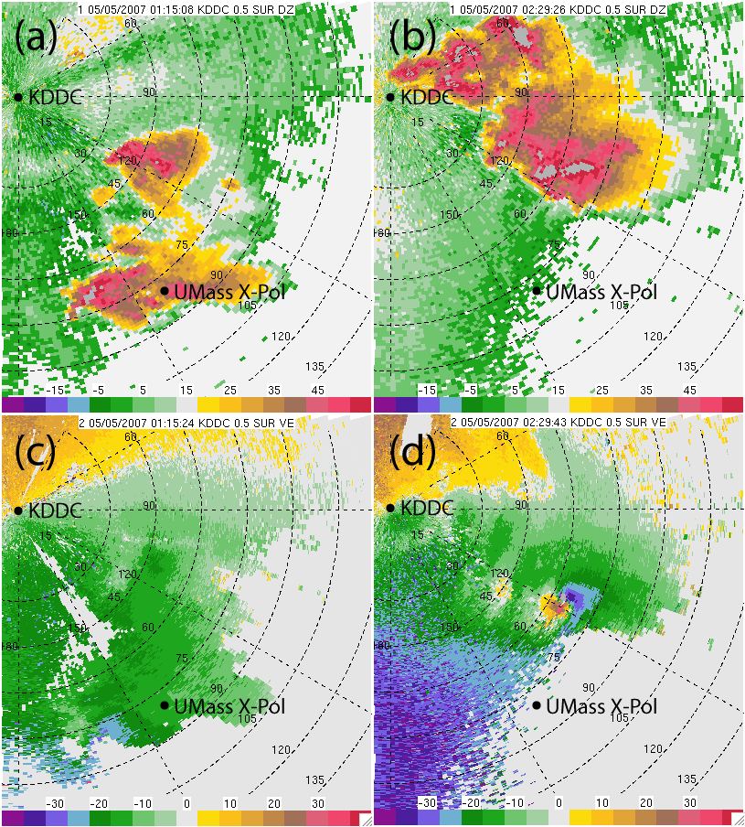
Greensburg Storm
KDDC
0.5°
0115
UTC
0230
UTC
LLJ
Notes:
These are two 0.5° WSR-88D scans from KDDC, one relatively early in the life cycle of the Greensburg storm and one later on, when the Greensburg tornado was mature and 15 minutes from hitting Greensburg. I’ve marked the location of the UMass X-Pol in both panels; it was stationary throughout its deployment.
One thing I’d like to point out is the large amount of clear-air return around Dodge City. In this data, the strengthening of the noctural 850 mb low-level jet can clearly be seen. This suggests that there was substantial modification to the low-level flow during the maturation of the Greensburg storm, and as we’ll see, this poses some challenges in the data assimilation study.

Slide 5
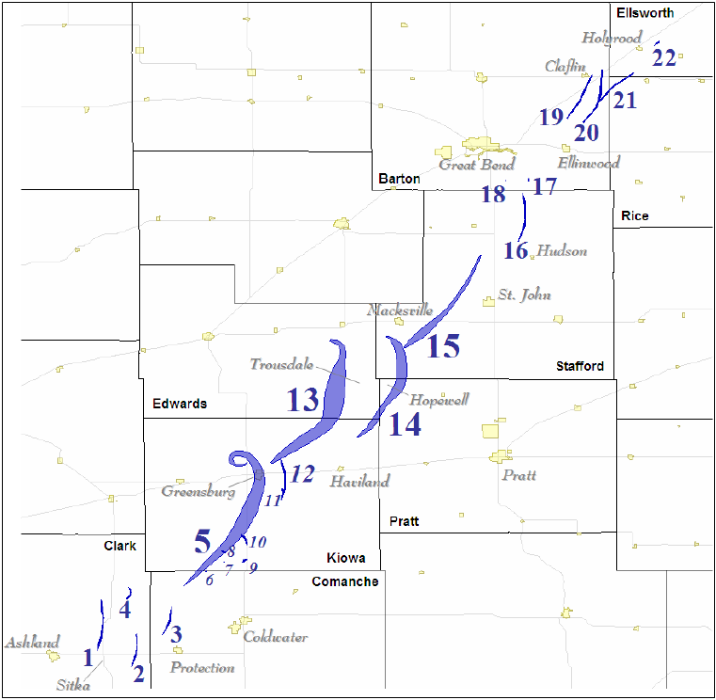
Greensburg Storm
Tornado Tracks
Graphic from Lemon and Umscheid (SLS, 2008)
Nebraska
Kansas
Oklahoma
Texas
Focus of this study
UMass X-Pol Radar

Slide 6
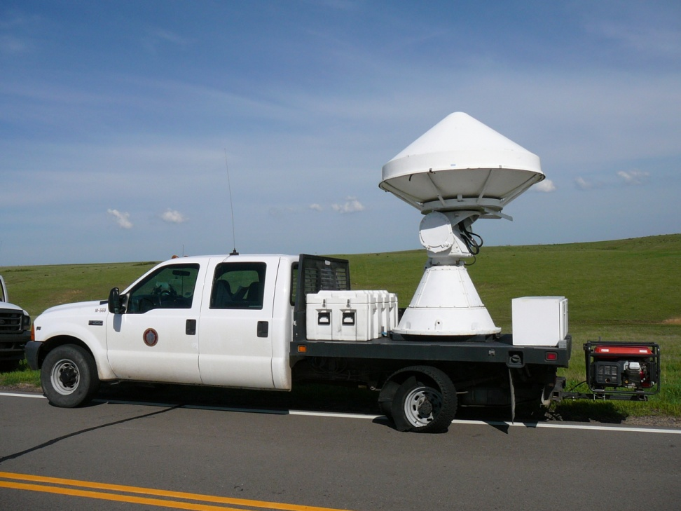
University of Massachusetts Mobile, X-band, Polarimetric Doppler Radar
X-band (3 cm wavelength)
Beamwidth: 1.2°
Max. unambiguous range: 75 km
Max. unambiguous velocity: 19.2 m s⁻¹
Range gate spacing: 150 m
UMass X-Pol 2007 configuration
Notes:
This is the UMass X-Pol radar; mounted on a truck. It has a shorter wavelength and range than the WSR-88D, but is portable. Also note that while its 3 dB beamwidth is slightly wider than that of the 88D, its range gate spacing is much smaller, thus providing high-resolution reflectivity and velocity data.

Slide 7

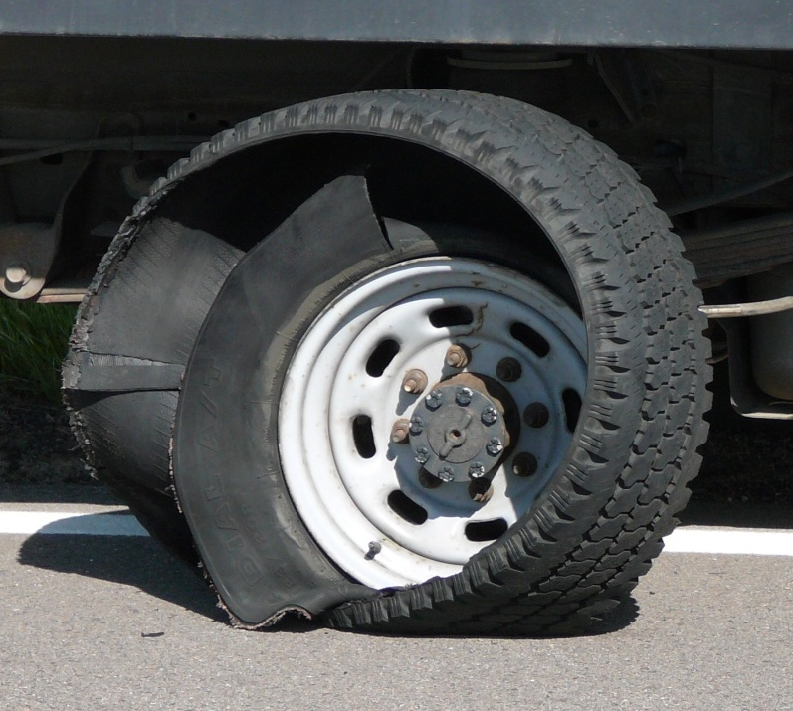
Serendipity?

Slide 8
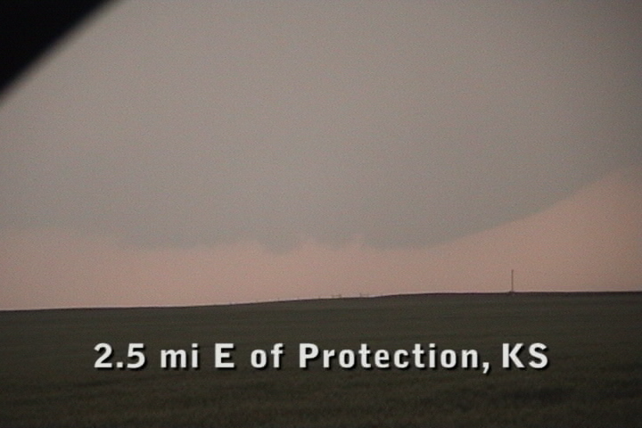
What we saw:

Slide 9
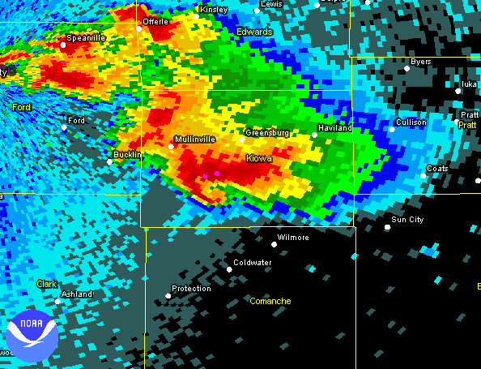
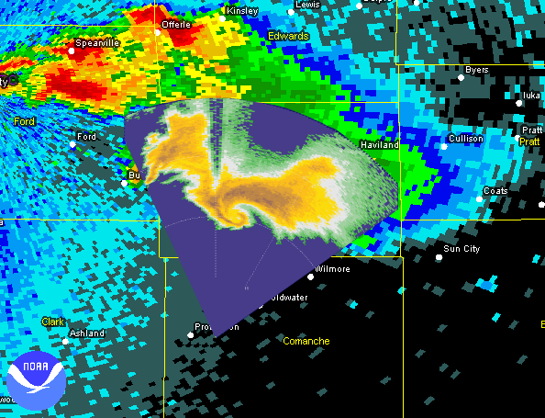
Radar coverage comparison
KDDC reflectivity, 0.5°, 0225 UTC
UMass X-Pol reflectivity, 3.0°, 0226 UTC
Notes:
The UMass X-Pol blew the tire on the road between Ashland and Bucklin, Kansas. We got the tire changed in Protection, and just as we got east of the town, the Greensburg storm passed by to our west. We decided not to look a gift horse in the mouth and just started collecting data. We collected data on the Greensburg storm and caught the development of the Greensburg tornado as well as several smaller tornadoes that occurred beforehand.
Please indulge me for a couple of minutes while I show you a video clip of our deployment. (No more than 3 min.)

Slide 10
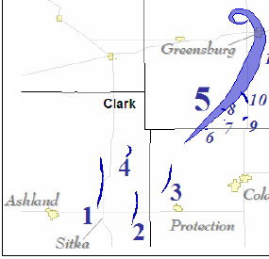
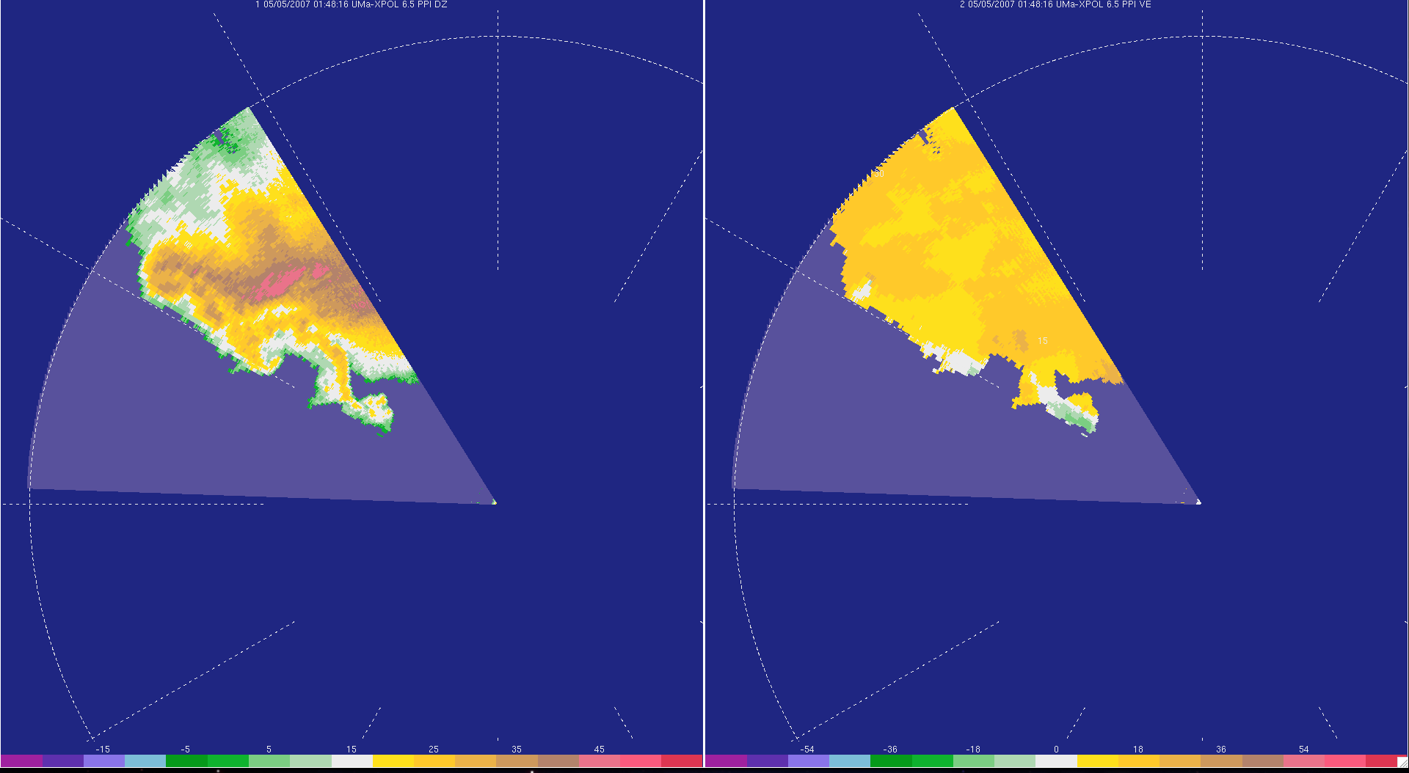
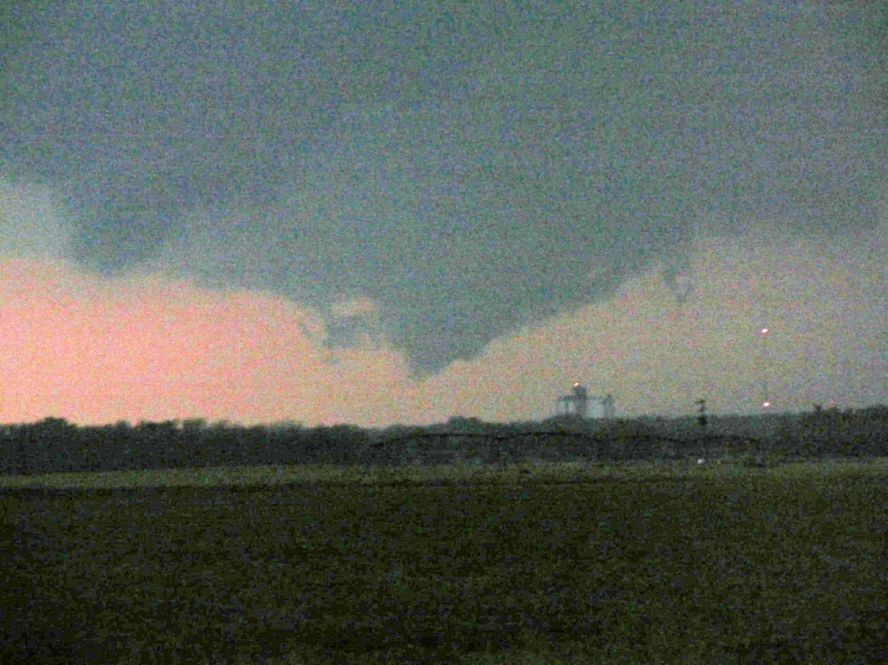
UMass X-Pol data
#4
#4
#2
#2
#3
#3
#3
#2
01:48 UTC; 6.5° elev.
© R. Tanamachi
Notes:
At 01:48 UTC, one tornado is on the ground just west of Protection, while a second circulation is forming closer to the radar.

Slide 11
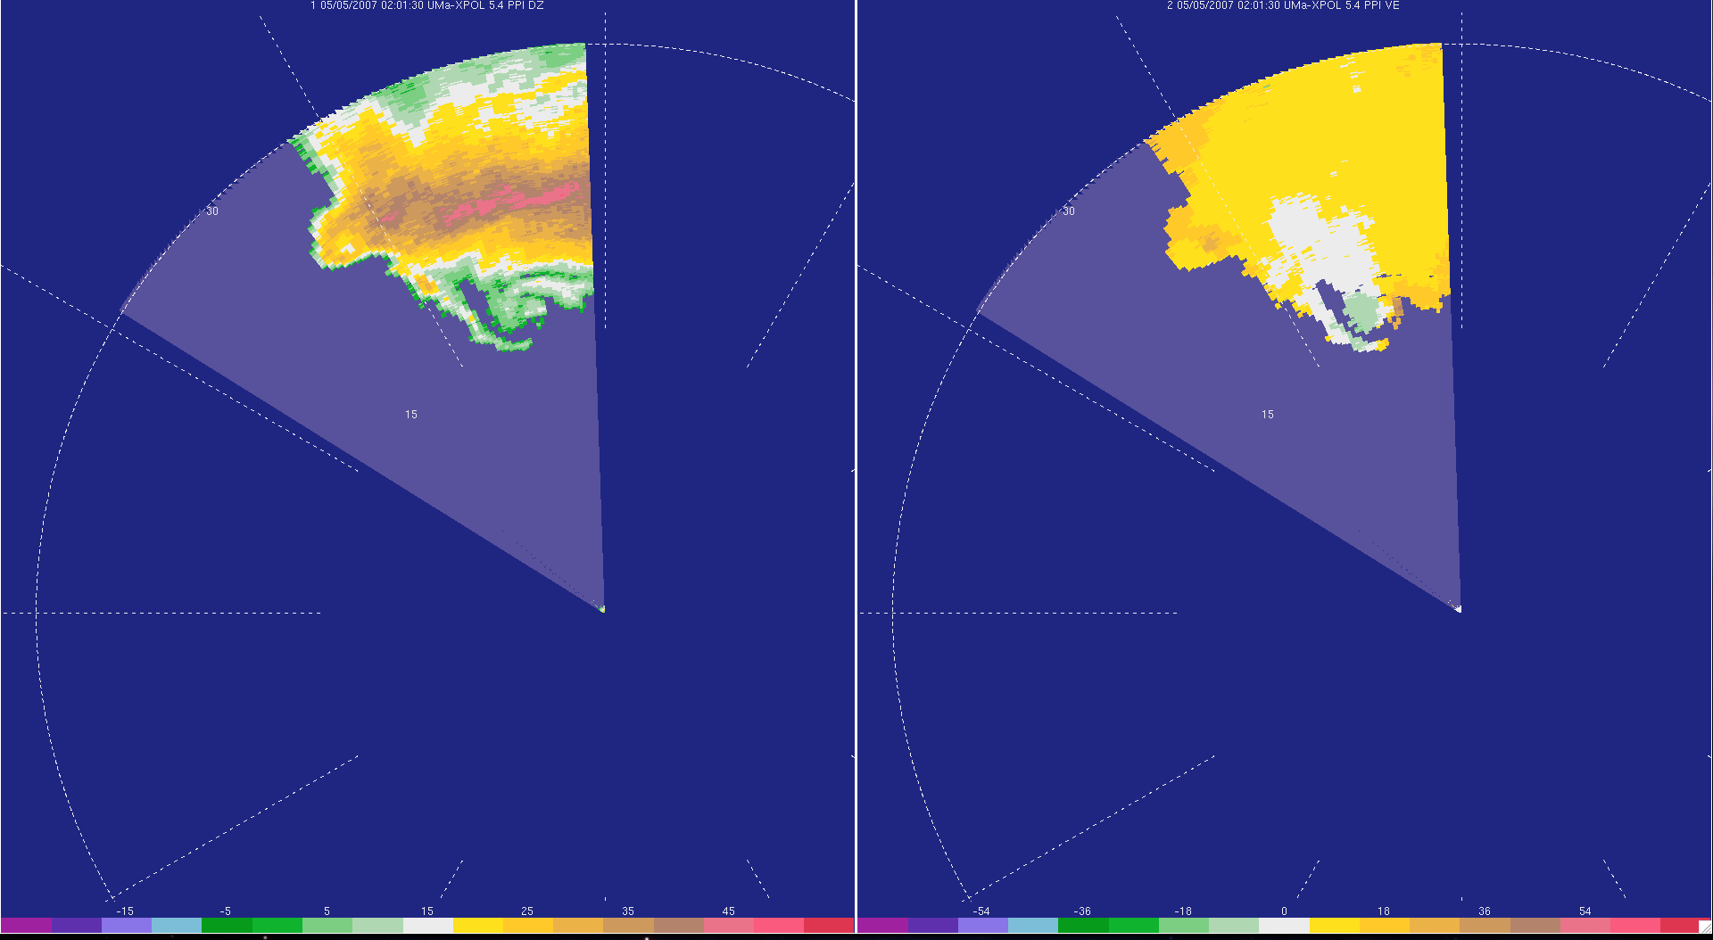
UMass X-Pol data
#3
(remnant)
#3
(remnant)
#5
#5
02:01 UTC; 4.0° elev.
Notes:
This sweep was collected just as the Greensburg tornado touched down. The circulation and spiraling inflow bands are evident.

Slide 12
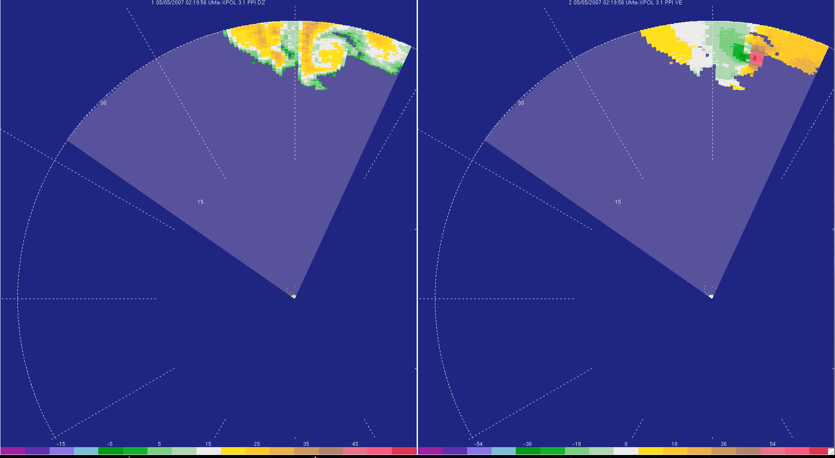
UMass X-Pol data
#5
#5
02:20 UTC; 3.1° elev.
Notes:
The tornado intensified quickly after about 15 minutes on the ground; this sweep shows winds exceeding 50 m s-1 near the core of the tornado.

Slide 13
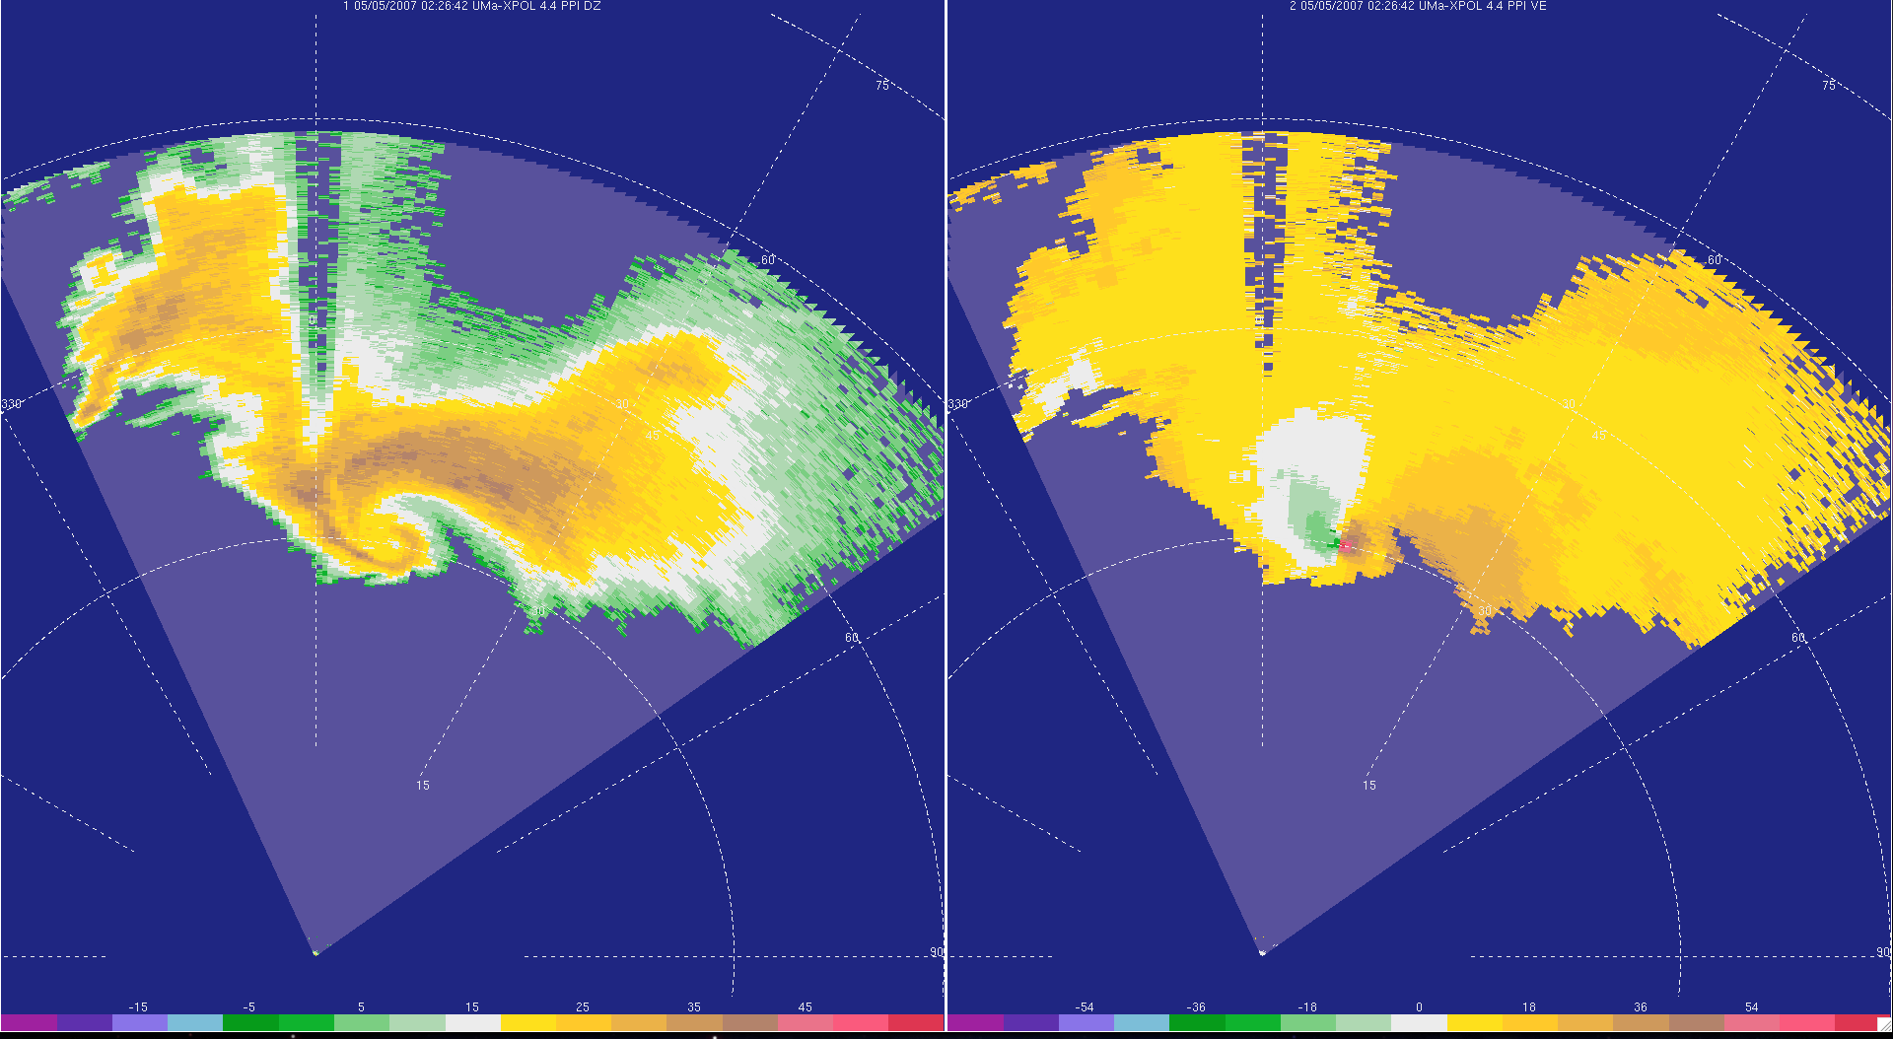
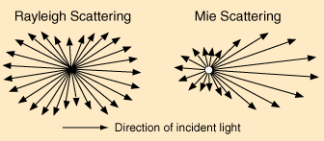
UMass X-Pol data
Large hail attenuating X-band signal
#5
#10
#5
#10
02:27 UTC; 4.4° elev.
Notes:
Eventually, we had the sense to switch to a longer range of 60 km). Here we capture much more of the storm structure. However, the effects of attenuation on the radar signal are apparent. At about this time, hail with diameter at or exceeding 3 cm (the wavelength of the radar) was reported. The attenuation is a result of scattering by the hail of the radar signal in the Mie regime. When particles are much smaller than the wavelength, radiation is scattered forward and backward in similar proportions. However, when the size of the particles is close to that of the radar wavelength, more radiation is scattered forward rather than backward, decreasing the power returned to the radar. This complicates interpretation of the results slightly.

Slide 14
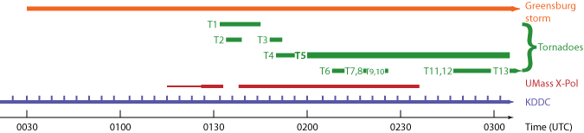
Greensburg radar coverage
Greensburg struck
Moved truck
Battery
KDDC
UMass X-Pol
65 – 75 km from storm
Continuous coverage
VCP 12 (“storm mode”)
Volumes every 4.1 min
10 – 55 km from storm
Single-elevation scans from 0115 - 0126 UTC
Volumetric sector scans (3° to 10°, 15°, 20°) from 0126 - 0236 UTC
Notes:
This is a timeline showing the relative coverage of the two radars and the times of each of the tornadoes. The thin red line indicates that we were collecting single-elevation scans at 3 or 4 degrees; the thick line indicates when we started collecting volume scans. There’s a gap when we had to reposition the truck in order to avoid beam blockage. In the prospectus, I provide a table of the different coverage sectors for the UMass X-Pol.

Slide 15
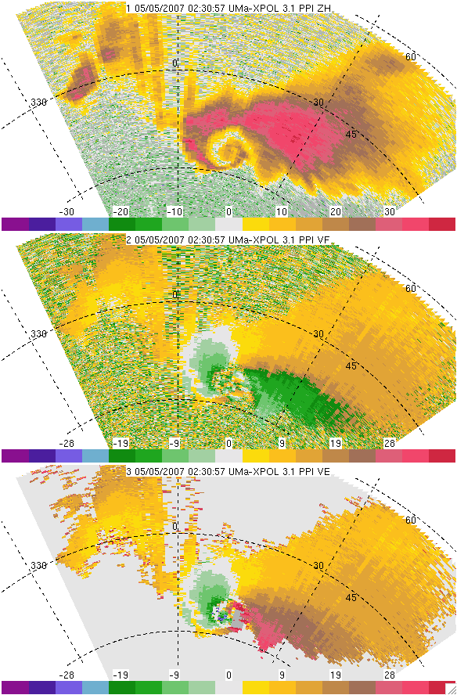
UMass X-Pol data: caveats
Z (uncalibrated)
Elev. angle 3.1°
0230 UTC
V_{r},
raw
Reflectivity not
well calibrated
(~30 dBZ < KDDC)
Dual-pol data incomplete
  imaginary phase not recorded
  Z_{DR}, ρ_{hv} probably OK
  No K_{DP} or Φ_{DP} available
Truck may not have been oriented exactly N-S (± 3°); pitch/roll ± 1°
Manual V_{r} dealiasing
V_{r},
edited
Notes:
We deployed the UMass X-Pol about 4 km east of Protection, KS which is about 50 km SSW of Greensburg.
We started off taking single elevation scans for about 10 minutes. At 0127 UTC, we started taking volume scans, gradually increasing the number of elevation angles, the width of the sector, and the range (from 30 to 60 km) as it became obvious that the storm was ramping up to tornadogenesis. We ended up with 81 radar volumes in total, with maximum elevation angles ranging from 10 to 20 degrees. In all, we captured the formation of several small tornadoes prior to the Greensburg EF-5.
One big caveat about this data set is that our exact orientation isn’t known. I was driving and I tried to keep the truck as level as possible and as straight (in a north-south direction) as possible. But, we were parked on a dirt road, and didn’t have working levelers on the truck. If our pitch and roll were off by as much as 2°, at a range of 50 km that translates to 1.7 km, and that’s about one grid space in the horizontal direction in this 2 km experiment.
In spite of these caveats, we are excited about the potential research questions we can address with this data set. The one that I’m going to focus on today is whether these data can improve an NWP model simulation of the Greensburg storm via assimilation.
If our pitch and roll were off by as much as 2°, at a range of 50 km that translates to 1.7 km, and that’s about one horizontal grid space in this 2 km-resolution experiment.

Slide 16
Z
V_{r}
#5
#5
ρ_{hv}
Z_{DR}
#5
#5

Slide 17
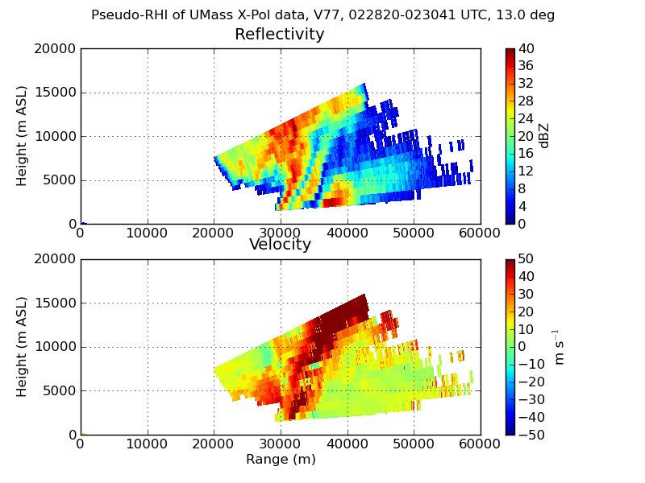
Weak-echo
hole / tube
Attenuation
(uncalibrated)
Echo overhang
BWER

Slide 18
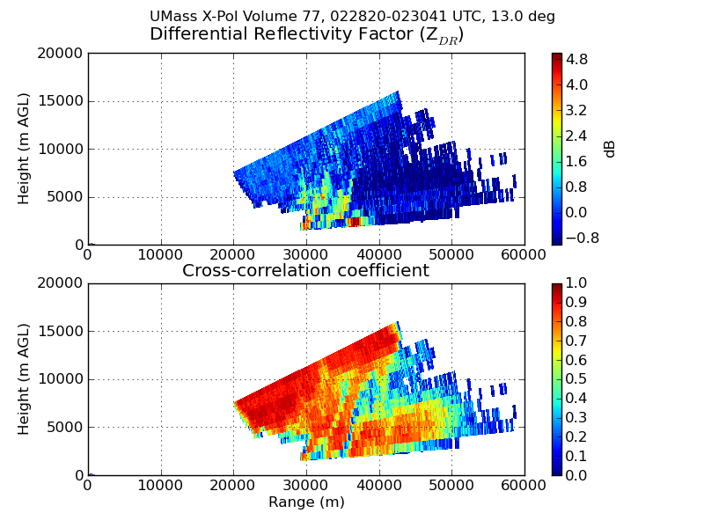
Low-Z_{DR}
hole / tube
(ρ_{hv})
Low-ρ_{hv}
hole / tube

Slide 19
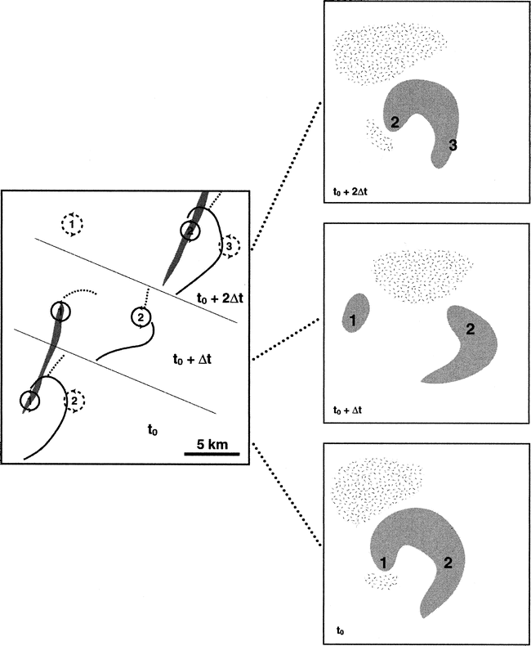

Dowell and Bluestein (2002, Part II): Cyclic tornadogenesis in the 8 June 1995 McLean, Texas storm resulted from “a mismatch between the horizontal motion of successive tornadoes and the horizontal velocity of the main storm-scale updraft and downdraft.”
As a corollary, long-track tornadoes resulted when the horizontal motion of a tornado closely matched that of its associated updraft and downdraft.
“Vortex shedding” model
Downdraft
Updraft
Z (uncalibrated)

Slide 20
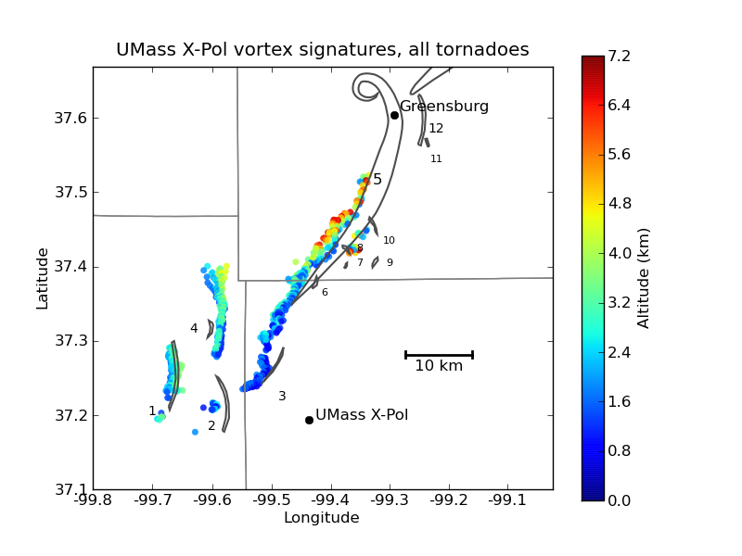
#4 tilts NE
w/height

Slide 21
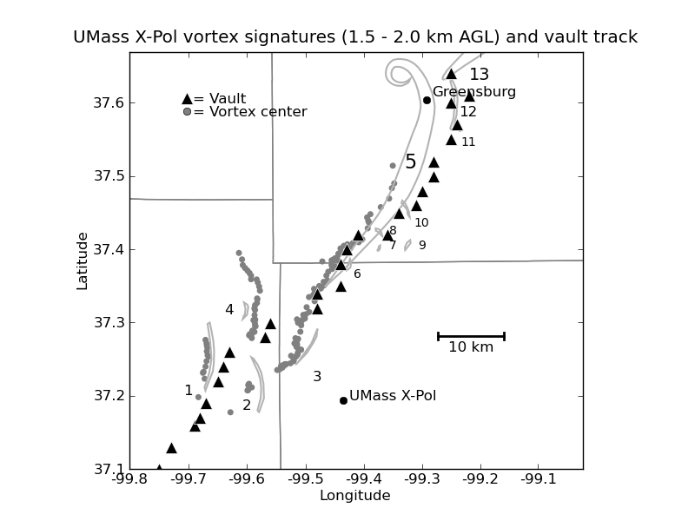

Slide 22
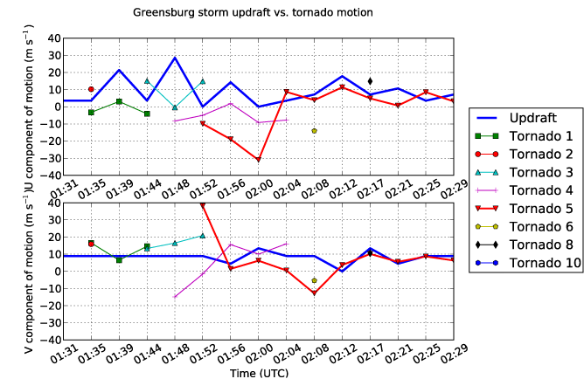
Mature Greensburg tornado closely matched updraft motion
U
V

Slide 23
Future work
GBVTD analyses of UMass X-Pol data, e.g. Lee and Wurman (2005) and Tanamachi et al. (2007)
Dual-Doppler analyses between KDDC and UMass X-Pol (Jana Houser, OU)
High-resolution EnKF experiments (Δx = Δy = 1 km, 500 m, 250 m; Δz = 200 m, 100 m) assimilating UMass X-Pol V_{r} data

Slide 24
Acknowledgments
NSF grant ATM-0637148 and ATM- 0934307
Ph.D. Committee:
  Howie Bluestein
  Lou Wicker
  Alan Shapiro
  Ming Xue
  Robert Palmer
  John Albert
Steve Frasier
Kery Hardwick
Les Lemon
Mike Umscheid
Jeff Hutton
David Dowell
SoM Staff
Vijay Venkatesh
Dan Dawson
Aaron Botnick
Nate Snook
Ryan May
Ted Mansell
Chuck Doswell
Python / Matplotlib
And many, many others…

Slide 25
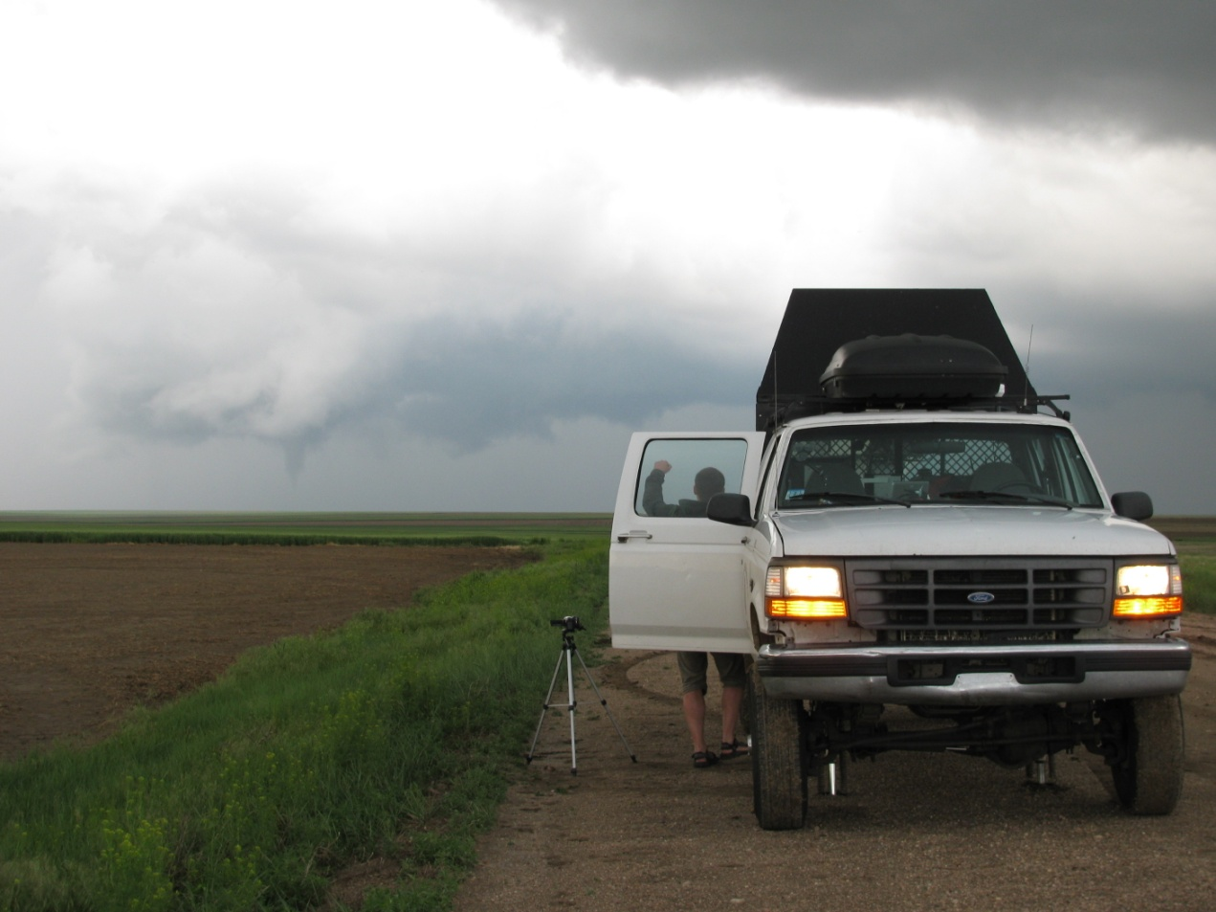
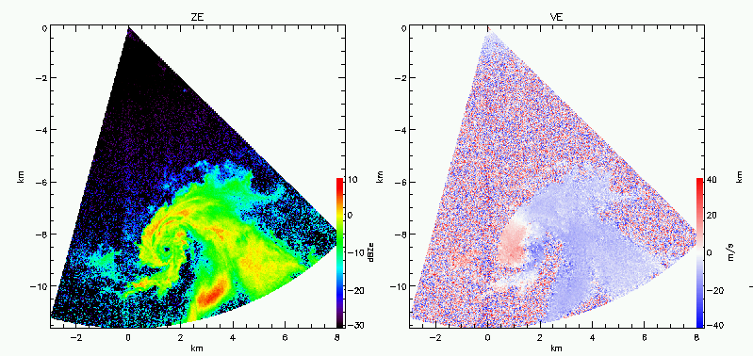
VORTEX2:
25 May 2010 near Tribune, Kansas
UMass W-band radar
Z
V_{r}
2316 UTC
0.7°

