Slide 1
May 3, 1987 satanta, ks tornado…a case study
Michael J. Scott
National Weather Service Dodge City

Slide 2
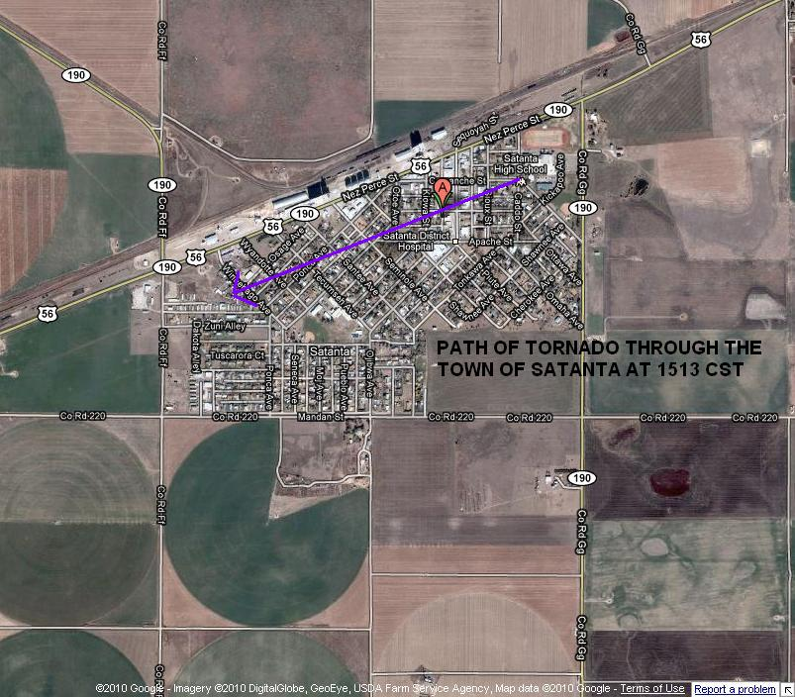

Slide 3
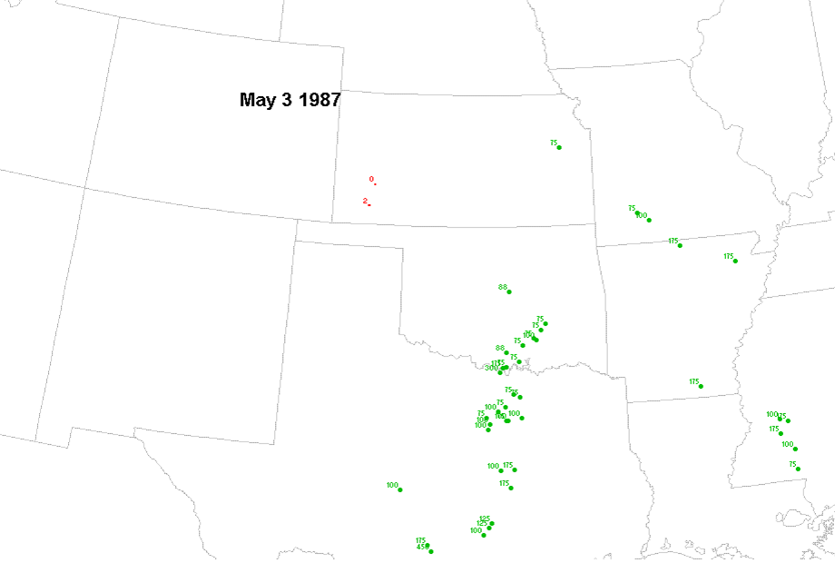
Storm Reports Plotted using John Hart’s SeverePlot Program

Slide 4
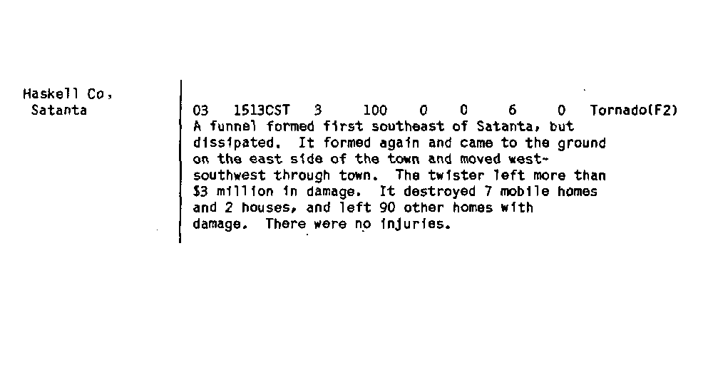
STORM REPORT FROM NCDC STORM DATA MAY 1987

Slide 5
500 MB ANALYSES

Slide 6
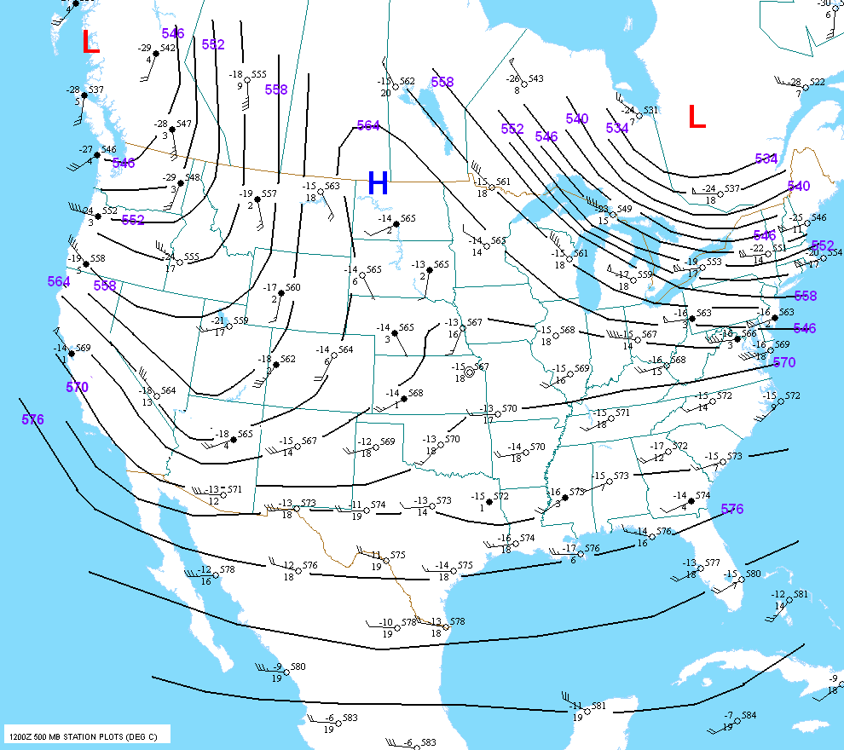
May 2 1987 12 UTC

Slide 7
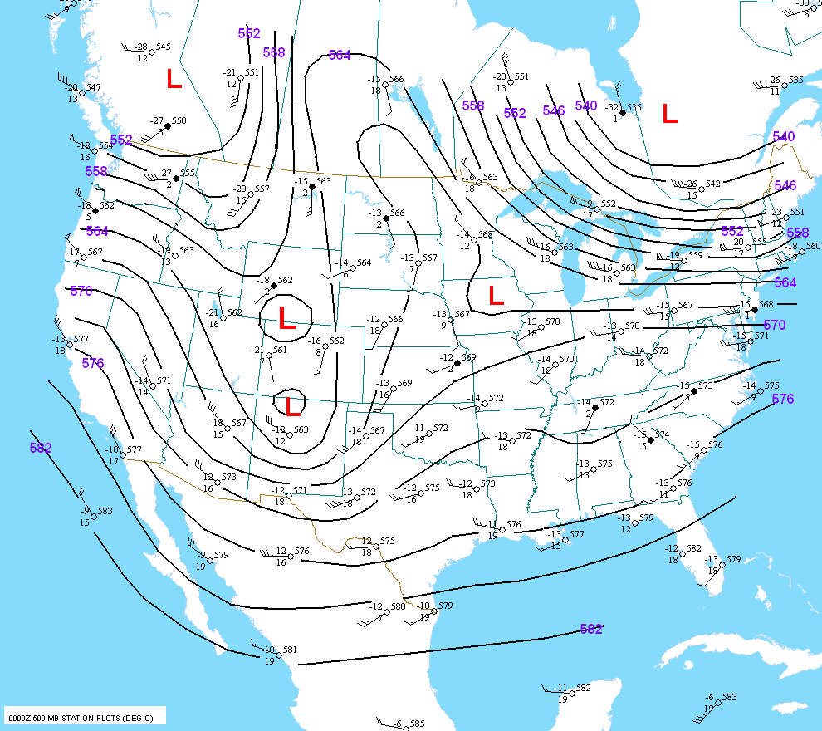
May 3 1987 00 UTC

Slide 8
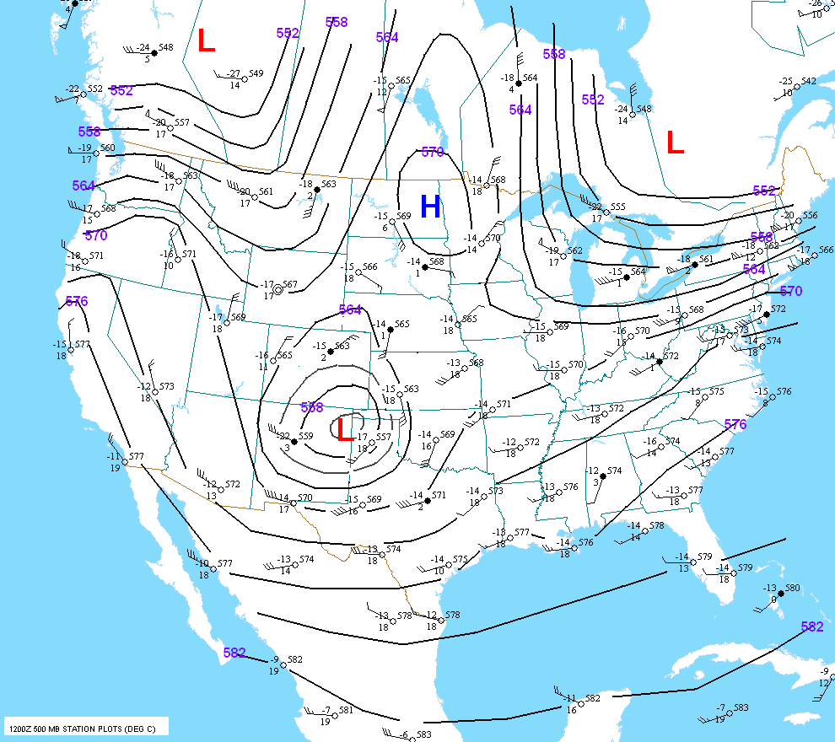
May 3 1987 12 UTC

Slide 9
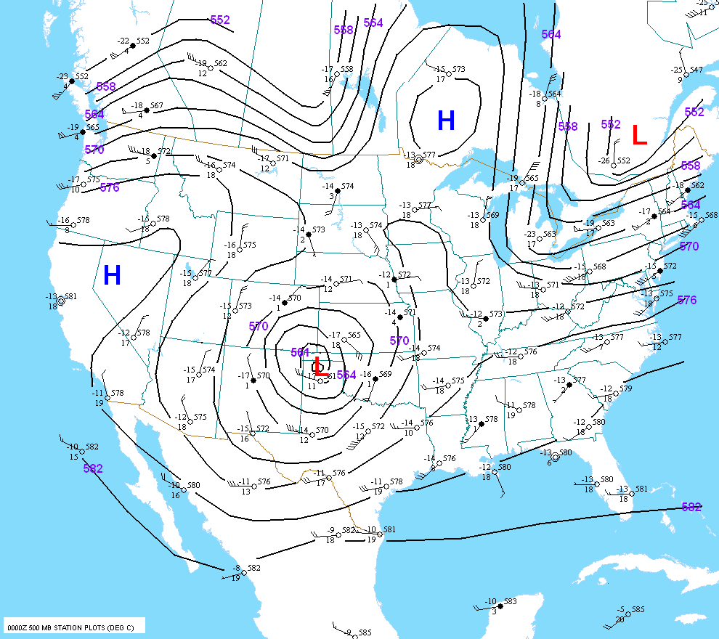
May 4 1987 00 UTC

Slide 10
250 MB ANALYSES

Slide 11
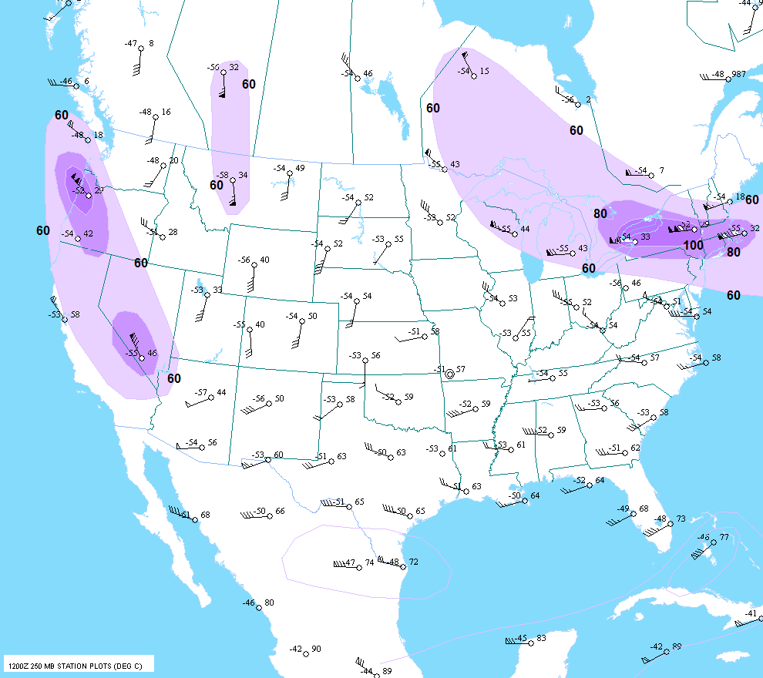
May 2 1987 12 UTC

Slide 12
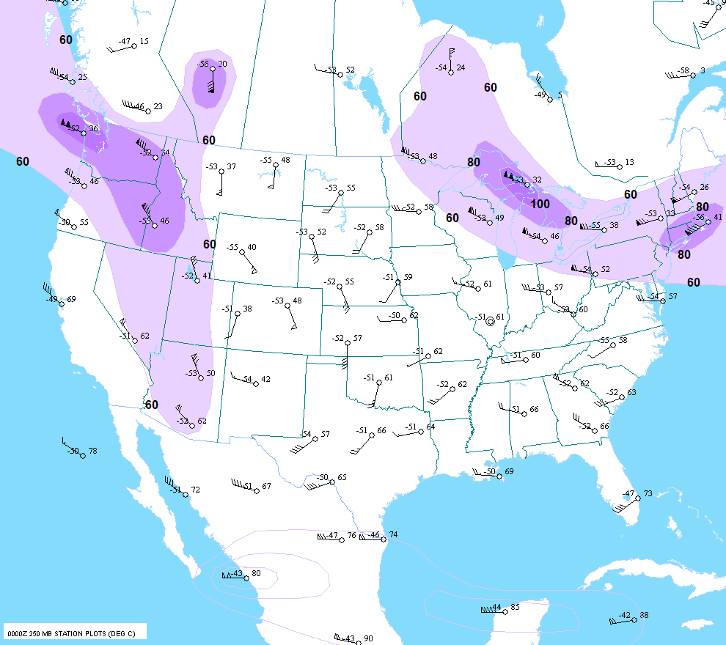
May 3 1987 00 UTC

Slide 13
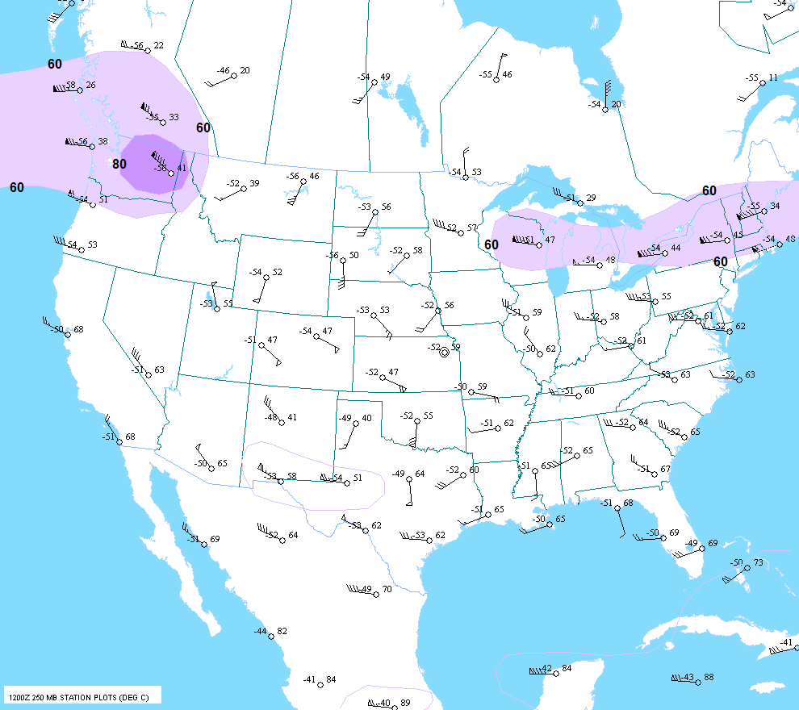
60
May 3 1987 12 UTC

Slide 14
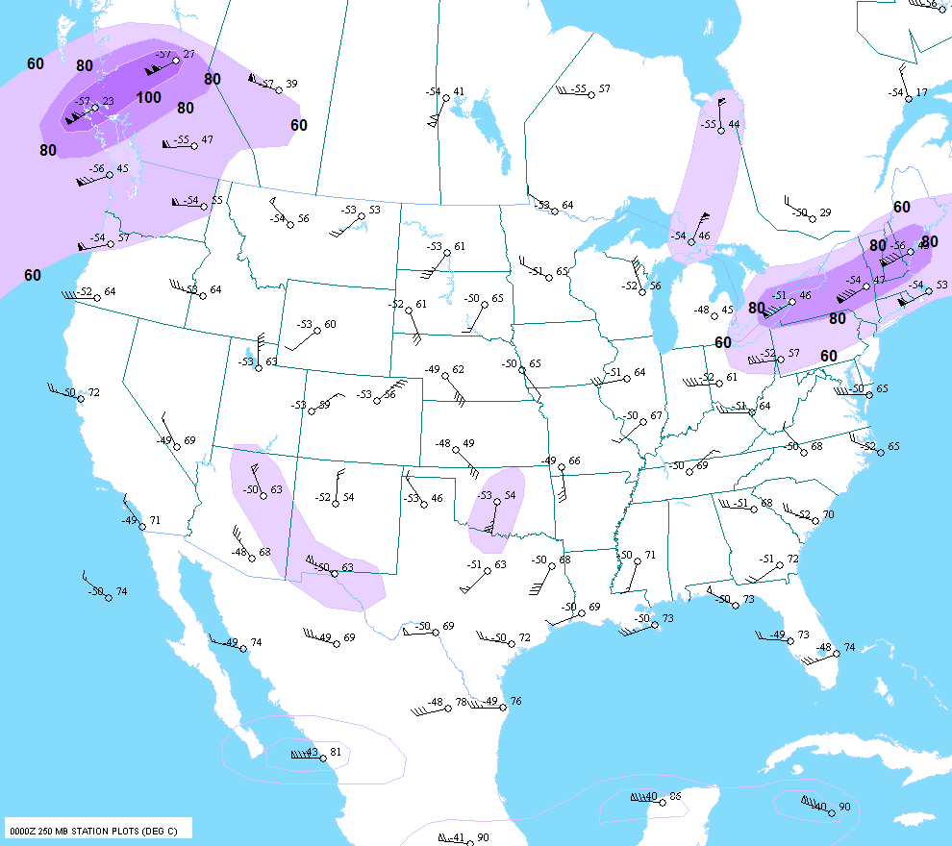
60
60
May 4 1987 00 UTC

Slide 15
SURFACE ANALYSIS

Slide 16
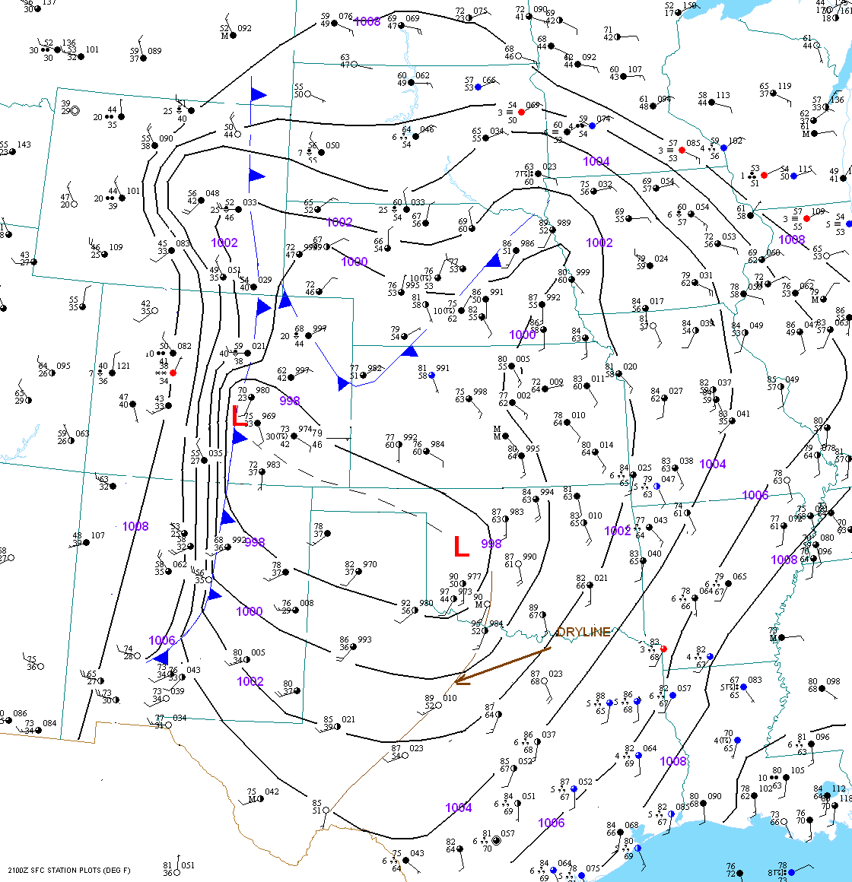
2nd 21z

Slide 17
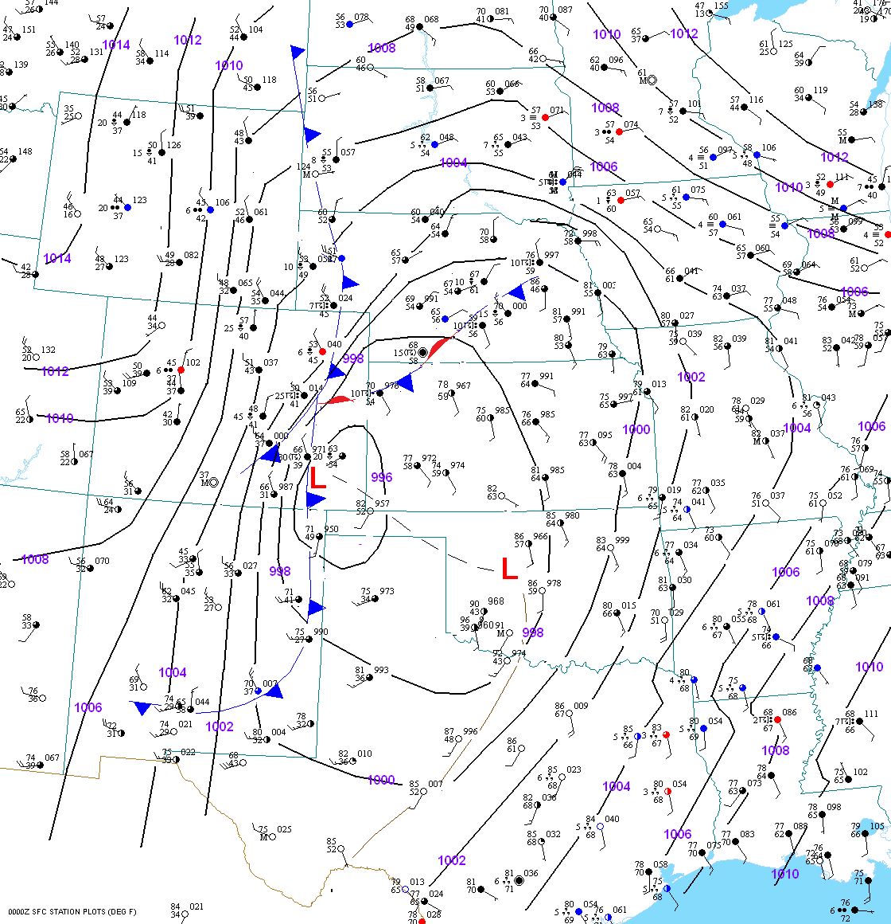
3rd 00z

Slide 18
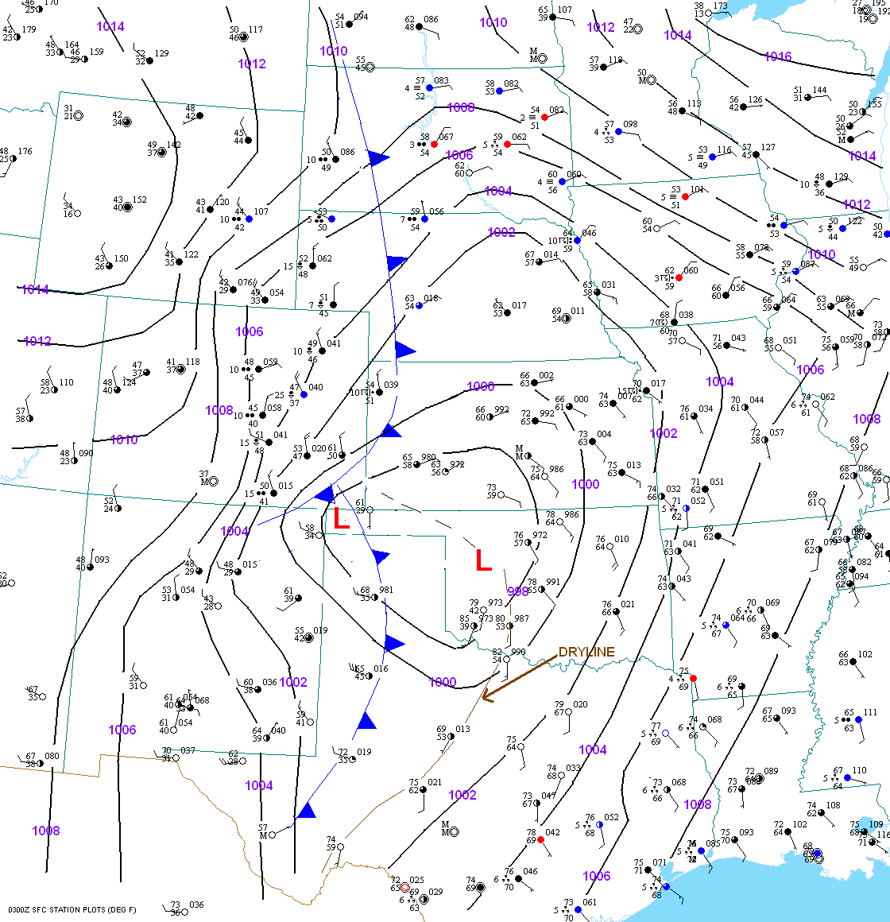
3rd 03z

Slide 19
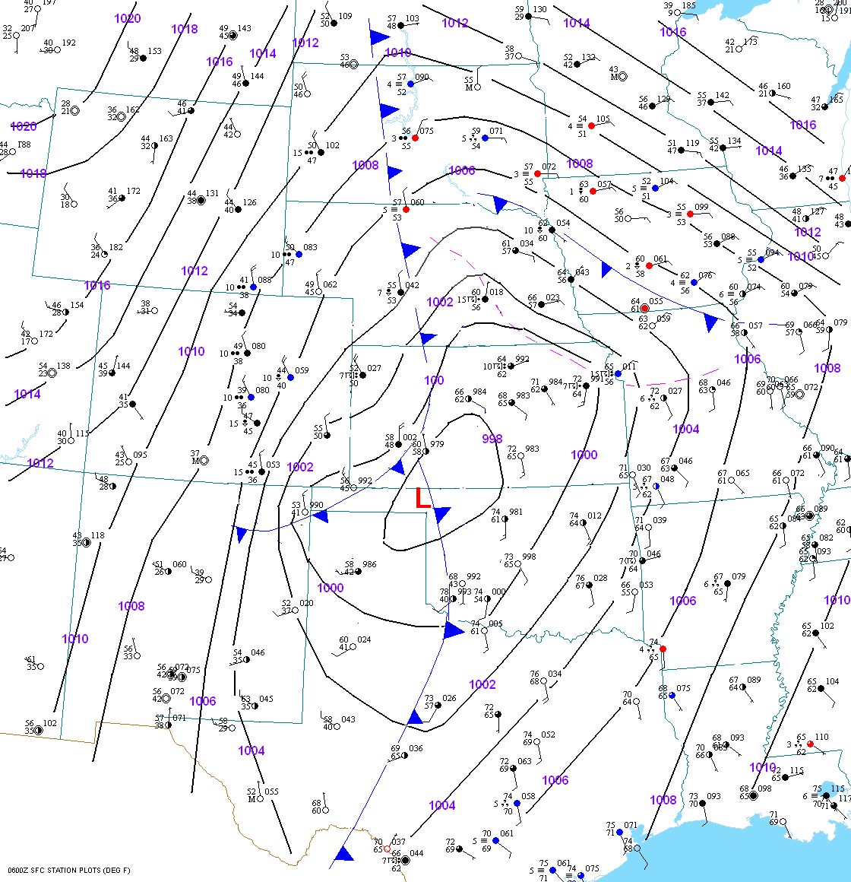
3rd 06z

Slide 20
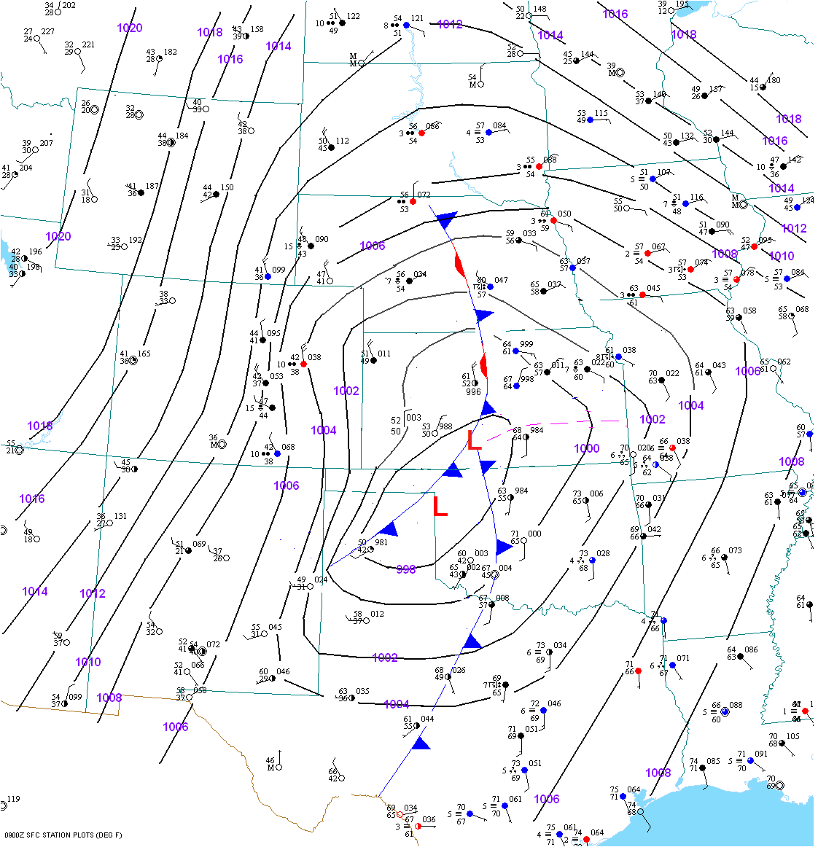
3rd 09z

Slide 21
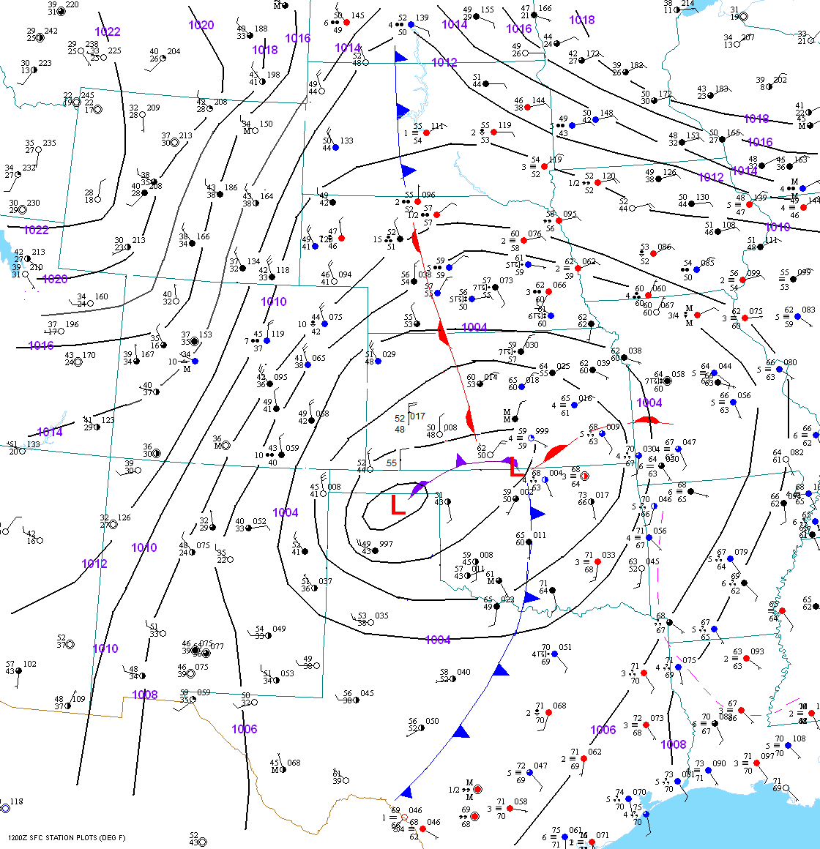
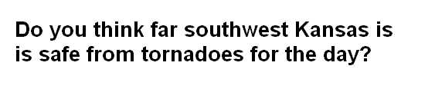
3rd 12z

Slide 22
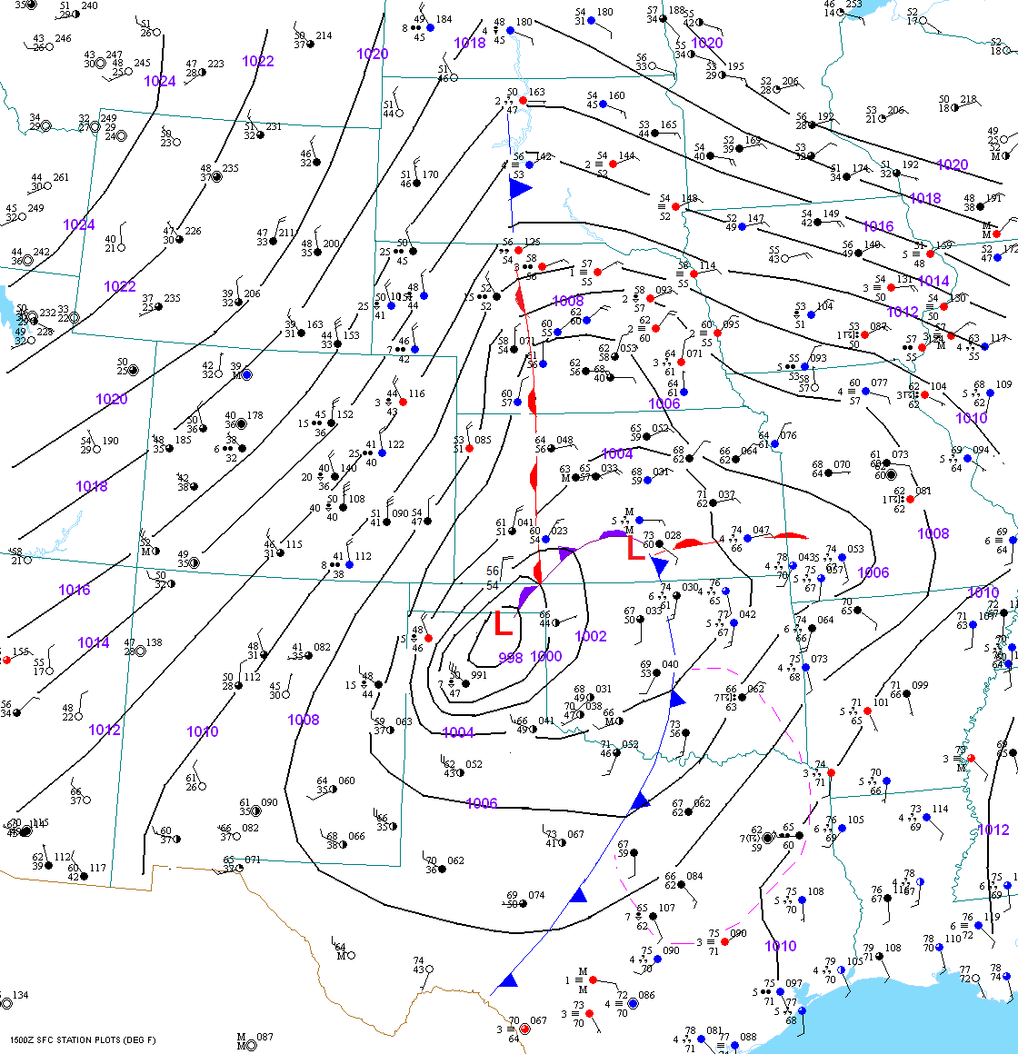
3rd 15z

Slide 23
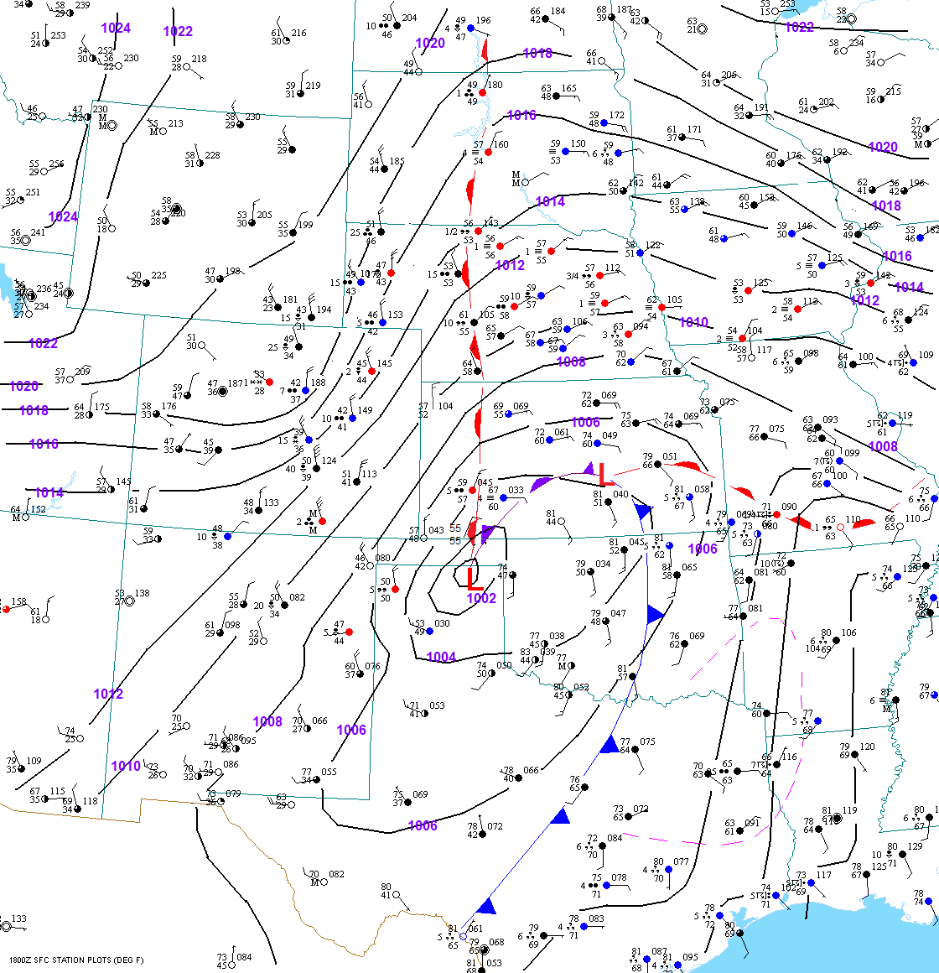
3rd 18z

Slide 24
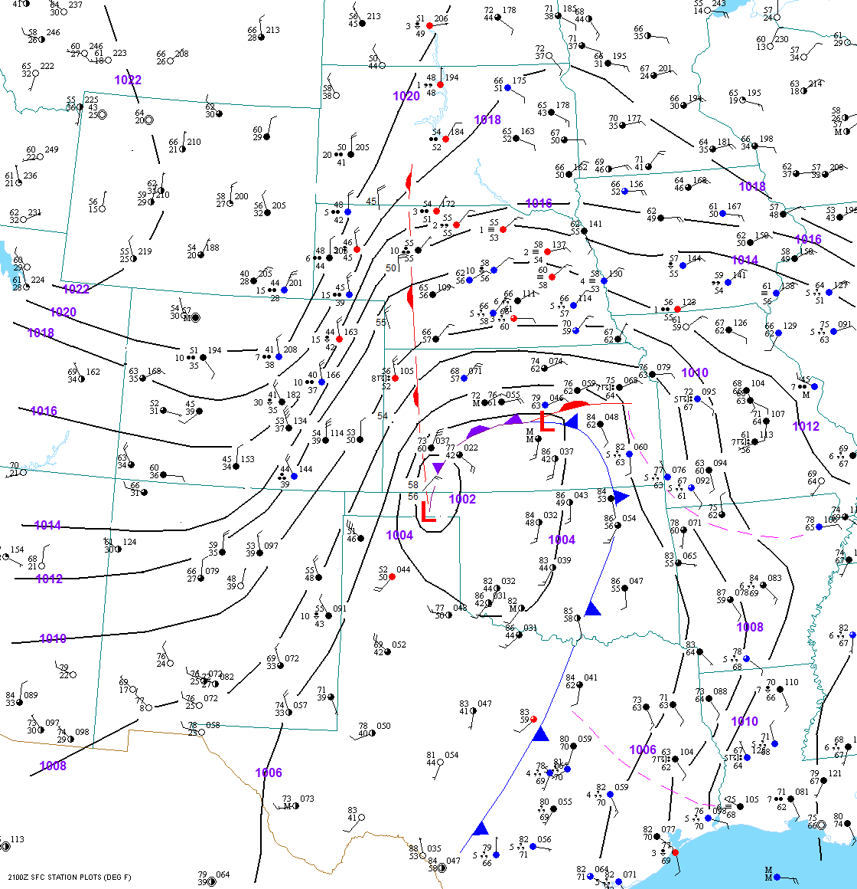
T
3rd 21z

Slide 25
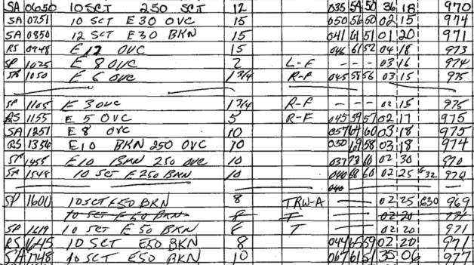
Surface Observations from Garden City, KS
May 3, 1987

Slide 26
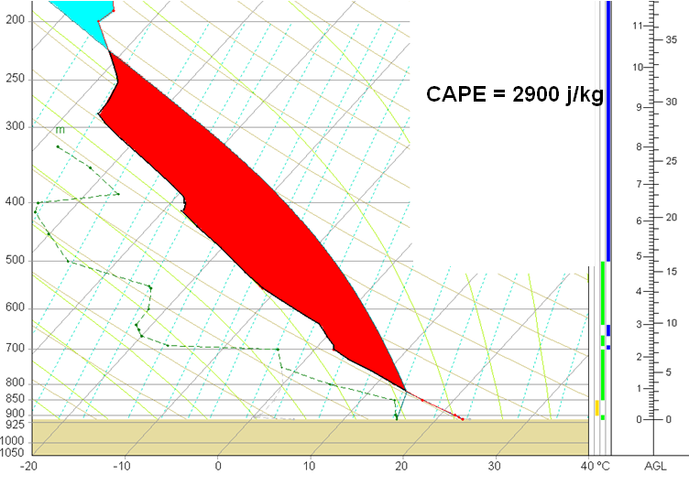
Dodge City, KS Sounding May 4 1987 00 UTC
Modified for Conditions at Garden City

Slide 27
THANK YOU

