Slide 1
Improving Probabilistic Ensemble Forecasts of Convection through the Application of QPF-POP Relationships
Christopher J. Schaffer¹
William A. Gallus Jr.²
Moti Segal²
¹ National Weather Service, WFO Goodland
² Iowa State University, Ames, IA

Slide 2
Ensemble vs. Deterministic
Probabilistic forecasts provide uncertainty
Small errors in forecast’s initial conditions grow exponentially (Hamill and Colucci 1997)
Ensemble mean forecasts tend to be more skillful (Smith and Mullen 1993, Ebert 2001, Chakraborty and Krishnamurti 2006)
Notes:
Ensemble forecasts have many advantages over deterministic forecasts. Unlike deterministic forecasts, ensemble forecasts facilitate the creation of probabilistic forecasts and provide a measure of uncertainty. Ensemble forecasts are more useful than single deterministic forecasts because small errors in a single forecast’s initial conditions will grow exponentially over time, making the forecast increasingly unreliable (Hamill and Colucci 1997). Also, ensemble mean forecasts tend to be more skillful than any single member forecast (Smith and Mullen 1993, Ebert 2001, Chakraborty and Krishnamurti 2006).

Slide 3
Gallus and Segal (2004) and
Gallus et al. (2007)
Precipitation-binning technique for deterministic forecasts
Larger forecasted precipitation => greater probability to receive precipitation
POPs increased further if different models showed an intersection of grid points with rain in a bin
Notes:
There are methods to determining probabilistic information from deterministic forecasts, however. GS04 and GBE07 used a precipitation-binning technique in a deterministic forecast to show that, at grid points where the “binned” quantity of forecasted precipitation was larger, the probability that those grid points would receive at least a small amount of precipitation was greater than where the forecasted precipitation amount was smaller. They attributed this to the fact that when the models predicted larger amounts of precipitation the atmospheric state was such that precipitation was more likely to occur. In GS04, it was noted that POP values increased even further if two different models showed an intersection of grid points with rainfall in a specified bin. Their findings indicated that the QPF-POP relationship might yield an even better forecast if the relationship was applied to ensemble forecasts.

Slide 4
Overview of study
Goals
  Apply post-processing techniques similar to the Gallus and Segal (2004) technique to ensemble forecasts
  Examine how the forecasts compare to those from more traditional approaches
Notes:
The specific goal of this study is to apply post-processing techniques similar to the GS04 technique to ensemble forecasts and to examine how the results compare to those from more traditional approaches.

Slide 5
Data
NOAA Hazardous Weather Testbed (HWT) Spring Experiments (2007 and 2008)
Ensemble of ten WRF-ARW members with 4 km grid spacing run by Center for Analysis and Prediction of Storms (CAPS)
30 hours per case (five 6-hour time periods); 00Z
Present study uses a subdomain of 2007/2008
Coarsened onto 20 km grid spacing
Notes:
Ensemble forecast output for the early warm season was generated by the 2007 and 2008 NOAA Hazardous Weather Testbed Spring Experiments, which took place during April-June of both years. The ensemble consisted of ten WRF-ARW members with 4-km grid spacing run by the Center for Analysis and Prediction of Storms (CAPS) located at the University of Oklahoma.

Slide 6
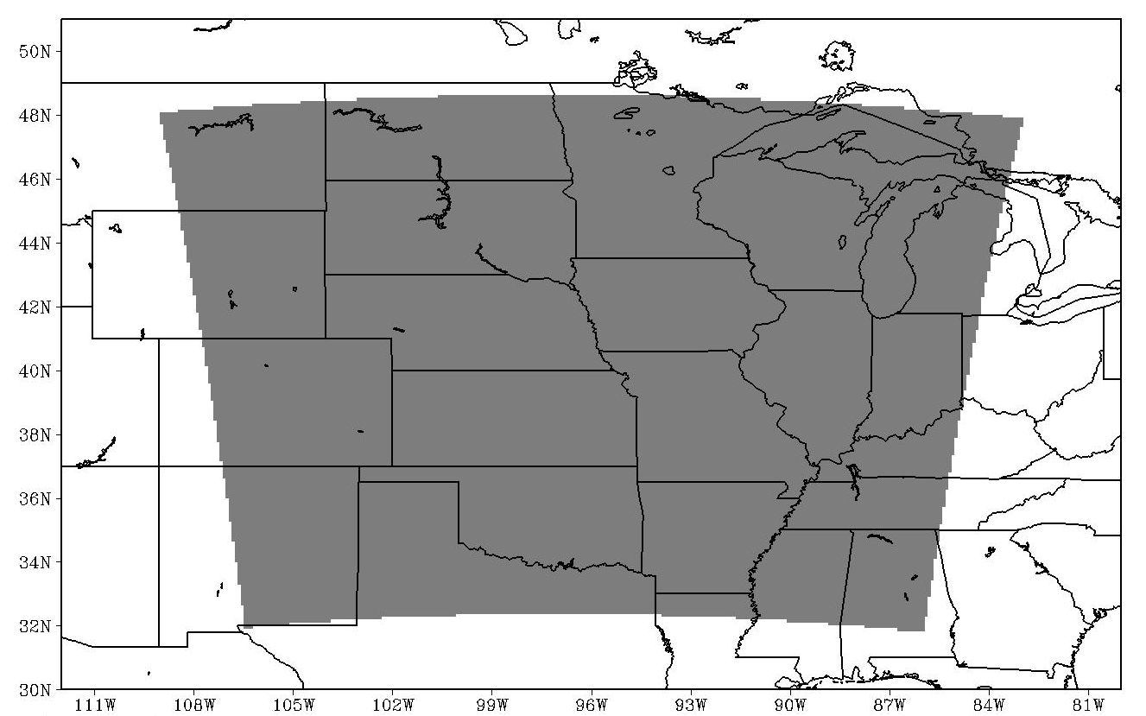
Subdomain of Present Study
1980 km x 1840 km rather than 3000 km x 2500 km (2007)

Slide 7
Methodology
Creation of 2D POP tables
  Forecasted precipitation amount within a bin
    Maximum or average amount
  Number of ensemble members forecasting agreement on precipitation amounts above a threshold
Notes:
The new approaches of determining POPs typically involved the creation of 2D POP tables based on forecasted precipitation amount within a bin (as in GS04) and the number of ensemble members forecasting agreement on amount of precipitation above a threshold amount (as traditionally used for ensemble-based POP forecasts). In this paper, the term “ensemble” will not only refer to the traditional definition of sets of model variants as defined previously but will also include a number of related grid points within an area (i.e. neighborhood). Conceptually, POP tables can be of higher dimensions if additional variants of the properties are considered. In the present study the first of the above two properties is given either by taking the maximum forecasted amount from any ensemble member at that point, or by taking the ensemble average. Using a characteristic precipitation amount was necessary because each of the ensemble members provides a precipitation amount, and a single representative precipitation amount was needed at each grid point to apply the binning approach as used by GS04. In the tables, the second property used to construct POP forecasts was the percentage of ensemble members forecasting precipitation amounts above specified thresholds (agreement).

Slide 8

Methodology continued
Seven precipitation bins
POPs assigned through hit rates
NCEP Stage IV observations designated hits
Three thresholds: 0.01, 0.10, and 0.25 inch
-h is the number of “hits”, or points where the observed precipitation also exceeded the specified threshold
-f is the number of grid points with precipitation forecasted for a given bin/member scenario
Notes:
Seven precipitation bins were used (with units in inches), including <0.01, 0.01-0.05, 0.05-0.10, 0.10-0.25, 0.25-0.50, 0.50-1.00, and >1.0. The POPs in the tables were assigned by finding the hit rate (or correct-alarm ratio) for each case in the training dataset. The hit rate is defined as h/f, where f is the number of grid points with precipitation forecasted for a given bin/member scenario, and h is the number of “hits”, or points where the observed precipitation also exceeded the specified threshold. NCEP Stage IV precipitation observations (Baldwin and Mitchell 1997) were used to designate hits at a forecast point if the observed rainfall amount was greater than a threshold.

Slide 9
Approach #1
Two-parameter point forecast approach

Slide 10
 | <0.01 | 0.01-0.05 | 0.05-0.10 | 0.10-0.25 | 0.25-0.50 | 0.50-1.0 | >1.0 | Col Ave (Cali_trad)
0% | 2.8 | - | - | - | - | - | - | 2.8
10% | - | 11.4 | 15.4 | 18.1 | 18.6 | 19.7 | 28.7 | 12.8
20% | - | 14.3 | 19.2 | 22.3 | 23.8 | 26.7 | 31.3 | 18
30% | - | 16.1 | 23.5 | 26.2 | 30.5 | 30.6 | 39.1 | 23.4
40% | - | 18.5 | 25 | 31.5 | 36.3 | 39.9 | 39.9 | 29.3
50% | - | 19.4 | 27.6 | 36 | 42.5 | 45.8 | 46.8 | 35.5
60% | - | 19.7 | 28.3 | 39.3 | 47.4 | 52.9 | 55.3 | 41.6
70% | - | 23 | 31.4 | 42.5 | 53.1 | 57 | 61.7 | 47.9
80% | - | 21.5 | 33 | 47.2 | 56.9 | 63.3 | 66.3 | 54.5
90% | - | 15.8 | 35.4 | 53.6 | 66.8 | 71.4 | 77.6 | 65.5
100% | - | 16.8 | 27.6 | 55.2 | 73.3 | 83.9 | 89.2 | 78.6
Row Ave | 2.8 | 13.7 | 23.7 | 36.6 | 53.1 | 65.6 | 74.5 | 19.4
Notes:
An illustrative 2D POP table created for the 0.01 inch observed precipitation threshold using the Max_thr method is shown in this table. This table was created by considering the 2008 dataset, so these POPs could be tested on the smaller 2007 dataset. As the amount of simulated precipitation increased, the POP tended to increase for each of the three thresholds. In the few instances where POPs decreased with higher forecasted binned precipitation, there were relatively few points associated with the percentage calculation, which may have accounted for the unusual behavior.
As the percentage of ensemble members with precipitation amounts greater than the threshold (a traditional way of defining POPs from ensembles) increased, the POPs also generally increased. The increase of POPs associated with both increasing accumulated precipitation and ensemble member agreement percentage resulted in the highest POPs (lower-right corner of the table). Conversely, a combination of low precipitation amounts and low member agreement percentages yielded low POPs (upper-left side of the table). Points in the second column of Table 3-2 are restricted by definition of the method; if the maximum precipitation was less than 0.01 inch (essentially no precipitation), then all members had accumulated precipitation less than the lowest threshold. This definition results in a very low POP value for this scenario which is fitting because we would expect a very low likelihood of precipitation when none of the ensemble members are forecasting measurable precipitation.
The right-most column of the table is a summation over all bins for each member agreement percentage, indicating what the POP would be for each member percentage if binning of the precipitation amount was not considered. These POPs increase with increasing member agreement percentage and are the values used for Cali_trad. Cali_trad can also be thought of as a traditional method (defined as equally-weighted forecasts yielding POPs of 0%, 10%, 20%, etc.) that has been adjusted using observations, and as the marginal distribution of the joint probability distribution. Max_thr and Ave_thr by definition provide a refinement of Cali_trad.
The bottom row of the table is a summation over all member percentages, similar to what would be determined from the GS04 approach. This row provides a single POP representative of each precipitation bin (i.e. reflecting the ensemble average POP). The POPs increase with increasing bin amounts. These POPs are used when making reliability and ROC diagrams, because they allow for bin-representative points on the diagrams, like the diagrams in GS04 and GBE07.
A common trend in the POP tables was a decrease in the number of domain grid points with increasing precipitation amount and member agreement percentage. Few points had both high amounts and member agreement percentages, and the POPs were generally very high (between 80% and 100%) for these points. The high POPs indicate that precipitation was almost inevitable when most or all members forecasted heavy amounts.

Slide 11
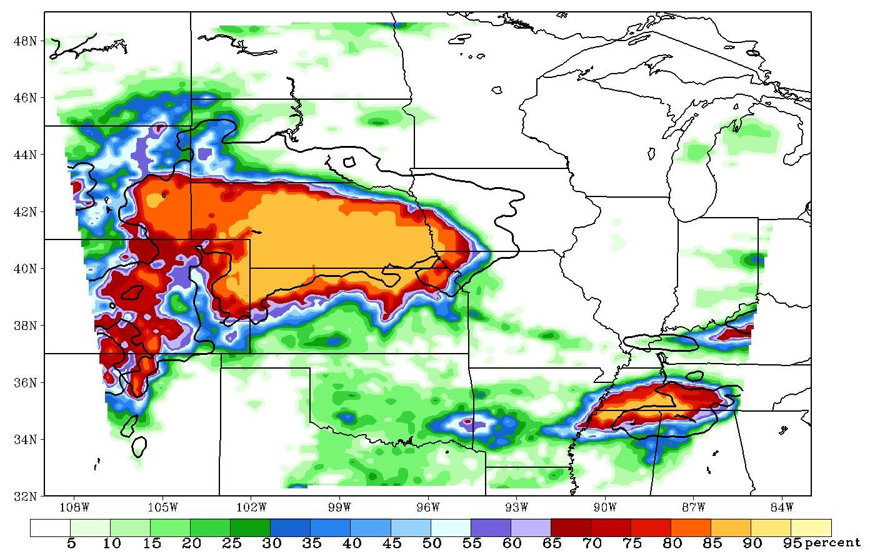
Max_thr POPs for April 23, 2007
06Z – 12Z
Notes:
Max_thr

Slide 12
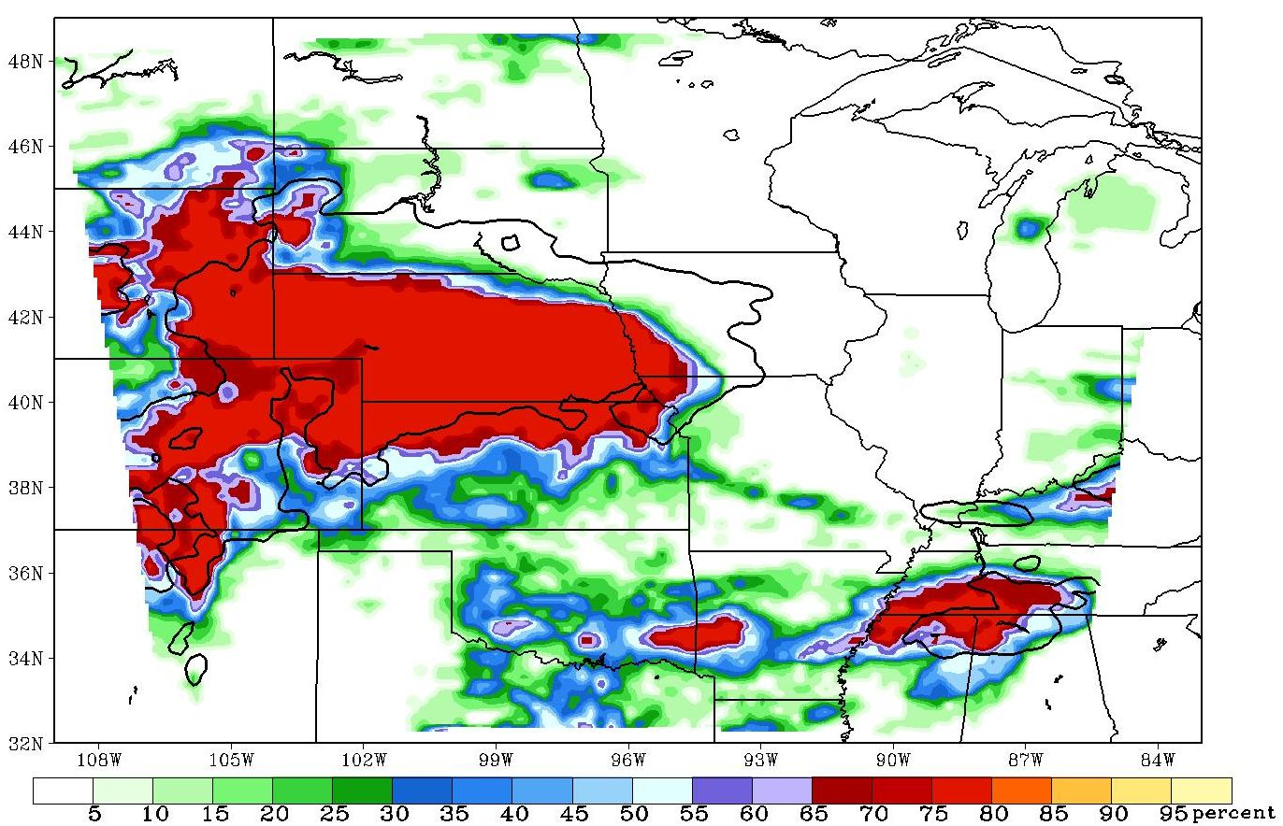
Cali_trad POPs for April 23, 2007
06Z – 12Z
Notes:
Cali_trad

Slide 13
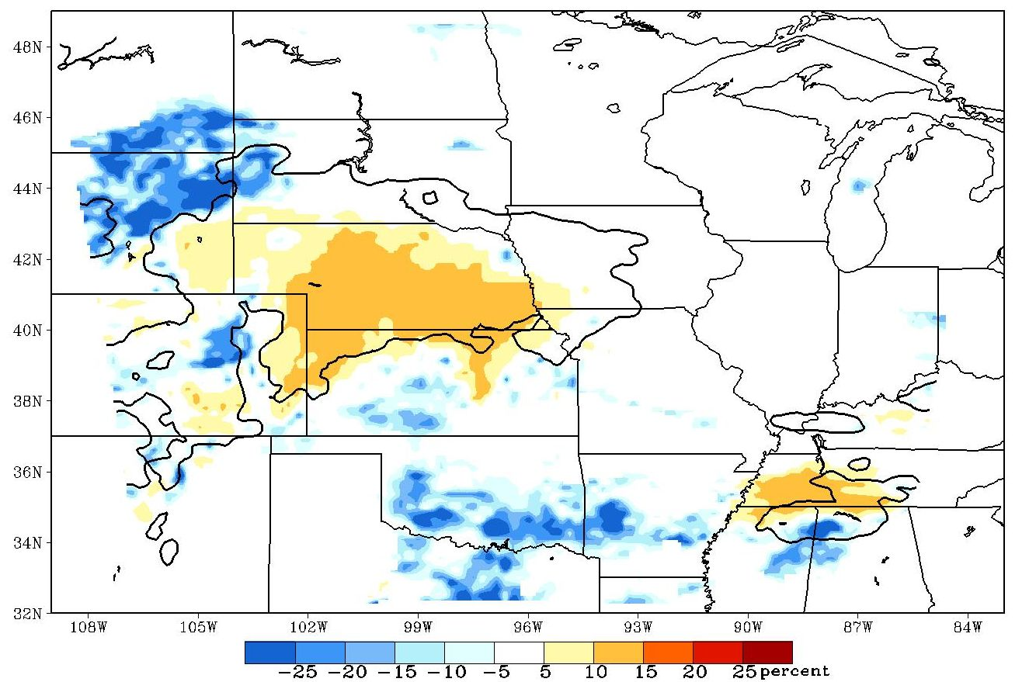
Max_thr – Cali_trad

Slide 14
 | Score
Method | BS | Reli | Resol | Uncert | BSS | Bias
GSD 0.01 inch | 0.1175 | 0.0073 | 0.0354 | 0.1456 | 0.1932 | 1.3488
0.10 inch | 0.0653 | 0.0046 | 0.0161 | 0.0767 | 0.1489 | 1.6043
0.25 inch | 0.0386 | 0.0029 | 0.0072 | 0.0429 | 0.1006 | 1.9621
Uncali_trad 0.01 inch | 0.1234 | 0.0257 | 0.0480 | 0.1456 | 0.1530 | 1.4707
0.10 inch | 0.0705 | 0.0152 | 0.0214 | 0.0767 | 0.0810 | 1.6305
0.25 inch | 0.0440 | 0.0105 | 0.0095 | 0.0429 | -0.0243 | 1.9159
Cali_trad 0.01 inch | 0.1040 | 0.0064 | 0.0480 | 0.1456 | 0.2855 | 1.2609
0.10 inch | 0.0593 | 0.0040 | 0.0214 | 0.0767 | 0.2267 | 1.4582
0.25 inch | 0.0363 | 0.0028 | 0.0095 | 0.0429 | 0.1547 | 1.7572
Max_thr 0.01 inch | 0.1013 | 0.0097 | 0.0540 | 0.1456 | 0.3041 | 1.2501
0.10 inch | 0.0586 | 0.0059 | 0.0240 | 0.0767 | 0.2357 | 1.4192
0.25 inch | 0.0359 | 0.0037 | 0.0108 | 0.0429 | 0.1633 | 1.6722
Notes:
This table shows the overall decomposed BSs at each threshold for Max_thr, GSD, Uncali_trad, and Cali_trad. Instead of showing each of the ten GSD forecasts, the results in the table are the averaged results for the ten members. For all thresholds, the BSs for the new methods were always smaller (closer to zero) than the GSD and Uncali_trad BSs. As thresholds increase, however, the degree by which the scores differ becomes small. The new methods always had higher BSSs and lower bias scores than GSD and Uncali_trad. When compared to the Cali_trad BSs, Max_thr, Ave_thr, and Ave_bin still have more favorable scores. When the BSs of Max_thr and the three related methods were compared to the Cali_trad scores, however, the differences were not statistically significant.
The decomposed BS equation shows that in order to have a low BS, the reliability and uncertainty terms should be small and the resolution term should be large. All of the new presented methods using the two-parameter point forecast approach had larger resolution terms than GSD, Uncali_trad, and Cali_trad. Cali_trad had the smallest reliability term of all the methods. The reliability diagrams (Fig. 3-2) clearly showed that Uncali_trad had worse reliability than the other methods, which the reliability component of the Brier decomposition confirmed. Finally, the uncertainty term decreased with increasing thresholds, but it did not differ between methods because the uncertainty is only a function of the sample climatology and is thus independent of forecast method.

Slide 15
Approach #2
Two-parameter neighborhood approach

Slide 16
Two-parameter neighborhood approach
Neighborhoods: Theis et al. (2005), Ebert (2009)
Within a specified square area around a center point, the max or ave precip. amount is determined and binned
Number of points within the neighborhood that have forecast precip. amounts greater than a threshold
Spatially generated ensemble
Forecasts for each member
3x3 Neighborhood
1 | 2 | 3
4 | 5 | 6
7 | 8 | 9
Notes:
A second forecasting approach was developed using neighborhood methods (e.g., Ebert 2009, Gilleland et al. 2009, Schwartz et al. 2009, among others). Within a specified square area around a center point (a 3x3 point area, 5x5, 7x7, etc.), the maximum or average precipitation amount was determined and placed in a bin. It is worth noting that specifying a 1x1 point “area” reduces the approach to binning precipitation at a single point, i.e. to the GSD approach.
This approach not only uses the binned precipitation amount but also the number of points within the neighborhood that have forecast precipitation amounts greater than a threshold. Max_thr and similar methods considered forecasts from 10 ensemble members, but because this neighborhood approach (abbreviated as Max_nbh or Ave_nbh) uses each of the points within the neighborhood, all of these points can be thought of as a spatially generated “ensemble” (e.g. Theis et al. 2005) yielding more than just 10 members and thus the potential for better results. The size of the neighborhood/square determines the number of points considered in the method, so different tables were created based on neighborhood size for each of the ten members. This approach is different than the method tested in Schwartz et al. (2009) which issued POP forecasts for entire neighborhood areas, while in the present study the POP forecast is for individual points.

Slide 17
Statistics for Ave_nbh (15x15 g.p.)
Member | Score
 | BS | Reli | Resol | Uncert | BSS | Bias | ROC area
0.01 inch
Mem1 | 0.1043 | 0.0279 | 0.0691 | 0.1456 | 0.2836 | 1.4890 | 0.862
Mem2 | 0.1113 | 0.0299 | 0.0642 | 0.1456 | 0.2354 | 1.4252 | 0.850
Mem3 | 0.1091 | 0.0261 | 0.0626 | 0.1456 | 0.2507 | 1.0603 | 0.829
Mem4 | 0.1102 | 0.0271 | 0.0625 | 0.1456 | 0.2430 | 1.1854 | 0.835
Mem5 | 0.1109 | 0.0280 | 0.0628 | 0.1456 | 0.2385 | 1.2827 | 0.836
Mem6 | 0.0990 | 0.0232 | 0.0699 | 0.1456 | 0.3203 | 1.1532 | 0.860
Mem7 | 0.1037 | 0.0270 | 0.0690 | 0.1456 | 0.2881 | 1.4137 | 0.863
Mem8 | 0.0988 | 0.0235 | 0.0703 | 0.1456 | 0.3218 | 1.1730 | 0.861
Mem9 | 0.0996 | 0.0239 | 0.0699 | 0.1456 | 0.3163 | 0.9587 | 0.861
Mem10 | 0.1007 | 0.0252 | 0.0701 | 0.1456 | 0.3085 | 1.3627 | 0.869
Notes:
The 1x1 BSs for Max_nbh and Ave_nbh matched those of the GSD method (shown in Table 3-3), because a 1x1 “neighborhood” is a single point. As neighborhood size increased, the reliability decreased, but resolution increased to a larger extent. The best BSs generally occurred for a 15x15 point neighborhood for Ave_nbh (Table 3-5), after which the loss of reliability began to outweigh improvements in resolution. For Max_nbh, the best BSs occurred for a 13x13 neighborhood. The best BSs for Ave_nbh, however, were lower (better) than the best scores for Max_nbh suggesting that averaging of nearby points provides a more skillful forecast than selecting the maximum precipitation within the neighborhood.
The 15x15 Ave_nbh results (Table 3-5) showed that some BSs were greater than the Max_thr scores, while others were less. The lowest scores for Ave_nbh were below 0.1000, which was more skillful than the Max_thr and also Cali_trad values. This result is surprising, because Max_thr considered all 10 ensemble members when creating POPs, but Ave_nbh considered only an individual member. The neighborhood approach provided additional information so that POP forecasts made from single deterministic forecasts were comparable (or sometimes superior) to POP forecasts made using Cali_trad.

Slide 18
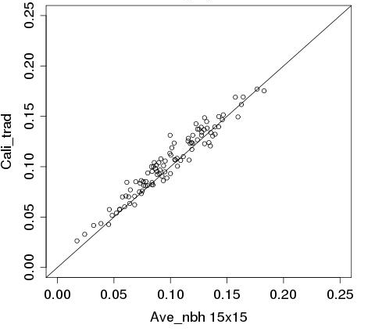
Scatterplot of Brier scores
(0.01 inch threshold)
Notes:
Improvement over Cali_trad can also be seen in scatterplots of Ave_nbh 15x15 and Cali_trad’s BSs (Fig. 3-5) where each point is a BS comparison of the methods for a case and time. The majority of points are above the diagonal, indicating that the Ave_nbh forecasts had lower BSs and thus higher skill than Cali_trad.

Slide 19
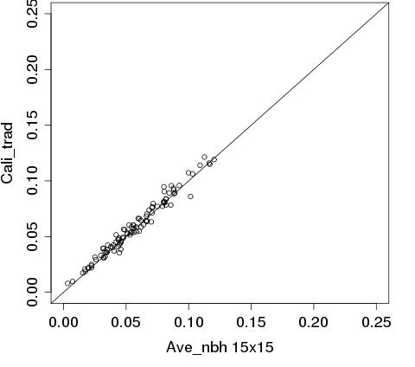
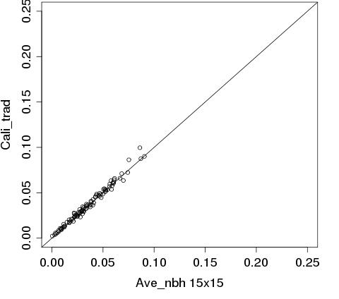
Scatterplot of Brier scores
(0.10 and 0.25 inch thresholds)

Slide 20
Approach #3
Combination of methods

Slide 21
Combination of methods
Considers each method as an ensemble member that itself consists of ensemble members
Uses the different POP tables to determine POPs for each method, then averages POPs
Different trends in POP fields
Many variations of the approach
Notes:
A final forecasting approach was examined that combined several of the previous methods. Considering each contributing method as an ensemble member that consists itself of ensemble members, this approach can be viewed as a “super-ensemble” generated by post-processing. Because POP fields over the domain for the different methods evidenced forecast spread, we believed that a combination of the forecasts might result in a forecast superior to the individual methods.

Slide 22

 | Score
Threshold | BS | Reli | Resol | Uncert | BSS | Bias | ROC area
3x3
0.01 inch | 0.0995 | 0.0097 | 0.0559 | 0.1456 | 0.3170 | 1.3098 | 0.818
0.10 inch | 0.0573 | 0.0061 | 0.0255 | 0.0767 | 0.2529 | 1.5435 | 0.872
0.25 inch | 0.0349 | 0.0039 | 0.0119 | 0.0429 | 0.1870 | 1.8700 | 0.894
15x15
0.01 inch | 0.0959 | 0.0104 | 0.0601 | 0.1456 | 0.3411 | 1.2512 | 0.875
0.10 inch | 0.0556 | 0.0066 | 0.0278 | 0.0767 | 0.2759 | 1.4126 | 0.903
0.25 inch | 0.0340 | 0.0042 | 0.0131 | 0.0429 | 0.2083 | 1.6498 | 0.916
P-value (compared to Cali_trad): 0.07884 (90% C.I.)
Notes:
By averaging the POPs for Ave_nbh, Max_thr, and Cali_trad, and increasing the Ave_nbh neighborhood from 3x3 to 15x15 (Table 3-7), the BS improved from 0.0995 to 0.0959 for the 0.01 inch threshold. The forecasts were superior to any of the forecasts from other methods examined thus far. When compared to Cali_trad, the results for this combination approach were statistically significantly improved at the 90% confidence level with a p-value of 0.07884. In addition to the improvement in BSs, the bias values also improved for each threshold.
When the neighborhood was increased from 3x3 to 15x15 grid points, the reliability worsened, but the resolution improved to a greater extent. This behavior was observed in Ave_nbh, as well. The reliability was lower (better) for the ensemble of methods compared to Ave_nbh, however, likely due to the contribution of Max_thr and Cali_trad, which had better reliability scores than Ave_nbh for larger neighborhoods. Thus, the combination of methods had low reliability (comparable to Max_thr), and high resolution (like Ave_nbh). By including Ave_thr in this combination method, the skill increased marginally. When Max_bin and Ave_bin were added in, skill did not improve, likely because these methods had lower skill than Max_thr and Ave_thr.
By including the 3P approach as an additional member in the combination approach, the skill increased slightly. However, as noted previously, the skill of the 3P approach was very good, and sensitivity tests showed that enhancing its weight in the combination increased the skill further. By including versions of Ave_nbh, Cali_trad, and the 3P method where their precipitation fields were multiplied by a “reduction factor” in the combination method, skill was increased further. By multiplying the forecast precipitation amounts by scalars which were determined (through sensitivity tests) to improve BSs at the 0.01 inch threshold specifically, the reduction factor helped correct forecast overestimation. Effectively, the reduction is a readjustment of the original selection. The sensitivity tests involved first multiplying the characteristic precipitation amount used for the binning and agreement parameters by reduction factors such as 0.25, 0.50, and 0.75, and determining which factor yielded improved BSs. The factors were then tested in 0.05 increments, until an “ideal” factor was found. These ideal factors ranged from 0.15 to 0.30, depending on the method, and were meant only to improve the 0.01 inch threshold results. In most cases, the other thresholds experienced an increase in BSs as a result of the reduction factor.

Slide 23
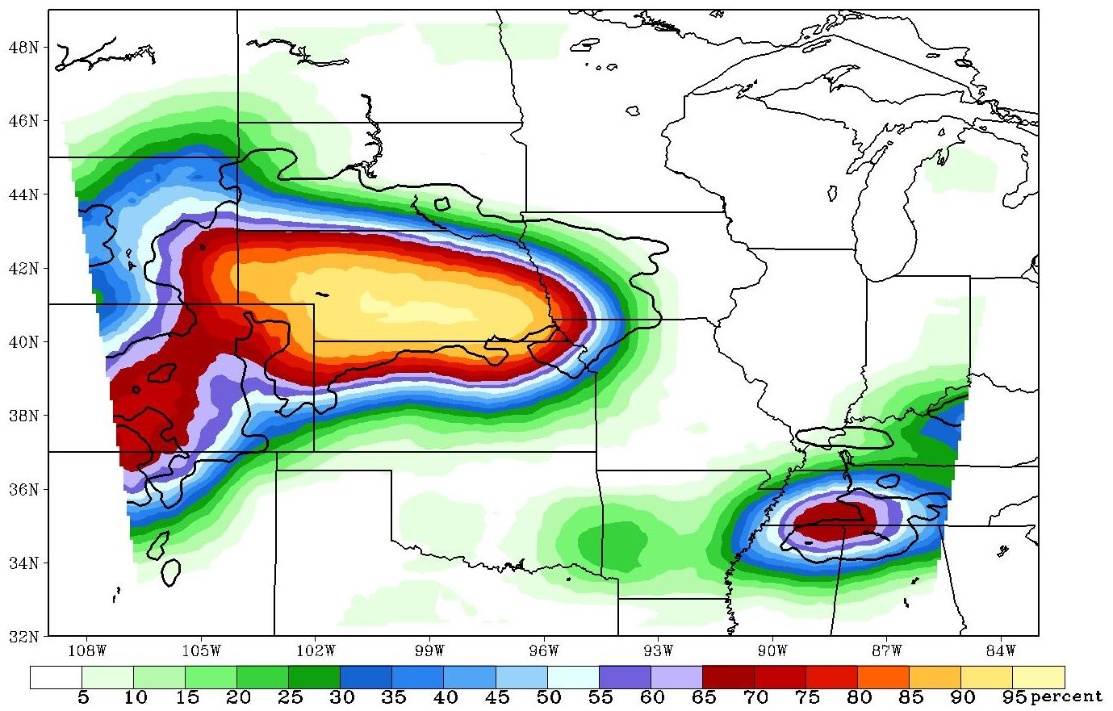
Combination approach

Slide 24
Max_thr

Slide 25
Conclusions
  Two-parameter point forecast approach
    Improvements over Cali_trad, which encouraged the development of other approaches
  Two-parameter neighborhood approach
    Deterministic, but comparable to Cali_trad
    Improvements due to spatial ensembles
    Increased neighborhood size led to better Brier scores
  Combination approach
    Brings several methods/approaches together by averaging POPs
    Statistically significantly different Brier scores compared to Cali_trad at 90% C.I.
Notes:
The present study is an extension of the POP approach used in GS04 and GBE07 to a 10-member WRF ensemble, while providing a comparison to a calibrated traditionally-used equal weighting approach used to determine POPs from ensembles. Exploratory tests were performed using a range of approaches, and some related variant methods were considered using data from early in the convection season. The POP was evaluated based on the performance at each domain grid point. Quantification of the skill of the new approaches emphasized the use of BSs and ROC areas.
Because the approaches are based on post-processing of simulated precipitation fields, tests were performed using both 20 km and 4 km grid representations of the precipitation field. Hamill and Colucci (1997) showed that calibration over observations can improve forecasts using a statistical technique, and the present paper found other techniques that improve forecasts.
For all methods, the most pronounced improvements in POP skill occurred for the lowest threshold, with skill diminishing above a threshold of 0.25 inch. Hence, the methods may be better at delineating areas experiencing precipitation and determining the location and timing of convective initiation compared to Cali_trad and Uncali_trad. Comparison of POP maps against those generated by Cali_trad and Uncali_trad may provide additional guidance into relevant aspects of the forecasted precipitation.
By examining binned precipitation amounts and the number of ensemble members with precipitation greater than a threshold (the two-parameter point forecast approach), tabular POP forecasts Max_thr, Ave_thr, Max_bin, and Ave_bin were created. While most of these methods had lower BSs than Cali_trad (e.g. 0.1013 for Max_thr compared to 0.1040 for Cali_trad), the differences between these methods and Cali_trad were not statistically significantly different.
The two-parameter neighborhood approach (which is conceptually similar to that of Theis et al. (2005) when the calibration is not applied) provided skillful results that exceeded expectations. As discussed in Theis et al. (2005), the approach (consisting of the methods Max_nbh and Ave_nbh) is effectively an ensemble that is generated based on the spatial distribution of points in a neighborhood. Ensembles generated in this manner produced POPs as skillful as those from the 10-member ensemble forecast Cali_trad. This suggests that the approach is very attractive operationally, and we are currently testing options to refine it in order to improve its performance. Because post-processing of a single deterministic simulation can provide skill comparable to that obtained by Cali_trad, computer resources used for the ensemble simulation might be better used for further refinement of the model grid spacing or for improved model physical formulation. The ensemble information can be obtained from POPs using post-processing to generate spatially based ensembles. Still, it is possible that when using an ensemble with more than 10 members (as was used in the present study) or when using an ensemble with different design characteristics, the POP of a single member may not yield forecasts as good as that from Cali_trad.
The neighborhood approach can be thought of in more than one way. For instance, within a neighborhood with squares of (NxN) points, a set of grid points with the same relative orientation to the grid points (I,J) can be considered an ensemble of (NxN) members. Alternatively, the neighborhood may be viewed as shifting the grid (NxN) times relative to the observed point (I,J) by one grid point. Hence, for an example using N=3, the ensemble effectively represents the original grid (no displacement) and 8 displacements of the simulated domain by one grid point northward, westward, eastward, southward, southeast, southwest, northeast and northwest.
A limited comparison of skill between 20 km and 4 km gridded precipitation forecasts indicated better POP skill for the 4 km setting. While this pattern needs to be confirmed in future studies, it may suggest an additional consideration in evaluating the merit of fine grid resolution single runs versus coarse grid ensembles. Questions remain about the best usage of computer resources for predicting convective QPF. For instance, is it better to run a single deterministic refined grid simulation or a coarser grid ensemble? Clark et al. (2009) found that finer grid spacings tended to provide more accurate forecasts than forecasts on coarser grid spacings. Faster error growth at finer grid spacings led to more reliable forecasts. In the present study, the finer grid spacing forecasts had better Brier scores than those of the coarser grid spacing.
A three-parameter approach considered binned precipitation amounts and a representation of the number of ensemble members (in the 10-member ensemble and the neighborhood ensemble) with precipitation greater than a threshold in order to produce POP forecasts of even higher skill than the two-parameter point forecast approach and the two-parameter neighborhood approach. When all three approaches were considered together with Cali_trad and their appropriate reduction factors, the resulting combination approach produced forecasts that were statistically significantly better (p-value = 0.04831) compared to Cali_trad’s forecasts at the 95% confidence level.

Slide 26
This research was funded in part by National Science Foundation grants ATM-0537043 and ATM-0848200, with funds from the American Recovery and Reinvestment Act of 2009.
christopher.schaffer@noaa.gov

