Slide 1
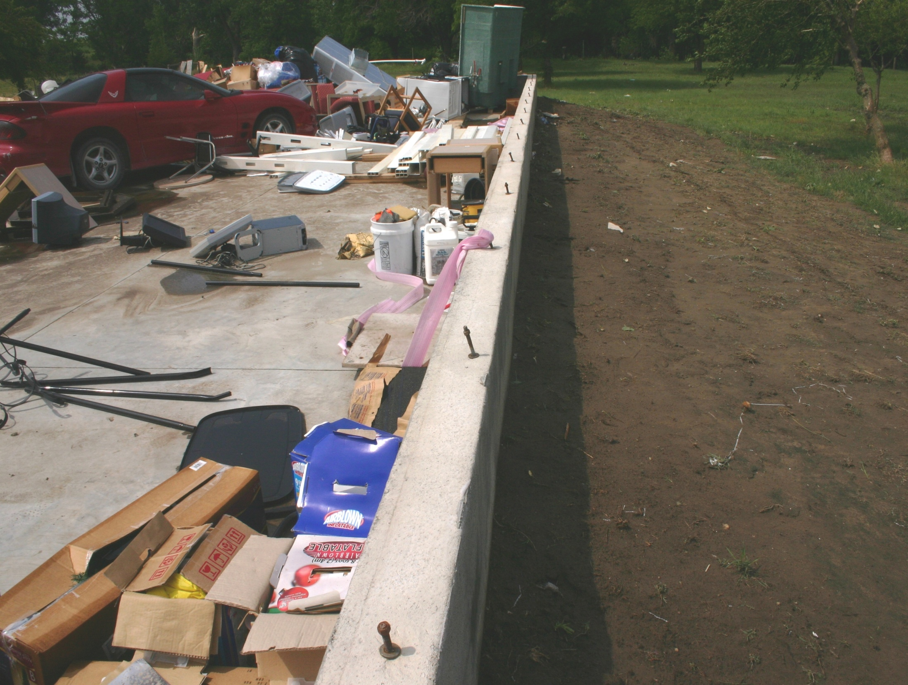
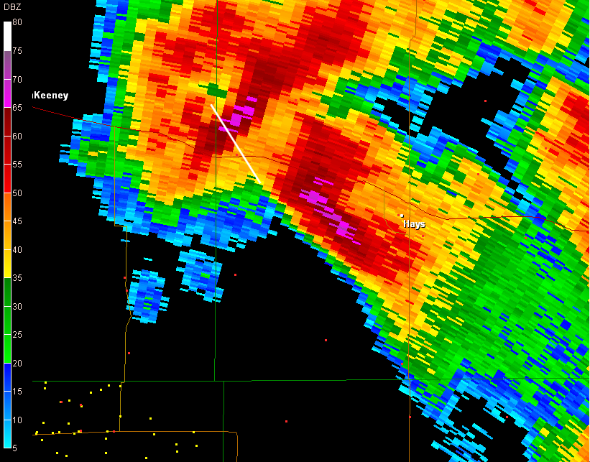
The 7 June 2010
Ellis, KS severe downburst
Marc Russell, NWS Dodge City, KS

Slide 2
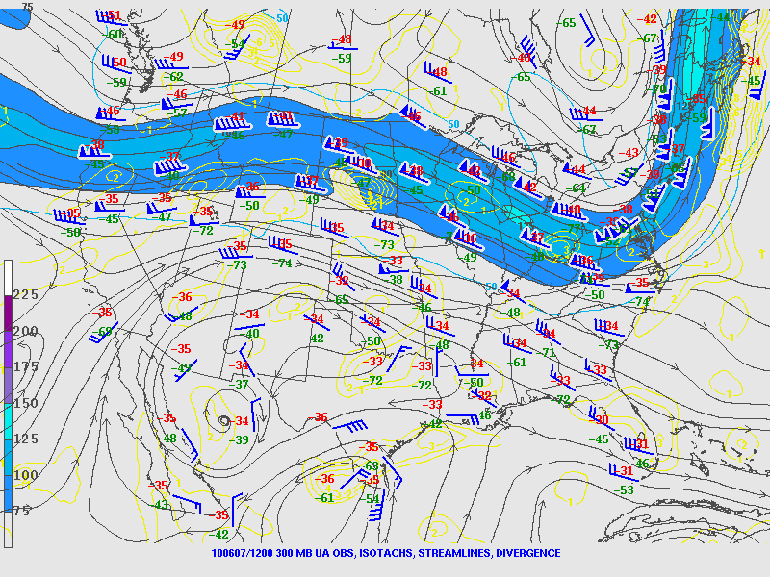
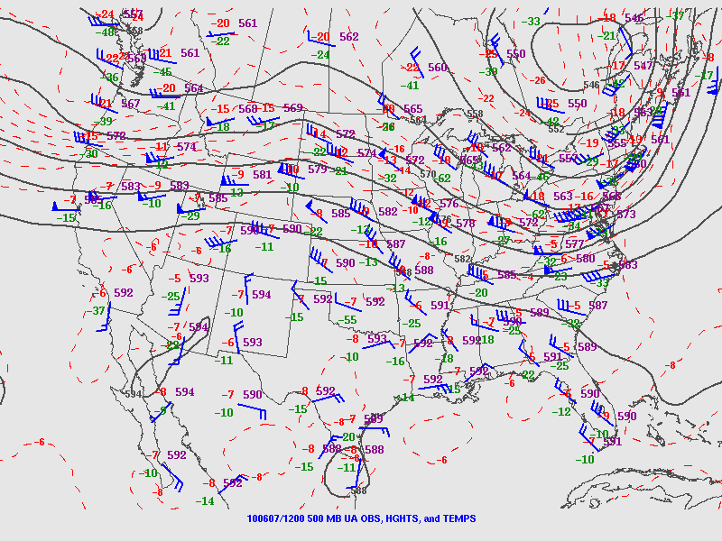
12 UTC 7 June 2010
300 MB
500 MB

Slide 3
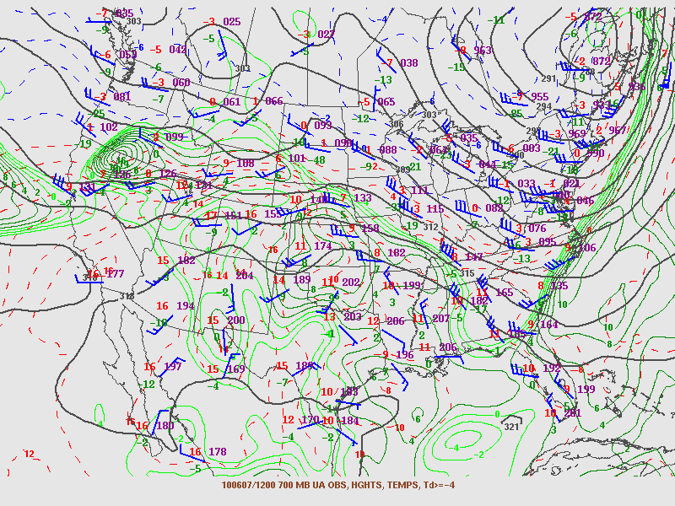
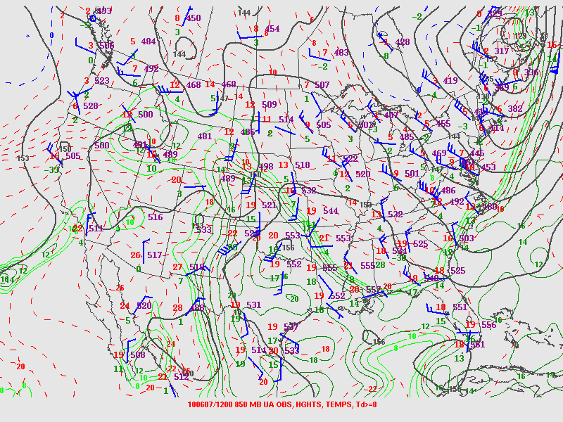
12 UTC 7 June 2010
700 MB
850 MB

Slide 4
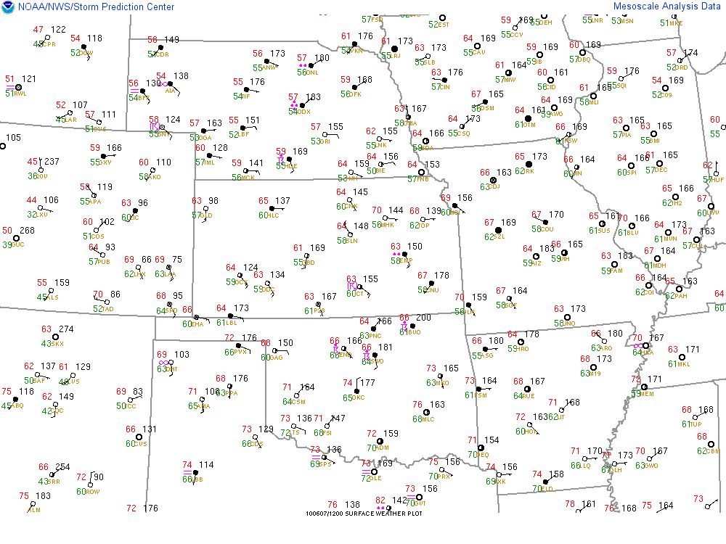
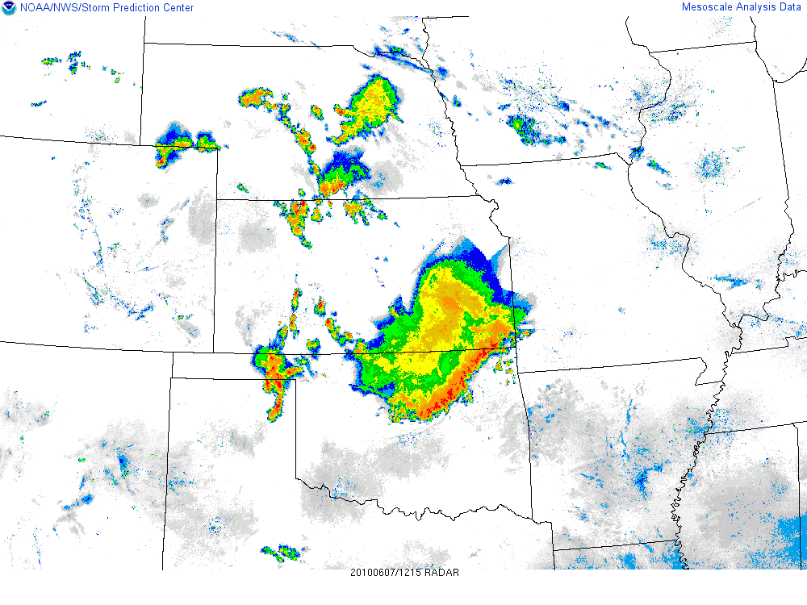

Slide 5
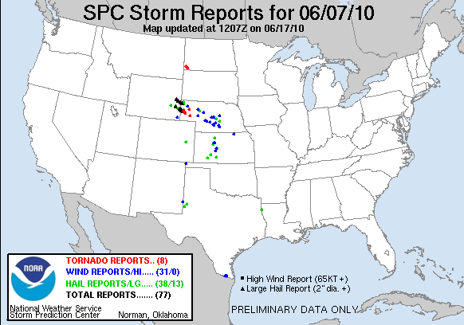

Slide 6
Considerations
> Wet Microburst profiles (soundings)
> Forward Propagation (new cell generation)
> Storm relative wind
> Radar characteristics
  mid level convergence?
  High reflectivity core descended rapidly?

Slide 7
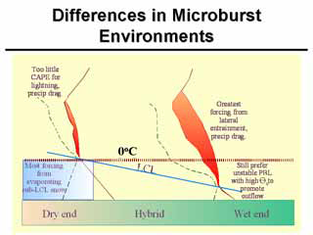

Slide 8
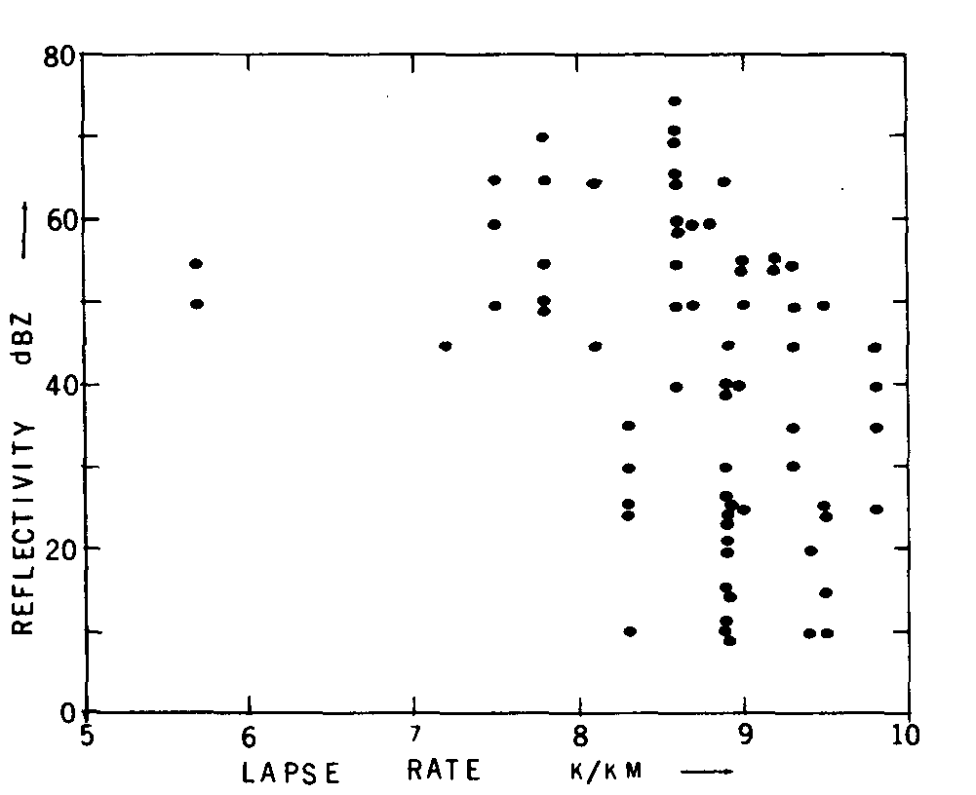
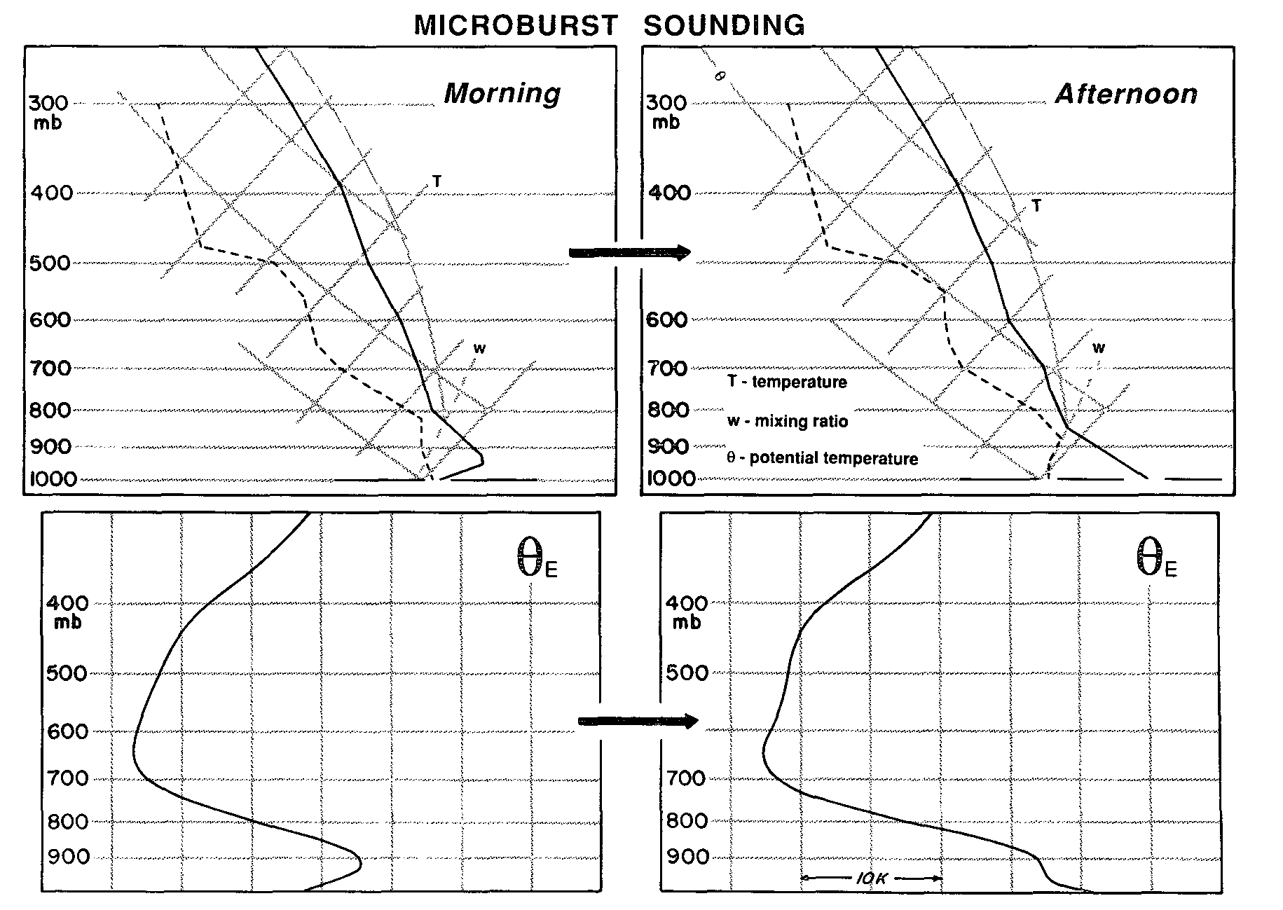
From Atkins and Wakimoto 1991
From Srivastava - 1985
Significant for Theta E >20 C and < 13 C
between sfc and mid levels.

Slide 9
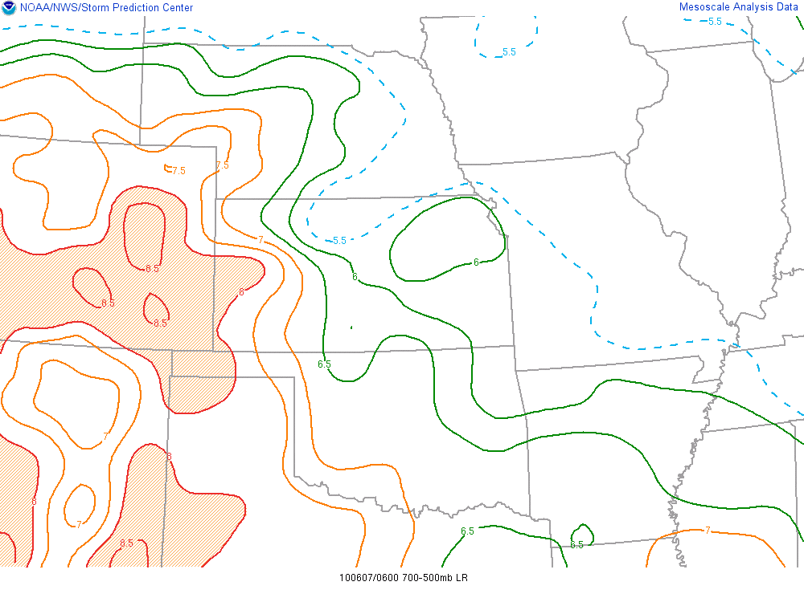
06 UTC Mid level lapse rates

Slide 10
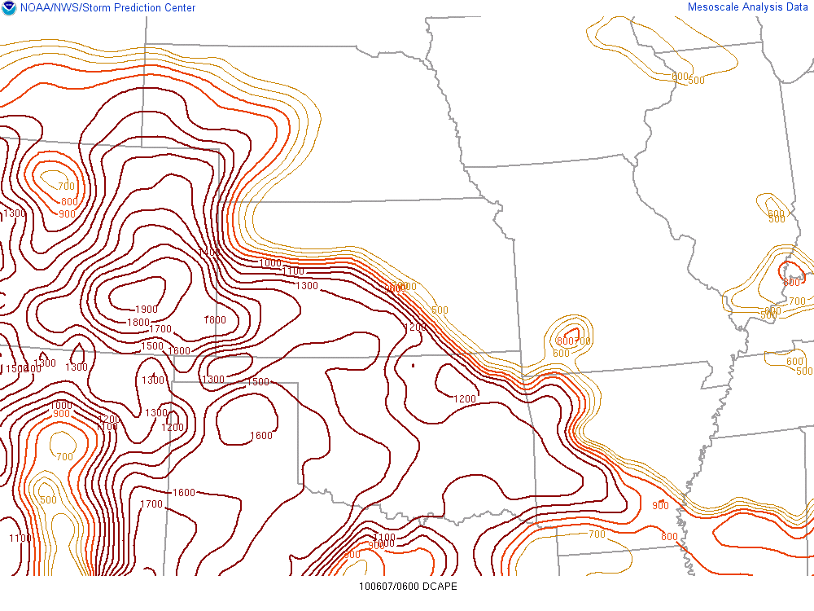
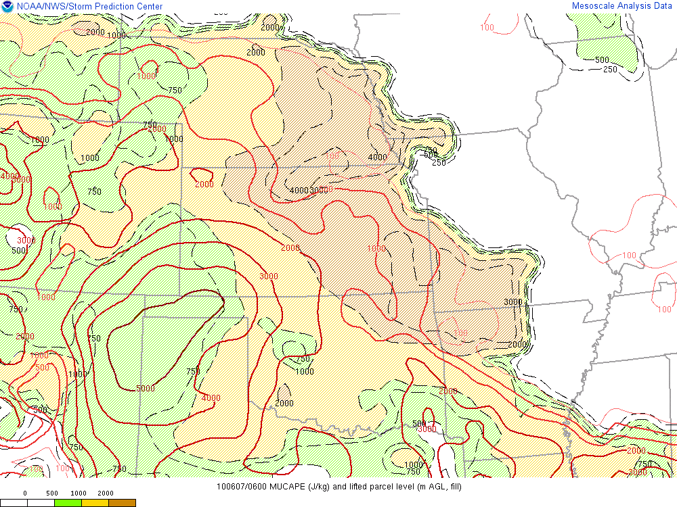
06 UTC MUCAPE vs DCAPE

Slide 11
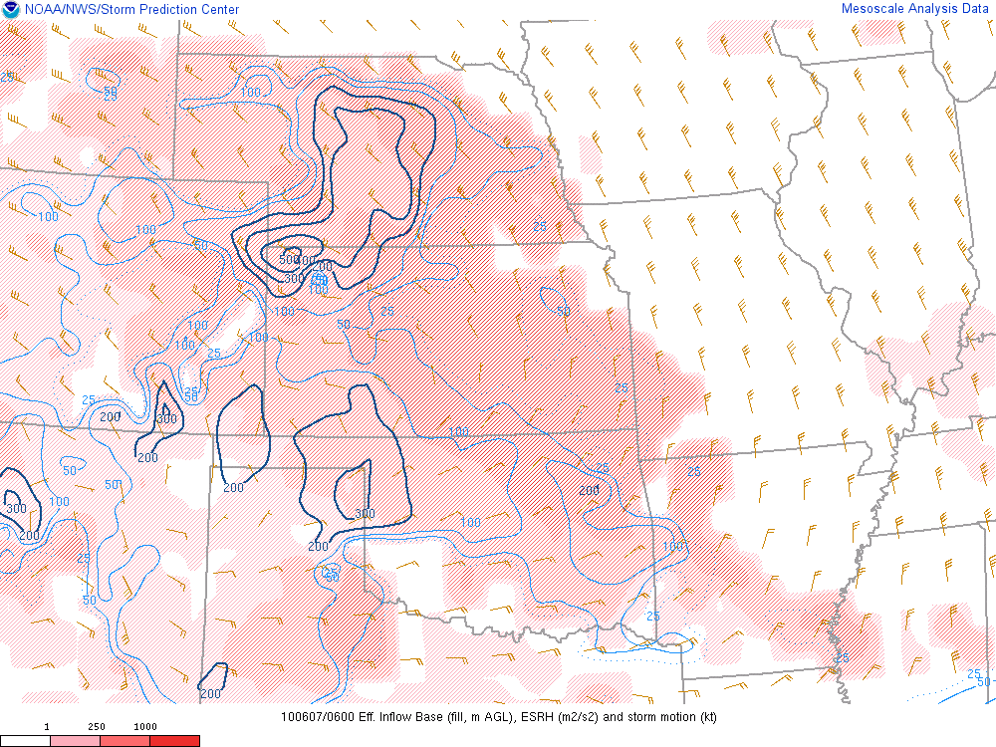
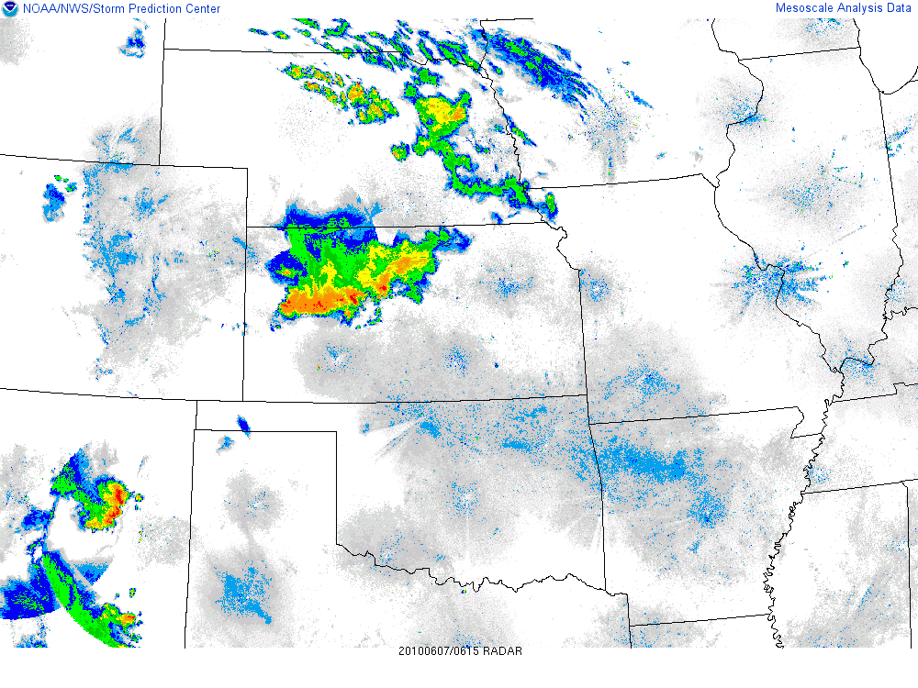
SRH and composite radar

Slide 12
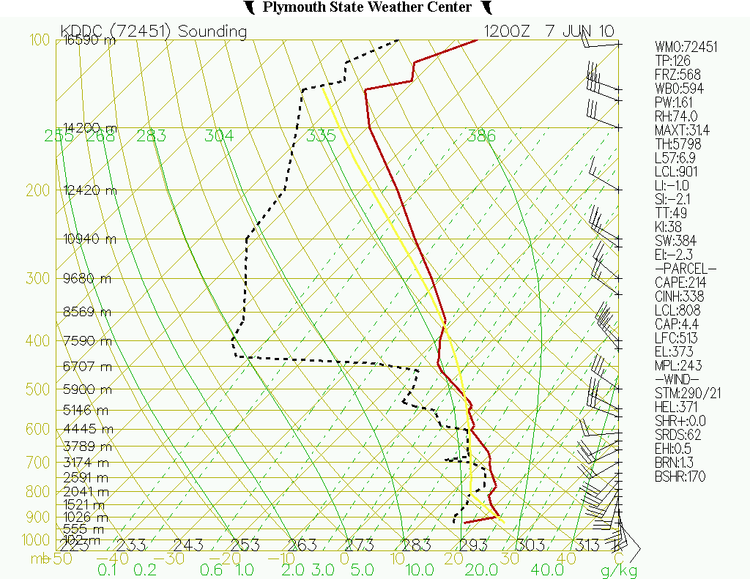
Winds veering
strongly with
height

Slide 13
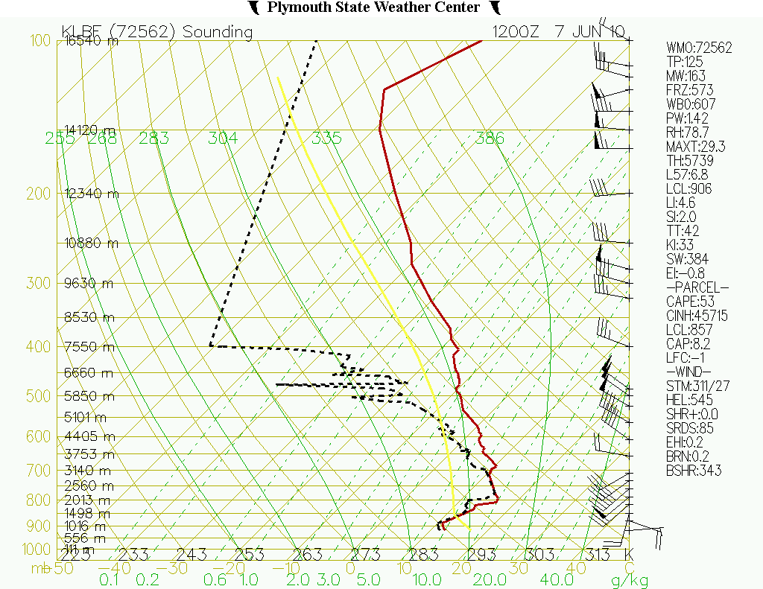

Slide 14
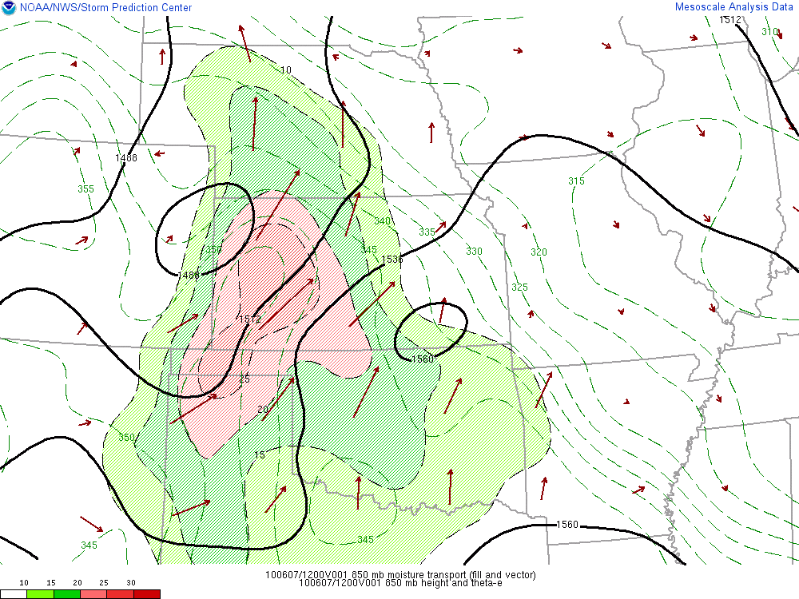
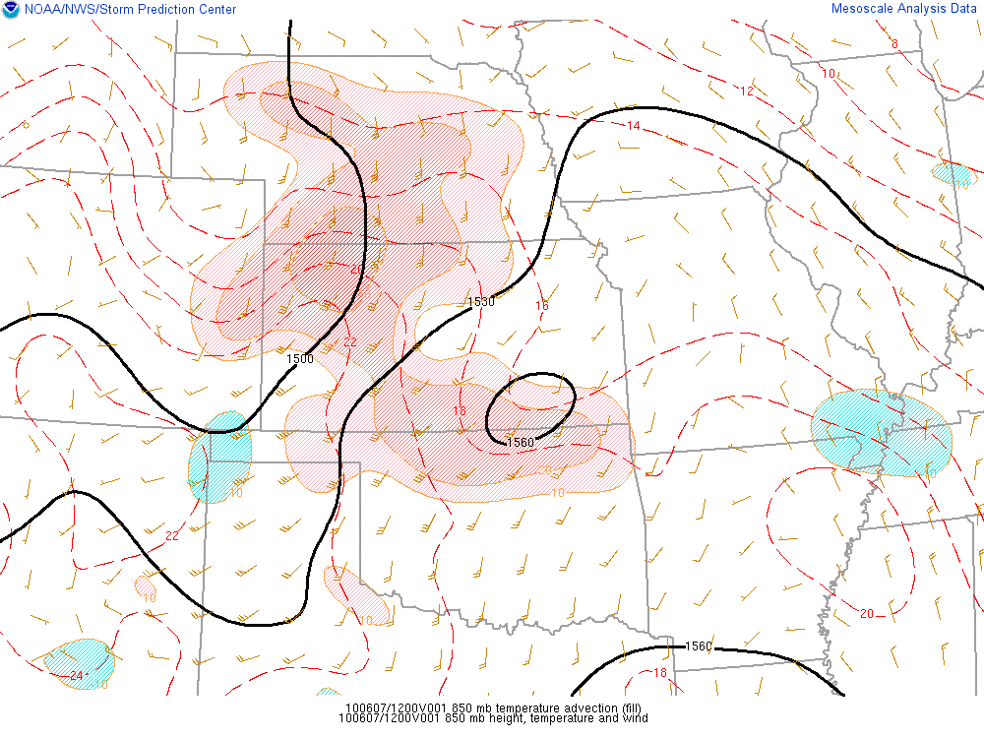
12 UTC 850mb M and T advection

Slide 15
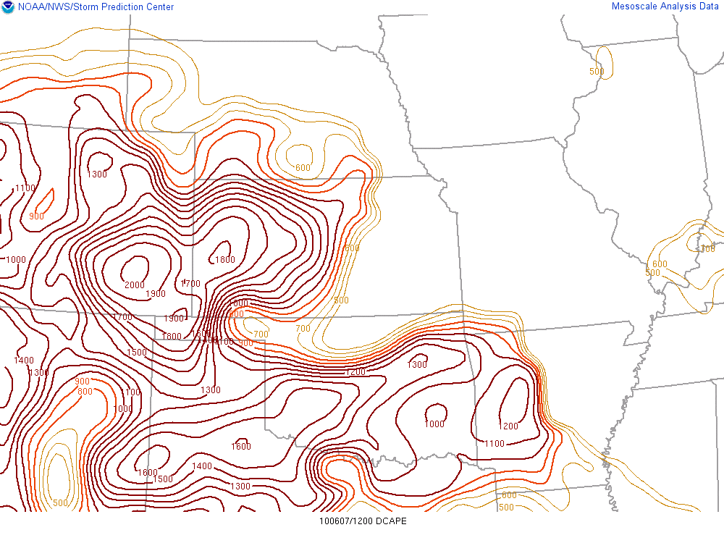
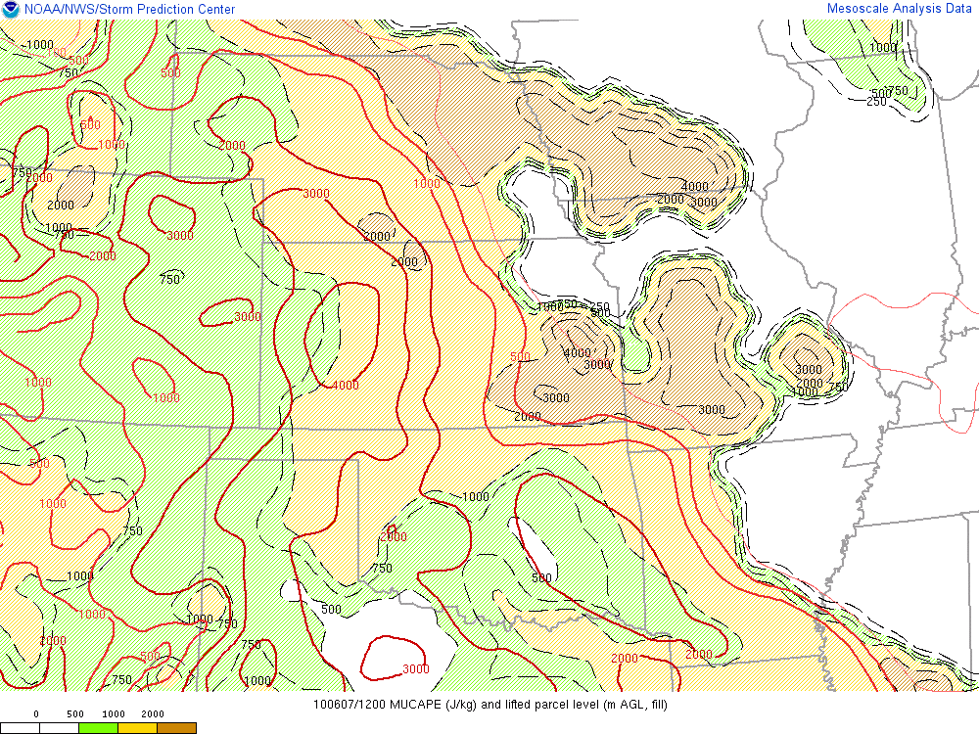
12 UTC MUCAPE vs DCAPE

Slide 16
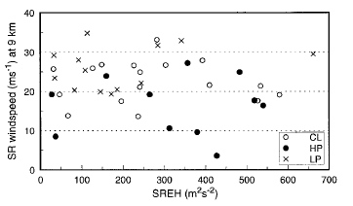
From Rasmussen and Straka, 1997
What are we dealing with?
Single Microburst?
Multicell cluster
HP Supercell?

Slide 17
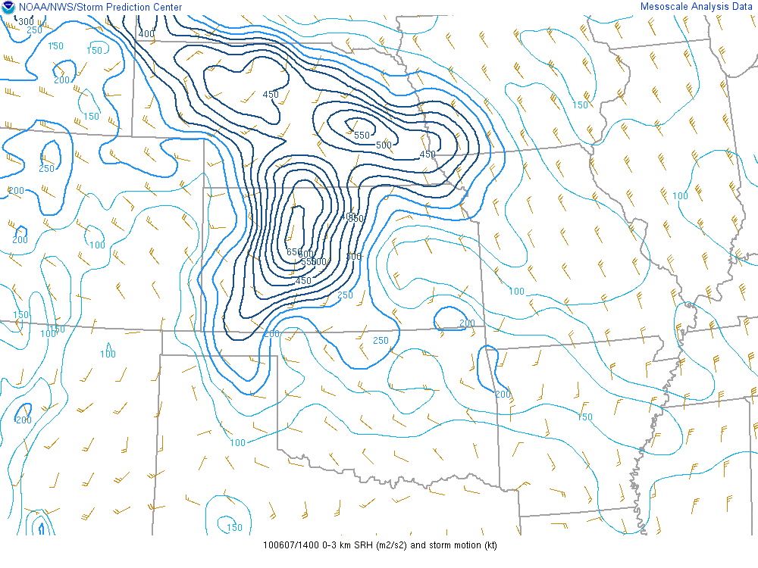
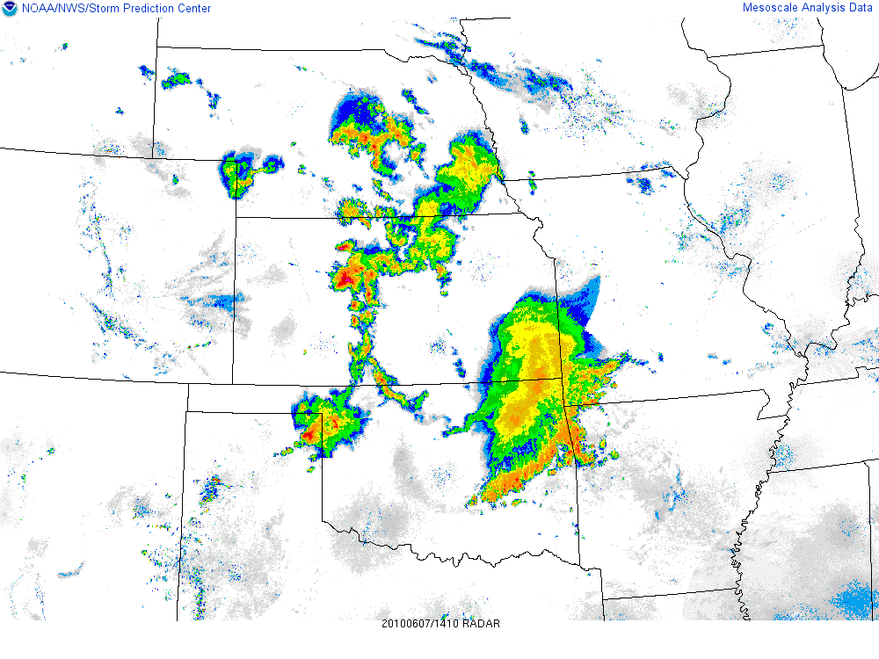
3 km SRH

Slide 18
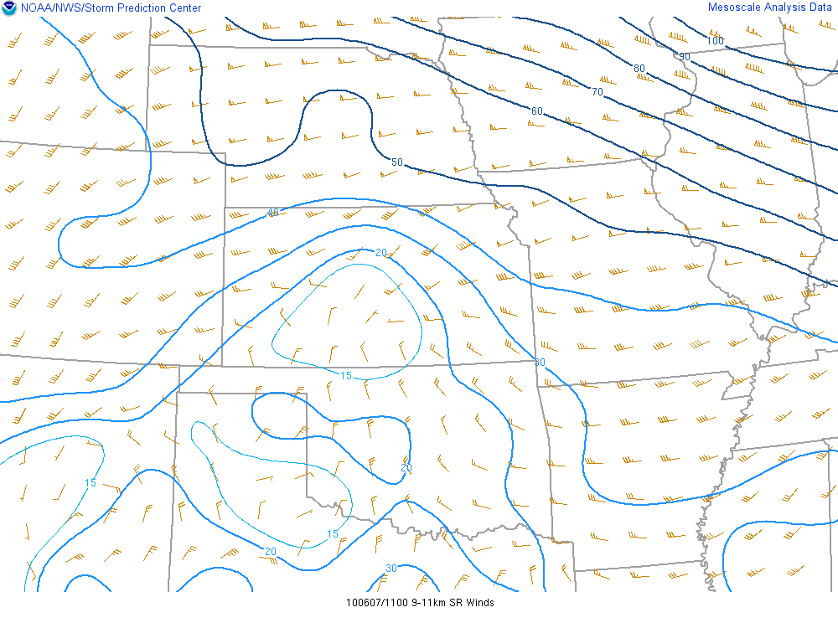
12 UTC 9-11km SR flow

Slide 19
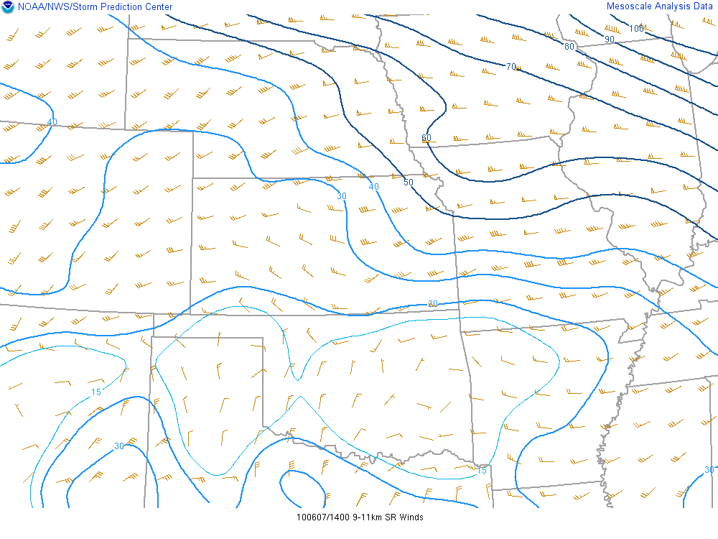
14 UTC 9-11km SR flow

Slide 20
From Rasmussen and Straka, 1997
Our local
Storm
environment

Slide 21
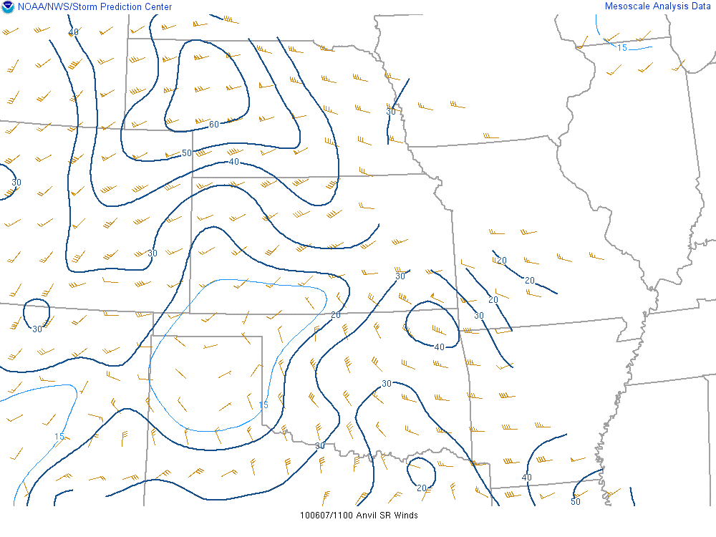
Anvil level SR Flow (12 UTC)

Slide 22
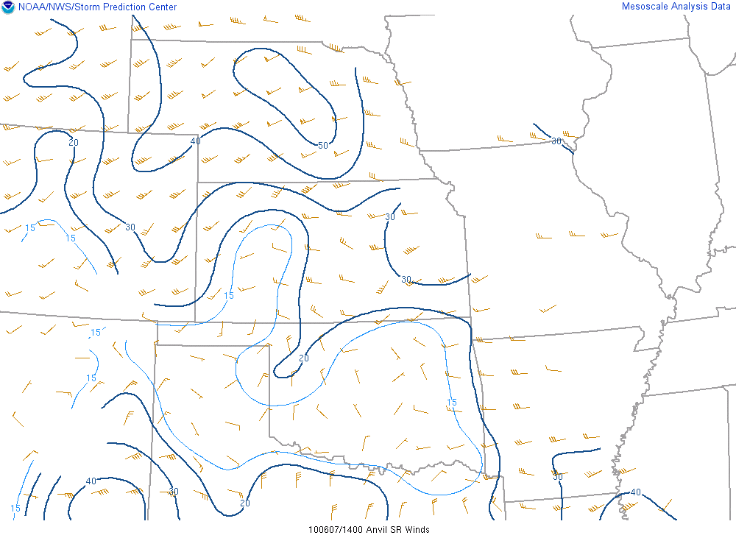
Anvil level SR Flow (14 UTC)
20-30 kt decrease in
Storm relative
Winds from 12 UTC

Slide 23
1996 SR Technical attachment (SR/SSD 96-43)
(Falk, et al)
Severe wind damage was correlated with 88D
- Descending high reflectivity core
- Mid level velocity convergence above cloud base
- Divergent winds near the surface (from radar)

Slide 24
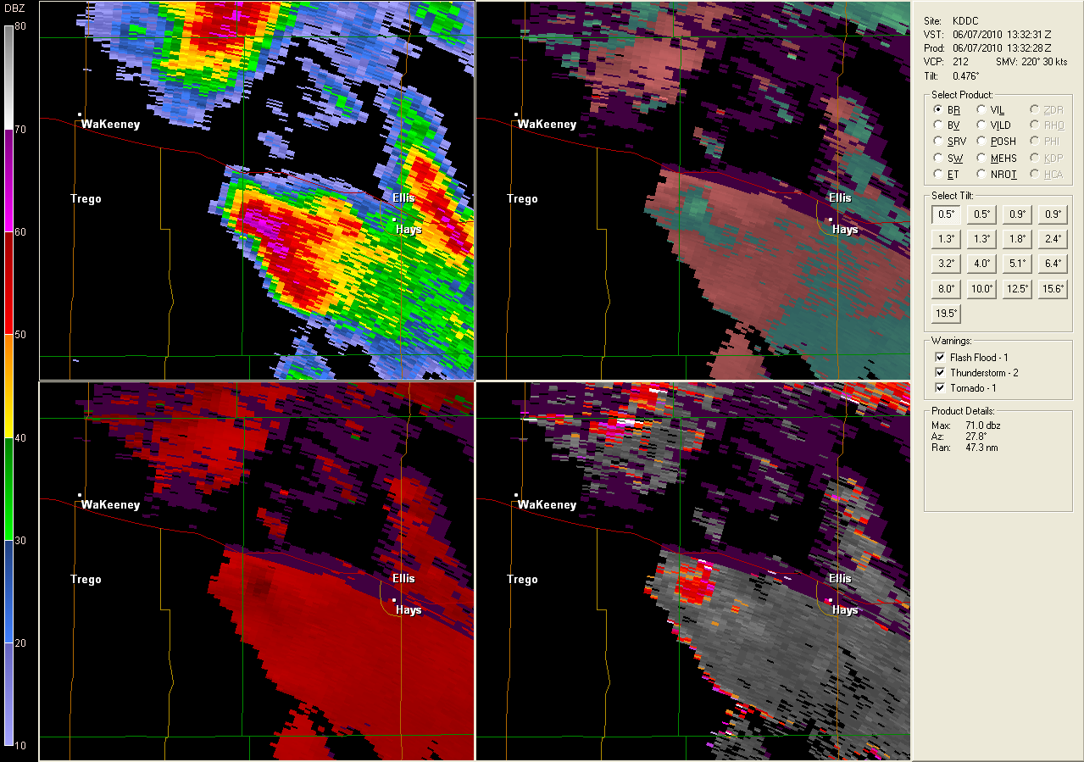
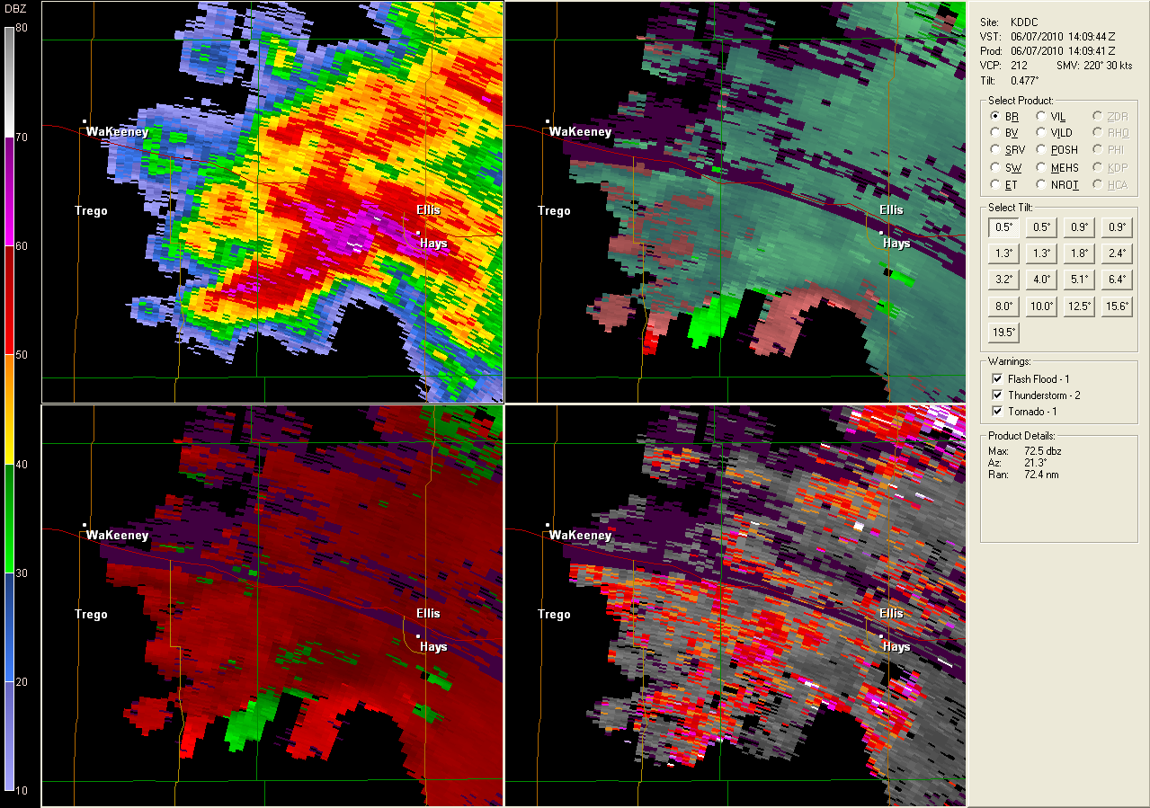

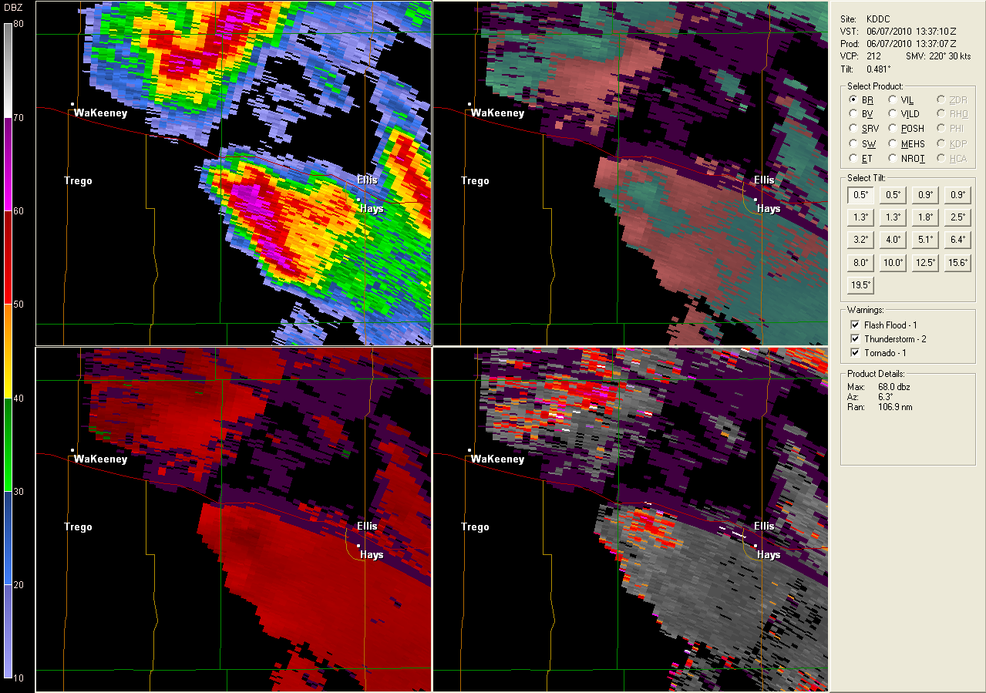
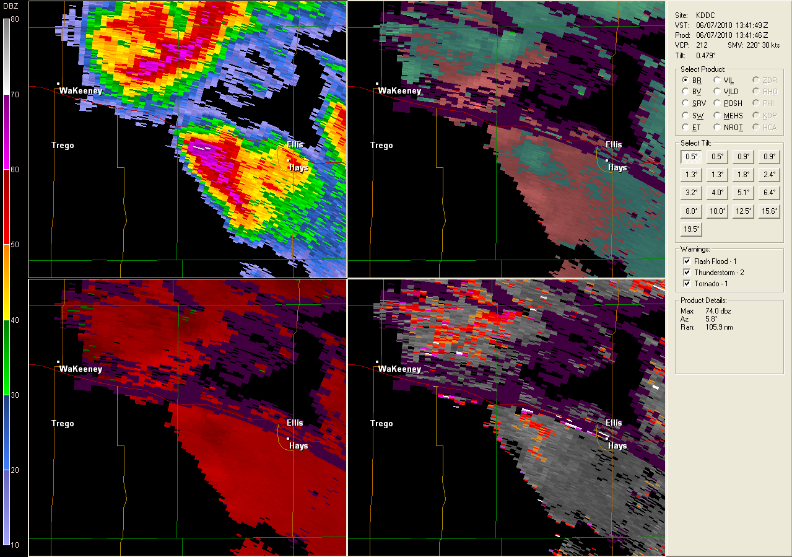
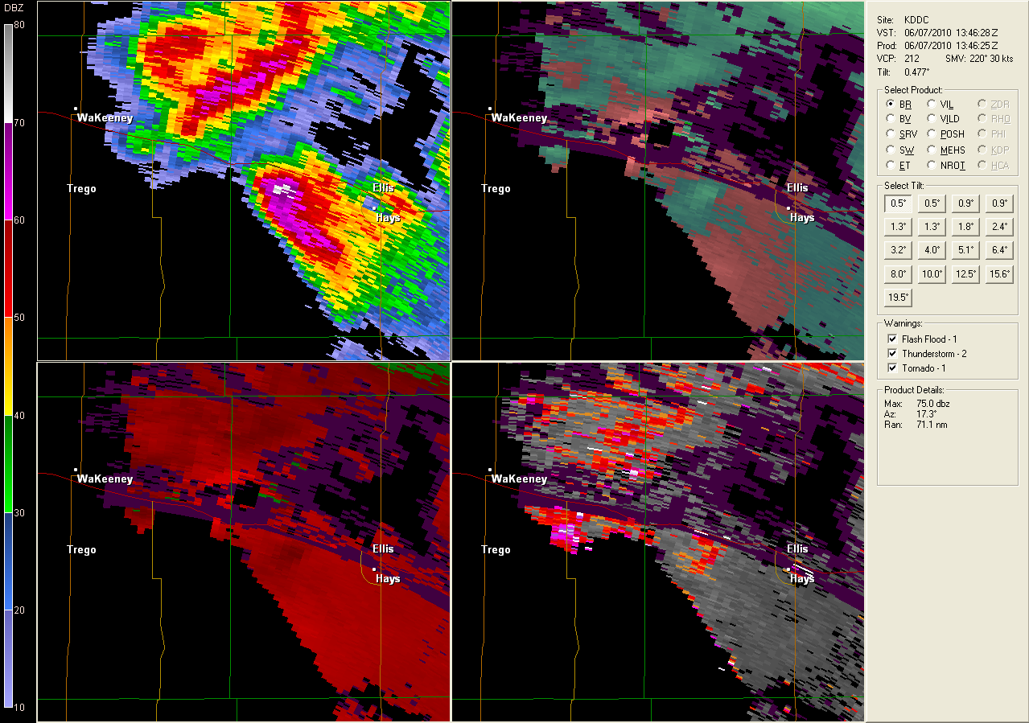
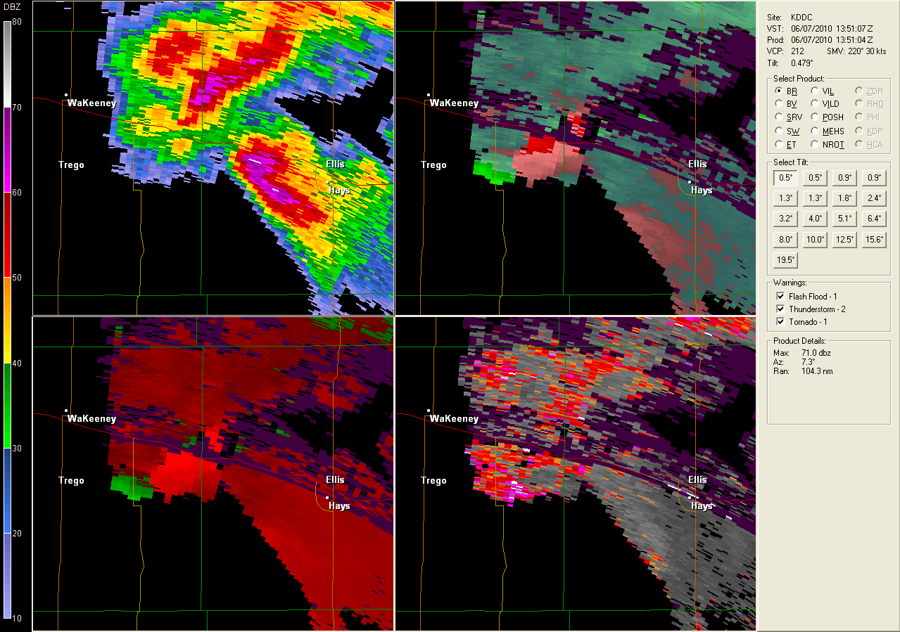
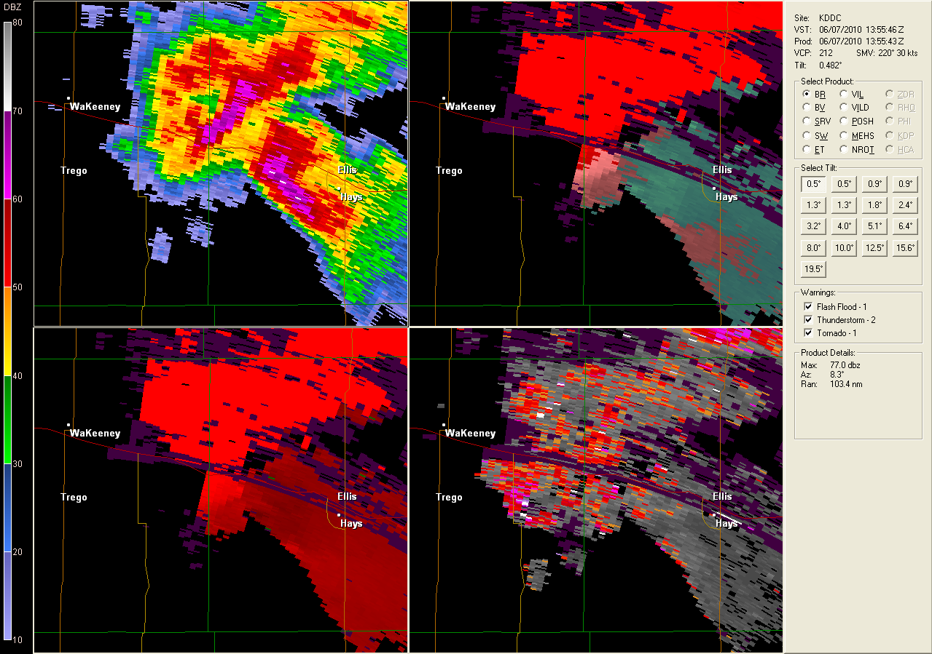
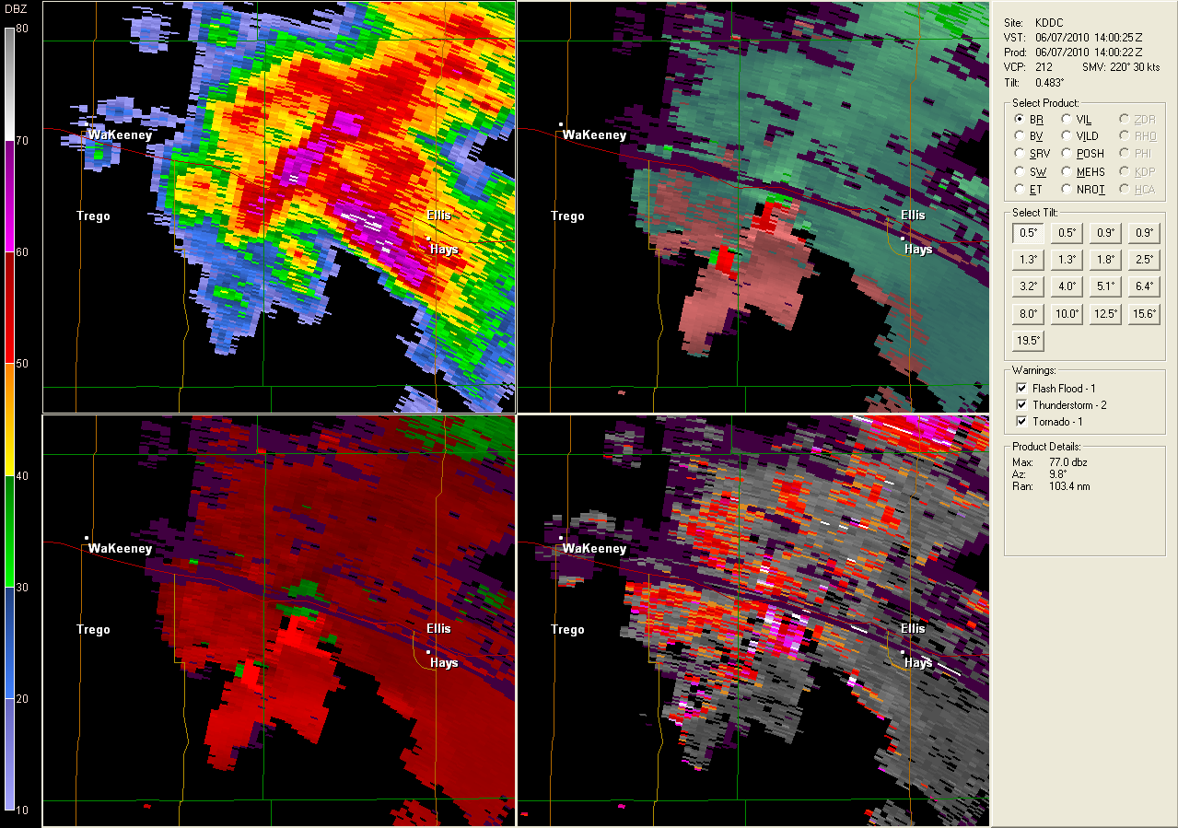
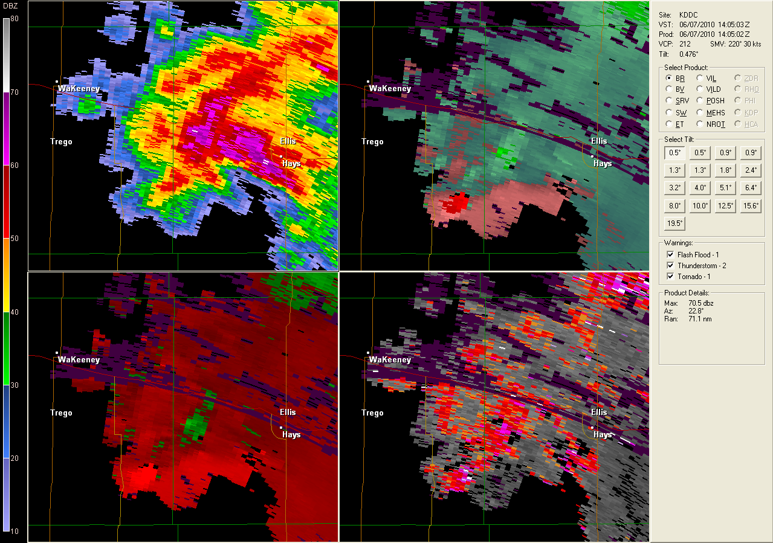

Slide 25
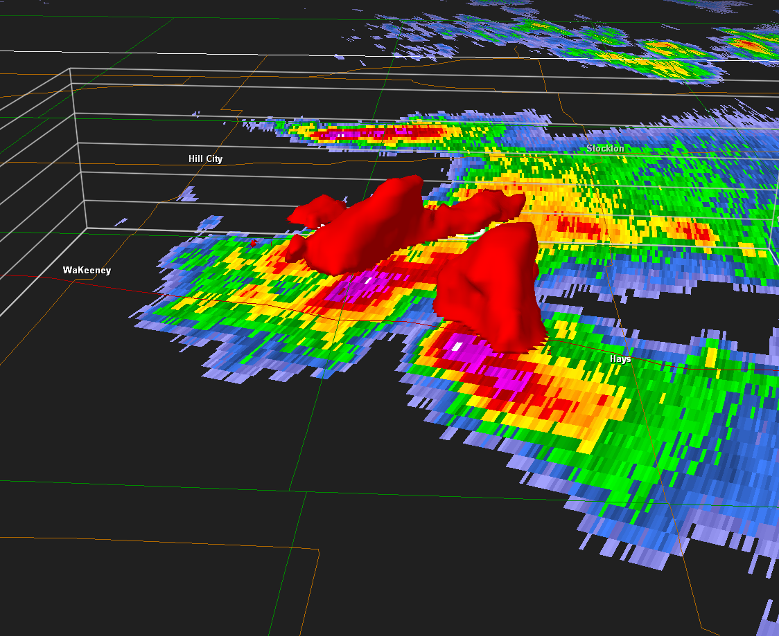
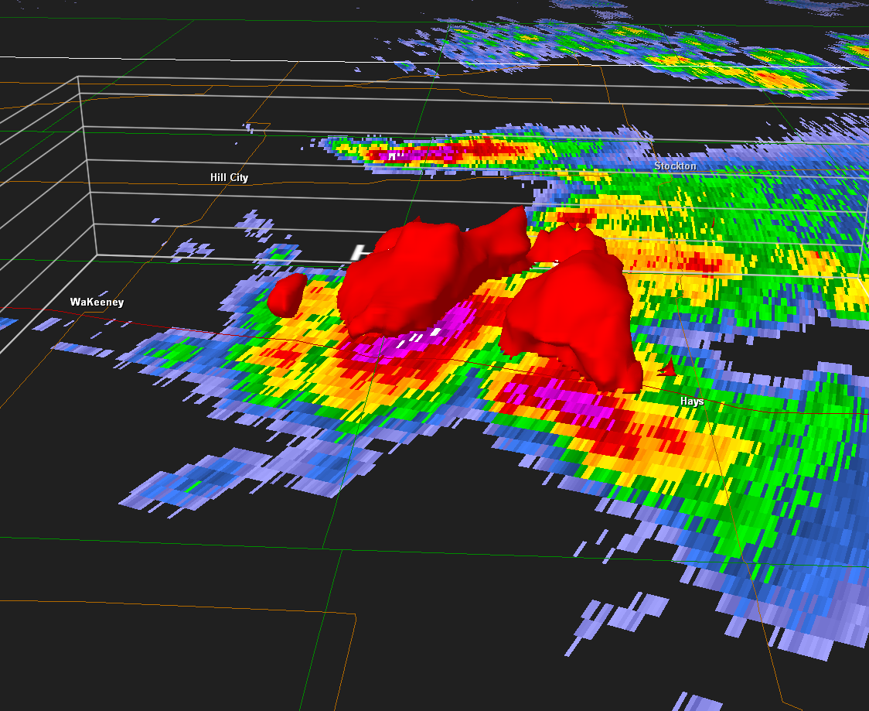
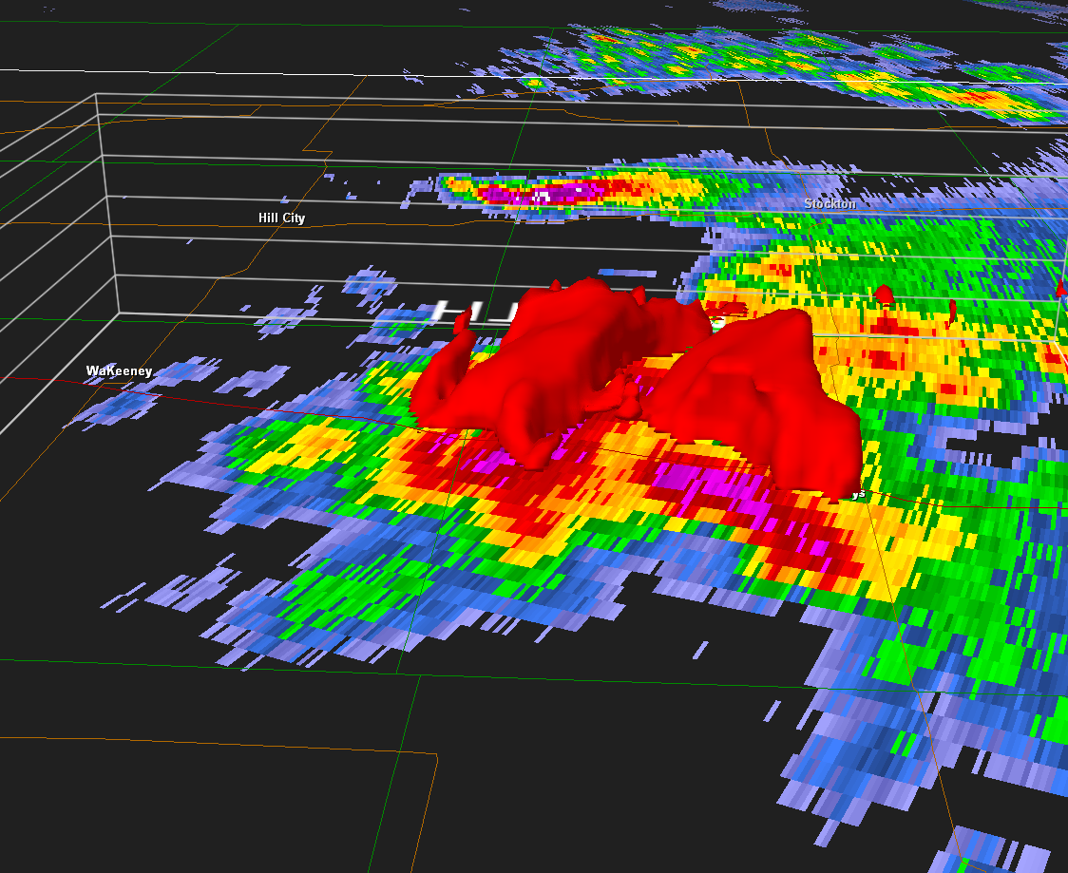
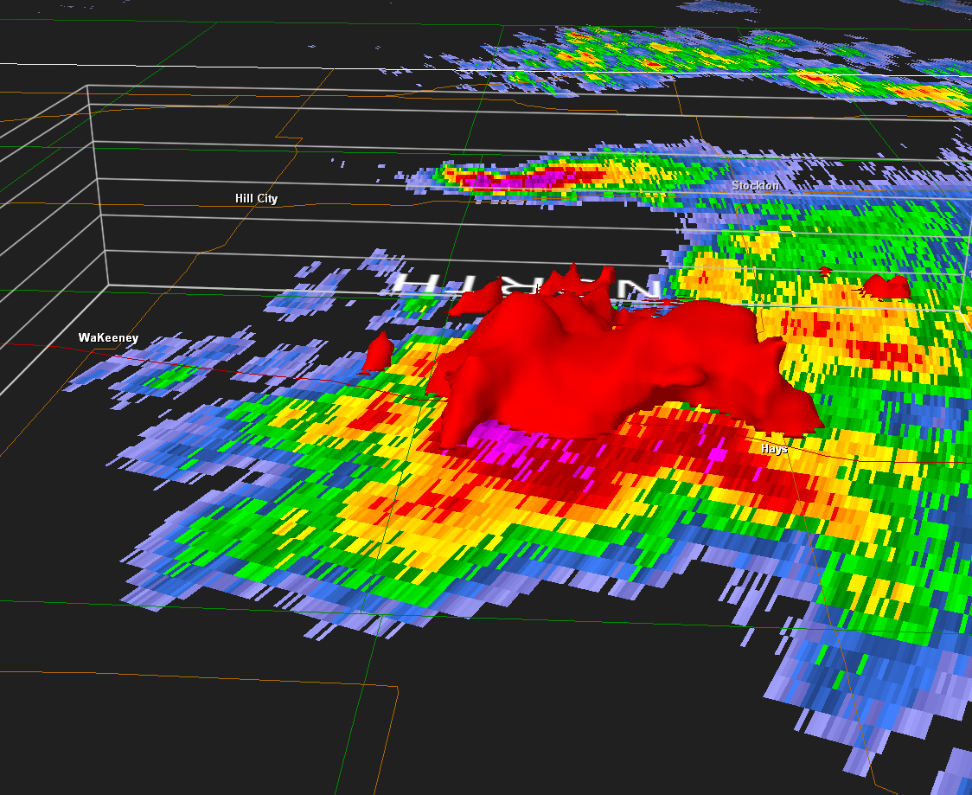
Time Lapse 1345 UTC-1404 UTC

Slide 26
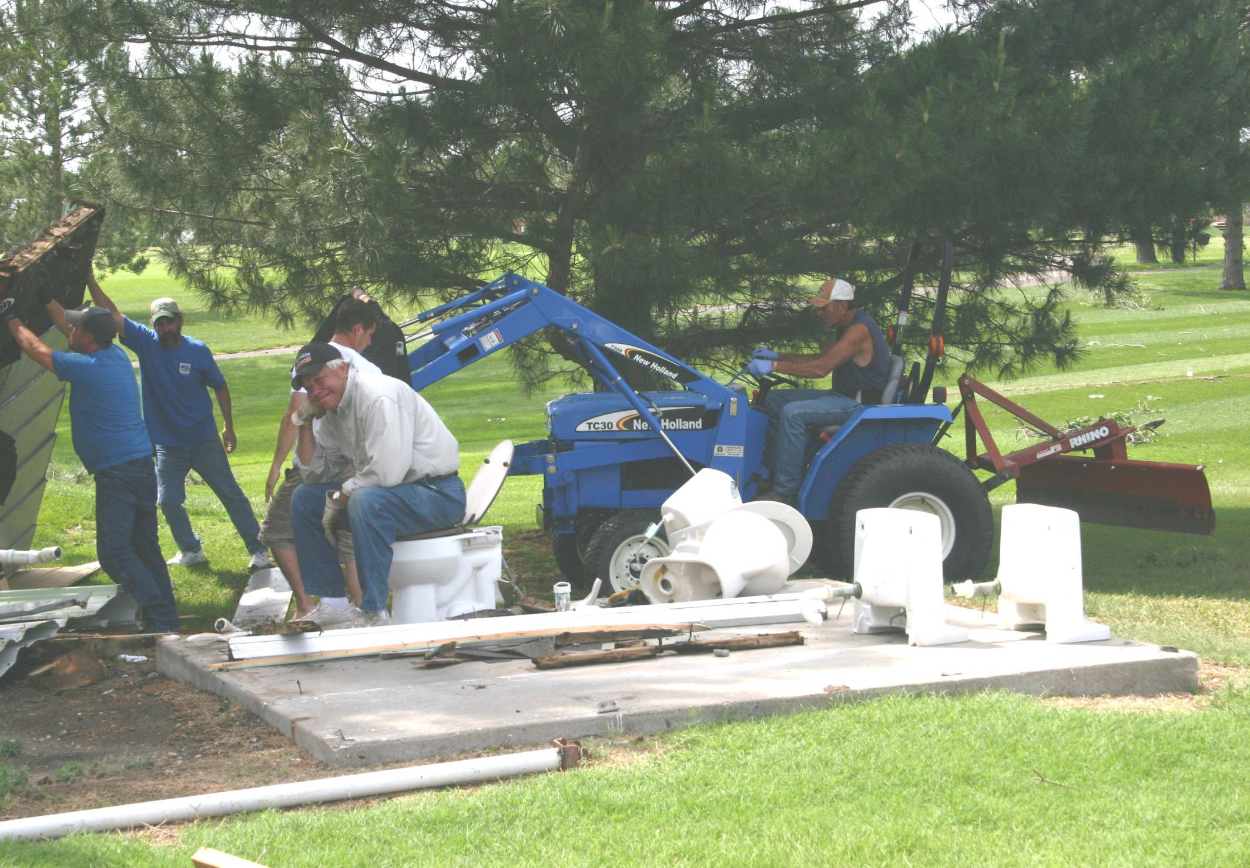
How could I have received better lead time?

Slide 27
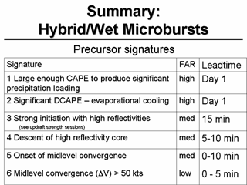
From AWOC

Slide 28
Other Conclusions - Mesoscale
Elevated Supercell environment but rapidly increasing instability at all levels.
  Wet end microburst type sounding at 12 UTC
  Significant dry air above mid levels , low LCL , Theta-E profiles appeared favorable
  Upper level (9-11 km) SR winds remained nearly steady while anvil level winds significantly decreased. While the majority of the convective supercells maintained an easterly track, the cluster of convection across north central Kansas became rooted in the region of higher helicity along the elevated warm front and propagated south into a significantly weakened anvil level storm relative flow environment. It is possible enhanced precipitation loading was a direct result. Additional precipitation loading may also have been contributed from colliding cells.
  A low level jet was ongoing during the early morning probably enhanced the low level shear and helicity across central Kansas creating an environment for better organized and longer sustained updrafts in addition to the already extremely unstable mid levels.

Slide 29
More Conclusions - Radar
  50 kt mid level convergence signature on KDDC radar collocated with high reflectivity core (1400 UTC).
  Storm relative flow decreased at the anvil level which may have contributed to additional precipitation loading. Precipitation loading may have been additionally enhanced by cell collision around 1400 UTC. New Cell growth appeared to build to the southwest.
  Once onset of initial downburst occurred radar may have indicated more definitely that strong winds were likely occurring from reflectivity bowing segments.

Slide 30
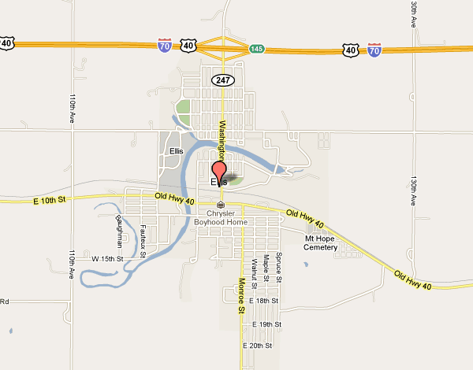
Wind direction based on evidence from NWS DDC Damage Survey
Easterly
Gust Front
with evidence
of divergent
flow

Slide 31
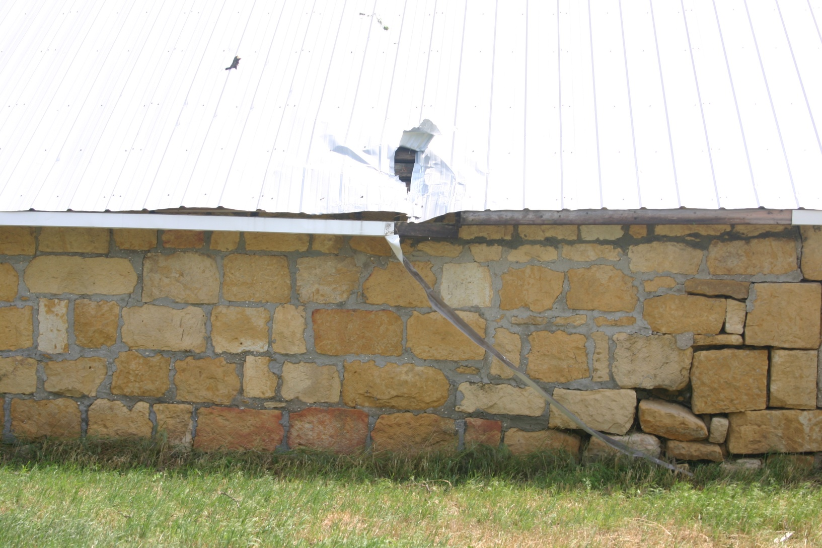
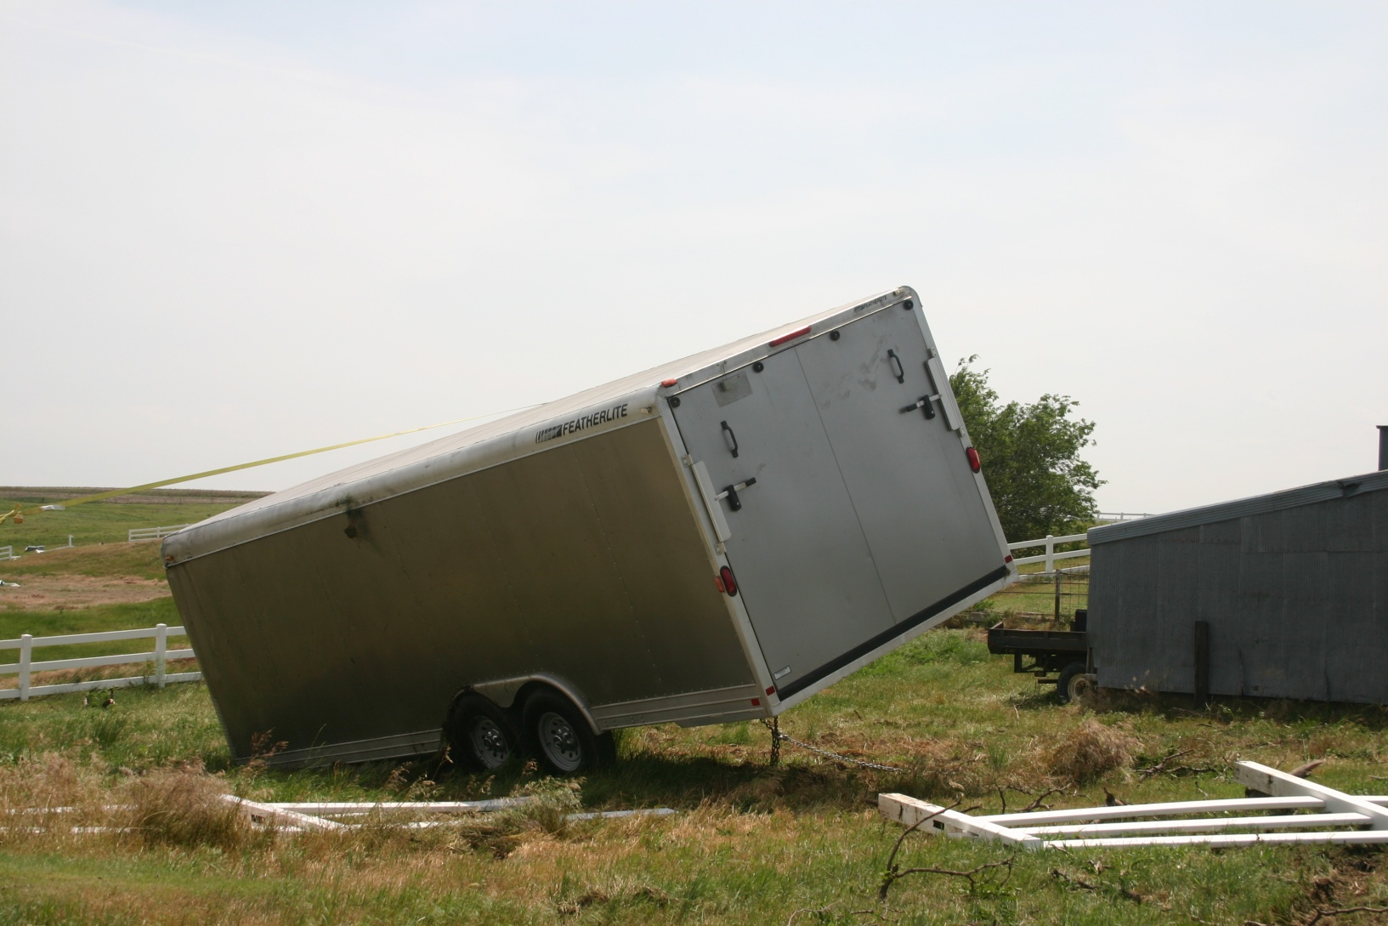
Trailer near building lofted and tossed a few tens of feet for the building .

Slide 32
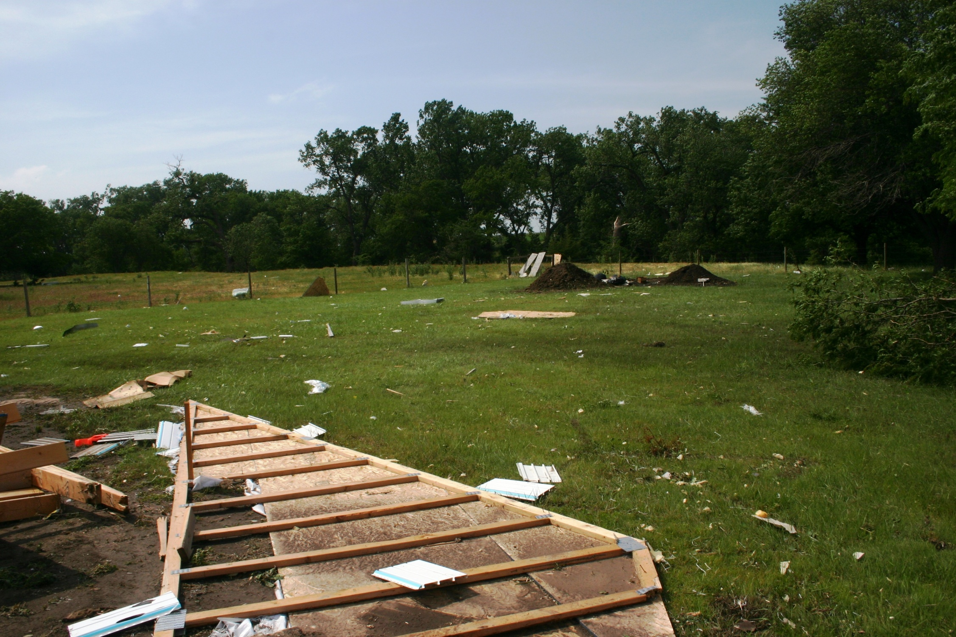

Slide 33
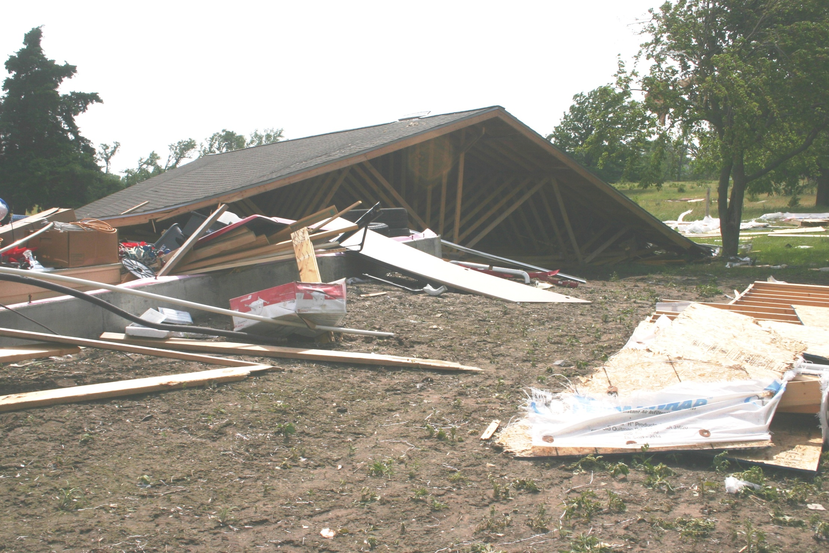

Slide 34


Slide 35


Slide 36

Uprooted Tree

Slide 37


Slide 38

Tree damage

Slide 39


Slide 40
References
Nolan T. Atkins and Roger M. Wakimoto. 1991: Wet Microburst Activity over the Southeastern United States: Implications for Forecasting. Weather and Forecasting: Vol. 6, No. , pp. 1148–1164.
Srivastava. 1985: A Simple Model of Evaporatively Driven Downdraft: Application to Microburst Downdraft. Journal of the Atmospheric Sciences: Vol. 42, No. 10, pp. 1004-1023.
Advanced Warning Operations Course. (National Weather Service)
Rasmussen, E. N. and J. M. Straka. 1997: Variations in Supercell Morphology. Part I: Observations of the role of Upper-Level Storm Relative Flow. Monthly Weather Review: Vol. 126, pp. 2406–2421.
Falk, K. W., and L. Harrison, 1996: Waskom, Texas, Single Cell Microburst Detected on National Weather Service Doppler Radar – July 23, 1996. Technical Attachment SR/SSD 96-43.

Slide 41
References
Rasmussen, E. N. and J. M. Straka. 1997: Variations in Supercell Morphology. Part I: Observations of the role of Upper-Level Storm Relative Flow. Monthly Weather Review: Vol. 126, pp. 2406–2421.
Falk, K. W., and L. Harrison, 1996: Waskom, Texas, Single Cell Microburst Detected on National Weather Service Doppler Radar – July 23, 1996. Technical Attachment SR/SSD 96-43.
Nolan T. Atkins and Roger M. Wakimoto. 1991: Wet Microburst Activity over the Southeastern United States: Implications for Forecasting. Weather and Forecasting: Vol. 6, No. , pp. 1148–1164.
Srivastava. 1985: A Simple Model of Evaporatively Driven Downdraft: Application to Microburst Downdraft. Journal of the Atmospheric Sciences: Vol. 42, No. 10, pp. 1004-1023.
Advanced Warning Operations Course. (National Weather Service)

