Slide 1

“Collaboration between Storm Chasers and Local NWS offices”
A WCM perspective
Stan Rose
Notes:
Collaboration between Storm Chasers and Local NWS Offices – How chasers can help local NWS offices even more.

Slide 2
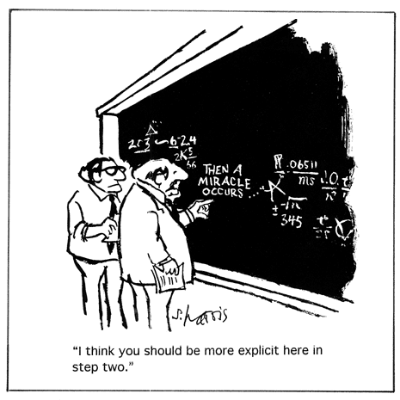
A WCM perspective

Slide 3
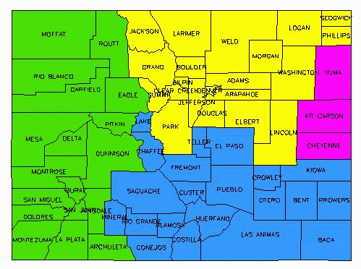
NWS Pueblo’s CWA
Notes:
WFO Pueblo’s area of responsibility in Colorado – shaded blue. A note to storm chasers. A supercell can pass from our CWA to Boulder’s, to Goodland’s and back to ours as it moves east-southeast through Colorado.

Slide 4
NWS Pueblo’s CWA
Leadville
Kansas
Colorado Springs
Salida
Eads
Pueblo
La Junta
Lamar
Walsenburg
Wolf Creek Pass
Alamosa
Trinidad
Springfield
New Mexico
Notes:
The National Weather Service office in Pueblo is responsible for the Upper Arkansas Valley, and south central and southeast Colorado…around 32,000 square miles. Elevation range is from 3300 feet to 14,440 feet. The majority of severe weather occurs from the Interstate 25 corridor eastward.

Slide 5
Background
Been the WCM at WFO Pueblo for
15 years
There has been an evolution of
available SKYWARN spotters and
storm chasers across the CWA
Wide open spaces in southern CO

Slide 6
Background
An avg. of a dozen tornadoes each
year across the CWA
An avg. of 250 SVRs, TORs, and
FFWs each year

Slide 7
Storm Data Purposes
Local NWS offices need to provide the most detailed and accurate storm information we can find…
Location
Timing
Size and magnitude
Notes:
For Storm Data…the official severe weather database of the NWS…we need to provide the most detailed, accurate information on hail, wind, and tornadoes possible. The database is used by a variety of customers, including researchers, insurance companies, other private businesses, etc.

Slide 8
Mission Statement
The National Weather Service (NWS) provides weather, hydrologic, and climate forecasts and warnings for the United States, its territories, adjacent waters and ocean areas, for the protection of life and property and the enhancement of the national economy. NWS data and products form a national information database and infrastructure which can be used by other governmental agencies, the private sector, the public, and the global community. “
Notes:
For Storm Data…the official severe weather database of the NWS…we need to provide the most detailed, accurate information on hail, wind, and tornadoes possible. The database is used by a variety of customers, including researchers, insurance companies, other private businesses, etc.

Slide 9
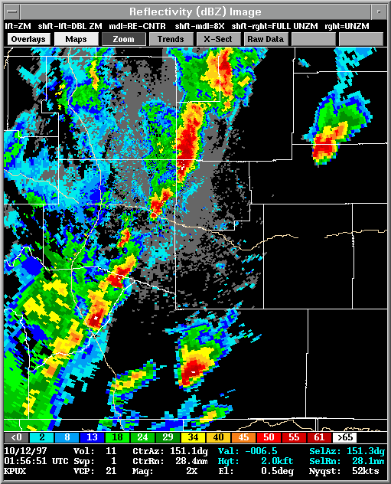
10/11/97 – southeast CO
Notes:
Back in the ‘90s, detailed information on tornadoes was hit and miss. In this case classic and HP supercells produced several tornadoes across southeast Colorado before and after nightfall. Descriptions of tornado occurrences were sketchy, except were short damage paths were recognized. There was much guess work that went into the descriptions of the events.

Slide 10
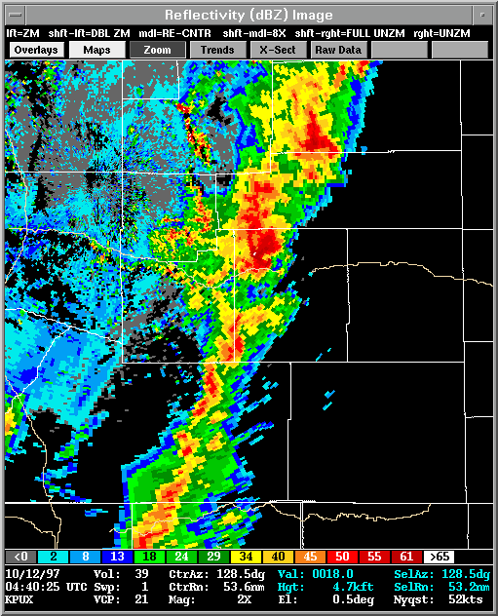
10/11/97 – southeast CO
Notes:
Nice HP supercell that produced damage near Las Animas in Bent County (slightly up from center).

Slide 11
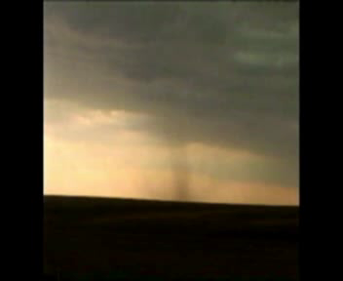
6/16/2004 – Bent County
Roger Hill
Notes:
In 2004 collaboration between chasers and WFO Pueblo could have been better. This video shot be Roger Hill was received in the Spring of 2005. It was used in spotter training in 2006. There was no real time or post-episode conversations.

Slide 12
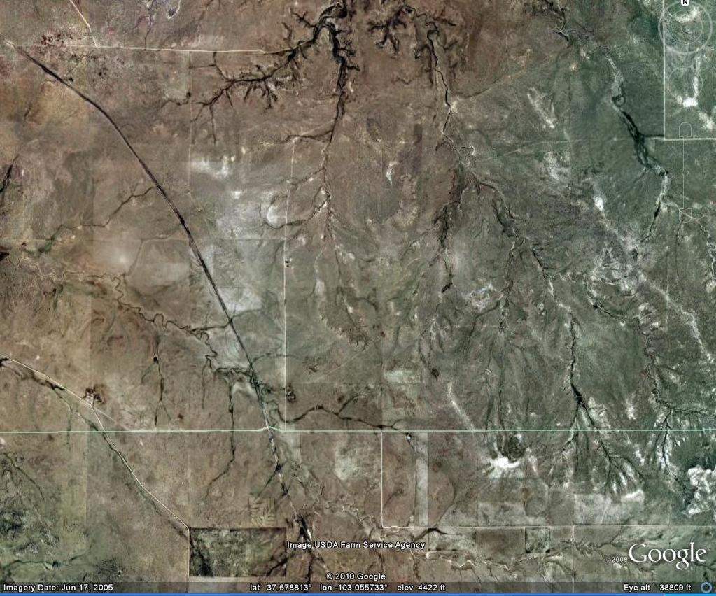
6/16/2004 – Bent County
35 square miles
Crandell’s house
house
Notes:
The tornado and RFD occurred in southern Bent County. In the 35 square mile area above, there were two houses, the Crandells and another a few miles south. The Crandell’s house was in the cross-hairs of either the tornado or RFD.

Slide 13
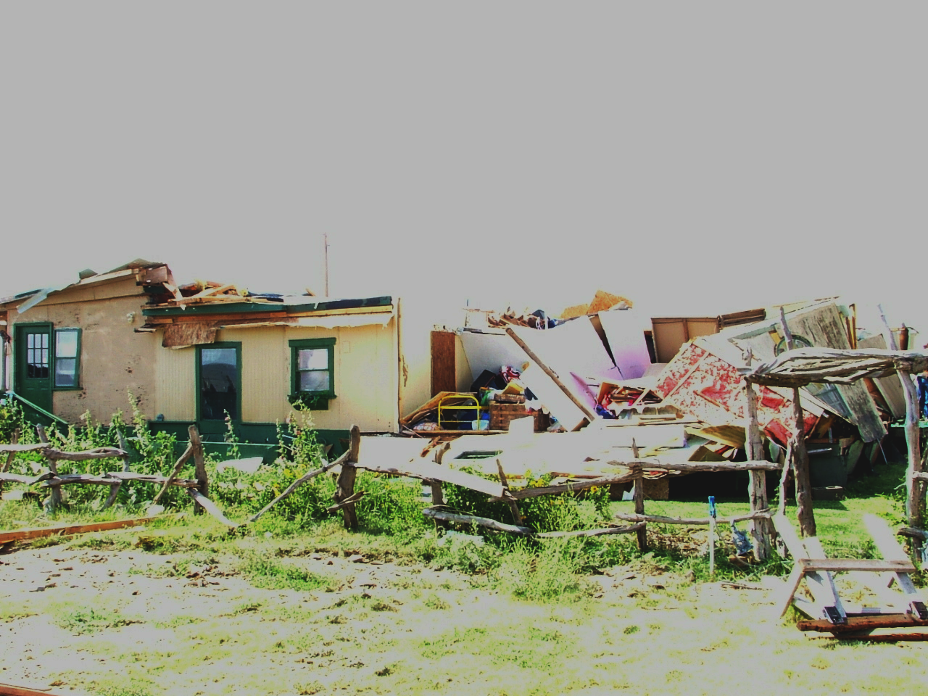
6/16/2004 – Bent County
Notes:
EF2 damage occurred on the Crandell’s property. Without this direct hit, it would have been difficult to figure out a precise location of the tornado, and impossible to assign an EF number other than 0.

Slide 14
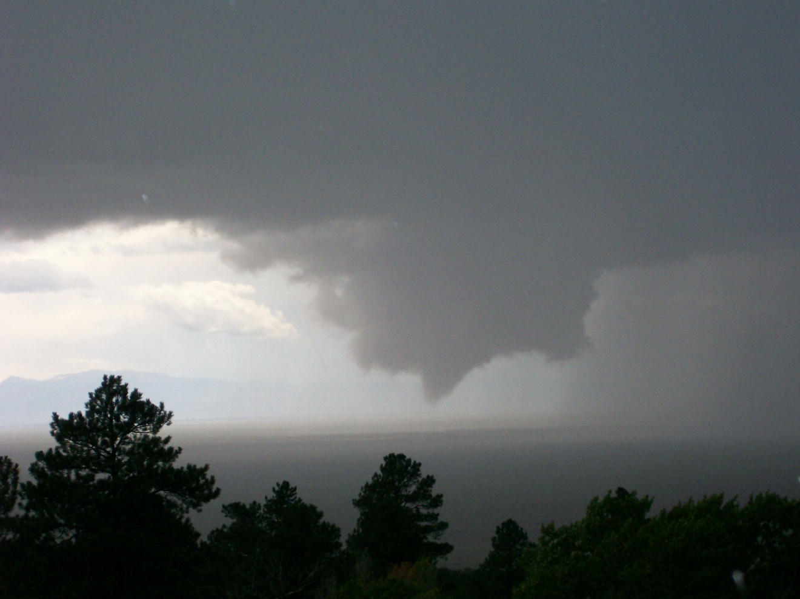
8/16/2008 – San Luis Valley
Notes:
This photo was taken several hundred feet above the feature at a distance of over 25 miles. It would have been difficult to determine an exact location of this short-lived tornado.

Slide 15
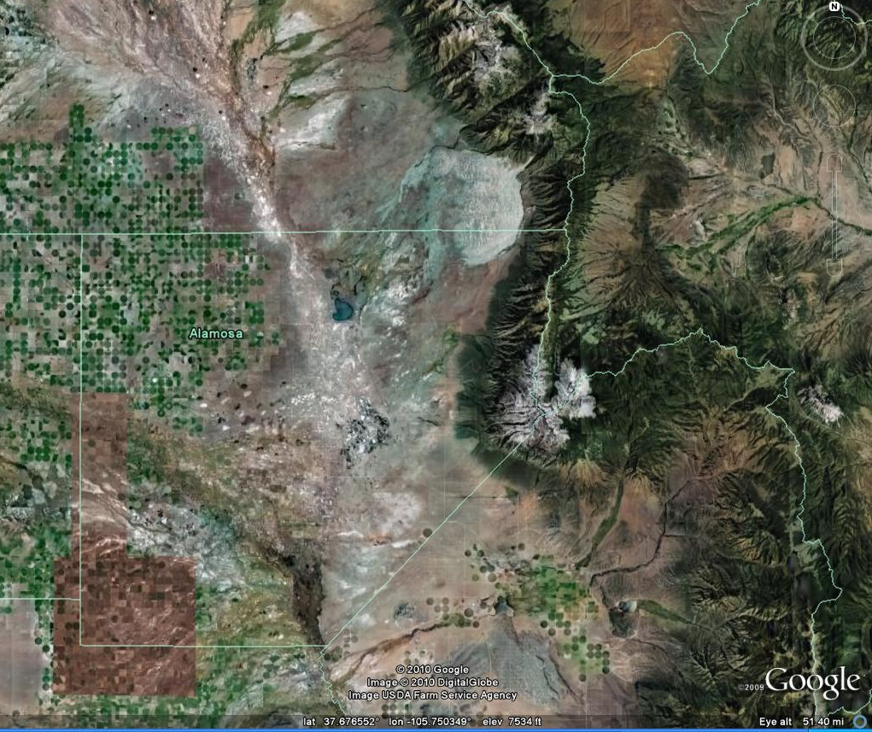
8/16/2008 – San Luis Valley
Great Sand Dunes
San Luis Lake
Notes:
The tornado occurred over open country between Alamosa and the Great Sand Dunes in the San Luis Valley, a high, desert valley in south central Colorado.

Slide 16
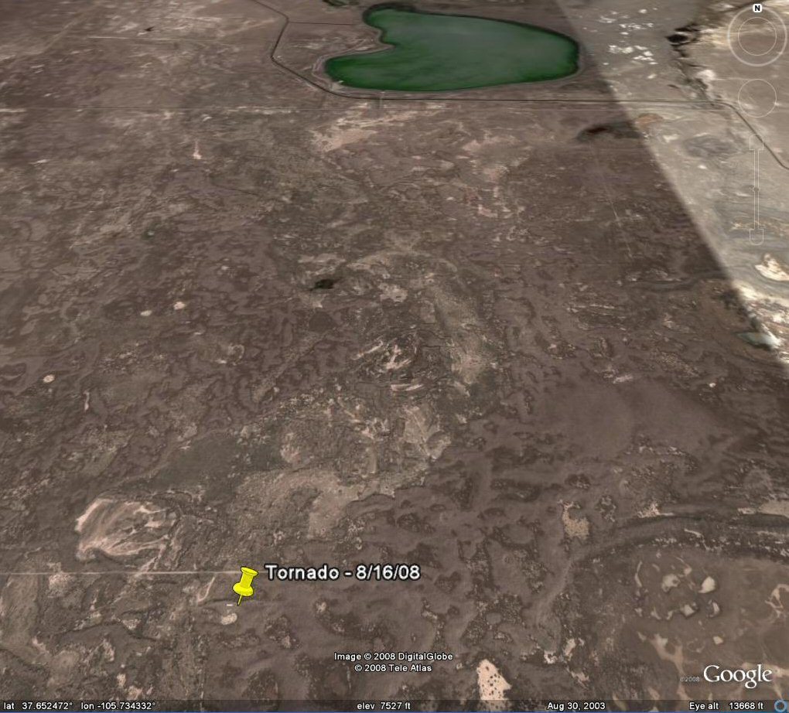
8/16/2008 – San Luis Valley
20 square miles
Notes:
In this 20 square mile area, there are a few dirt roads and grazing land for cattle and bison. But, notice the small horizontal “line” just to the left the yellow push pin.

Slide 17
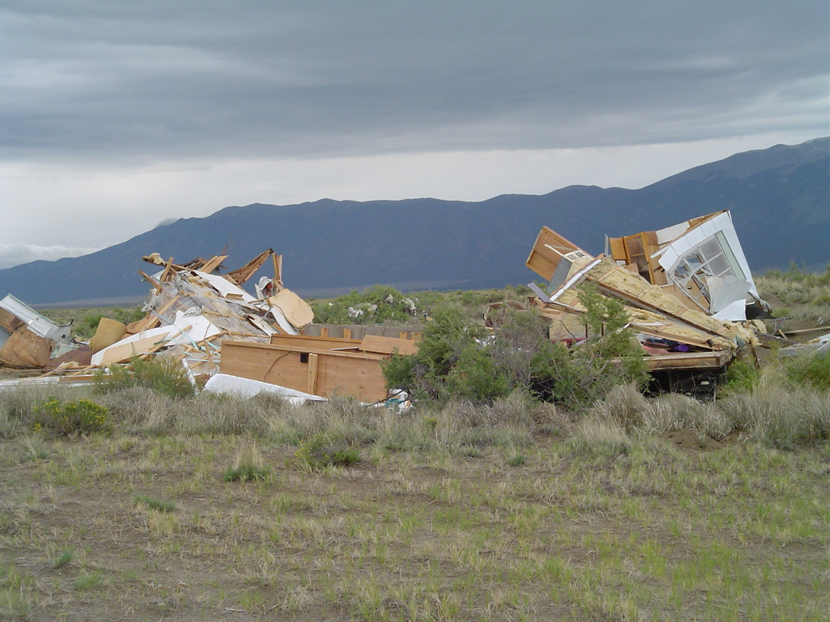
8/16/2008 – San Luis Valley
Notes:
The tornado hit the only man-made object in the immediate area, a seasonal mobile home. This enabled a precise location of the event, and a rating of EF1.

Slide 18
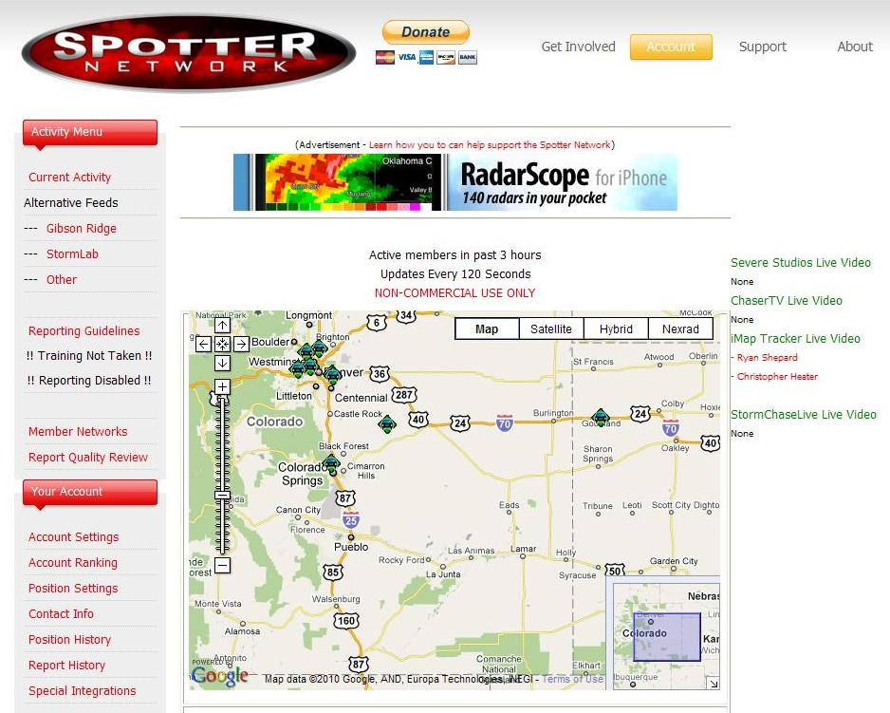
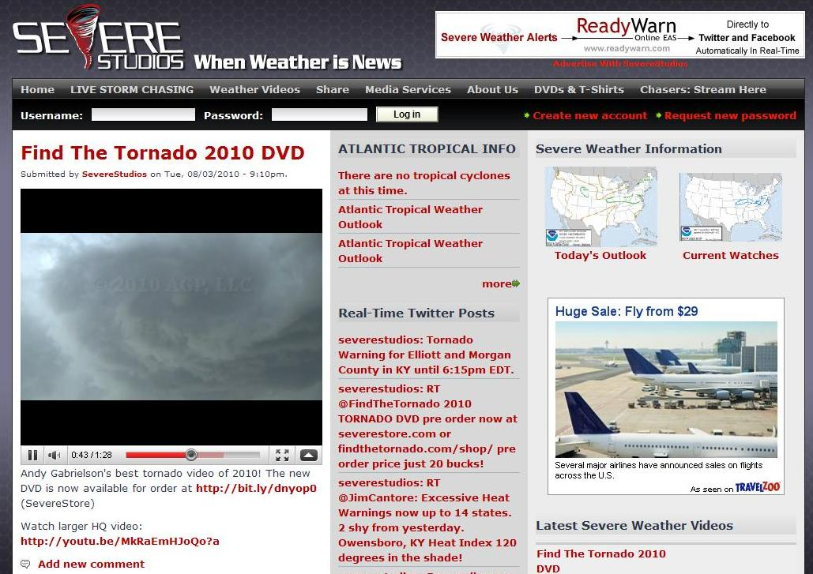
Collaboration with Chasers
For real-time reports and information
Notes:
WFO Pueblo has been using Spotter Network since 2006 for location of spotters/chasers in our CWA, and it has been a very effective collaboration tool. As you know, chasers are given a contact phone number for the local WFO when he or she submits a report. We also tap into Severe Studios live streaming video.

Slide 19
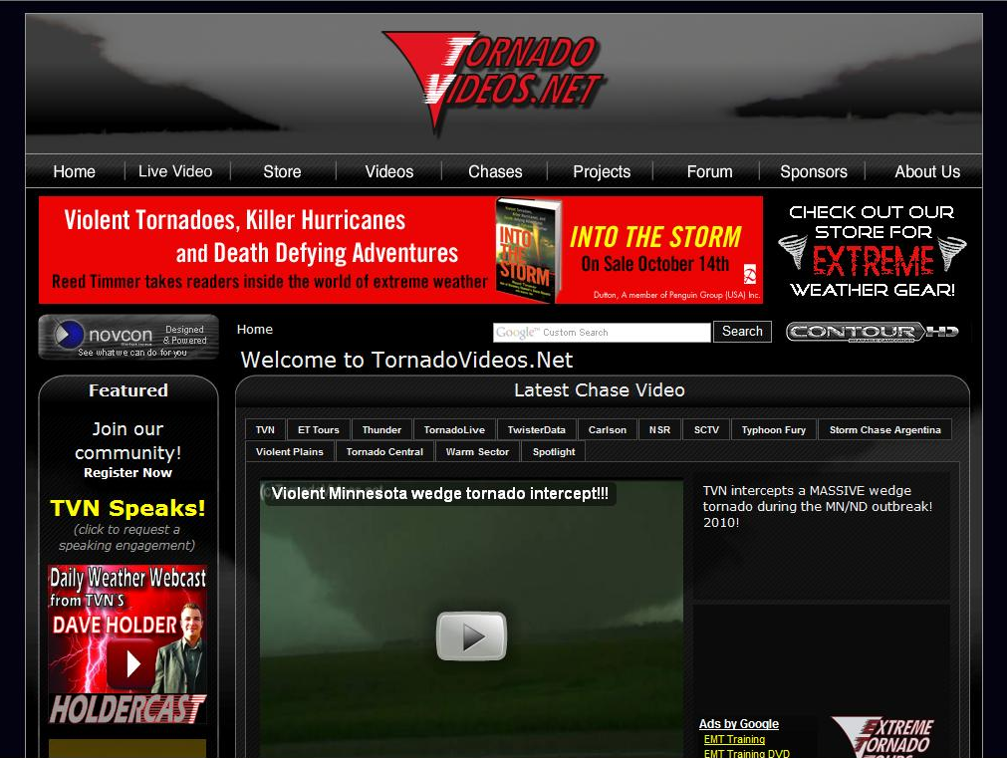
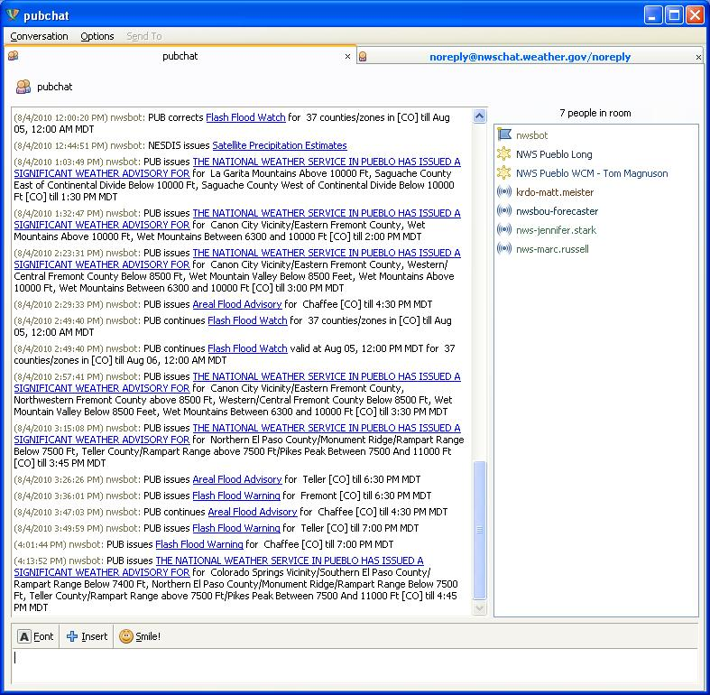
Collaboration with Chasers
For real-time reports and information
Notes:
And Tornado Videos as well. Sometimes a chaser will be in contact with a person who is logged into NWS Chat, and reports are relayed in that manner.

Slide 20

Collaboration with Chasers
For real-time reports and information
And, of course,
mobile or land line.
Notes:
Occasionally, WFO Pueblo will get phone calls from chasers on our severe weather line.

Slide 21

But…what’s a WCM to do
for detailed post-episode information ???
It can be quite an issue
across the high plains !!!

Slide 22
What’s a WCM to do
for detailed post-episode information ???
So far in 2010...36 tornadoes
April 22nd - 13 tornadoes
May 25th - 15 tornadoes
May 31st - 3 tornadoes
Notes:
2010 has been a particularly challenging season across the WFO Pueblo CWA. Surely, this is routine for some WFOs across the central US. On April 22nd, one cyclic supercell produced 13 tornadoes with the mesocyclone and on the storm’s east edge. On May 25th, an amazing landspout fest occurred over Kiowa County, producing 12 landspouts and one mesocyclone tornado. On May 31st, Memorial Day, a day to remember, three tornadoes occurred with a very slow moving supercell across Baca County. Without the assists of several storm chasers, these episodes would have been very difficult to piece together in a timely fashion.

Slide 23
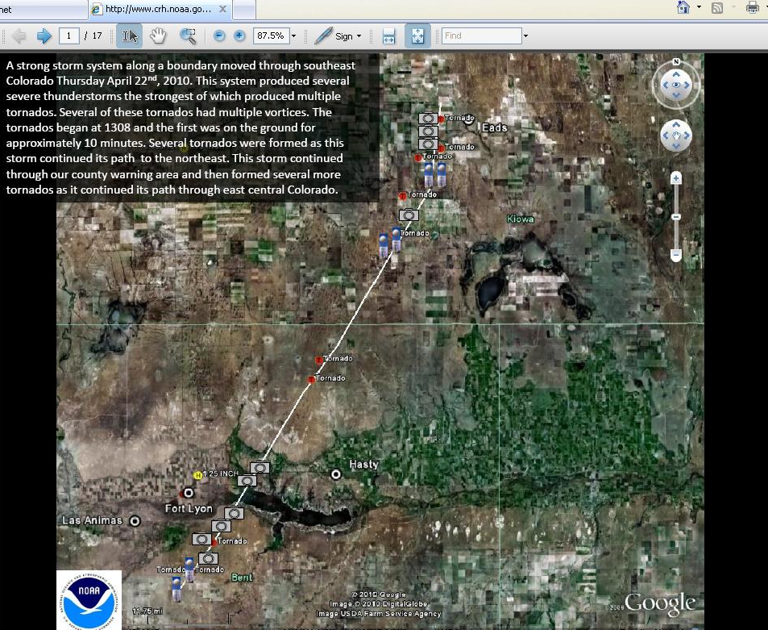
April 22nd 2010
News Story on WFO Pueblo’s Web site
Notes:
I say that because local WFOs are “required” to get a News Story posted on their Web sites as soon as possible after an episode has occurred. Initially, there is usually an somewhat incomplete account of the episode, then more details are added after the TSI (tornado scene investigation) takes place.

Slide 24
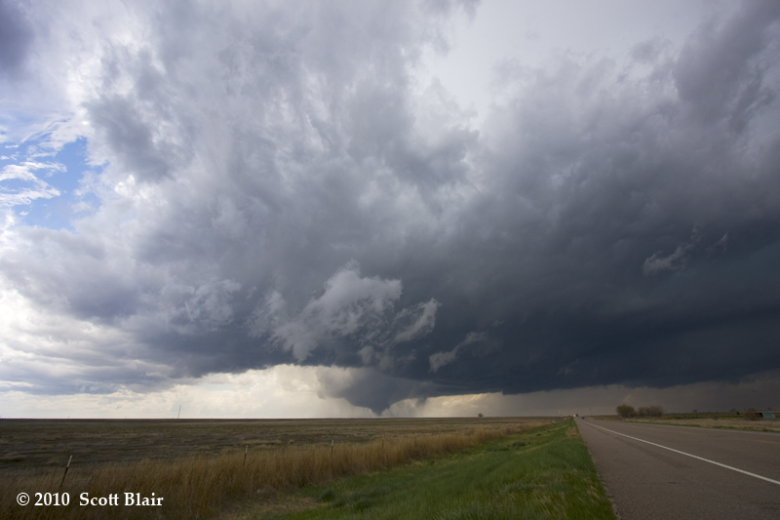
April 22nd 2010
13 tornadoes in Bent and Kiowa Counties from 1:05 p.m. to 3:14 p.m.
Notes:
A prolific supercell produced 13 tornadoes in just over two hours. This was the first one, observed by hundreds of people near Las Animas, Colorado, and captured here by Scott Blair along US Highway 50 in Bent County. Note the RFD cut to the east of the tornado. You are looking west, and the storm was moving north-northeast.

Slide 25
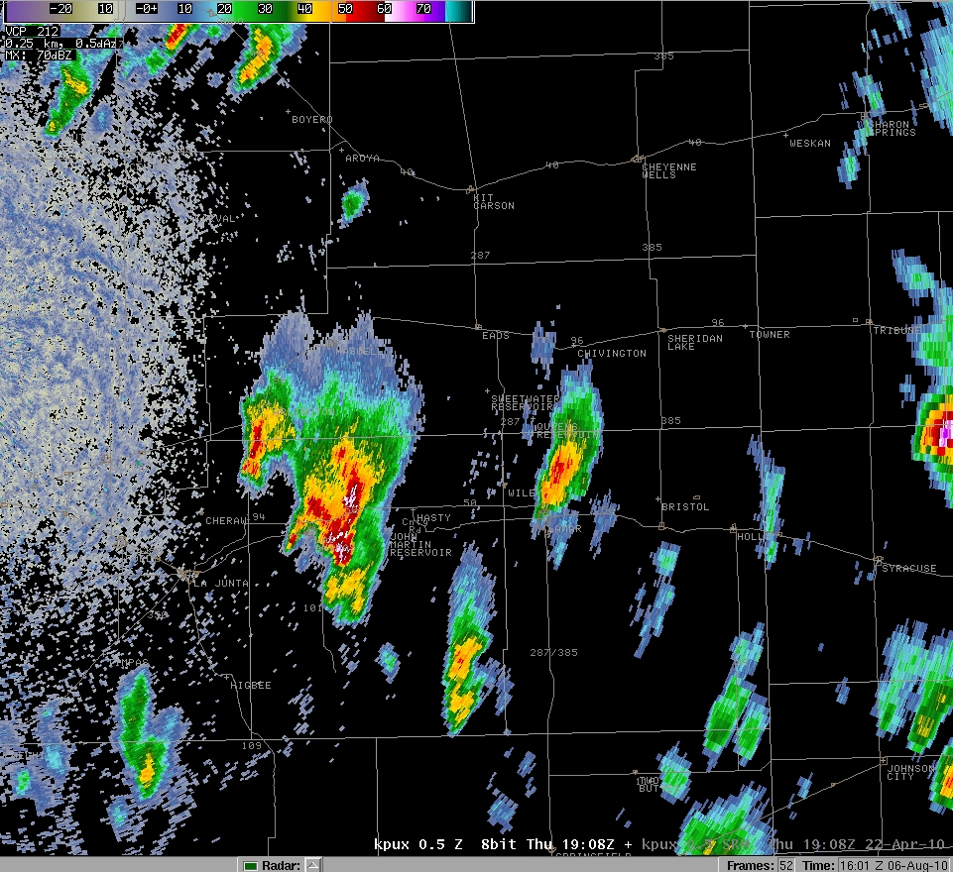
April 22nd 2010 – 108 pm
Notes:
There were numerous strong to severe storms in the area that day, with the most obvious to the left of center.

Slide 26
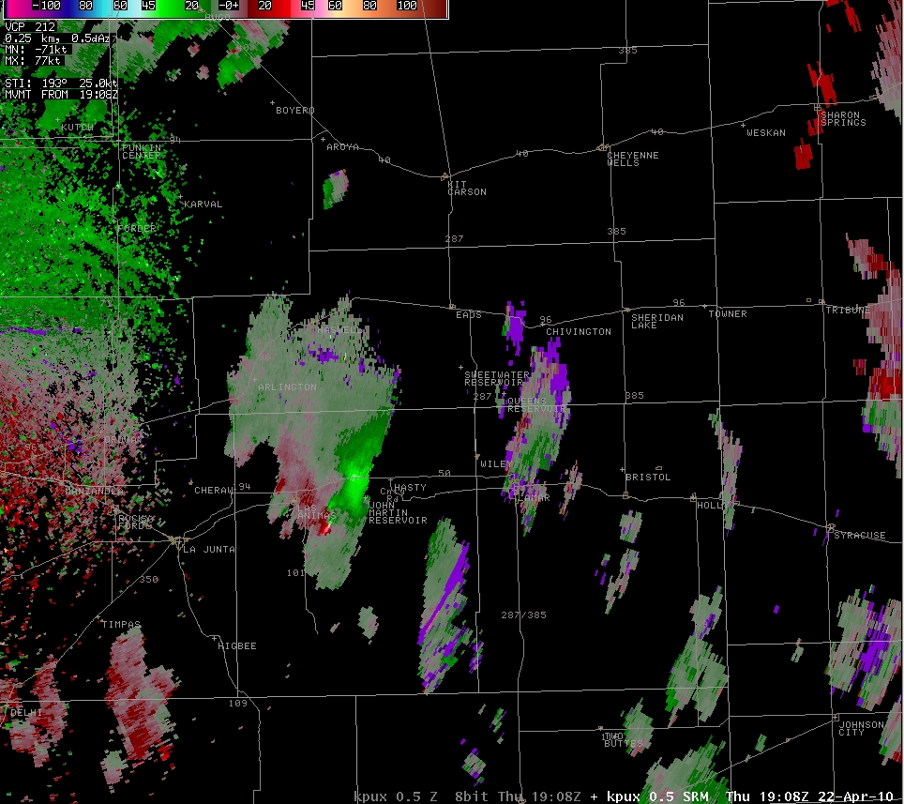
April 22nd 2010 – 108 pm
Notes:
There was a velocity couplet on the SRM.

Slide 27
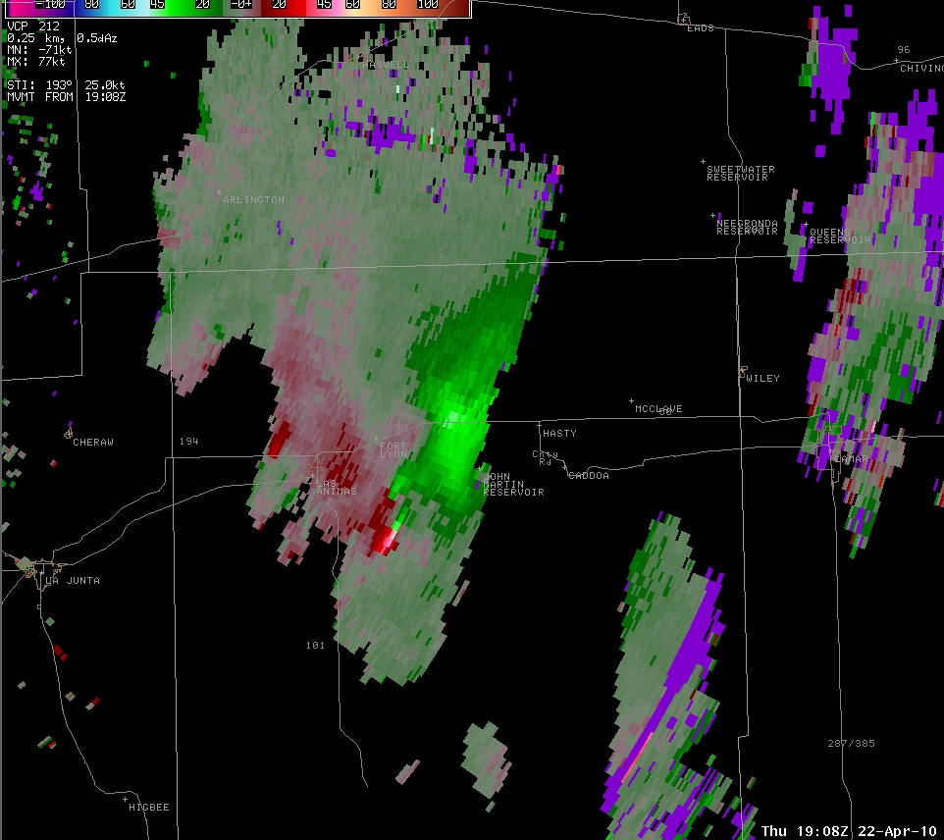
April 22nd 2010 -108 pm
Notes:
In fact, there were two couplets southeast of Las Animas, the stronger one (greater than 100 kts of shear) to the south of the weaker one.

Slide 28
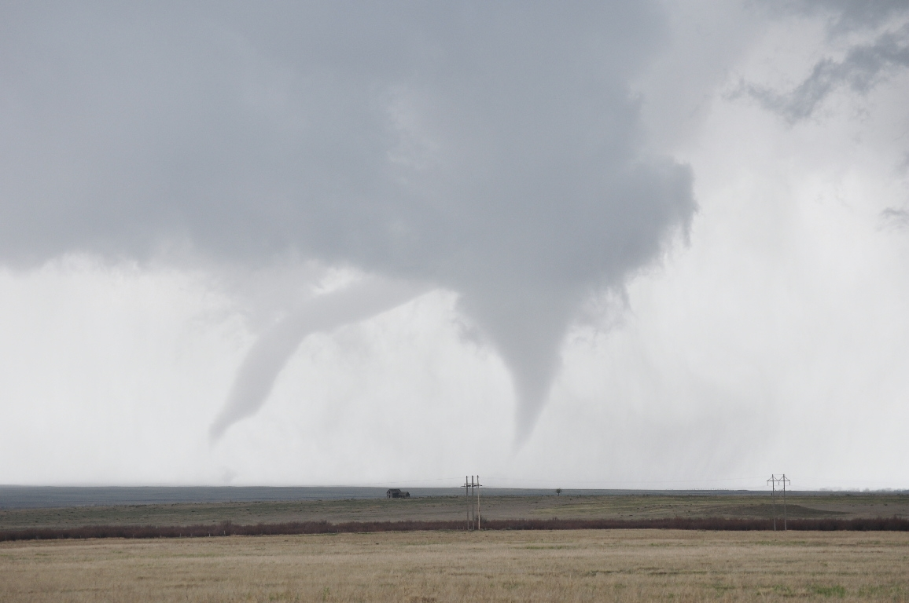
April 22nd 2010
Notes:
Indeed there were two separate tornadoes with the first tornadic cycle of the supercell.

Slide 29
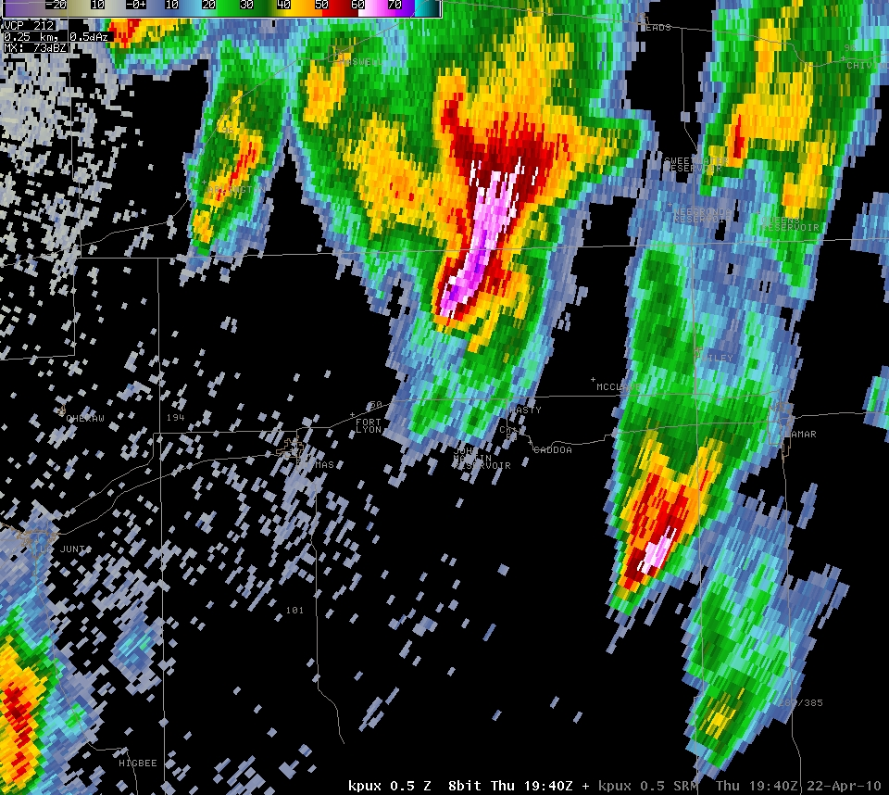
April 22nd 2010 – 140 pm
Notes:
The supercell continued to cycle through…and frequently volume scans would show velocity couplets.

Slide 30
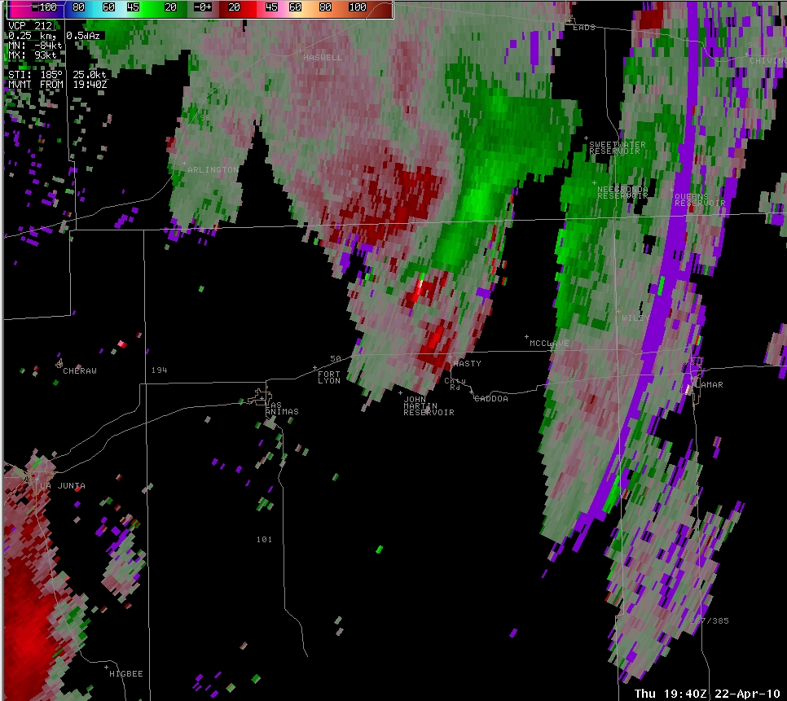
April 22nd 2010 – 140 pm
Notes:
…and frequently velocity couplets would pop in and out on the SRM as time passed.

Slide 31
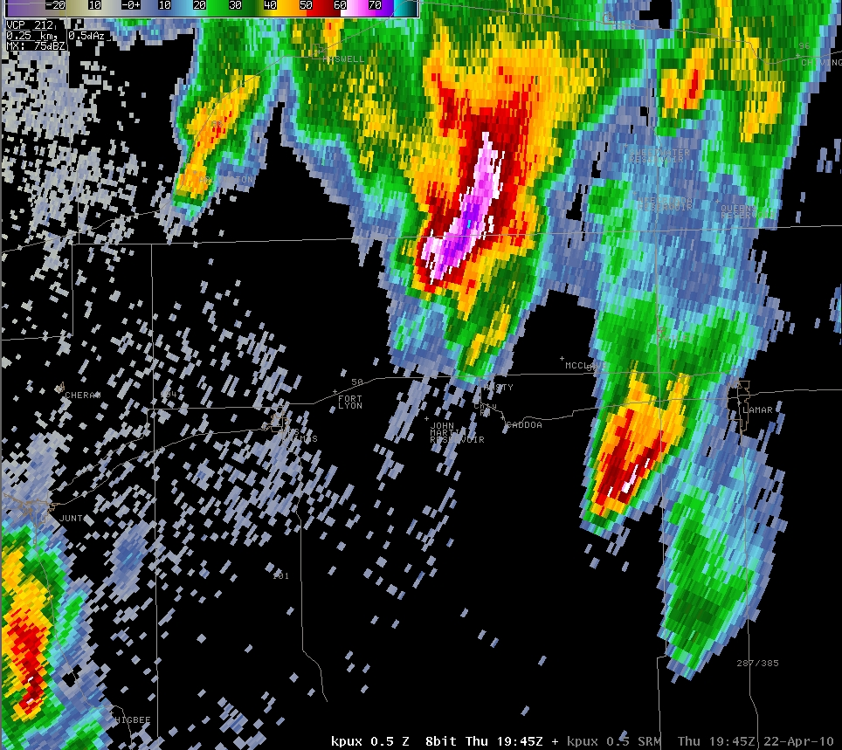
April 22nd 2010 - 145 pm

Slide 32
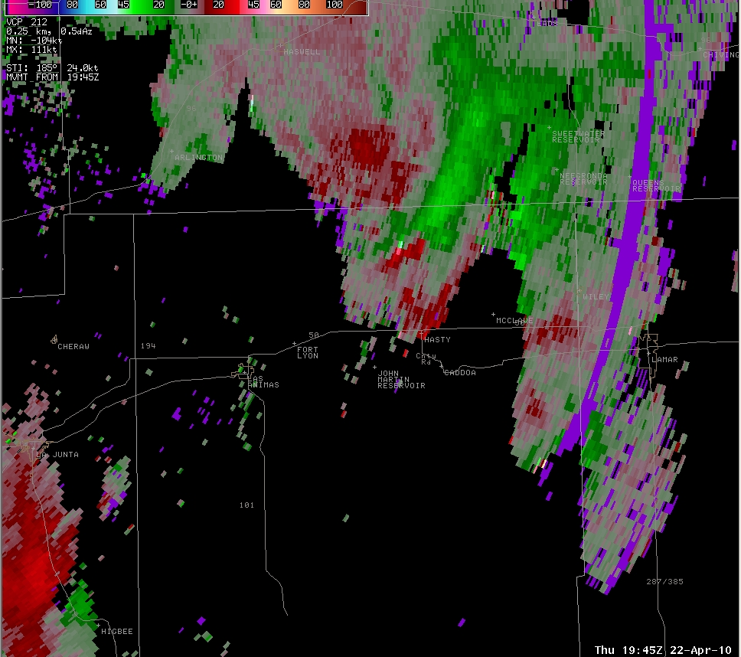
April 22nd 2010 – 145 pm

Slide 33
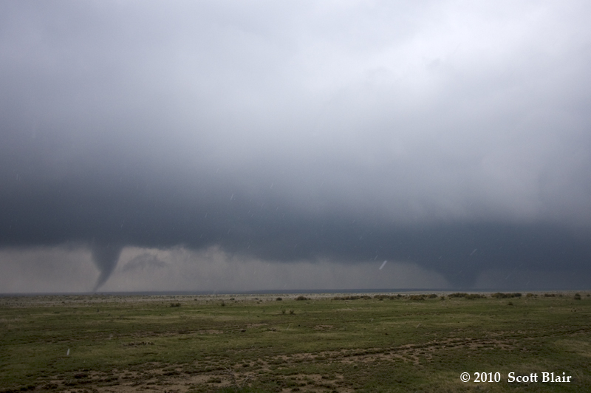
April 22nd 2010
Notes:
A few times during the life of the supercell, tornadoes were occurring simultaneously. This was near the Bent-Kiowa County line.

Slide 34
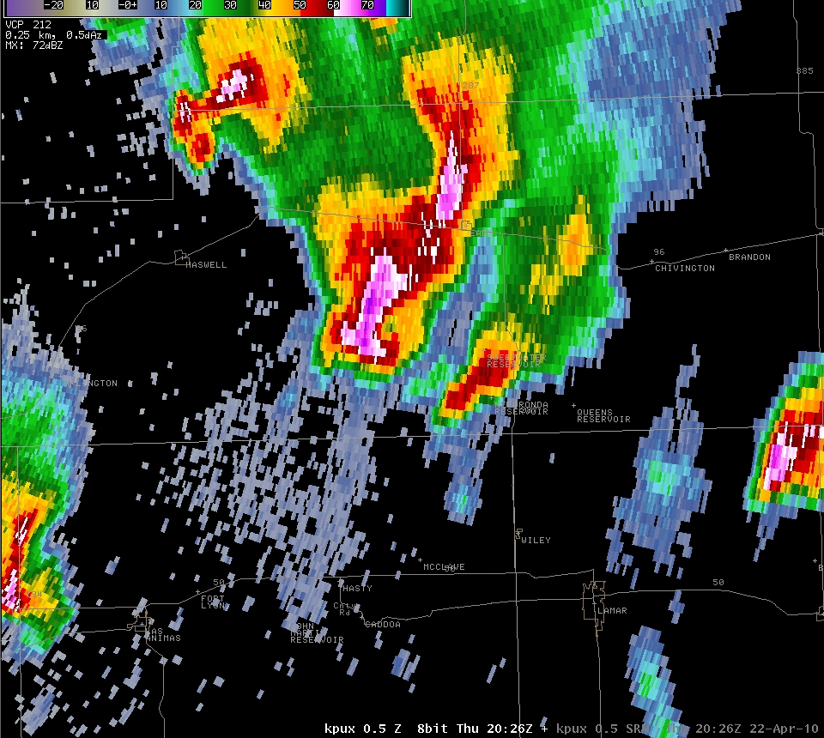
April 22nd 2010 - 226 pm
Notes:
At this point, in southern Kiowa County, the radar signature was quite impressive, showing a hook, and nice BWER.

Slide 35
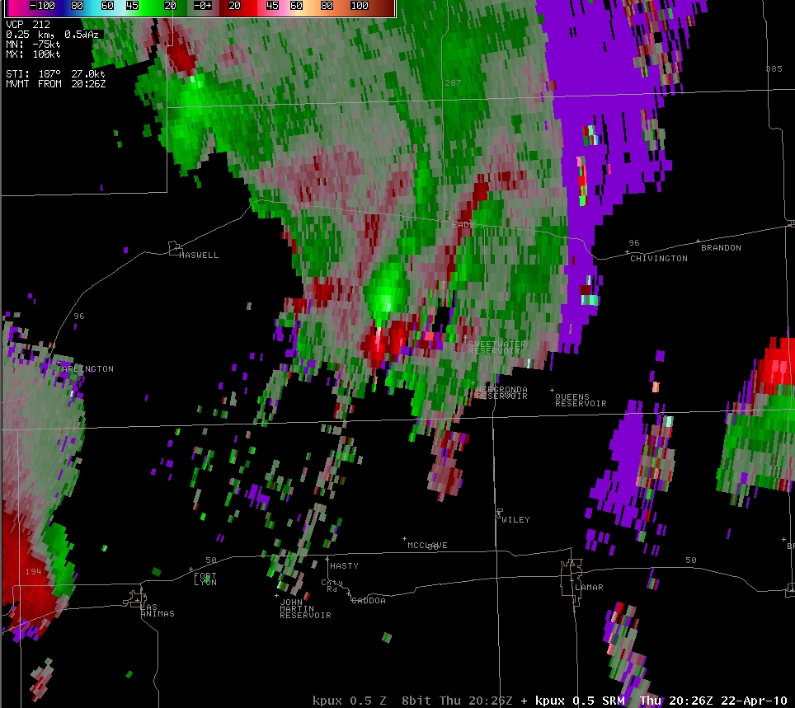
April 22nd 2010 – 226 pm
Notes:
…and gate-to-gate shear of over 100 kts.

Slide 36
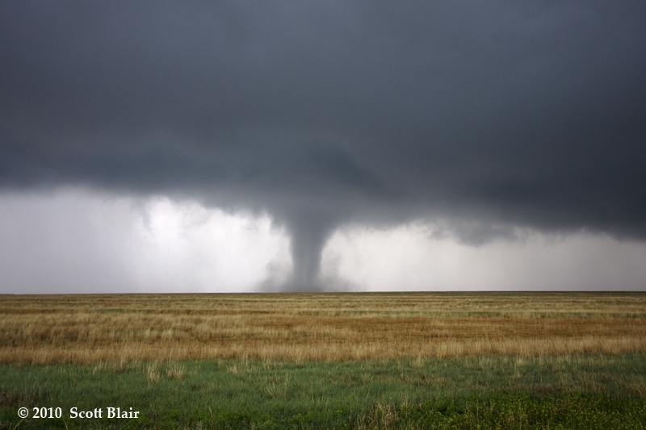
April 22nd 2010
Notes:
This was the resultant tornado, and the only one that damaged anything man-made.

Slide 37
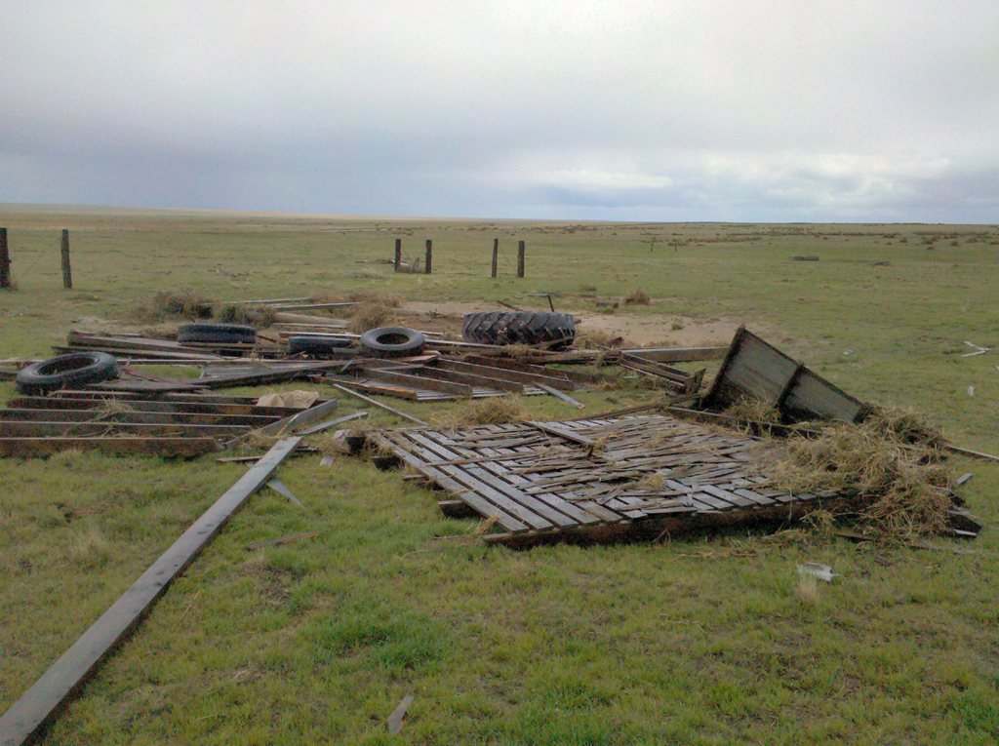
April 22nd 2010 – 232 pm
Only DI – one small barn destroyed in south central Kiowa County
Notes:
With the help of storm chaser Scott Blair’s account, local law enforcement, and a chance meeting with a telephone repairman on a county road in south central Kiowa County, the WCM located this small depression-era storage barn.

Slide 38
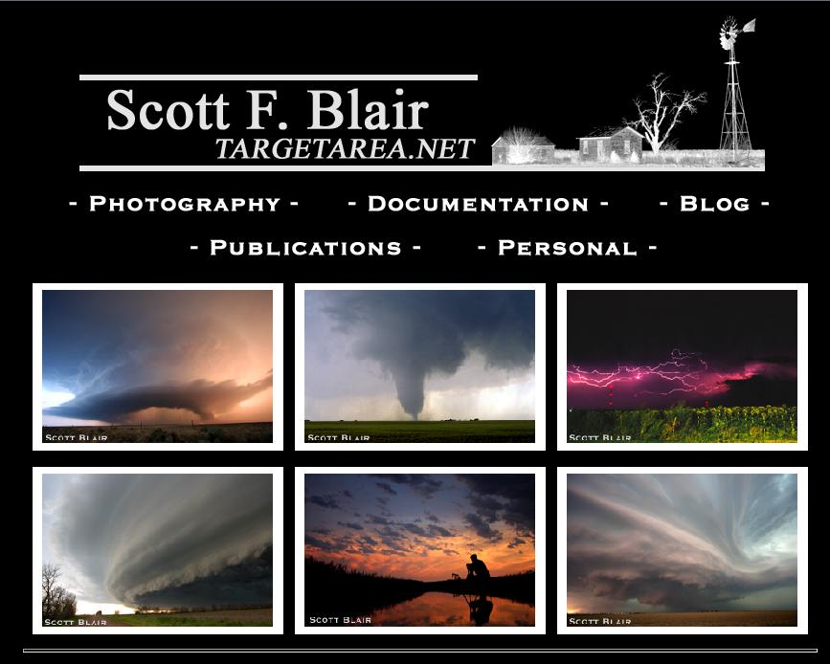
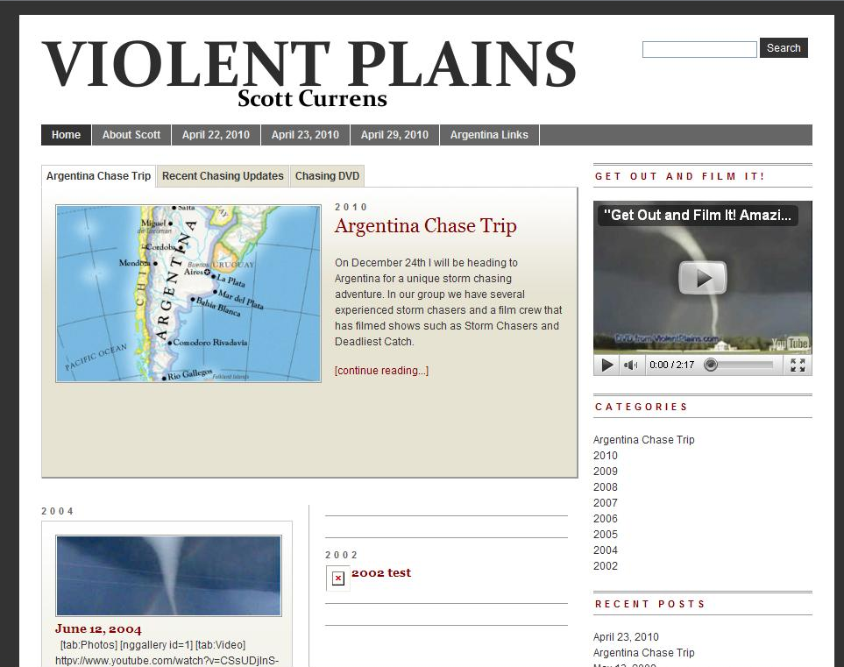
April 22nd 2010
Scott Blair Scott Currens
Notes:
Scott was especially helpful, because he is a NWS employee. He is sensitive to our needs, both from real-time reporting and post-episode description aspects. Scott Currens also provided some very detailed descriptions and photos of the episode.

Slide 39
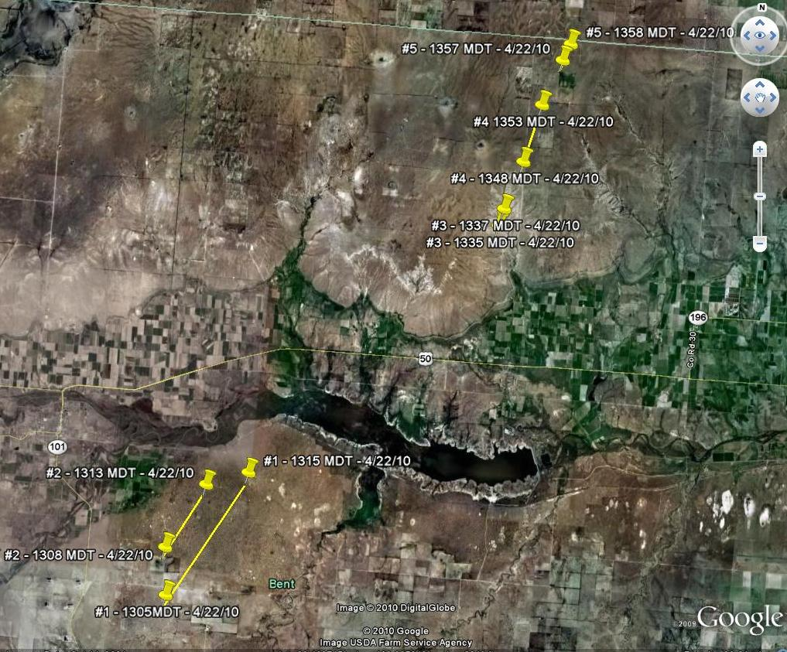
April 22nd 2010
Notes:
With that detailed, accurate information, we were able to put together a very accurate account of the episode on April 22nd, consisting of five tornadoes over open country of Bent County…

Slide 40
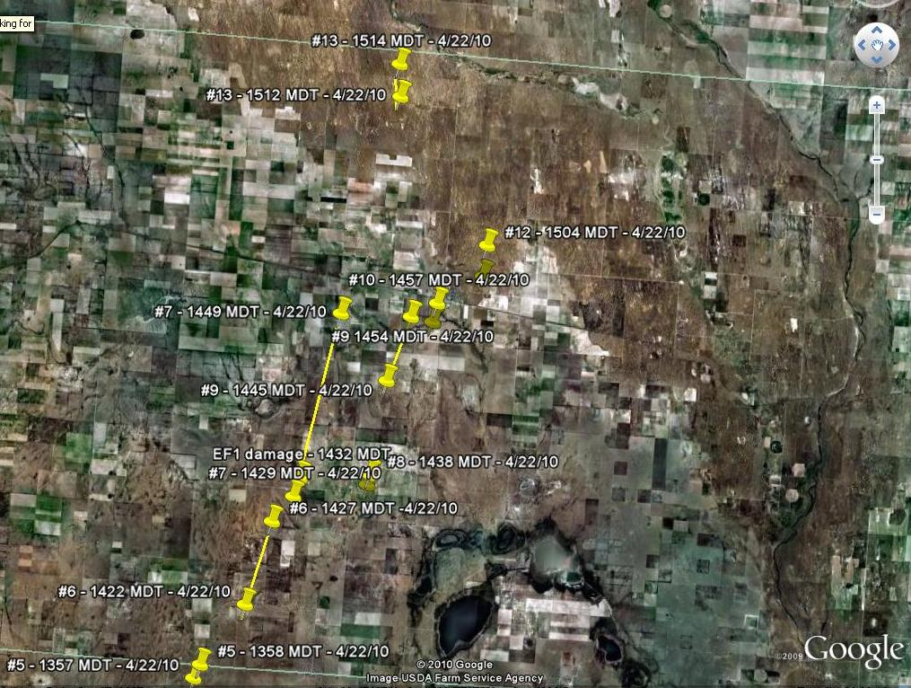
April 22nd 2010
Notes:
And eight more tornadoes over mostly open country of central Kiowa County.

Slide 41
What’s a WCM to do
for detailed post-episode information ???
So far in 2010...36 tornadoes
April 22nd - 13 tornadoes
May 25th - 15 tornadoes
May 31st - 3 tornadoes
Notes:
On May 25th, 15 tornadoes occurred over Kiowa and Baca Counties. Twelve of those tornadoes were landspouts.

Slide 42
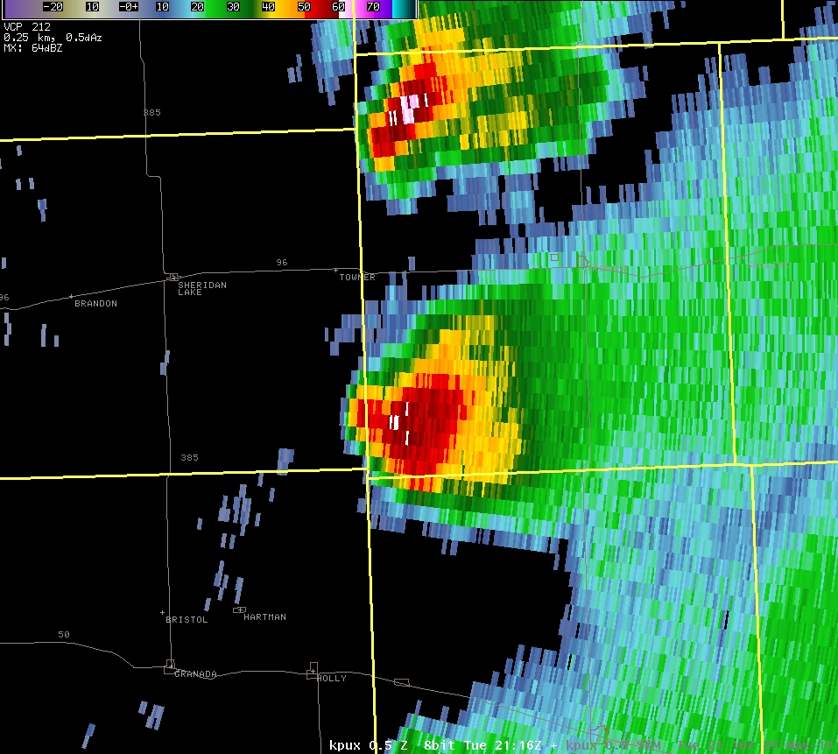
May 25th 2010 – 316 pm
Notes:
A very strong storm, mostly on the Kansas side of the state line developed, and was moving northward. We always look for the possibility of back-building into our CWA in these kinds of situations.

Slide 43
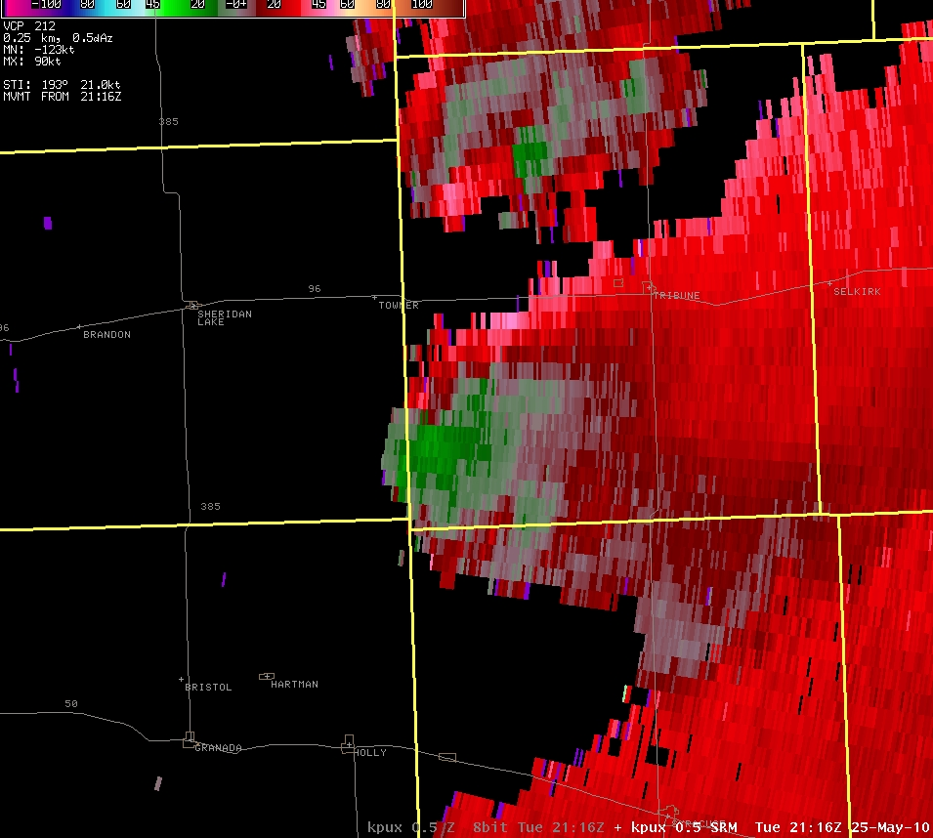
May 25th 2010 – 316 pm
Notes:
There was little indication, either from our radar, or Kansas radars of rotation with this storm with this volume scan. There was a Severe Thunderstorm Watch in effect for that area.

Slide 44
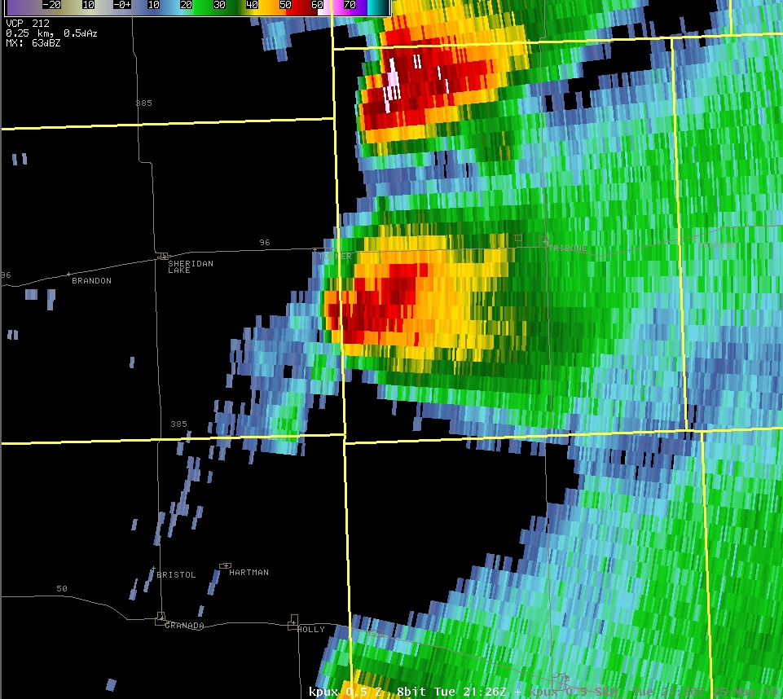
May 25th 2010 – 326 pm
Notes:
Minutes later, a line of convection was developing to the west and southwest of the now severe cell in Kansas. At this point WFO Pueblo issued a severe thunderstorm warning for far eastern Kiowa County, with the areas in and around the small town of Towner in the cross-hairs.

Slide 45
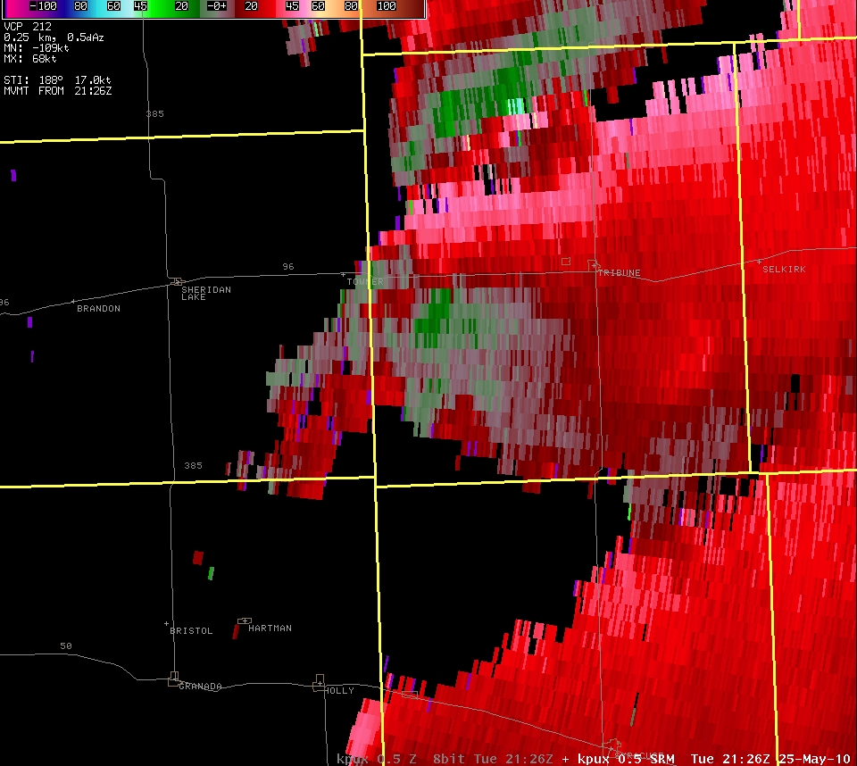
May 25th 2010 – 326 pm
Notes:
There was no evidence of strong rotation on the SRM in Colorado.

Slide 46
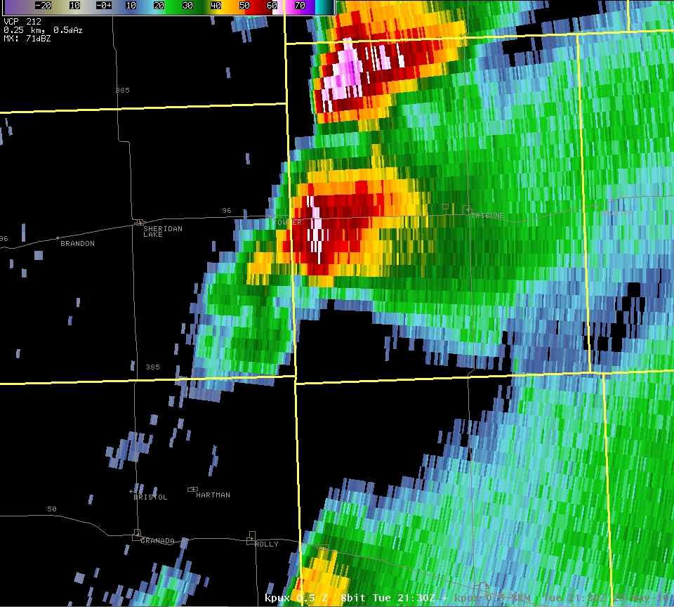
May 25th 2010 – 330 pm
Notes:
A few minutes later, the reflectivity over the area south and west of Towner intensified some, and we felt very good about the SVR we had issued.

Slide 47
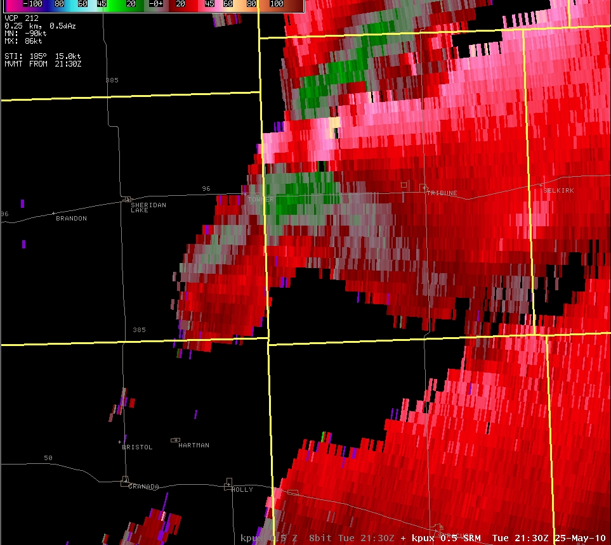
May 25th 2010 – 330 pm
Notes:
The SRM display did not show anything obvious in Colorado. In actual fact, the first landspout was about to form, and another would occur shortly after. At approximately 3:40 p.m. a call came into our office, relayed via law enforcement of a tornado southwest of Towner. Several other calls came in shortly after that of more than one tornado, some claiming one was in Prowers County. At 3:44 p.m. WFO Pueblo issued a tornado warning.

Slide 48
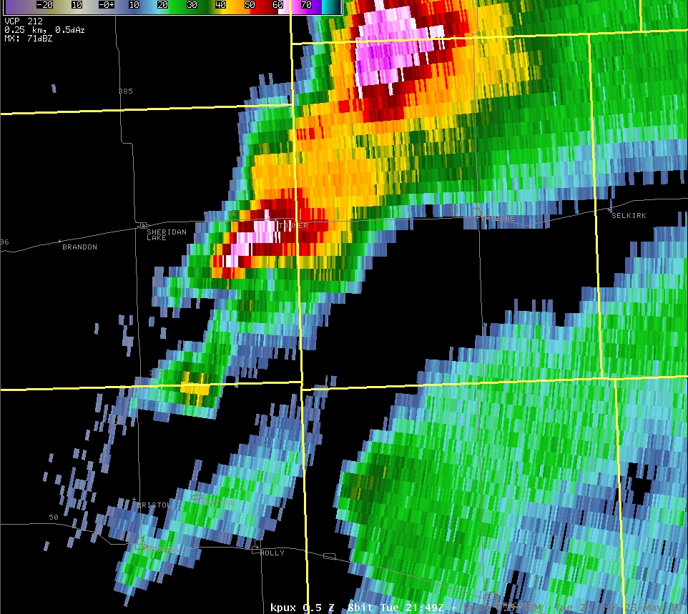
May 25th 2010 – 349 pm
Notes:
Thereafter, the storm intensified southwest of Towner, and the spoutfest was on…

Slide 49
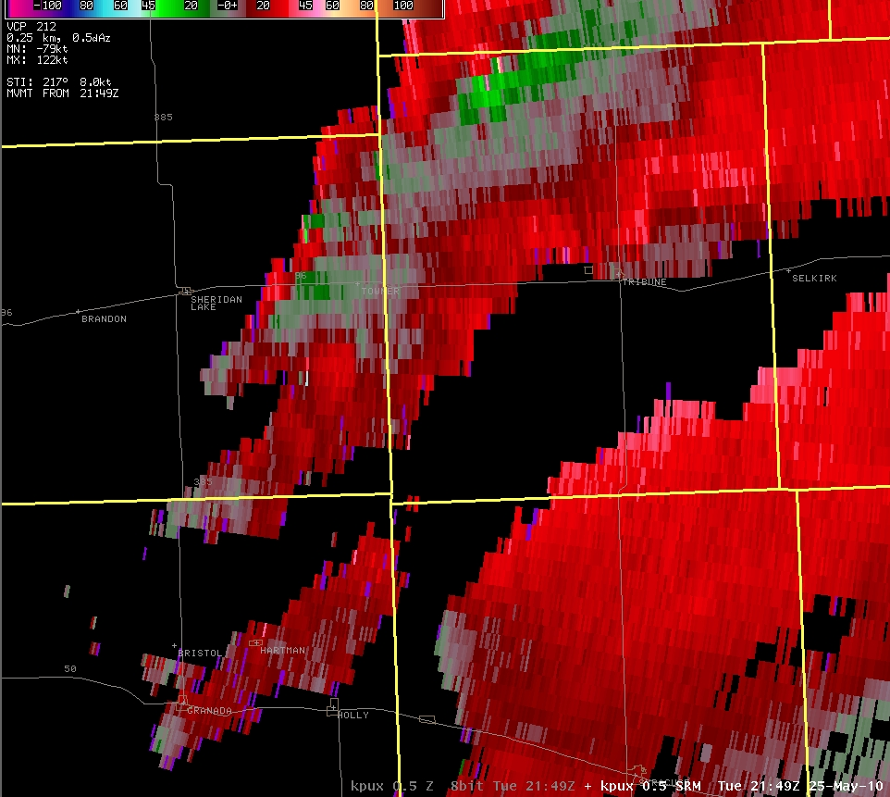
May 25th 2010 – 349 pm
Notes:
SRM showed no strong rotations…not surprising, since the tornadoes were non-mesocyclonic, and the radar beam was nearly two miles above ground level.

Slide 50
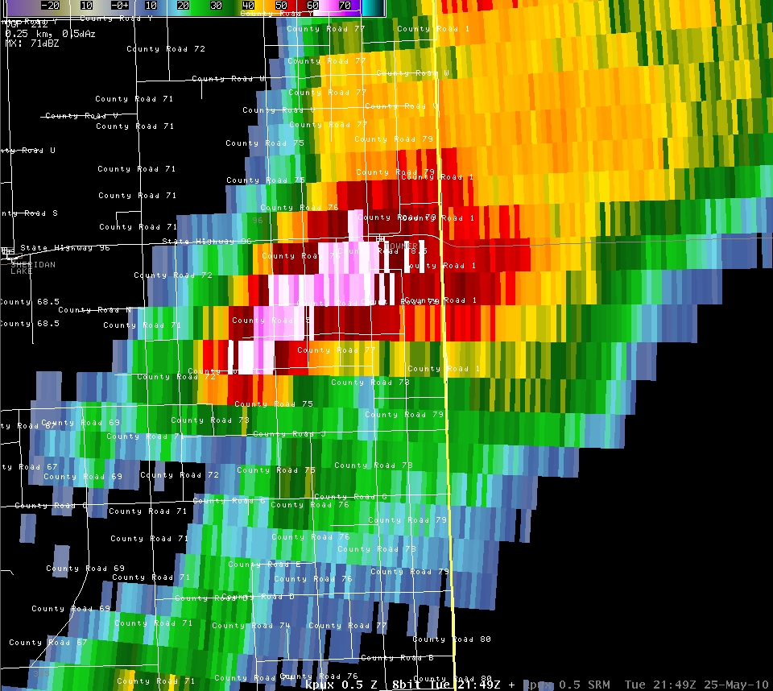
May 25th 2010 – 349 pm
Notes:
The spoutfest occurred along the reflectivity gradient to the southeast of the higher reflectivities.

Slide 51
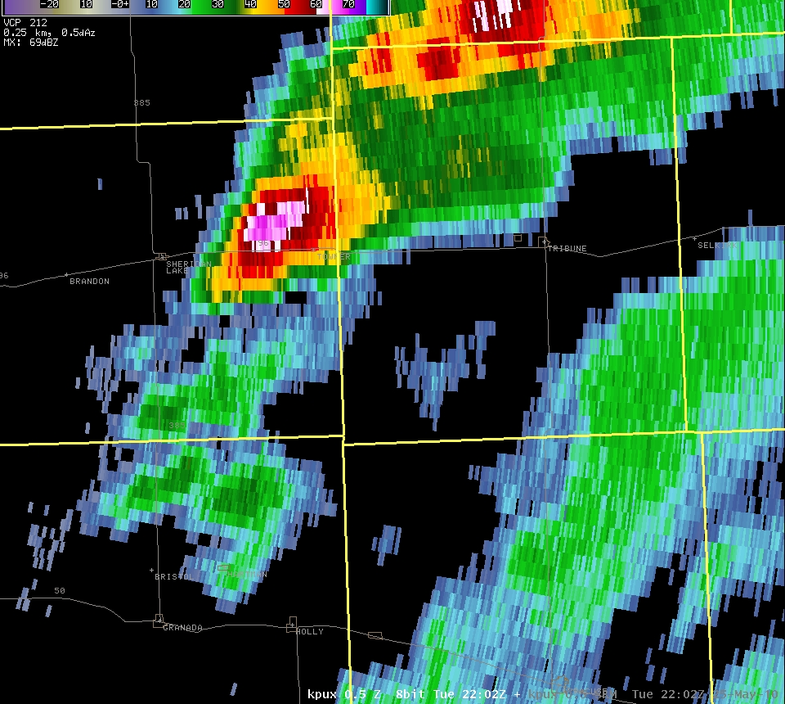
May 25th 2010 – 402 pm
Notes:
By this time, the spoutfest was winding down.

Slide 52
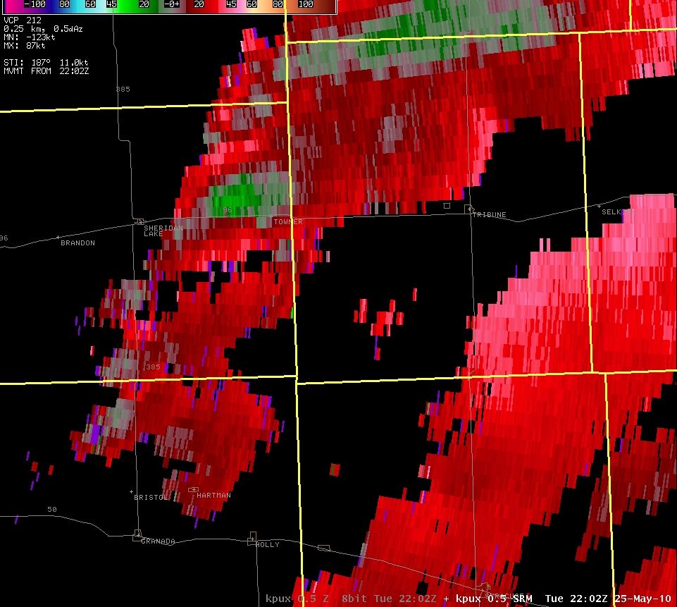
May 25th 2010 – 402 pm
Notes:
There was a continued threat of landspouts and mesocyclone tornadoes.

Slide 53
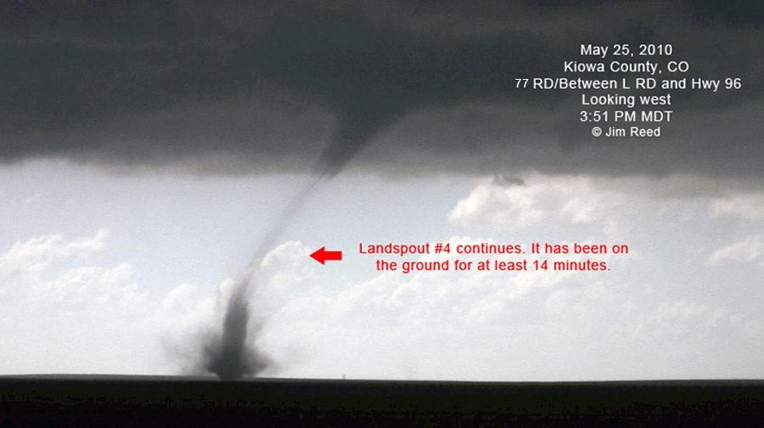
May 25th 2010

Slide 54
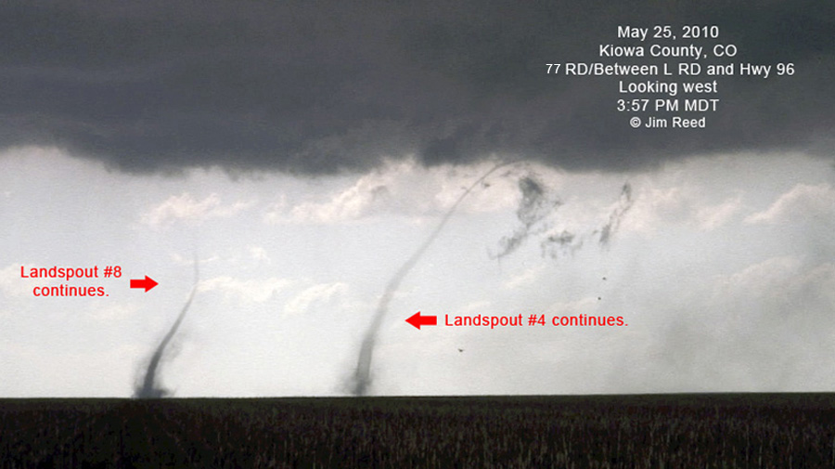
May 25th 2010

Slide 55
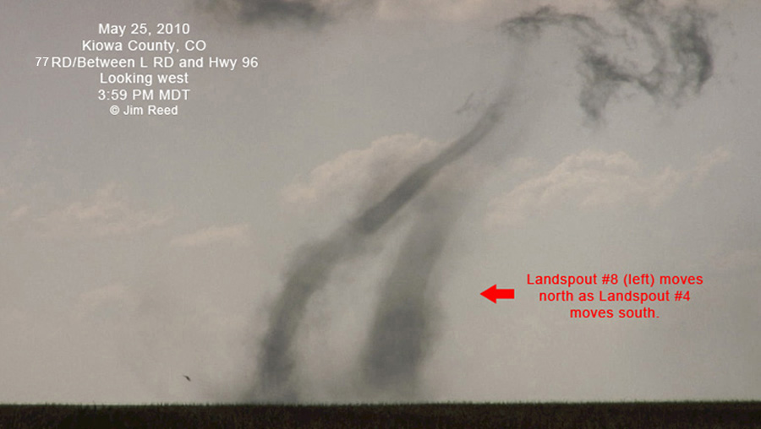
May 25th 2010

Slide 56
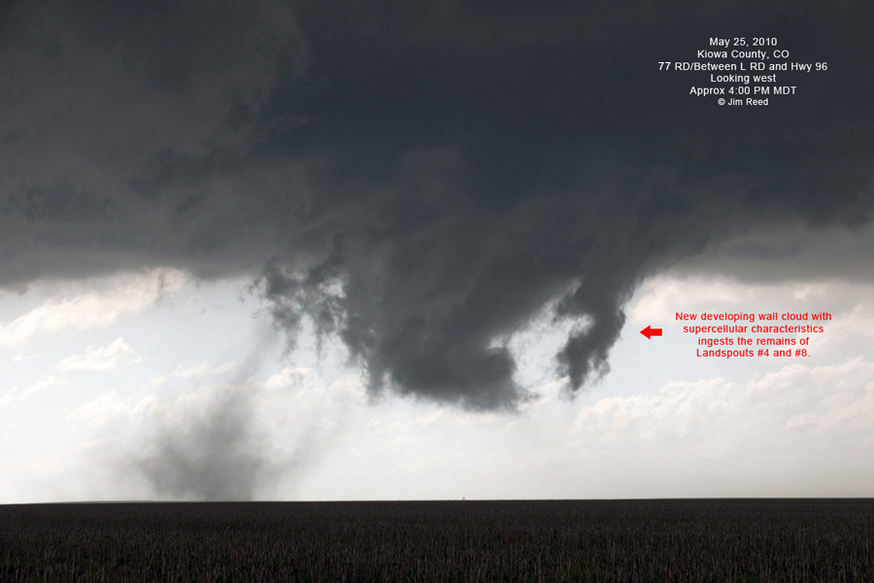
May 25th 2010
Notes:
Photo shows dissipating landspout lower left, and wall cloud center.

Slide 57
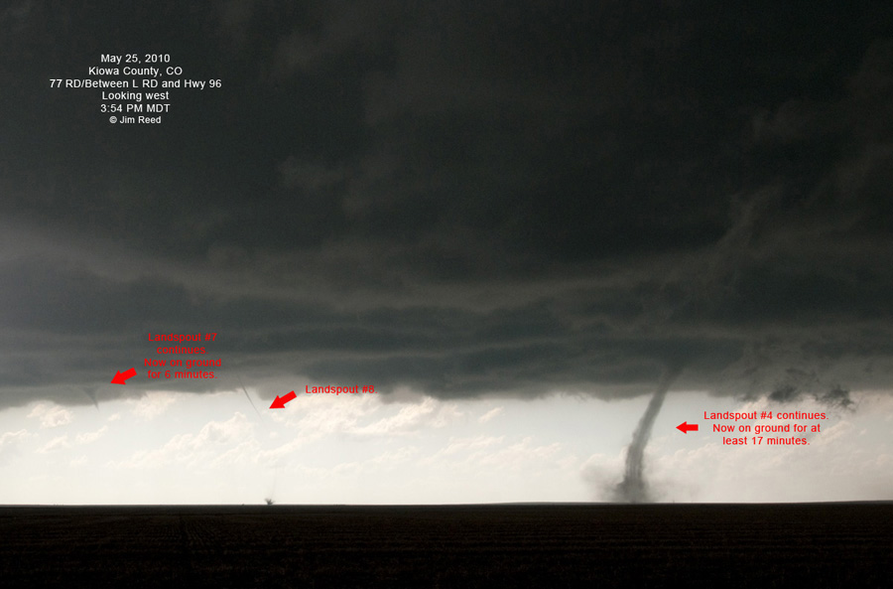
May 25th 2010

Slide 58

May 25th 2010
Notes:
The initial call in of a tornado was by videographer/chaser Jim Reed. Here is his video of eight landspouts and a likely mesocyclone tornado.

Slide 59

May 25th 2010

Slide 60

May 25th 2010
Notes:
The initial local storm reports, all estimates, put the tornadoes just south of highway 96.

Slide 61

May 25th 2010
Notes:
The best estimates of the locations of the landspouts thanks to videographer Jim Reed’s account.

Slide 62

May 25th 2010
Notes:
Close-up of the probable locations of eight of the tornadoes.

Slide 63

May 25th 2010 - 734 pm
Notes:
Later that evening…a long-lived supercell drifted across the Colorado- Kansas border…then

Slide 64

May 25th 2010 - 757 pm
Notes:
Began moving northwest back into Baca County.

Slide 65

May 25th 2010 – 806 pm
Notes:
The storm continued to track to the northwest.

Slide 66

May 25th 2010 – 757 pm
Notes:
There was no strong velocity couplet observed on our radar or surrounding radars. This location is more than or close to 100 miles distance from any NWS radar.

Slide 67

May 25th 2010 – 806 pm
Notes:
This storm was rotating, but a tight couplet was not observed.

Slide 68


May 25th 2010
Notes:
During the event, Roger Hill called WFO Pueblo with the report of a tornado at Bartlett, CO. A subsequent follow-up with Roger yielded very detailed information of two tornadoes encountered in and near Bartlett. Roger’s account made it relatively easy for the WCM to piece together the event. Residents and ranchers in that immediate vicinity were found and contacted. Descriptions of the event and photos were shared with WFO Pueblo.

Slide 69

May 25th 2010
Notes:
In addition, by looking at the Google Earth display, the WCM could reference roads and landmarks, and could intelligently carry on a conversation with the people affected by the tornadoes. One result was the map above.

Slide 70

May 25th 2010
Notes:
The WCM had conversation with the family affected by the first tornado, on the southeast corner of US Highway 160 and CR 51.

Slide 71

May 25th 2010
Notes:
Google Earth street view was used to better visualize the mobile home that was damaged by the EF0 tornado.

Slide 72

May 25th 2010
Notes:
With the help of Google Earth, conversations with ranch owners helped to reconstruct the path of the second, larger tornado. The cottonwood trees damaged were easily seen on GE, in the Bear Creek arroyo.

Slide 73

May 25th 2010
Notes:
A 300-yard wide swath of damage to cottonwood trees was created by the EF1 tornado.

Slide 74
What’s a WCM to do
for detailed post-episode information ???
So far in 2010...36 tornadoes
April 22nd - 13 tornadoes
May 25th - 15 tornadoes
May 31st - 3 tornadoes
Notes:
On Memorial Day, a long-lasting supercell across Baca County, was labeled by some chasers as…

Slide 75

May 31st 2010
THE “DREAM”
CHASE ???

Slide 76

May 31st 2010 – 305 pm
Notes:
The supercell developed shortly after Noon. Around 3 p.m. it kicked into overdrive…

Slide 77

May 31st 2010 – 306 pm
Notes:
Gate-to-gate shear of 110 kts was observed on KPUX radar, impressive since the beam was two miles above ground level.

Slide 78

May 31st 2010
Notes:
Storm chasers by the scores targeted this small area, since it was the only area outlooked that day over the plains. Two tornadoes occurred southwest of Pritchett, Colorado, captured here by Brian Morganti…

Slide 79

May 31st 2010
Notes:
And Mike Umscheid. The one on the left lasted 22 minutes…and had a path only around three miles long.

Slide 80

May 31st 2010 - Pritchett
Roger Hill
Notes:
Here’s a short clip from Roger Hill near the intersection of CR 10 and US Highway 160.

Slide 81

May 31st 2010
Notes:
Path length around three miles. The greatest width was close to 400 yards. As the circulation crossed US Highway 160 14 power poles were taken down.

Slide 82

May 31st 2010 – 609 pm
Notes:
Three hours later the supercell had moved only around 20 miles to the southeast. Hail up to baseball size was occurring, and it continually cycled, but did not produce another tornado until 6:09 p.m., south of Campo, Colorado.

Slide 83

May 31st 2010 – 609 pm
Notes:
The gate-to-gate shear was around 110 kts, observed at 13,000 feet above ground level on the KPUX radar.

Slide 84

May 31st 2010 – 618 pm
Notes:
Around this time, the magnificent tornado cross US Highway 287 between the state line and Campo.

Slide 85

May 31st 2010 – 618 pm
Notes:
Gate-to-gate shear at 13,000 feet above ground level was 110 kts.

Slide 86

May 31st 2010
Notes:
Thanks to follow up conversations with storm chasers, written correspondence, and great video, a very accurate time-line and description of the event was compiled by the WCM. A storm damage survey was also conducted by the MIC and WCM the followed morning.

Slide 87

May 31st 2010
Notes:
A remarkable time lapse (25x) of tornadogenesis was made available on You Tube by Janek Zimmer.

Slide 88

May 31st 2010
Notes:
Power poles and a couple of windmills were affected by this EF2 tornado…

Slide 89

May 31st 2010
Notes:
As well as a small outbuilding which was rolled to the north by the eastern side of the tornado circulation.

Slide 90
What I did…and am doing…
Compiled a list of storm chasers I have dealt with and noticed in our area…with phone numbers and email addresses.
Bookmarked their web sites on all the laptops and PCs I use.
Notes:
After tornado season waned in June and July…here’s what I did and am doing.

Slide 91
What I did…and am doing…
I will be adding them to my smart phone contacts and providing contact information to the staff at WFO Pueblo.
I will be composing a contact letter to let them know the importance of their post-episode accounts to local WFOs

Slide 92
What I did…and am doing…
I will encourage them to keep WFO Pueblo contact information (including my personal contact information) at hand, and encourage them to call WFO Pueblo or me immediately after an event to provide detailed, accurate information.
Notes:
In my ideal world, it would be easier for the WCM to have information pushed to him/her than to have to go fishing for information during the followings days.

Slide 93
Suggestions from you ???
I am here to share, and to get ideas…
I plan to attend and, perhaps, share at the chaser conference in Denver early next year.
Notes:
In my ideal world, it would be easier for the WCM to have information pushed to him/her than to have to go fishing for information during the followings days.

Slide 94



Contact me
e-mail: thomas.magnuson@noaa.gov

