Slide 1
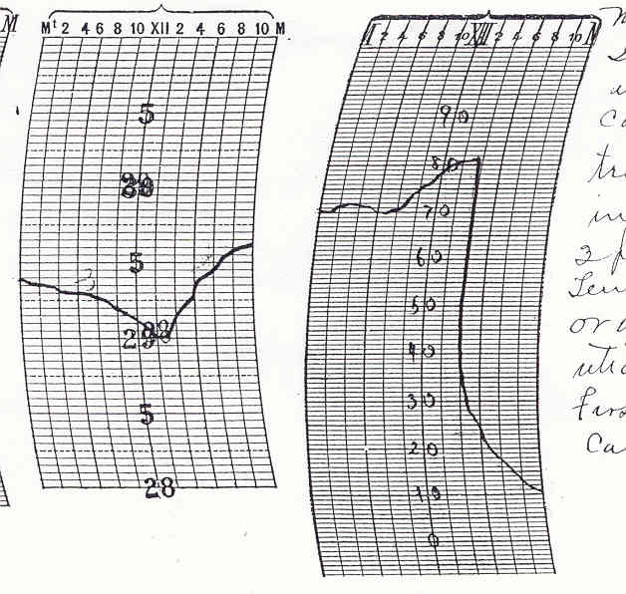
Climatology of Wind Chill Warning Events In and Surrounding the Cheyenne WFO
Researched by
Jesse Lundquist
Hourly temperature at SGF
November, 1911

Slide 2
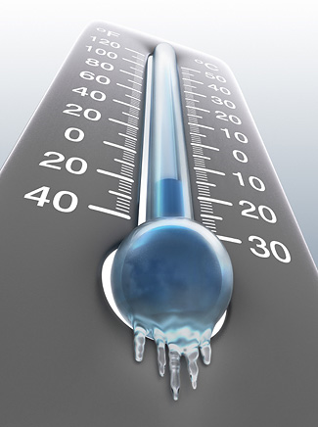
Outline
Background
Gathering the data
Analyzing the data
Current results
Future work
From Earthweek: A Diary
of the Planet website

Slide 3
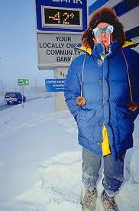
Background
Temperatures are one of the most difficult variables to forecast
  Terrain effects
  Land cover
  Cloud cover
  Air mass interactions
Wind chill is highly important
  Livestock
  Safety
From News Miner newspaper 2/2008

Slide 4
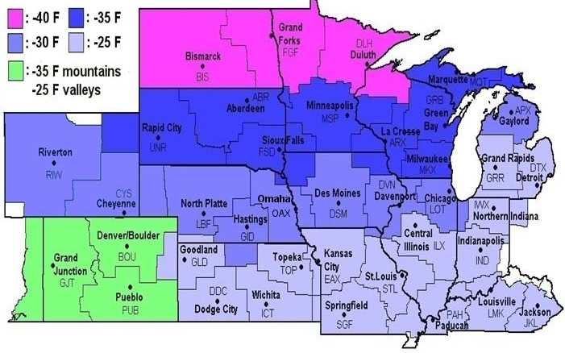
Background continued
Issued when wind chills become life threatening
Different offices, different criteria
Having a local climatology of wind chill warning events will help us better serve the public

Slide 5
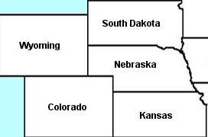
Gathering data – site locations
Used NCDC hourly observations for CYS, BFF, LBF, UNR, CPR
Rapid City
3202 ft.
Casper
5319 ft.
Scotts Bluff
3958 ft.
North Platte
2800 ft.
Cheyenne
6140 ft.

Slide 6
Gathering the data – site requirements
Had to be a “reasonable” amount of data available to be included in the study
Data had to go back to the early 1970s
  LBF, CYS and BFF data went back to the 1940s
  All of the sites had data gaps from the mid 1960s to the early to mid 1970s

Slide 7
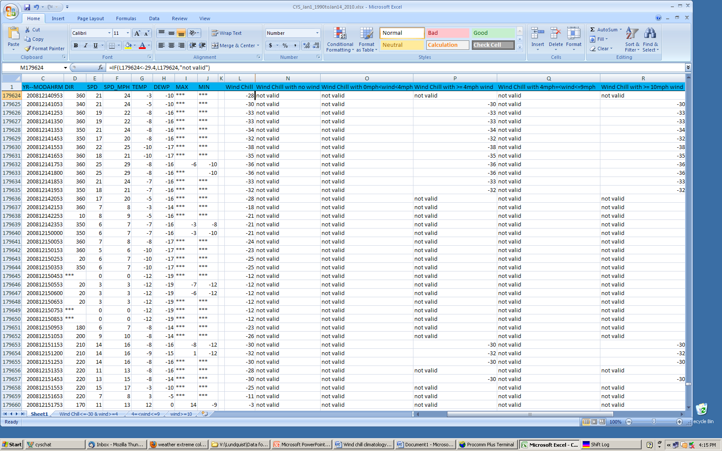
Analyzing the data
Placed data in a spreadsheet
Used NWS formula for wind chill calculation
  Windchill (ºF) = 35.74 + 0.6215T - 35.75(V^{0.16}) + 0.4275T(V^{0.16})
Sorted the data according to wind chills at or below -30º F
Further sorted data according to wind speed
  0 MPH<windspeed<4 MPH, 4 MPH<=windspeed<9, windspeed>=10 MPH

Slide 8
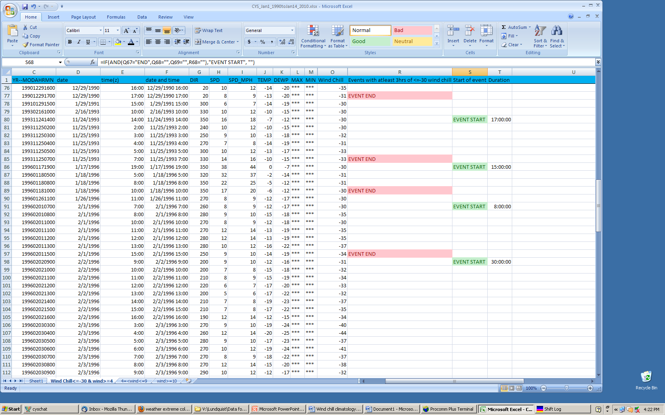
Analyzing the data continued
Filtered data to only include observations with wind chills of – 30º F or colder
Separated data into events
  Each event could be no shorter than 3 consecutive hours and be separated by at least 12 hours
Can now graph the data

Slide 9
Current results – data categorized by wind speed
Nearly all wind chill warning events have winds speeds equal or above 4 MPH, with the majority of winds at or above 10 MPH

Slide 10
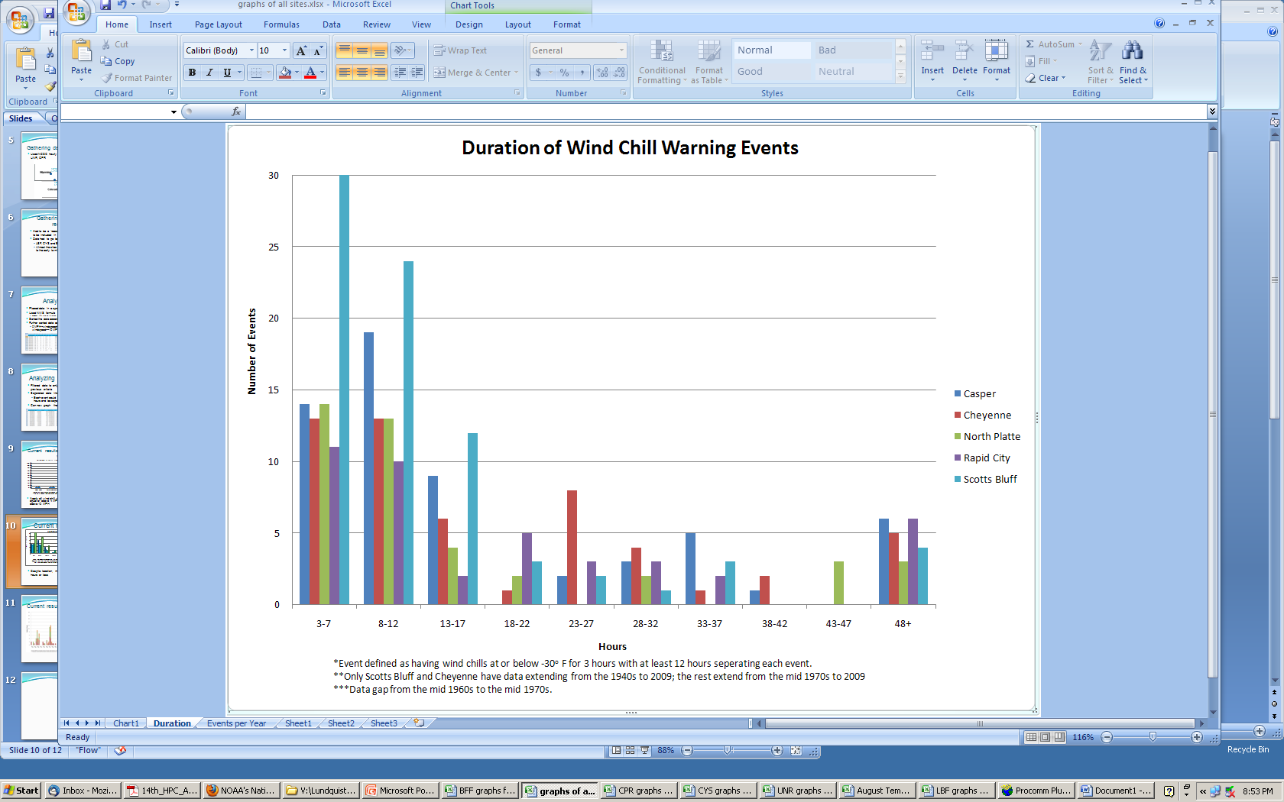
Current results - duration
Despite location, majority of events tend to be 12 hours or less
  Twice as likely to have a short event (12 hours or less)

Slide 11
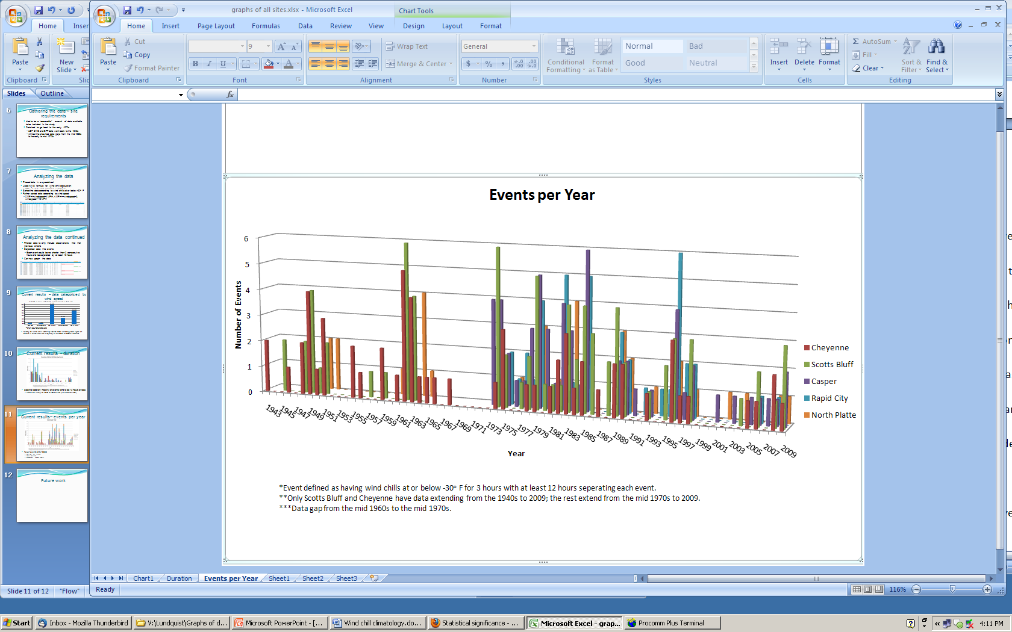
Current results– events per year
More events in 1970s to mid 1980s and less after 2000
  Cycle in the climate

Slide 12
Future work
Compare climatology of each site to wind chill warnings that were issued for those areas
  See how the office verified
Look at weather patterns for the longer events as well as a few of the shorter events
  Have a better idea of the type of weather pattern set-up
  Help get a handle on possible wind chill warnings sooner

Slide 13
Final Points
Will almost always have wind with an event
  2/3s of the time wind will be at or above 10 MPH
Twice as likely to have an event only last up to 12 hours
Fewer events after the year 2000

Slide 14
Any Questions?

