Slide 1

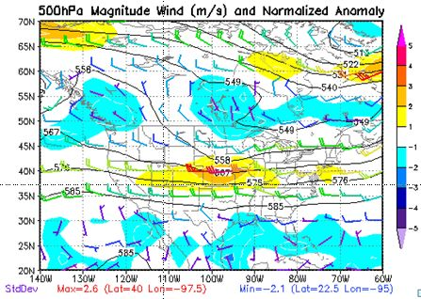
Examination of 700mb Temperatures and Wind Anomaly Relationship to Significant Severe Wind and Hail
Chris Jakub
NWS Wichita, KS
August 12th, 2010

Slide 2
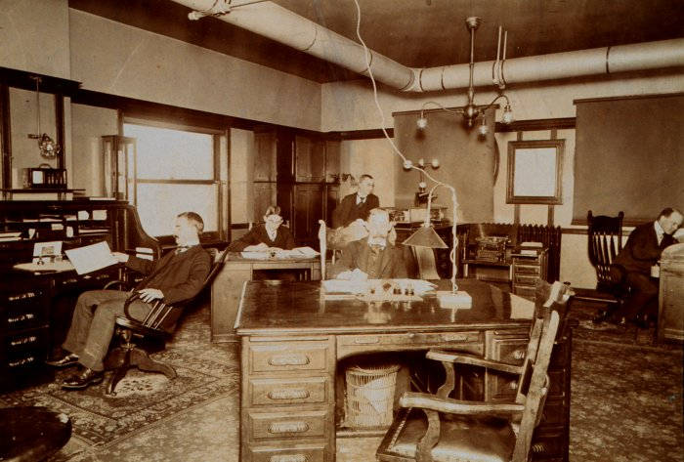
The Main Thing
Provide forecasters with a few simple techniques for quick
diagnosis of predicting severe weather events with
increased confidence during the peak severe weather months

Slide 3

Data Collection and Method
Severe reports of Wind and Hail were collected for 1996-2009
months of May-Aug (NOAA Storm Data ) KS, NE, and OK
Radar data/storm report comparison for the Study Area
http://locust.mmm.ucar.edu/
Minimum 5 reports of Significant Severe to capture more widespread = 1 Sig event
Damaging Winds 75 mph/65kts or greater, 123 Sig Wind events
Baseball Size hail/2.75” or larger, 54 Sig Hail events
700mb Temperature analysis http://vortex.plymouth.edu/
Many forecasters use CIN for estimating cap strength, however this parameter
is derived by models which can have complications. 700mb temps is a good
first guess for determining cap strength
Wind Magnitude Anomaly analysis http://hart.met.psu.edu/meteo497/mapper.html
Wind max in the vicinity < 150 miles, 250mb/500mb/850mb levels

Slide 4
The
Anomaly
Positive
(stronger than normal)
Negative
(weaker than normal)
http://eyewall.met.psu.edu/ensembles/java/ModelDisplay.html
GFS, CMC, SREF, SREF21

Slide 5
The Peak
Months
Sig Hail events
Hales (1988): ‘‘sig. hail’’ includes hail with diameter 2.0 in and ‘‘sig. wind’’ includes wind gusts 65 kts. All NOAA Storm Data severe convective reports for March-October from 1993-2006 were obtained for the continental United States (CONUS).
Sig Wind events

Slide 6
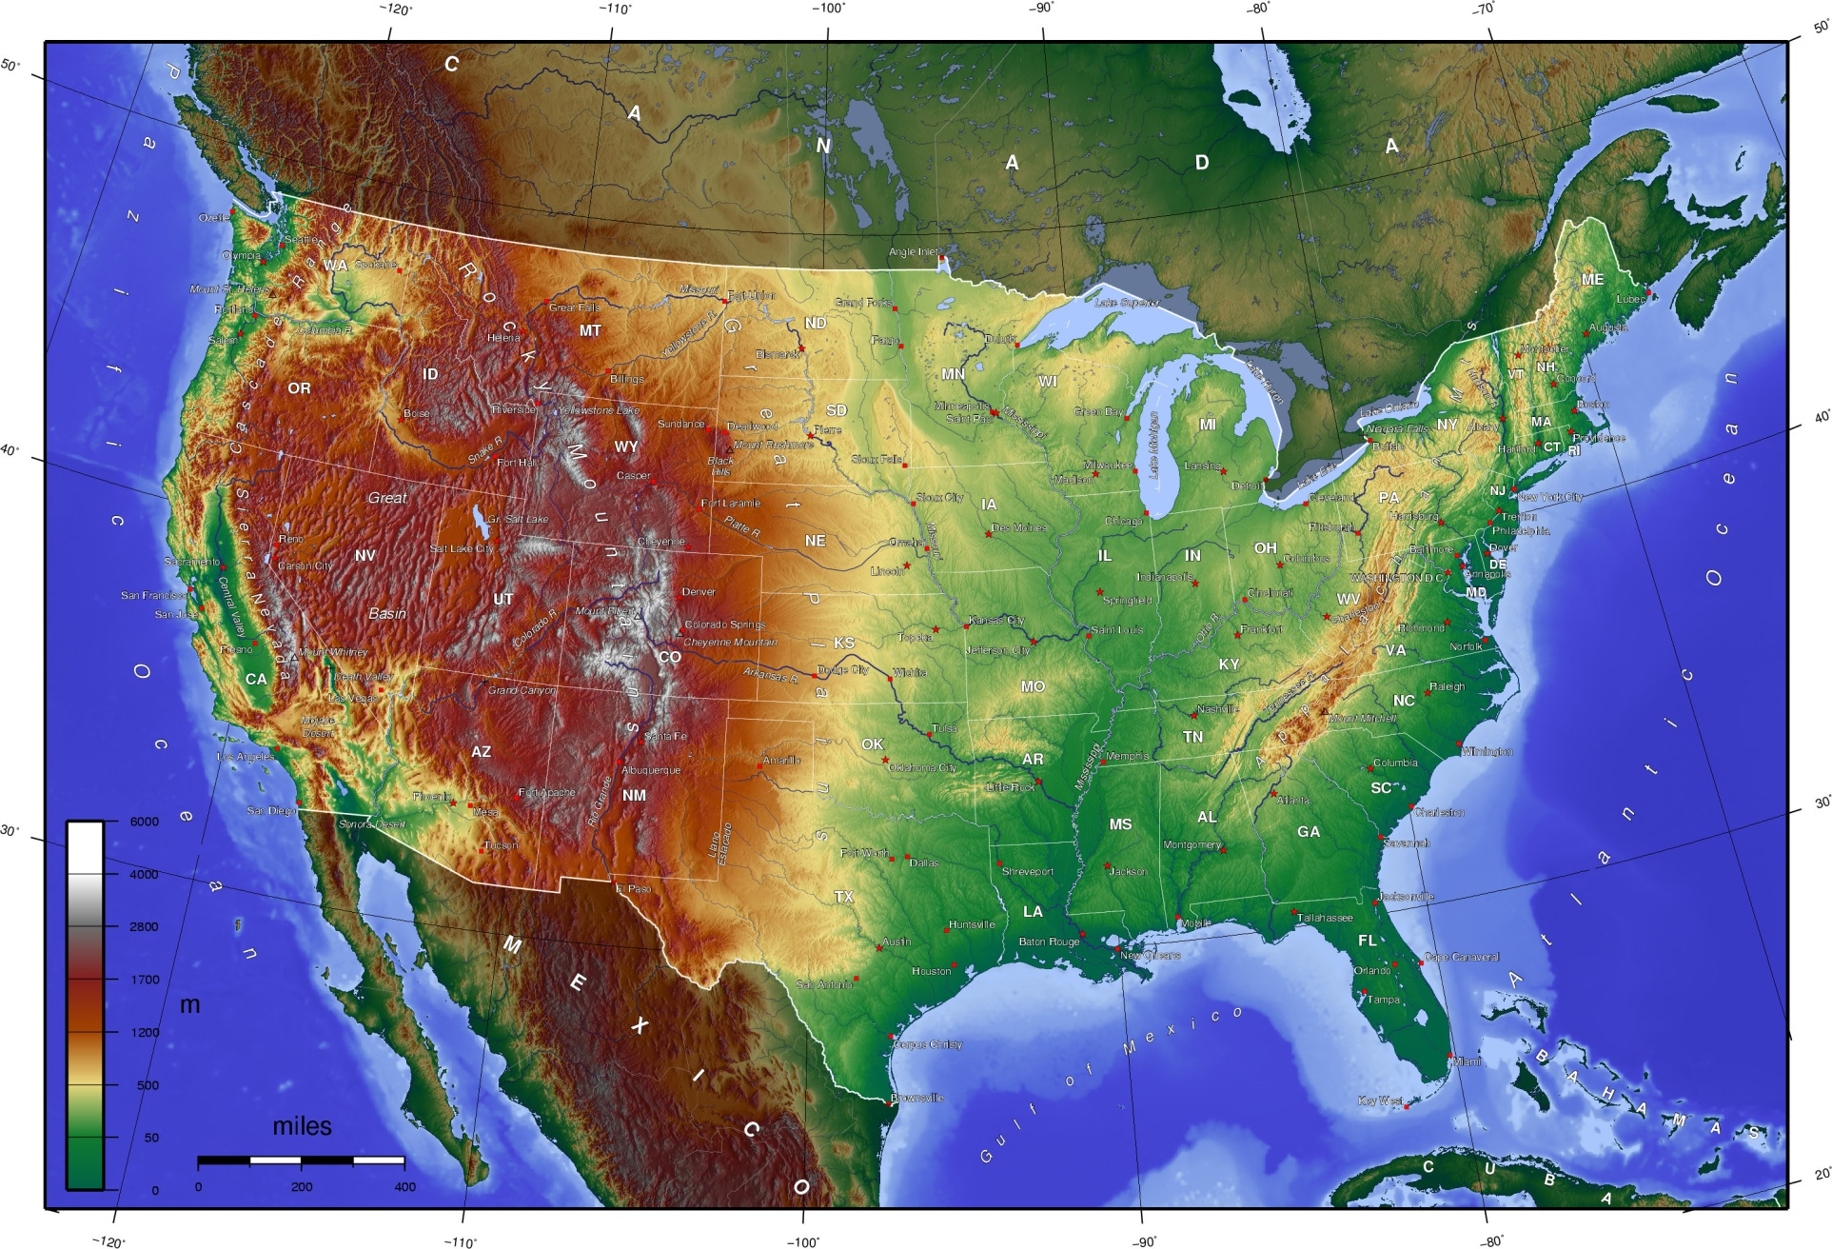
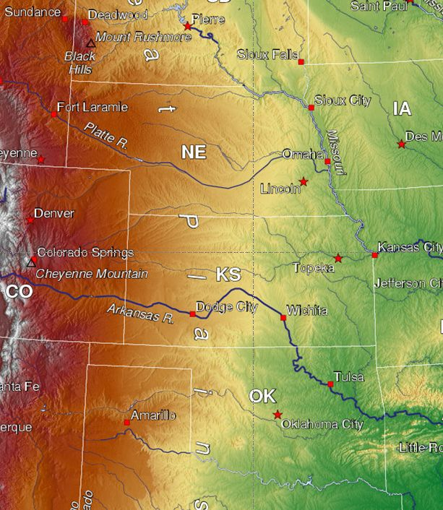
The Study Area
Nebraska, Kansas, and Oklahoma, does not include the higher surface elevations where the 700-mb level can become part of the mixed layer (High Plains)
H
I
G
H
P
L
A
I
N
S

Slide 7

The
Results

Slide 8

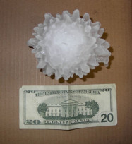
Hail Anomaly Data
Sig Hail %
Non-Sig Hail %
Significant Hail
54 events
Severe Hail but Not Sig Hail
173 events
850mb wind anomaly not a good
signal for severe or sig events
Upper level wind anomalies
showed a much better signal
with a positive anomaly ~80%
for significant Hail events that
meet study criteria
250mb
Wind
500mb
Wind
850mb
Wind
850mb
Spec H
925mb
Spec H

Slide 9
Hail 700mb Temps
~90% of Severe events occurred in the 700mb 6-12C range, meeting criteria
42%
30%
30%
23%
24%
17%
13%
11%
3%
2%
2%
1%
3%
Significant Hail 54 events
Non-Significant Hail 173 events

Slide 10

Wind Anomaly Data
Sig Hail %
Significant Wind
123 events
Non-Sig Hail %
Non-Significant Wind
94 events
850mb wind anomaly not a good
signal for severe or sig events
Upper level wind anomalies
showed a very strong signal
with a positive anomaly ~90%
for significant Hail events that
met study criteria
250mb
Wind
500mb
Wind
850mb
Wind
850mb
Spec H
925mb
Spec H

Slide 11
Wind 700mb Temps
~90% of Severe events occurred in the 700mb 8-12C range, meeting criteria
46%
36%
27%
28%
22%
24%
2%
5%
5%
3%
1%
3%
Significant MCS Wind events
Non-Significant Wind events

Slide 12

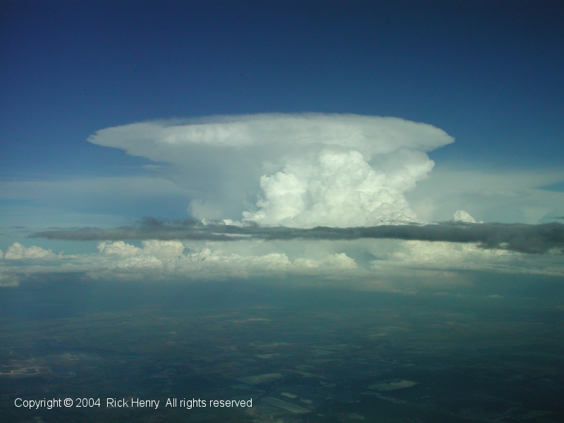
Recent Event Reviews
May 8th 2009
June 8th 2009
July 8th 2009
June 6th & 7th 2010

Slide 13
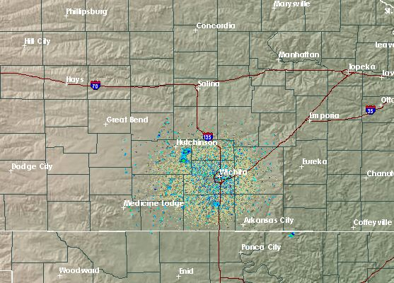

Three Significant Events for Wichita CWA which all
occurred on the 8th day of May, June, and July in 2009
8th is enough !!

Slide 14
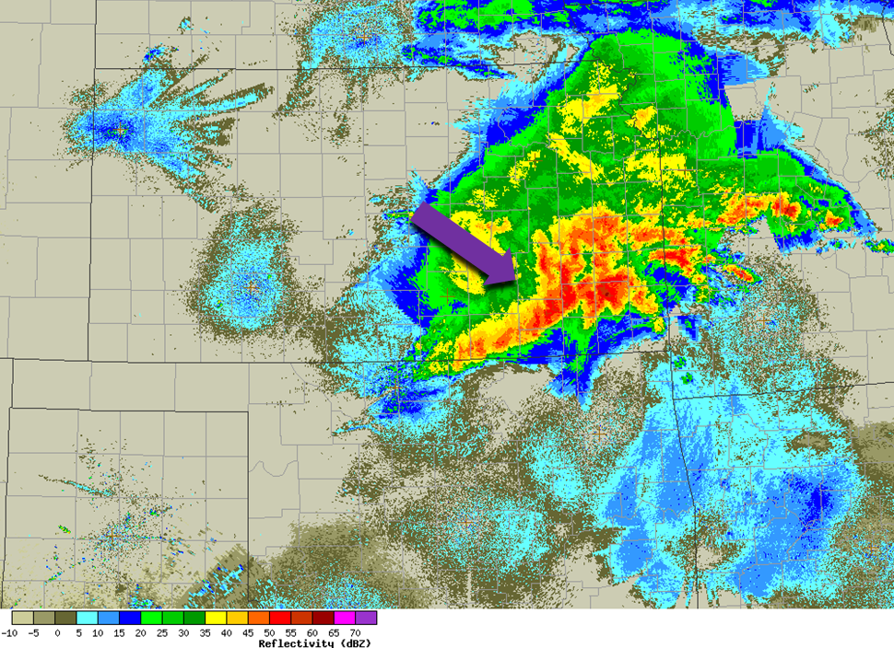
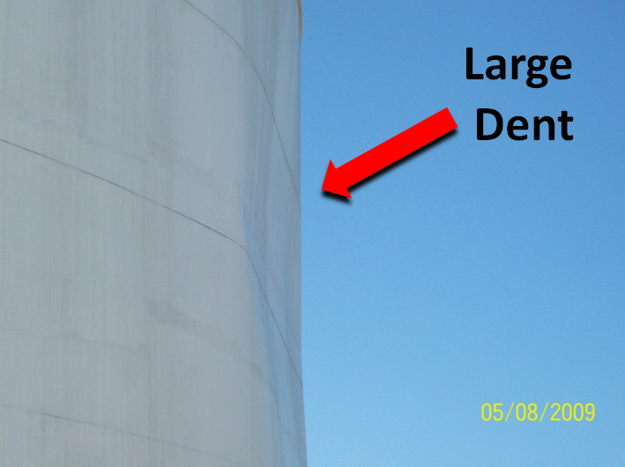

Significant
Derecho
Event
May 8th 2009

Slide 15
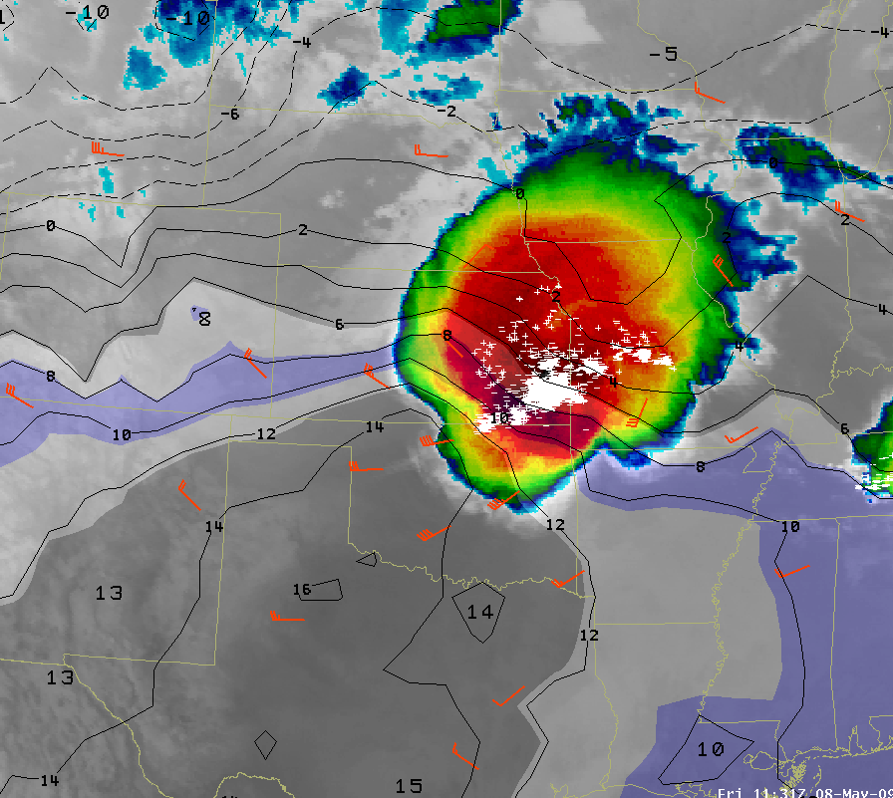
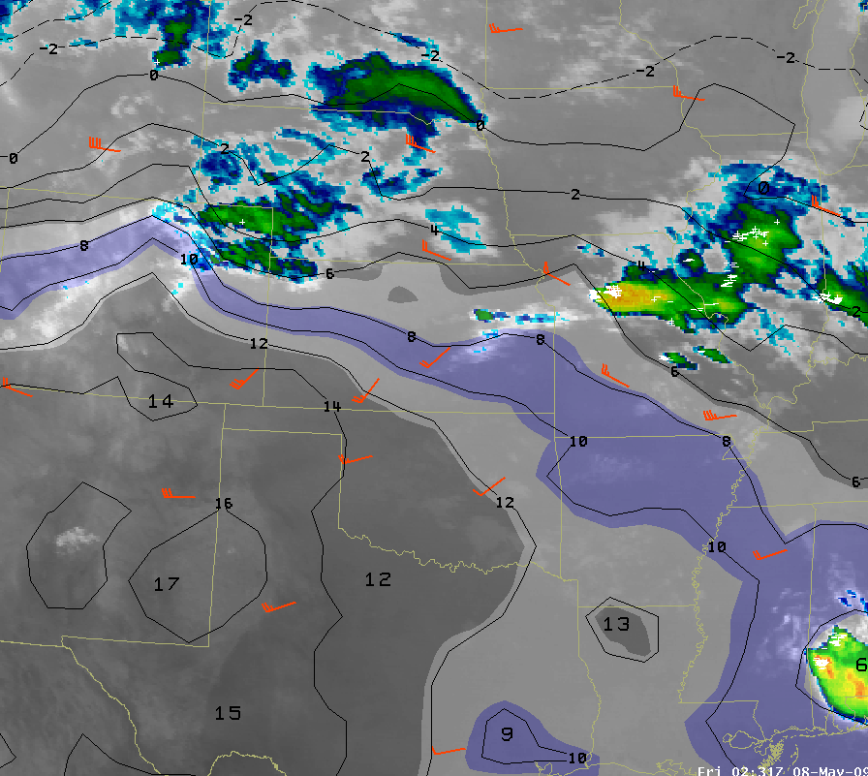
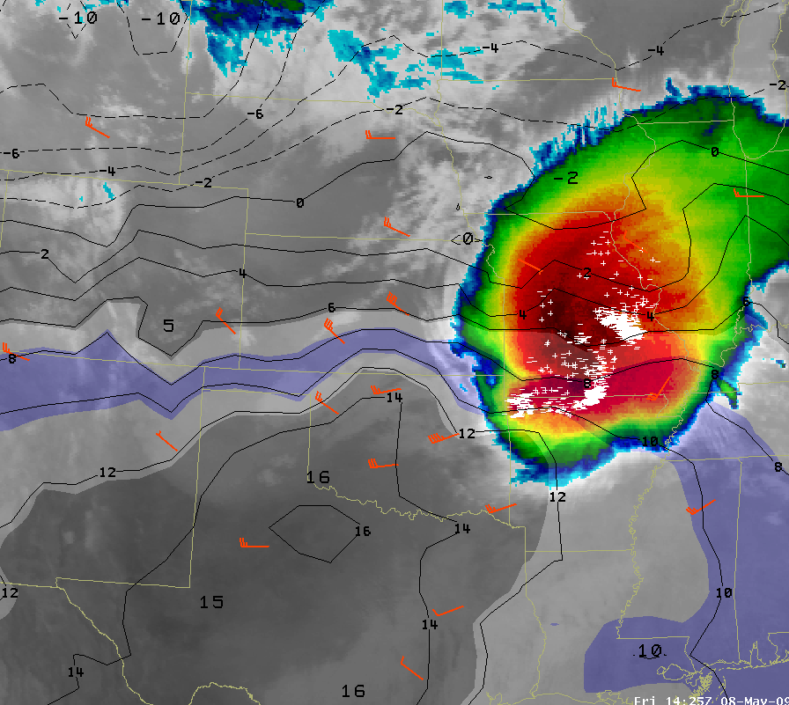
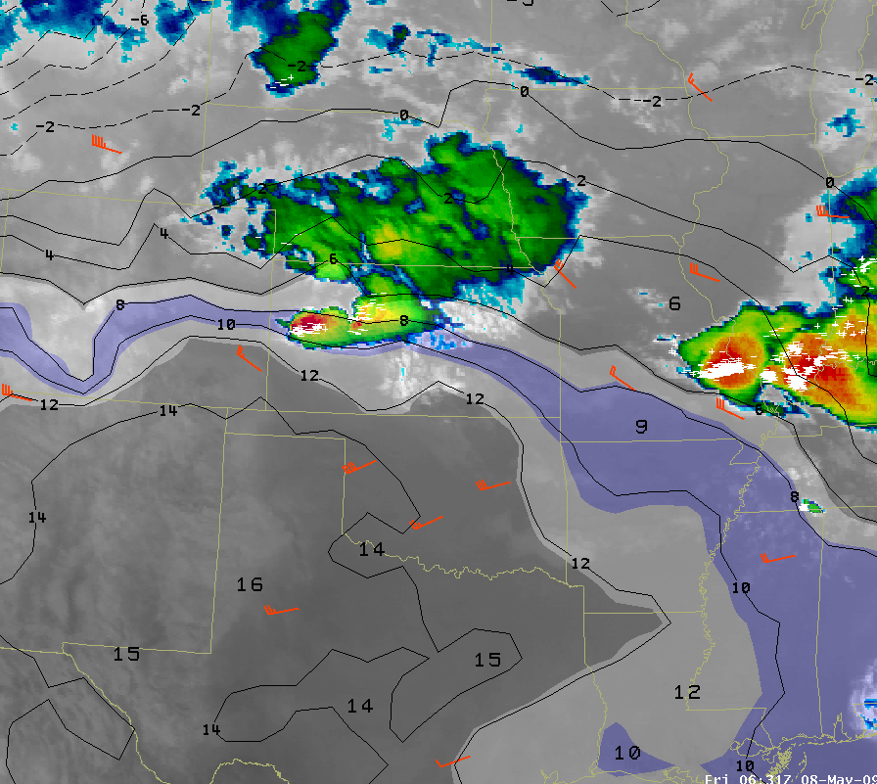
May 8th 2009

Slide 16
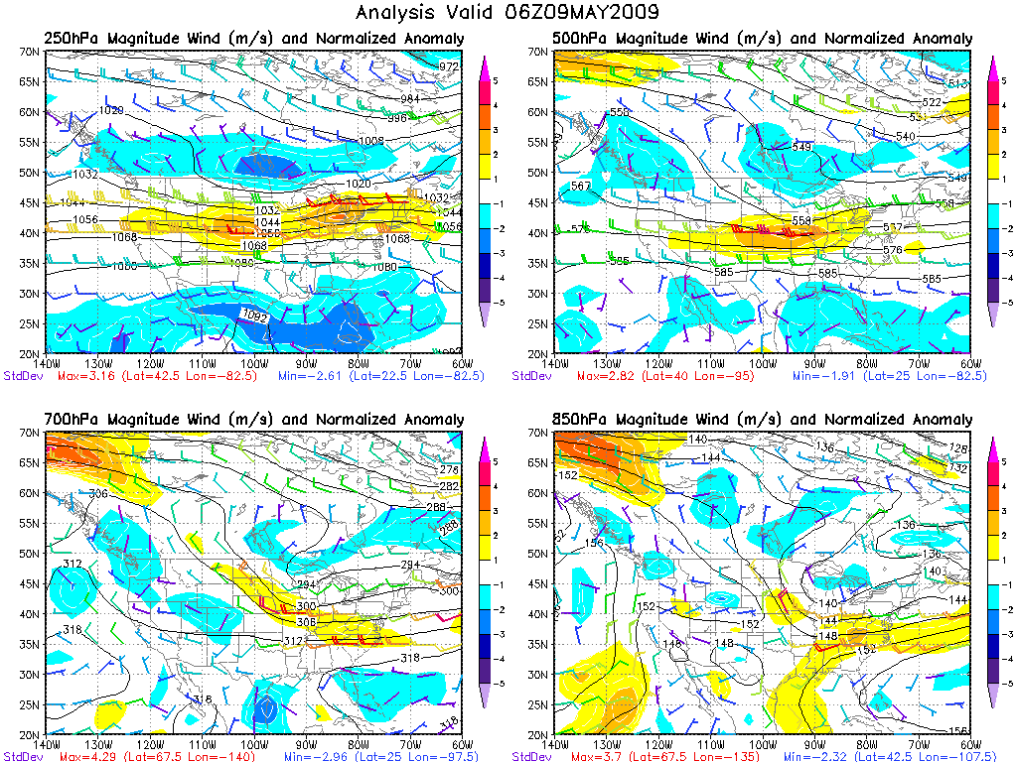
May 8th 2009

Slide 17
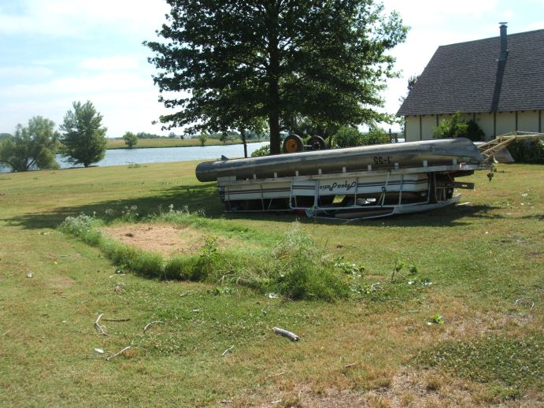
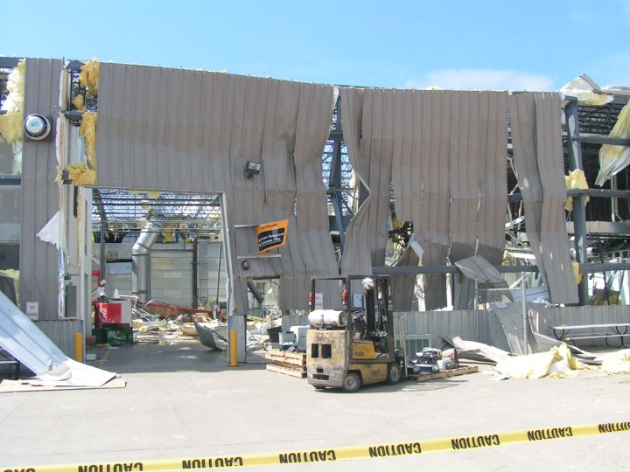
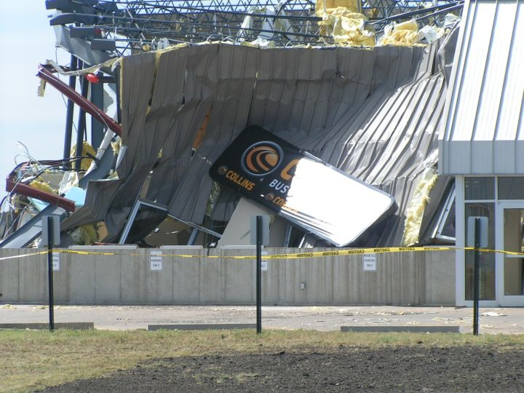
Significant
Wind
Event
June 8th 2009

Slide 18
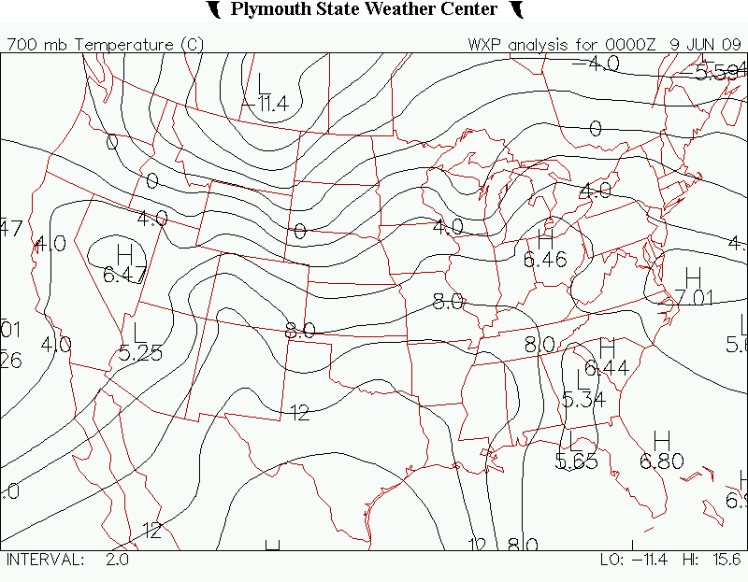
June 8th 2009
8
10
12
14

Slide 19
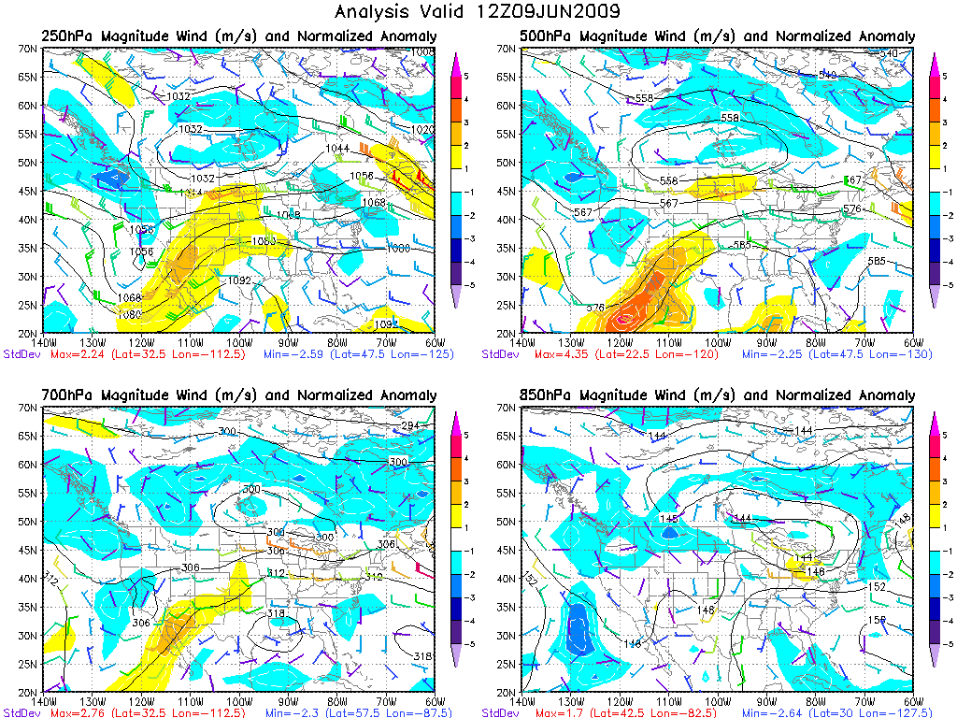
June 8th 2009

Slide 20
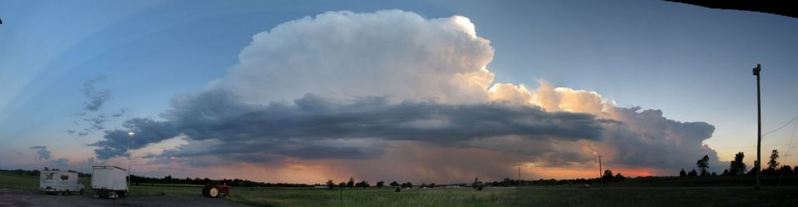
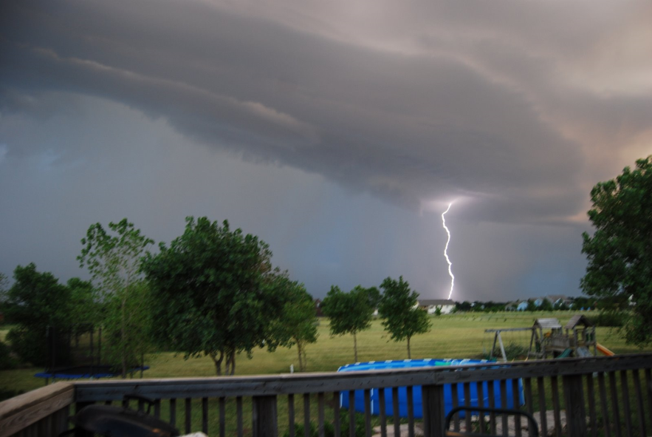
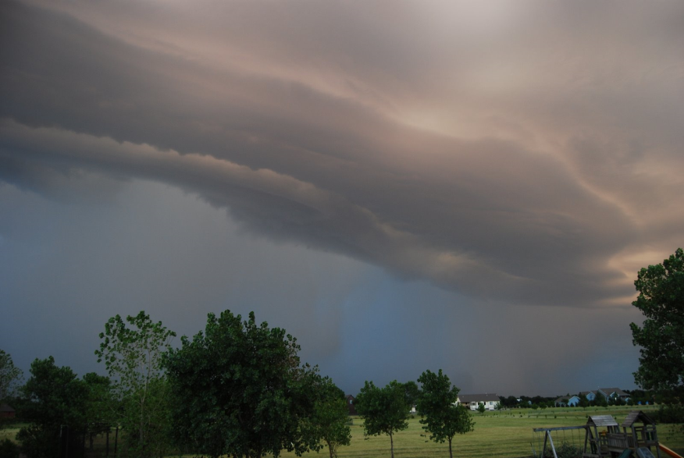
Surprise Significant Hail Event
July 8th 2009
Picture courtesy Brian Johnson

Slide 21
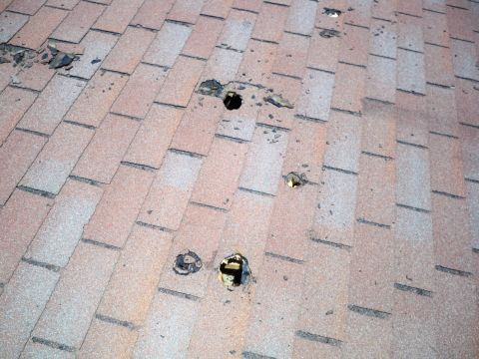
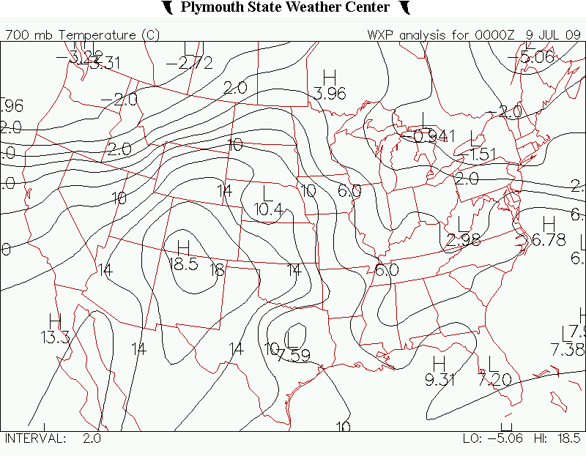
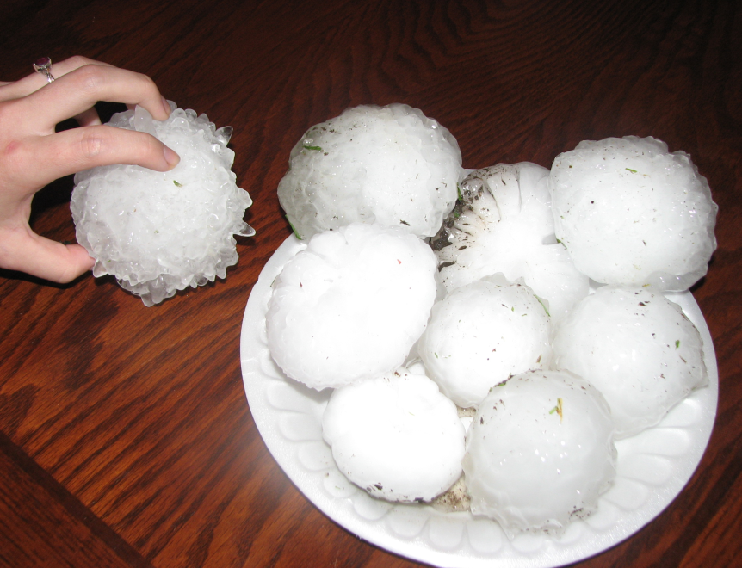
July 8th 2009
Thunderstorms caused baseball size hail to fall for about 30 minutes at Lawrence-Dumont Stadium, covering the field by the time the storm ended. Many locations east of Wichita witnessed 20 to 30 minutes of very large hail!
14
12
10
8

Slide 22
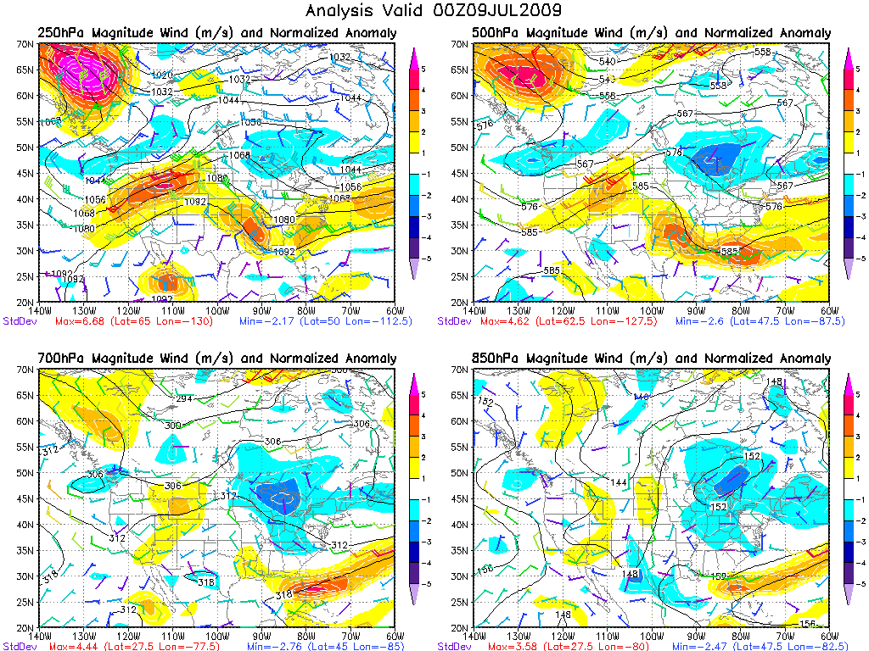
July 8th 2009

Slide 23
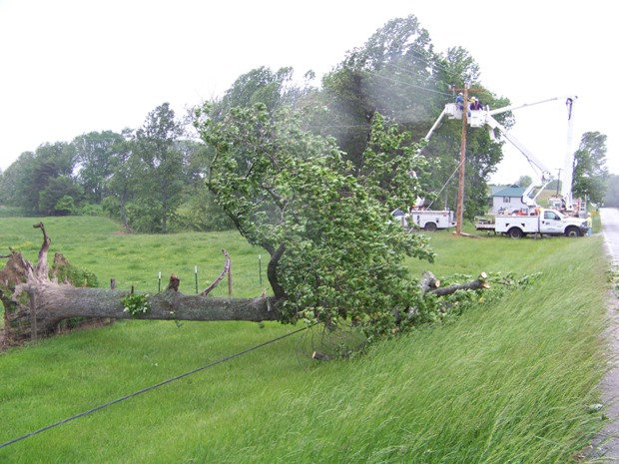
MCS Wind Events
June 6th & 7th 2010

Slide 24
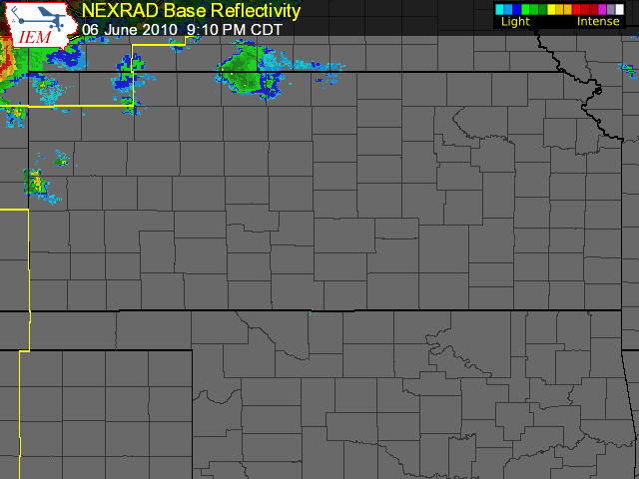
June 6th 2010

Slide 25
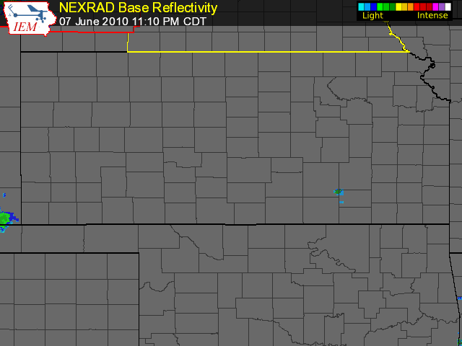
June 7th 2010

Slide 26
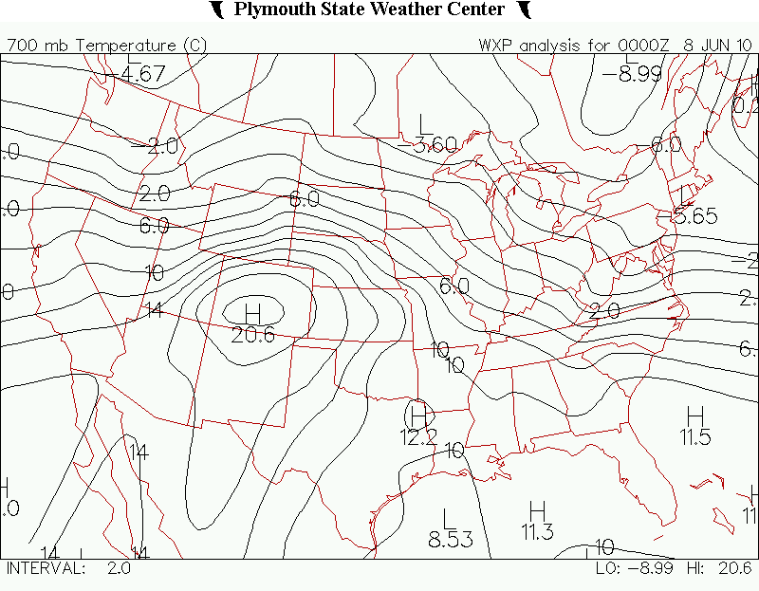
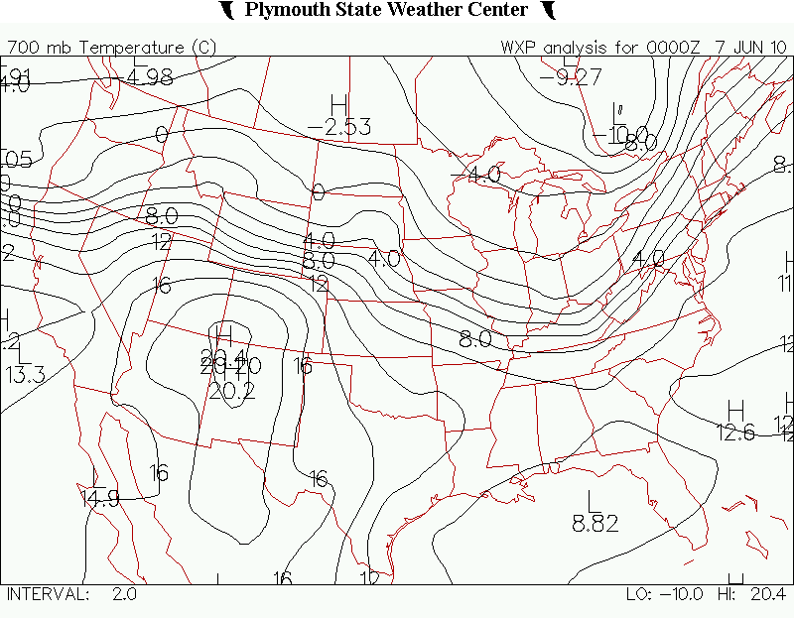
8
8
10
10
12
14
12
14

Slide 27
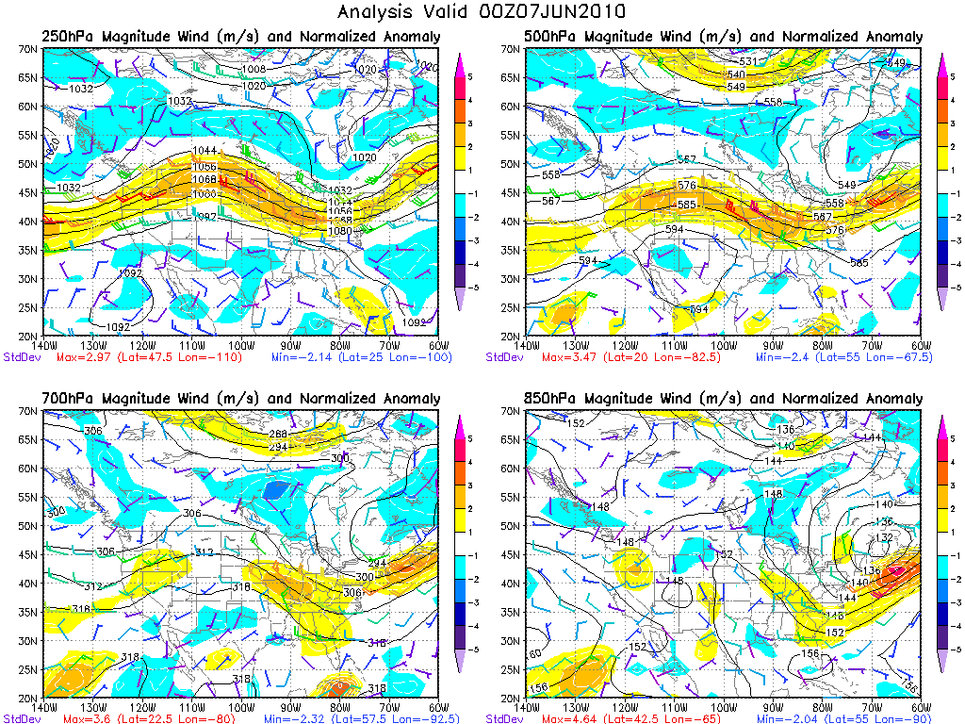
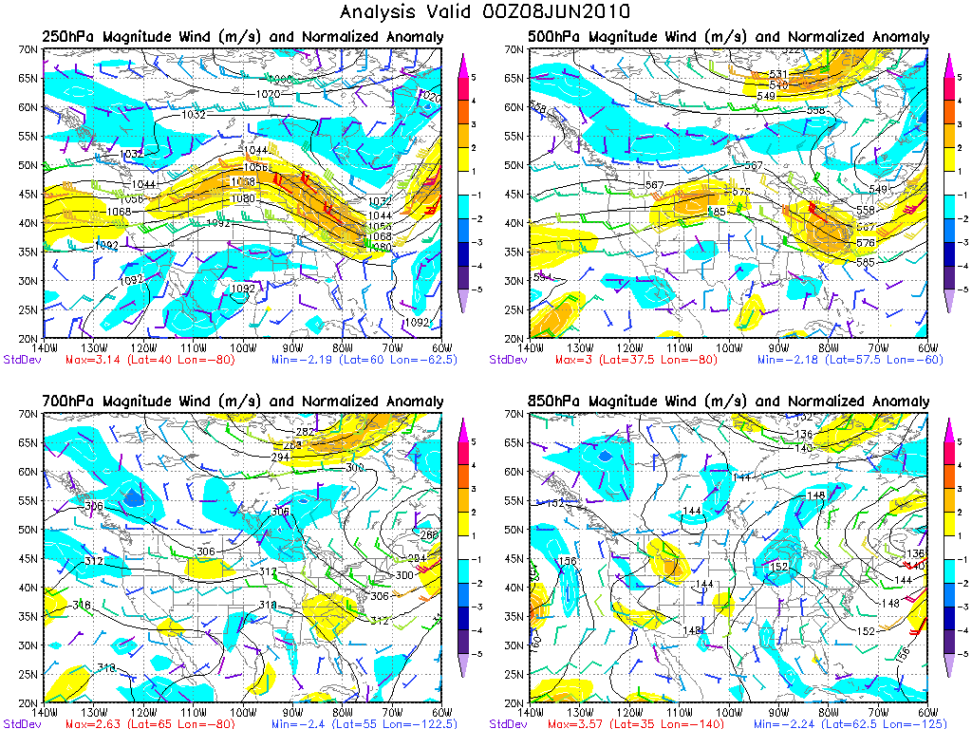
Upper Wind Anomaly in the region on June 6th but moves away from the region for June 7th event

Slide 28

Summary
Significant Wind events showed a good correlation with 250mb & 500mb magnitude wind anomalies compared to 850mb winds, mid-upper level wind speeds are key!
High percentage of widespread severe wind events occurred with-in the
8-12C 700mb temp range(90% wind events), 6-12C 700mb temp range
for severe hail events (meeting criteria)
Just knowing that there is a Mid or Upper level wind anomaly present, and in
the favored 700mb temp ranges gives us a good first guess for severe weather potential (Severe Weather events likely need some sort of an anomaly)
Try to gain access to the Normalized Anomaly Data Base for usage of forecasting versus only research applications (Robert Hart at Florida State University)

Slide 29

Questions/Comments to help enhance future studies ??
Presentation Terminated (this is the last slide)
Warning: Advancing to the next slide will cause the screen to go blank!

