Slide 1


Ensemble Numerical Prediction of the 4 May 2007 Greensburg,
Kansas Tornadic Supercell using EnKF
Radar Data Assimilation
Dr. Daniel T. Dawson II
NRC Postdoc, NSSL, Norman, OK

Slide 2
Motivation and Questions
Need for more accurate storm-scale warnings (increase lead time, decrease false alarm rate)
Can we numerically predict thunderstorms and associated severe weather?
What are some of the forecast sensitivities?
Goal: Examine ensemble prediction of a significantly tornadic supercell

Slide 3
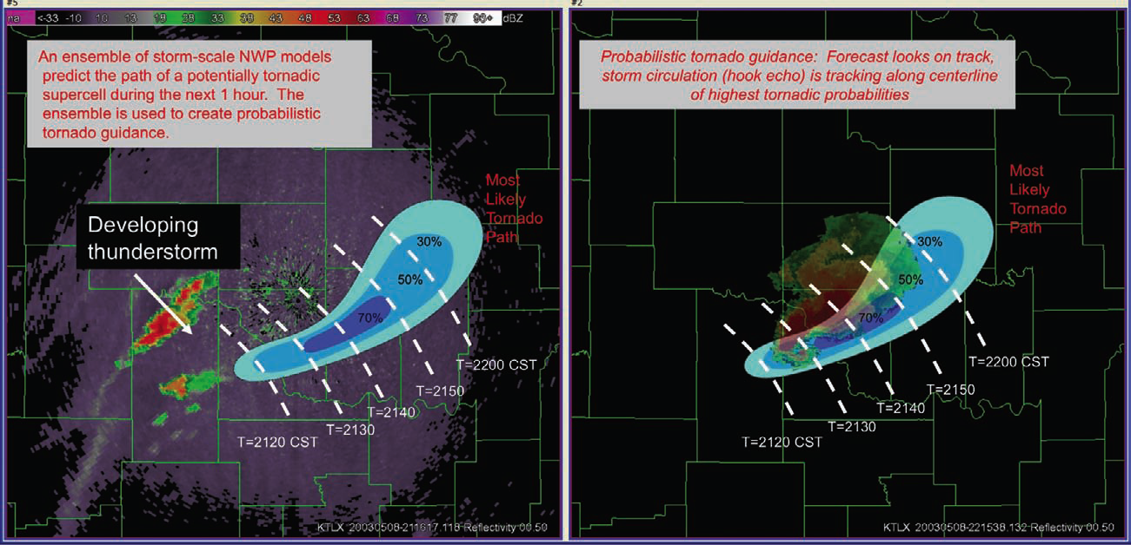
Warn on Forecast
An emerging concept
Contrast with “Warn on Detection”, the current paradigm
Aim is to provide probabilistic forecasts of individual storms and associated severe weather
Courtesy, David Stensrud, NSSL

Slide 4
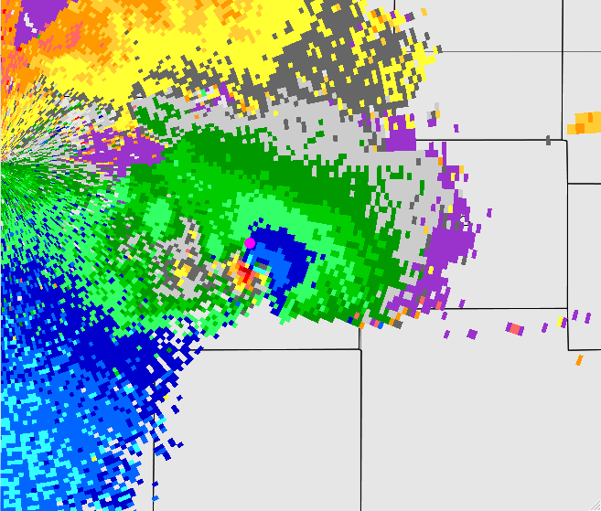
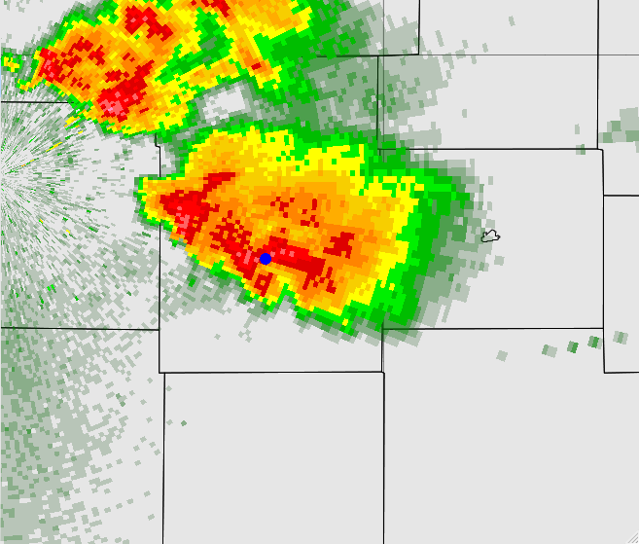
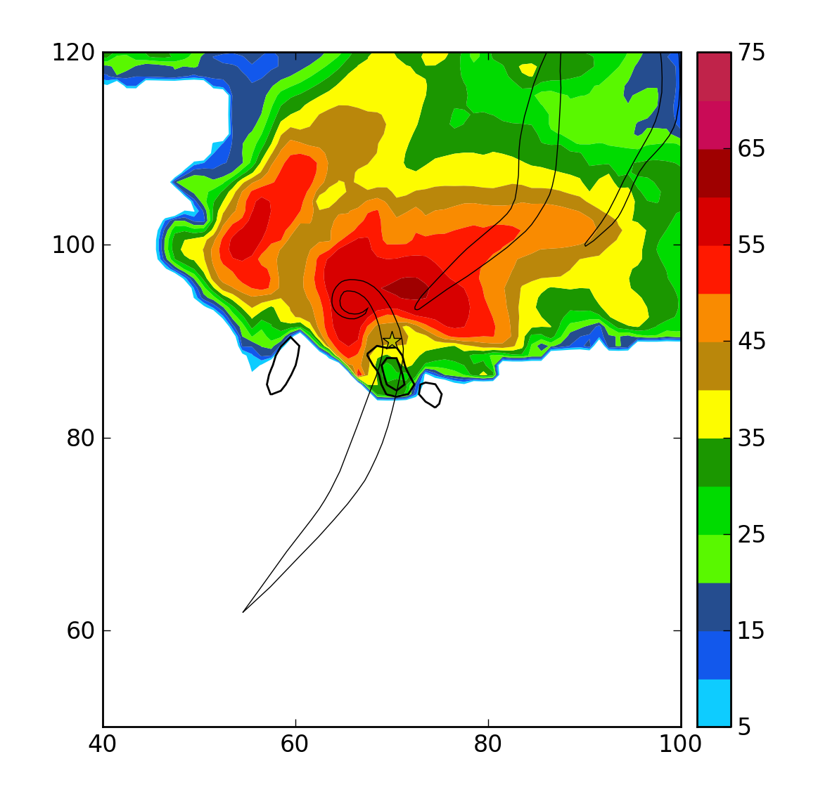
The Greensburg Storm
0245 UTC Observed 0.5° dBZ
1.5 km AGL EnKF Analysis

Slide 5
Experiment Setup
COMMAS model used
30-member EnKF and forecast ensemble
1 km grid spacing in horizontal – 140x160 km domain
150 m grid spacing in vertical near ground, stretched to 700 aloft
KDDC Level-II reflectivity and velocity data assimilated from 0030 UTC to 0300 UTC
  Data binned in 2 min intervals
Additive noise and bubbles added to increase ensemble spread
2-moment microphysics (Ziegler variable-density)
  Rain, snow, ice, graupel, and hail

Slide 6
Environmental Soundings
Three different soundings used
Identical thermodynamics, but different wind profiles
Data sources:
  0000 UTC Dodge City RAOB
  KDDC VADs at 0200, 0230, and 0300 UTC
  0200 UTC Pratt, KS Surface obs used for low-level thermodynamics

Slide 7

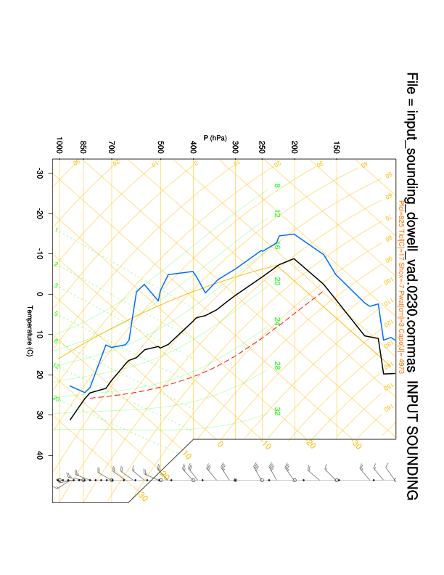
The “Frankensounding”

Slide 8
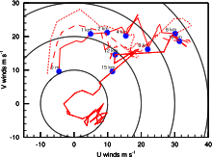
0300 UTC
0230 UTC
0200 UTC
VAD wind profiles showing increasing low-level shear from 0200-0300 UTC
Spans lifetime of Greensburg tornado

Slide 9
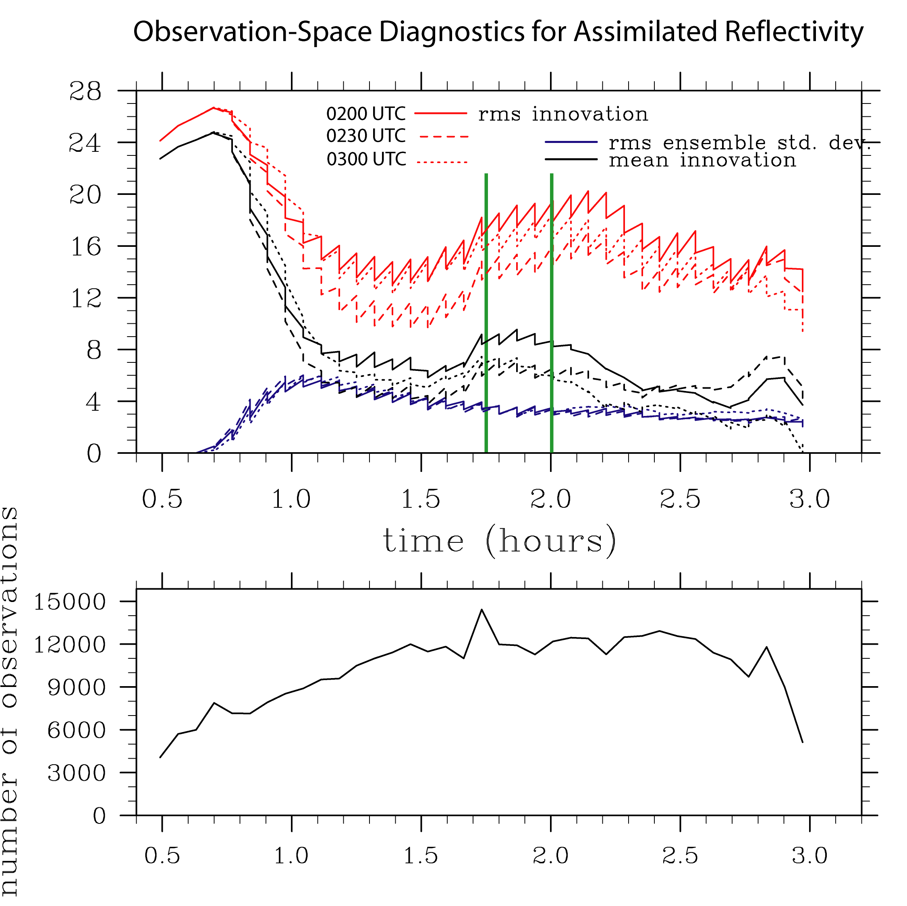

Slide 10
Forecast Evaluation
Preliminary analysis
Look at surface vorticity “swaths”
  Maximum vorticity experienced at a point over a given time interval
  A proxy for surface mesoscyclone/tornado track
Probability of vorticity exceeding a given threshold

Slide 11
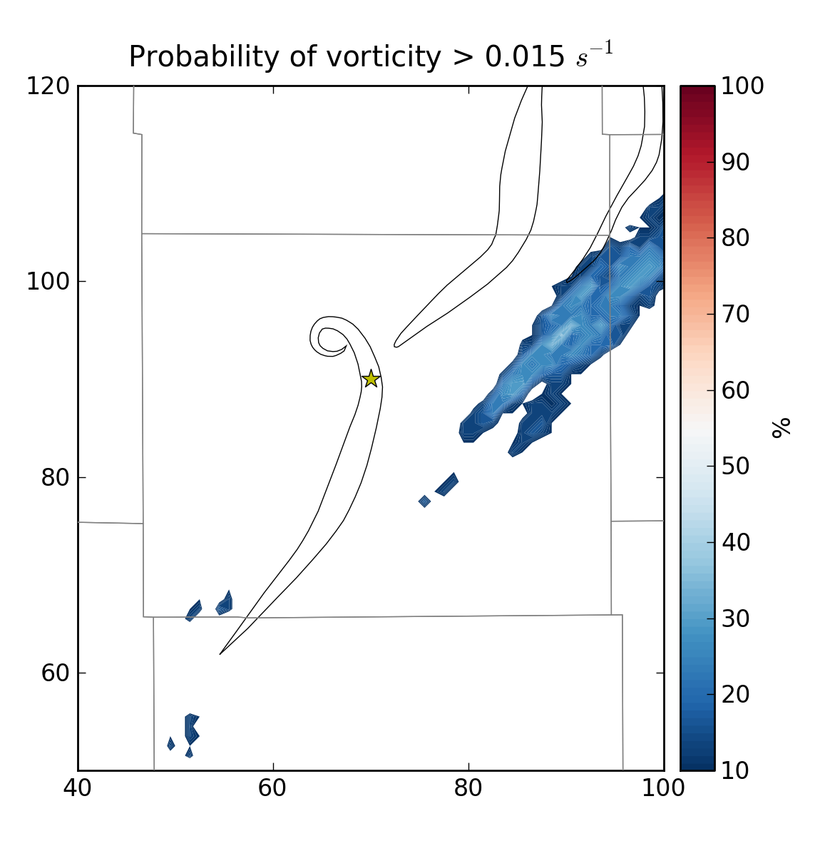
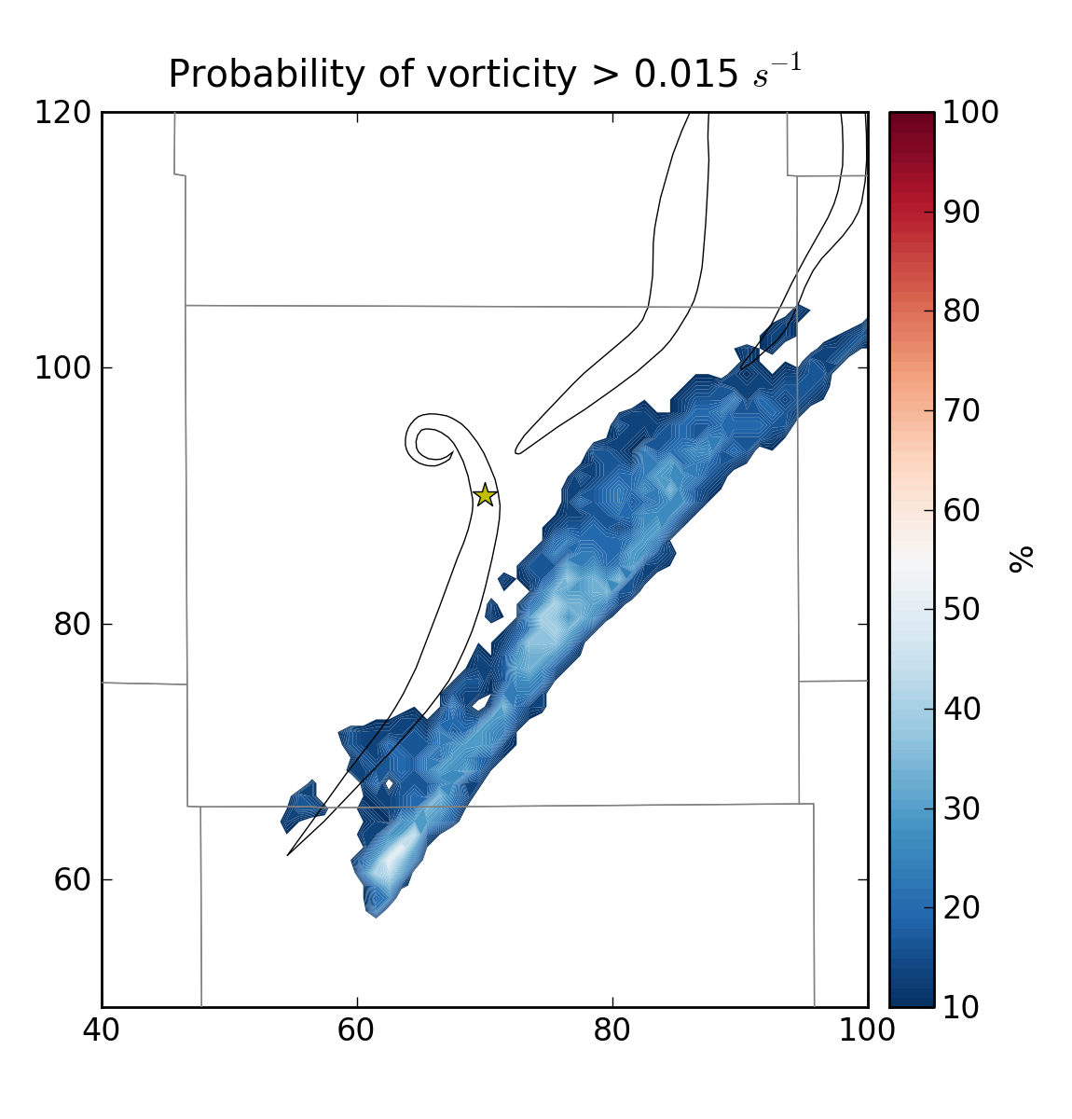
Using 0200 UTC VAD
Forecast from 0145 UTC
Forecast from 0200 UTC

Slide 12
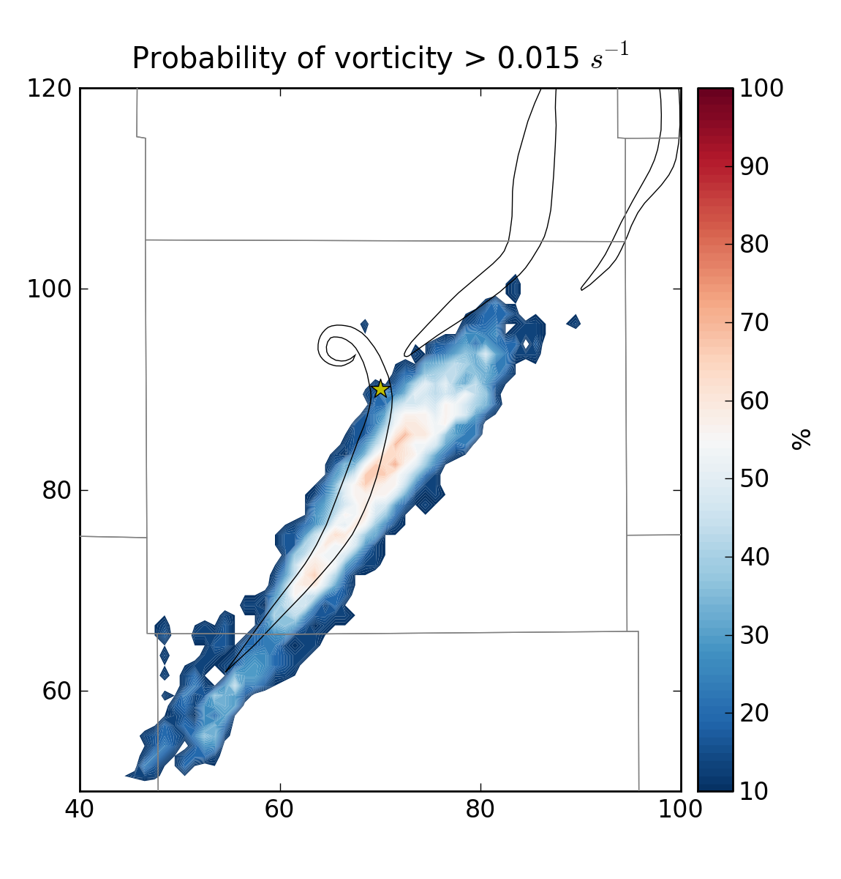
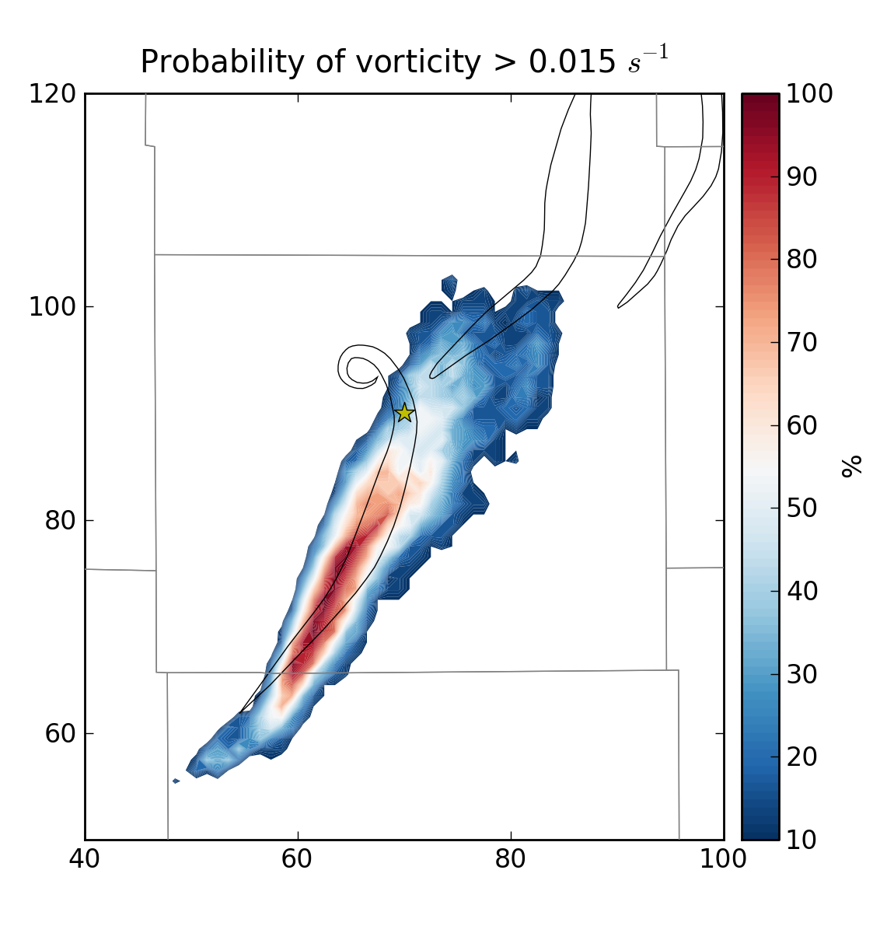
Using 0230 UTC VAD
Forecast from 0145 UTC
Forecast from 0200 UTC

Slide 13
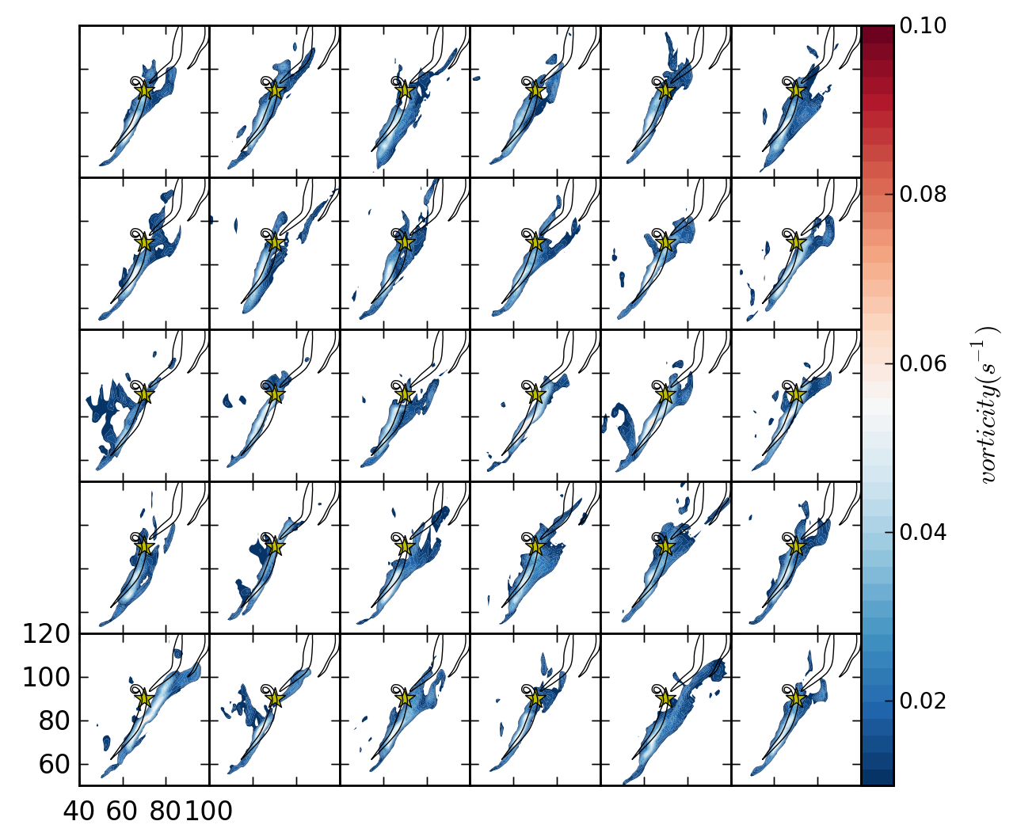

Slide 14
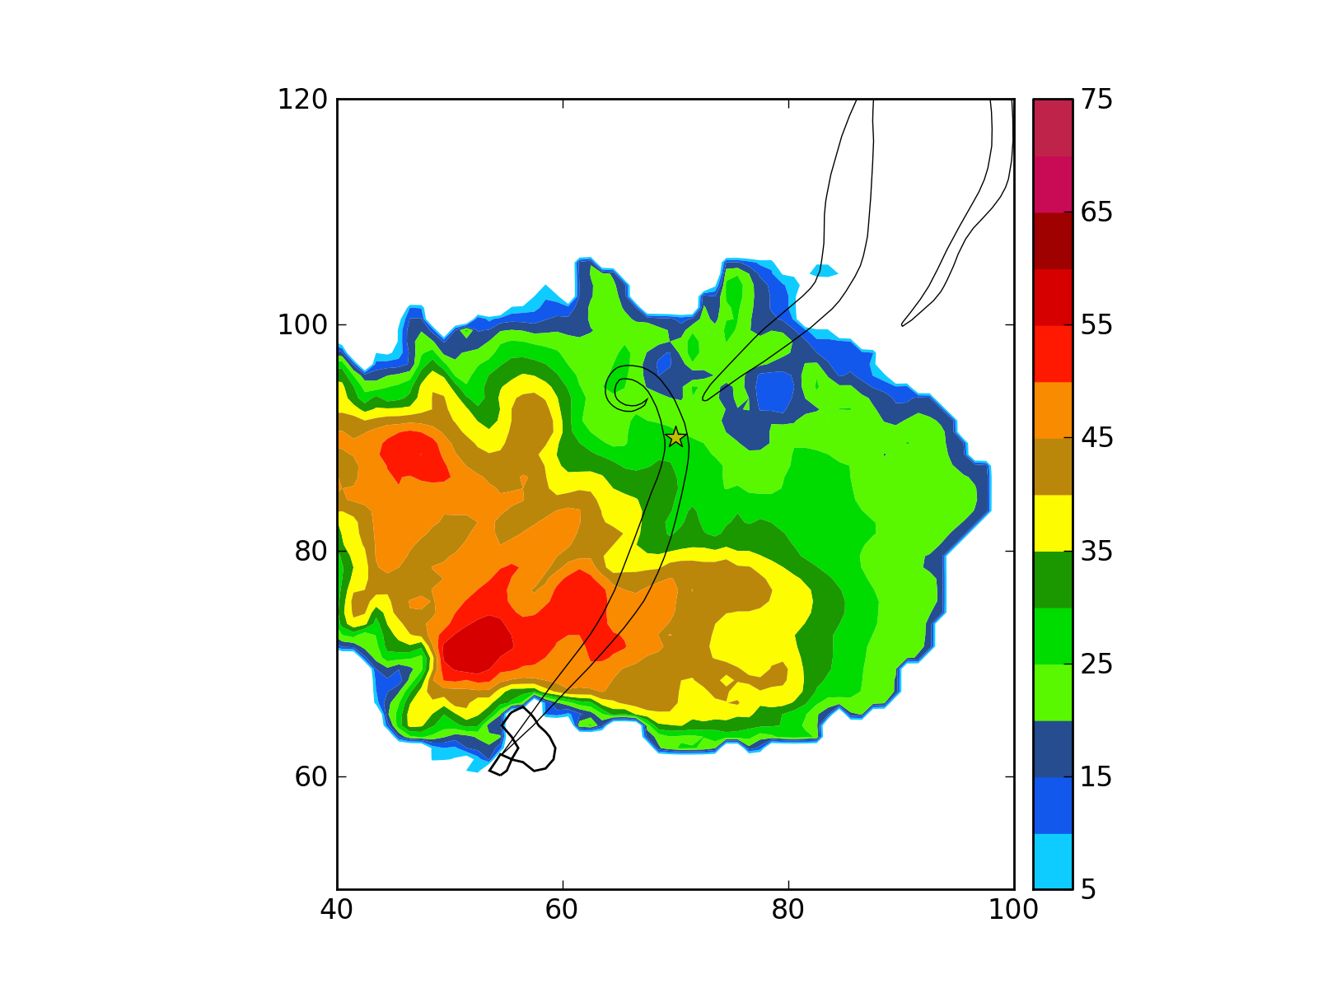
“Mean” Member 0200 UTC

Slide 15
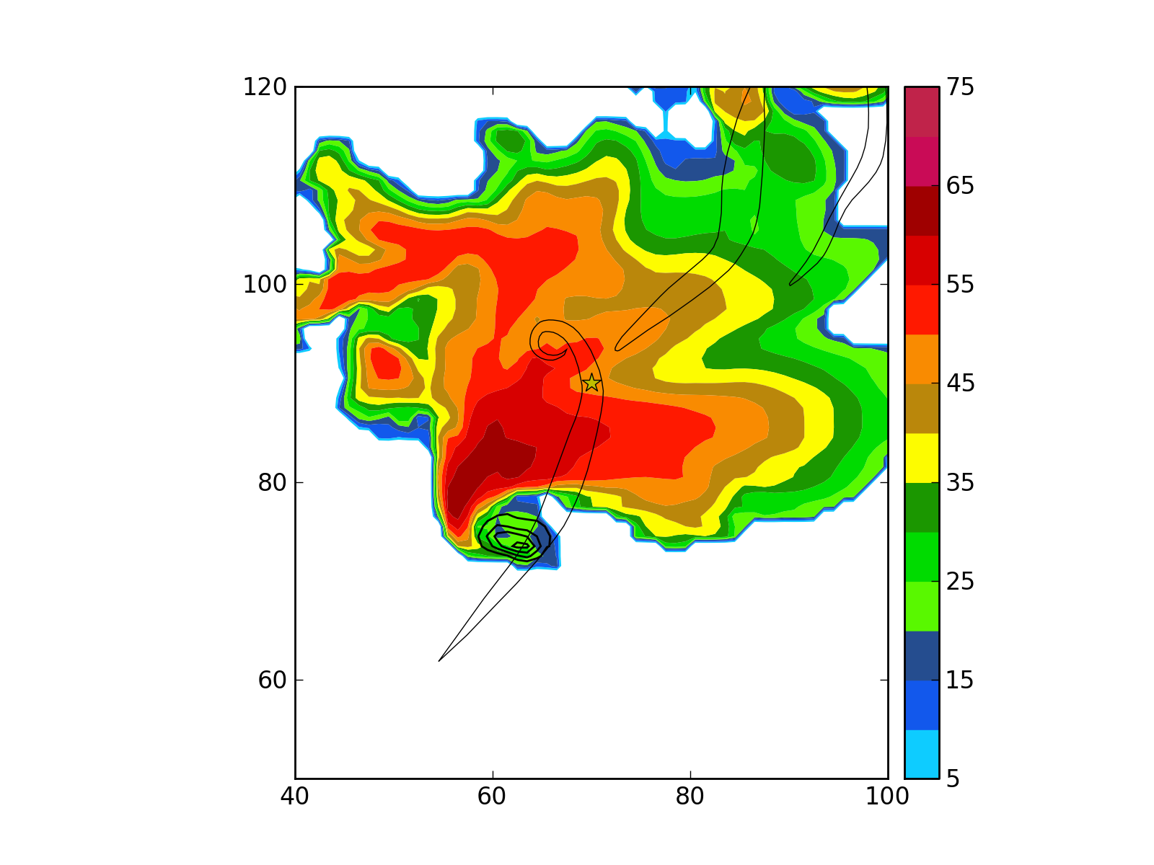
0215 UTC

Slide 16
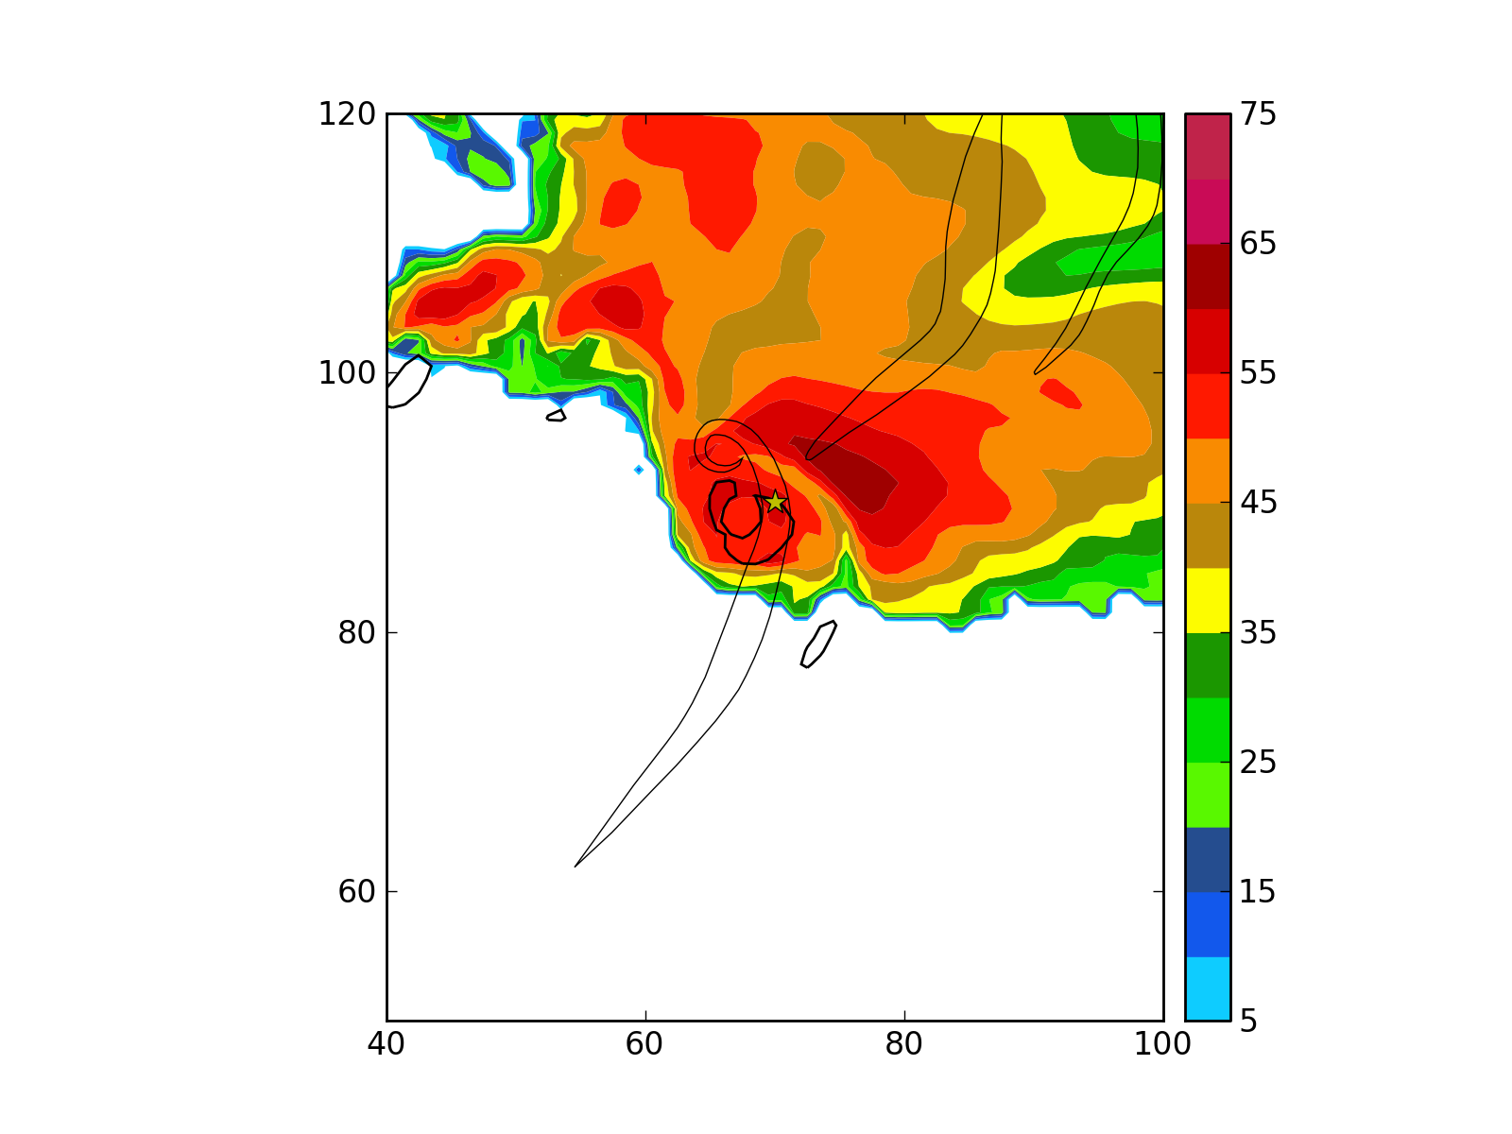
0230 UTC

Slide 17
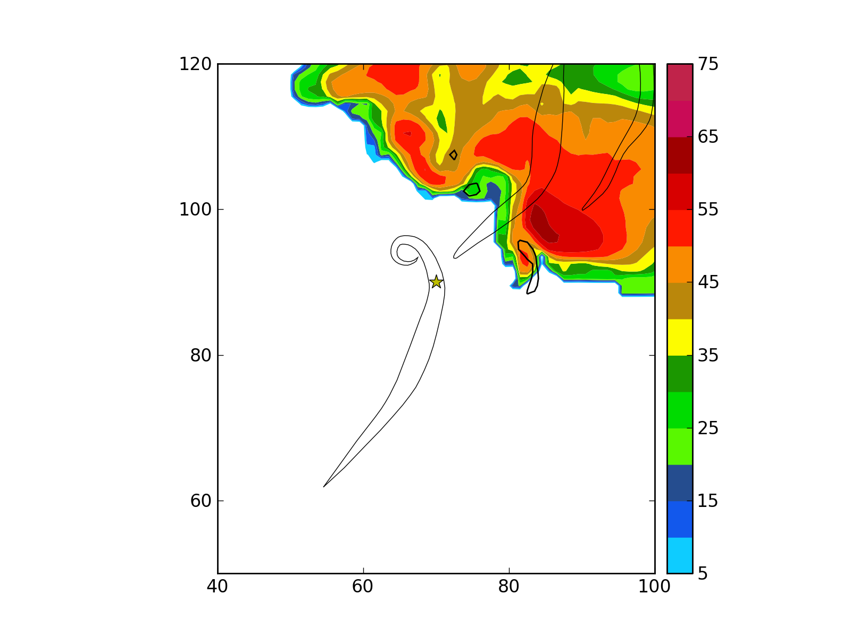
0245 UTC

Slide 18
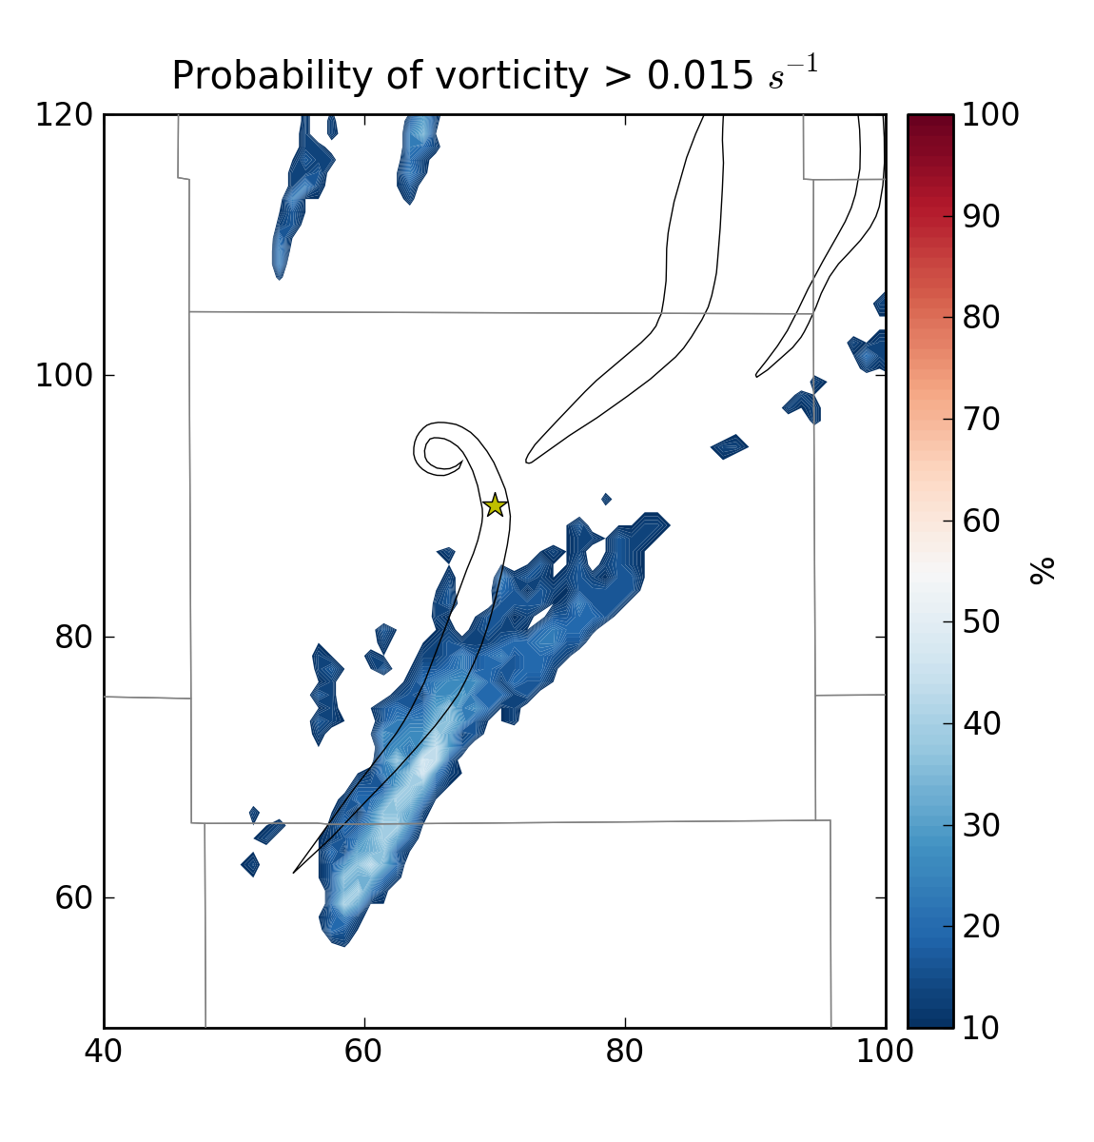
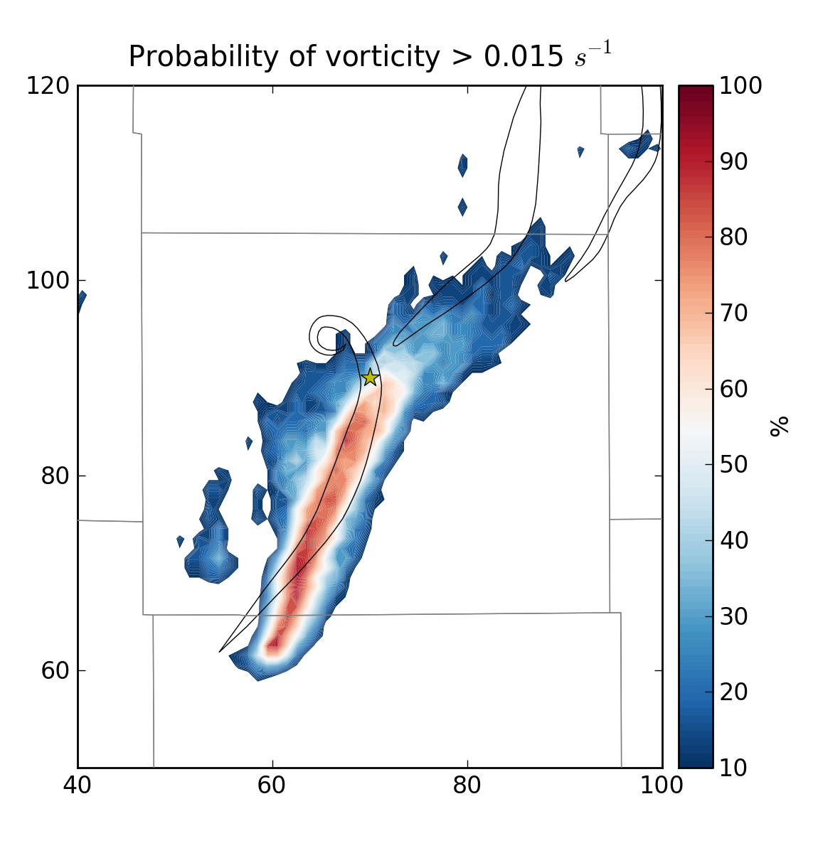
Using 0300 UTC VAD
Forecast from 0145 UTC
Forecast from 0200 UTC

Slide 19
Conclusions
Overall track and behavior of Greensburg storm predicted reasonably well out to ~ 1 hour
  However, model storm moves too fast!
Overall, best results using 0230 UTC VAD
  Valid during the middle of the Greensburg tornado
Implications for probabilistic storm and tornado forecasting – promising!
  Still plenty of room for improvement

Slide 20
Future work
Continued analysis of current experiments
Improve environment
  3D mesoscale analyses instead of single-sounding homogeneous environment!
Down-nesting of forecasts to high resolution -- O(100 – 250 m) -- to resolve tornadoes
Microphysical sensitivities
  2-moment microphysics > 1-moment!

