Slide 1
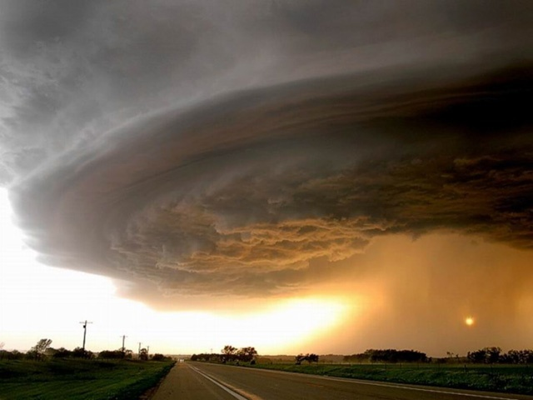
ICT CWA Early AM Significant Hail Events: May 31, 2008 Analysis & Other Comparisons
By: Andy Kleinsasser
Modified and Presented by: Ken Cook
NWS Wichita

Slide 2
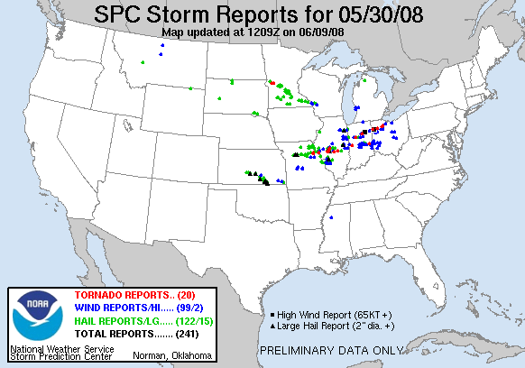
ICT CWA 09-14 UTC …
  24 severe thunderstorm warnings.
  17 reports of golfball size hail or larger.
  ROUGHLY $80-100 million in damages.
Numerous elevated supercells trained east/southeast across south-central/southeast KS.
Primary hazard large hail (although did receive a few 60 mph convective gusts).
Counties affected: Reno, Kingman, Harvey, Sedgwick, Sumner, Cowley, Butler, Chautauqua, Elk, Montgomery.
  Cowley & Chautauqua counties hardest hit, in/near Burden, Dexter, New Salem, Cedar Vale & Chautauqua, hail reached size of baseballs-softballs.
  Other areas received quarters-tennis balls.

Slide 3
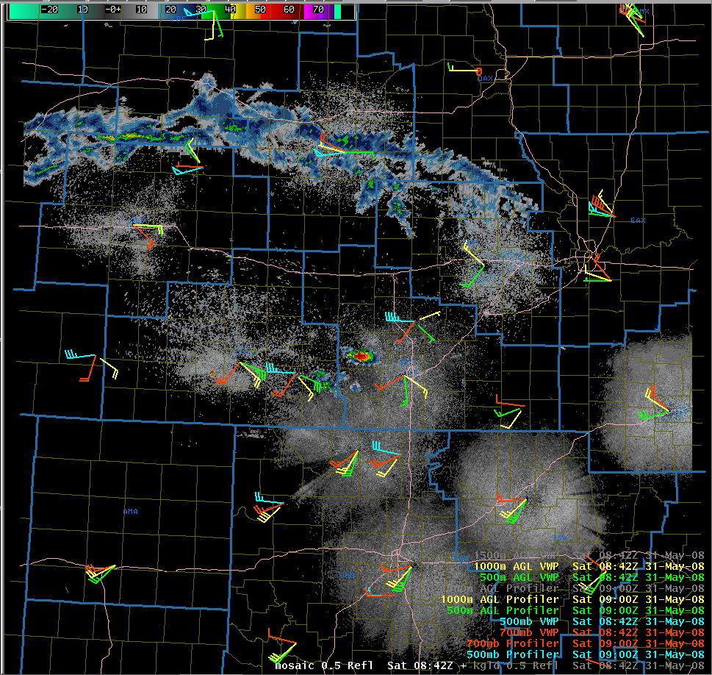
4 am Wake Up Call…
500 mb
700 mb
1000 m AGL
500 m AGL
Numerous training elevated supercells.
Strong deep layer shear.
Largest hail occurred with most deviant storms.

Slide 4
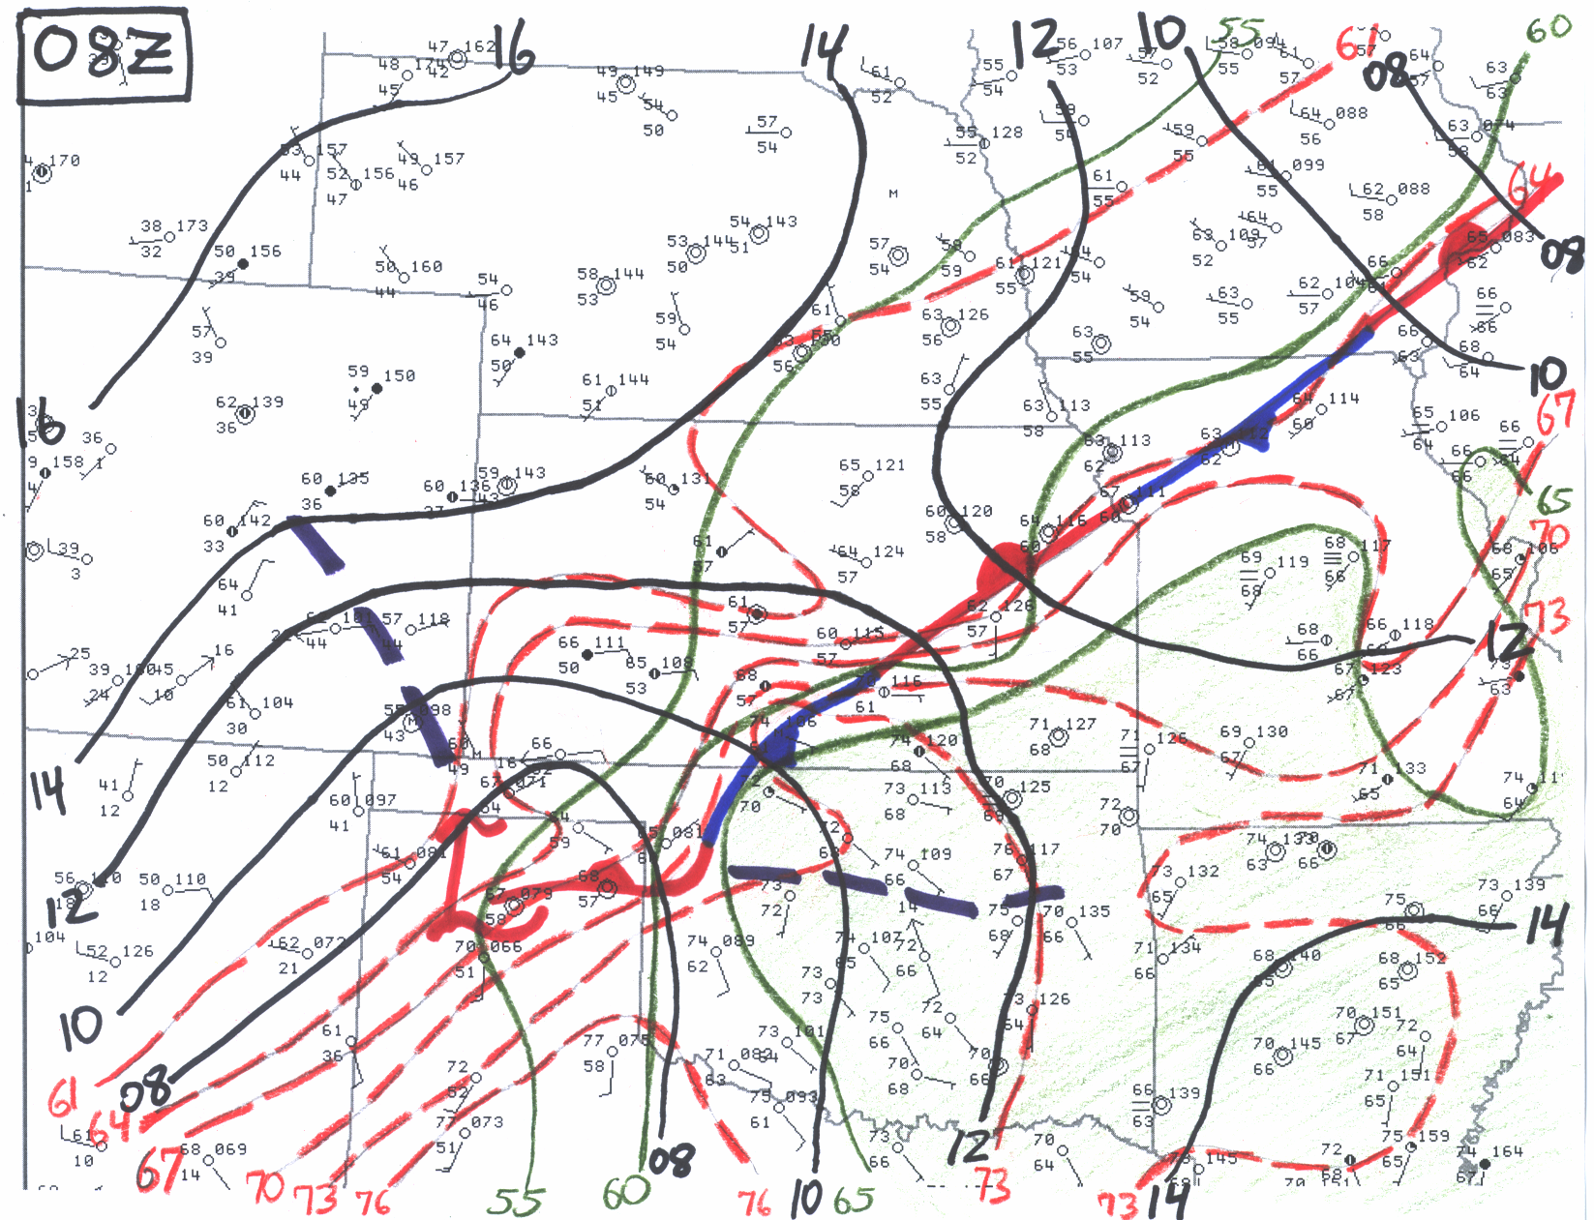
Respectable thermal/moisture gradient.

Slide 5
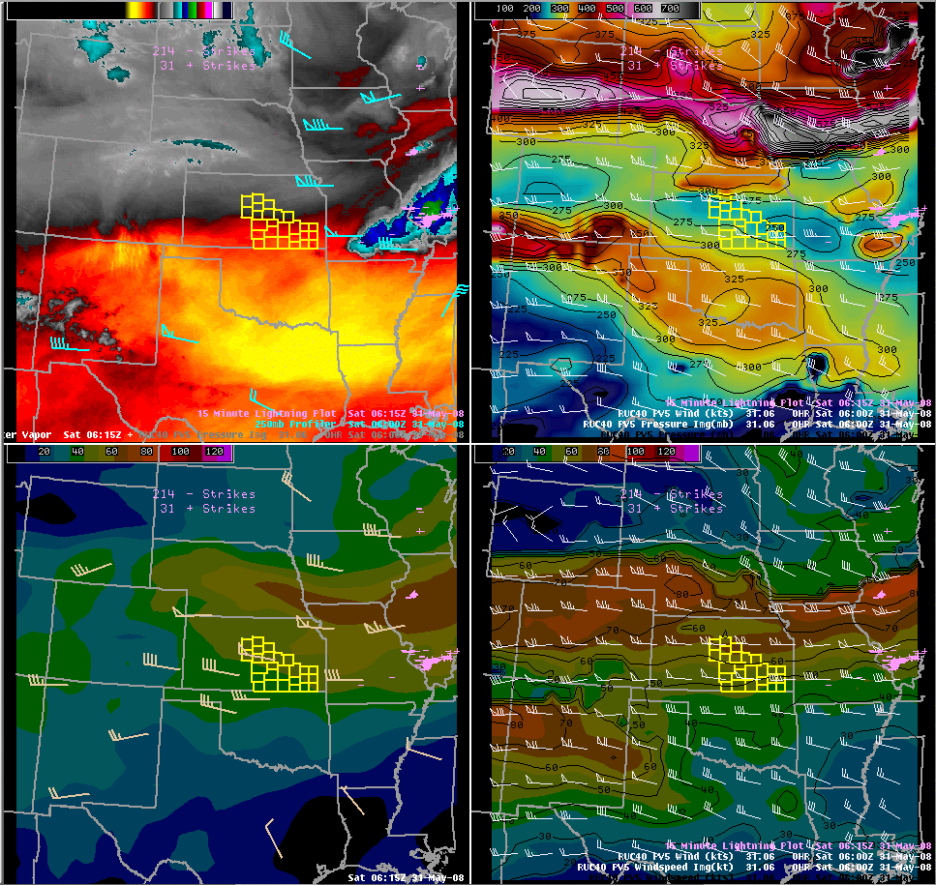
Synoptic Setup
Water Vapor, 250 mb Profilers
RUC PV 0.5 Pressure/Wind
Approaching 0.5-1.0 PV Anomaly.
  Correlated well with WV drying.
1.5-2.0 too high for subtle warm season disturbances?
Upper jet right entrance region.
Coupled jet structure?
RUC 500 mb Windspeed, Profilers
RUC PV 0.5 Windspeed

Slide 6
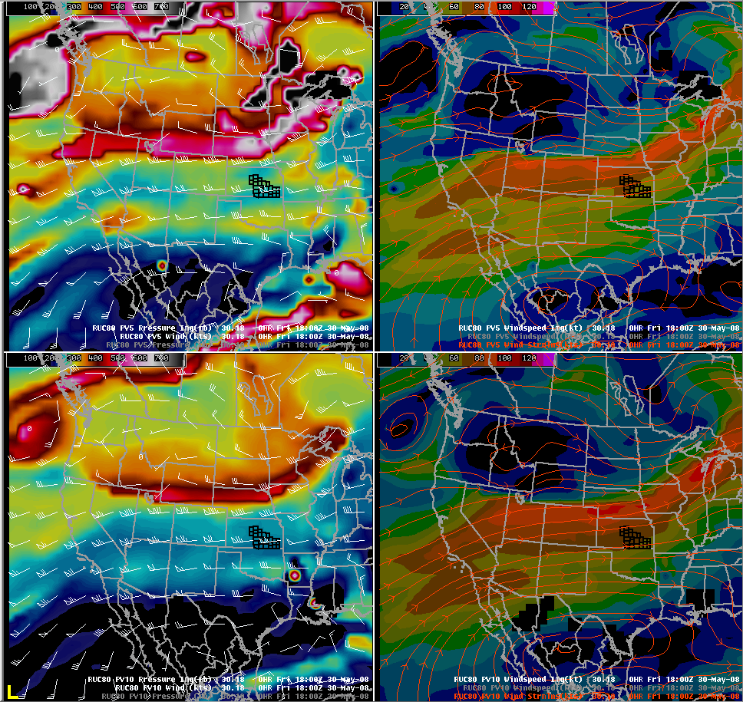
Tracing the PV Anomaly
RUC PV 0.5 Pressure/Wind
RUC PV 0.5 Windspeed
PV anomaly traced back to desert southwest 18z on 30th.
Standard pressure levels (i.e. 250-300 mb) did not give detail like PV plots.
RUC PV 1.0 Pressure/Wind
RUC PV 1.0 Windspeed

Slide 7
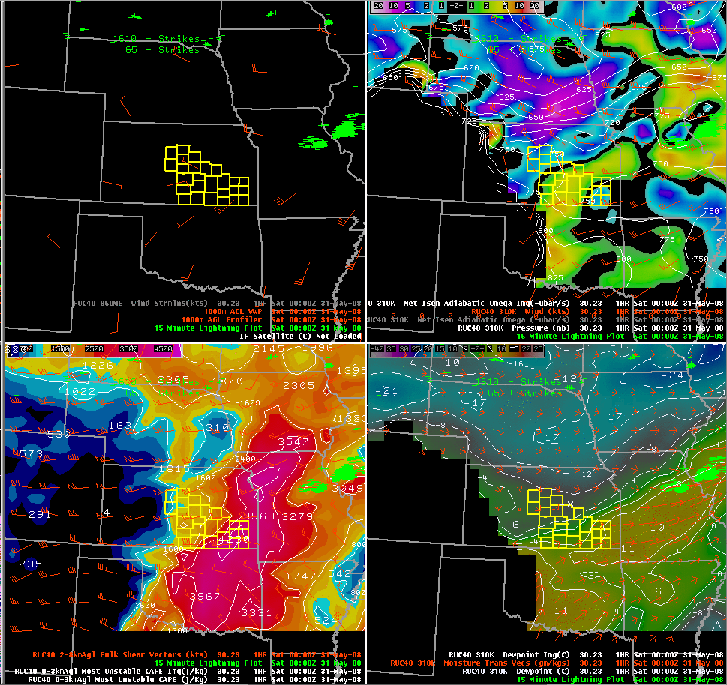
Lift, Instability & Shear
1000 m AGL Profilers
RUC 310 K Pressure/Omega
Strong 850-700 mb isentropic ascent, convergence & moisture transport.
MUCAPE values ~2500 j/kg.
2-8 km shear (essentially effective shear) ~45-50 kts.
RUC 0-3 km AGL MUCAPE/2-8 km AGL Bulk Shear
RUC 310 K Dewpoint/Moisture Transport Vectors

Slide 8
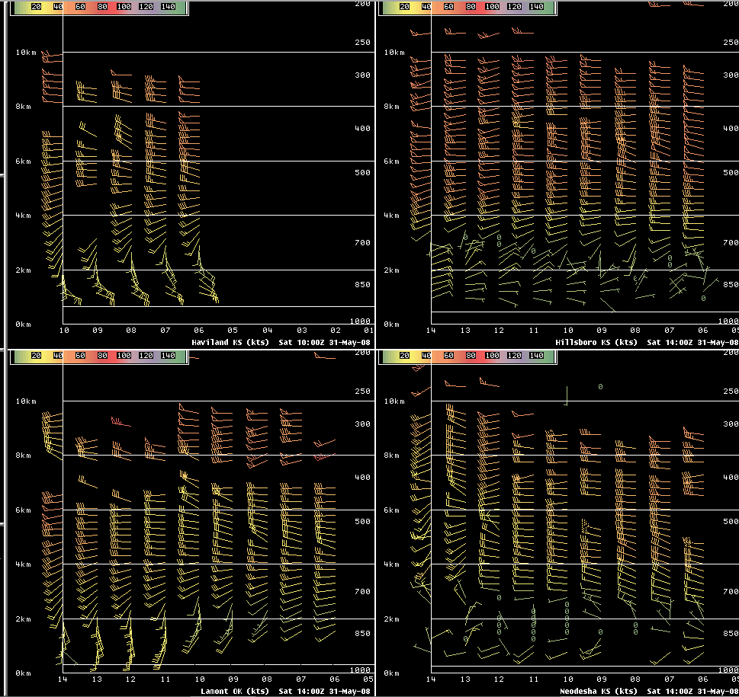
Area Profilers
Haviland
Hillsboro
Strong directional shear , especially Haviland & Lamont.
Storms likely rooted 1-2 km AGL.
Lamont
Neodesha

Slide 9
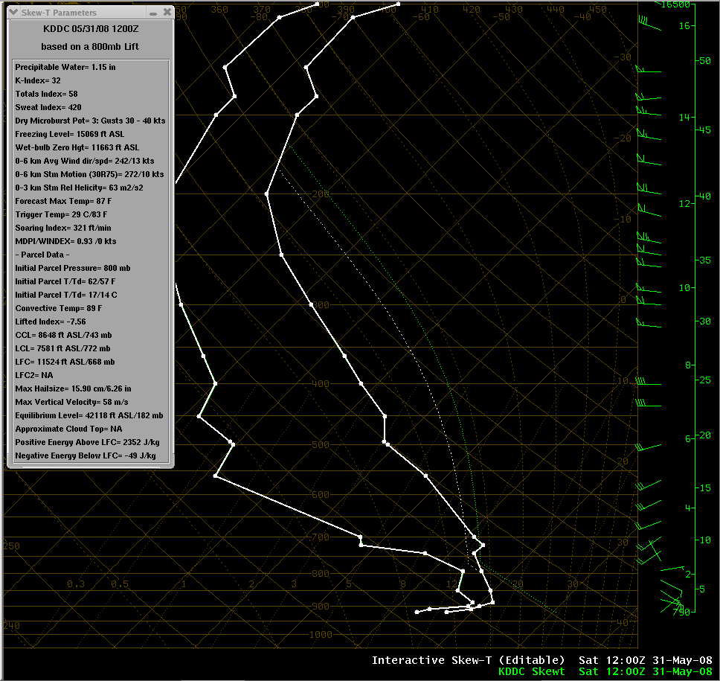
5/31 12 UTC DDC Sounding
Most representative of all surrounding RAOBs.
Elevated environment.
MUCAPE ~2300 j/kg.
Effective bulk shear likely ~30-40 kts…likely a bit weaker than storm environment shear.
Parcel lifted from 800 mb

Slide 10
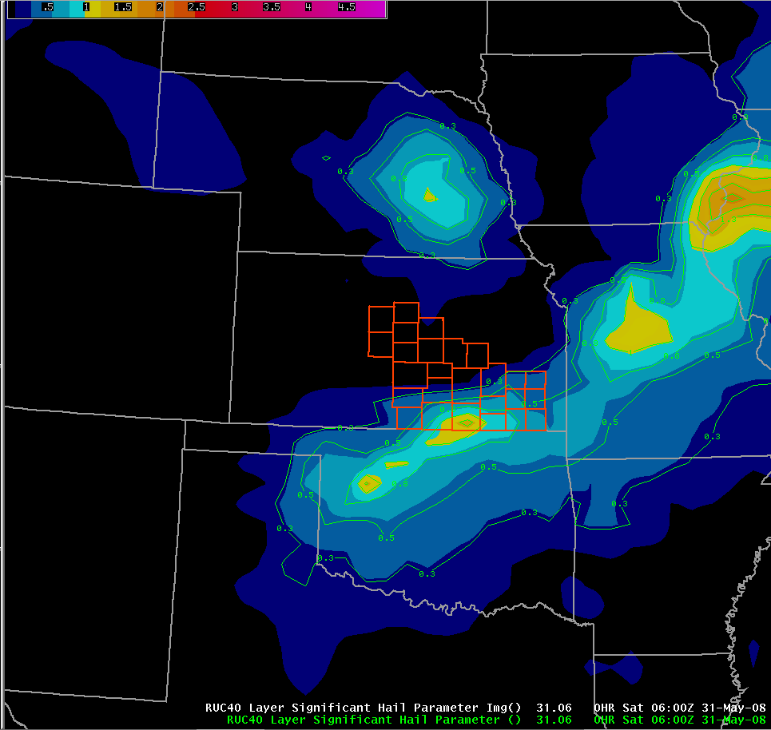
Significant Hail Parameter
06 UTC RUC indicated values of 1-1.5.
Values > 1 indicate environment favorable for sig hail (≥ 2 inches).
Uses 0-6 km bulk shear in calculation…may not be representative in elevated cases.
Develop SHP utilizing effective bulk shear?
Yellow ≥ 1 SHP

Slide 11
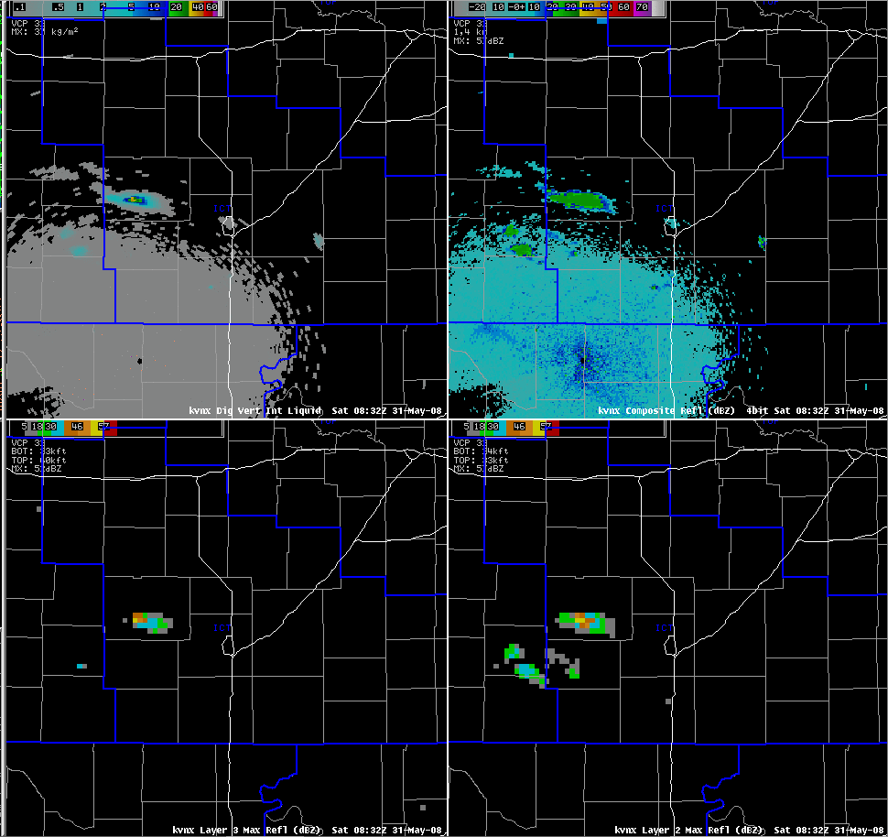
VNX Heads-UP Display
KVNX DVIL
KVNX Composite Refl
Several DVIL “blobs”.
Splitting supercells.
Several layer 2 & 3 max refl “blobs” greater than 57 dBZ .
KVNX Layer 3 Max Refl (Above 33k ft)
KVNX Layer 2 Max Refl (24-33k ft)
0C = 14k ft AGL
0C = 14k ft AGL
-20C = 22.5k ft AGL
-20C = 22.5k ft AGL

Slide 12
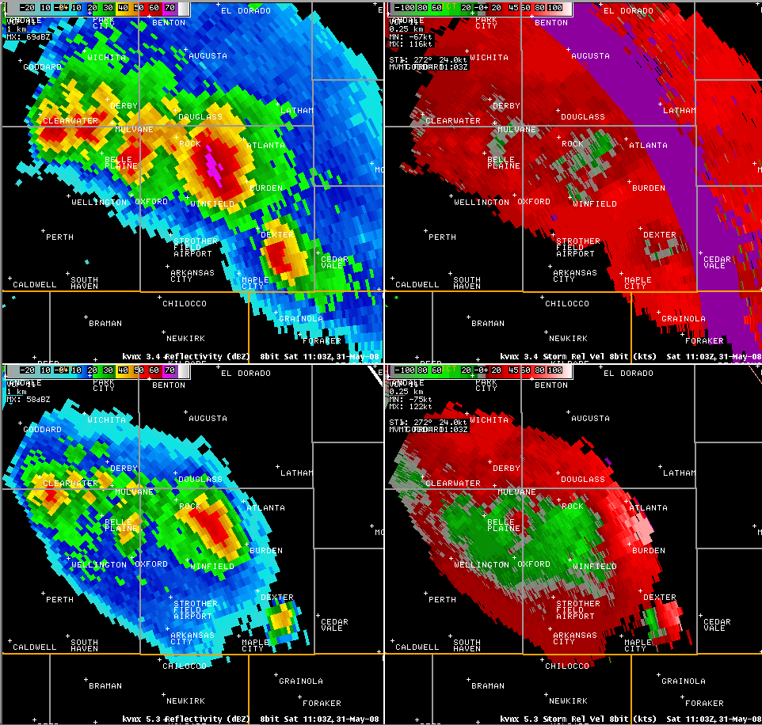
Cowley County Beast
65 dBZ above 30k ft
Persistent mid-level Rotation
0C = 14k ft AGL
-20C = 22.5k ft AGL
50 dBZ above 45k ft
Storm-Top Divergence

Slide 13
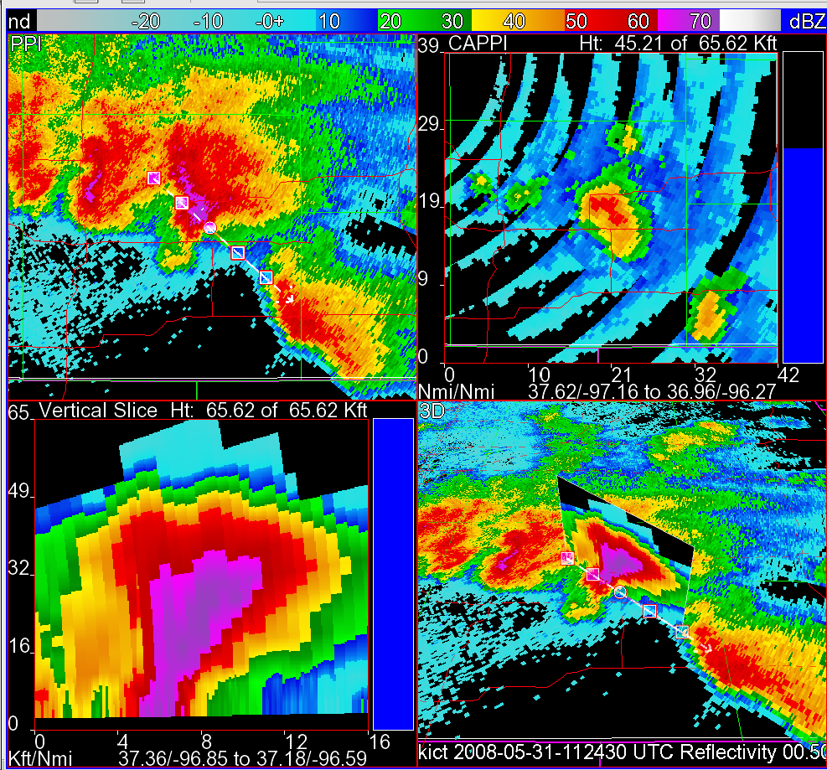
VNX FSI Perspective
Cross section through Burden/Dexter storm.
Strong tilt.
Solid core of at least 55-60 dBZ to almost 40k ft.
Holy Tilt Batman!!

Slide 14
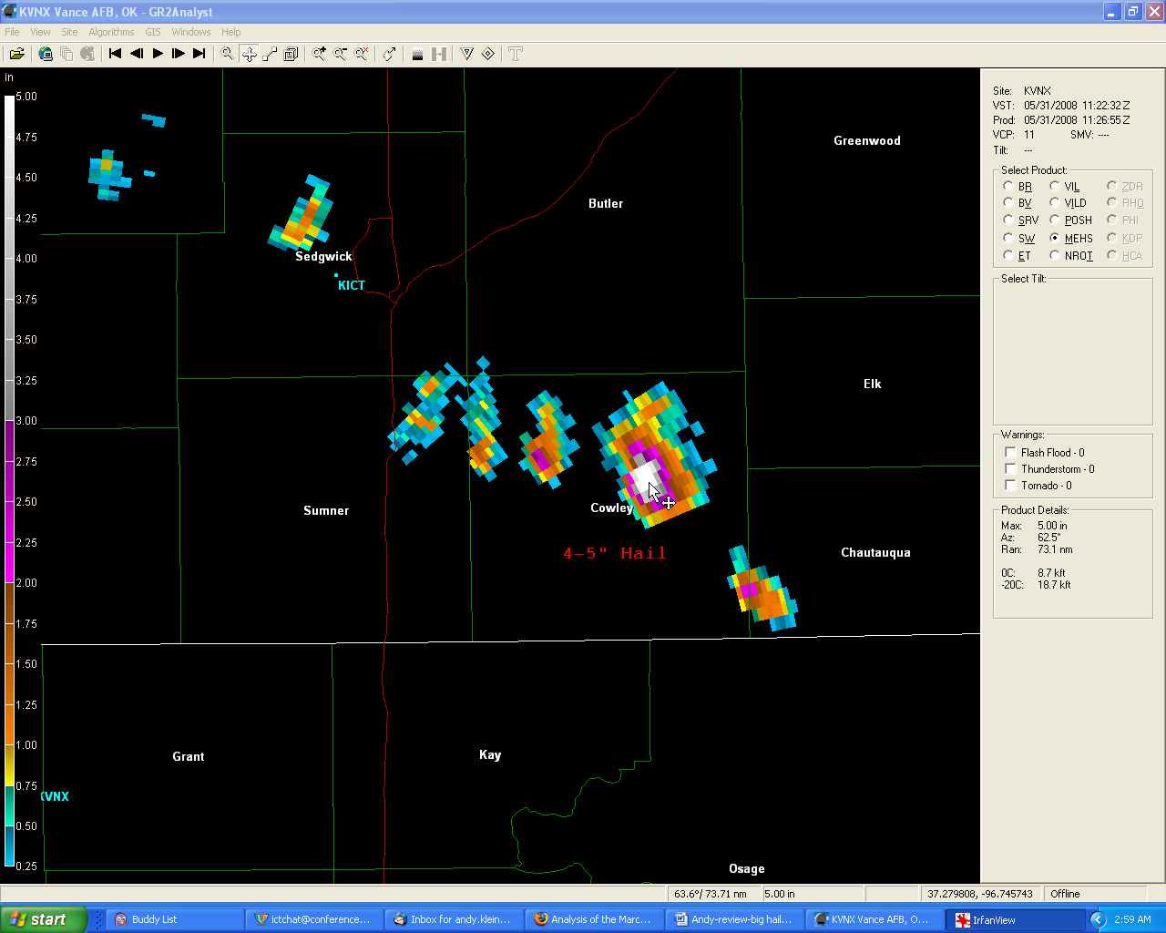
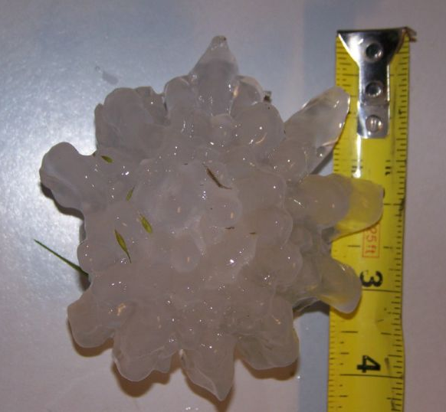
GR2 Analyst MEHS Perspective
MEHS of 4-5 inches near Burden.
Ground truth 4.25”
4-5” Hail
Courtesy of Yvonne Stone

Slide 15
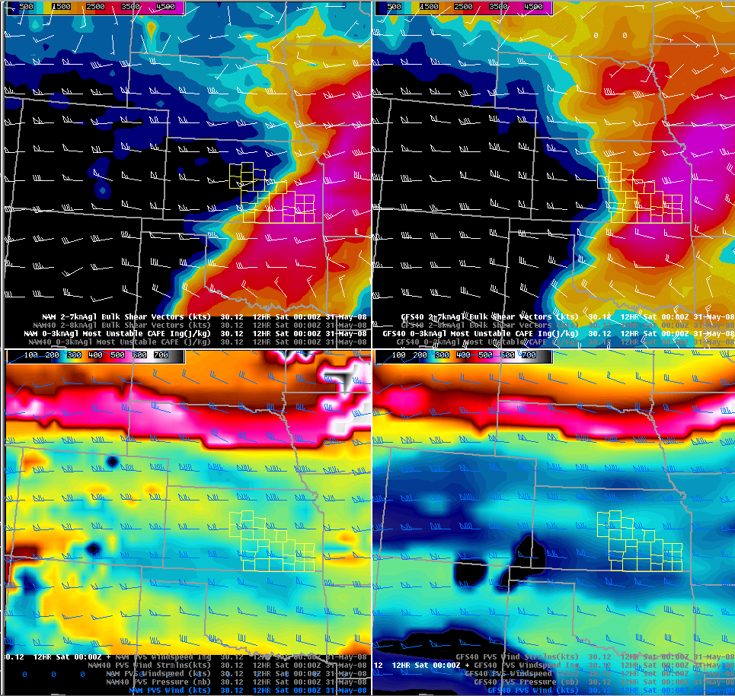
NAM/GFS 18-24 hr Forecast: PV0.5, Instability & Shear
NAM 2-7 km bulk shear/0-3 km MUCAPE
GFS 2-7 km bulk shear/0-3 km MUCAPE
GFS & NAM indicated instability returning north, although too far north. NAM closest in magnitude…GFS underdone.
Both indicated 40-50 kts 2-7 km shear.
Both indicated the subtle PV 0.5 anomaly approaching from west.
NAM PV 0.5 Pressure/Wind
GFS PV 0.5 Pressure/Wind

Slide 16
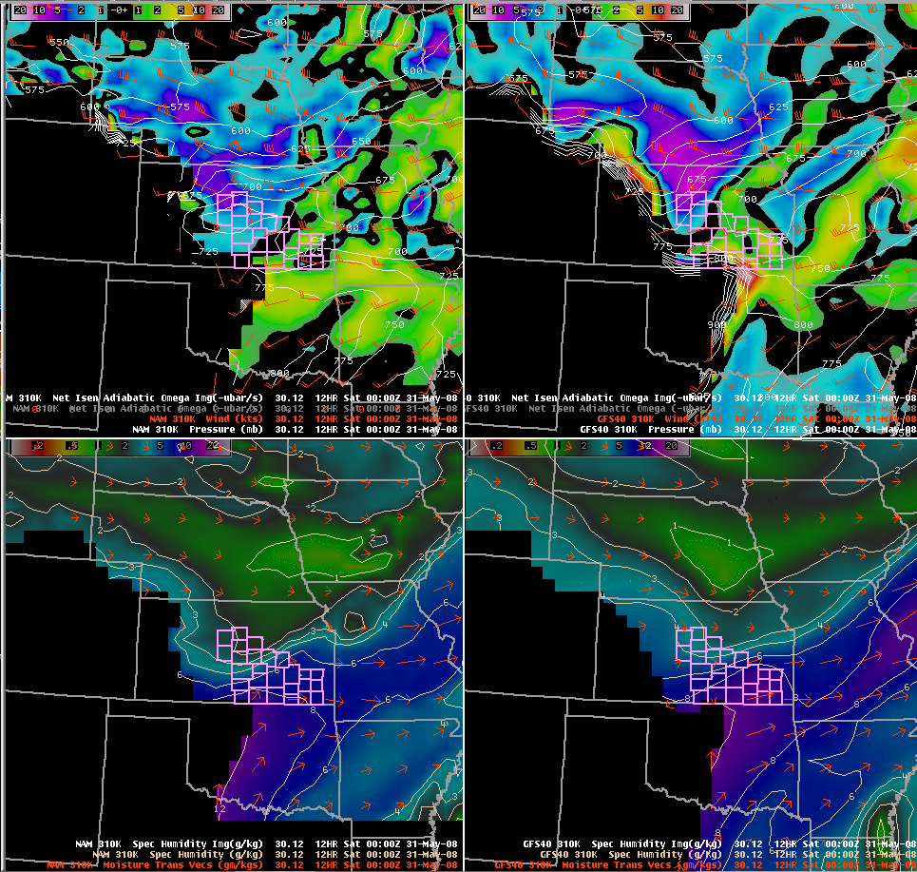
NAM/GFS 18-24 hr Forecast: Isentropic Ascent, Moisture Transport
NAM 310 K Pressure/Omega
GFS 310 K Pressure/Omega
Though not perfect correlation, NAM & GFS suggested modest/strong isentropic ascent & moisture transport toward 09-12z.
NAM fields looked more representative.
NAM 310 K Specific Humidity/Moisture Transport
GFS 310 K Specific Humidity/Moisture Transport

Slide 17
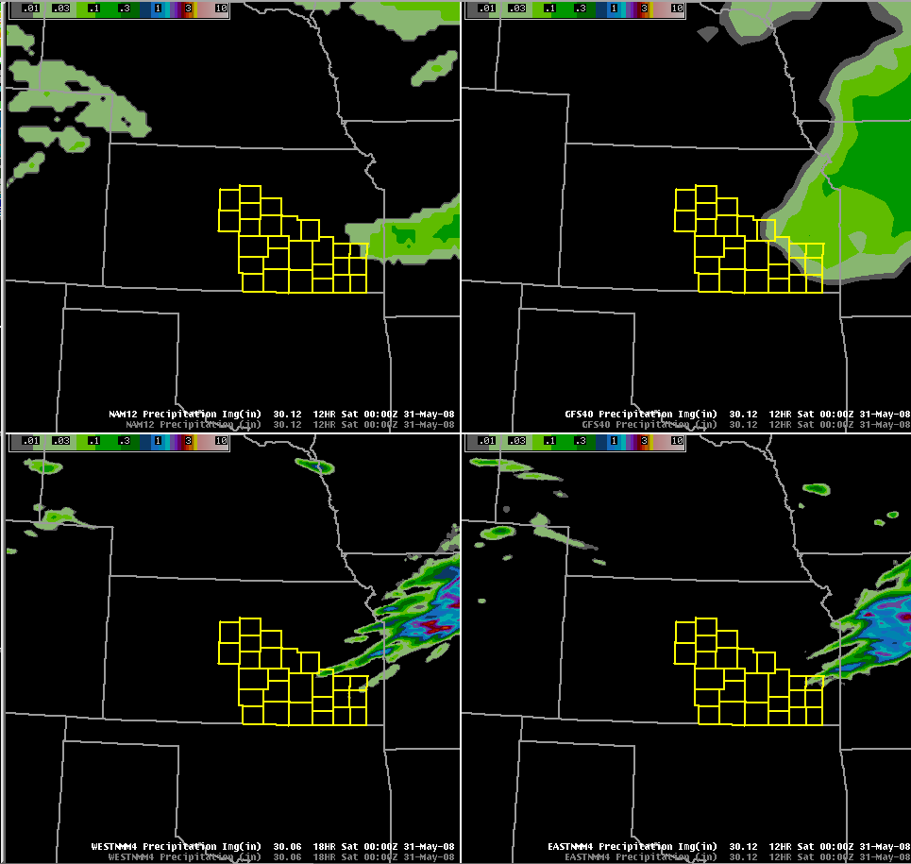
Model QPF: 18-24 hr Forecast
NAM QPF
GFS QPF
NAM, GFS, EASTNMM4, WESTNMM4 suggested convection initiating over and/or spreading west/northwest over portions of south-central & southeast KS toward 12 UTC.
WRFARW32 and WRFARW16 unavailable.
Not perfect, but good correlation.
West NMM4 QPF
East NMM4 QPF

Slide 18
So why the Presentation?
We all know that significant hail is most likely in an environment characterized by ample instability & deep layer shear:
  However, since 2003, WFO ICT and SPC have typically under-forecast (sometimes grossly) predawn significant hail events.
    Typically, thunderstorms are forecasted, but magnitude of hail isn’t.
Possible reasons why these events are under-forecasted?
  Mind-set that significant hail doesn’t occur late at night…rare events?
  Work load of day/evening shifts…dealing with ongoing severe weather in midst of active severe weather week?
    Definitely the case May 31, 2008.
Better anticipation!! (hopefully help prevent understaffing at the worst time of the night, staff-wise.)

Slide 19
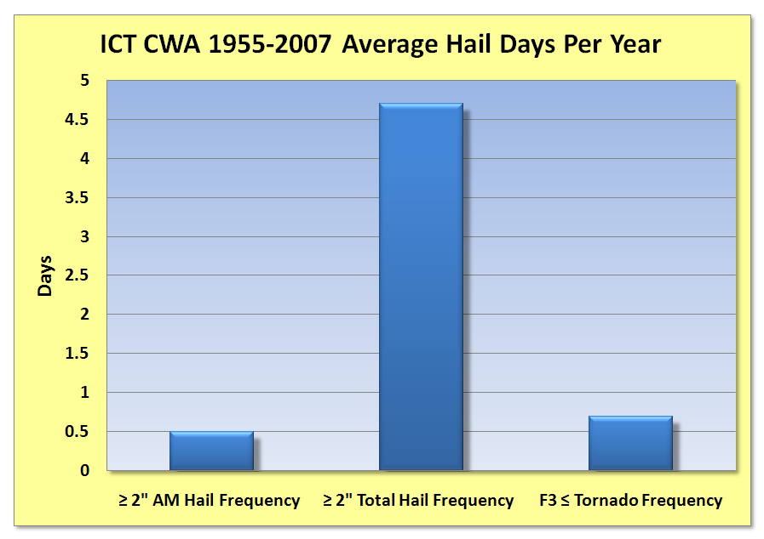
Roughly one event every 1.5 years
Roughly 1 event every 2 years

Slide 21
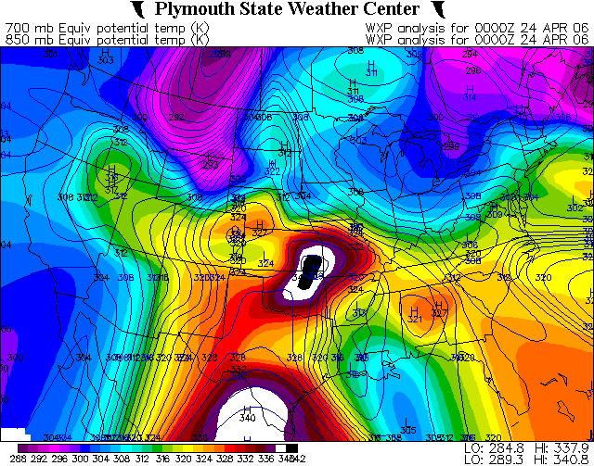
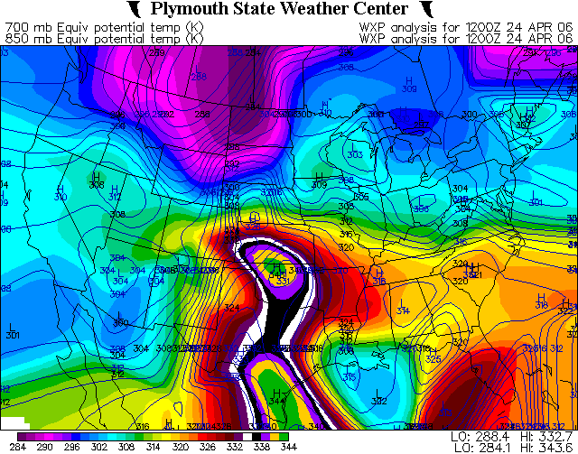
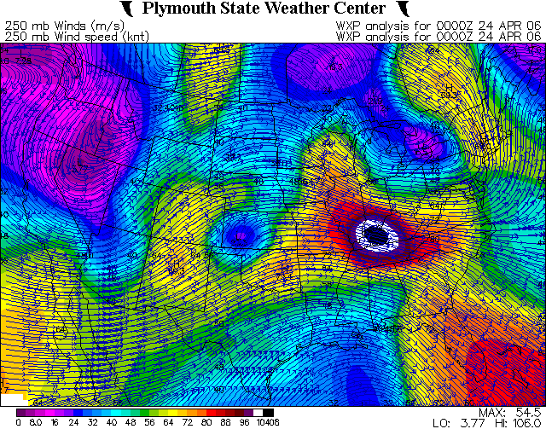
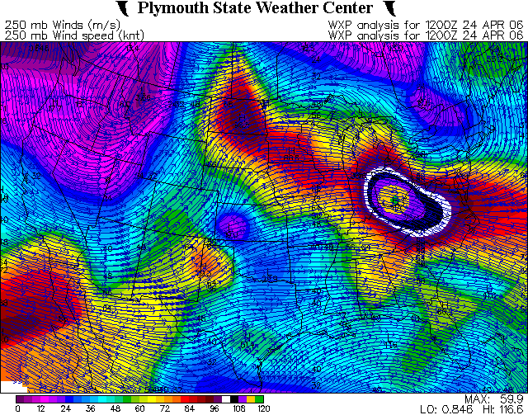
4/24/06 South-Central KS Sig Hail
00 UTC 850 (fill) & 700 mb (line) Theta-E
12 UTC 850 (fill) & 700 mb (line) Theta-E
L
L
L
L
00 UTC 250 mb Windspeed/Streamlines
12 UTC 250 mb Windspeed/Streamlines

Slide 22
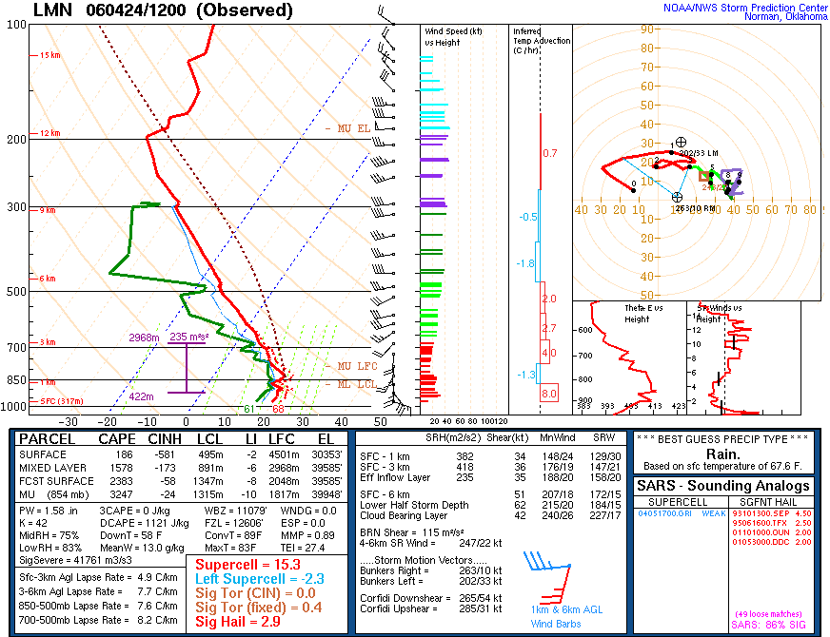
4/24/06 South-Central KS Sig hail

Slide 23
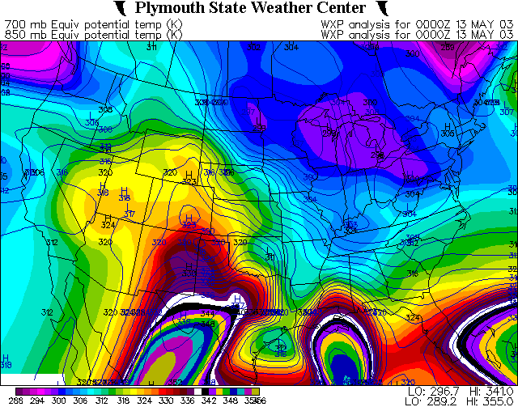
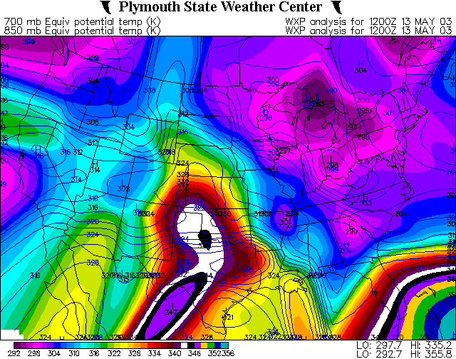
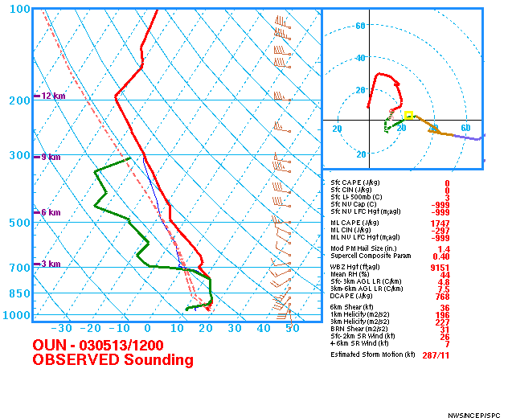
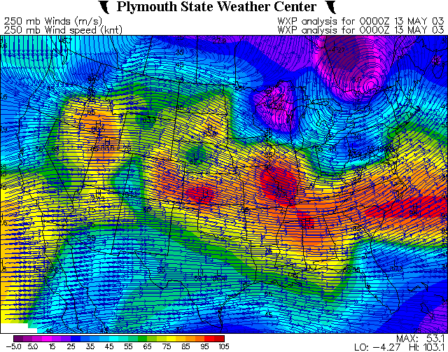
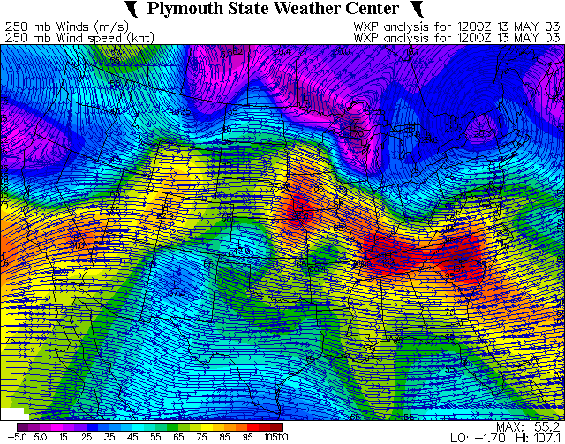
5/13/03 Central/South-Central KS Sig Hail
00 UTC 850 (fill) & 700 mb (line) Theta-E
12 UTC 850 (fill) & 700 mb (line) Theta-E
L
L
L
L
00 UTC 250 mb Windspeed/Streamlines
12 UTC 250 mb Windspeed/Streamlines

Slide 24
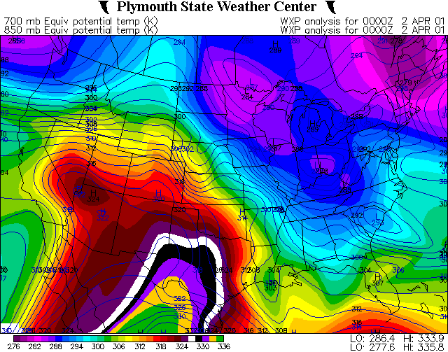
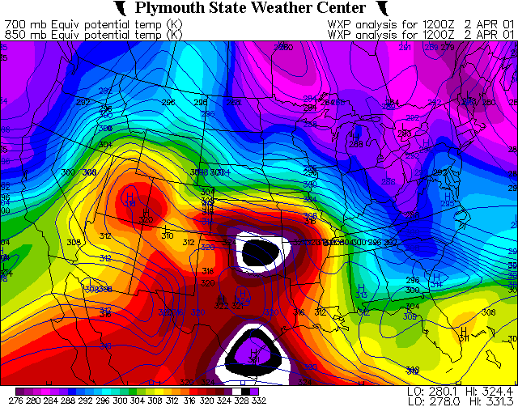
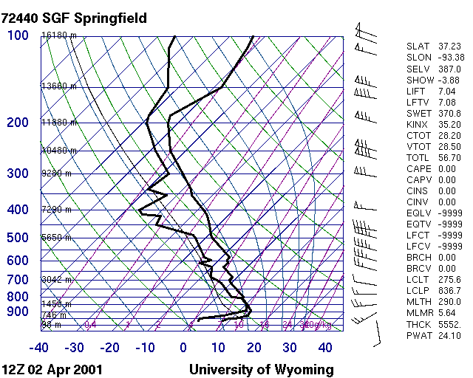
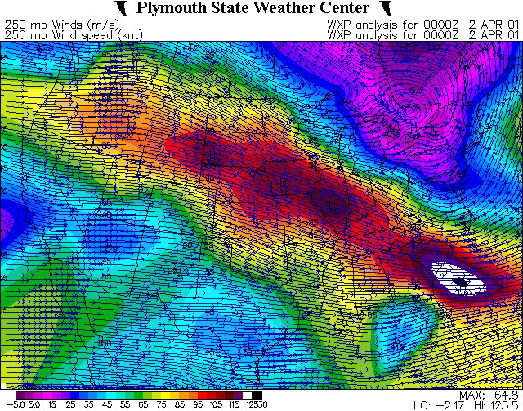
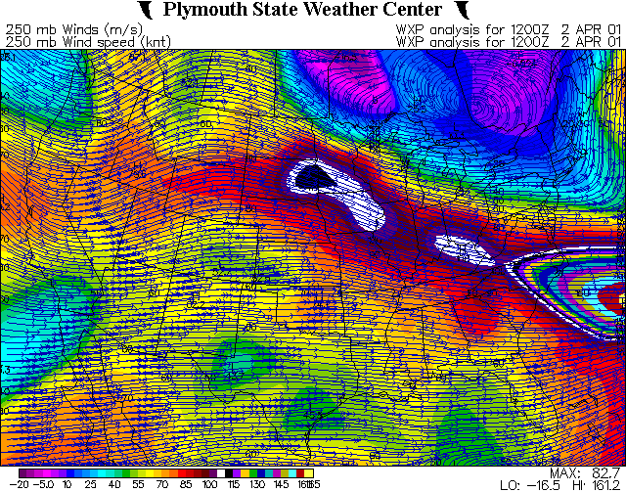
4/2/01 Southeast KS Sig Hail
00 UTC 850 (fill) & 700 mb (line) Theta-E
12 UTC 850 (fill) & 700 mb (line) Theta-E
L
L
00 UTC 250 mb Windspeed/Streamlines
12 UTC 250 mb Windspeed/Streamlines

Slide 25
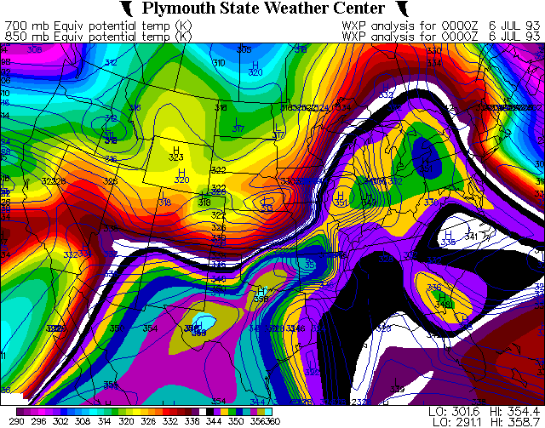
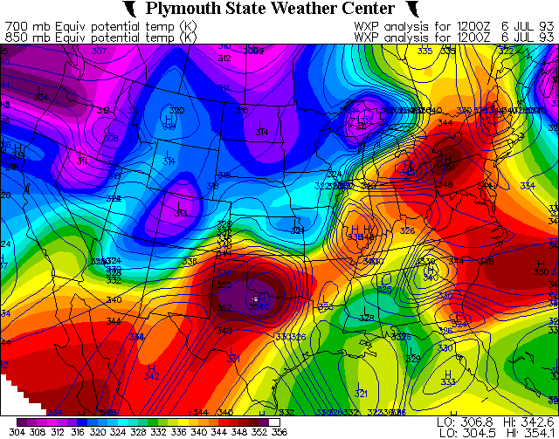
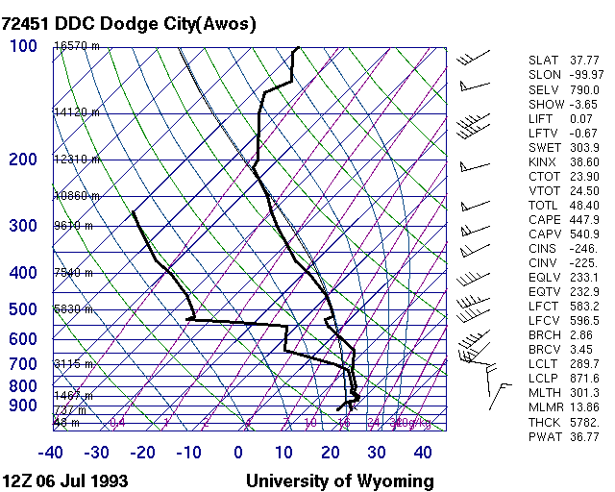
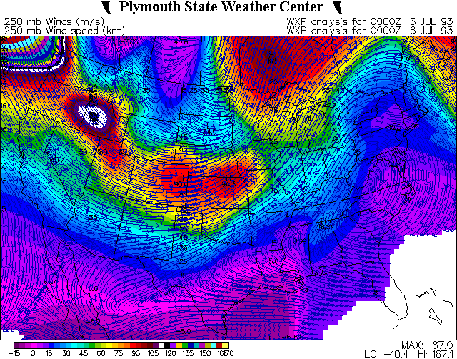
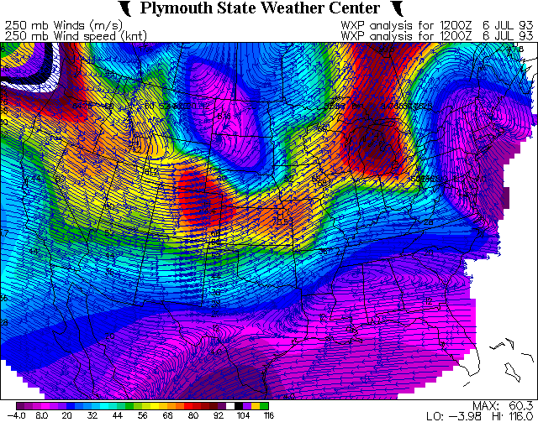
7/6/93 Central/South-Central KS Sig Hail
00 UTC 850 (fill) & 700 mb (line) Theta-E
12 UTC 850 (fill) & 700 mb (line) Theta-E
L
L
L
L
00 UTC 250 mb Windspeed/Streamlines
12 UTC 250 mb Windspeed/Streamlines

Slide 26
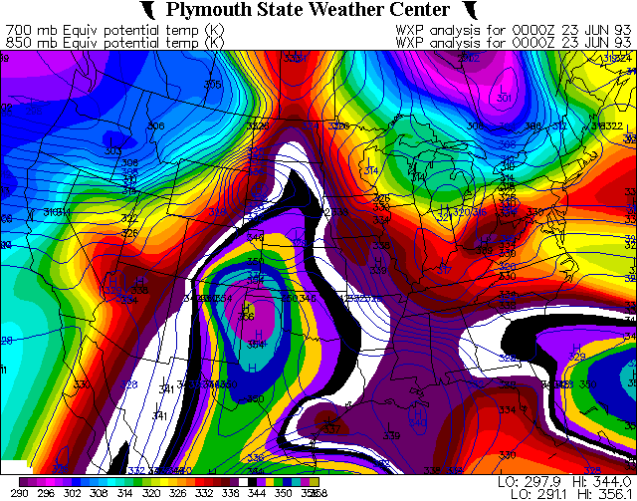
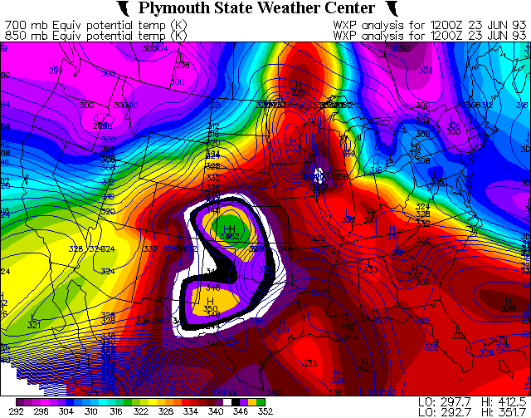
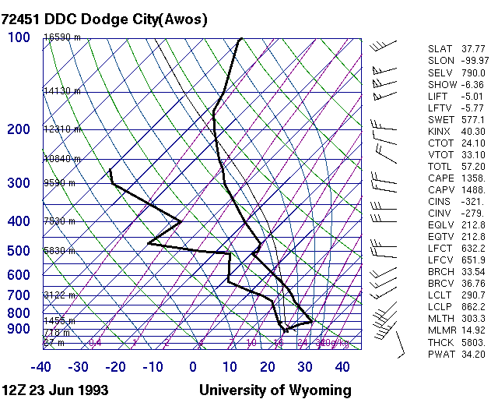
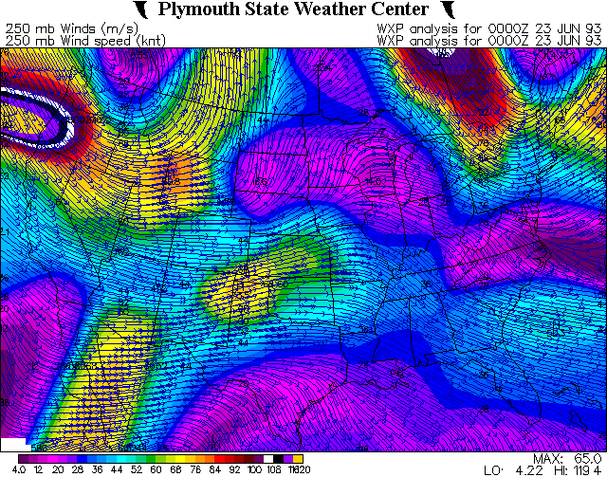
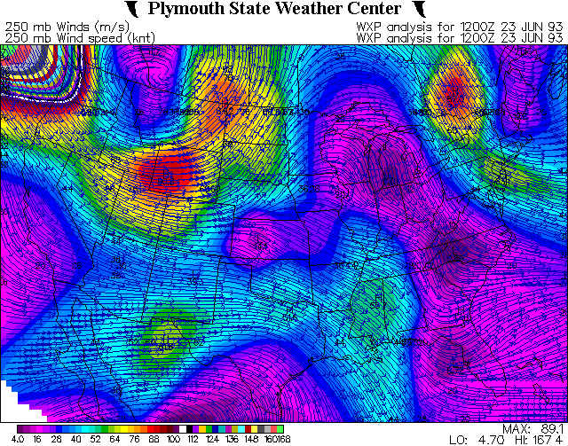
6/23/93 South-Central KS Sig Hail
00 UTC 850 (fill) & 700 mb (line) Theta-E
12 UTC 850 (fill) & 700 mb (line) Theta-E
L
L
L
00 UTC 250 mb Windspeed/Streamlines
12 UTC 250 mb Windspeed/Streamlines

Slide 27
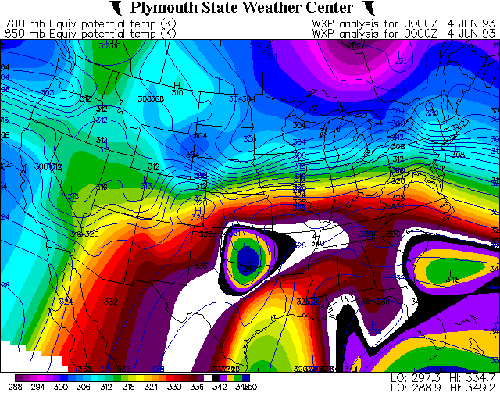
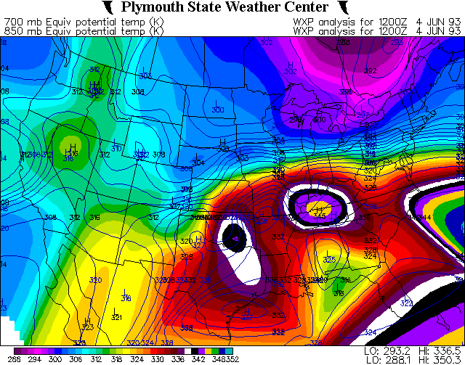
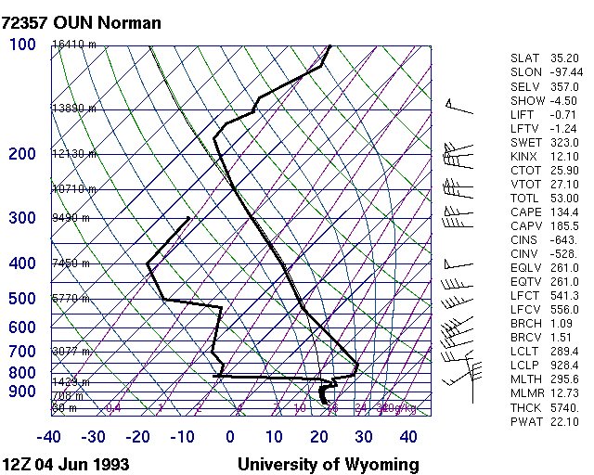
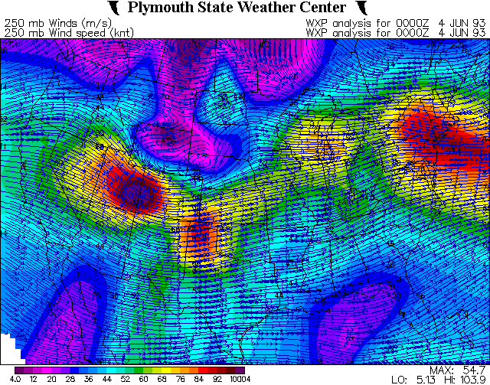
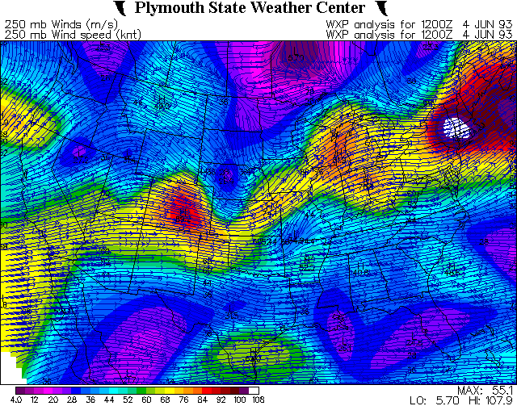
6/4/93 Southeast KS Sig Hail
00 UTC 850 (fill) & 700 mb (line) Theta-E
12 UTC 850 (fill) & 700 mb (line) Theta-E
L
L
00 UTC 250 mb Windspeed/Streamlines
12 UTC 250 mb Windspeed/Streamlines

Slide 28
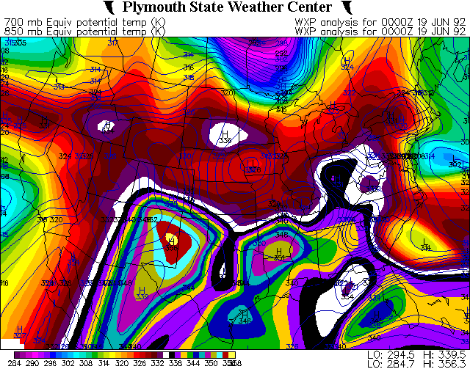




6/19/92 South-Central KS Sig Hail
00 UTC 850 (fill) & 700 mb (line) Theta-E
12 UTC 850 (fill) & 700 mb (line) Theta-E
L
L
00 UTC 250 mb Windspeed/Streamlines
12 UTC 250 mb Windspeed/Streamlines

Slide 29





5/31/08 South-Central/Southeast KS Sig Hail
00 UTC 850 (fill) & 700 mb (line) Theta-E
12 UTC 850 (fill) & 700 mb (line) Theta-E
L
L
00 UTC 250 mb Windspeed/Streamlines
12 UTC 250 mb Windspeed/Streamlines

Slide 30
Discussion/Conclusions
Commonalities:
  Quasi-stationary baroclinic zone in place (Extending NW-SE)
    Strong LLJ/Moisture Transport can be inferred.
  Zonal to weakly meridional mid/upper flow.
    Ample deep layer directional shear can be inferred.
  Strong CAPE (esp. for time of day)
  Personal opinion: most widespread/substantial events occur with zonal-WNW flow aloft, with LLJ pointing into upper jet right entrance region and orthogonal to low level (850 mb boundary).
    Potential for greater directional deep layer shear and low level frontogenesis/forcing

Slide 31
Discussion/Conclusions (con't)
  GR2 Analyst MEHS algorithm did a very good job estimating hail size in Burden storm.
  GFS & NAM 18-24 hour forecasts of moisture, instability, deep layer shear, QPF and subtle mid/upper disturbance was very good.
  Lower PV values may find weak disturbances that pressure analysis does not.
  Bottom line: Don’t underestimate strong moisture return underneath steep mid-level lapse rates & ample deep layer shear in the absence of strong mid/upper forcing…even at night. Estimation: be watchful for significant hail when CAPE ≥ 1500-2000 j/kg and effective deep layer shear ≥ 35-40 kts.
    Especially if storms remain at least somewhat discrete.

