Slide 1
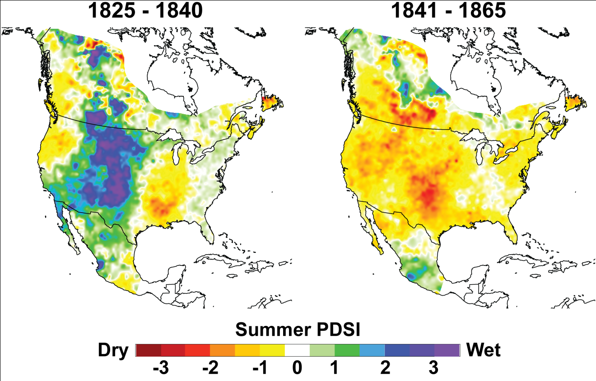
Historical Perspective on the Dust Bowl Drought in the Central United States
Dr. Dorian J. Burnette, Department of Geosciences, University of Arkansas
19th Century “Environmental Crisis” (West 1995)

Slide 2
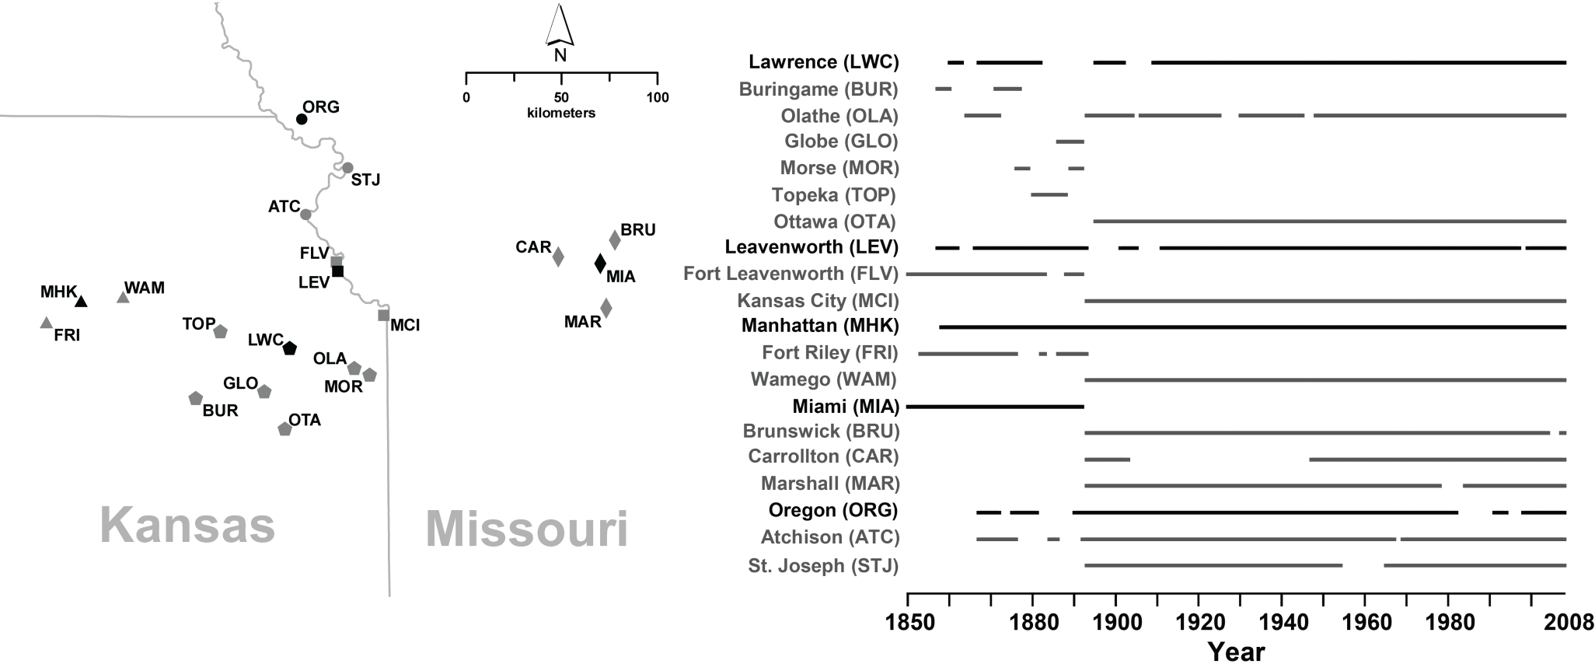
Precipitation Stations
Five primary stations augmented with surrounding station data
Reconstruct back to 1850 when at least two station clusters were available

Slide 3
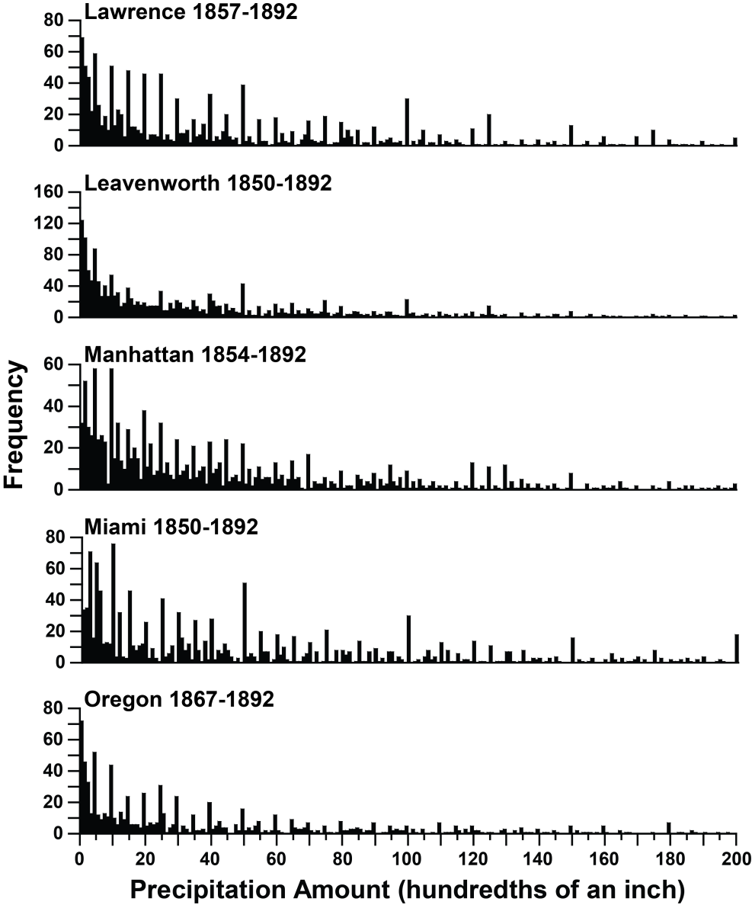
Assessing Precipitation Data Quality
Ideal = negative exponential curve (Daly et al. 2007)
Truncation of light amounts = undercount
Spikes = “5/10 bias”
Threshold analysis = undercount minimized for totals ≥ 0.50 inches

Slide 4
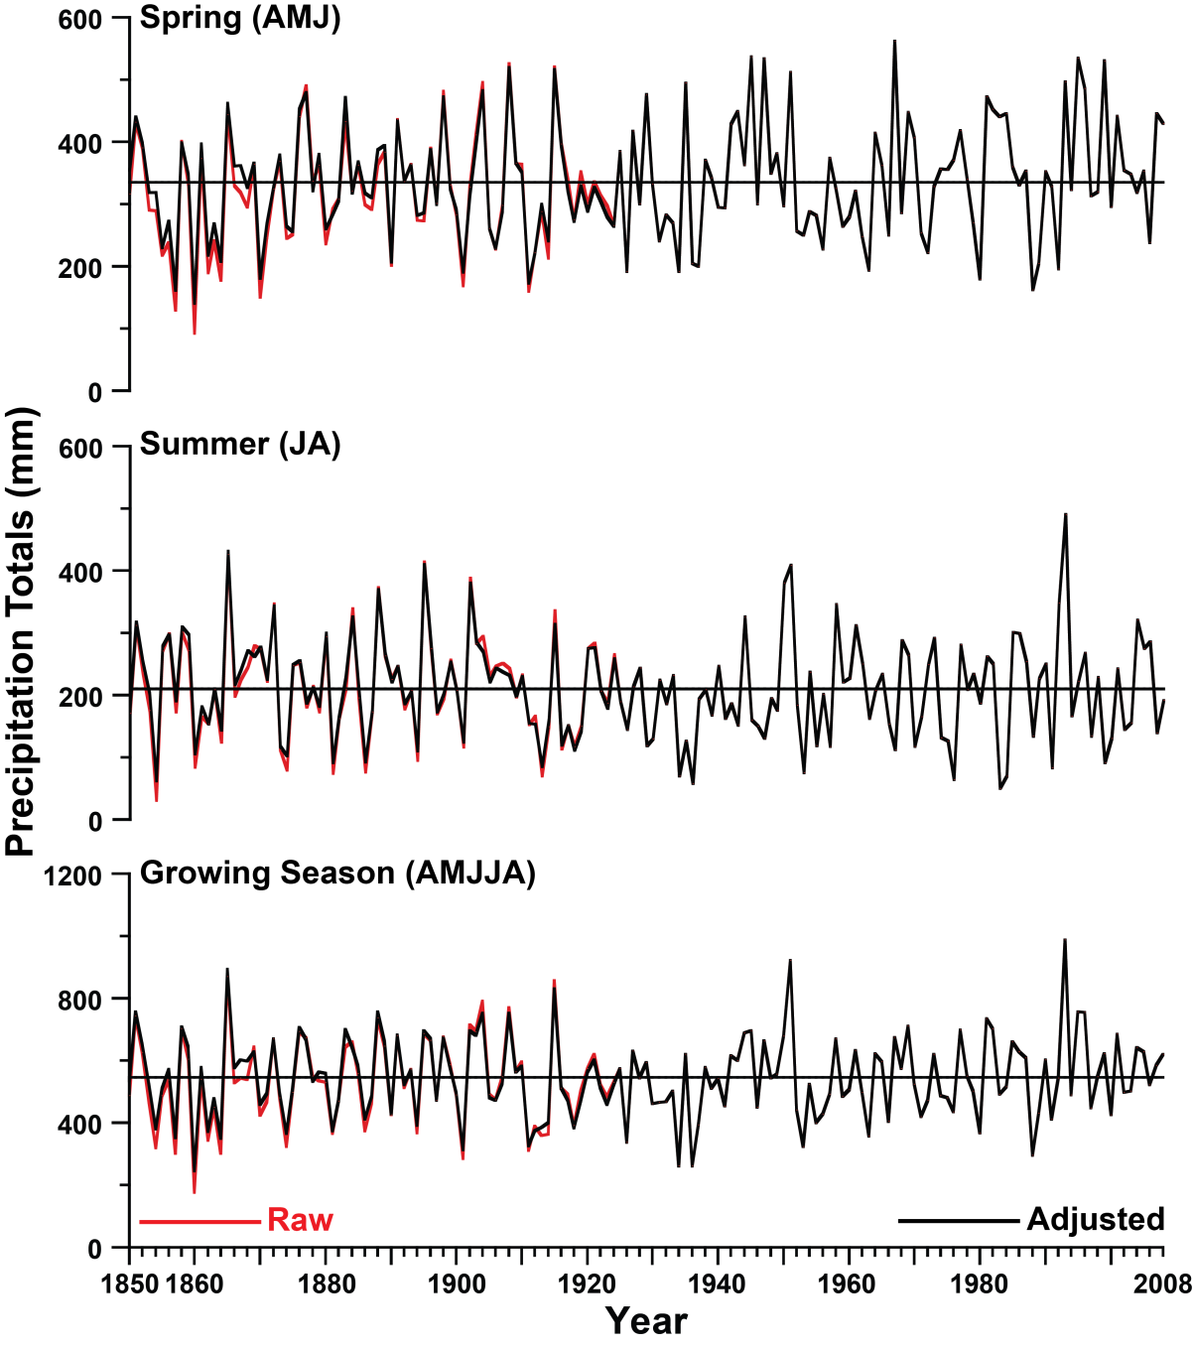
Raw vs. Adjusted Precipitation Totals
Undercount bias appears prior to 1925, so data from 1850-1924 were adjusted
Adjustment =
  Use precipitation totals ≥ 0.50 inches (“Half-Inch Threshold”)
  Estimate the missing amount between below 0.50 inches based on an average of the modern observations at each station
  Add estimate to the “Half-Inch Threshold”

Slide 5
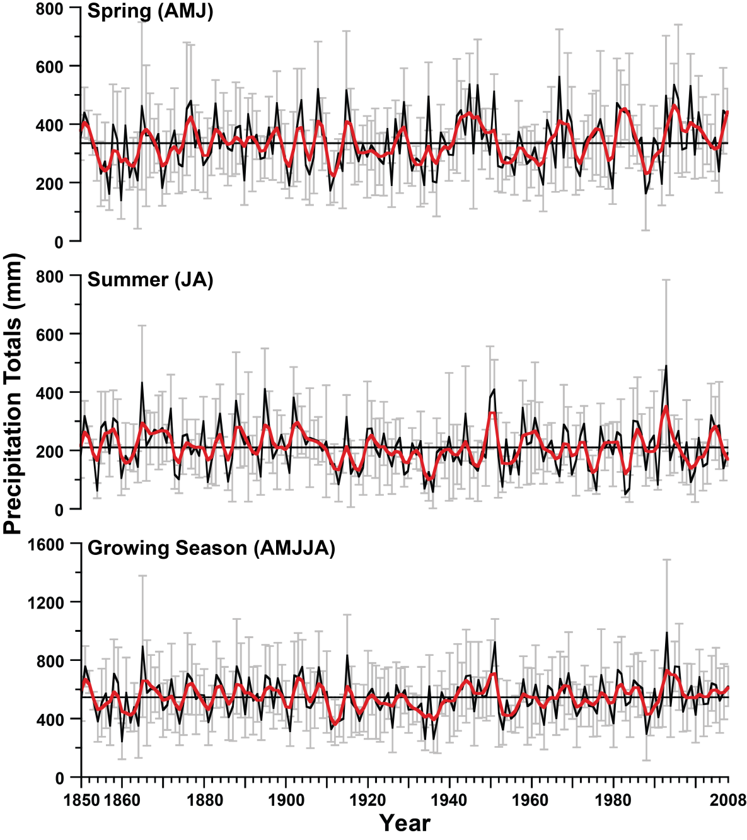
Reconstructed Precipitation Totals for Kansas/Missouri
Spring Totals
1860-64 = 246.28 mm
1910-14 = 256.84 mm
1933-37 = 272.14 mm
1952-56 = 260.81 mm
Rank
1
2
4
3
Summer Totals
1860-64 = 158.85 mm
1910-14 = 156.72 mm
1933-37 = 135.99 mm
1952-56 = 163.42 mm
Rank
3
2
1
4
Growing Season Totals
1860-64 = 405.13 mm
1910-14 = 413.56 mm
1933-37 = 408.13 mm
1952-56 = 424.23 mm
Rank
1
3
2
4

Slide 6
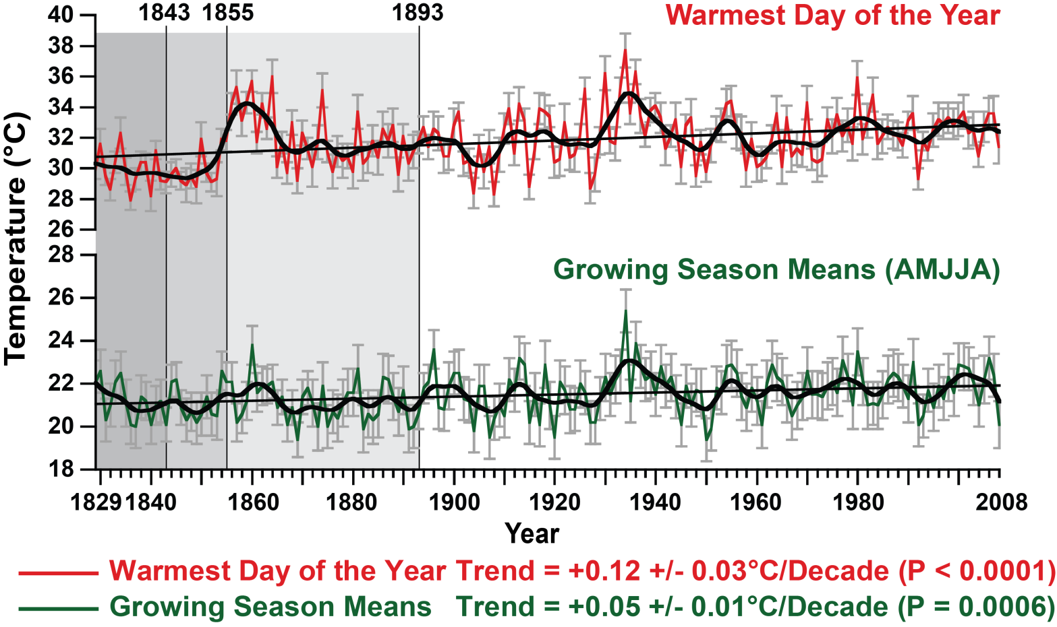
Growing Season Temperatures
Burnette et al. (2010), Journal of Climate
Potential evapotranspiration computed from reconstructed temperature data using Thornthwaite’s method
Effective Moisture Estimate = precipitation – potential evapotranspiration
Effective Moisture transformed into anomalies by subtracting the seasonal median

Slide 7
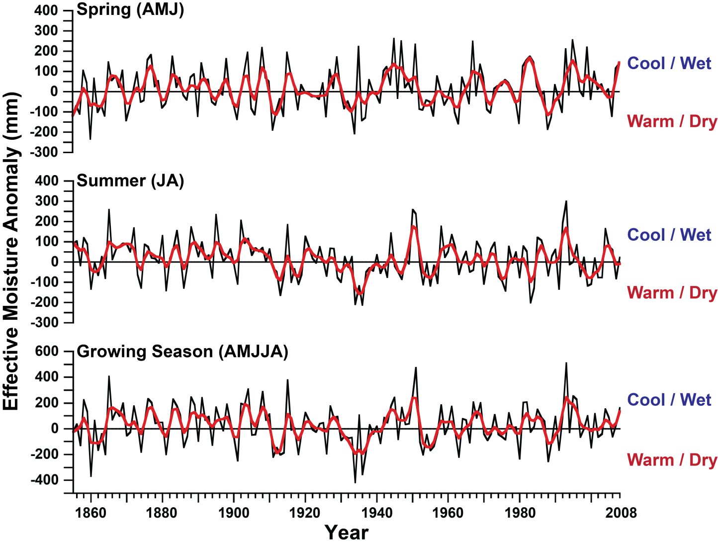
Effective Moisture Reconstruction
Spring Anomaly
1860-64 = -90.87 mm
1910-14 = -78.49 mm
1933-37 = -69.36 mm
1952-56 = -77.08 mm
Rank
1
2
4
3
Summer Anomaly
1860-64 = -51.00 mm
1910-14 = -48.94 mm
1933-37 = -112.47 mm
1952-56 = -52.68 mm
Rank
3
4
1
2
Growing Season Anomaly
1860-64 = -141.87 mm
1910-14 = -127.43 mm
1933-37 = -181.83 mm
1952-56 = -129.76 mm
Rank
2
4
1
3

Slide 8
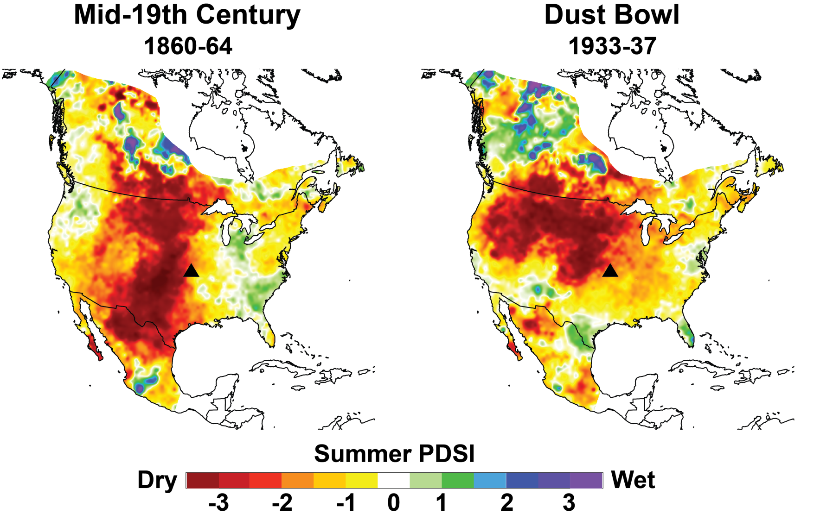
Tree-Ring PDSI 1860s vs. 1930s
Study area on the edge of the two intense droughts
Both droughts similar in magnitude but differ in coverage area

Slide 9
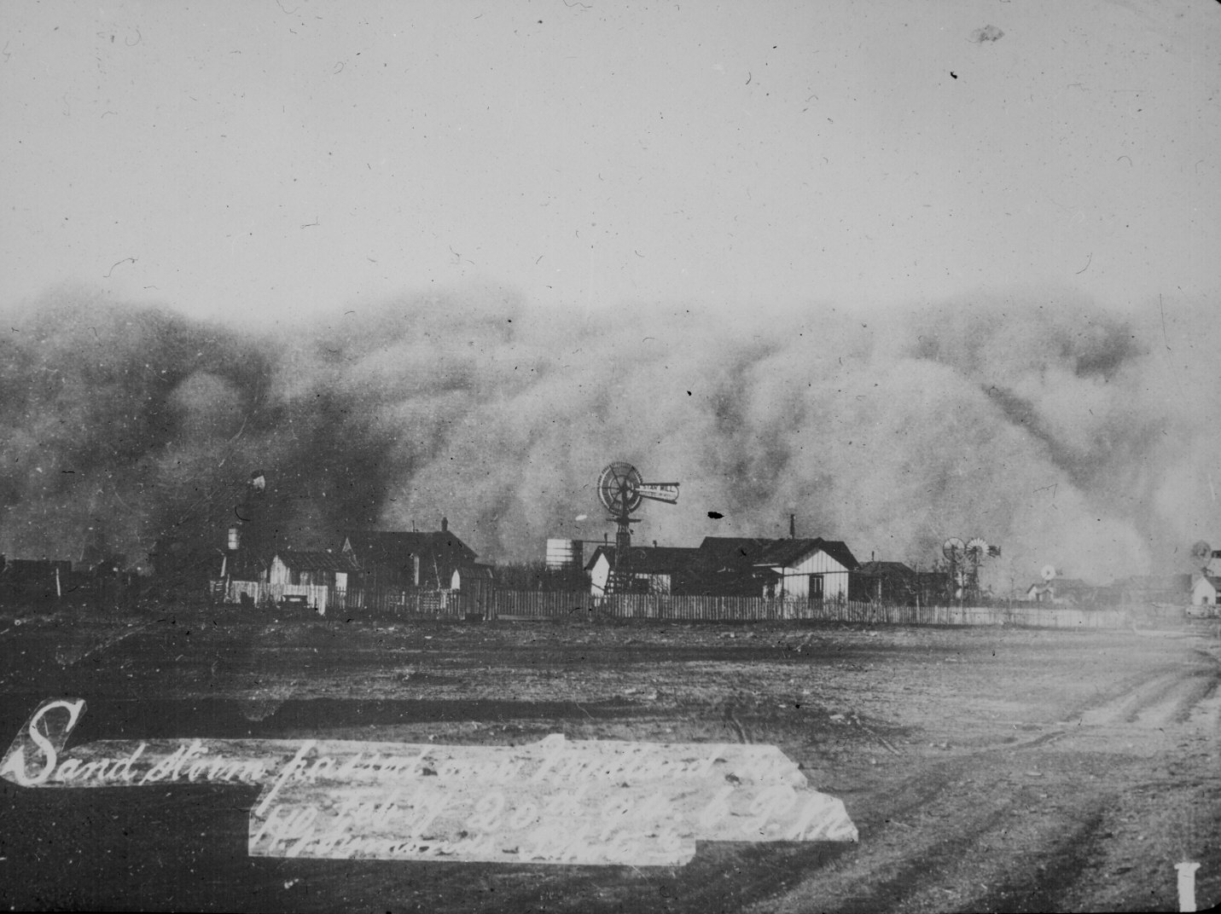
Thank You
Acknowledgements:
NSF Doctoral Dissertation Research Improvement Grant
Dissertation Committee:
  Dr. David Stahle
  Dr. Malcolm Cleaveland
  Dr. Cary Mock
  Dr. Elliott West
Dr. Ed Cook
E-Mail:
djburne@uark.edu
Dust Storm over Midland, TX, 20 February 1894
From Library of Congress
Website:
www.djburnette.com/research/kansas/

