Slide 1
Dual Polarization:
How Will it Change the WSR-88D?
Don Burgess
OU CIMMS/NSSL (Ret.)

Slide 2

Important Information
The fundamentals of this presentation and other Dual-Polarization training materials for outreach (NWS, media, others) are at:
  http://www.wdtb.noaa.gov/modules/dualpol/index.htm
Notes:
2

Slide 3
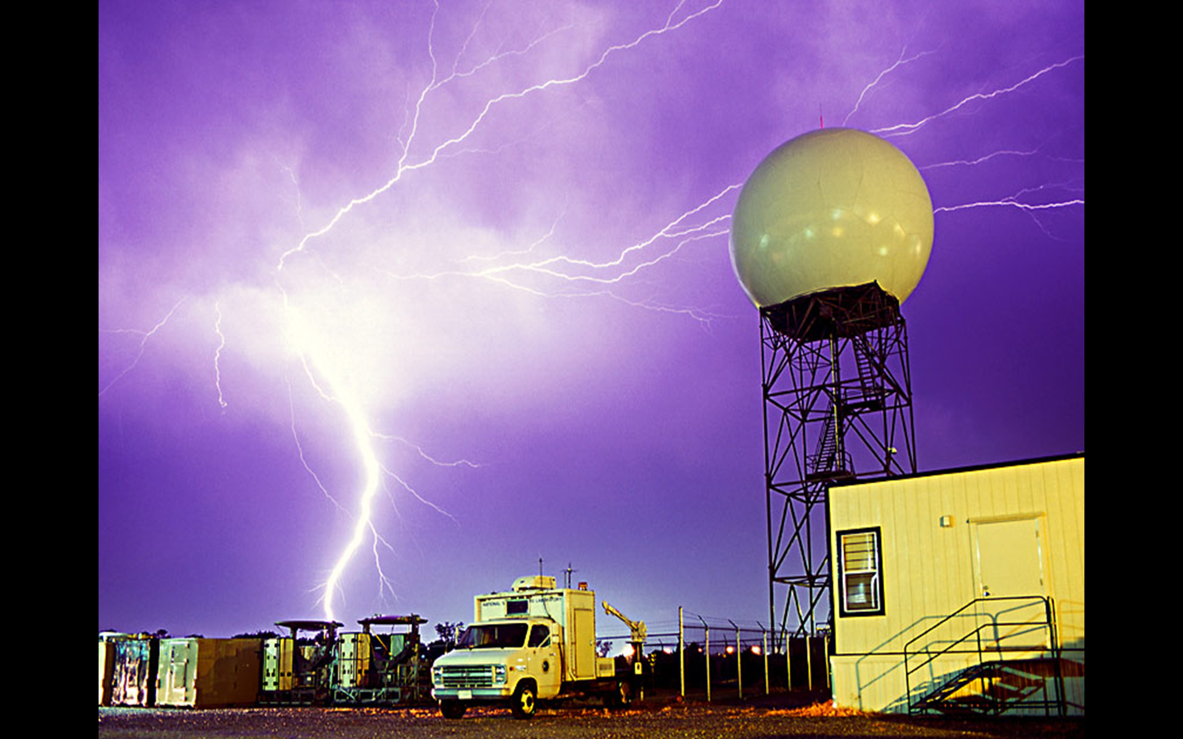
The WSR-88D Prior to Dual-Pol Upgrade
88D
  Traditional radars transmit and receive each pulse with the E-field parallel to the local horizontal surface.
_

Slide 4
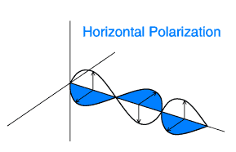
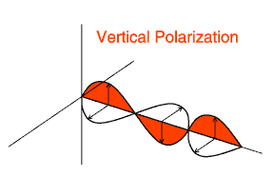
Explaining Dual-Polarization
OK, so what?

Slide 5
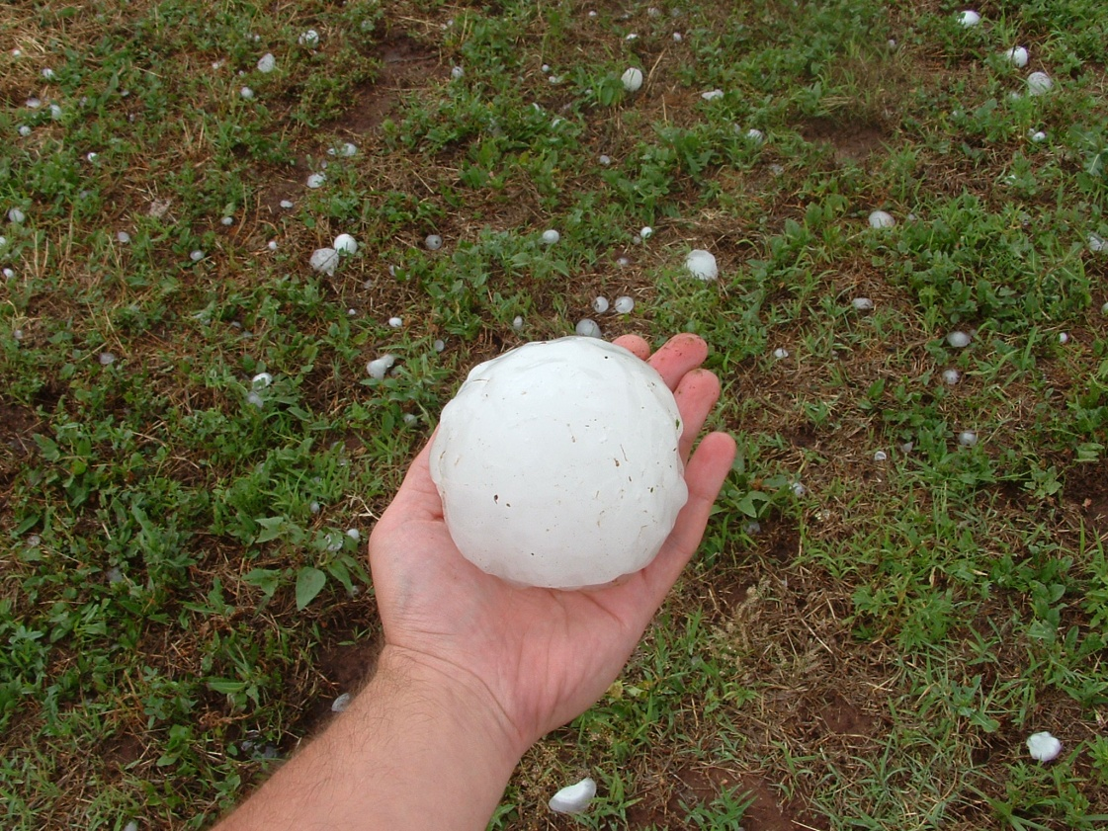
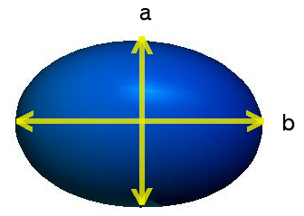
Explaining Dual-Polarization
- Precipitation particles such as raindrops, hailstones, graupel, snowflakes, and ice crystals are collectively called “hydrometeors.” These particles are more or less spheroidal in shape.
- In electromagnetic considerations, hydrometeors are often represented as two crossed dipoles.

Slide 6
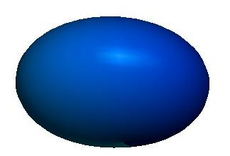
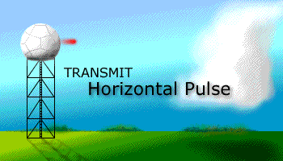



Explaining Dual-Polarization
Dual-polarization radars emit EM waves with horizontal and vertical polarizations.
- Alternating H & V Transmission requires an expensive fast switch and longer acquisition times

Slide 7
The WSR-88D Dual-Pol Upgrade

Slide 8
WSR-88D Dual-Polarization Upgrade
Simultaneous Transmission And Reception (STAR); Slant 45
Transmit at 45º, receive at both horizontal and vertical
There is a PROBLEM!

Slide 9
WSR-88D Dual-Polarization Upgrade
Simultaneous Transmission And Reception (STAR); Slant 45
Transmit at 45º, receive at both horizontal and vertical
There is a PROBLEM! Split the power; 3-dB sensitivity loss

Slide 10
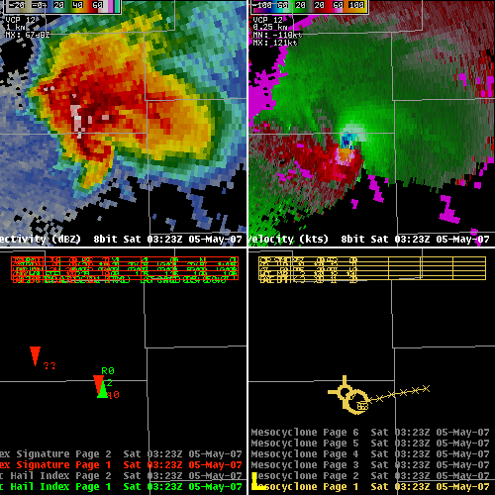
WSR-88D Dual-Polarization: Rule #1
Policy of “Do no harm”
Retrofit on existing dish, tower, etc.
Same VCPs, wavelength, beamwidth
Reflectivity, Velocity, SW, Algorithms: All Unchanged
Except…Sensitivity Loss

Slide 11
List of New WSR-88D Dual-Pol Outputs
3 New Variables (like moments)
  Differential Reflectivity (ZDR; Zdr)
  Correlation Coefficient (CC; Rhv)
  Specific Differential Phase (KDP; Kdp)
3 New Algorithms
  QPE
  Hydrometeor Classification
  Melting Layer
9 NEW Precipitation Estimation Display Products

Slide 12
New Product #1: Differential Reflectivity (ZDR)
Definition | Possible Range of Values | Units | Abbreviated Name
Measure of the log of the ratio of the horizontal to vertical power returns | -4 to 10 | Decibels (dB) | ZDR
Horizontal Reflectivity
Vertical Reflectivity
Notes:
The differential reflectivity is a measure of the log of the ratio of the horizontal to vertical power returns in a pulse volume. Its values range from -4 to 8 in units of decibels (dB). In AWIPS and the literature, differential reflectivity is abbreviated as ZDR.

Slide 13
ZDR Physical Interpretation
Spherical (drizzle, small hail, etc.) | Horizontally Oriented (rain, melting hail, etc.) | Vertically Oriented (i.e. vertically oriented ice crystals)
ZDR ~ 0 dB | ZDR > 0 dB | ZDR < 0 dB
P_{v}
P_{v}
P_{v}
P_{h}
P_{h}
P_{h}
Z_{h} ~ Z_{v}
Z_{h} > Z_{v}
Z_{h} < Z_{v}
Notes:
This chart here summarizes the general physical interpretation of differential reflectivity. For spherical hydrometeors such as drizzle drops, the power returned from both the horizontal and vertical pulses are approximately equal. This leads to a ratio of horizontal to vertical powers of approximately 1. The log of this ratio is therefore zero, which means ZDR is approximately 0 dB. The same logic can be applied for the horizontally and vertically oriented columns. Horizontally oriented hydrometeors such as rain drops will have positive ZDRs, while vertically oriented hydrometeors such as vertically oriented ice crystals will have negative ZDRs.

Slide 14
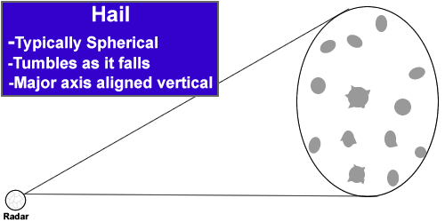
Why Would You Examine ZDR?
Larger ZDR: large liquid drops dominate
Smaller ZDR: small drops or hail dominate

Slide 15
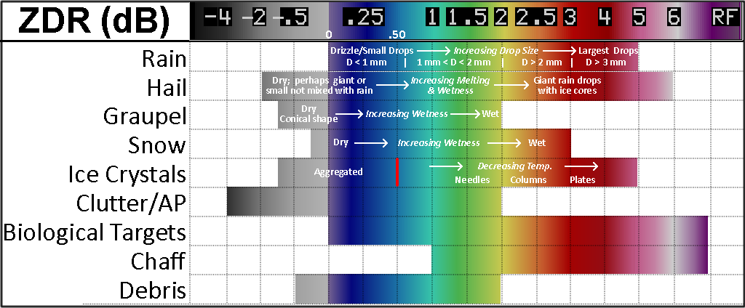
Typical ZDR Values for Various Targets

Slide 16
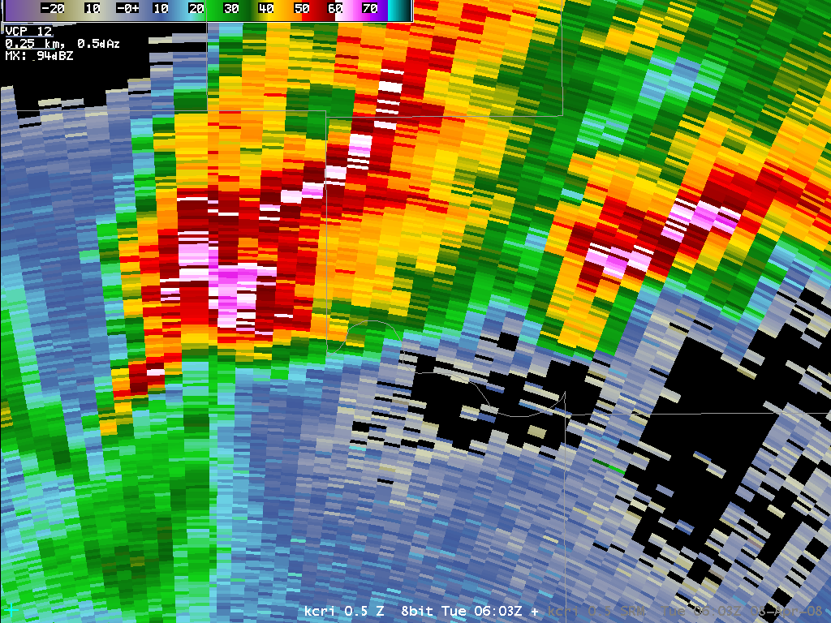
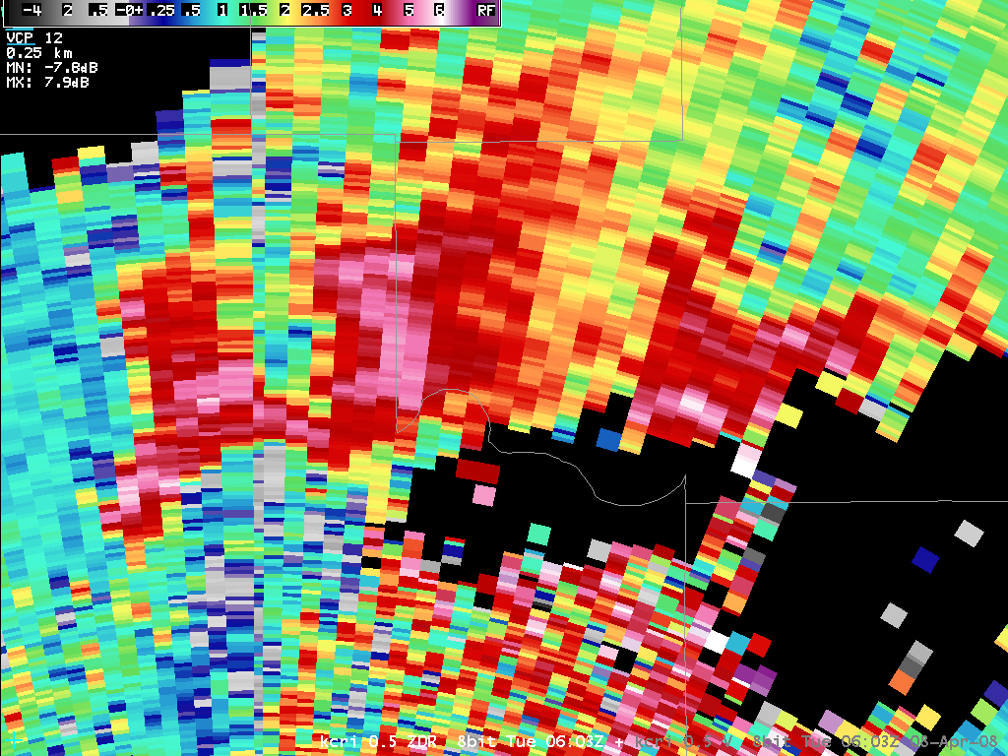
Marginally Severe Supercell

Slide 17
New Product #2 Correlation Coefficient (CC)
Definition | Possible Range of Values | Units | Abbreviated Name
Measure of similarly of the horizontally and vertically polarized pulse behavior within a pulse volume | 0 to 1 | None | CC (AWIPS) ρ_{HV} (Literature)
N
Notes:
The correlation coefficient is a measure of how similarly the horizontally and vertically polarized waves are behaving within a pulse volume. Its values can range from 0 to 1 and have no units. In AWIPS, this variable is referred to as CC, but in the literature it will be referred to as rhoHV.

Slide 18

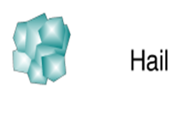
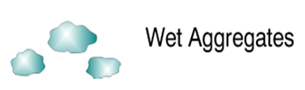
CC Physical Interpretation
Non-Meteorological (birds, insects, etc.) | Metr (Uniform) (rain, snow, etc.) | Metr (Non-Uniform) (hail, melting snow, etc.)
Shapes are complex and highly variable. Horizontal and vertical pulses will behave very differently with these objects | Shapes are fairly simple and do not vary much. Horizontal and vertical pulses behave very similarly with these objects | Shapes can be complex and are mixed phase. Horizontal and vertical pulses behave somewhat differently with these objects
Low CC (< 0.85) | High CC (> 0.97) | Moderate CC (0.85 to 0.95)

Slide 19
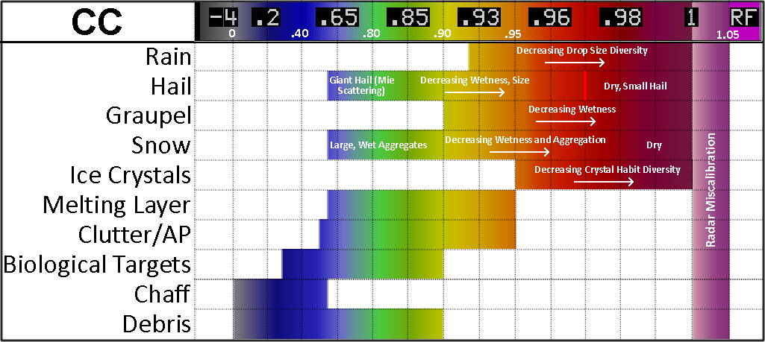
Correlation Coefficient (CC) Typical Values

Slide 20
What is CC Used for?
Non-weather targets (LOW CC < 0.80)
  Best discriminator
Melting layer detection (Ring of reduced CC ~ 0.80 – 0.95)
Giant hail or tornadic debris (LOW CC < 0.70 in the midst of high Z/Low ZDR)

Slide 21
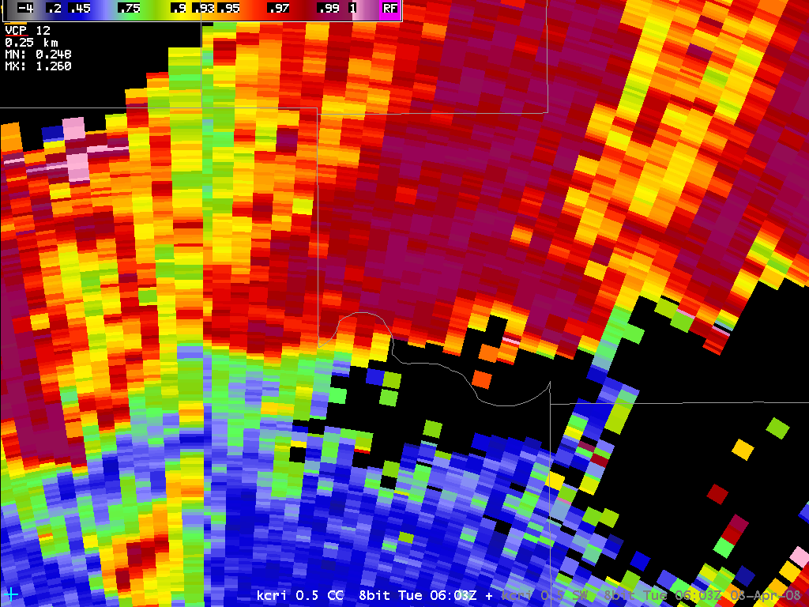
Marginally Severe Supercell
Rain
What about the rest?
All > 0.97
Precip
Insects

Slide 22
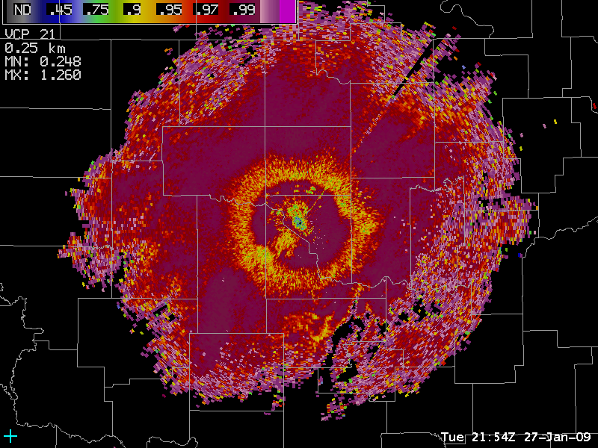
3. Melting Layer Detection
Melting Layer Example
Frozen
Mixed Phase
Liquid
2.4 deg CC

Slide 23
New Product #3: Specific Differential Phase Shift (KDP)
Definition: gradient of the difference between phase shift in the horizontal and vertical directions
Units: degrees per kilometer (º/km)
Differential phase shift

Slide 24
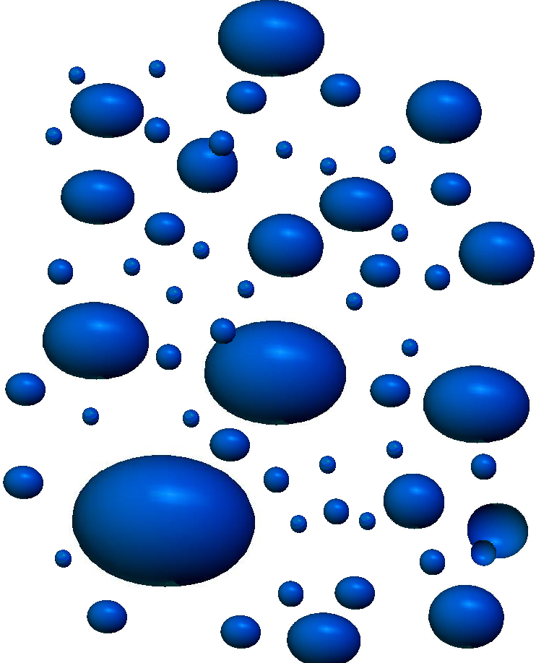
What ΦDP Means
t₂

Slide 25
What ΦDP Means
t₃

Slide 26
What ΦDP Means
t₄

Slide 27
What ΦDP Means
t₅

Slide 28
What ΦDP Means
t₆
Φ_{DP}

Slide 29
What KDP Means
The propagation differential phase shift Φ_{DP} monotonically increases with distance from the radar. KDP is the ΦDP change per unit area
t₁
Φ_{DP}
Measured in degrees
Distance from radar (range)
KDP value is large because of the steep slope (rapid increase in differential phase shift = lots of liquid water =heavy rain

Slide 30
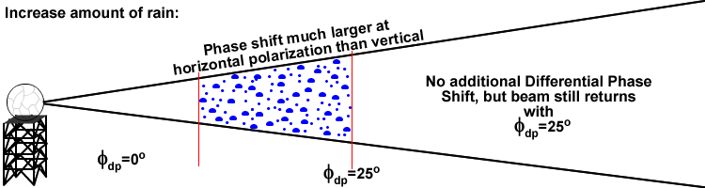
KDP Has Big Advantages
Immune to partial (< 40%) beam blockage, attenuation, radar calibration, presence of hail
Used primarily for rainfall estimation and locating heavy rain
Gradients Most Important
= KDP!!!

Slide 31
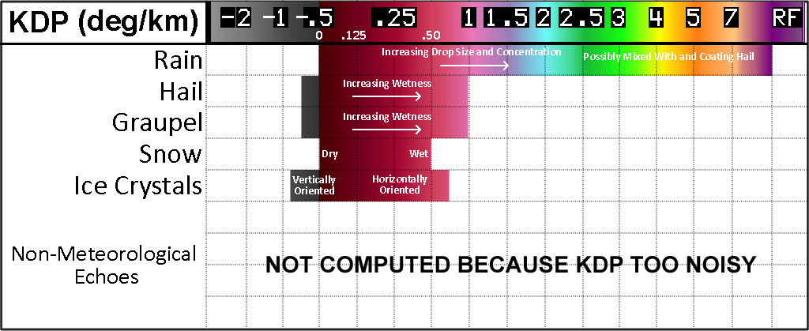
Typical Values of Specific Differential Phase Shift (KDP)

Slide 32
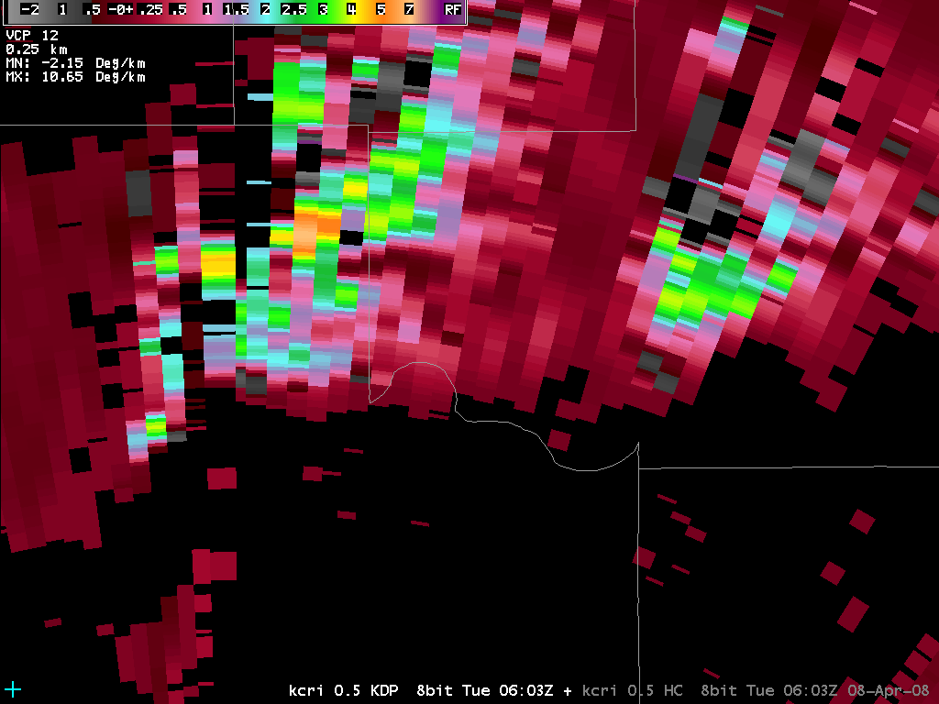
Marginally Severe Supercell

Slide 33
The Dual-Pol Algorithms
QPE, Hydrometeor Classification, and Melting Layer

Slide 34
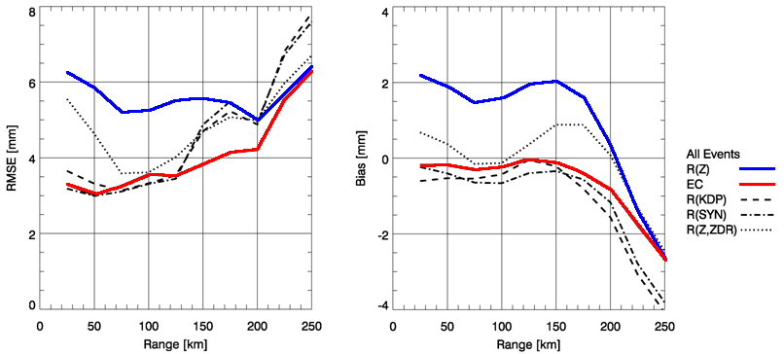
Precipitation Estimation (QPE) Improvement with Dual-Pol
R(QPE)
→ Based on 43 events (179 hrs) of radar rainfall data comparisons to a dense network of rain gauges in C. OK

Slide 35
Dual-Pol QPE Output
9 new products
  Match Legacy PPS
  Instantaneous Rate
  User Selectable (Up to 10 durations) for the NWS
  Difference products

Slide 36
Hydrometeor Classification Algorithm (HCA)
Algorithm makes best guess of dominant radar echo type
  Display Product for each radar elevation angle
Based on Fuzzy Logic
Lgt/mod
rain
Heavy
rain
Hail
“Big
drops”
Graupel
Ice
crystals
Dry
snow
Wet
snow
Unknown
AP or
Clutter
Biological
Current Classification Options

Slide 37
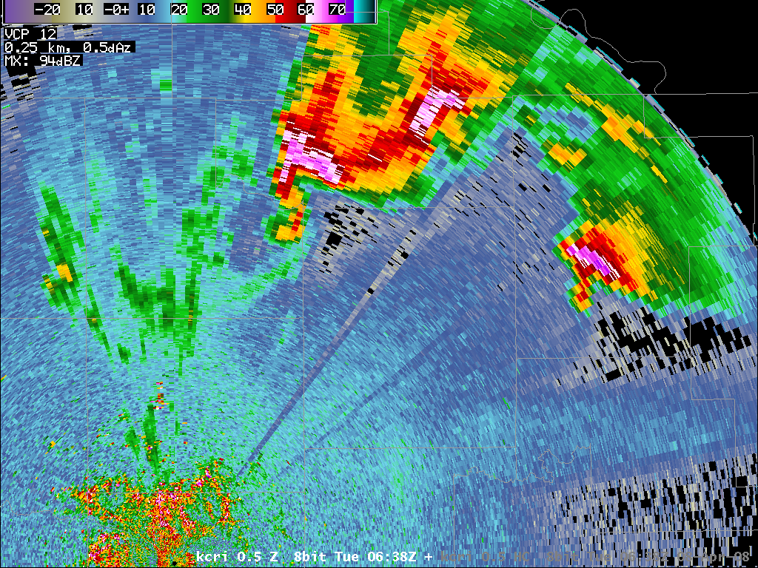
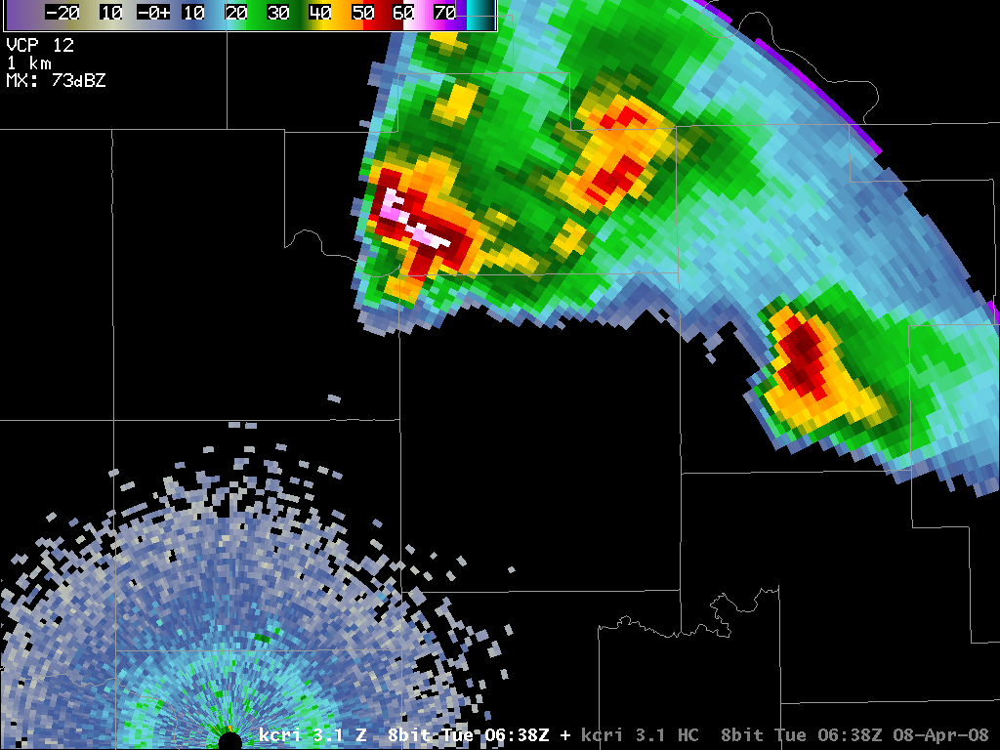
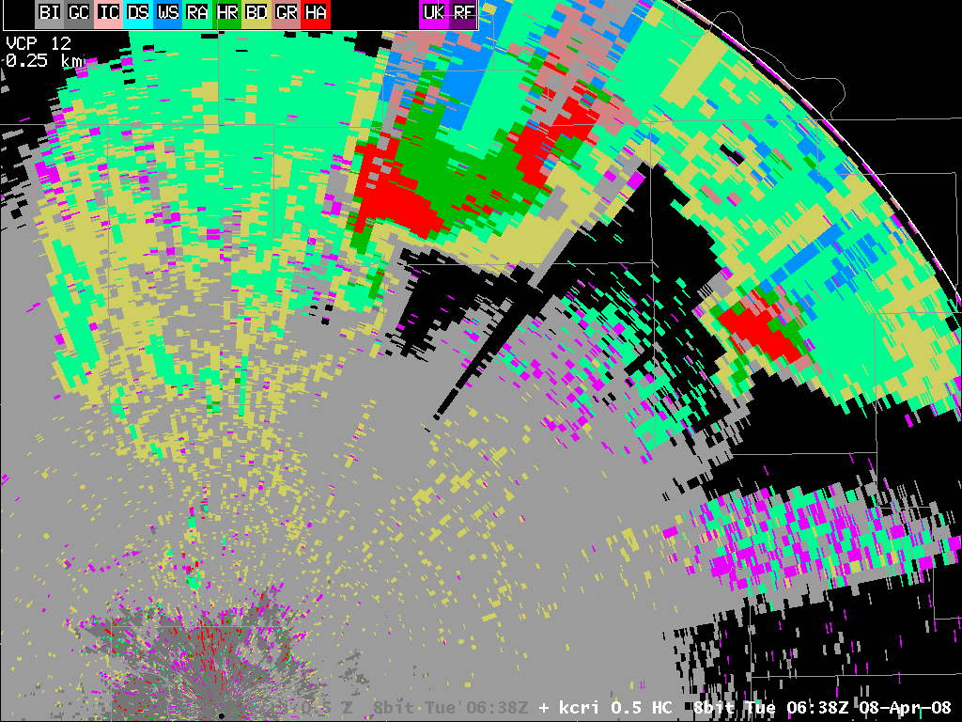
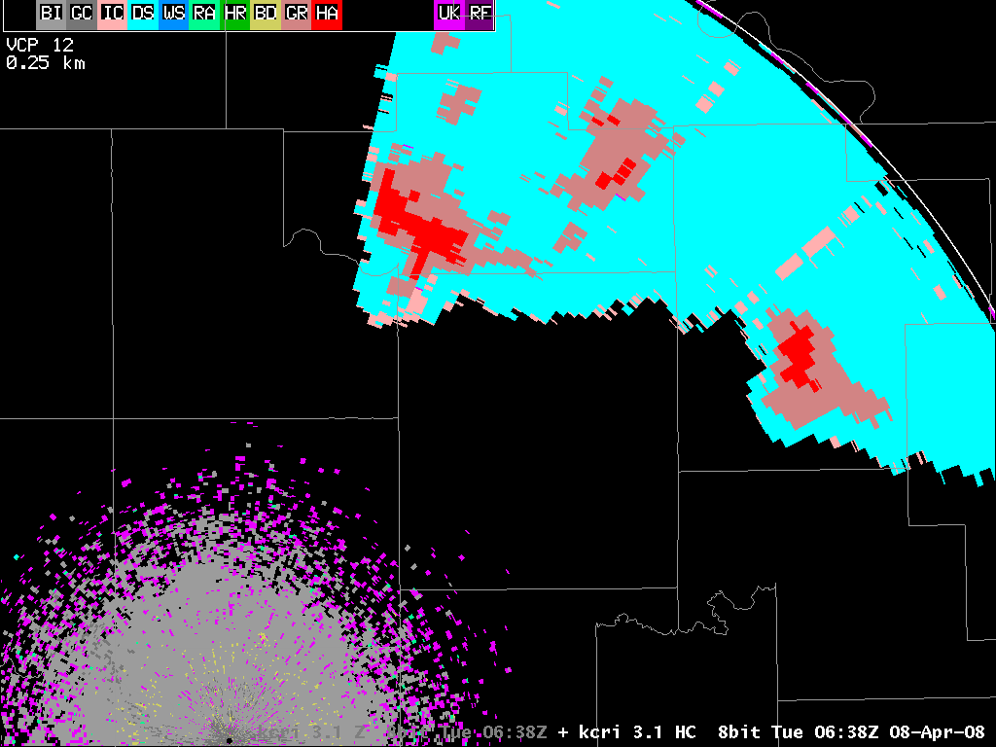
SOO-DOH Images\kcri_0.5_HC_20080408_0638.png
20000 ft MSL

Slide 38
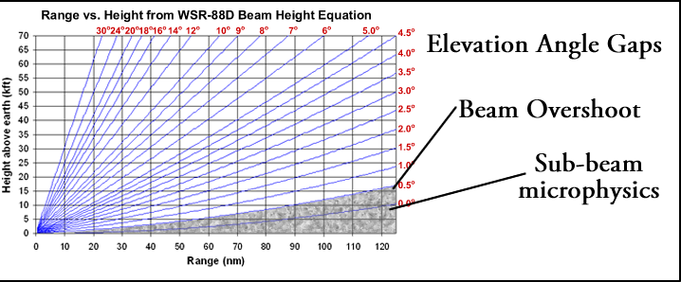
Hydrometeor Classification Algorithm Challenges
Verification
“Fuzzy” Logic and ambiguity between types
Typical Radar sampling limitations (snow at 2000 ft AGL may not be snow at the surface)

Slide 39
Melting Layer Detection Algorithm
Mixed phase hydrometeors: Easy detection for dual-pol!
  Z typically increases (bright band)
  ZDR and KDP definitely increase
  Coexistence of ice and water will reduce the correlation coefficient (CC ~0.95-0.80)
Algorithm overlay product for top and bottom of melting layer
User Selectable MLDA, RUC, Sounding

Slide 40
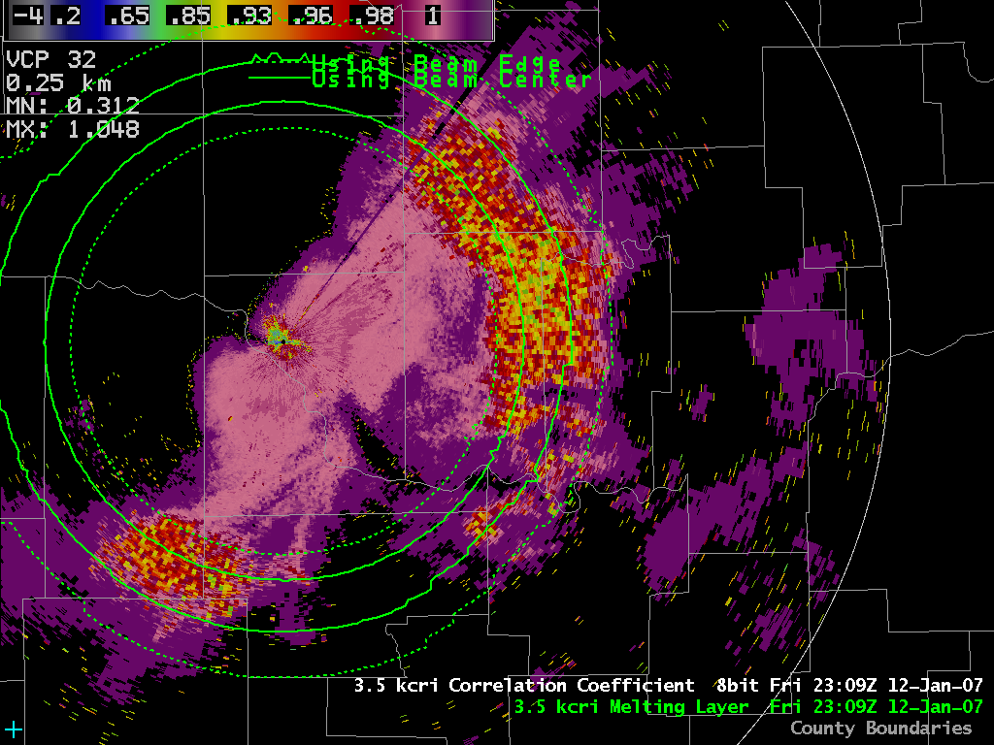
ML Product in AWIPS

Slide 41
WSR-88D Dual-Pol Applications
Flash Flood
Severe Convective Storms
Winter Storms
Notes:
41

Slide 42
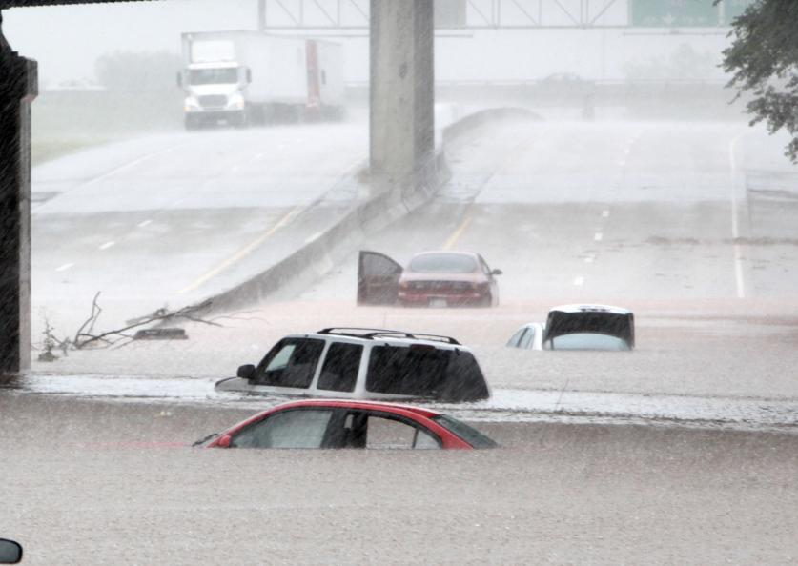
Oklahoma City Flash Flood 6/14/10
Compare Legacy PPS and Dual-pol QPE
©Newsok.com

Slide 43
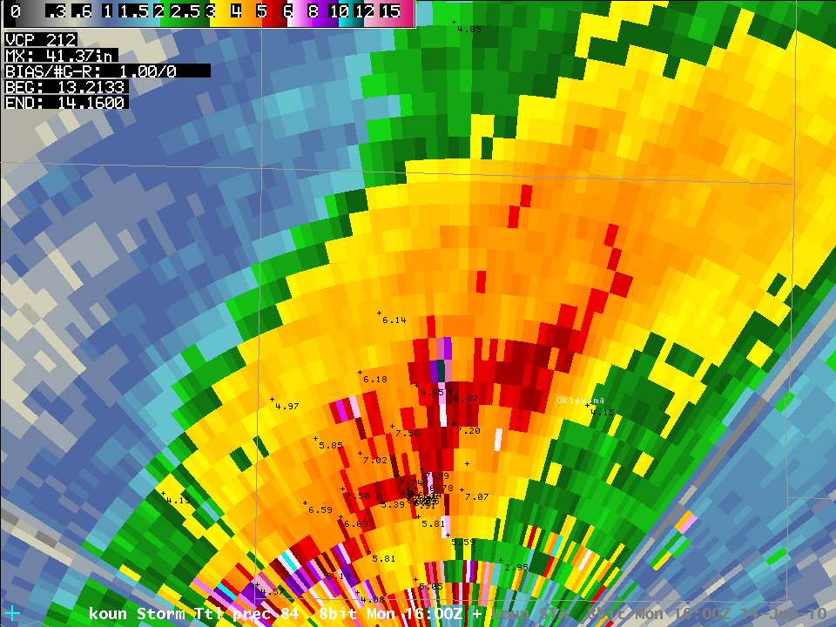
KOUN
PPS Storm Total
300R^{1.4}

Slide 44
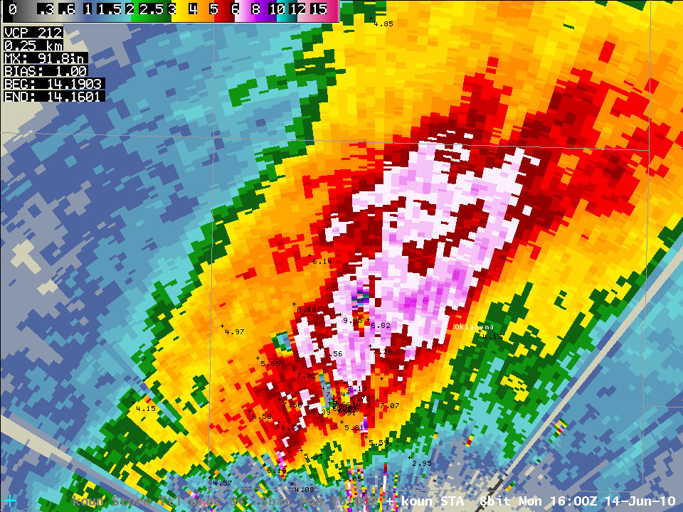
KOUN
DP Storm Total
13.1903

Slide 45
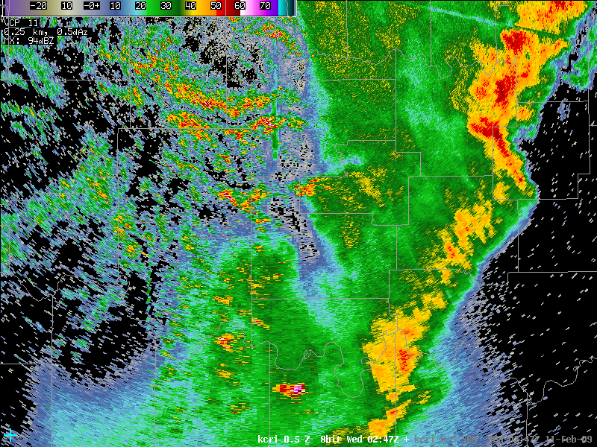
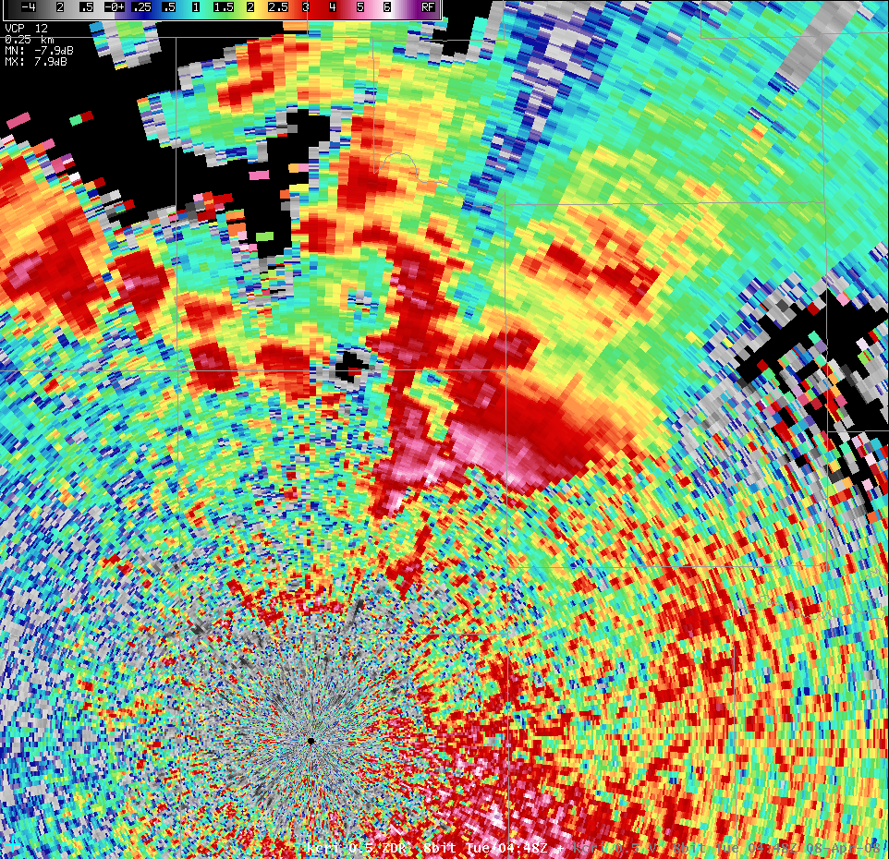
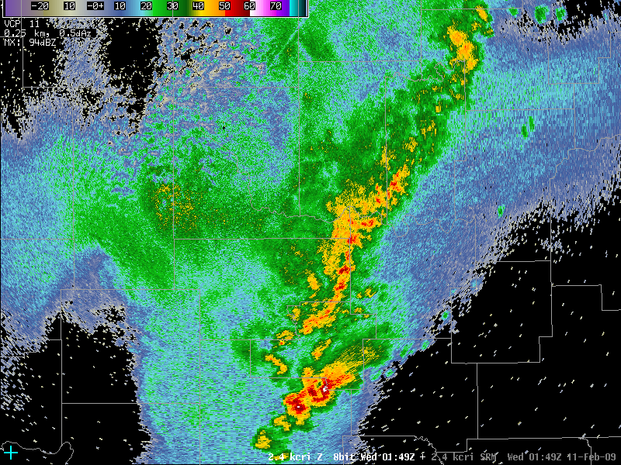
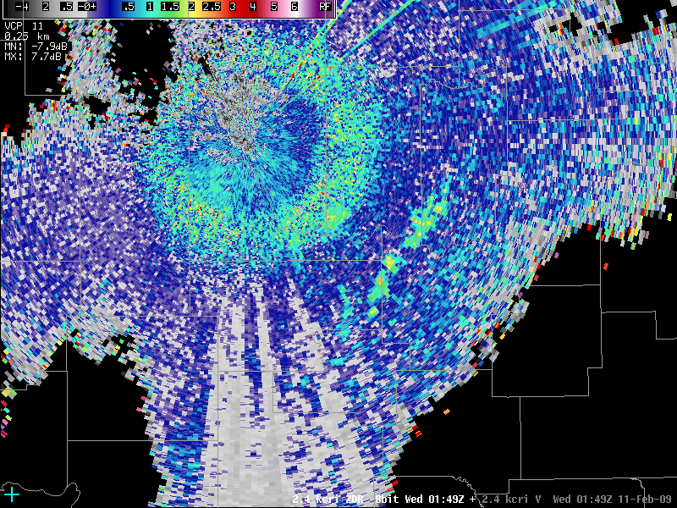
Thunderstorm Updraft Example
“ZDR Columns”
Melting layer
Updrafts
Horizontal Reflectivity
2.4° tilt
Differential Reflectivity

Slide 46
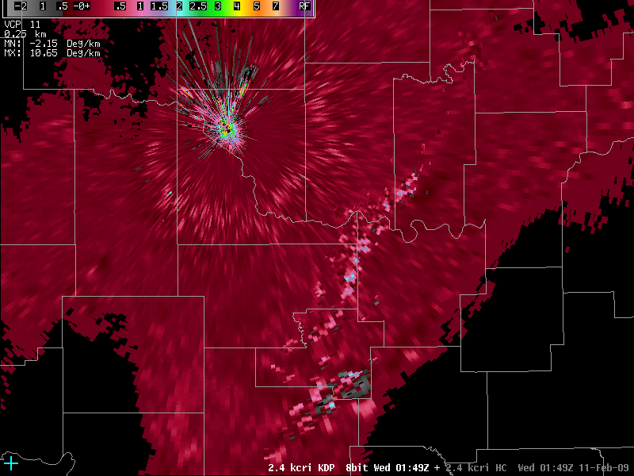
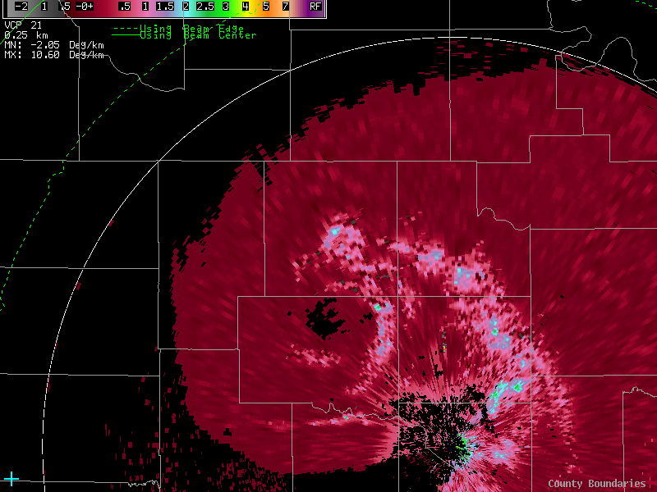
Thunderstorm Updraft Example
“KDP Columns”
Melting layer
Updrafts
Horizontal Reflectivity
2.4° tilt
Specific Differential Phase Shift

Slide 47
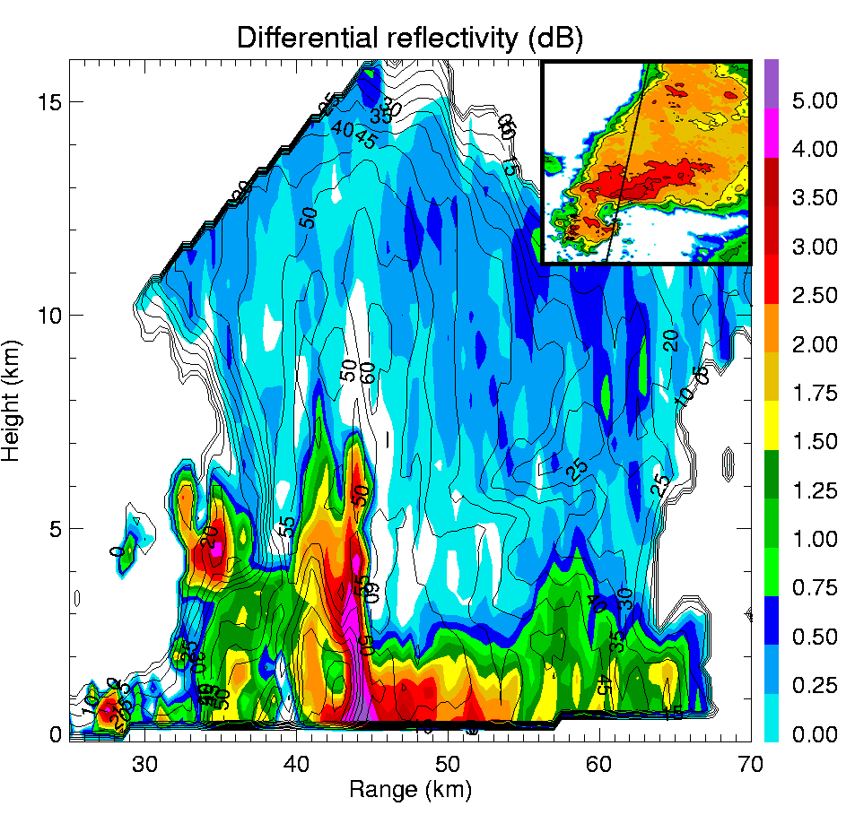
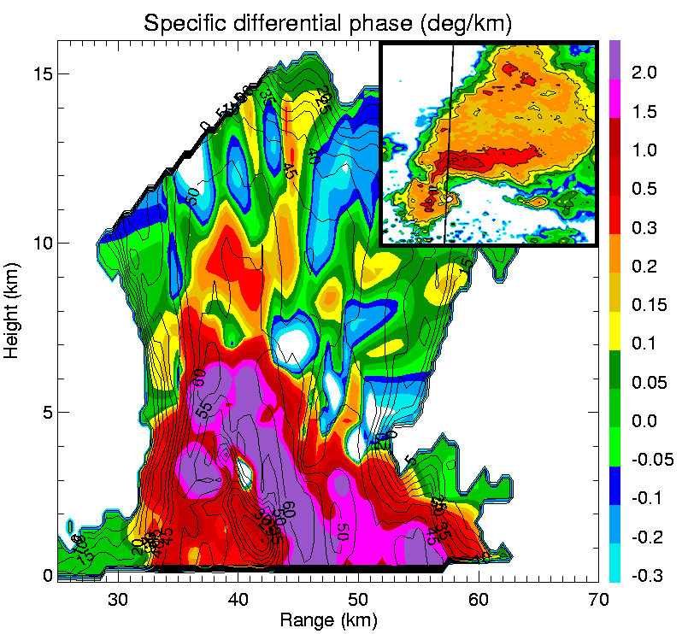
Updrafts and Downdrafts : ZDR & KDP Columns
Storm Kinematics
ZDR Columns show updraft location…Lead Time…Updraft Strength
KDP Columns show updraft summit (above freezing level) and downdraft location…Lead Time

Slide 48
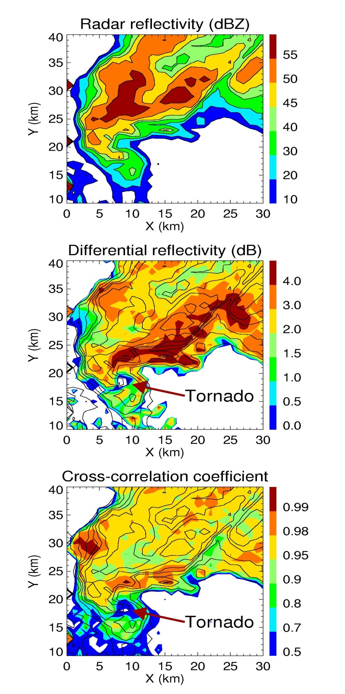
Dual-Polarization Tornado Signature
Description: Radar Return from Tornado Debris: low Rhv, low Zdr
Utility: Help with Tornado Warnings
  Prevent missed tornadoes
  Accurate Severe Weather Updates, pinpoint tornado location
Limitations: Not Seen with All Tornadoes
  Seen with strong (F2 & F3) & violent (F4) tornadoes
  Seen with only a few weak (F0/F1) tornadoes
  Max detection range not yet known
Further Work: More Data Collection/Analysis
  Need to get data to define max detection range
  Need to find wind strength for debris lofting
  Tornado precursor signature may exist within developing hook echo precip distribution: more data collection/analysis needed (i.e. VORTEX2)

Slide 49
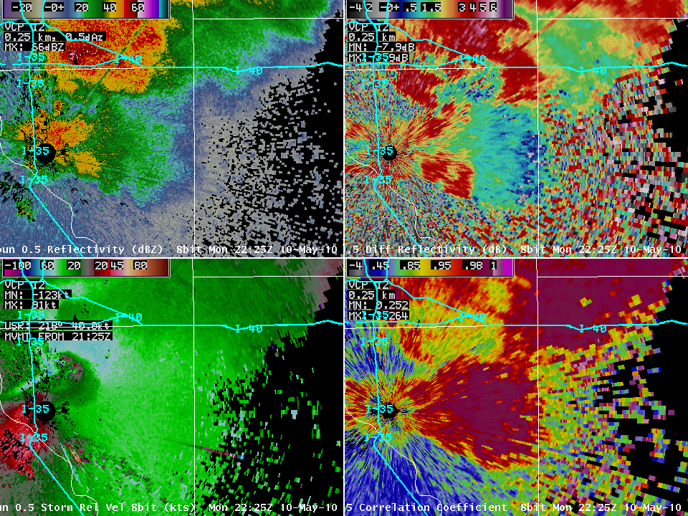
Z
ZDR
SRM
CC
KOUN
0.5 deg

Slide 50
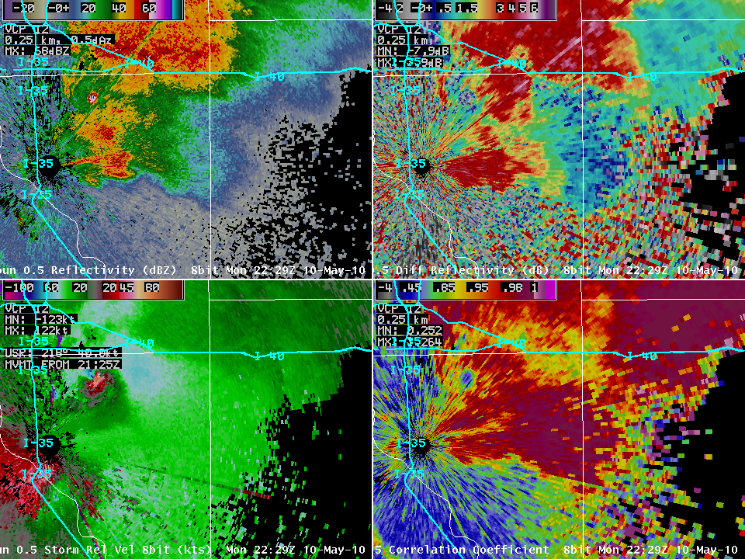
Z
ZDR
SRM
CC
KOUN
0.5 deg

Slide 51
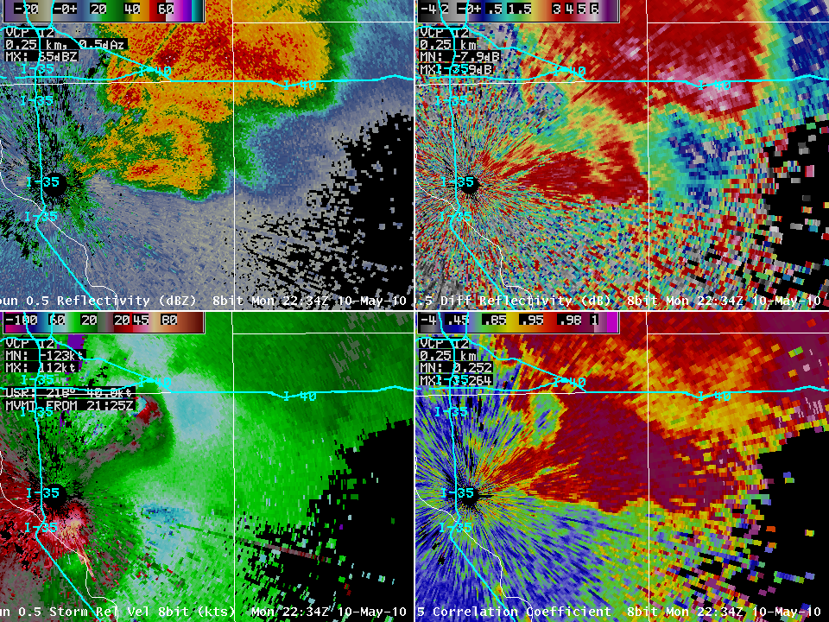
Z
ZDR
SRM
CC
KOUN
0.5 deg

Slide 52
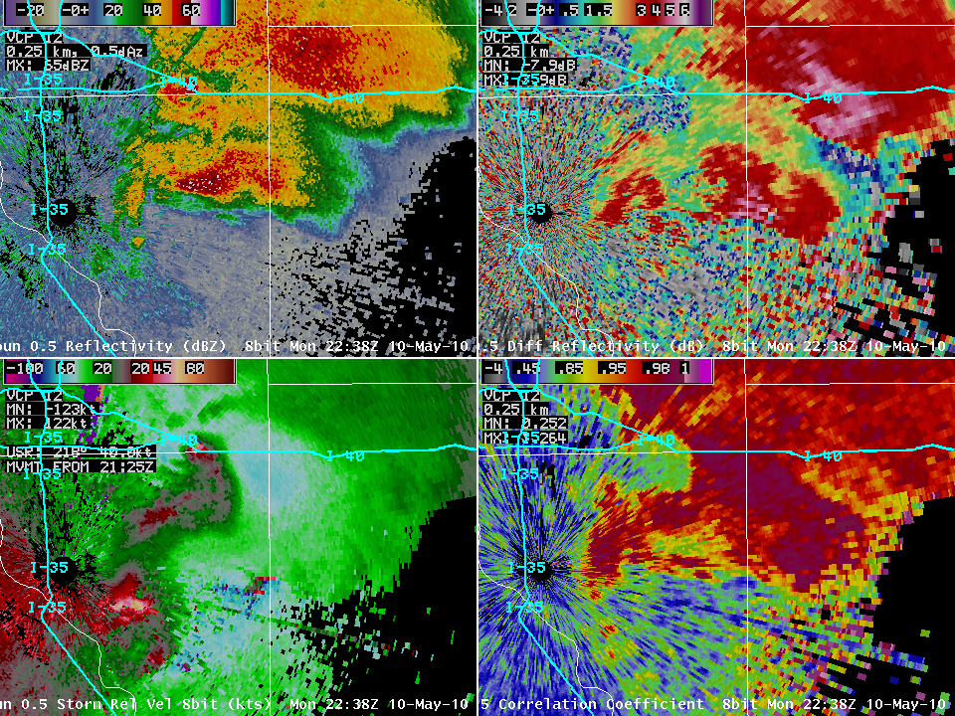
Z
ZDR
SRM
CC
KOUN
0.5 deg

Slide 53
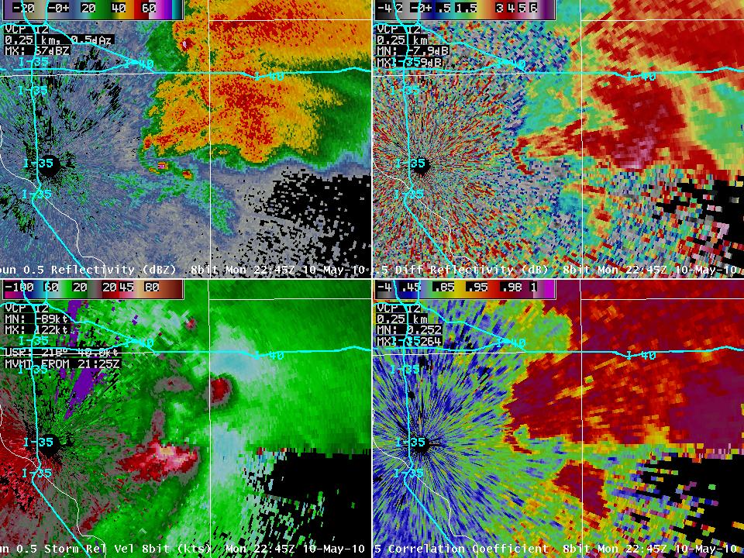
Z
ZDR
SRM
CC
KOUN
0.5 deg

Slide 54
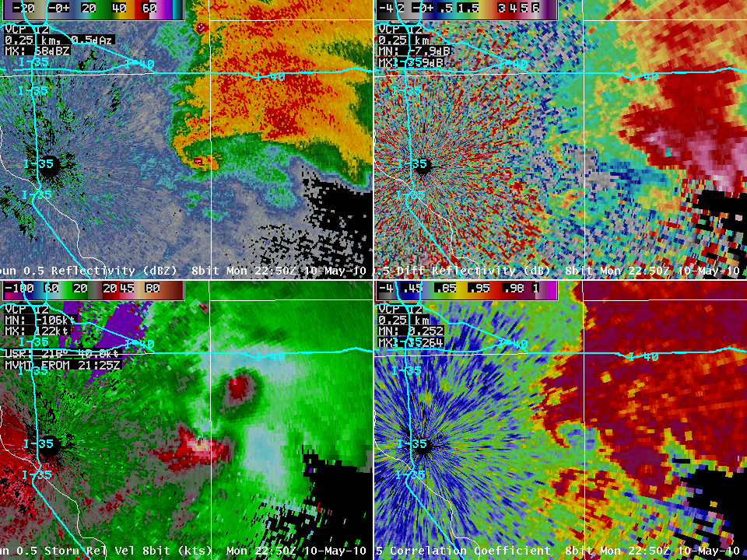
Z
ZDR
SRM
CC
KOUN
0.5 deg

Slide 55
Christmas Eve 2009 Blizzard in Central Oklahoma
Wind Speed
Temperature
Snowfall

Slide 56
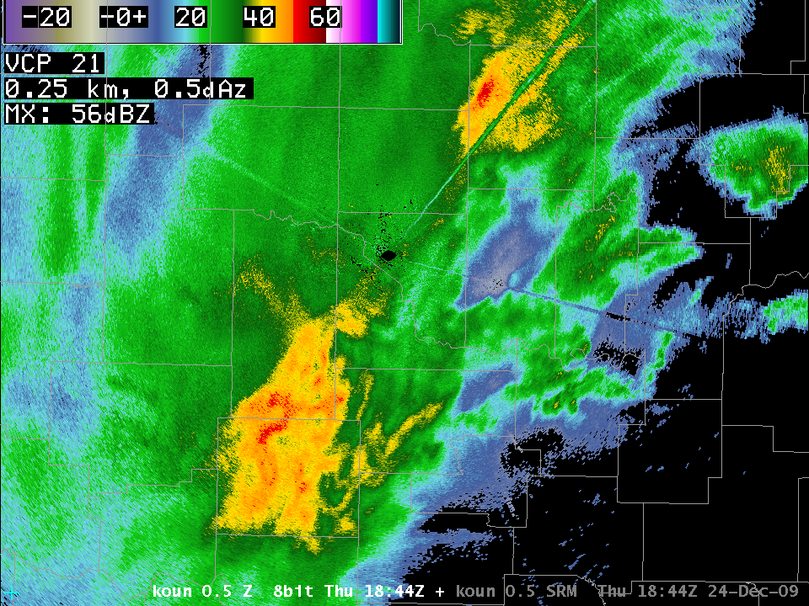
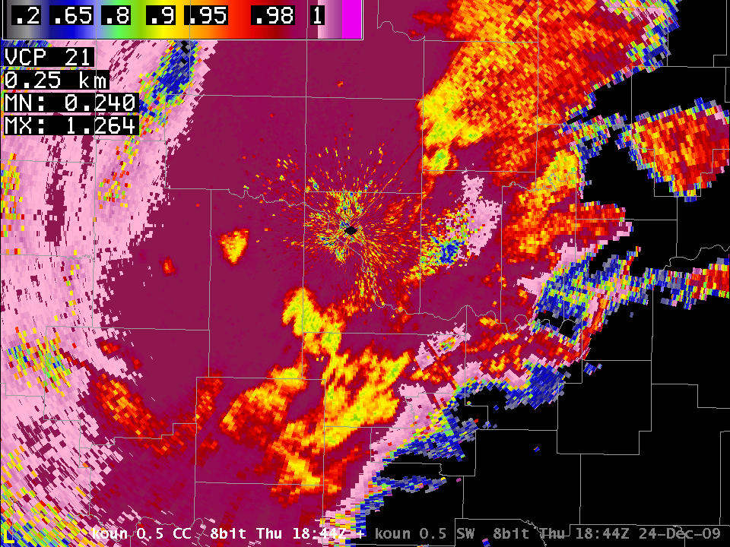
KOUN Data at 18844Z
Reflectivity
Rhv or CC

Slide 57
WSR-88D Dual-Pol Issues and Deployment

Slide 58
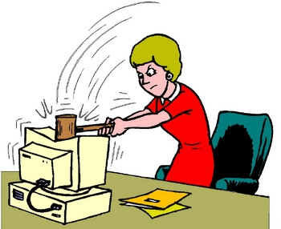
What Dual-Pol Can’t Do
Overcome the laws of physics
Perfect rainfall estimation
Exact hail sizes
Identify surface precipitation type
Detect every tornado
Predict any tornado (yet?)

Slide 59
What Dual-Pol Must Do
Calibration, Calibration, Calibration
  ZDR needs accuracy of 0.1 - .2 dB!!
  ΦDP needs initial system phase accuracy of +/- 10º!!
Same level of maintenance as legacy
  Automated calibration routines
Minimize Sensitivity Loss
  1st Contractor Sensitivity Loss: ~8 DB
  Current Sensitivity Loss: ~3.5 dB
  Has Caused Schedule Delay

Slide 60
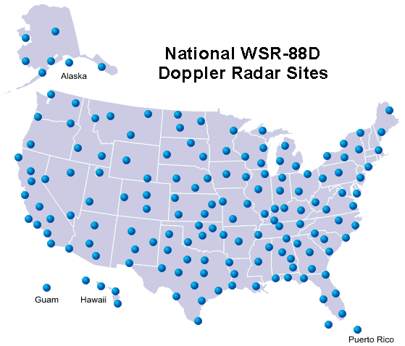
The WSR-88D Upgrade Deployment
All WSR-88Ds upgraded 2010-2012 ?
10-14 days radar downtime during upgrade
System Test: Apr 10 – Sep 10
Ops Test: Sep 10 – Nov 10
Beta Test: Nov 10 – Mar 11
  Wichita: Nov 8, 2010
  Phoenix: Dec 6, 2010
  Ft Polk: Jan 3, 2011
  Morehead City: Jan 17, 2011
  Chicago: Jan 23, 2011
Full Deployment: Mar 2011 to Dec 2012

Slide 61

Questions?
Tel: (405)325-6318
Email: Donald.Burgess@noaa.gov

Slide 62

Highlights of How Dual-pol Data Will Aid Decision Makers
P
Better precipitation estimation
Data Quality: Improved detection and mitigation of non-weather echoes
Melting layer identification
Hydrometeor classification
New/improved storm signatures (NEXT)
P
P

Slide 63



Tornadic Debris Signature
Reflectivity Lowest Cut
Storm-Relative Velocity
0.5 deg CC

Slide 64


Reflectivity
0.5 deg CC

Slide 65
OUTLINE
Explain What Dual-Polarization Means
Explain 10-cm WSR-88D Dual-Polarization
Current Status of NEXRAD Dual-Pol Upgrade
Explain Differences for 5-cm & 3-cm Radar

Slide 66
Explaining Dual-Polarization
Polarization - how the electromagnetic field wiggles as the EM wave propagates
z
y
x
Horizontal Polarization

Slide 67
Explaining Dual-Polarization
z
y
x
Vertical Polarization

Slide 68
Explaining Dual-Polarization
Pulse Doppler radars like the WSR-88Ds emit short bursts of EM energy and then “listen” for the secondary radiation from targets like hydrometeors, which is known as the backscattered radiation.
The conventional WSR-88D network consists of single-polarization radars that emit EM waves with horizontal polarization.

Slide 69

Hail Detection
HAIL
HAIL
Horizontal Reflectivity
Differential Reflectivity

Slide 70


Thunderstorm updraft example
CC
Melting layer
Updrafts
Horizontal Reflectivity
2.4° tilt
Correlation Coefficient

Slide 71
Deployment/Training High-level Schedule
System Test (Apr-Jun 10); Operations Test (Jul-Sep 10)?
First Beta Test Site is KICT (Winter 2010-2011)?
2009 OND | 2010 JFM | 2010 AMJ | 2010 JAS |  | 2010 OND |  | 2011 JFM | 2011 AMJ | 2011 JAS | 2011 OND | 2012 JFM | 2012 AMJ | 2012 JAS | 2012 OND | 2013 JFM | 2013 AMJ | 2013 JAS
 |  |  |  | Beta Test 1st WSR-88Ds upgraded
 |  |  |  |  |  | Deployment 10-14 days downtime each radar
 |  | WDTB’s Dual-Pol Outreach Course Targeted audience: EMs, first responders, media, general public
 |  | Beta DPOC |  | WDTB’s Dual-Pol Operations Course Part 1 Topics: Background and Theory End Goal: Develop Expertise
 |  |  |  |  |  |  |  |  | WDTB’s Dual-Pol Operations Course Part 2 Topics: Advanced Applications and Simulations End Goal: Fully Integrated into Operations
?
?

Slide 72
Life Gets More Complicated With 5-CM and 3-CM Radar
Notes:
72

Slide 73
Those Darn Laws of Physics Again
The Full Radar Equation is Ugly
Radar Scattering Cross-Section Equation is Ugly
We Simplify Things at 10-cm Wavelength
10-cm: Rayleigh Approximation
  Scattering by particles whose radii are ~1/10 of the radar wavelength or smaller
5-cm & 3-cm we must use the full Mie
Scattering Equation…the Ugly Equation

Slide 74


The Result for 5-CM & 3-CM
Scattering response different for
shorter wavelengths (above)
ZDR and KDP are different at the shorter wavelengths (right)

Slide 75

NOXP (3-CM) Data for VORTEX2-09 (June 5)
222229Z 1.0 deg elevation

Slide 76

NOXP Attenuation Corrected Z Data V2-09 (June 5)
222229Z 1.0 deg elevation

Slide 77

NOXP Corrected Zdr V2-09 (June 5)
222229Z 1.0 deg elevation

Slide 78
WSR-88D Dual-Polarization Upgrade
Simultaneous Transmission And Reception (STAR); Slant 45
Transmit at 45º, receive at both horizontal and vertical
There is a PROBLEM: Split the power; 3-dB sensitivity loss
Notes:
78

