Slide 1
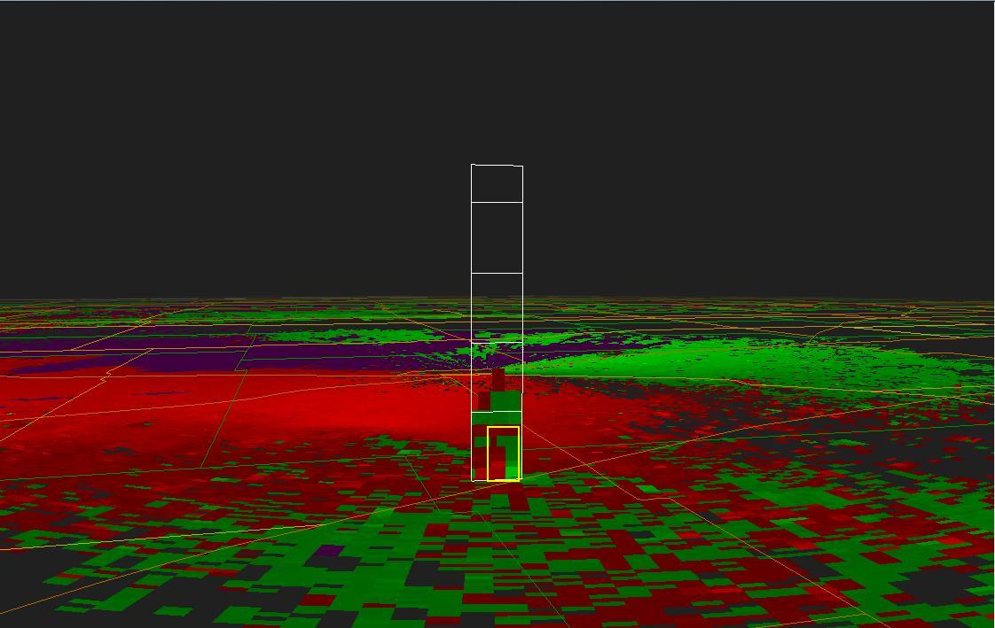
NON-MESOCYLONE TORNADOGENESIS IN THE 26 OCTOBER 2006 CLOSED MID LEVEL LOW SEVERE CONVECTIVE EVENT
Aaron Johnson
NWS Dodge City KS

Slide 2
previous non-mesocyclone tornado (nmt) research associated with a similar closed mid level low severe convective event created more questions than answers.
    Are there other cases where the WSR-88D provided strong evidence of nmt development?
    Do closed mid level low severe convective events with NON-MESOCYCLONE TORNADOES also produce supercell based tornadoes?

Slide 3
What do we know about mid level closed low tornado events through historical literature review? What does it reveal in terms of…
    Differences/similarities of mid level closed low events compared to a more traditional supercell tornado environment?
    Synoptic to meso-beta scale pattern similarities from one event to the next?

Slide 4
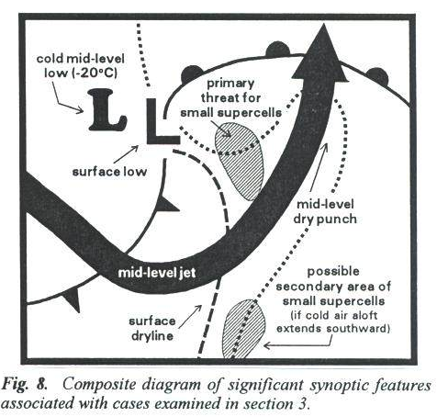
Do mini supercells explain tornadogenesis in closed mid level low events?
Davies (1990;1993a)
Theory/conceptual model emanates from extensive Tropical Cyclone research and what appeared to be a plausible connection with a strong “cold core” cyclone.
Steep low level lapse rates but potential instability very low.
Assumption is made that despite low potential instability…moderate to strong wind shear results in enough horizontal vorticity that is subsequently tilted into the vertical, that this can lead to shallow mesocylone/mini supercell
development. Tornado potential in
mid level closed low events is completely
explained in many readers minds.
Brief mention of non-supercell potential due to
stretching of pre-existing vertical vorticity but this
is largely ignored by subsequent research
emanating from these articles.

Slide 5
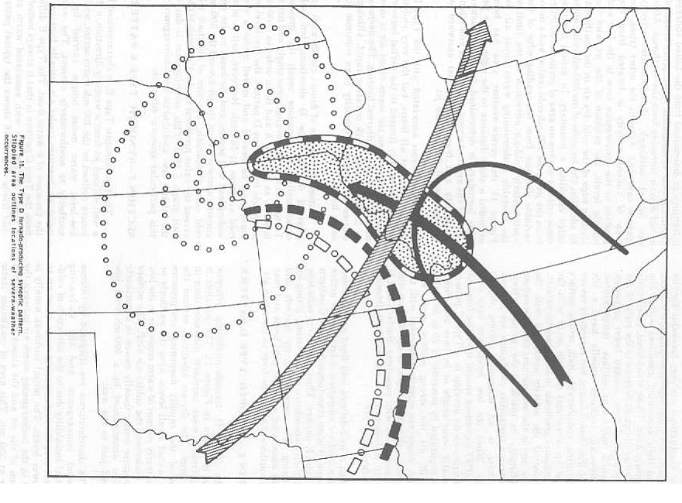
Literature Review
Miller (1972) – Type D Synoptic pattern

Slide 6
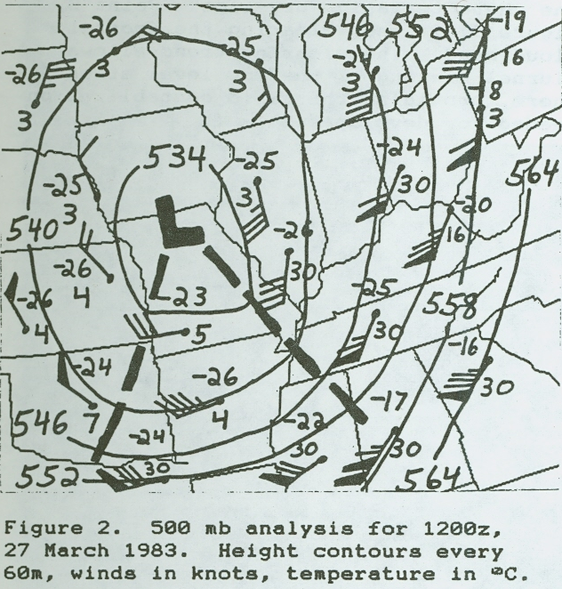
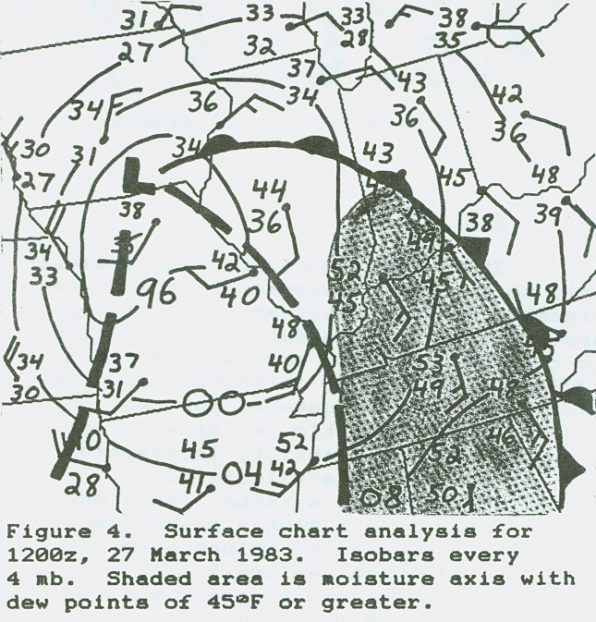
Literature Review
Goetsch (1988)
Found similar synoptic patterns with a closed mid level low and a nearly vertically stacked system resulting in destabilization through mid level cold pool and any diurnal heating.
Low level moisture axis is usually found protruding toward the surface low center from the southeast.
Defined “threat area” in a zone of strong low level convergence along a trough of secondary cold front.

Slide 7
Literature Review
Johns and Doswell (1992)
Briefly mention Miller (1972) Type D patterns for tornadoes.
However…they do state that these events come from relatively low-topped convection that is usually non-supercellular in nature.
Mcdonald (2000)
Similar synoptic pattern as previous literature.
Suggests NMT processes similar to a Landspout but
provides no empirical evidence.

Slide 8
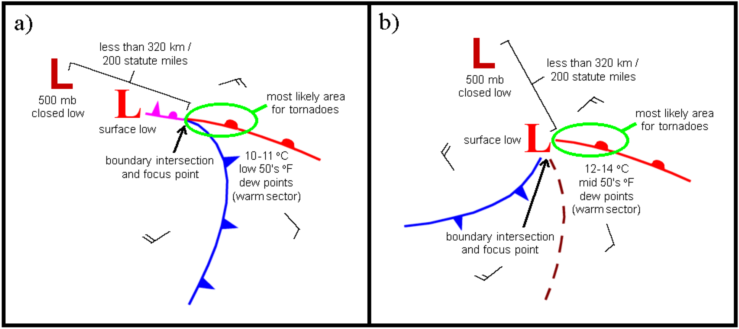
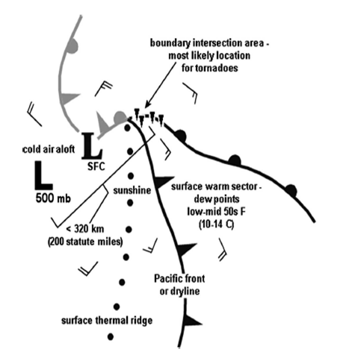
Literature Review
Davies/guyer (2004) and Davies (2006)
Composite diagrams showing common features associated with tornado producing CC500L systems.

Slide 9
Closed Low Tornado event Literature
Research/Literature lacking in comparison to other severe convective areas of interest.
Historically…research done by one or two individuals/research groups, with a decade or more between meaningful research at times.
Composite model on the synoptic scale very similar among research and utilized heavily in forecasting.
Little if any empirical evidence to support “cookie cutter “ tornadogenesis model via mini supercell events stemming from tight spin/vorticity from the nearby mid-level low or surface low.
Some theorize NMT processes but little, if any empirical evidence has been provided in literature up to this point.

Slide 10
detailed analysis of level ii data FOR THE OCTOBER 26, 2006 mid level closed low event across SOUTHWEST KANSAS appears to provide some empirical evidence of NMT processes by revealing…
multiple misoscale vorticies near/along boundaries that propagate into regions that spawned tornadoes.
Vorticies moved independent of convective cells and could be traced backwards 30-50 minutes.
NOTE: THE APPLICATION OF SUBSQUENT MATERIAL IS MOSTLY LIMITED TO RADAR INTEROGATION DUE TO FEW OTHER REAL-TIME ANALYSIS TOOLS THAT ARE CAPABLE OF RESOLVING FEATURES ON THIS SCALE .

Slide 11

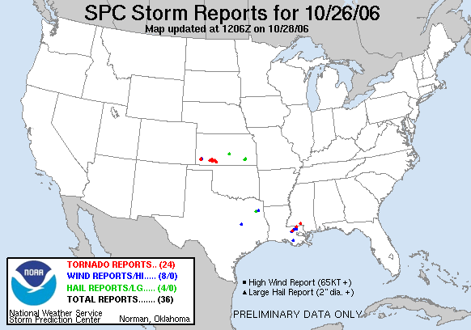
review of october 26 2006

Slide 12
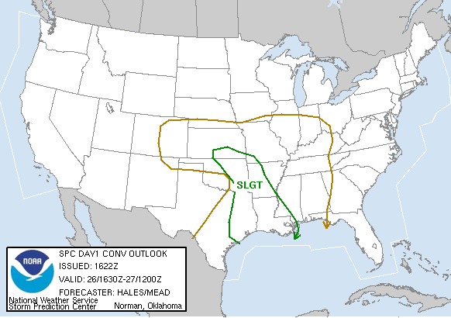
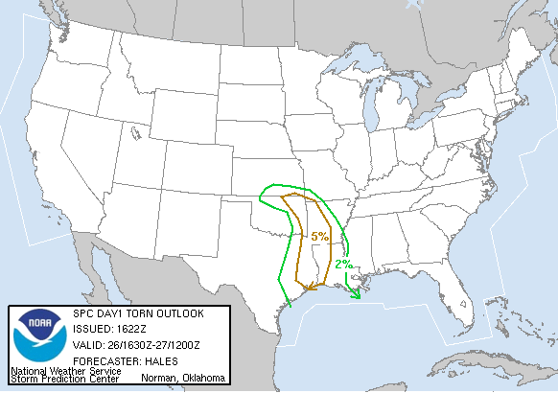
review of october 26 2006
“AMOUNT AND DEGREE OF SEVERE THREAT IS IN SOME DOUBT. HOWEVER MODEL SOUNDINGS CERTAINLY SUPPORT SUPERCELLS BY THIS EVENING AS LOW LEVEL WINDS RESPOND TO THE DEVELOPMENT OF THE SURFACE LOW OVER ERN OK.”

Slide 13
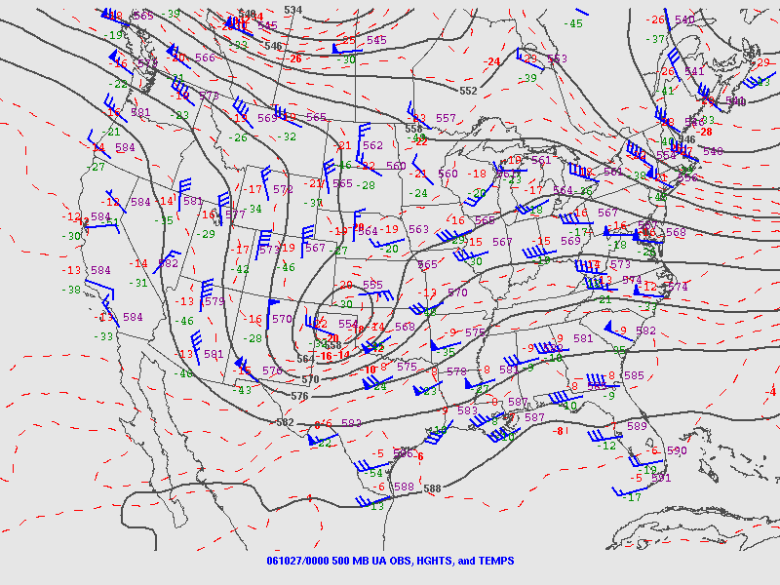
review of october 26 2006

Slide 14
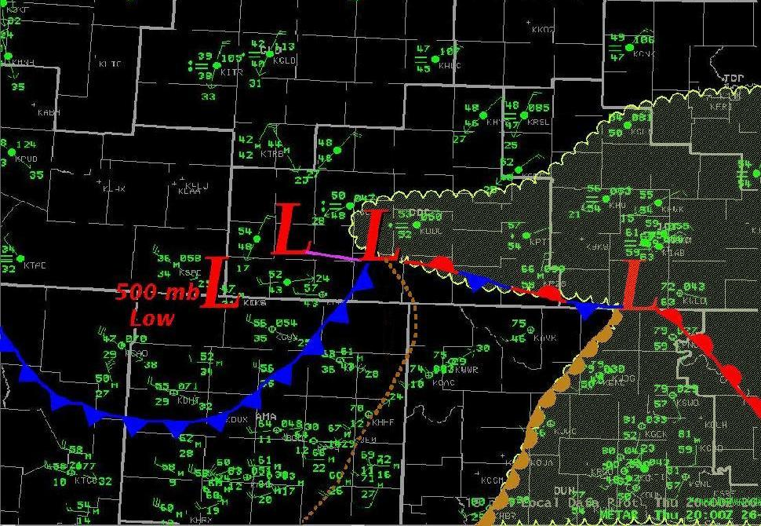
Surface chart 20Z

Slide 15
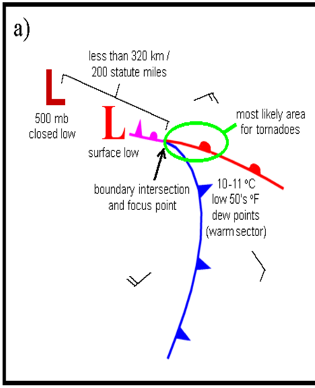
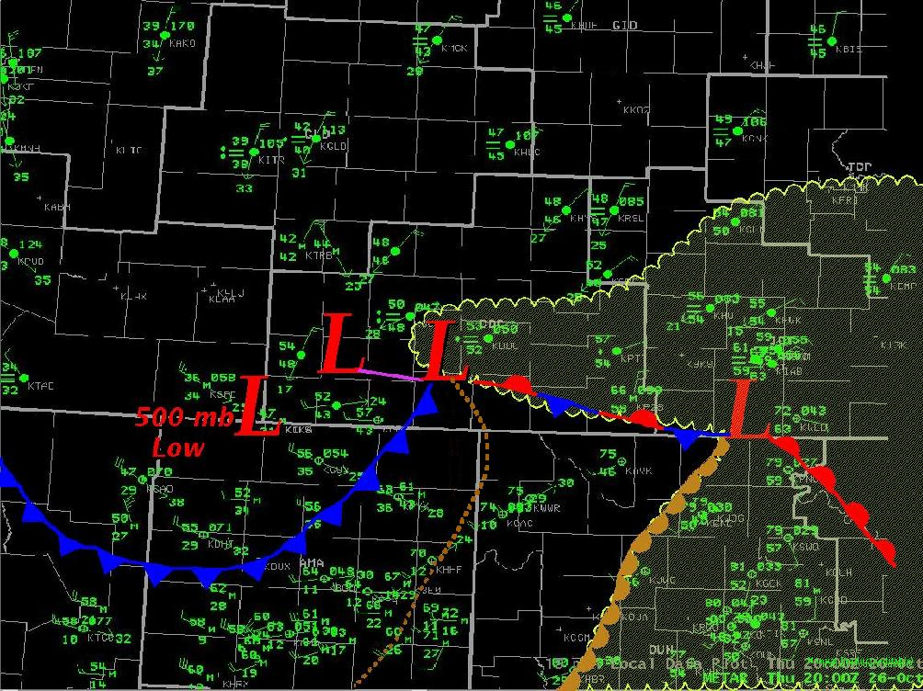
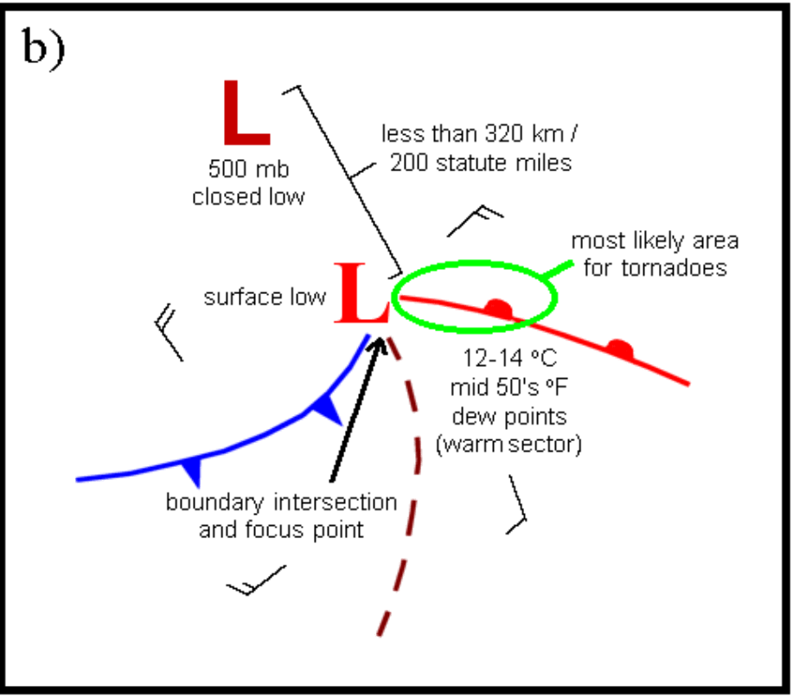
Matches conceptual model
Davies/Guyer 2004

Slide 16
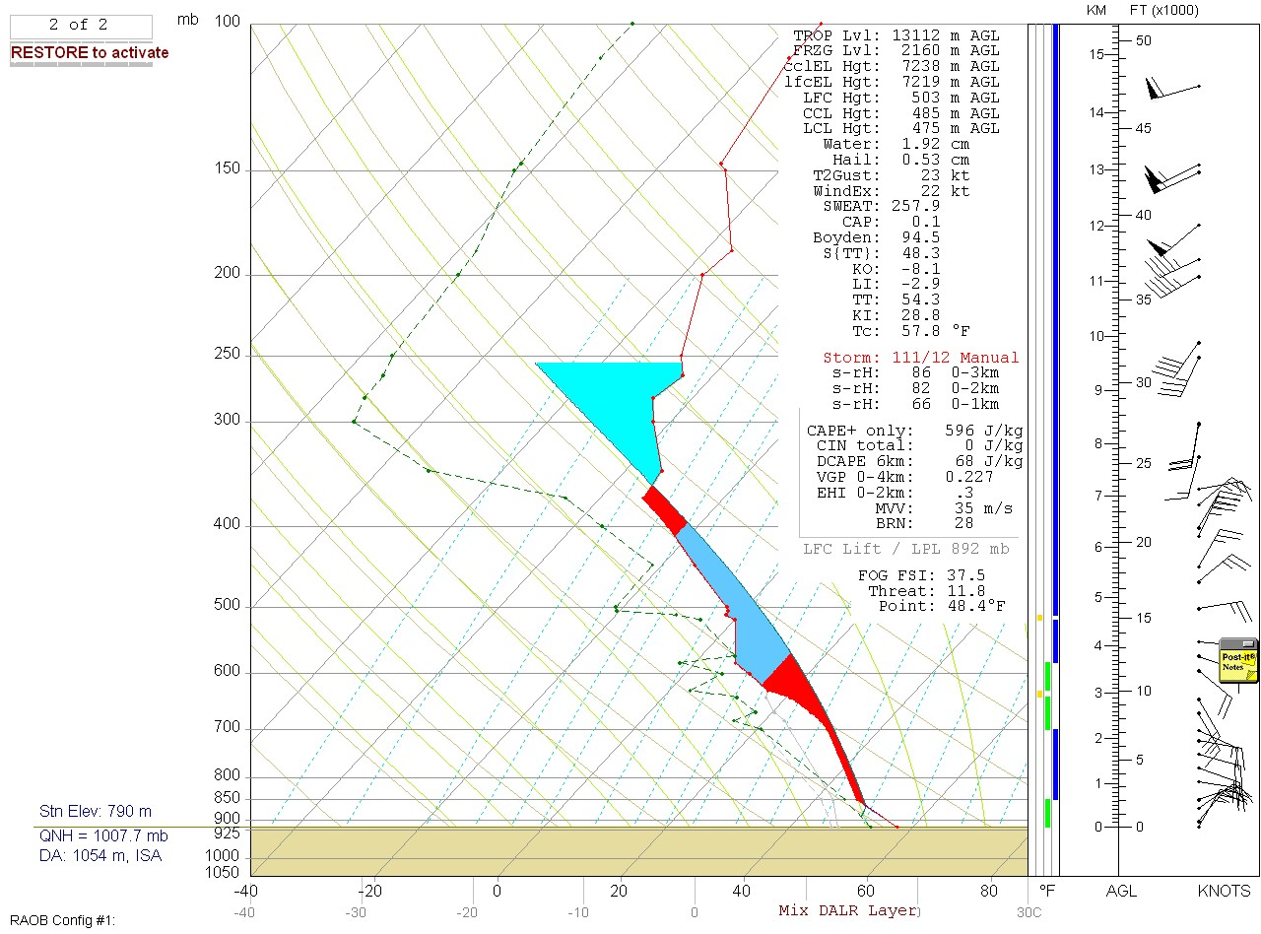
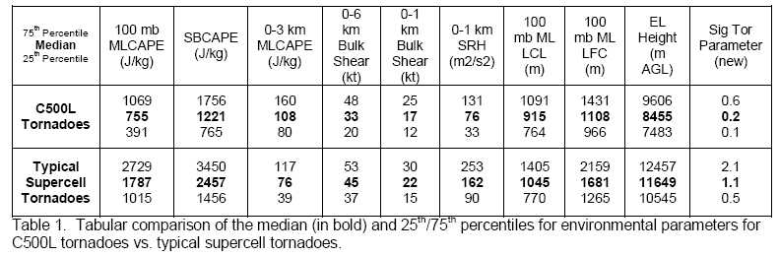
: Davies/guyer 2004
Parameter values ON october 26, 2007 (MODIFIED 00z DDC SOUNDING) ALSO SIMILAR BUT different than previous literature
sb/ML cape = ~500-700 j/kg
0-3km ml cape = ~170 j/kg
0-1KM SRH = 86 M2/S2
0-6km Bulk shear = 72 kts
Lcl/lfc = ~450-500 (m)
El height = ~7.2 km

Slide 17
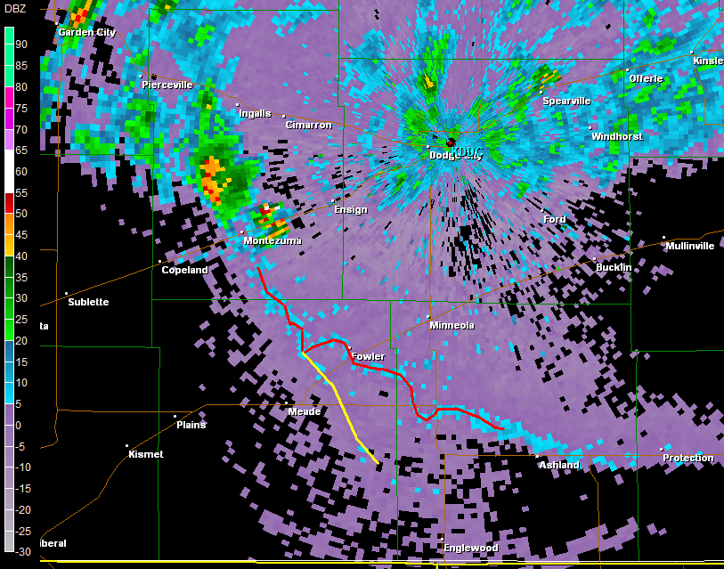
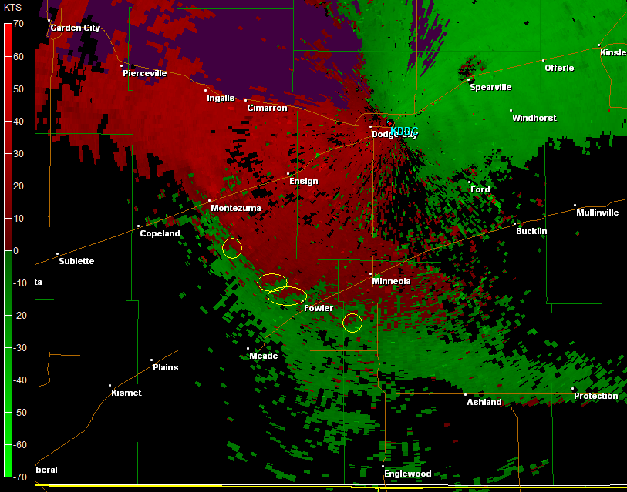
2022 GMT
A
B
C
D

Slide 18
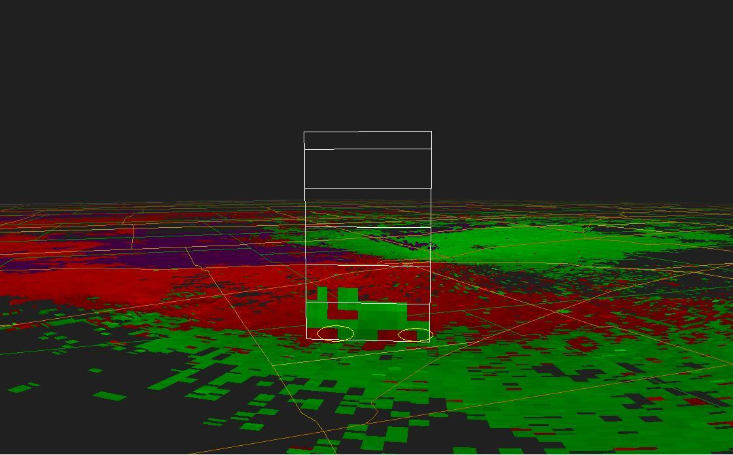
2022 GMT
B
C
B
C

Slide 19
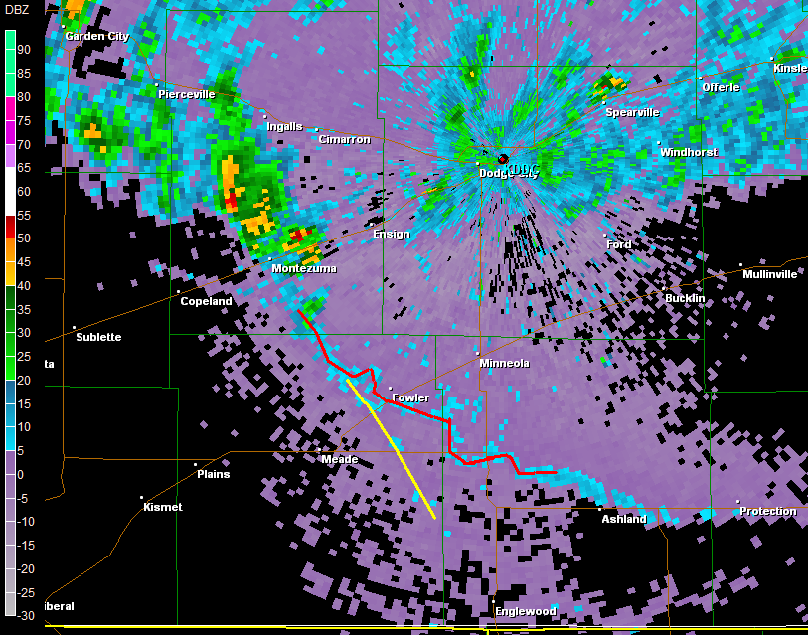
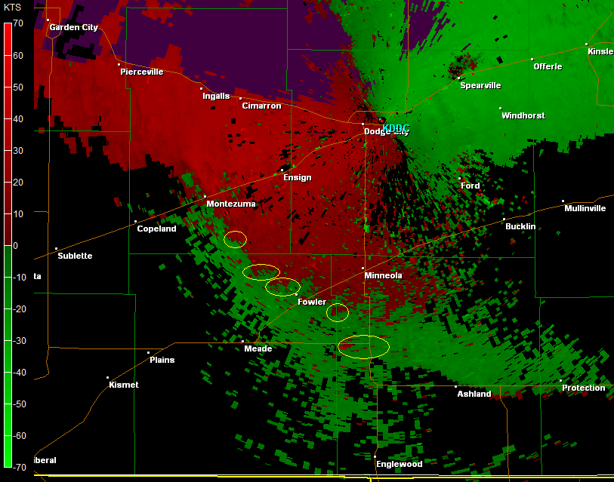
2028 GMT
A
B
C
D
E

Slide 20
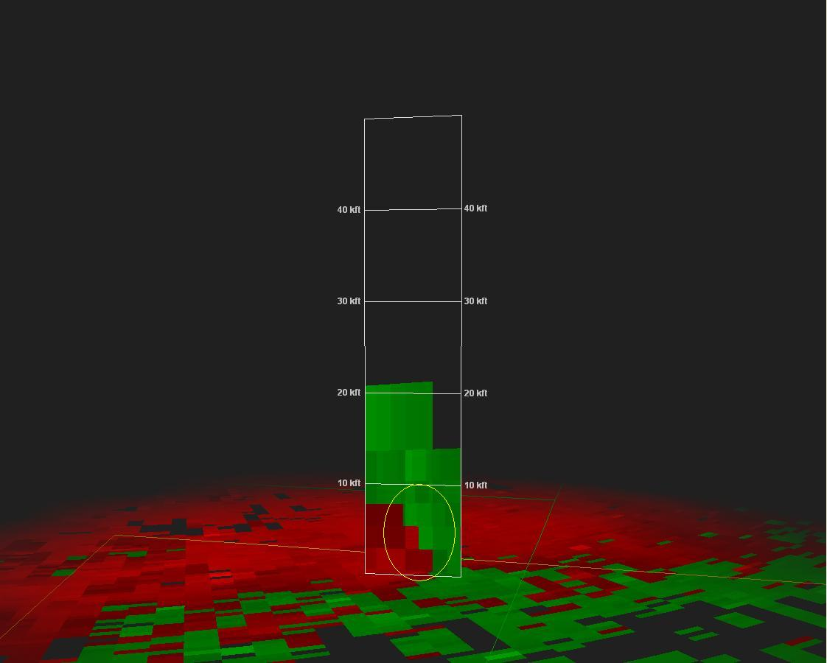
2028 GMT
A
A

Slide 21
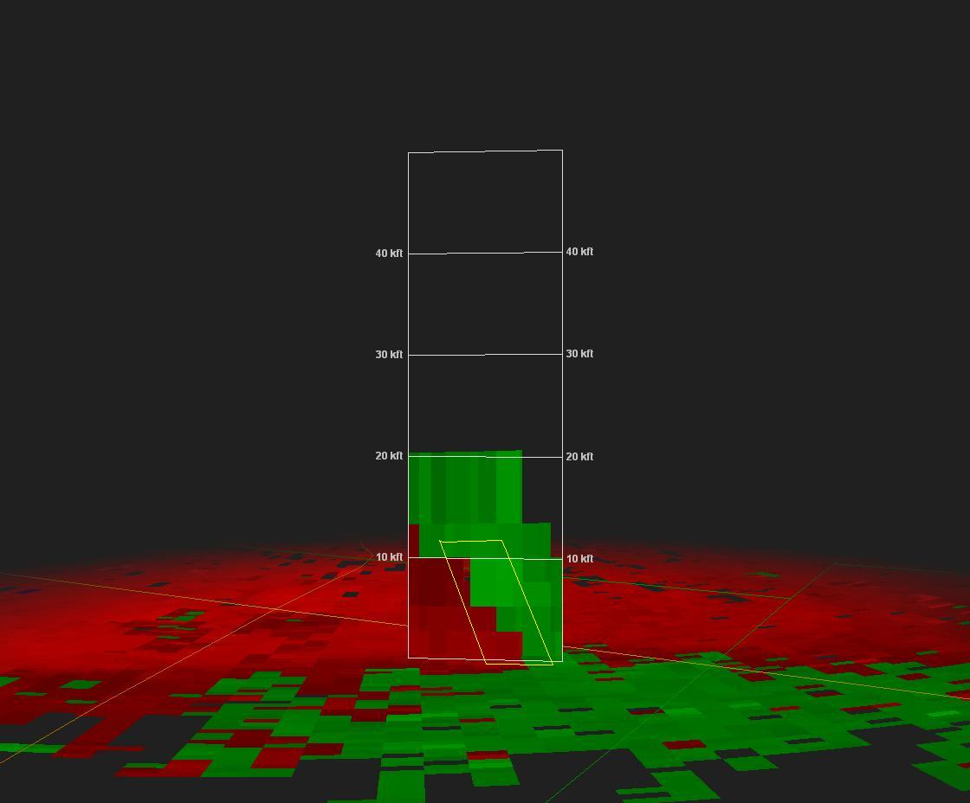
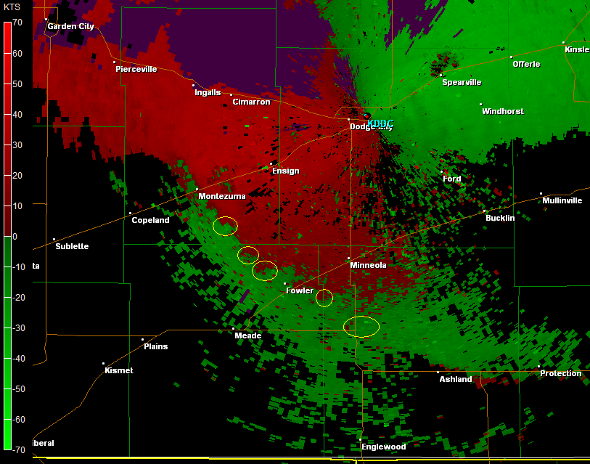
2034 GMT
A
A

Slide 22
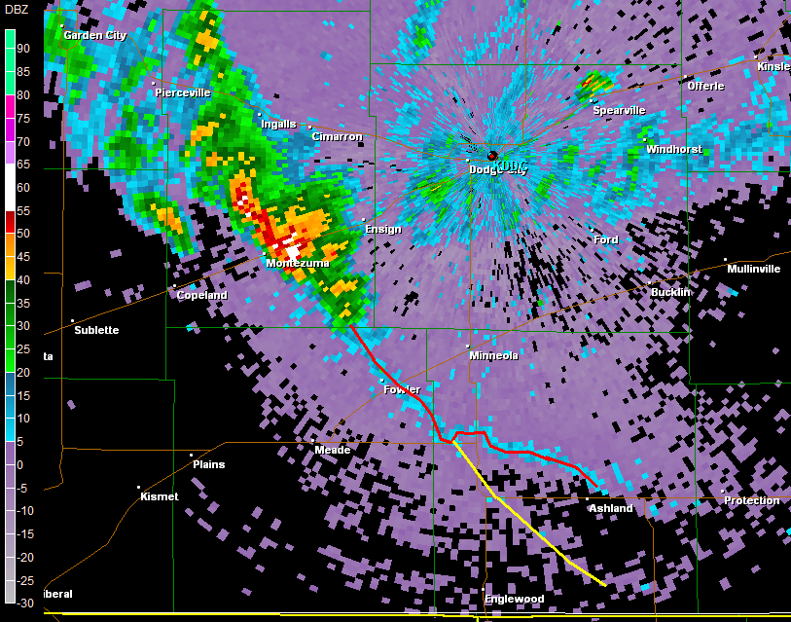
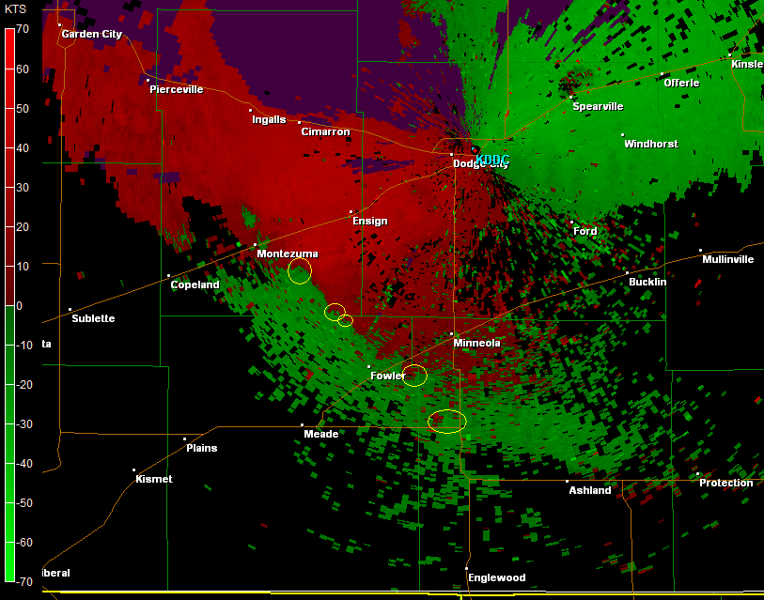
2049 GMT
B
C
D
E

Slide 23
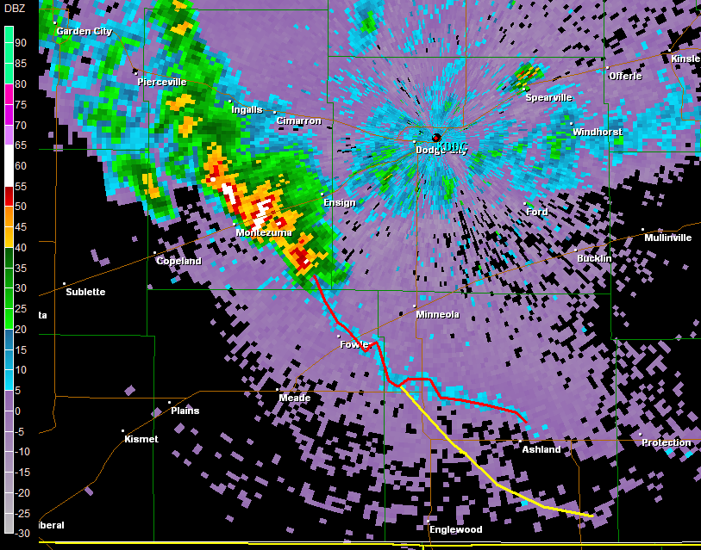
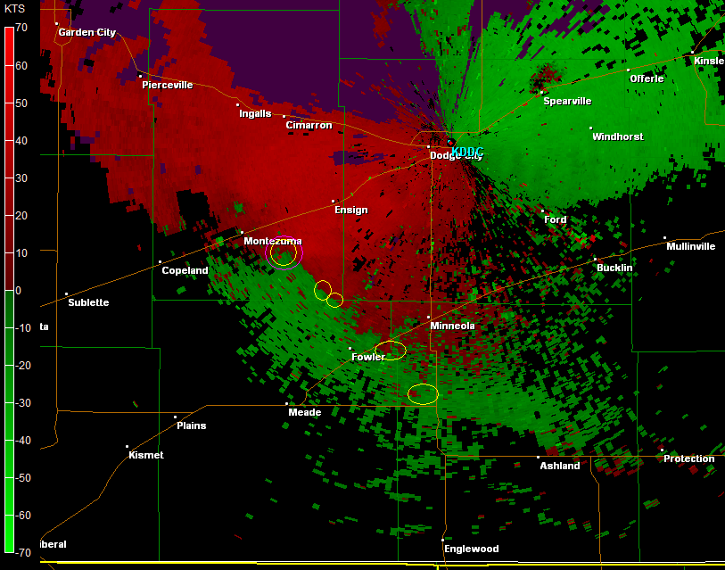
2053 GMT
Tornado reported ~2050-2055 GMT
B
C
D
E

Slide 24
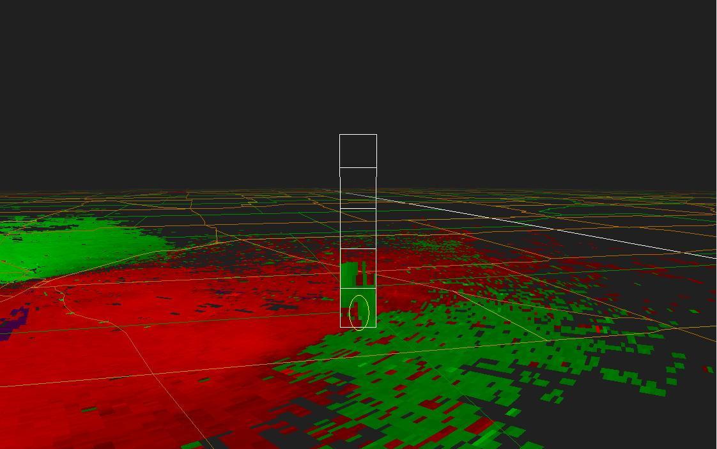
2053 GMT
Tornado reported ~2050-2055 GMT
B
B

Slide 25
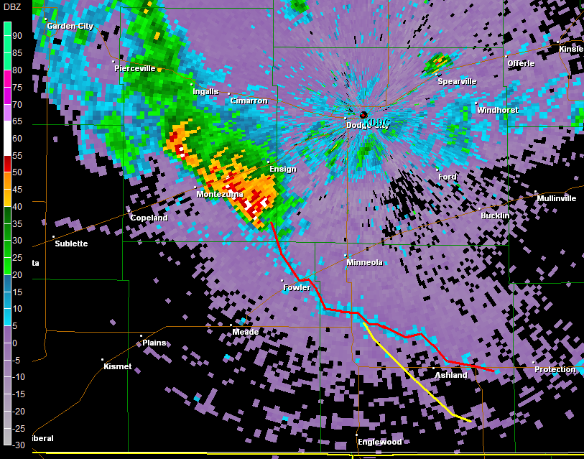
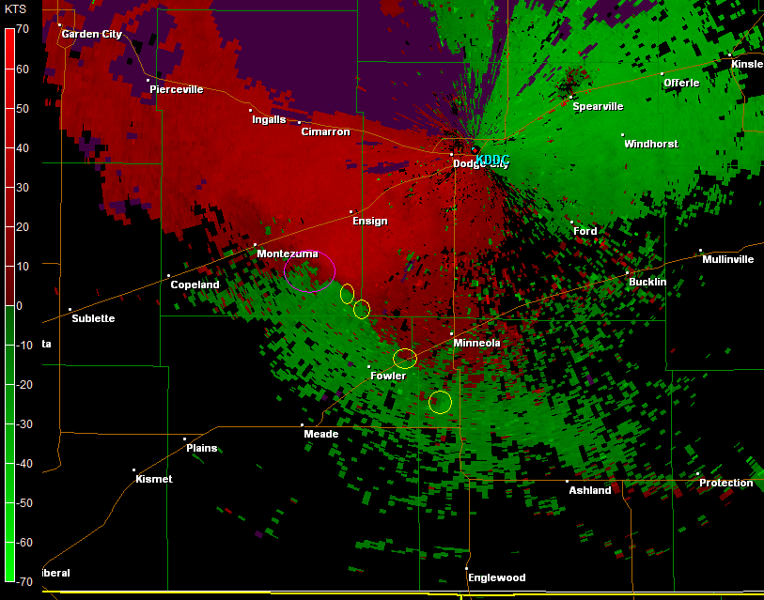
2101 GMT – tornado southeast gray/southwest ford
B
C
D
E

Slide 26
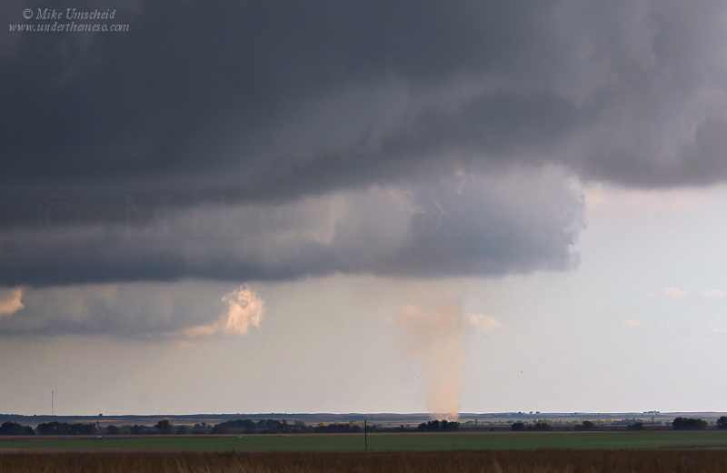
2101 GMT – tornado southeast gray/southwest ford
C

Slide 27
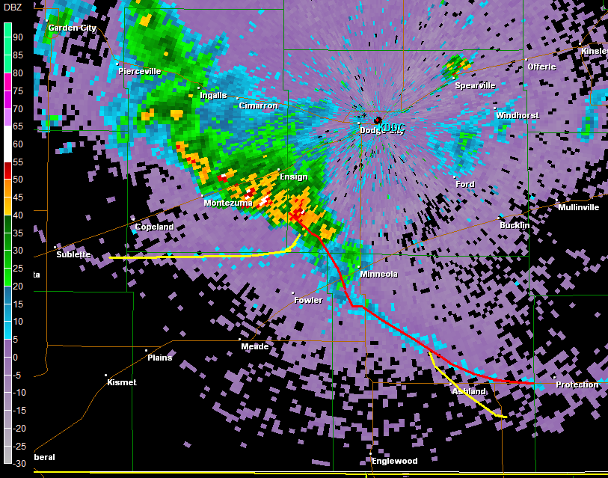
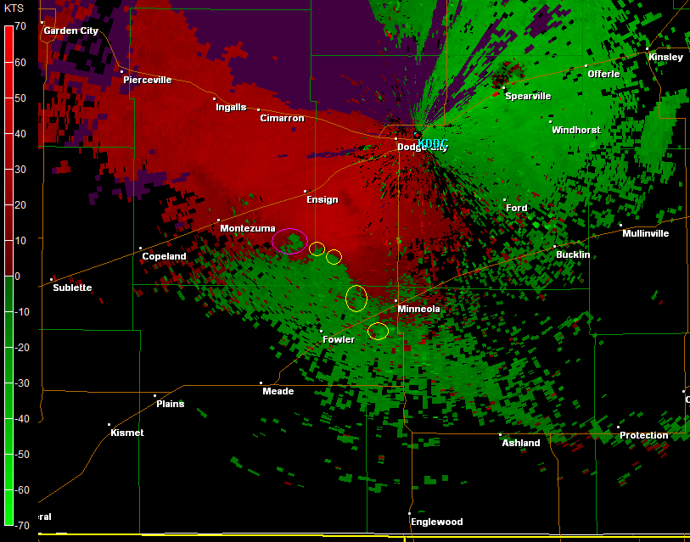
2116 GMT
B
C
D
E

Slide 28
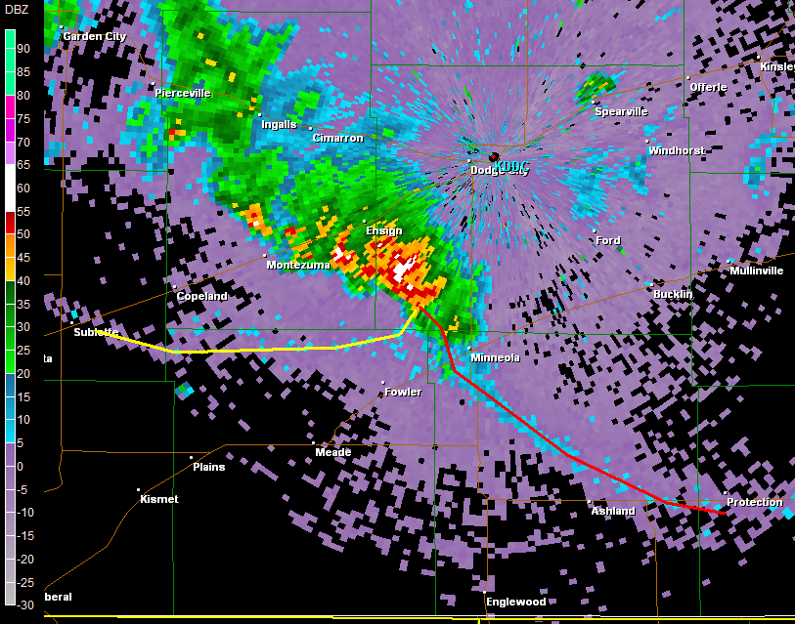
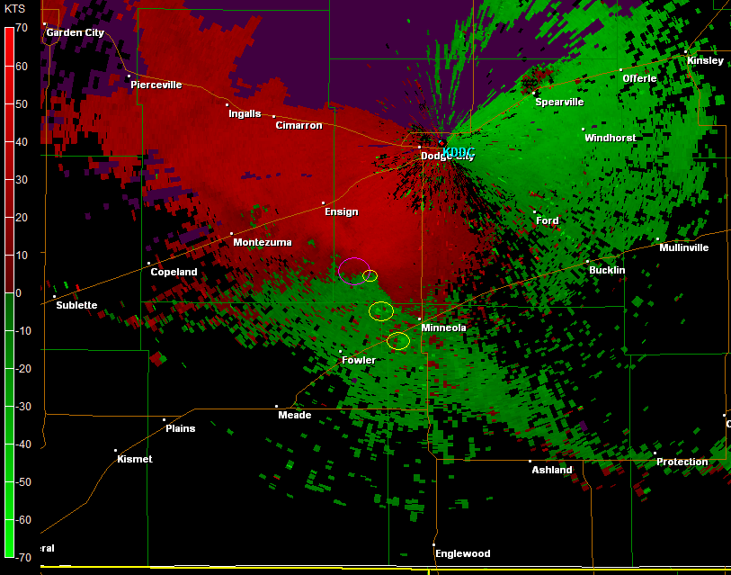
2123 GMT – tornado west/NORTHWEST of minneola
D
E

Slide 29
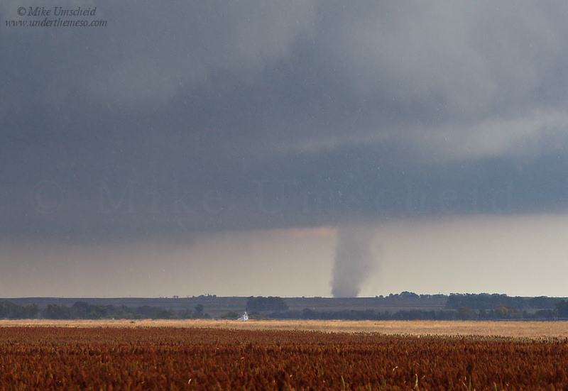
2123 GMT – tornado west of minneola
D

Slide 30
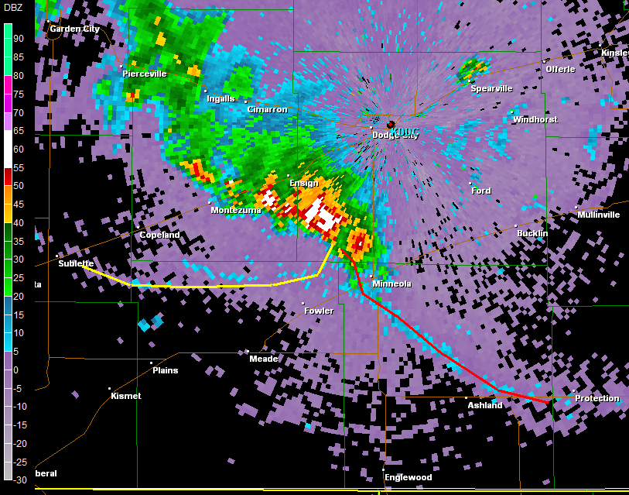
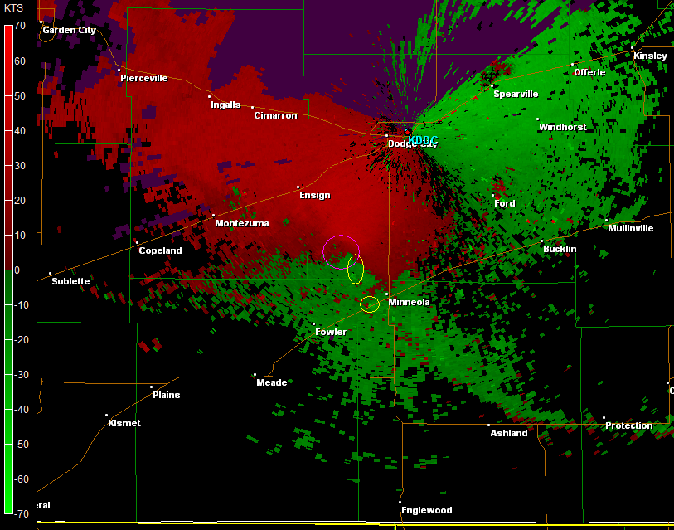
2130 GMT – new tornado southwest of minneola
E

Slide 31
2130 GMT – new tornado southwest of minneola
E
E

Slide 32
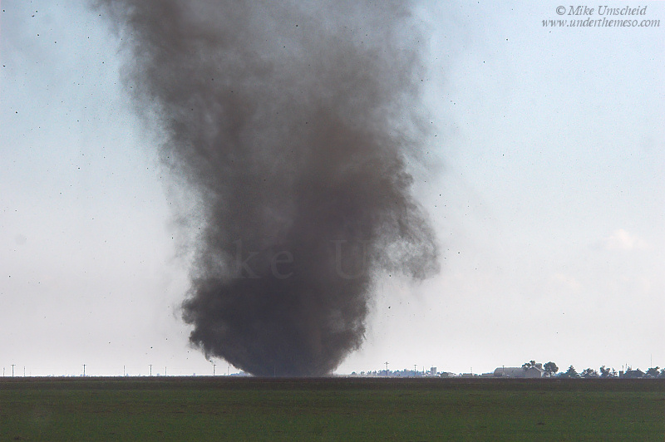
2130 GMT – new tornado southwest of minneola
E

Slide 33
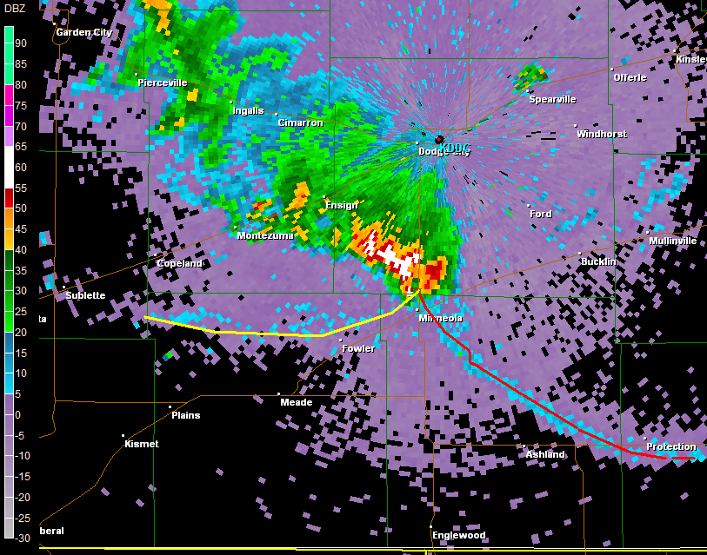
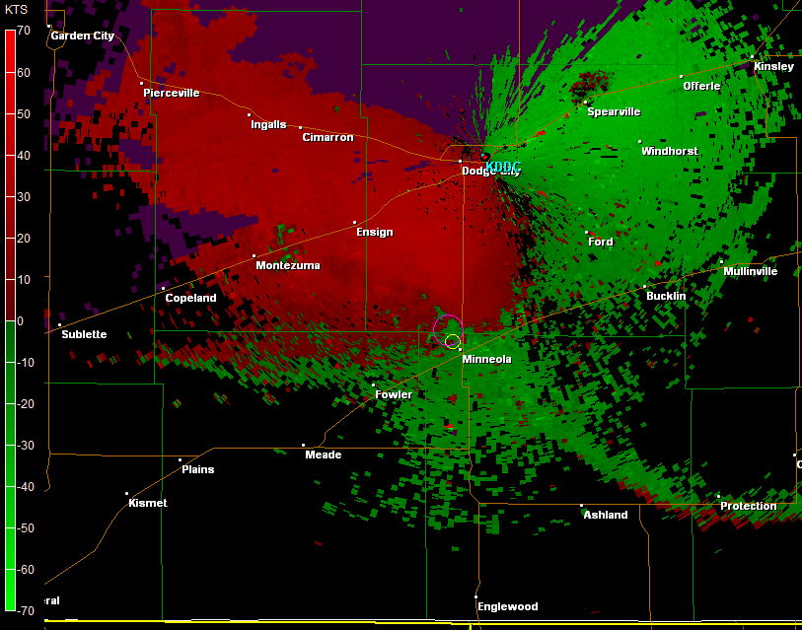
2144 GMT – same tornado north-northwest of minneola
E

Slide 34
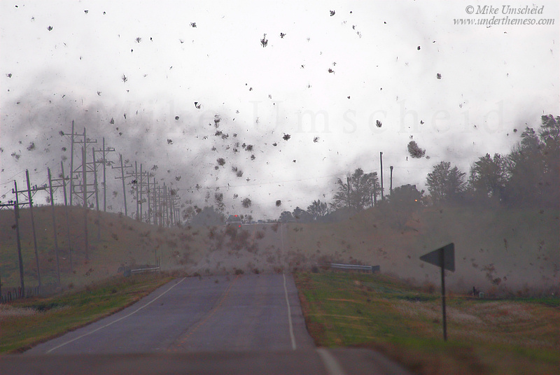
2144 GMT – same tornado northwest of minneola

Slide 35
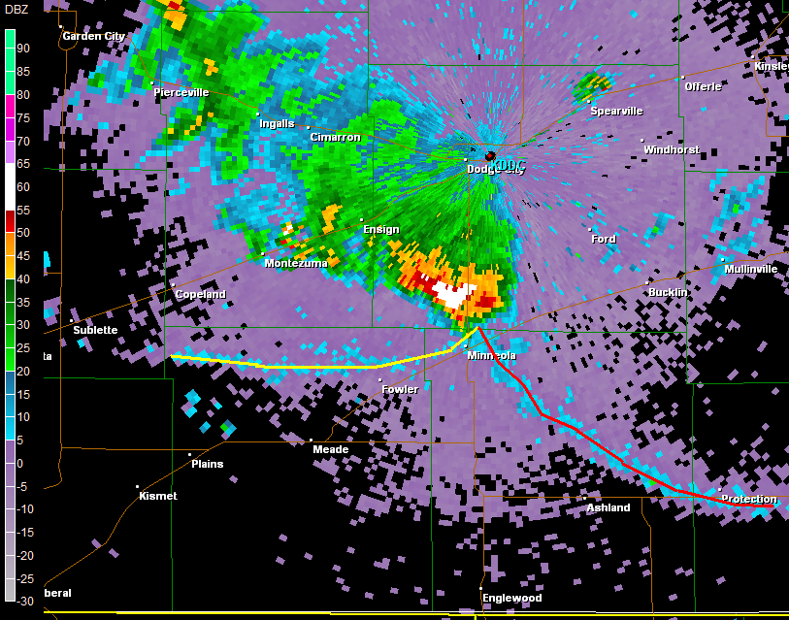
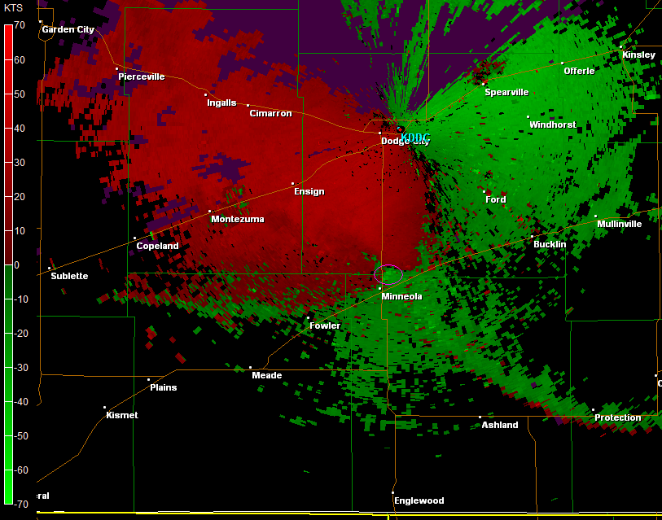
2148 GMT – mini supercell tornado north of minneola???

Slide 36
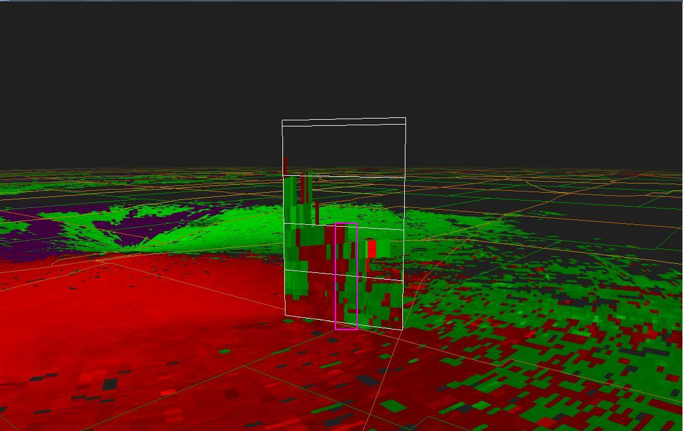
2148 GMT – mini supercell tornado north of minneola

Slide 37
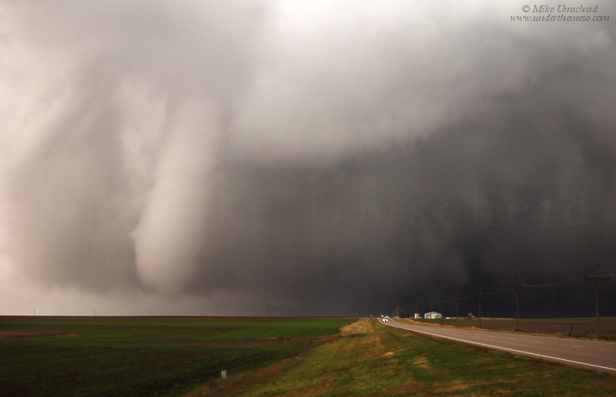
2148 GMT – mini supercell tornado north of minneola

Slide 38
Key points
synoptic/mesoscale environment very similar to Closed mid level low conceptual models derived from previous literature
Multiple vorticies seen traveling along a boundaries before tornado development
rapid stretching of preexisting vorticies appeared to be key component to tornadogenesis
mini supercell with associated tornado seen near the end of nmt tornado events
Does a possibility exist that most mid level closed low tornado events actually switch TORNADOGENESIS modes or are multi mode rather than simply mini supercell only? The evidence is trending toward “yes.”
Do other events exist with this multi mode characteristic?

Slide 39
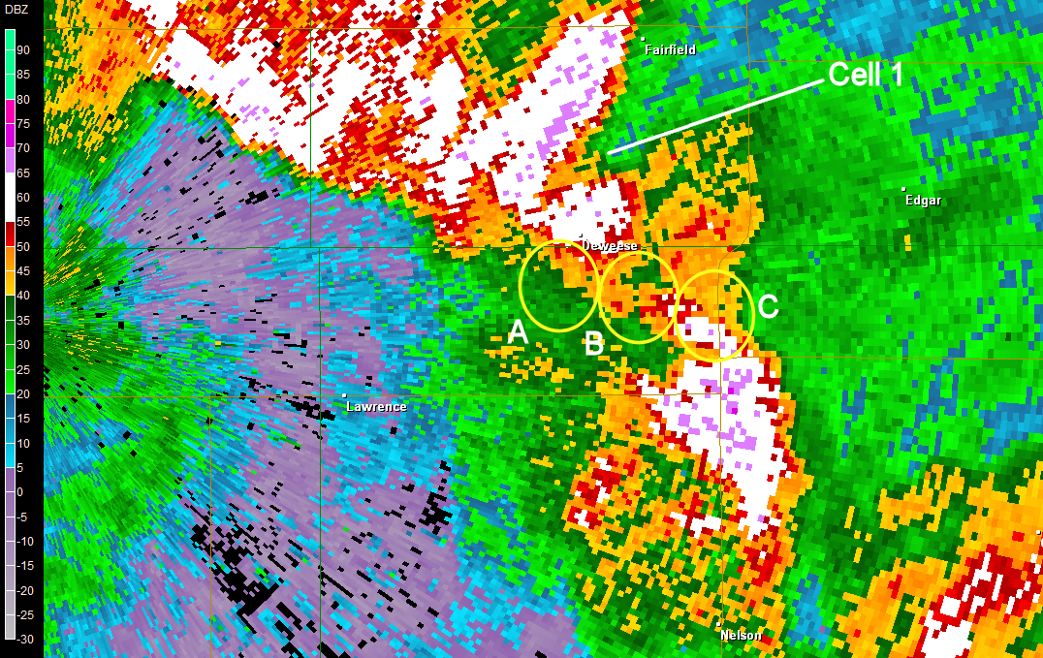
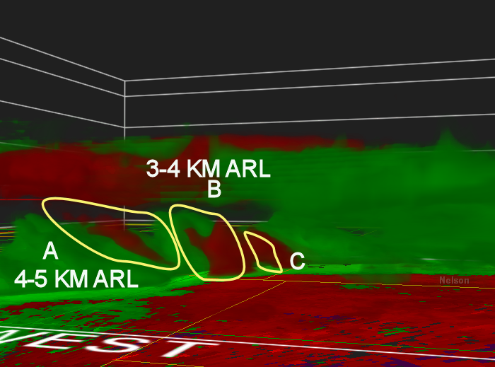

2032 GMT
APRIL 4, 2009 -
SOUTH CENTRAL NEBRASKA

Slide 40
2032 GMT
APRIL 4, 2009 -
SOUTH CENTRAL NEBRASKA

Slide 41

2202 GMT
Supercell
Phase after nmt phase?

Slide 42
recommendations
remain situationally aware of synoptic/mesoscale environment compared to conceptual models
monitor low level lapse rate trends in relation to boundary position for possible enhancement of low level stretching
adjust velocity color curve for enhancement near zero isodop because…

Slide 43

recommendations

Slide 44

recommendations

Slide 45

QUESTIONS???

