Slide 1
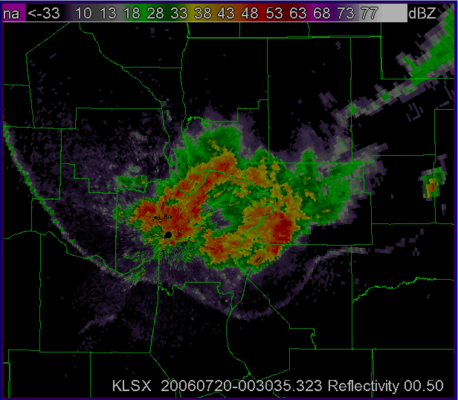


19 July 2006 Derecho:
A Meteorological Perspective and
Lessons Learned from this Event
Ron W. Przybylinski
SOO / WFO St. Louis
James Sieveking
Forecaster WFO St. Louis

Slide 2
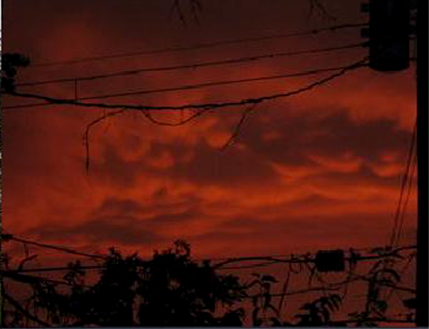
Outline of this Presentation:
Storm Prediction Center Perspective during the early part of the event.
Meteorological Conditions during the afternoon of 19 July 2006
WSR-88D Doppler radar analysis of the storm complex as it moved through the Bi-State region including the immediate St. Louis metro area.
Some final comments

Slide 3
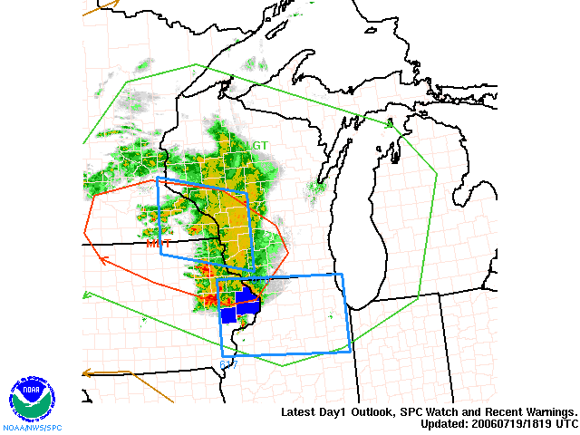
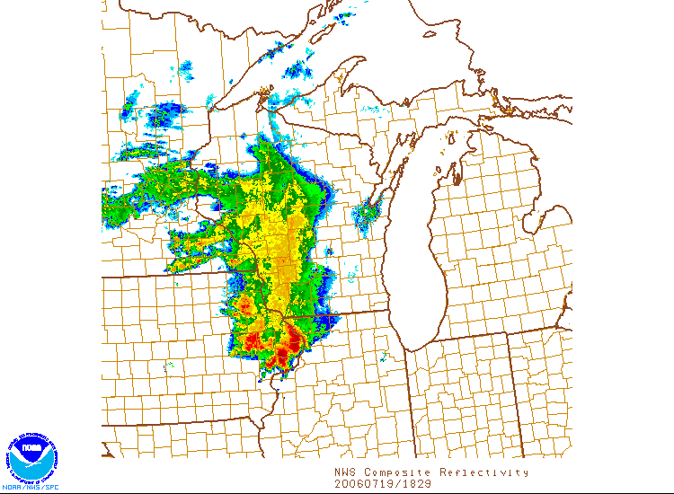
Storm Prediction Center Perspective
at 1:00 PM CDT
(Moderate Risk of SVR) stretched
from southeast Minnesota through
far northwest Illinois. A larger area
of Slight Risk covered much of
Upper-Mississippi Valley region.
Moasic radar imagery at 1:29 PM
showing the thunderstorm complex
entering northwest Illinois.

Slide 4
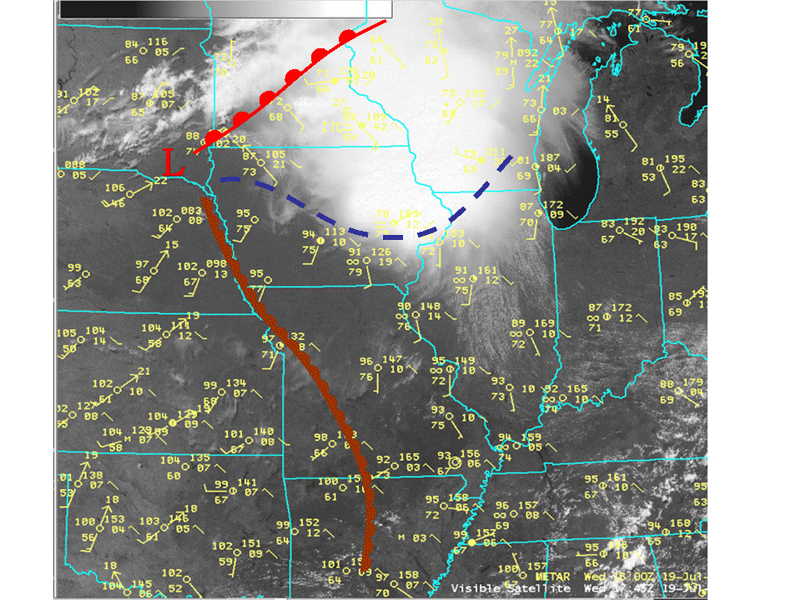
1:00 PM Surface Analysis 19 July 2006

Slide 5
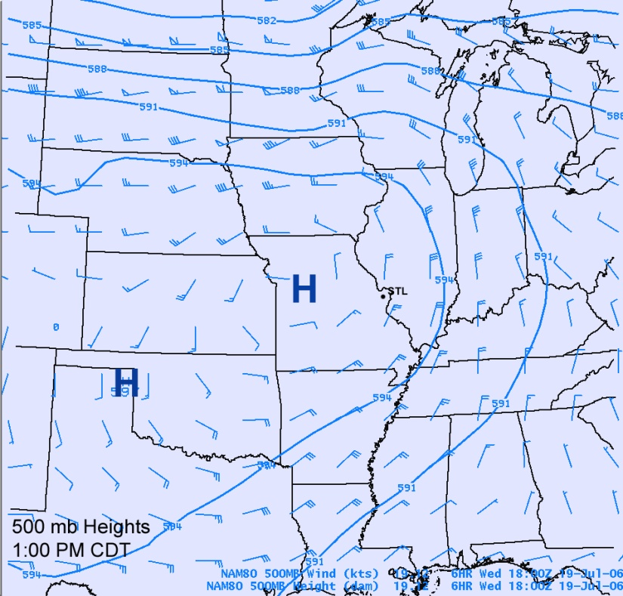
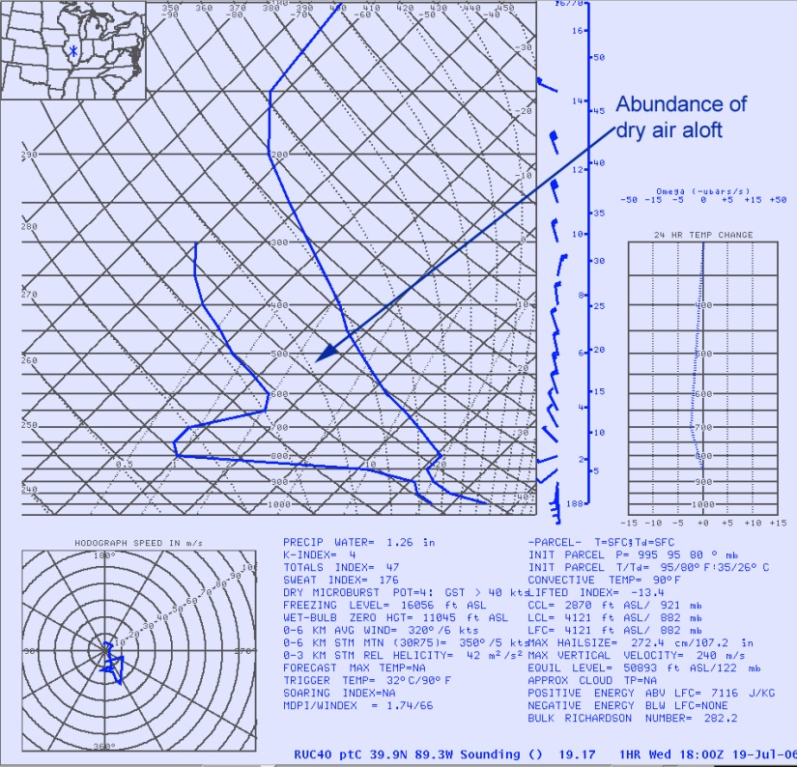
500 mb height and wind fields
at 1:00 PM CDT. Upper-level Ridge
extended across the region through
the central plains.
RUC Skew-t at 1:00 PM CDT
over Lincoln IL (ILX).
SBCAPE 7116 J/Kg
0 – 6 km Shear 14 m s-1
Note the presence of very dry air
aloft over central Illinois suggesting
strong downdraft potential.

Slide 6
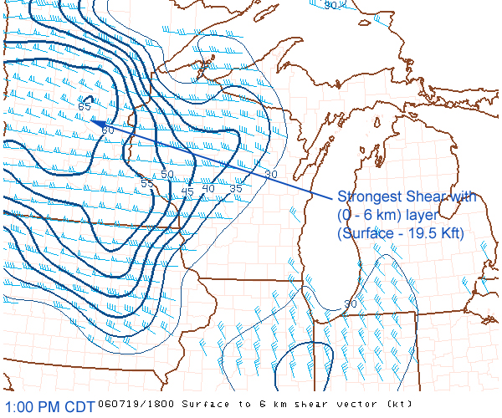
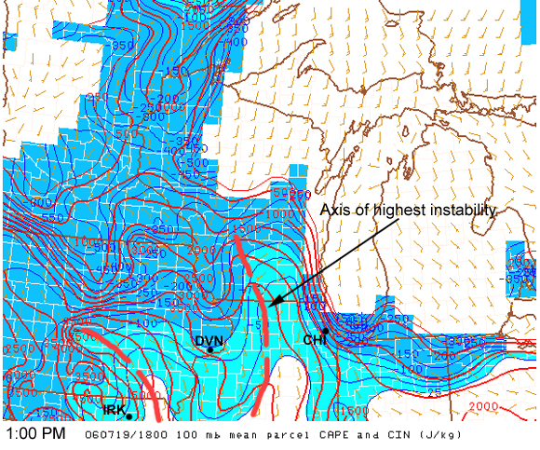
SPC Meso Analysis for 1:00 PM
Strength of the vertical wind shear
(0 – 6 km deep layer).
Strongest shear was confined to
the Upper Mississippi Valley
Region.
ML CAPE for 1800 UTC. Axis of
greatest instability extended
from southern Wisconsin through
central Illinois and from southeast
Iowa through east-central Missouri

Slide 7
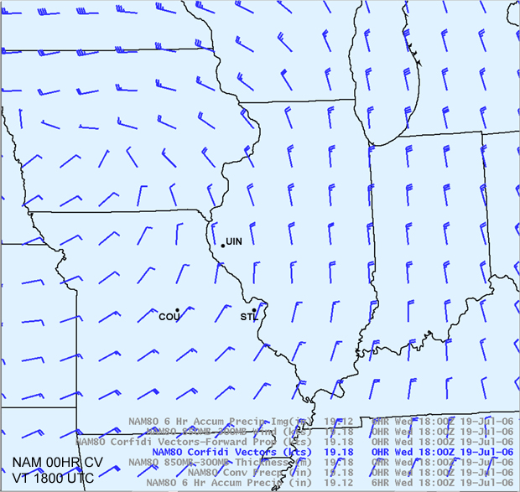
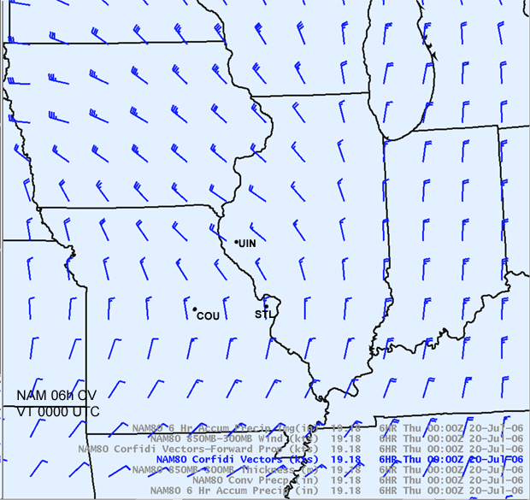
NAM 00HR Forecast
(VT 1800 UTC 19 July 2006)
Corfidi Vectors
NAM 06 HR Forecast
(VT 0000 UTC 20 July 2006)
Corfidi Vectors

Slide 8
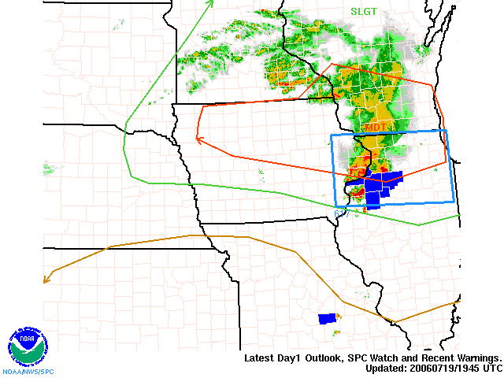
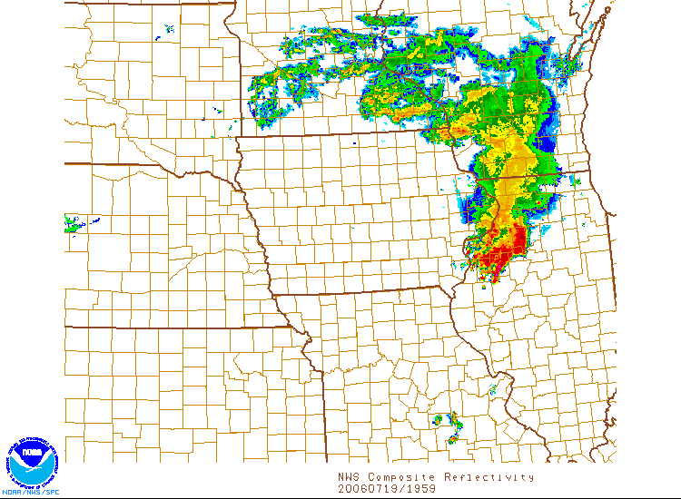
Storm Prediction Center
Perspective for 3:00 PM CDT.
Moderate Risk continued to
stretched from northern Iowa
through Northern Illinois. Slight
Risk surrounded the moderate
risk area.
Mosaic radar imagery at 2:45 PM
CDT showing the thunderstorm
complex moving south-southeast.

Slide 9
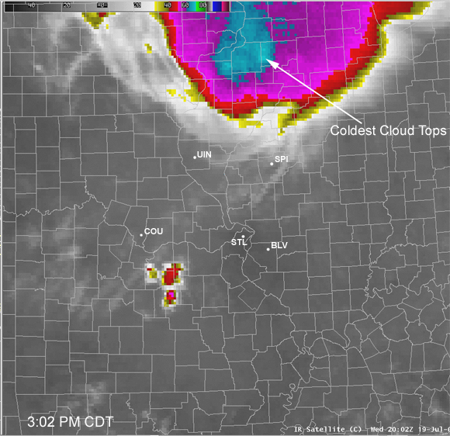
IR Imagery taken at 3:02 PM CDT. Coldest cloud tops were
located between Quad Cities and Peoria Illinois.

Slide 10
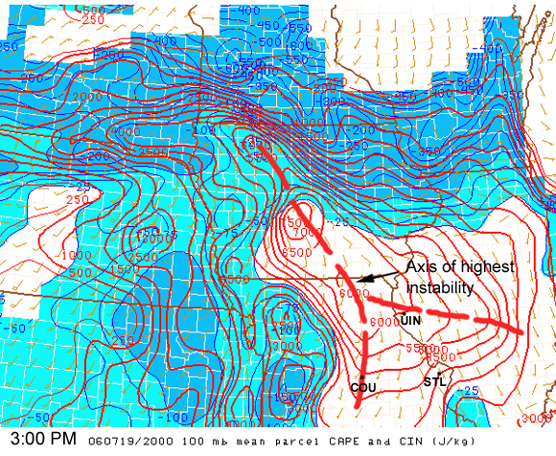
SPC Mesoscale analysis for
3:00 PM CDT.
ML CAPE / CIN.
Axis of strongest Instability
extended from central Iowa
through eastern half of Missouri
ML CAPE values > 6000 J/kg.
Light blue suggest stable region.
Severe convective complex
moving SSE along and east
of the axis of highest instability.

Slide 11
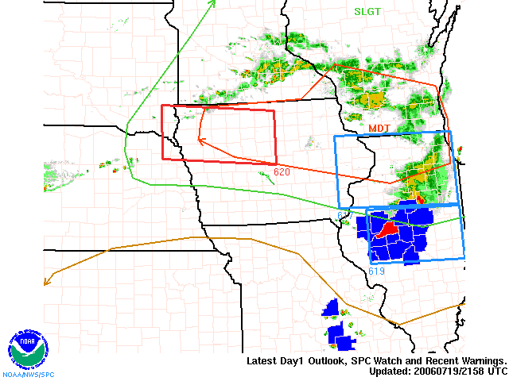
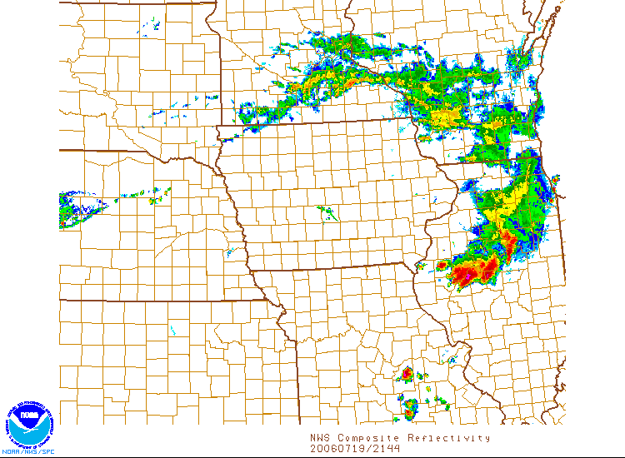
Storm Prediction Center
perspective for 5:00 PM CDT.
A new severe thunderstorm watch
was issued for much of Central
Illinois.
WFO LSX Issued SVR TSTM
Warnings for a few isolated storms
over central Missouri at this time.
Mosaic radar imagery for 5:00 PM
(right) continued to show the
complex of thunderstorms moving
nearly south at this time (Along and
east of the axis of greatest instability).

Slide 12
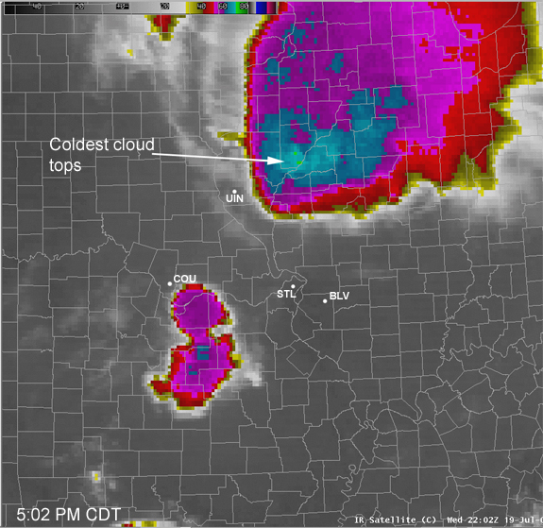
IR Imagery for 5:02 PM CDT. Coldest cloud tops have moved
toward the leading edge of the convective system and further cooled.

Slide 13
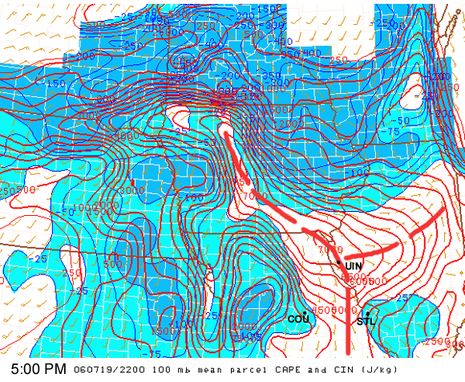
SPC Mesoscale analysis for
5:00 PM CDT.
Axis of highest instability (CAPE)
continued to stretch from
central Iowa through eastern
Missouri. The location of the instability
axis moved to the east over eastern
Missouri.
Note the blue area south-central Illinois
suggesting some stability.
Mosaic Radar Imagery for
5:00 PM CDT.

Slide 14
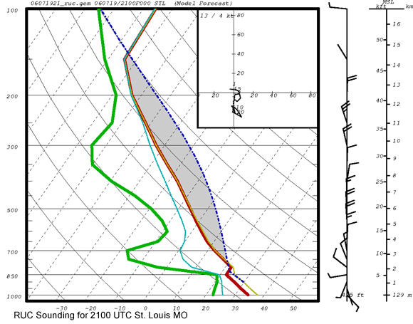
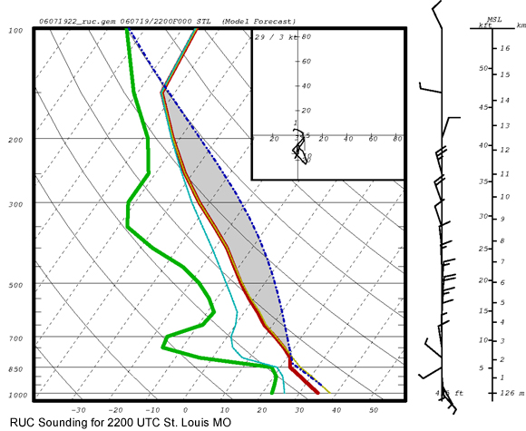
RUC model sounding for 2100 UTC
at STL. Most Unstable Parcel
CAPE 3733 J/Kg. CIN -19 J/kg;
Bulk Shear for 0 – 3 km 10 m s-1,
0 - 6 km 14 m s-1.
(Weak Shear category –
unorganized convection)
RUC model sounding for 2200 UTC
at STL. Most Unstable Parcel
CAPE 3629 J/Kg CIN -7 J/kg

Slide 15
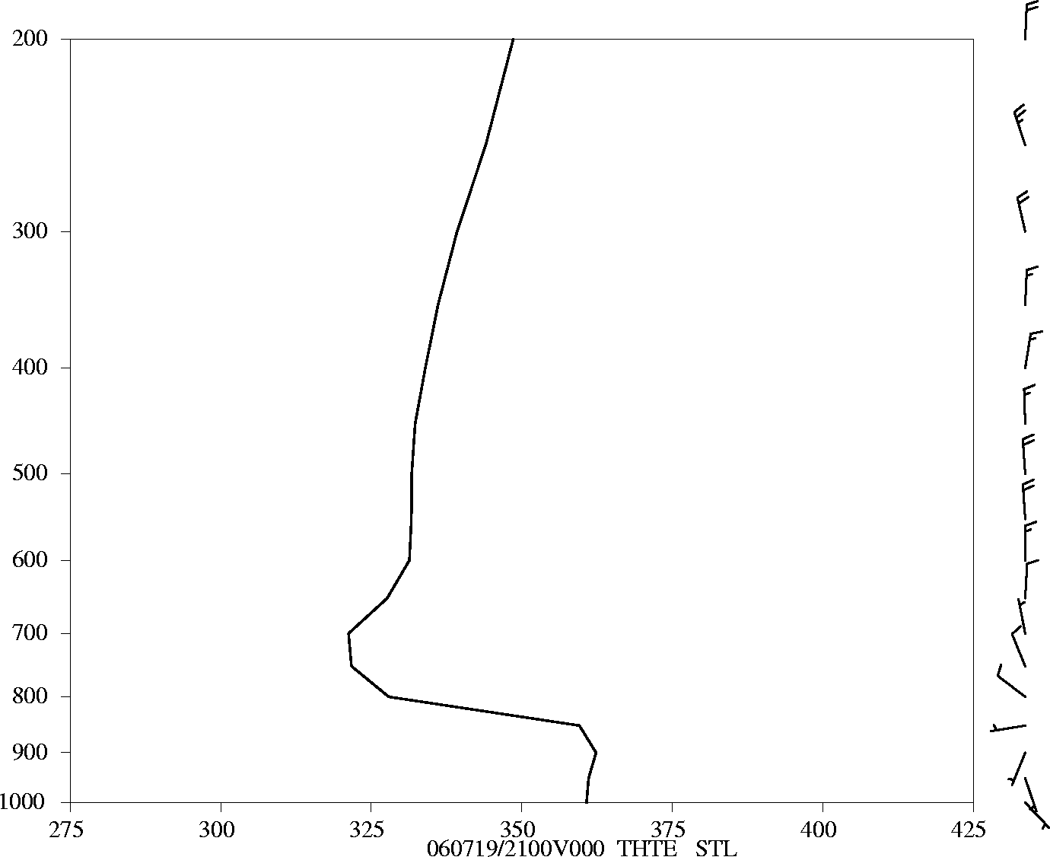
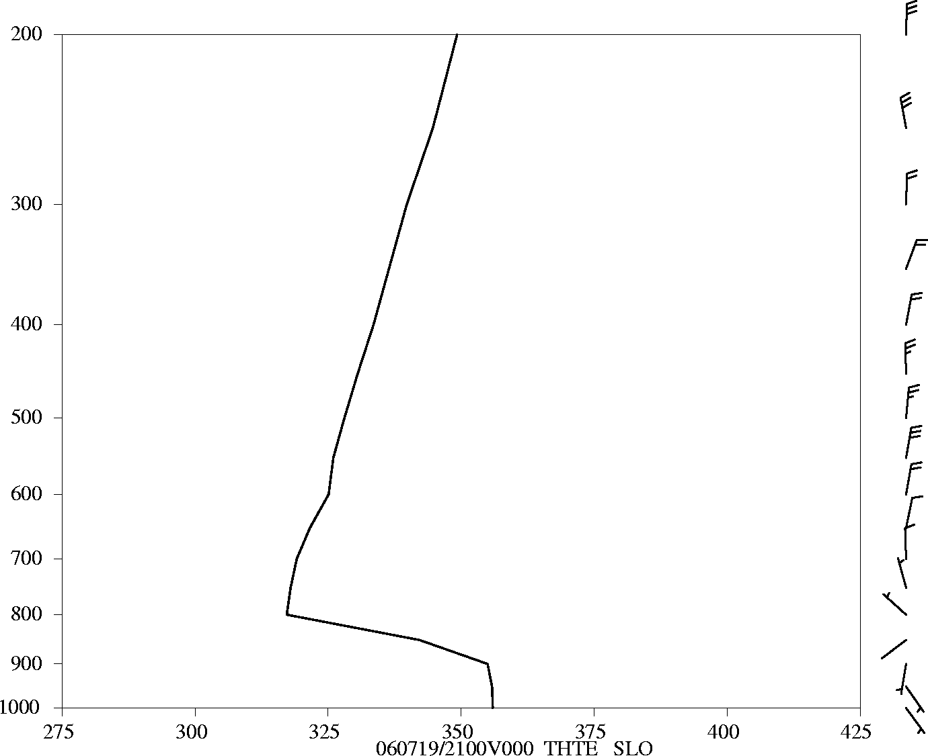
Theta-e plots from RUC for
STL and SLO at 2100 UTC
STL SFC – 700 mb (left)
38 K
SLO SFC – 700 mb (below)
33 K.

Slide 16
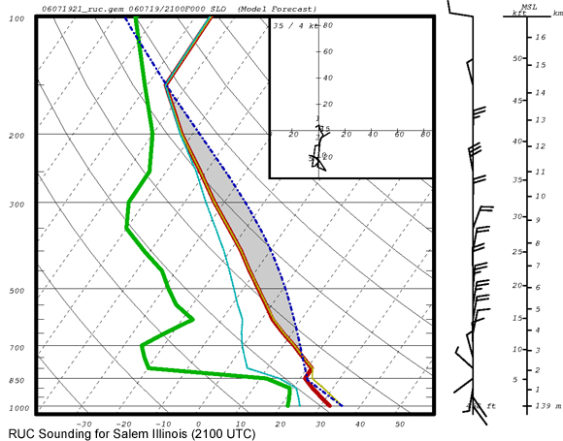
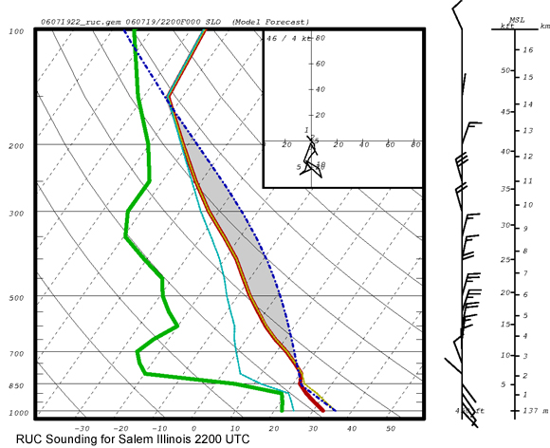
RUC Model sounding at 2100 UTC
at Salem (SLO) Illinois. Most
Unstable Parcel
CAPE 2476 J/Kg CIN -51 J/kg;
Bulk Shear 0 - 3 km 8 m s-1
0 – 6 km 13 m s-1
(Weak Shear category)
RUC Model sounding at 2200 UTC
at Salem (SLO) Illinois
CAPE 2560 J/kg CIN -22 J/kg

Slide 17
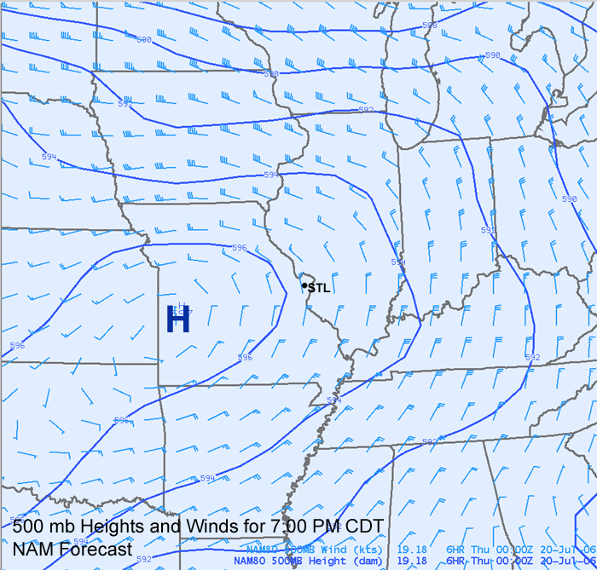
500 mb Height and Winds
(18 Kft) for 7:00 PM 19 July 2006
The convective complex moves
south-southwest along the
eastern side of the 500 mb
ridge.

Slide 18
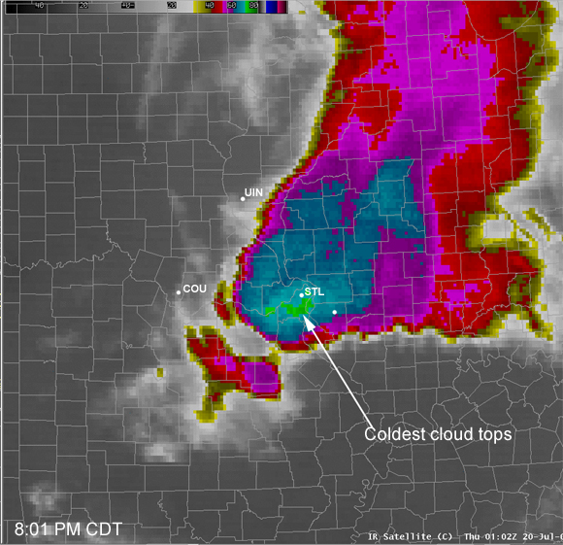
IR Imagery for 8:01 PM. Note how the coldest cloud tops
have shifted to the leading edge of the convective complex.
(Gurka 1979) documented the shifting of coldest cloud tops to
the leading edge with intensifying convective complexes

Slide 19
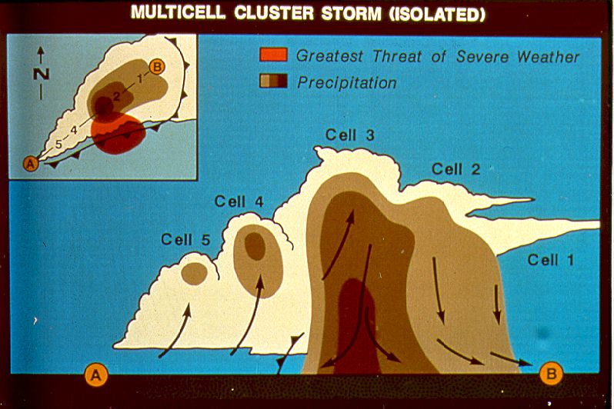
Conceptual model of a multicell cluster storm complex.
(NSSL)

Slide 20
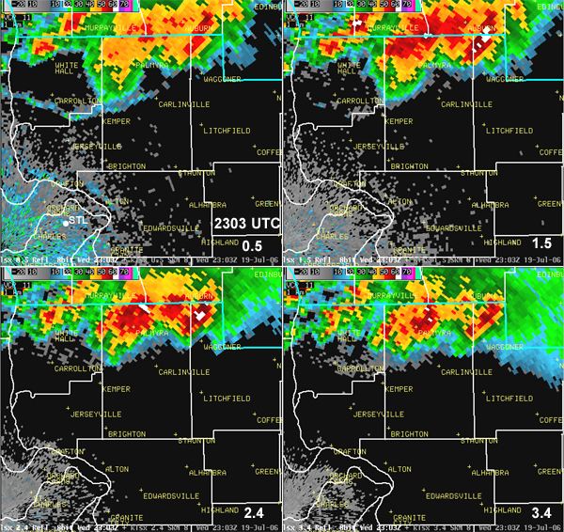
4-Panel Reflectivity images from KLSX at 2303 UTC
We are able to observe a mulitcellular cluster structure rather than
a solid bowing segment. Why? The vertical wind shear within the
0 – 3 km and 0 – 6 km layers fell into the weak shear category.

Slide 21
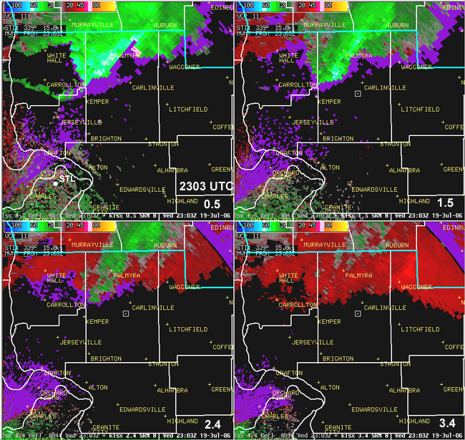
4 Panel storm-relative velocity images for 2303 UTC
Where is the MARC velocity signature? After reviewing a number of MARC
cases during the 1990s and early 2000s– the MARC signature was not
observed in multicell cluster or near the southwest end of an
asymmetric convective system.

Slide 22
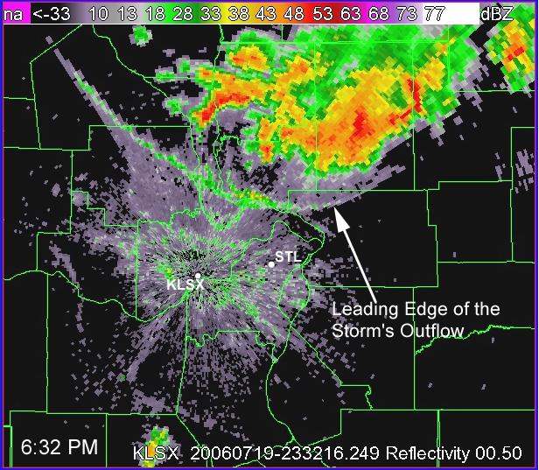
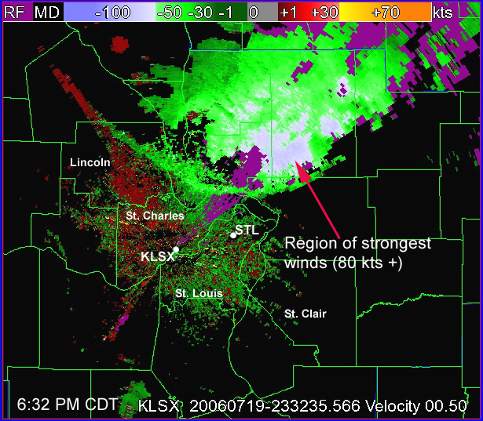
6:32 PM CDT Reflectivity (left), Base-velocity Image (right). The strongest
winds were detected along the leading edge and within the stronger
thunderstorm cells.
Several witnesses over southern Macoupin County experience hail up to
nickel size with the stronger downbursts behind the leading gust front.

Slide 23
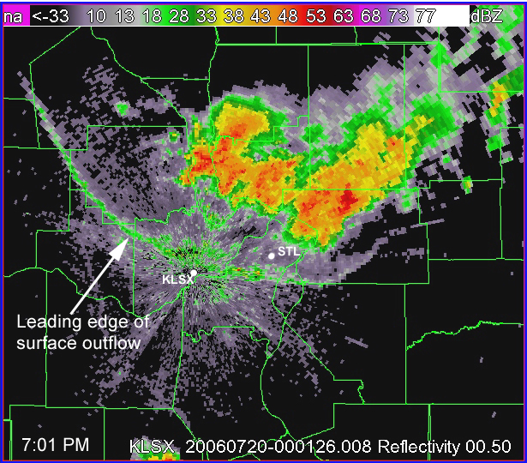
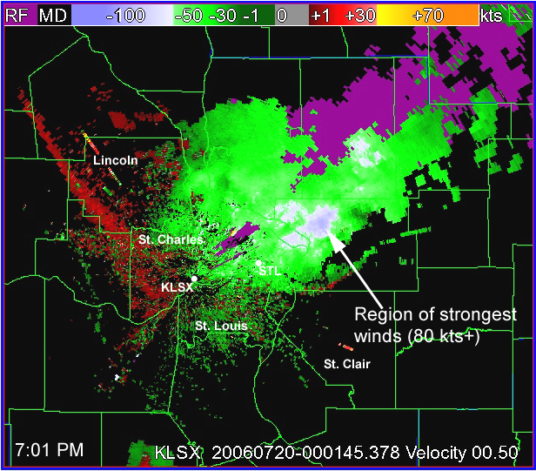
7:01 PM CDT Reflectivity (left), Base velocity (right). The strongest winds
were detected with the higher reflectivity cores over northwest Madison
County Illinois.

Slide 24
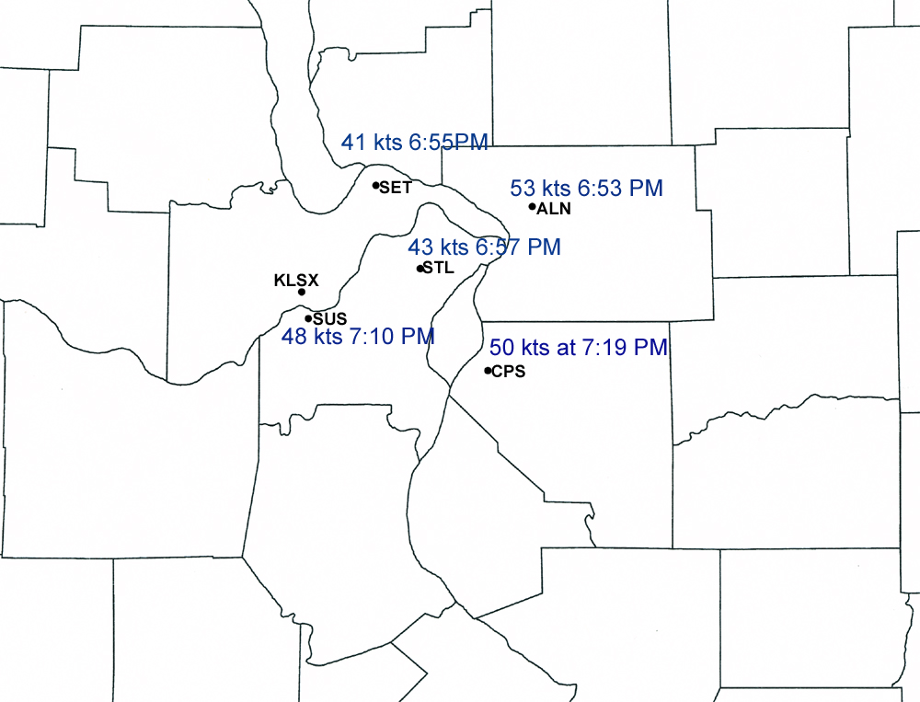
88 mph 6:35 PM
Bunker Hill
ASOS / AWOS Surface Observation sites around the Greater
St. Louis metro area. Bunker Hill – unofficial site.

Slide 25
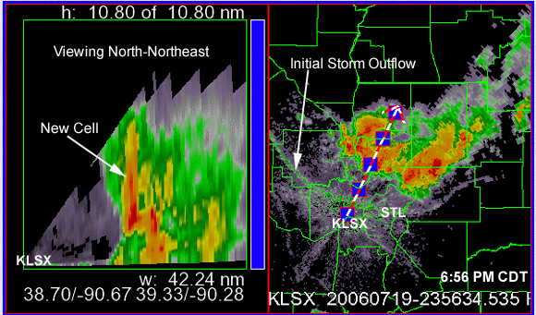
Now lets take a look how discrete severe cells embedded
within the cluster formed…mature and weakened with time.
Within this sequence we are viewing the storm NE of KLSX
6:56 PM CDT / Cross-section of a developing cell northeast of KLSX
using NSSL’s Warning Decision Support System II

Slide 26
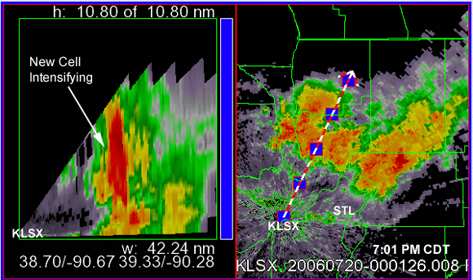
We are using NSSL’s Warning Decision Software System
(WDSS-II).
7:01 PM CDT - Our Cell is intensifying and growing since 6:56 PM

Slide 27
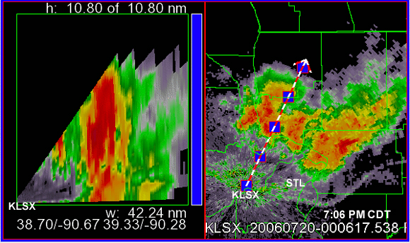
7:06 PM CDT – a mature cell has formed at this time. Much of the high
reflectivity is still aloft.

Slide 28
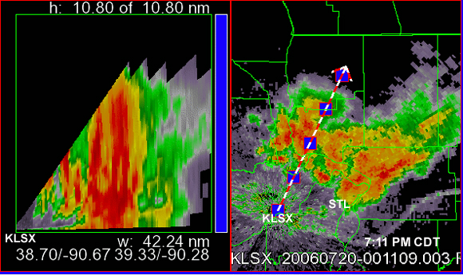
7:11 PM CDT: The high reflectivity core is descending – damaging winds
hail and rain reaches the surface just before this time.

Slide 29
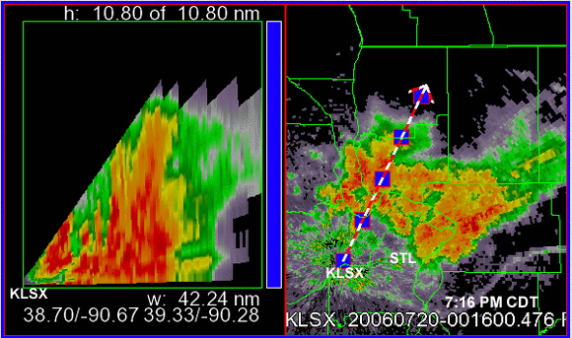
7:16 PM CDT…our cell further collapses with the high reflectivity core
descending to the surface.

Slide 30
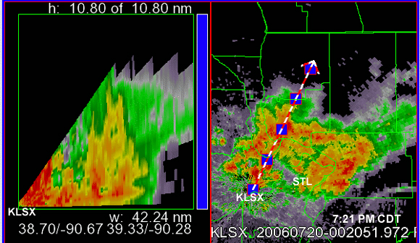
7:21 PM CDT…our original cell has weakened considerably. A very strong
new cell near the KLSX radar is descending at this time.

Slide 31
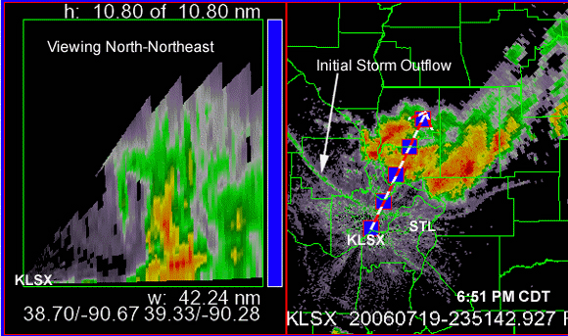
Loop of the evolution of a single severe cell within the storm complex.

Slide 32
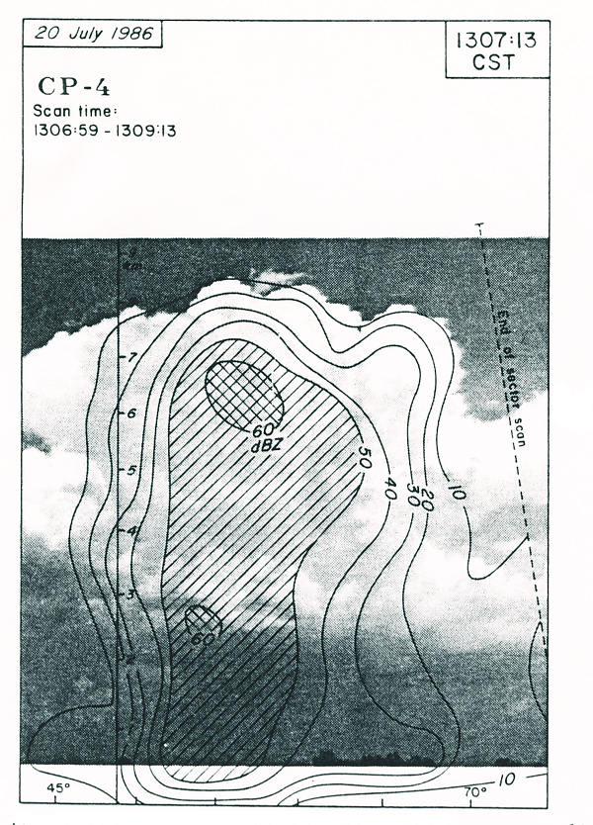
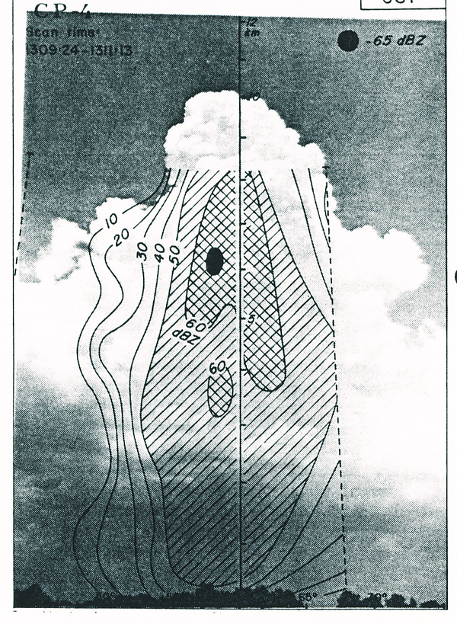
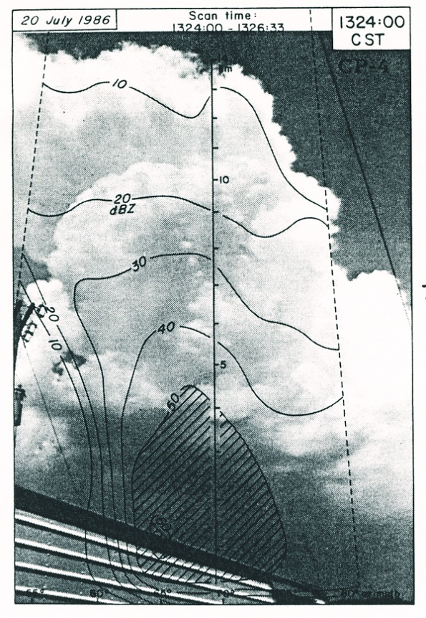
Microburst and Severe Thunderstorm Project (MIST)
– Huntsville AL (1986). Wakimoto (18th Conf. SLS)
1307 L
1311 L
1324 L
Sequence of cloud photogrammetry and radar reflectivity data from NCAR
CP-2 Doppler radar. Time sequence 1307 LST, 1311, and 1324 LST. 1307 L
– distinct growing tower with 60 dBZ (8 km) (Differential reflectivities (ZDR)
values are low (3 – 5 db) suggesting the presence of ice with the 60dBZ core.
1311 L: 60 dBZ core is mostly ice (ZDR values remain low (3 – 4 db). 1324L:
60 dBZ core has descended – microburst occurs with small hail. ZDR hole was
present. (Evaporation of pcpn and melting of ice drives intense downdrafts).

Slide 33
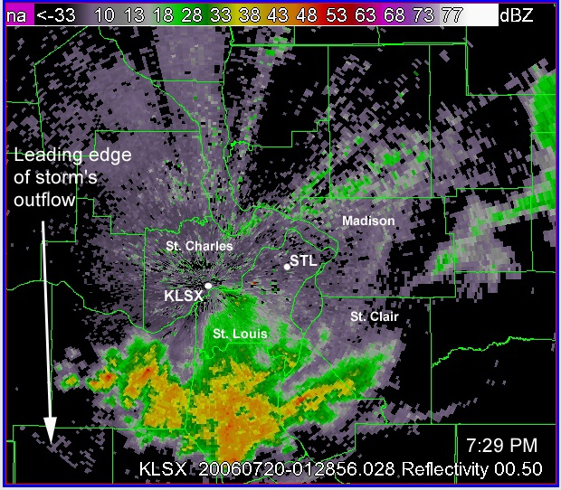
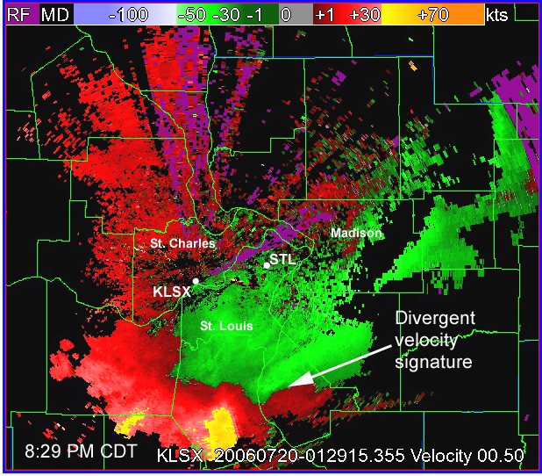
8:29 PM CDT Reflectivity (Left); Base velocity (right)
Some of the strongest velocities observed at this time were located in
southern Jefferson county MO (75 – 85 kts). Also note the divergent
velocity signature over Monroe county Illinois suggesting damaging
wind area.

Slide 34
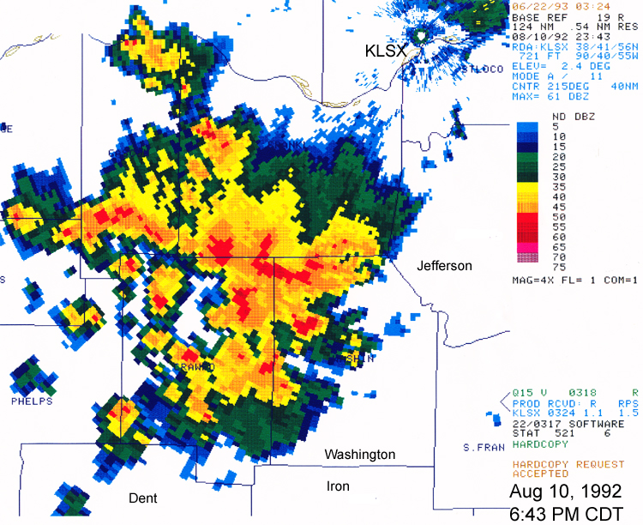
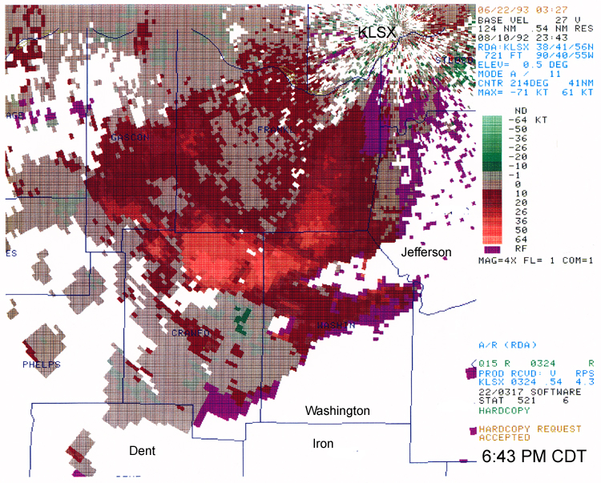
When was the last time we documented as case similar
to the July 19, 2006 Derecho?
Aug 10, 1992. The convective complex formed just southwest of KLSX
and moved south-southward through west-central Arkansas.
Widespread wind damage occurred across parts of southern Franklin,
Crawford, western Iron and points to the south-southwest.
(www.crh.noaa.gov/lsx/?n=damagingwnd)

Slide 35
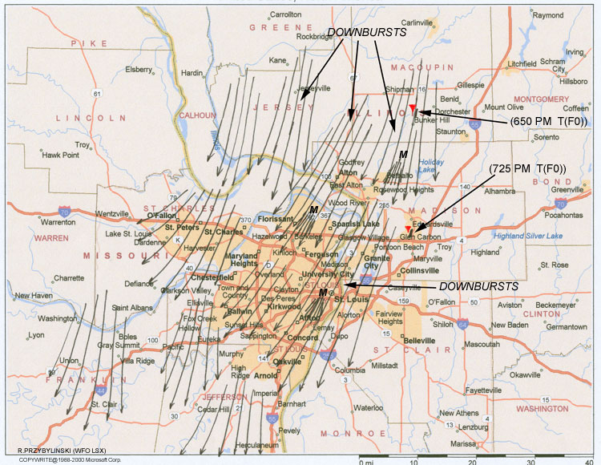
The July 19 2006 damage map reveals that much of the downbursts
was oriented from north-northeast to south-southwest – an unusual direction.
This direction of damaging winds future intensified the degree of damage
over the greater St. Louis metro area.

Slide 36





Slide 37
Summary
A convective complex of severe storms caused severe
wind damage and destruction over much of the greater
St. Louis metro area and surrounding counties during
the late afternoon and evening of 19 July 2006
Over 500,000 people were without power for several
days and suffering from the heat and humidity after the
event.
- The atmosphere over the Mid-Mississippi Valley region
was characterized and extremely unstable with ML
CAPE values reaching 6000 J/Kg while a deep dry layer
of air was present aloft over the region.

Slide 38

NAM forecast of Corfidi vectors for 1800 UTC (00 HR)
and 0000 UTC (06 HR) suggested that if the convective
complex survived through the early evening hours the
system would travel south across central Illinois then
south-southwest into parts of extreme east-central
through southeast Missouri.
- RUC soundings at 2100 and 2200 UTC over STL
showed a very weak cap at this time.
-

Slide 39

Surface winds along the leading edge of the gust
front varied between 20 to 25 m s-1.
- The stronger surface winds were associated with
the isolated convective towers and smaller convective
clusters trailing the gust front. Wind speeds were
estimated as high as 40 m s-1.
- This event was one of the more challenging
cases, from both a national and local WFO
perspective.

