Slide 1
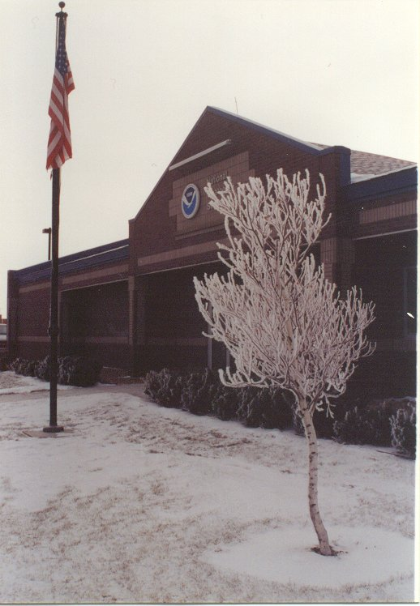
2006 – 2007
Winter Wonder? Land
North Platte, NE
Matt Masek

Slide 2
OUTLINE
Long wave patterns (3)
Trof (mid Dec to Feb)
  Active Pattern with Numerous Events
  Produced Significant Precipitation (Snowfall)
  Cold Temperatures
  Snow Cover

Slide 3
OUTLINE
Ridge (March)
  Continued High Precipitation / Trace Snowfall
  Above Normal Temperatures
  Spring Arrives Early
Trof (April)
  Record Cold Start
  Rough on Plants - Early Spring Arrival

Slide 4
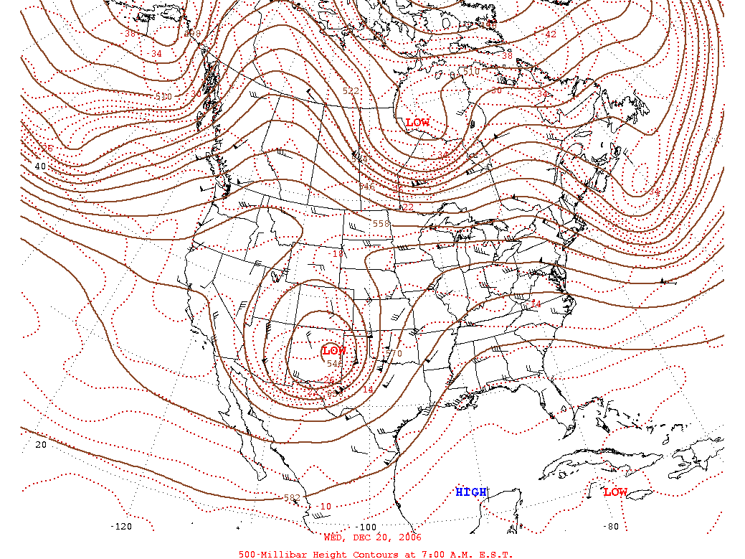
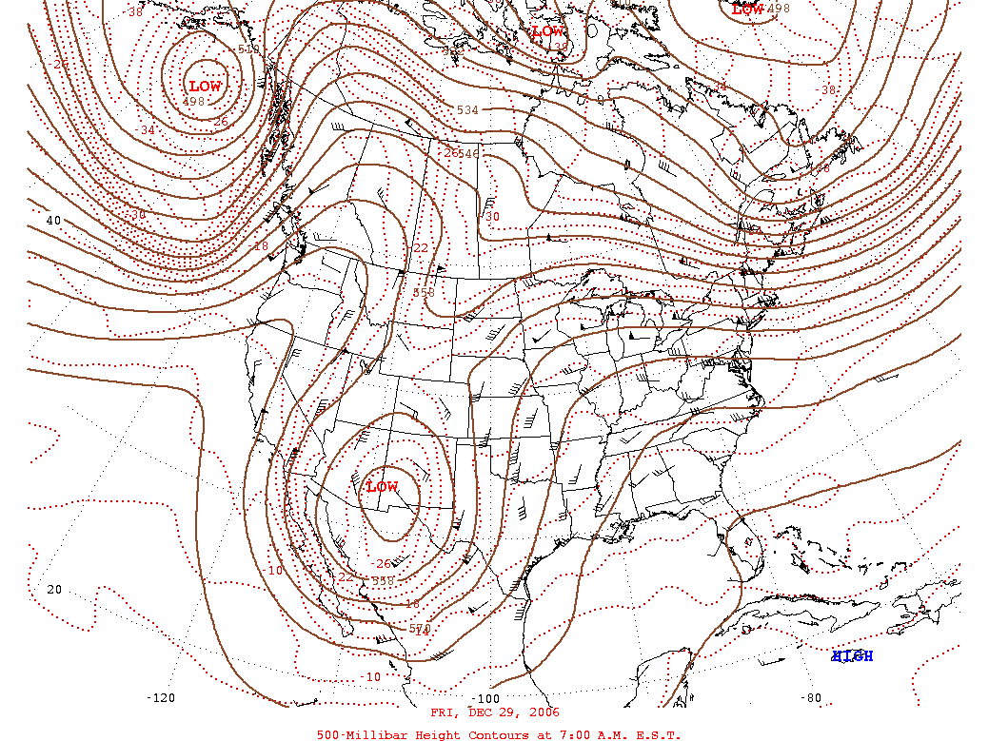
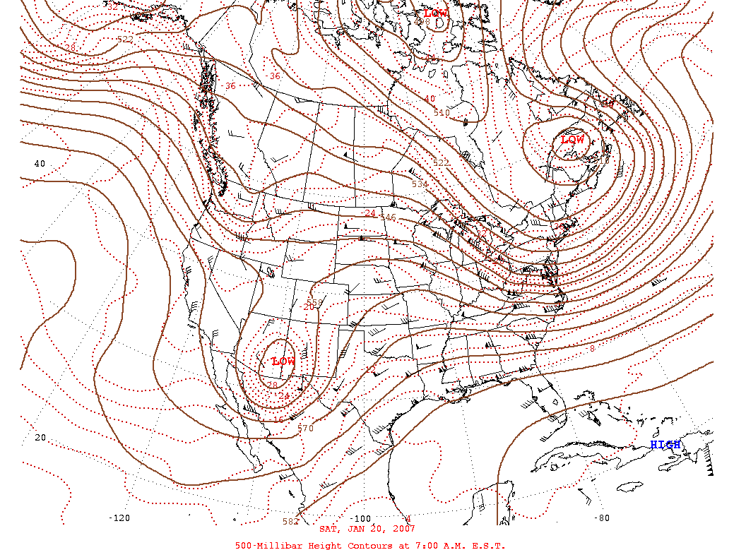
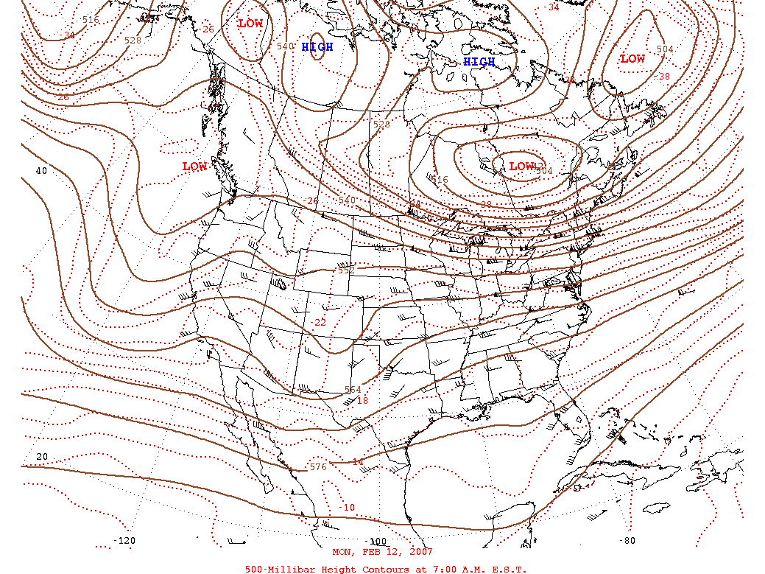
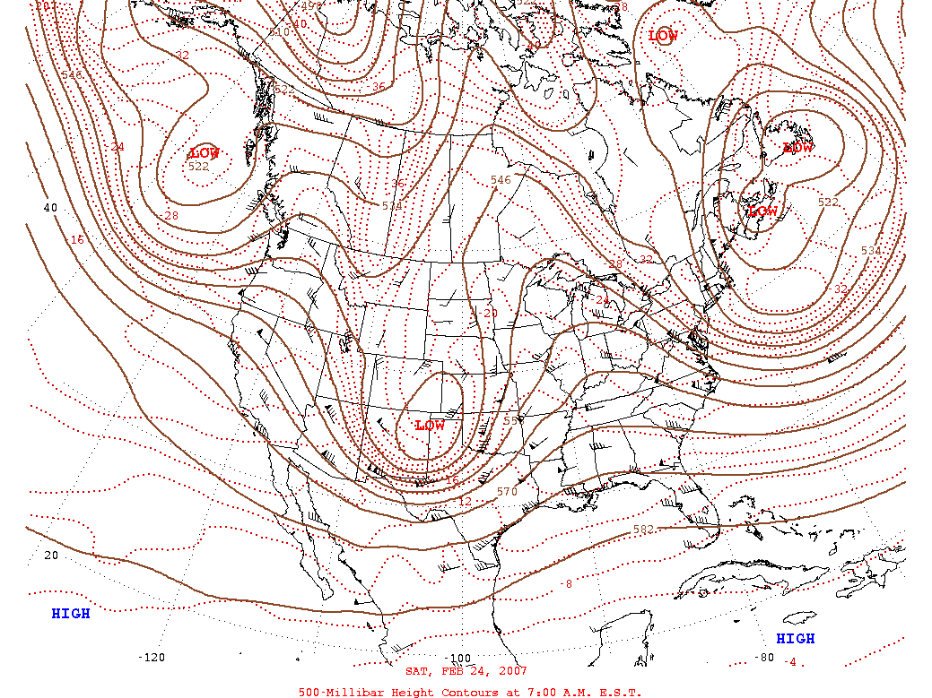
Pattern (Winter)
12/20
12/29
1/20
2/12
2/24

Slide 5
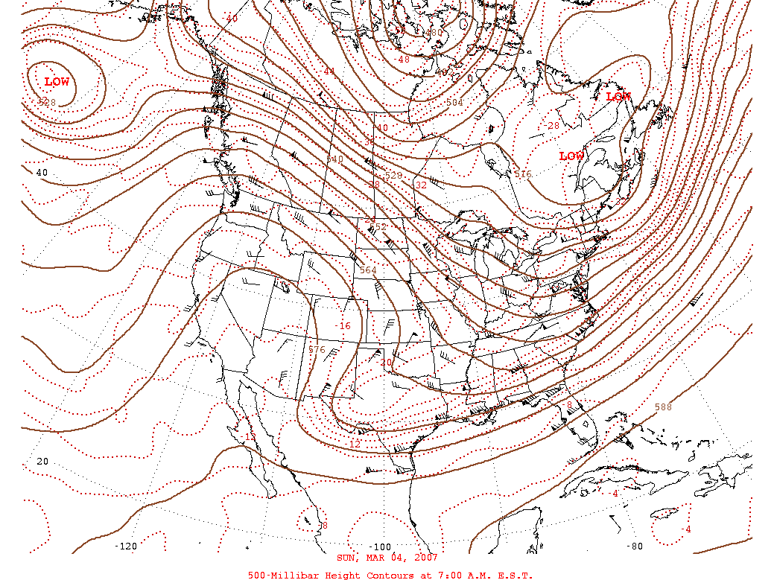
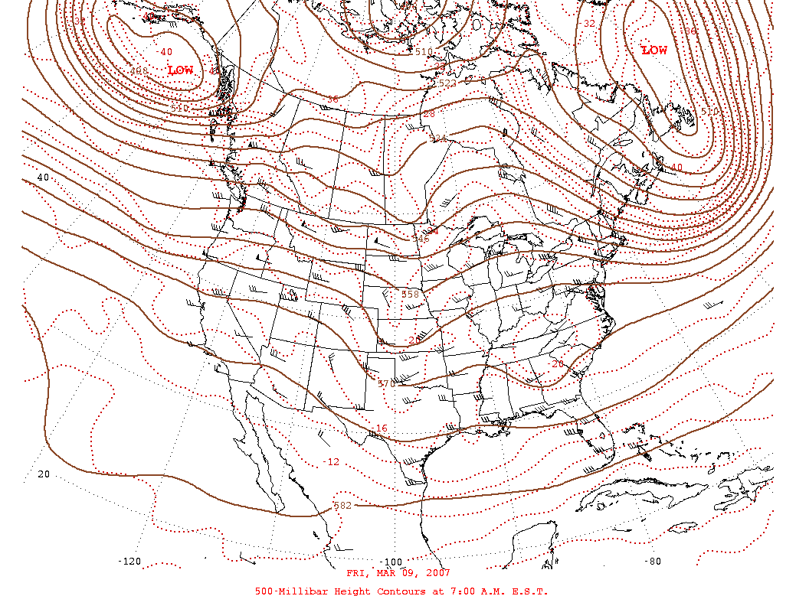
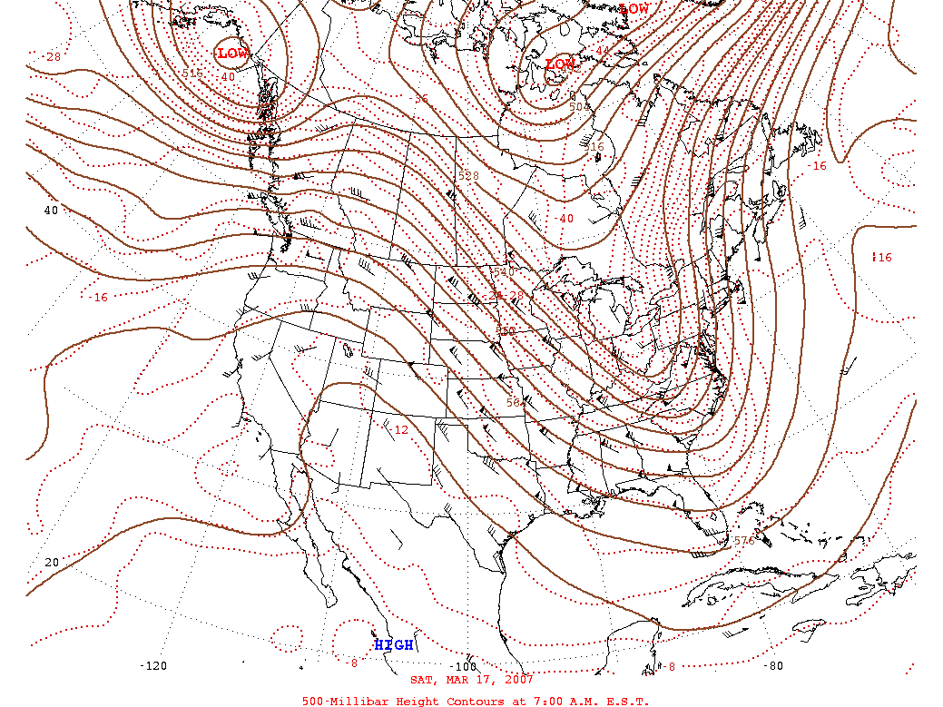
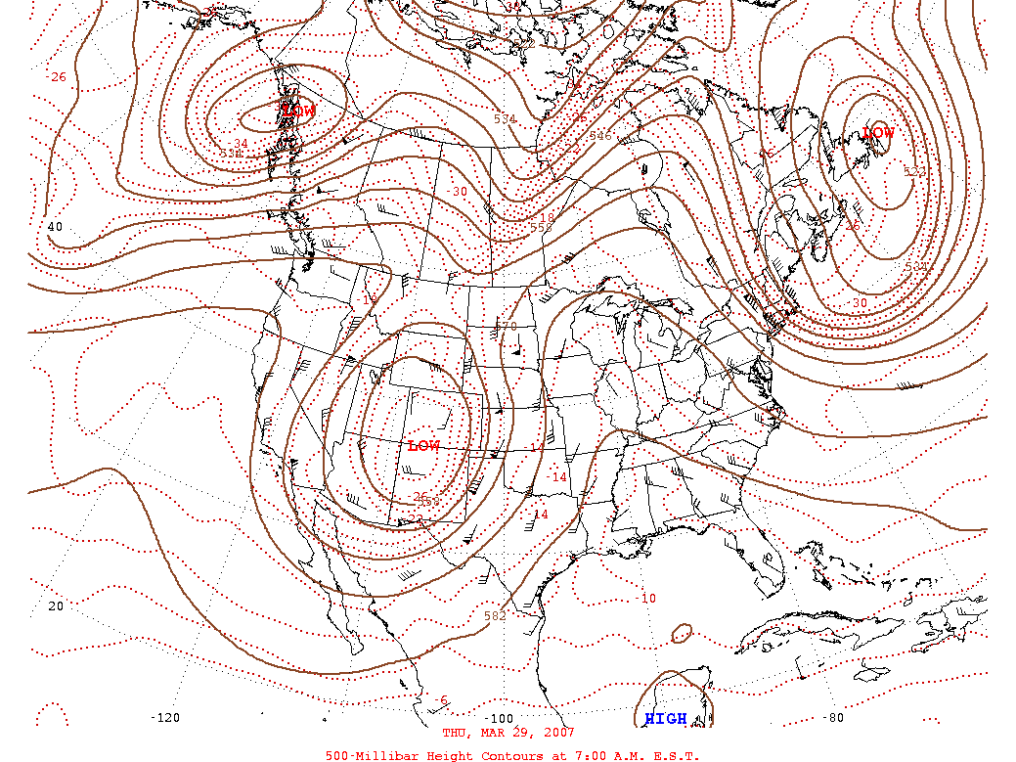
Pattern (March)
3/4
3/9
3/17
3/29

Slide 6
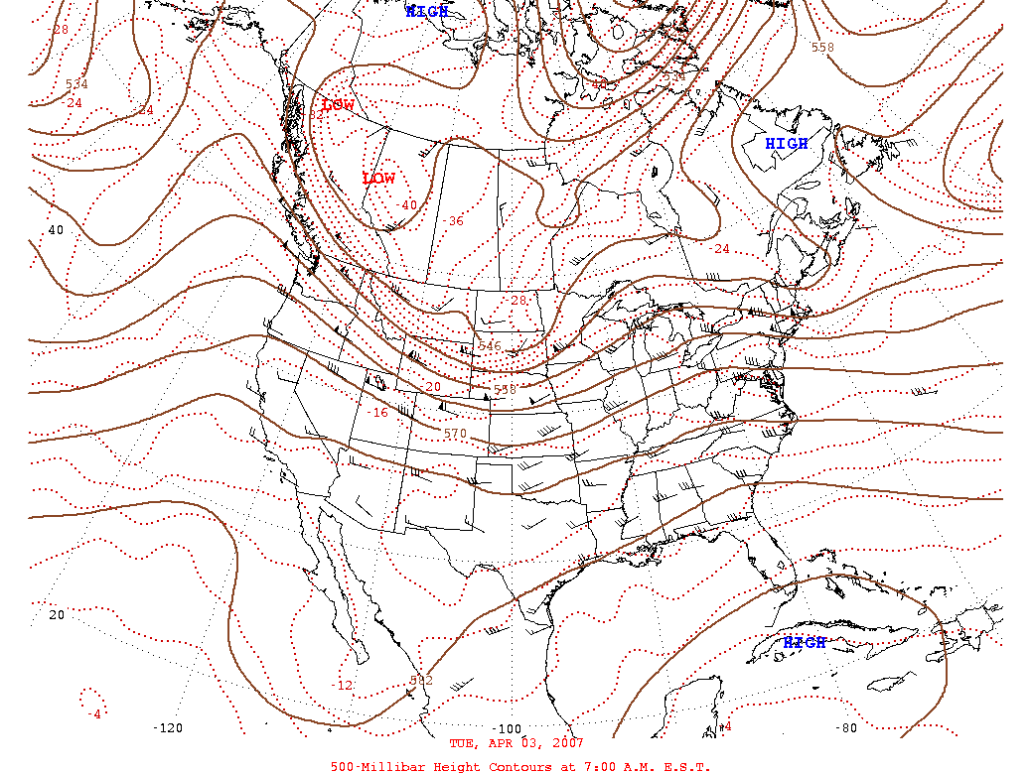
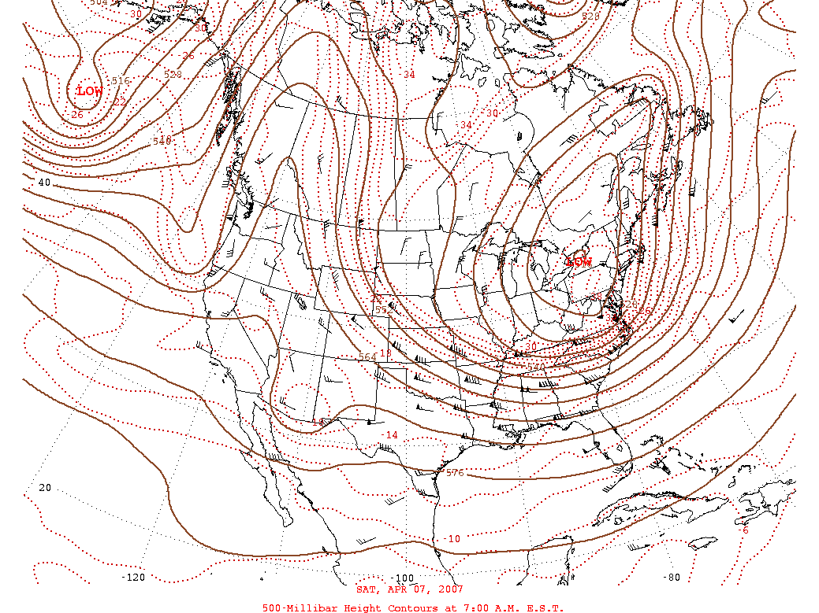
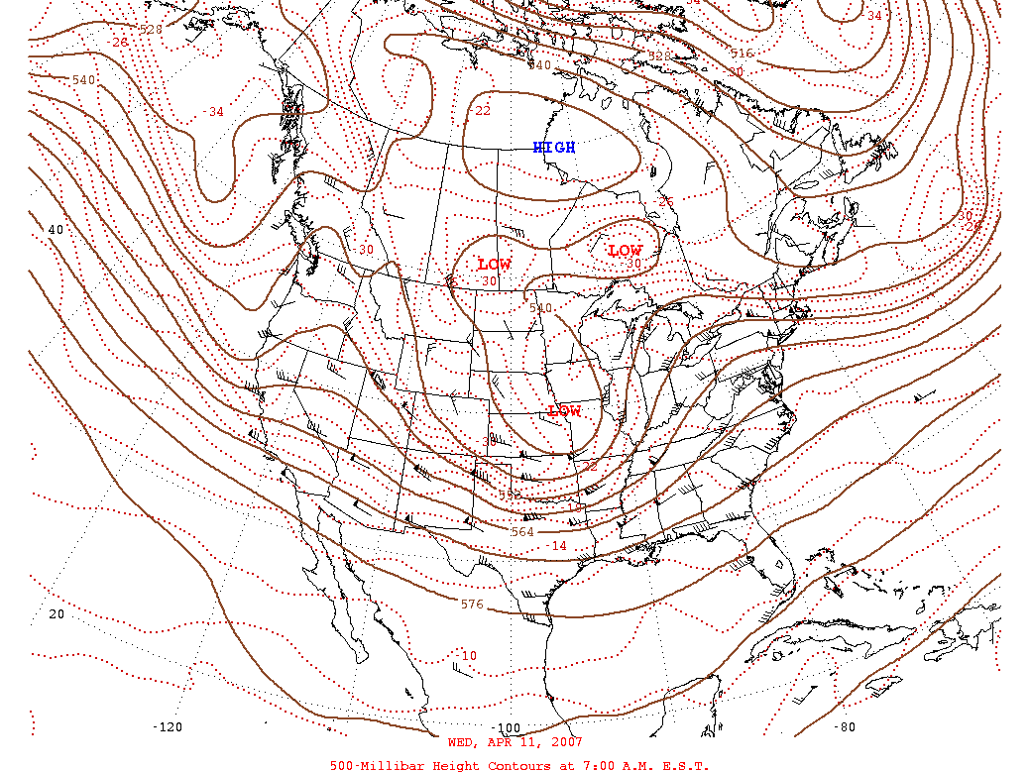
Pattern (April)
4/3
4/7
4/11

Slide 7
Daily Snow “Events” Dec-Feb
 | Trace or More
2006-2007 | 27 Days
2005-2006 | 18 Days
10 Year Ave | 21.3 Days
Average | 27.2 Days
Maximum (Year) | 51 Days 1977-78
 | Trace or More | More than Trace
2006-2007 | 27 Days | 17 Days
2005-2006 | 18 Days | 7 Days
10 Year Ave | 21.3 Days | 10.4 Days
Average | 27.2 Days | 12.5 Days
Maximum (Year) | 51 Days 1977-78 | 31 Days 1977-78
 | Trace or More | More than Trace | 1” or more
2006-2007 | 27 Days | 17 Days | 9 Days
2005-2006 | 18 Days | 7 Days | 3 Days
10 Year Ave | 21.3 Days | 10.4 Days | 4.0 Days
Average | 27.2 Days | 12.5 Days | 4.4 Days
Maximum (Year) | 51 Days 1977-78 | 31 Days 1977-78 | 11 Days 1977-78 1992-93
 | Trace or More | More than Trace | 1” or more | 2” or more
2006-2007 | 27 Days | 17 Days | 9 Days | 8 Days
2005-2006 | 18 Days | 7 Days | 3 Days | 0 Days
10 Year Ave | 21.3 Days | 10.4 Days | 4.0 Days | 2.2 Days
Average | 27.2 Days | 12.5 Days | 4.4 Days | 2.3 Days
Maximum (Year) | 51 Days 1977-78 | 31 Days 1977-78 | 11 Days 1977-78 1992-93 | 8 Days 1977-78 2006-07

Slide 9
WINTER SNOWFALL / PRECIPITATION
Rank | Total Snowfall | Year | Total Precip | Year
1 | 34.3” | 2006-2007 | 4.09” | 1913-1914
2 | 33.2” | 1977-1978 | 4.04” | 1877-1878
3 | 33.0” | 1948-1949 | 3.98” | 2006-2007
4 | 31.2” | 1992-1993 | 3.72” | 1977-1978
5 | 27.7” | 1902-1903 | 3.29” | 1882-1883

Slide 10
WINTER SNOWFALL / PRECIPITATION
 | SNOWFALL | PRECIPITATION
AVERAGE | 13.3” | 1.34”
2002-03 | 13.0” | 0.84”
2003-04 | 11.2” | 1.06”
2004-05 | 8.1” | 0.64”
2005-06 | 6.2” | 0.56”
2006-07 | 34.3” | 3.98”

Slide 11
WINTER TEMPERATURE
 | AVE TEMP
AVERAGE | 26.1º
MAX | 34.2º
YEAR | 1991-92
MIN | 12.4º
YEAR | 1978-79
2002-03 | 28.0º
2003-04 | 27.0º
2004-05 | 29.4º
2005-06 | 30.3º
2006-07 | 22.7º
 | AVE TEMP | AVE HIGH | AVE LOW
AVERAGE | 26.1º | 38.8º | 13.5º
MAX | 34.2º | 47.2º | 22.9º
YEAR | 1991-92 | 1991-92 | 1930-31
MIN | 12.4º | 23.7º | 1.0º
YEAR | 1978-79 | 1978-79 | 1978-79
2002-03 | 28.0º | 43.0º | 13.0º
2003-04 | 27.0º | 40.9º | 13.0º
2004-05 | 29.4º | 43.0º | 15.7º
2005-06 | 30.3º | 45.9º | 14.6º
2006-07 | 22.7º | 35.1º | 10.3º
 | AVE TEMP | AVE HIGH | AVE LOW | DAYS LOWS <0
AVERAGE | 26.1º | 38.8º | 13.5º | 12.5
MAX | 34.2º | 47.2º | 22.9º | 42
YEAR | 1991-92 | 1991-92 | 1930-31 | 1978-79
MIN | 12.4º | 23.7º | 1.0º | 0
YEAR | 1978-79 | 1978-79 | 1978-79 | 1930-31 1991-92
2002-03 | 28.0º | 43.0º | 13.0º | 7
2003-04 | 27.0º | 40.9º | 13.0º | 11
2004-05 | 29.4º | 43.0º | 15.7º | 6
2005-06 | 30.3º | 45.9º | 14.6º | 9
2006-07 | 22.7º | 35.1º | 10.3º | 20
 | AVE TEMP | AVE HIGH | AVE LOW | DAYS LOWS <0 | DAYS HIGHS 50+
AVERAGE | 26.1º | 38.8º | 13.5º | 12.5 | 22.7
MAX | 34.2º | 47.2º | 22.9º | 42 | 46
YEAR | 1991-92 | 1991-92 | 1930-31 | 1978-79 | 2005-06
MIN | 12.4º | 23.7º | 1.0º | 0 | 0
YEAR | 1978-79 | 1978-79 | 1978-79 | 1930-31 1991-92 | 1978-79
2002-03 | 28.0º | 43.0º | 13.0º | 7 | 32
2003-04 | 27.0º | 40.9º | 13.0º | 11 | 28
2004-05 | 29.4º | 43.0º | 15.7º | 6 | 34
2005-06 | 30.3º | 45.9º | 14.6º | 9 | 46
2006-07 | 22.7º | 35.1º | 10.3º | 20 | 11

Slide 12
DIFFERENCE A YEAR MAKES
Jan ‘06 to Jan ‘07
Ave High – 54.5º to 29.9º
Ave Low – 19.5º to 4.5º
Ave Temp – 37.0º (+13.8º) to 17.6º (-6.0º)
Precipitation – 0.21” to 0.61”
Snowfall – Trace to 10.2”

Slide 13
SNOW COVER
White Christmas finally (2006 - 3 inches)
Last White Christmas (1997 - 2 inches)
2 out of last 20 years were white (1997 & 2006)

Slide 14
SNOW COVER (consecutive days)
Rank | 1 Inch or More | End Date
1 | 88 Days | 2/21/1979
2 | 71 Days | 2/27/1969
3 | 61 Days | 2/19/2007
 | 61 Days | 2/21/1949
5 | 58 Days | 1/29/1925
Rank | 1 Inch or More | End Date | Rank | 2 Inches or More | End Date
1 | 88 Days | 2/21/1979 | 1 | 54 Days | 2/15/1949
2 | 71 Days | 2/27/1969 | 2 | 53 Days | 2/11/2007
3 | 61 Days | 2/19/2007 | 3 | 42 Days | 2/15/1979
 | 61 Days | 2/21/1949 | 4 | 37 Days | 1/28/1940
5 | 58 Days | 1/29/1925 | 5 | 33 Days | 1/18/1925

Slide 15
Then Came March
Precipitation Continued – 1.56” (+0.32”)
However Snowfall did not – Only a Trace
Tied for lowest March snowfall total with 4 other years
30yr Normal Snowfall 4.8”
Record Snowfall 27.8” (1912)
Why – Temperatures soared upward

Slide 16
Above Normal Temperatures
Every day in March after the 3rd was above normal
Reached 30 consecutive days with average temperature above normal (on April 2)
Last year presentation

Slide 18
Spring arrives Early
Trees budding out
Flowers blooming
Grass turning green
Then

Slide 19
Trof returns for April
Record cold temperatures
  April 6th reached 13º
  April 7th reached 8º
Consecutive hours below Freezing (32º)
  66 hours (10pm 4th – 3pm 7th)
  Also received 4.9” snow (on the 5th - Record)
Hard on Plants

Slide 20
Winter Summary
Total Snowfall 2007 (42.0”) winter - 34.3”
30 yr Normal Snowfall 27.8”
  2006 (19.9”), 2005 (23.5”), 2004 (14.6”)
Daily Records Set Dec-Apr
  4 precip, 4 snowfall
  (December all time daily snowfall)
  3 warm, 3 cold

Slide 21
SNOWFALL REVISITED
Winter Rank | Dec-Feb Total Snowfall | Year
1 | 34.3” | 2006-2007
2 | 33.2” | 1977-1978
3 | 33.0” | 1948-1949
4 | 31.2” | 1992-1993
5 | 27.7” | 1902-1903
Winter Rank | Dec-Feb Total Snowfall | Year | Seasonal Rank | Jun-Jul Total Seasonal Snowfall
1 | 34.3” | 2006-2007 | 11th | 42.0”
2 | 33.2” | 1977-1978 | 28th | 35.5”
3 | 33.0” | 1948-1949 | 2nd | 58.4”
4 | 31.2” | 1992-1993 | 20th | 38.1”
5 | 27.7” | 1902-1903 | 43rd | 30.7”

Slide 22
Summary
Tale of 3 Patterns (seasons)
Mid December to mid April
Record Precipitation Totals
Record Temperatures (High and Low)
Uncharacteristic compared to recent years
Winter of 2007-2008
  Will it be another Record setting
  January 2006? or January 2007?

Slide 23
THE END
??????

