Slide 1
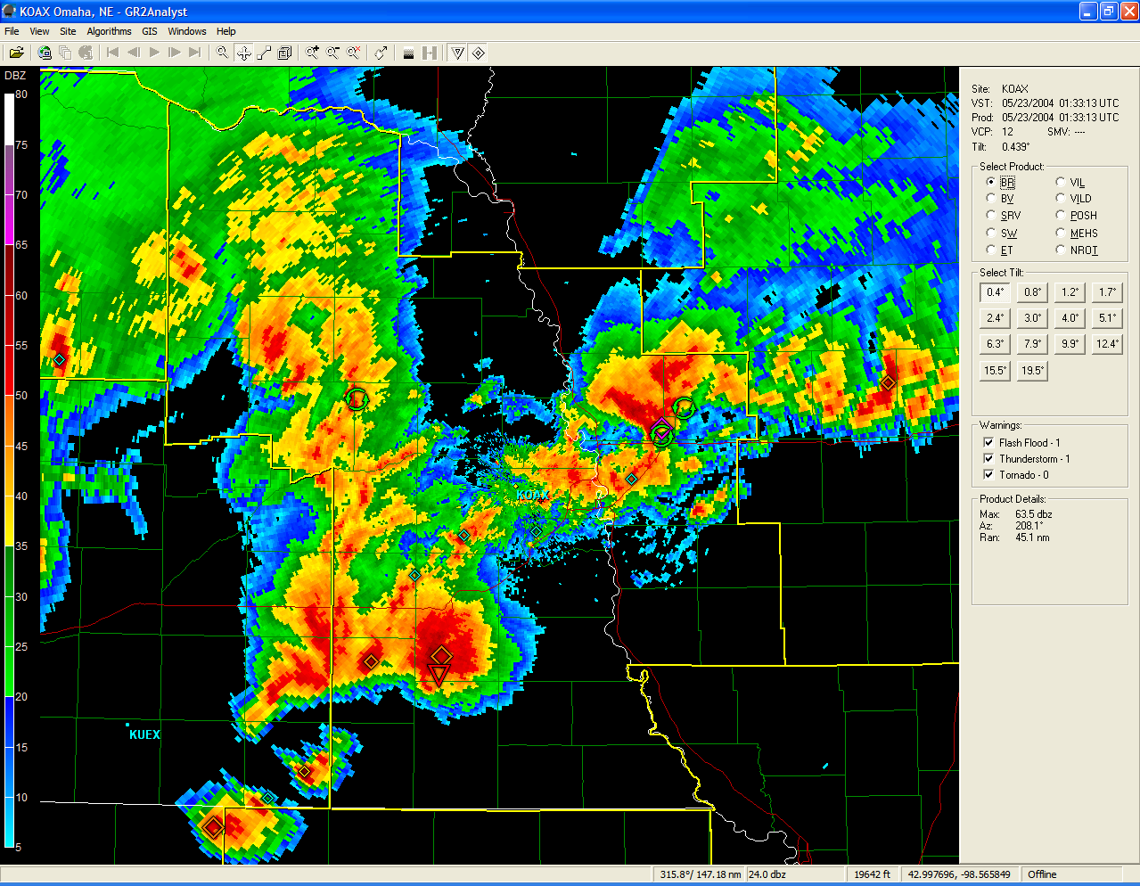
CUSTOMIZING gr2aNALYST Software
11th Annual High Plains Conference
Hastings, NE August 16th/17th
by Van DeWald
van.dewald@noaa.gov
Lead Meteorologist
National Weather Service Omaha/Valley

Slide 2

GR2Analyst
  A PC based radar viewing and analysis software package developed by Gibson Ridge Software. The software displays base WSR88D Level II and computed data.
  Implements 2D traditional plan views, pseudo 3D cross sections, and true 3D volumetric displays, the precursor to FSI software being developed for AWIPS OB8.3.
  A very useful and powerful program by itself, but can be highly customized with supplementary data.
  Does have specific hardware requirements (graphics and memory) to run.
  http://www.grlevelx.com/

Slide 3
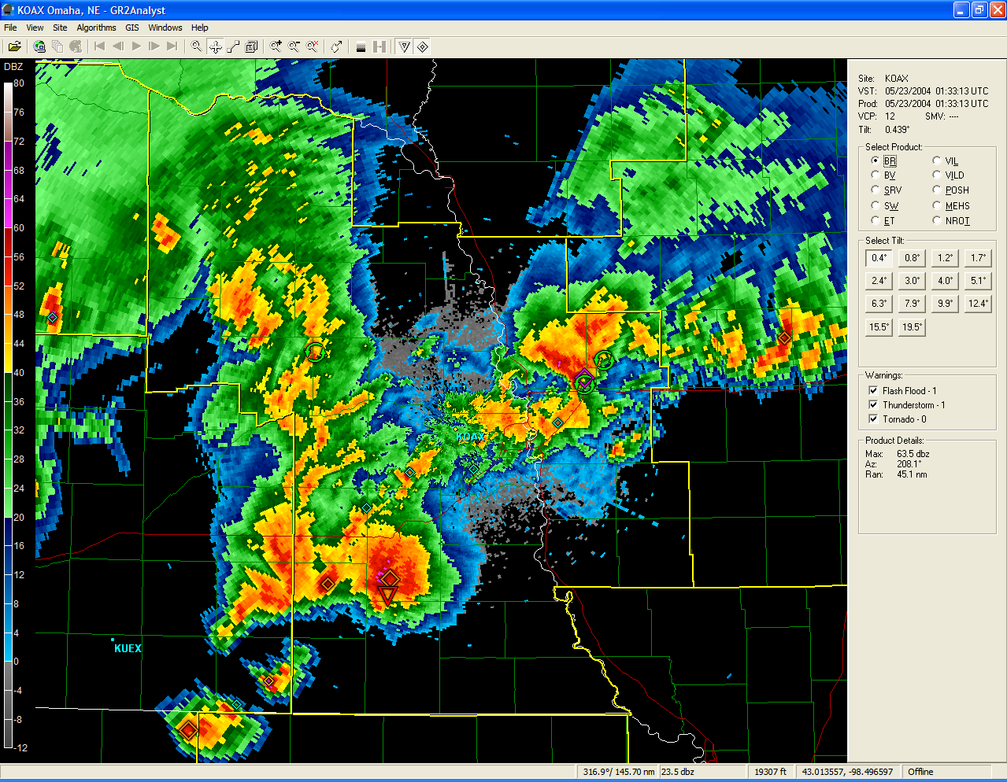

Slide 4
How to Obtain Real-Time Data
The Iowa State Environmental Mesonet (IEM) provides a
24-hour archive of WSR88D Level II data for all sites nationwide.
http://mesonet.agron.iastate.edu/data/nexrd2/raw
This is the only free site that currently exists that can be used for live polling of Level II data.
  Data mostly on time, but occasionally lags behind due to network design.
A paid data subscription can be purchased through a couple of private vendors.

Slide 5

Level II Data Flow
WSR88D
NWS Radar Server
Computer with GR2AE
BDDS
LDM
http://
ORPG
Iowa State Web Server

Slide 6
Archived Level II Data
Previous 30 Days – Texas Mesonet
http://mesonet.tamu.edu/products/RADAR/nexrad/CRAFT
Beginning of the WSR88D Network
http://hurricane.ncdc.noaa.gov/pls/plhas/has.dsselect
Neither of the above sites can be used for live polling!

Slide 7
Custom Background Images

Slide 8
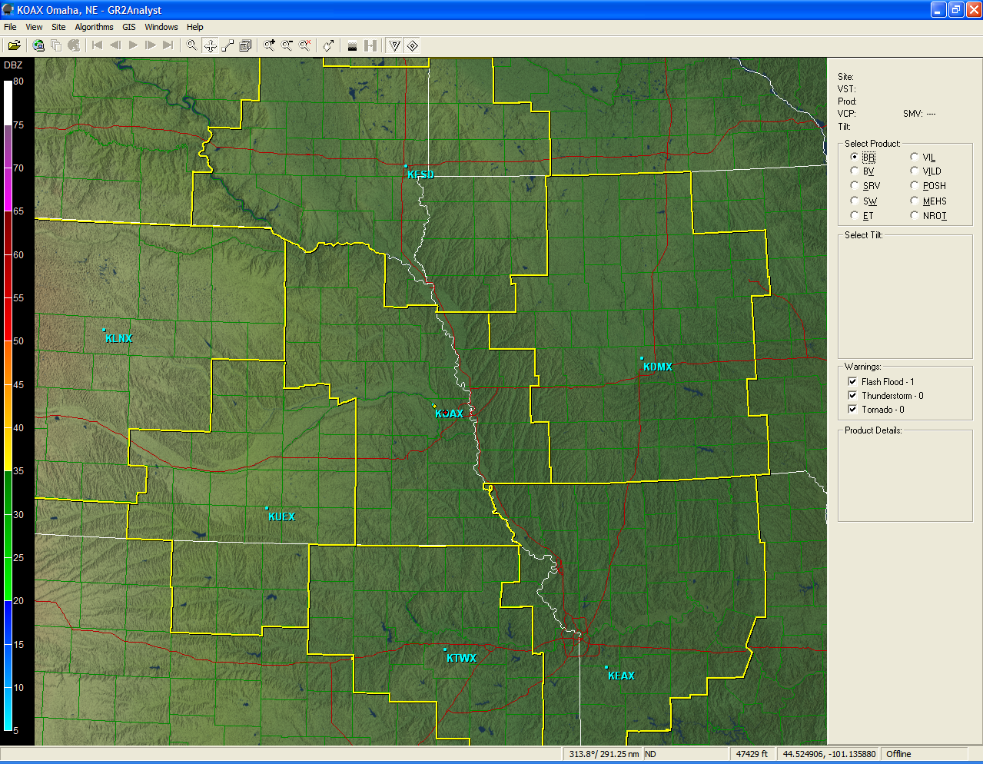

Slide 9
Custom Color Curves

Slide 10
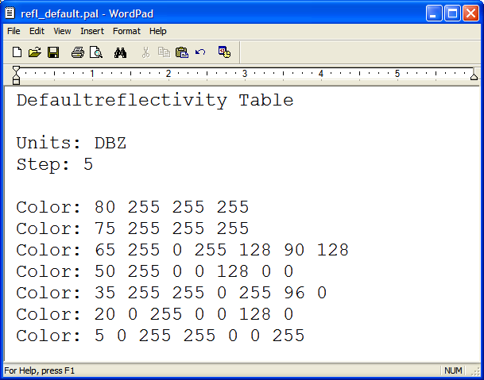

Slide 11
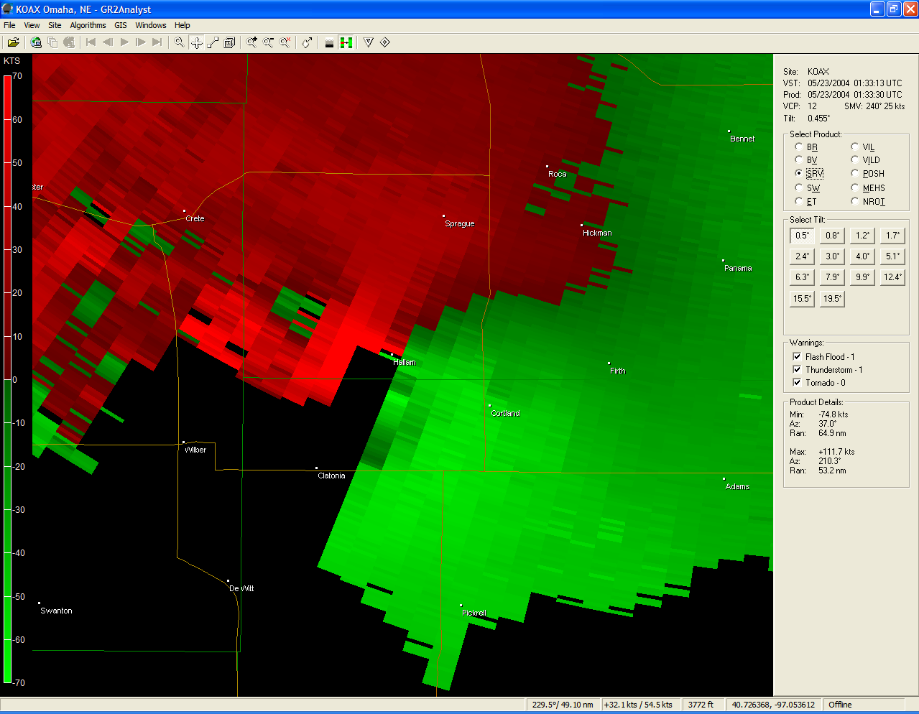

Slide 12
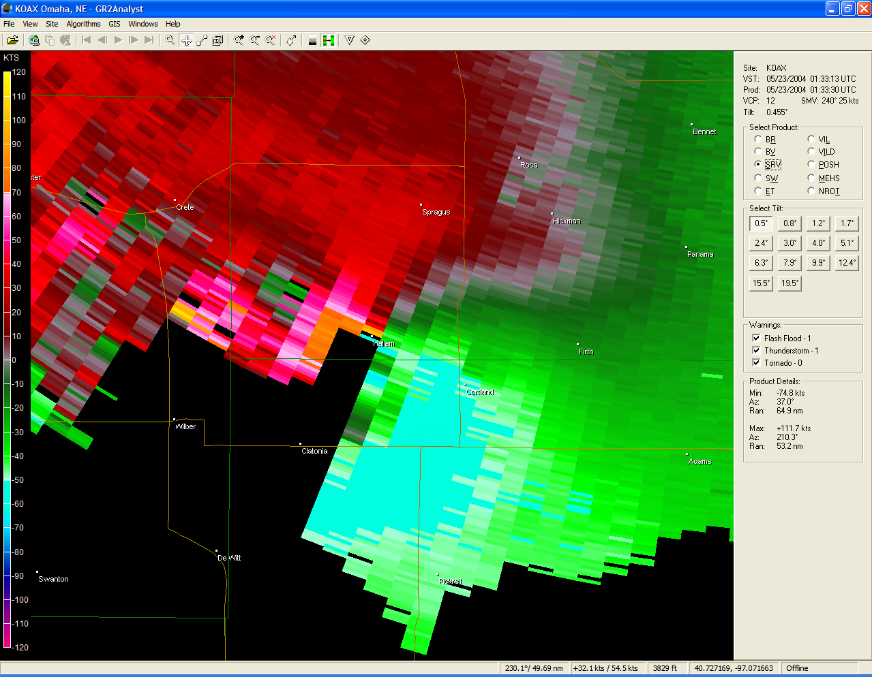

Slide 13
Custom Place Files
Places files are standard text files that display icons, polygons, line segments, text, etc.
Can have up to 128 place files per radar site.
Place files can be static (loaded once) or dynamic (loaded with a specific refresh interval).
Not supplied with the program, but obtained from other sources.
Mostly used during real-time polling of data.

Slide 14
NWS County Warning Outlines
Useful to track storms from one NWS area of responsibility to another.
Example of a static place file.

Slide 15
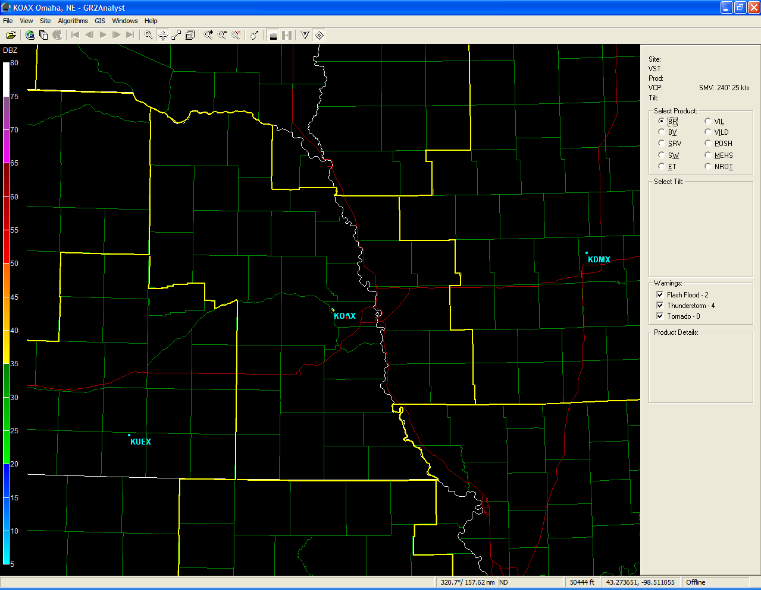

Slide 16
Severe Weather Boxes
Example of a dynamic place file, with new data loaded based on the refresh interval.

Slide 17
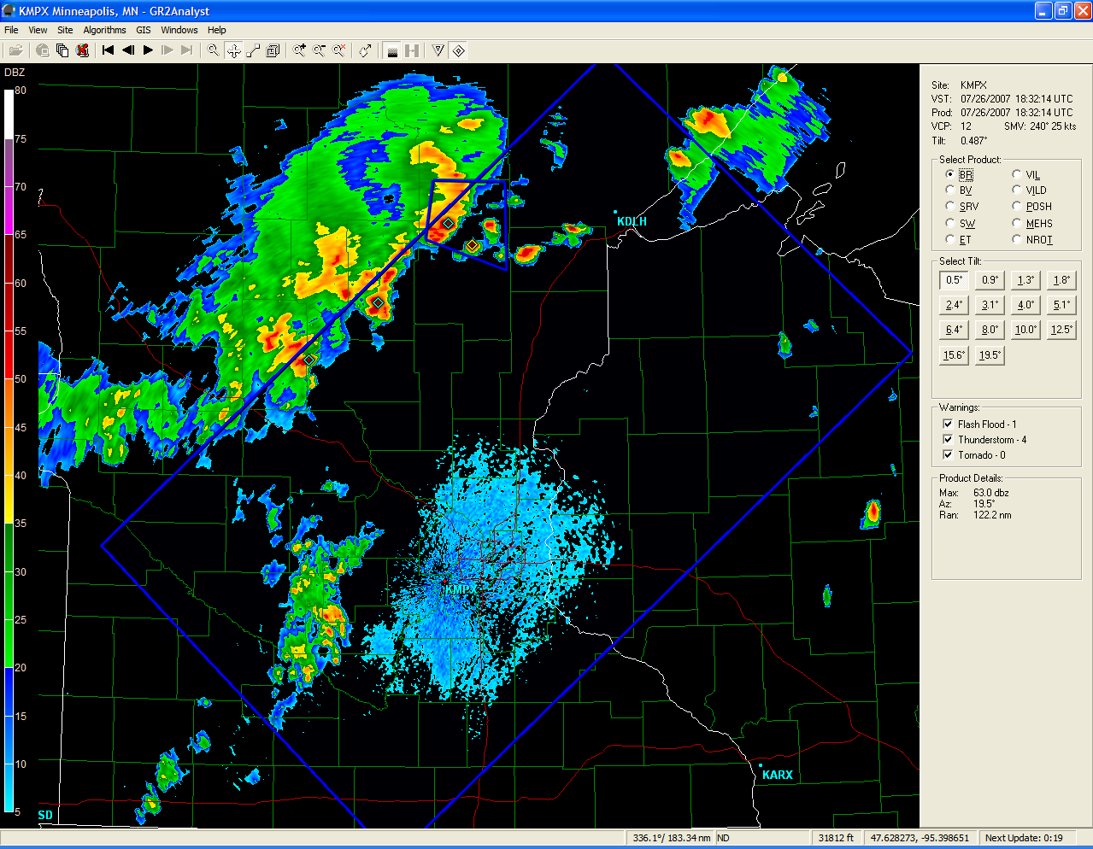
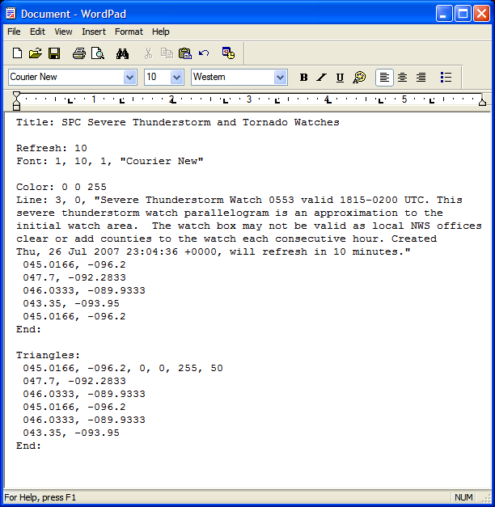

Slide 18
NOAA Weather Radio Icons
Another example of a static place file.

Slide 19
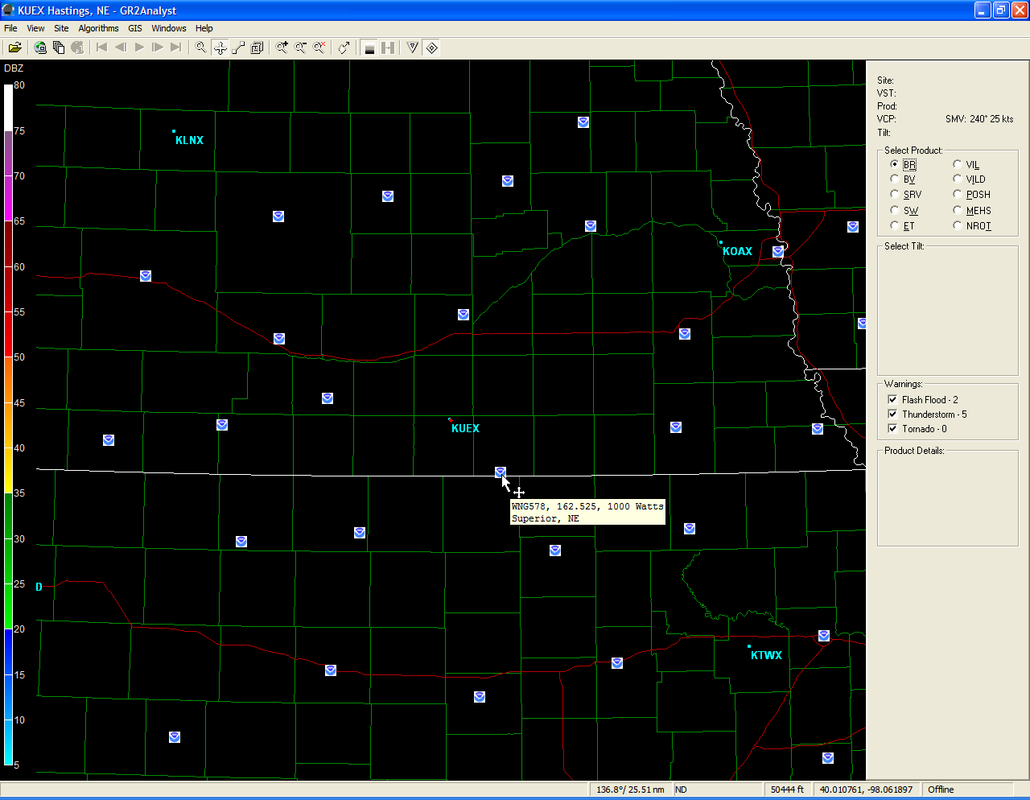

Slide 20
Local Storm Reports
A dynamic place file.

Slide 21
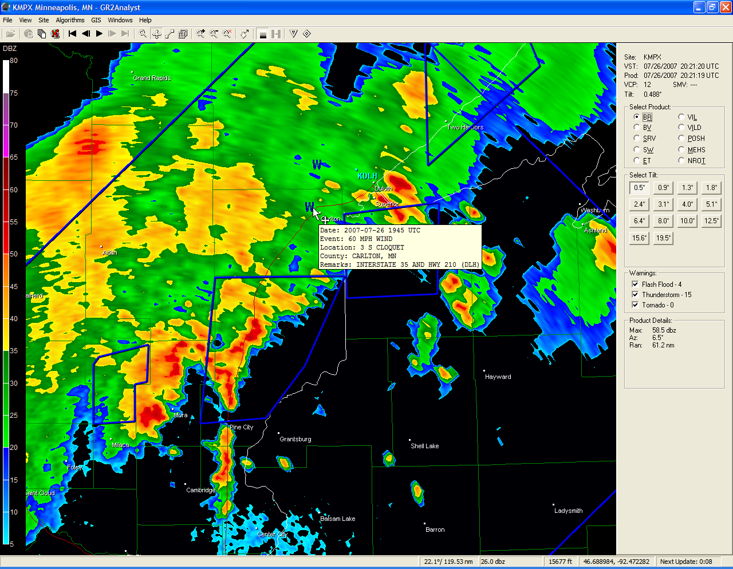

Slide 22
METAR Data

Slide 23
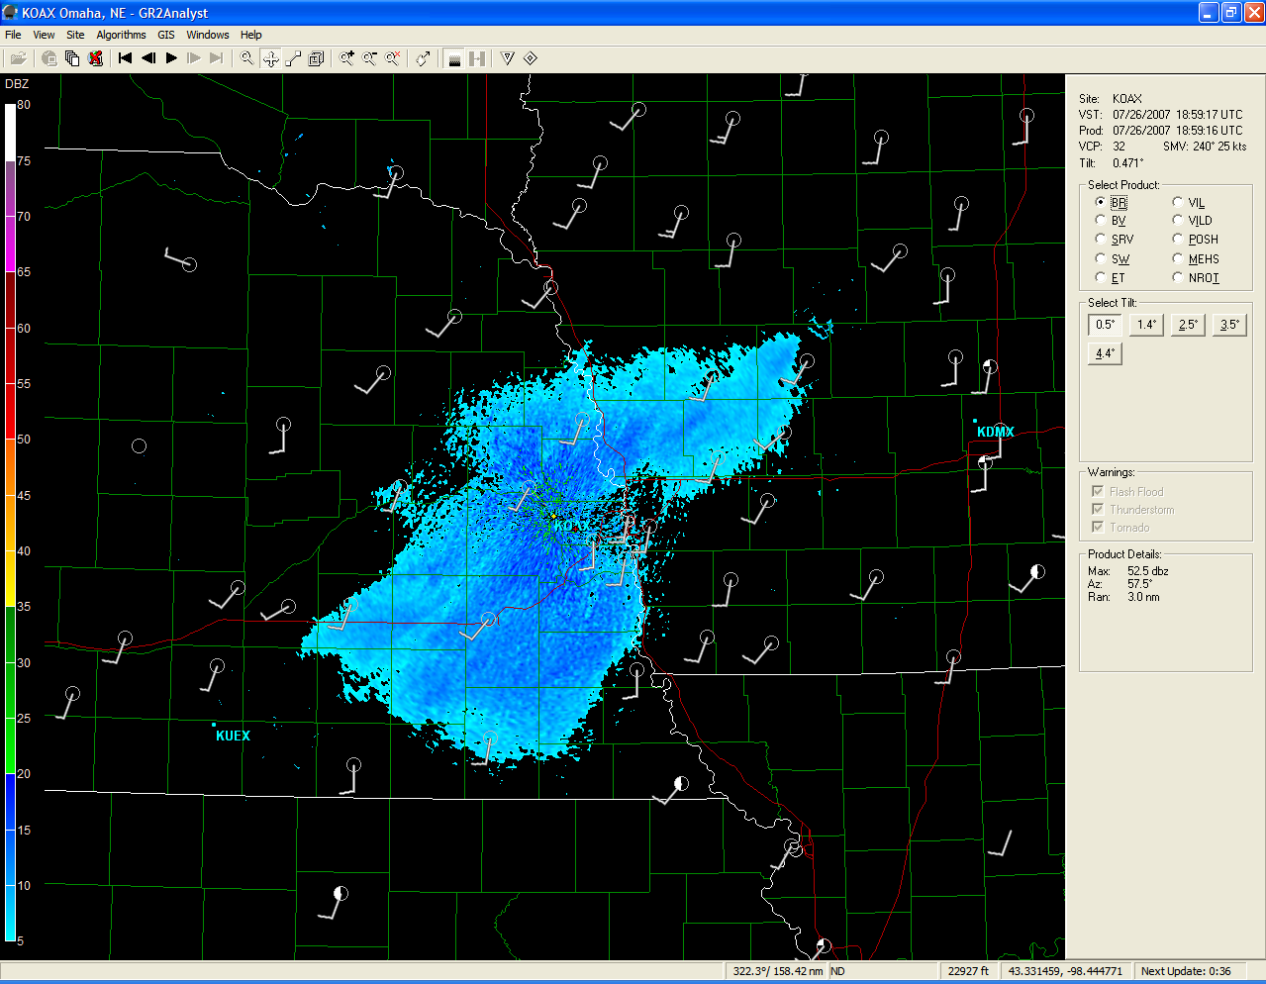

Slide 24
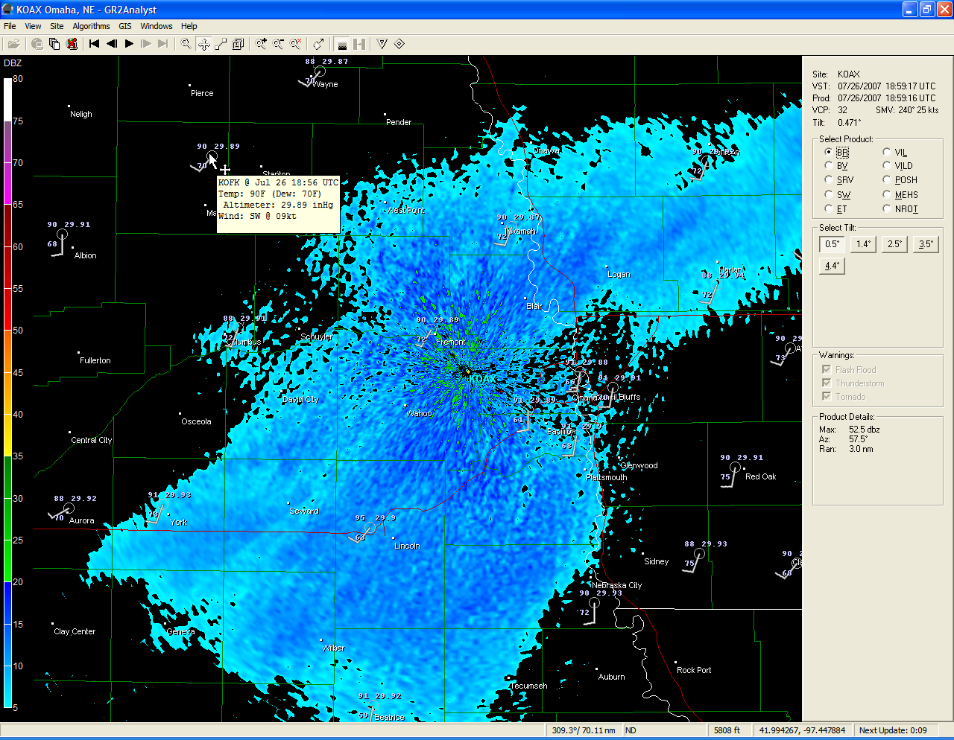

Slide 25

Spotter Network Icons
A voluntary program where spotters and storm chasers transmit their GPS coordinates every few minutes.
The next big thing?
http://www.spotternetwork.org/

Slide 26
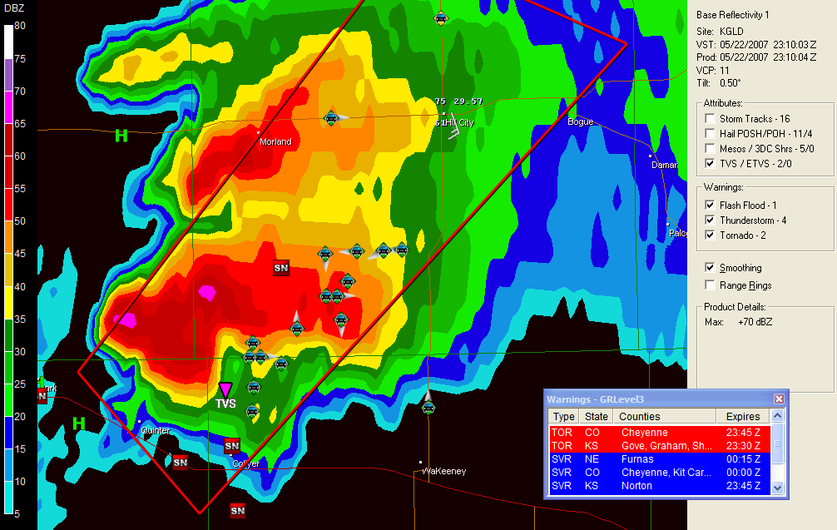
An estimated 200 spotters converged on this
storm, about 18 icons were noted here.

Slide 27
Day 1 Severe Weather Outlook

Slide 28
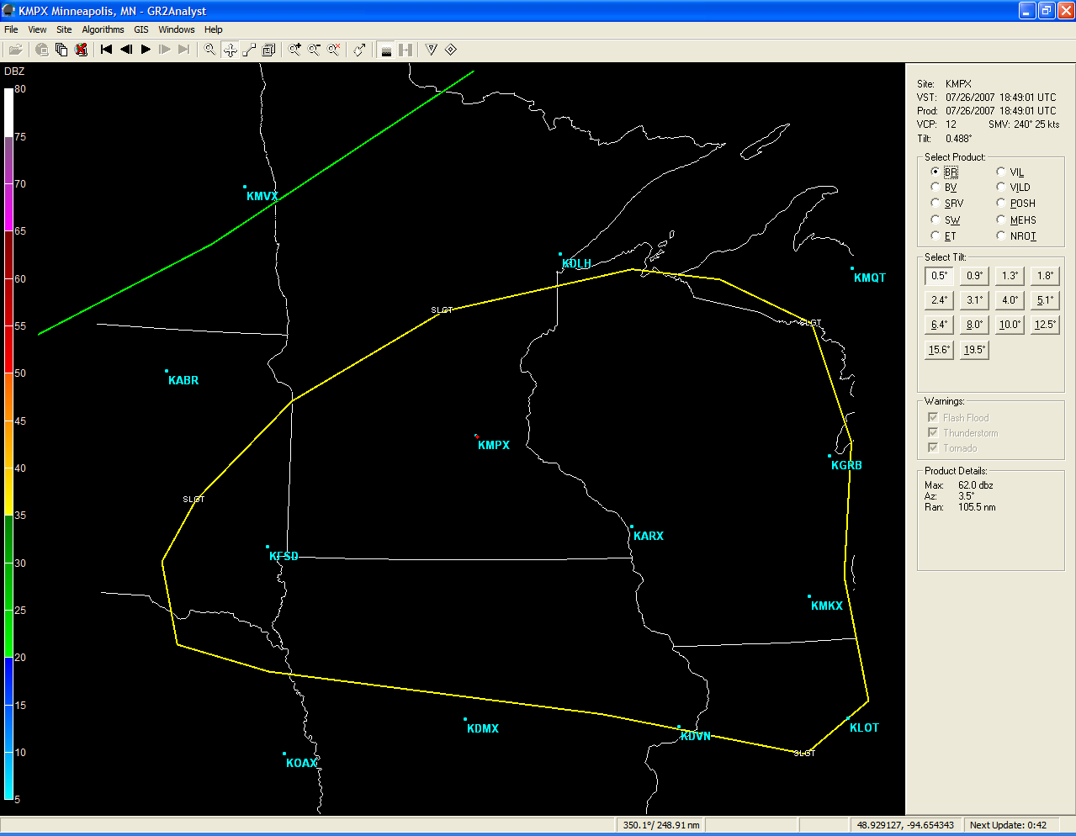

Slide 29
Mesoscale Convective Discussions
Contours with MCD text.

Slide 30
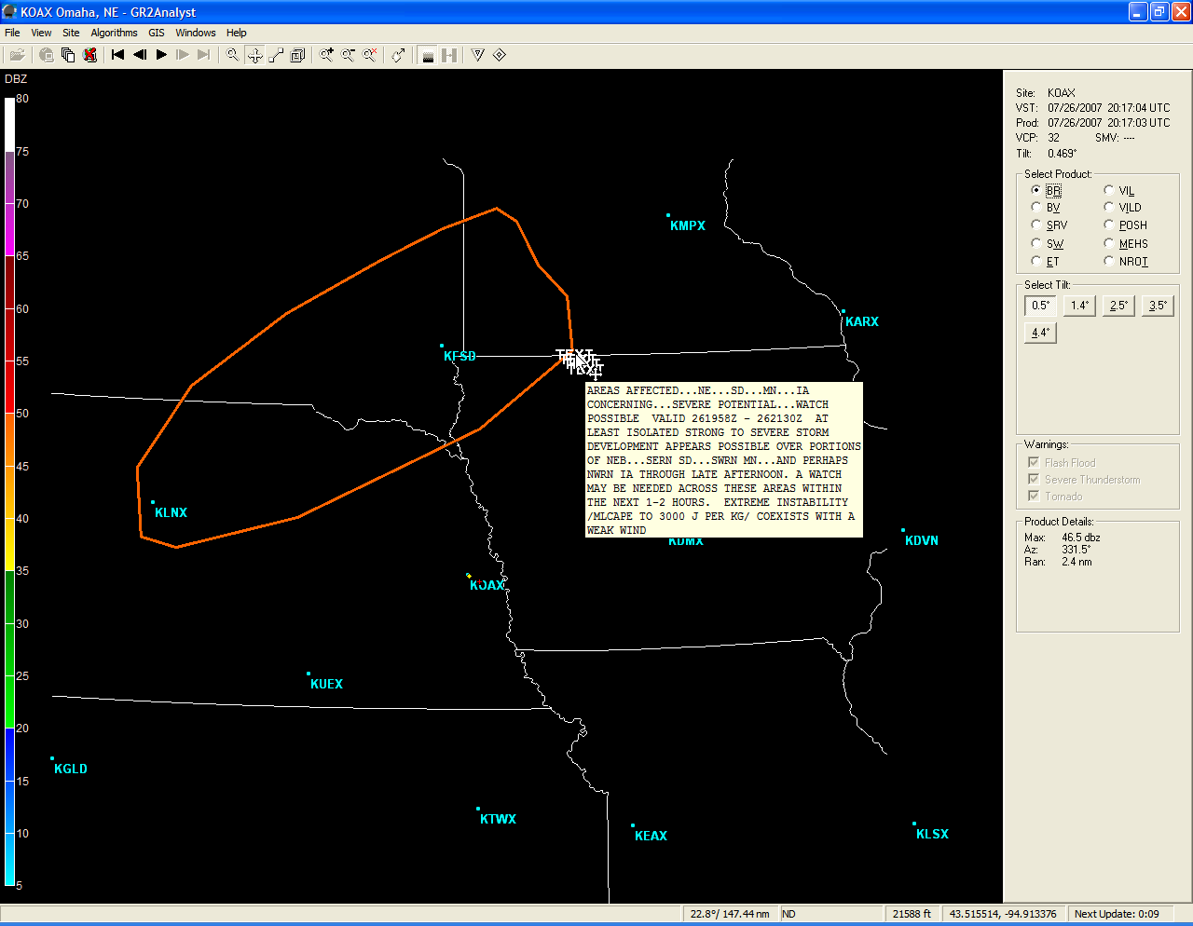

Slide 31
Shape Files
GIS
Standard GIS shape files can be loaded.
Useful to load additional mapping features that may be of interest.
Street-level roads and highways, streams, rivers, lakes, other transportation conduits, airports, etc.
Basically, anything GIS related that can be loaded in AWIPS can be used in the program.

Slide 32
County-Level Roads

Slide 33
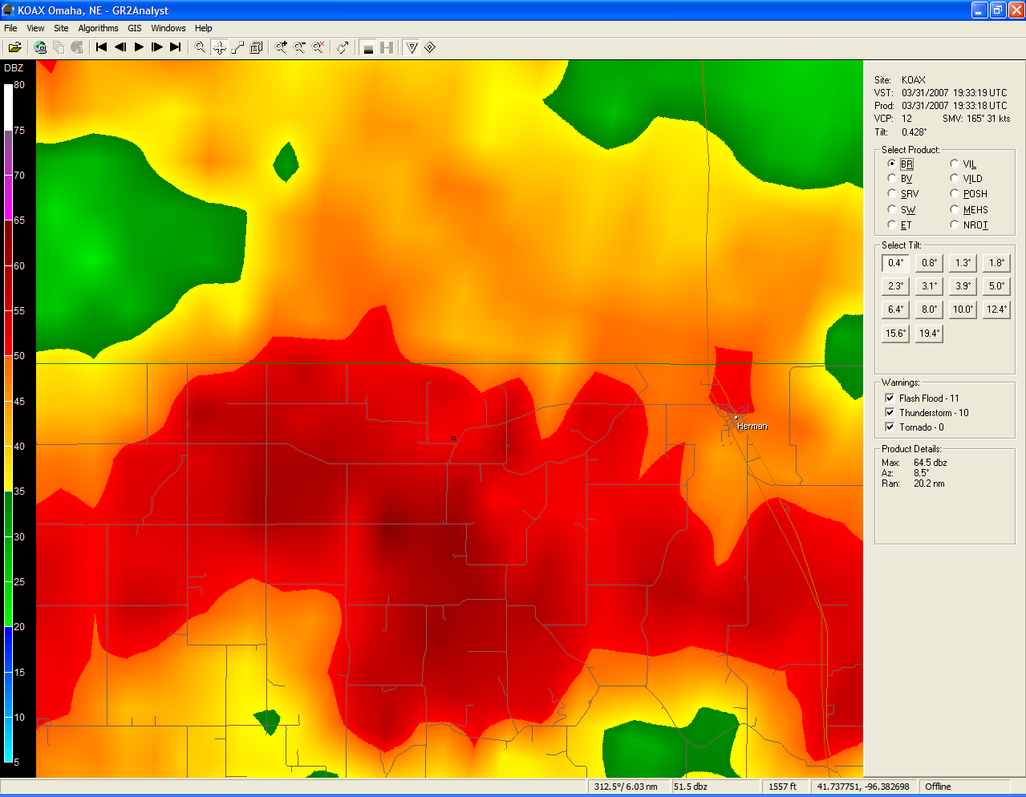
Street-level roads display when zooming in. When holding your cursor over a road, the name of the street or road will be displayed in the bottom left corner of the window.

Slide 34
Hydrography

Slide 35
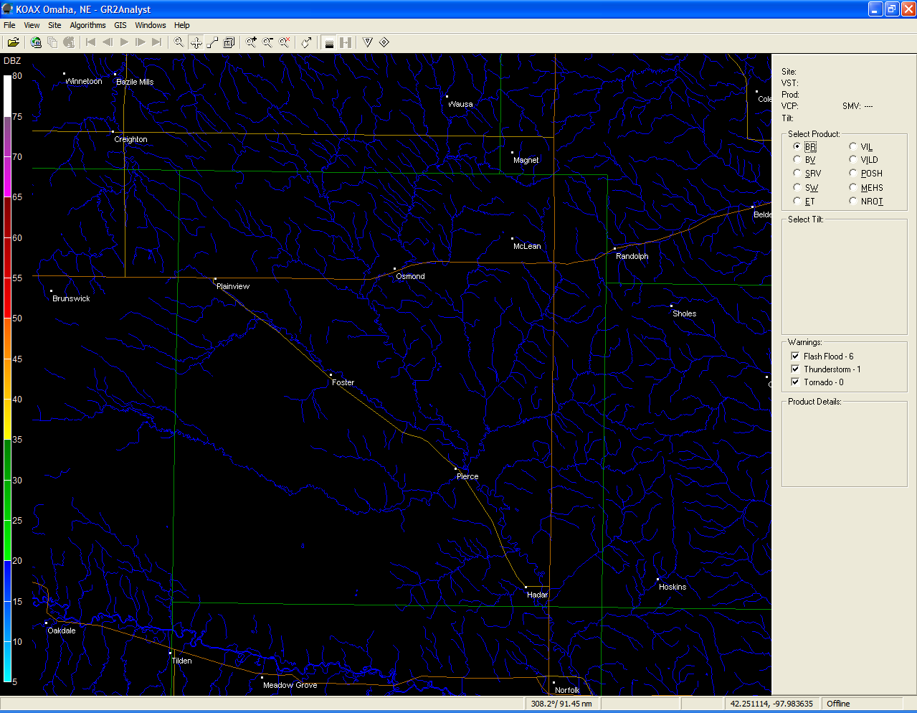
Pierce County

Slide 36
2/4-Panel Displays
Useful for loading multiple panes of data simultaneously, just like AWIPS.
Does not support linked cursors, but you can place a marker on the screen which will be visible on all panes.

Slide 37
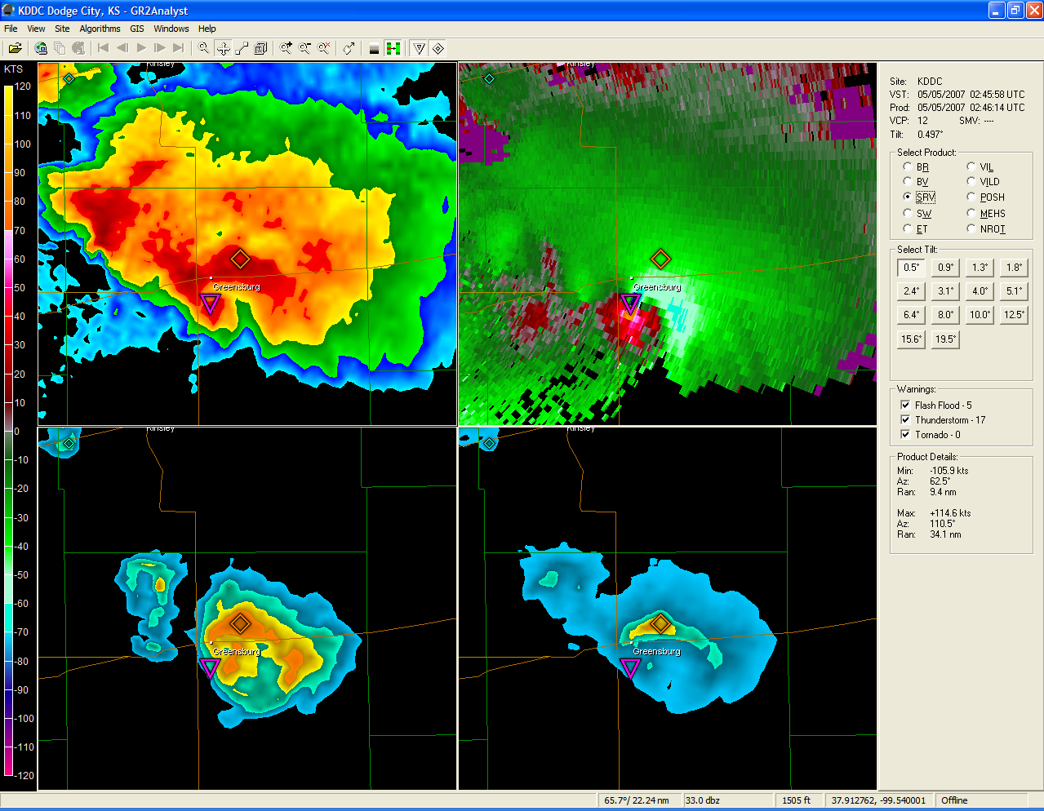

Slide 38
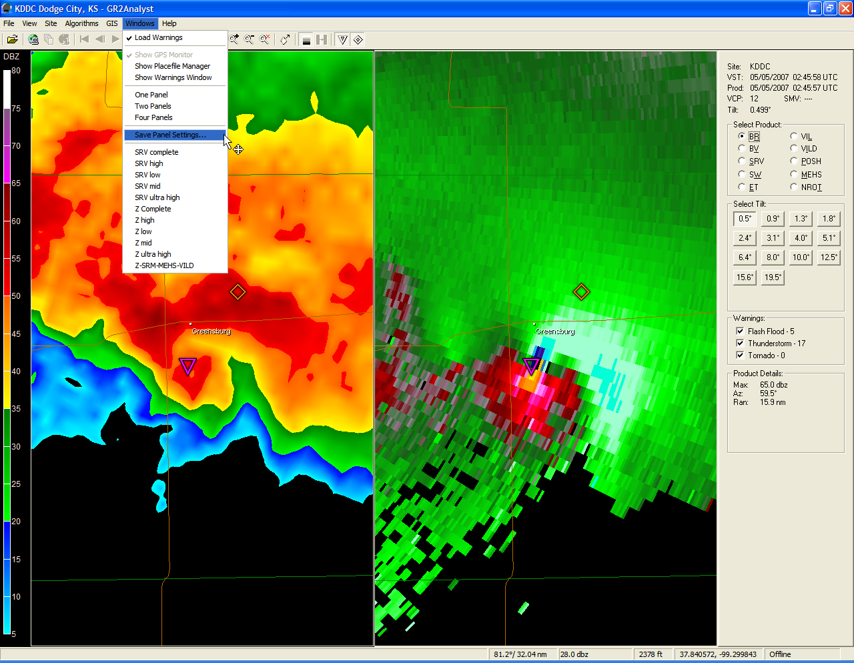

Slide 39
The Hail Algorithm
Utilizes the NSSL hail algorithm, along with near real-time RUC sounding data to calculate hail size.
Maximum Estimated Hail Size (MEHS) along with Probability of Severe Hail (POSH) values are computed.
Vertically Integrated Liquid (VILD) and VIL Density are also available.

Slide 40
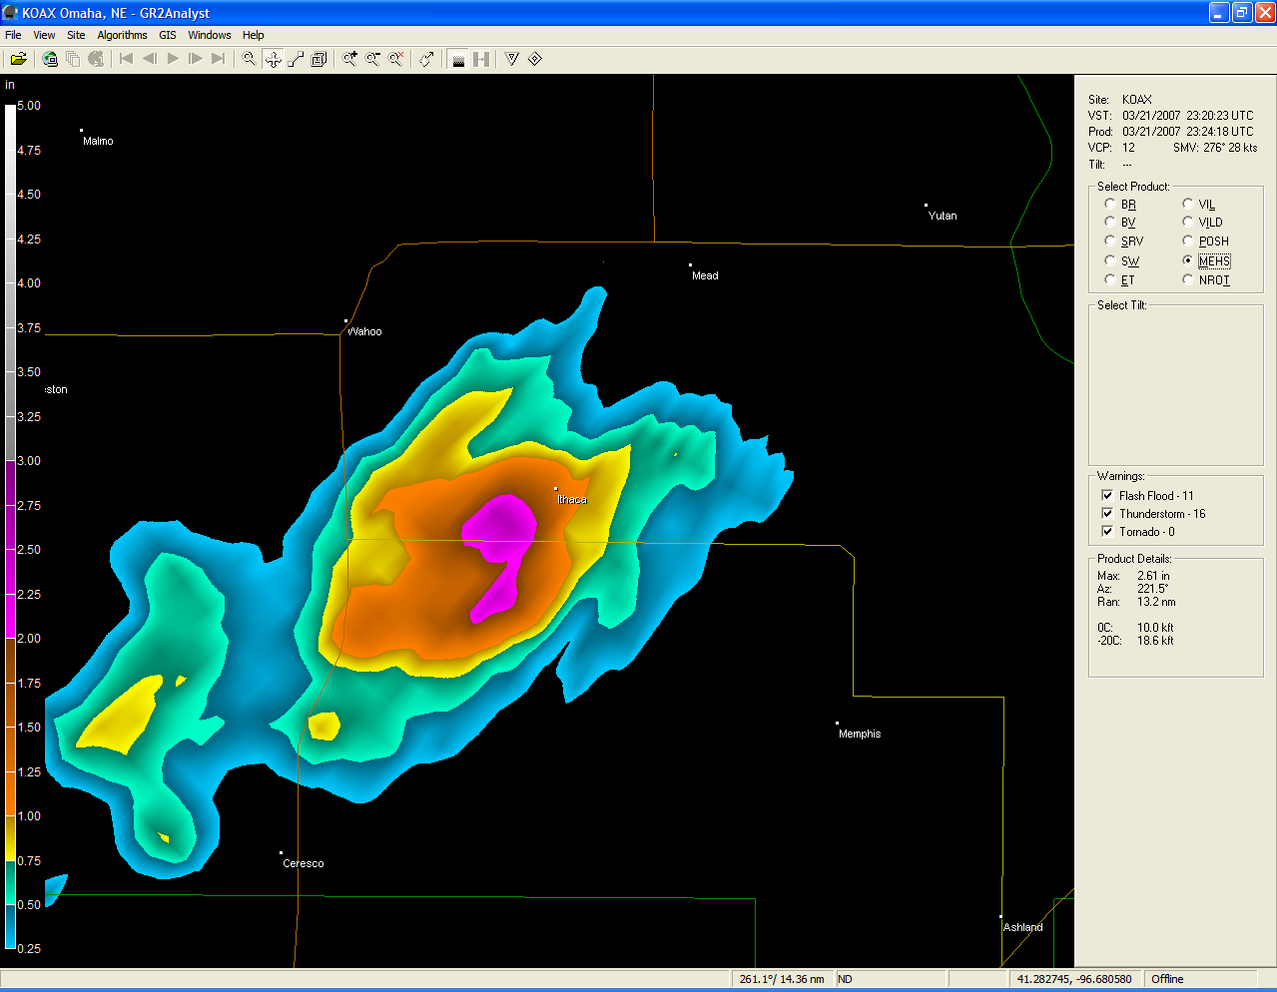
Gridded depiction of MEHS!

Slide 41
Loading Archived RAOB Sounding Data
When viewing archived data, for more accurate hail estimates, use the following website to load in archived RAOB sounding data.
http://raob.fsl.noaa.gov/

Slide 42
3-Dimensional Displays
Perhaps one of the most useful features of the software.
Allows meteorologists and weather enthusiasts to view storms as never seen before.
Pseudo 3D cross sections can be generated, along with true 3D volumetric displays.
Can see suspended hail cores, descending reflectivity cores, rotational couplets, etc.

Slide 43
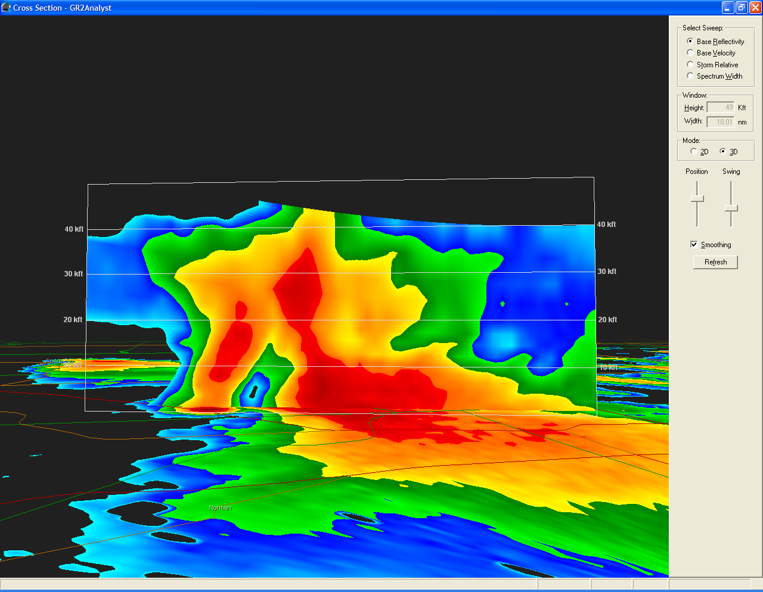
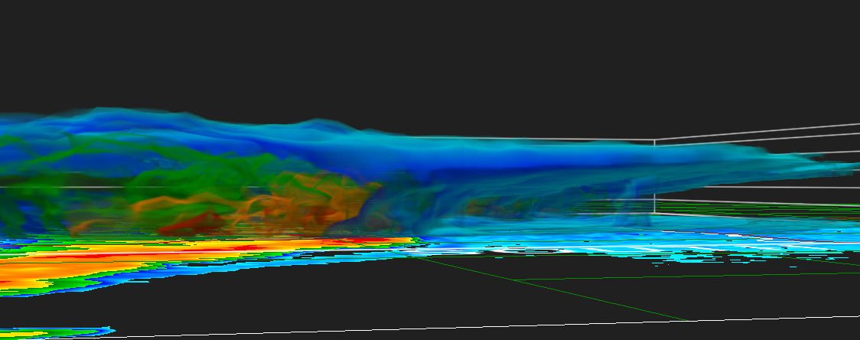
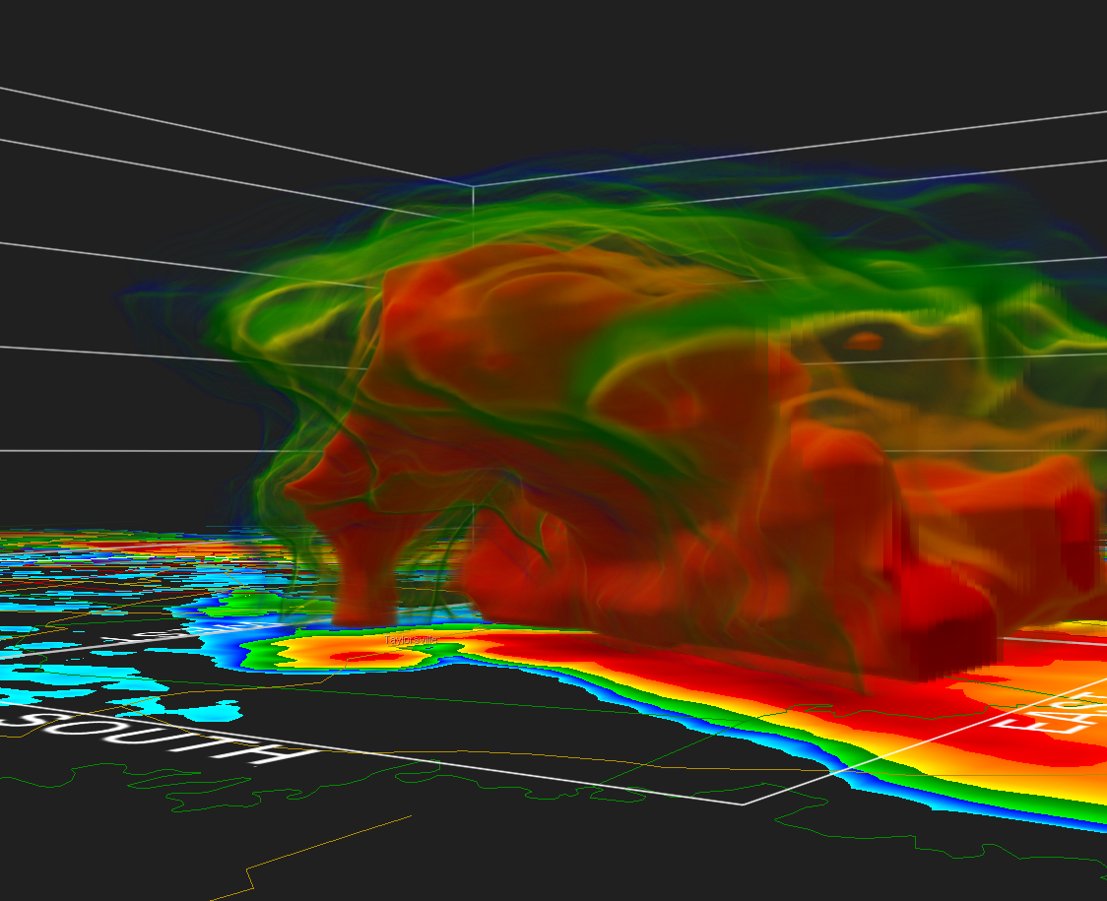

Slide 44
Understanding Alpha Curves
Alpha curves control the opacity (transparency) of the 3D display.
Can be tricky to comprehend at first.
Once you understand knobology, one can easily peel away layers of reflectivity to show the most important portion of the storm, or you can use pre-defined color curves to highlight various storm-scale features.

Slide 45
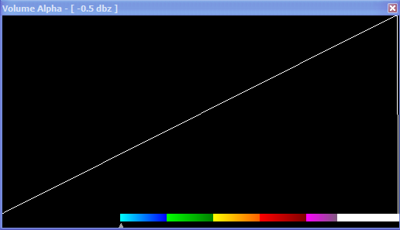
The Volume Alpha Window
10
20
30
40
50
60
70
80
90
100
Transparency
Huh, what the heck is this?

Slide 46
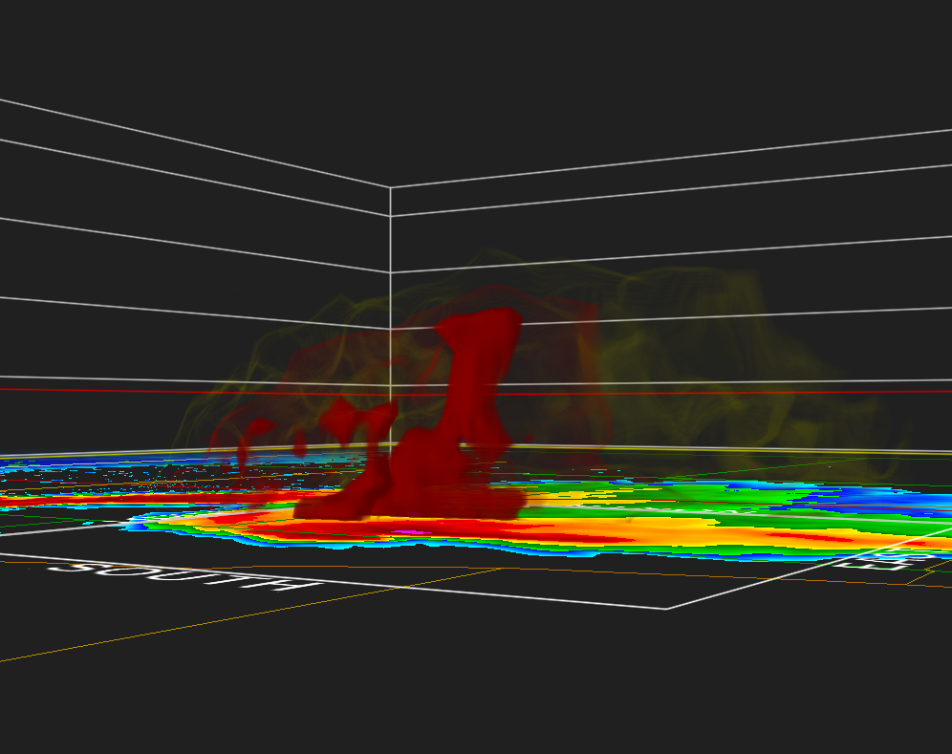
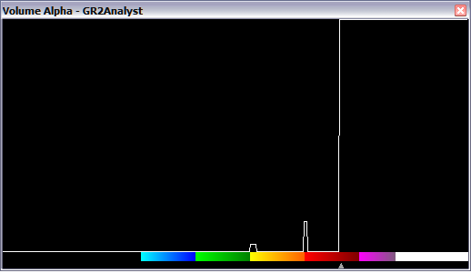
10
20
30
40
50
60
70
80
90
100
Transparency

Slide 47
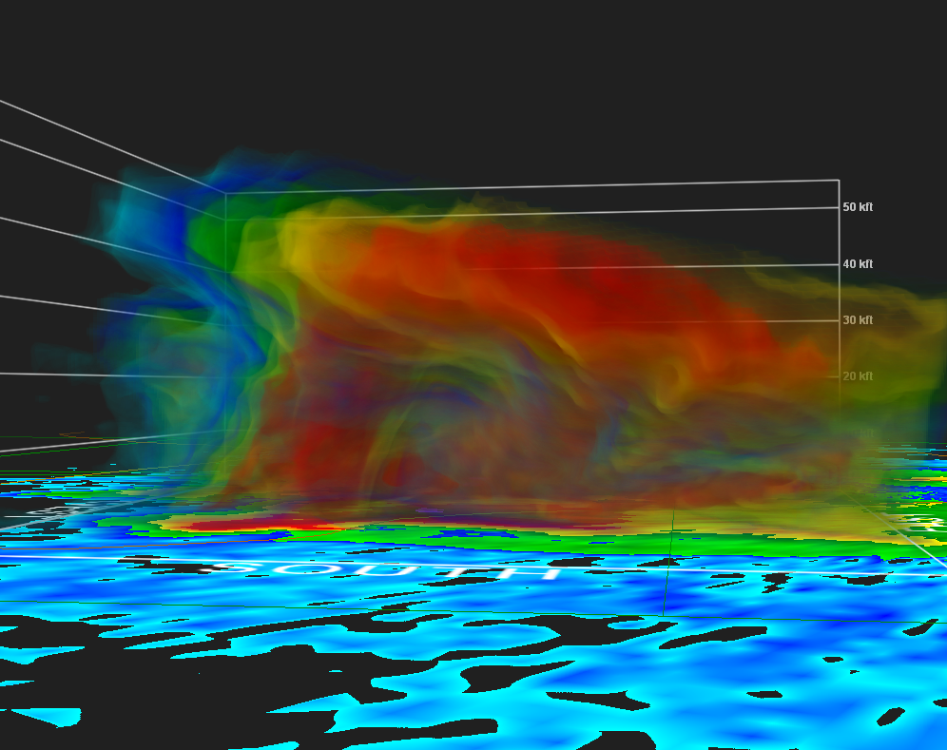
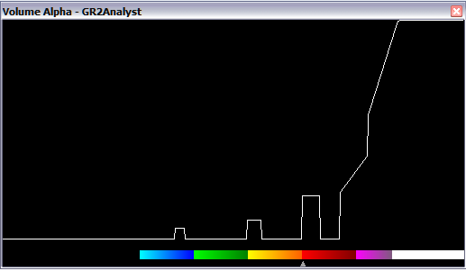
10
20
30
40
50
60
70
80
90
100
Transparency

Slide 48
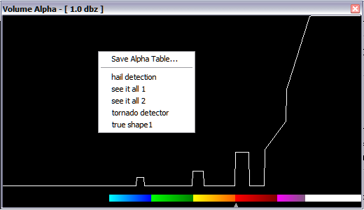
Saving Alpha Curves

Slide 49
Gibson Ridge Software
User-Submitted Repository
For custom background images, color curves, shape files, logos, place files and more…
http://www.grlevelxstuff.com/
You do have to register at this site to gain access, but it’s free!

Slide 50
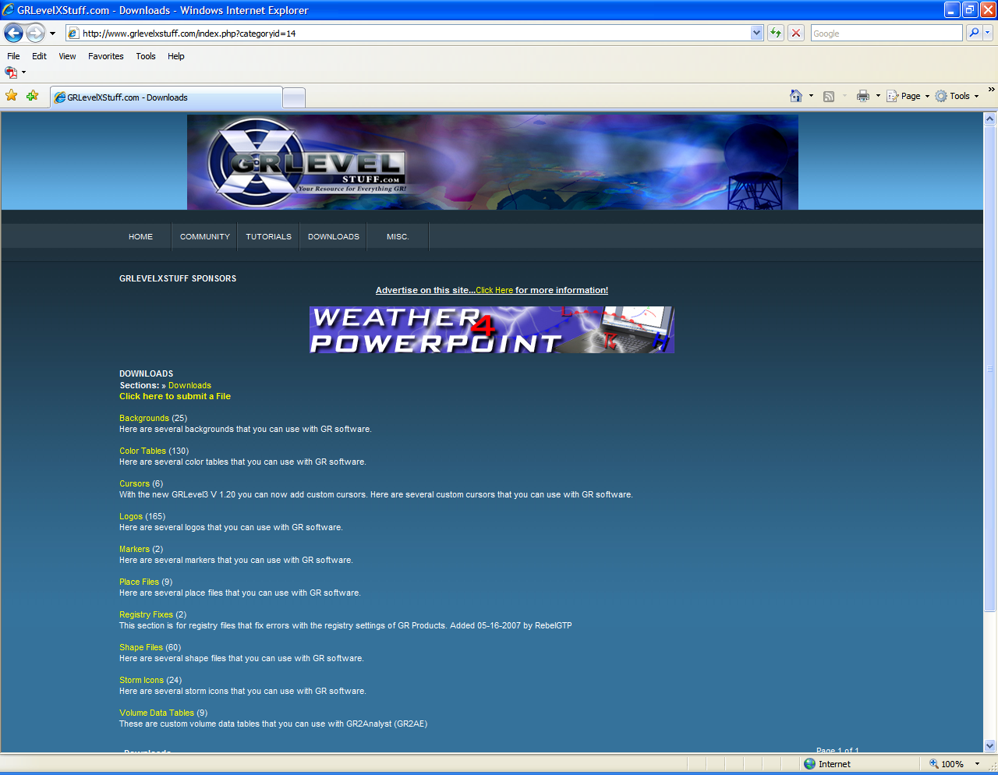

Slide 51
Where to Download
More Free Data
For METAR data, Day 1 Convective Outlooks, and more…
http://grlevel3.tornadocentral.com/
For Storm Reports, SPC Watch Boxes, Mesoscale Convective Discussions, NWS CWA boundaries, Shape Files, and more…
http://vansvault.org/weather/grlevelx/
  ../resources

Slide 52
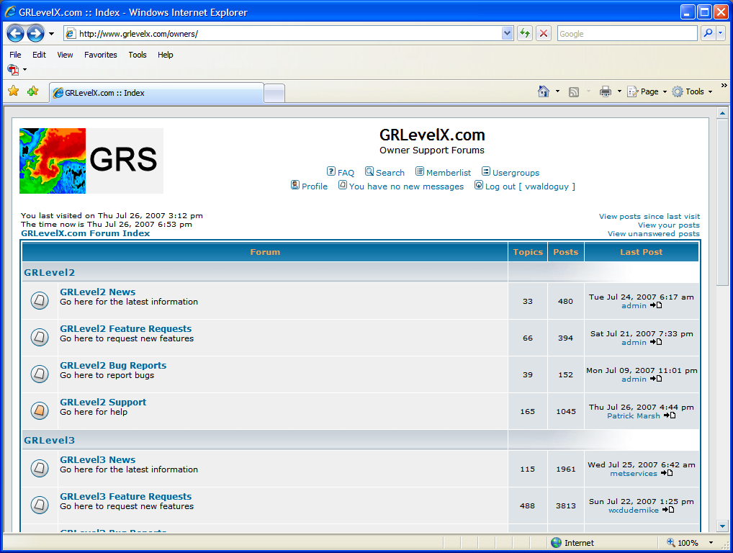
Additional Resources
http://www.grlevelx.com/owners/
The GRLevelX Bulletin Board, but must be a registered owner to access.
Moderated by the software author.
Can get results near instantaneously from a huge network.

Slide 53
In Summary
GR2Analylst is a very powerful radar display program on its own merit.
However there are several customizations that you can perform to take it to the “next” level which will enhance your experience.
This has/will revolutionize the way we interpret the radar data, and is the natural stepping stone to real-time 3D data in AWIPS via FSI.
van.dewald@noaa.gov 402-359-5166 x614

