Slide 1

Tomorrow’s Weather Service
By: Tyler Brooks

Slide 2

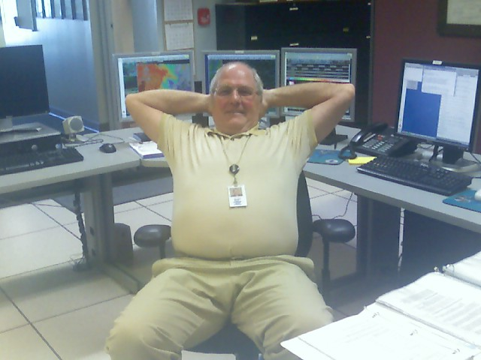

Slide 3
Tomorrow’s Weather Service
By: Tyler Brooks

Slide 4
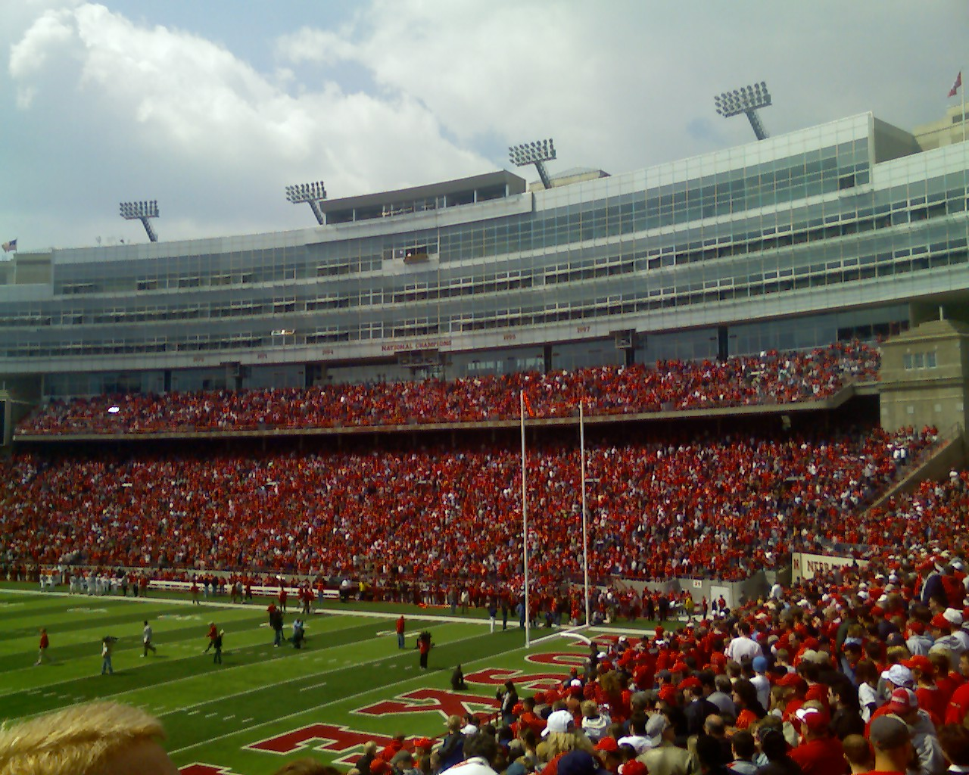
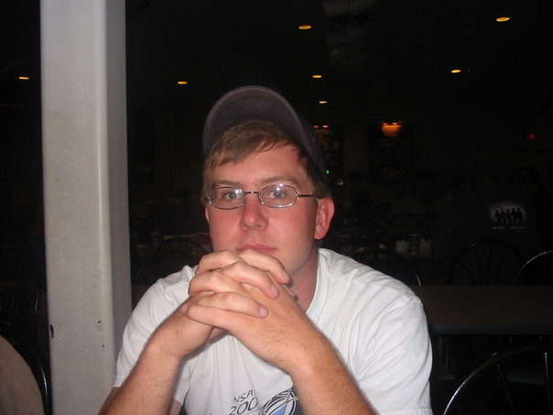

Tyler Brooks
2nd Year Meteorology Student – UNL
Graduated From North Platte High School
Started at Briar Cliff Playing Soccer
Reflected on Initial Interests
John Stoppkotte, Christmas Break Job Shadow
Transferred after 2/3 year
Transferred to UNL fall of 2006
Volunteer Work This Summer

Slide 5

Discussions
Summer 2007 - National Weather Service
Volunteers – Summer Projects
Experience

Slide 6
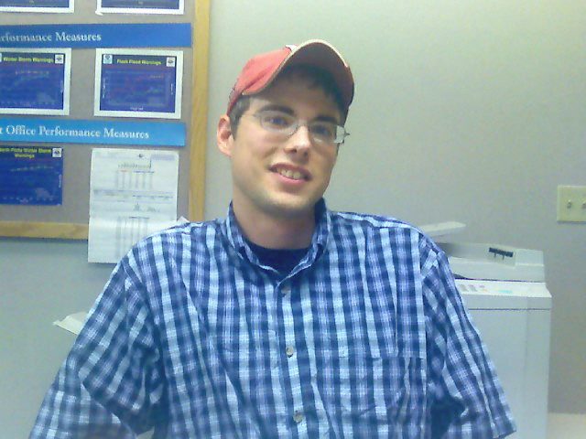
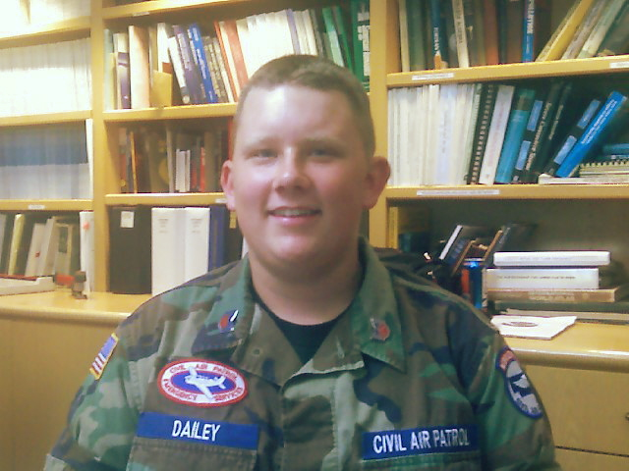


Other Volunteers
Matt Musgrave
Logan Dailey
McCook High School Alumni 2003
University of Kansas – 5th Year Senior
Summer Project: Case Study of the June 11-13th Chase County Floods
Sophomore at North Platte High School
Goals of Attending Air Force Academy
Summer Project: July 8, 2003 McPherson County Severe Weather

Slide 7
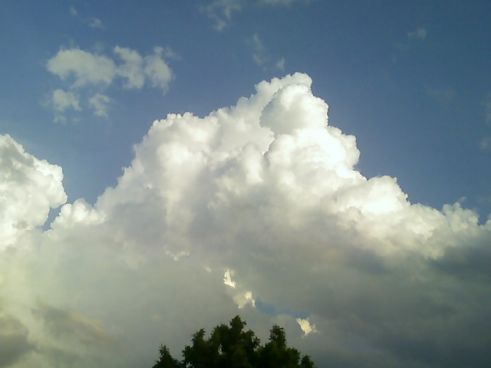
Summer 2007
Goals
Duties
To provide the groundwork for a career in the field of Meteorology
To support the NWS operational staff in providing services for the public
110 Hours
Started June 5
Tue/Wed 12:00 – 5:00
Research Topic
Answer Phones
Make phone calls to coop locations

Slide 8
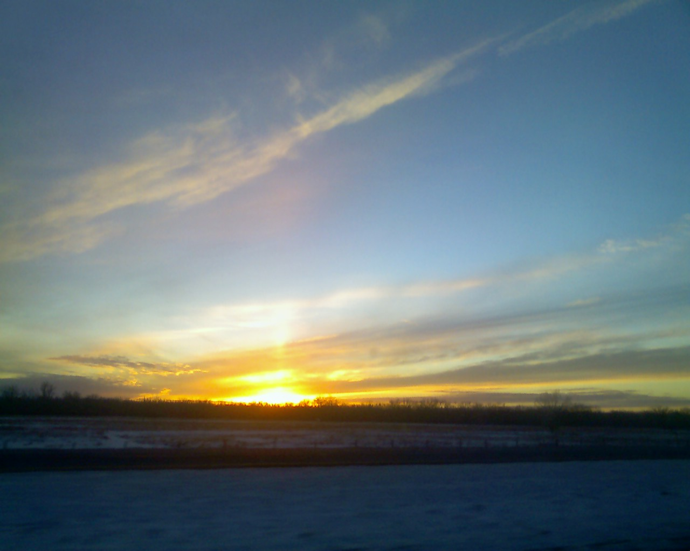
Principles of Convection I: Buoyancy and CAPE
Principles of Convection II: Using Hodographs
Principles of Convection III: Shear and Convective Storms
Severe Convection II: Mesoscale Convective Systems
Predicting Supercell Motion Using Hodograph Techniques
Mesoscale Convective Systems: Squall Lines and Bow Echoes
Freezing and Melting, Precipitation Type, and Numerical Weather Prediction

Slide 9
It Doesn’t Snow Like It Used To
(Or So They Say)

Slide 10
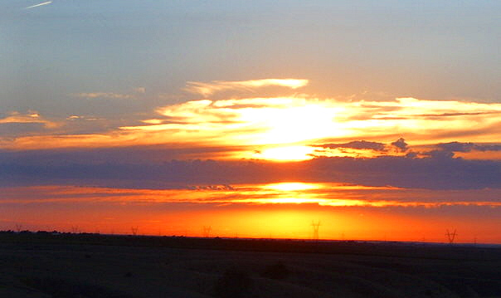
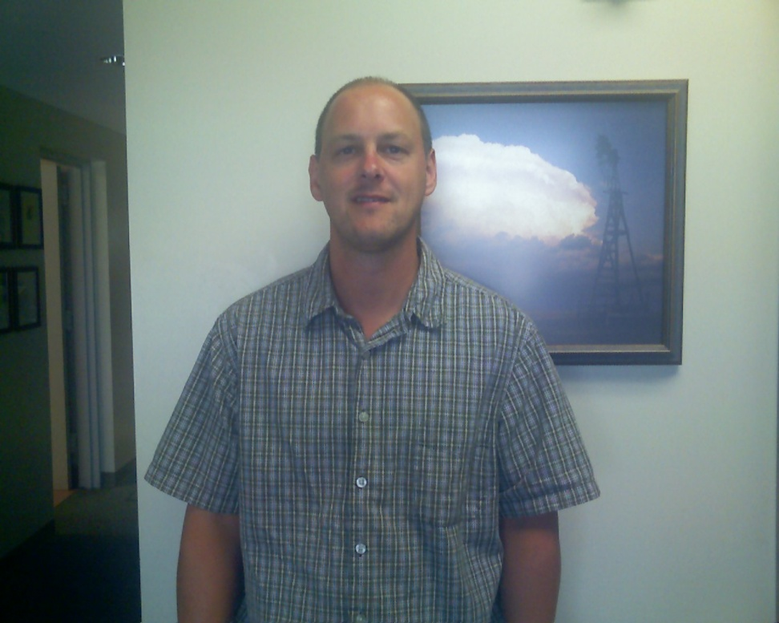
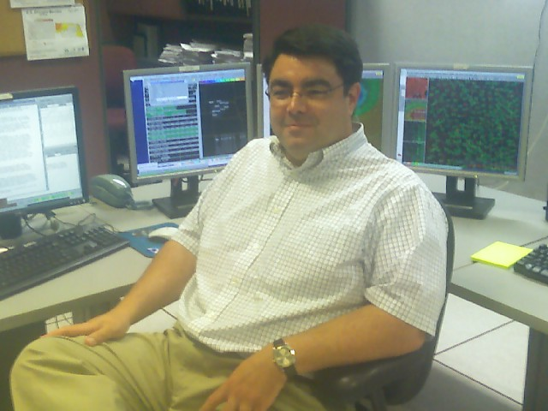
Meteorologists
John Stoppkotte, SOO
Brian Hirsch, MIC

Slide 11
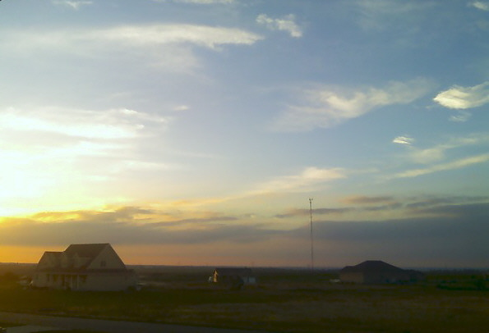
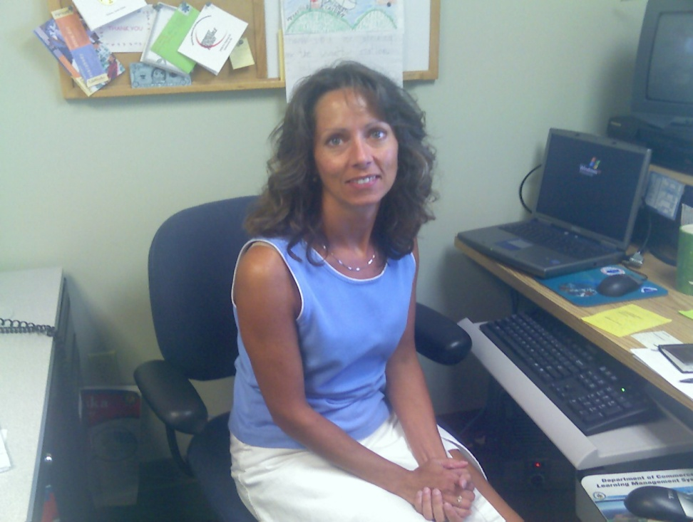
Meteorologists
John Springer
Showing how to do the job right!
Deb Blondin

Slide 12
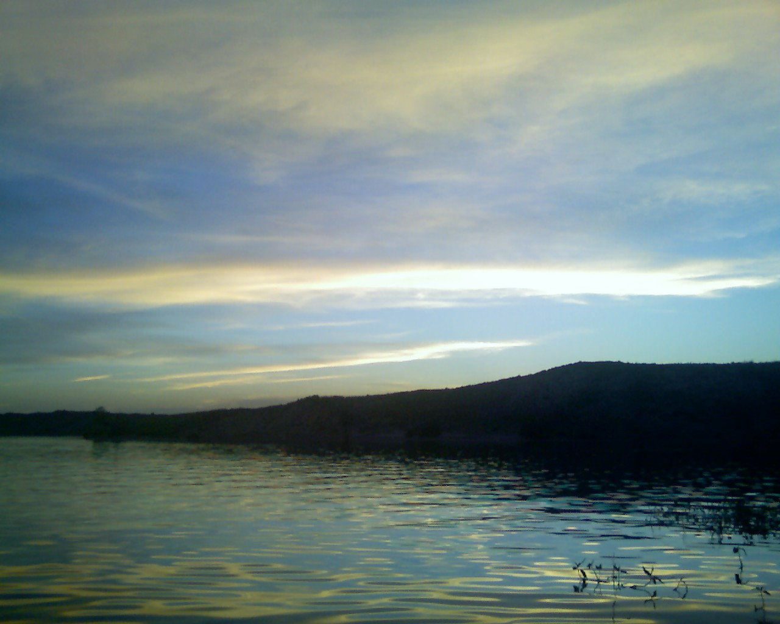
Results
“One of the major things I learned was doing surface analysis. I learned a lot of stuff about radar. All I used to know was green was rain and red was bad. . .Now I know that the red is just more than severe weather. I actually learned how to use the rotation diagram as well.”
“I would lump it all together and just say all the knowledge I gained. Not only from COMET but having someone there for me to bounce ideas off of asking them questions like ‘is this what happened?’”
“I wanted to see how all my schooling applied to the real world and I figured that you know hey whoever's doing the hiring is going to see that I drove an hour both ways two days a week is going to know that I wanted to be here.”
- Logan Dailey
- Matt Musgrave

Slide 13
Results
Knowledge of the system (NWS)
Questions for people already in the career field
Relationships outside work

Slide 14
Tomorrow’s Weather Service
Check out our research on the NWS intranet page. Let us know what you think.

Slide 15
Special Thanks To:
John Stoppkotte
Deb Blondin
Brian Hirsch
NWS North Platte Employees
Rick Ewald
AMS Members

